Slide 1
Discrete Mathematics R204GA05401
Narasimhulu M_{M. Tech.}
Assistant Professor
Department of Computer Science & Engineering

Slide 2
Objectives
Narasimhulu M_{M. Tech.}
Assistant Professor
Department of Computer Science & Engineering

Slide 3
Objectives
This course will introduce and illustrate in the elementary discrete mathematics for computer science and engineering students.
To equip the students with standard concepts like formal logic notation, methods of proof, induction, sets, relations, graph theory, permutations and combinations, counting principles.

Slide 4
Course Outcomes
Narasimhulu M_{M. Tech.}
Assistant Professor
Department of Computer Science & Engineering

Slide 5
Course Outcomes
Illustrate discrete mathematic components like statements, logic, sets, structures, numbers and combinatorics.
Evaluate and simplify propositional and predicate calculus using inference theory.
Perform the operations on Sets, Relations and functions and their properties.
Identify algebraic systems and use general properties on number theory.
Use combinatorics solving the counting problems.
Use graph algorithms for representing, identifying, generating and evaluating the Graphs.

Slide 6
Unit III Algebraic Structures and Number Theory
Narasimhulu M_{M. Tech.}
Assistant Professor
Department of Computer Science & Engineering

Slide 7
Unit III
Algebraic Structures: Algebraic Systems, Examples, General Properties, Semi Groups and Monoids, Homomorphism of Semi Groups and Monoids, Group, Subgroup, Abelian Group, Homomorphism, Isomorphism.
Number Theory: Properties of Integers, Division Theorem, The Greatest Common Divisor, Euclidean Algorithm, Least Common Multiple, Testing for Prime Numbers, The Fundamental Theorem of
Arithmetic, Modular Arithmetic ( Fermat’s Theorem and Euler’s Theorem)

Slide 8
Algebraic Structures
Narasimhulu M_{M. Tech.}
Assistant Professor
Department of Computer Science & Engineering

Slide 9
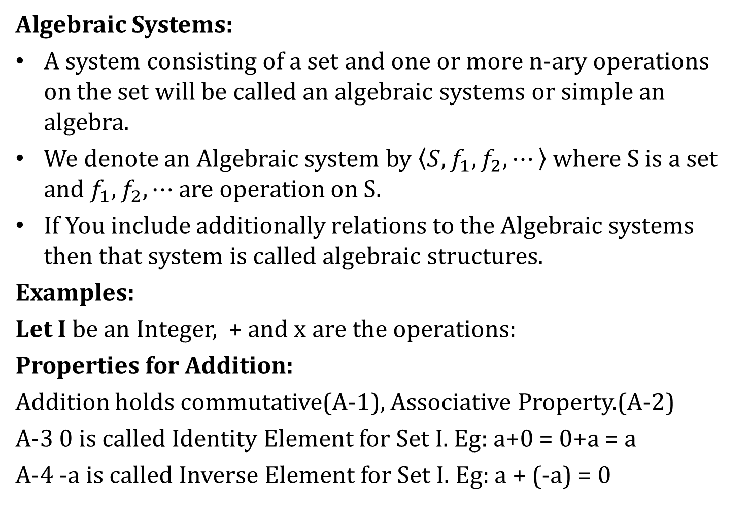
Algebraic Structures
Algebraic Systems:
A system consisting of a set and one or more n-ary operations on the set will be called an algebraic systems or simple an algebra.
We denote an Algebraic system by $\left\langle S, f_{1}, f_{2}, ⋯\right\rangle$ where S is a set and $f_{1}, f_{2}, ⋯$ are operation on S.
If You include additionally relations to the Algebraic systems then that system is called algebraic structures.
Examples:
Let I be an Integer, + and x are the operations:
Properties for Addition:
Addition holds commutative(A-1), Associative Property.(A-2)
A-3 0 is called Identity Element for Set I. Eg: a+0 = 0+a = a
A-4 -a is called Inverse Element for Set I. Eg: a + (-a) = 0

Slide 10
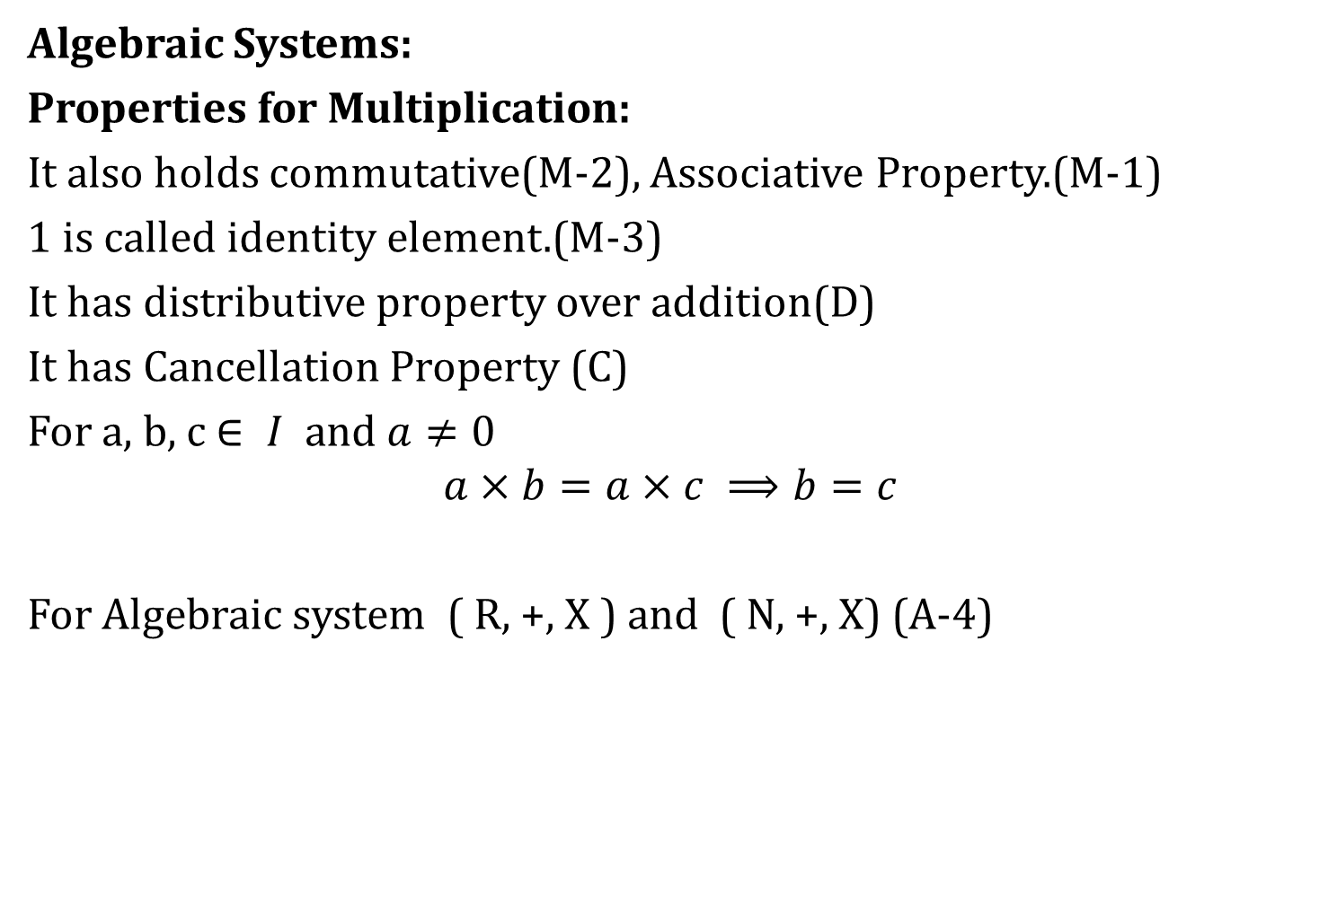
Algebraic Structures
Algebraic Systems:
Properties for Multiplication:
It also holds commutative(M-2), Associative Property.(M-1)
1 is called identity element.(M-3)
It has distributive property over addition(D)
It has Cancellation Property (C)
For a, b, c $∈ I$ and $a≠0$
$$a×b=a×c ⟹b=c$$
For Algebraic system ( R, +, X ) and ( N, +, X) (A-4)

Slide 11
Algebraic Structures
Algebraic Systems:
Some simple Algebraic systems and General Properties;
Composition of Functions

Slide 12
Algebraic Structures
Algebraic Systems:
Some simple Algebraic systems and General Properties;

Slide 13
Algebraic Structures
Algebraic Systems:
Some simple Algebraic systems and General Properties;

Slide 14
Algebraic Structures
Algebraic Systems:
Some simple Algebraic systems and General Properties;

Slide 15
Algebraic Structures
Algebraic Systems:
Some simple Algebraic systems and General Properties:
From the above examples we notice Some similarities between two tables. These similarities leads to several general properties of Algebraic systems.
Homomorphism:

Slide 16
Algebraic Structures
Algebraic Systems:
Some simple Algebraic systems and General Properties:

Slide 17
Algebraic Structures
Algebraic Systems:
Some simple Algebraic systems and General Properties:

Slide 18
Algebraic Structures
Algebraic Systems:
Some simple Algebraic systems and General Properties:

Slide 19
Algebraic Structures
Algebraic Systems:
Semi Groups and Monoids:

Slide 20
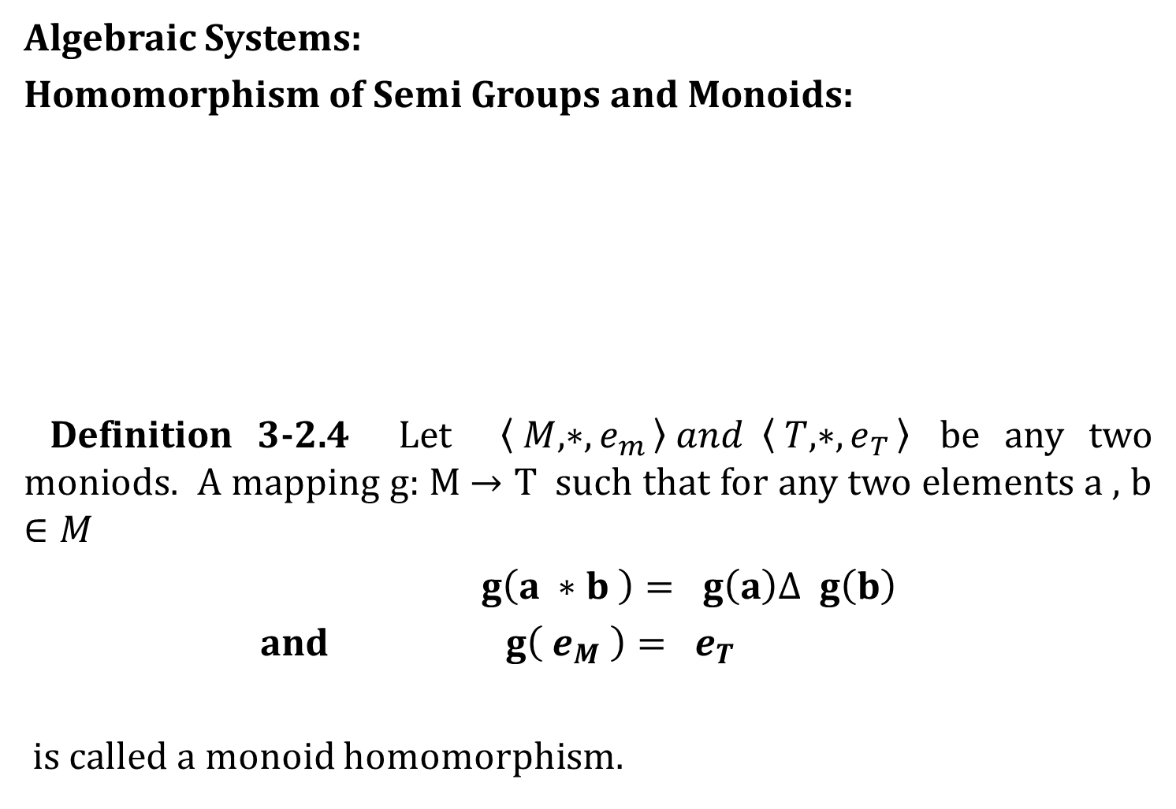
Algebraic Structures
Algebraic Systems:
Homomorphism of Semi Groups and Monoids:
Definition 3-2.4 Let $\left\langle M, ∗, e_{m }\right\rangle and \left\langle T, ∗, e_{T }\right\rangle$ be any two moniods. A mapping g: M $→T$ such that for any two elements a , b $∈M$
$g\left(a ∗b \right)= g\left(a\right)Δ g\left(b\right)$
and $g\left( e_{M} \right)= e_{T}$
is called a monoid homomorphism.

Slide 21
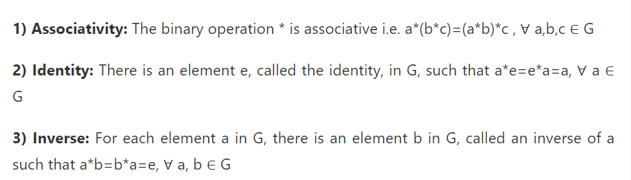
Algebraic Structures
Algebraic Systems:
Group:
Let G be a non-empty set with a binary operation * that assigns to each ordered pair (a, b) of elements of G an element of G denoted by a * b. We say that G is a group under the binary operation * if the following three properties are satisfied:

Slide 22
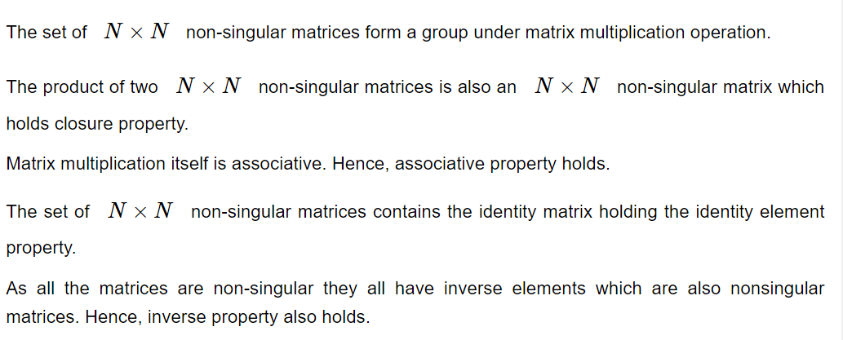
Algebraic Structures
Algebraic Systems:
Group:

Slide 23
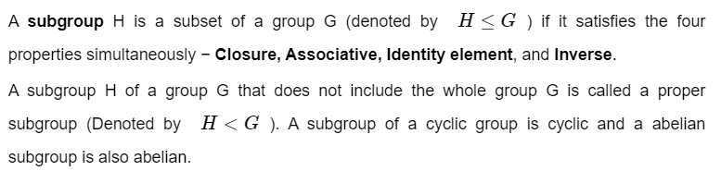
Algebraic Structures
Algebraic Systems:
Sub Group:

Slide 24
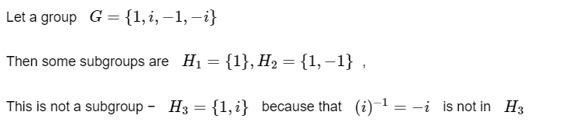
Algebraic Structures
Algebraic Systems:
Sub Group:

Slide 25
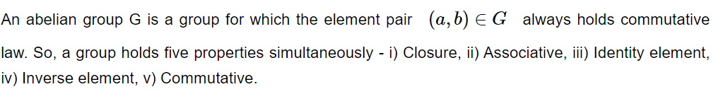
Algebraic Structures
Algebraic Systems:
Abelian Group:

Slide 26
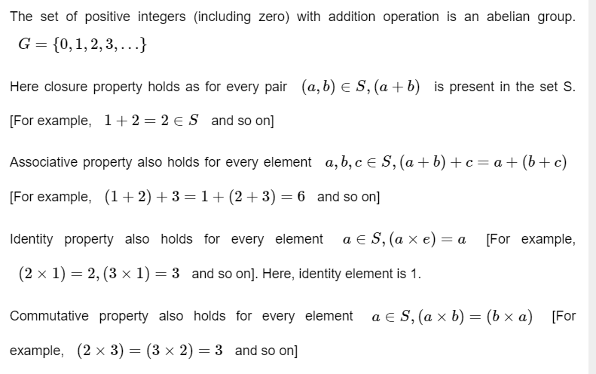
Algebraic Structures
Algebraic Systems:
Abelian Group:

Slide 27
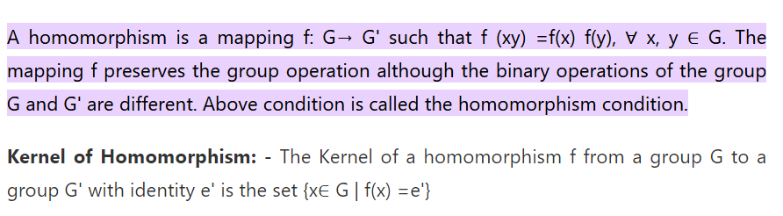
Algebraic Structures
Algebraic Systems:
Homomorphism:

Slide 28
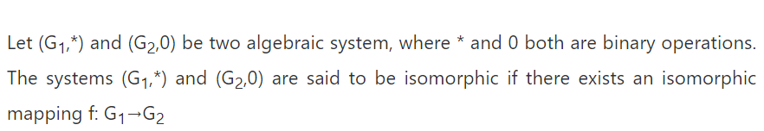
Algebraic Structures
Algebraic Systems:
Isomorphism:

Slide 29
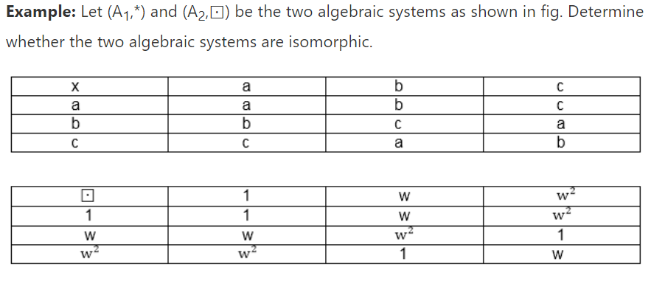
Algebraic Structures
Algebraic Systems:
Isomorphism:

Slide 30
Number Theory
Properties of Integers :

Slide 31
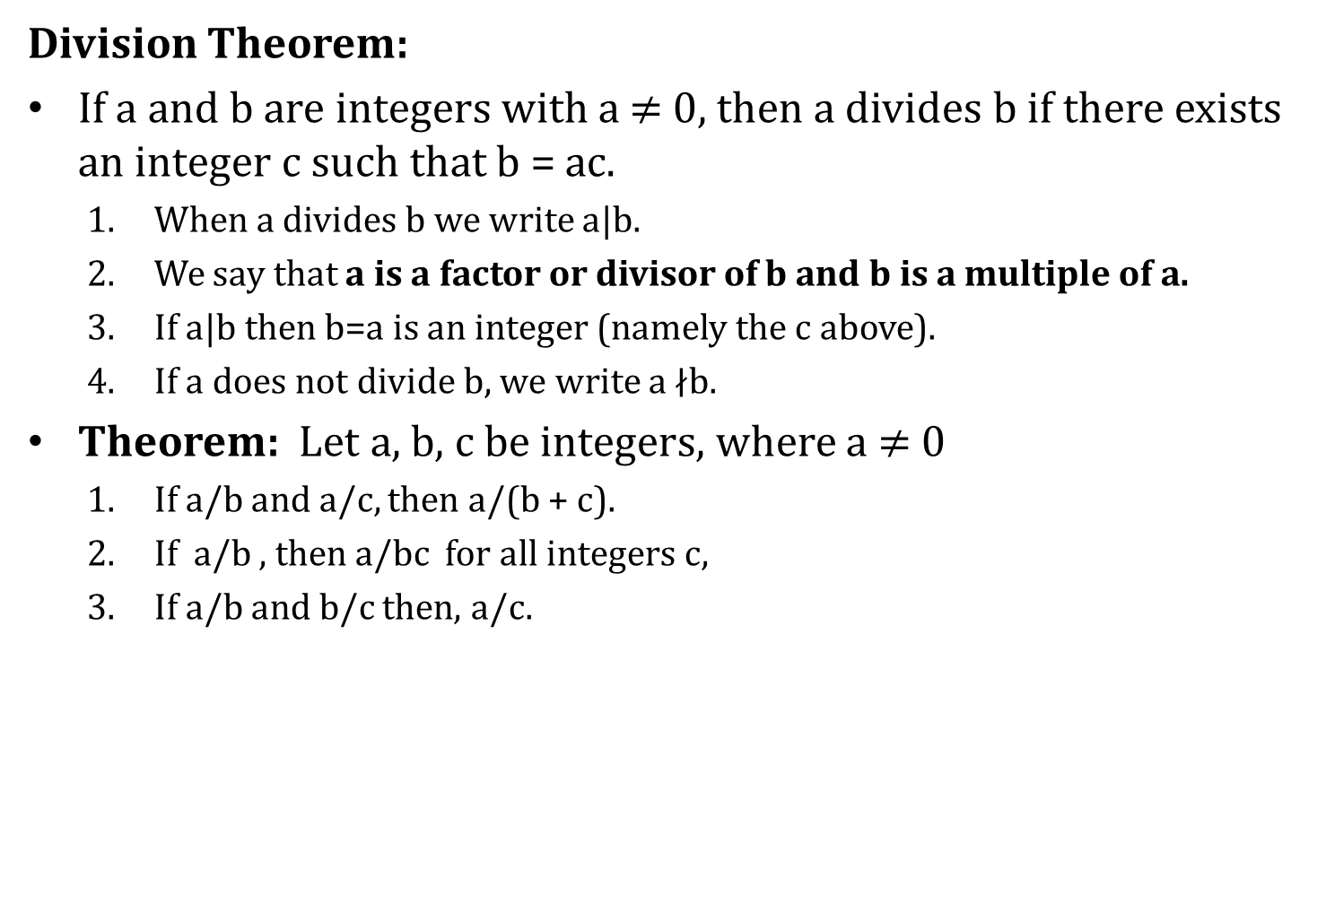
Number Theory
Division Theorem:
If a and b are integers with a $≠$ 0, then a divides b if there exists an integer c such that b = ac.
When a divides b we write a|b.
We say that a is a factor or divisor of b and b is a multiple of a.
If a|b then b=a is an integer (namely the c above).
If a does not divide b, we write a $∤$b.
Theorem: Let a, b, c be integers, where a $≠$ 0
If a/b and a/c, then a/(b + c).
If a/b , then a/bc for all integers c,
If a/b and b/c then, a/c.

Slide 32
Number Theory
Division Theorem:
When an integer is divided by a positive integer, there is a quotient and a remainder. This is traditionally called the “Division Algorithm”, but it is really a theorem.
Theorem: If a is an integer and d a positive integer, then there are unique integers q and r , with 0 <= r < d, such that a = dq + r.
a is called the dividend.
d is called the divisor.
q is called the quotient. q = a div d
r is called the remainder. r = a mod d

Slide 33
Number Theory
Greatest Common Divisor:
Let a and b be integers, not both zero. The largest integer d such that a/d and b/d is called the greatest common divisor of a and b. The greatest common divisor of a and b is denoted by gcd(a, b).
What is the greatest common divisor of 24 and 36?
What is the greatest common divisor of 17 and 22?
The integers a and b are relatively prime (coprime) iff gcd(a, b) = 1.
17 and 22. (Note that 22 is not a prime.)
The integers a1,a2, ... , an are pairwise relatively prime iff
gcd(ai , aj ) = 1 whenever 1 <=i < j <= n.

Slide 34
Number Theory
Euclidean Algorithm:
Let a = bq + r, where a, b, q, and r are integers. Then gcd(a, b) = gcd(b, r).

Slide 35
Number Theory
Euclidean Algorithm:
Let a = bq + r, where a, b, q, and r are integers. Then gcd(a, b) = gcd(b, r).

Slide 36
Number Theory
Least Common Multiple :
The least common multiple of the positive integers a and b is the smallest positive integer that is divisible by both a and b. It is denoted by lcm(a, b).
lcm(45, 21) = 7 X 45 = 15 X 21 = 315.
Formula for LCM is Prime Factorization:

Slide 37
Number Theory
Testing for Prime Numbers:
An integer p greater than 1 is called prime if the only positive factors of p are 1 and p. A positive integer that is greater than 1 and is not prime is called composite.
If n is a composite integer, then n has a prime divisor less than or equal to √n.
By using above rule we perform trail division to test whether the given number is prime.

Slide 38
Number Theory
The Fundamental Theorem of Arithmetic:
Every positive integer greater than 1 can be written uniquely as a prime or as the product of its prime factors, written in order of nondecreasing size.

Slide 39
Number Theory
Modular Arithmetic:
If a and b are integers and m is a positive integer, then a is congruent to b modulo m iff m|(a- b).

Slide 40
Number Theory
Modular Arithmetic:

Slide 41
Number Theory
Modular Arithmetic:

Slide 42
Number Theory
Modular Arithmetic:
FERMAT’s Theorem:
If a is an integer and m is a prime then a^{m} mod m = a mod m

Slide 43
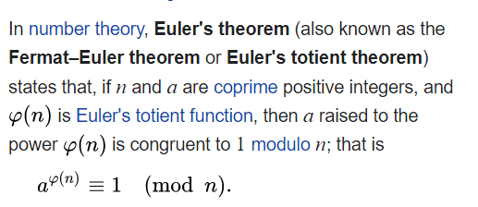
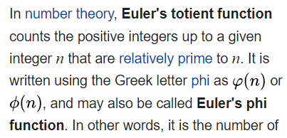
Number Theory
Euler’s Theorem

Slide 44
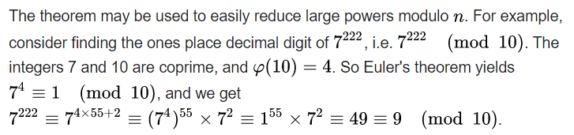
Number Theory
Euler’s Theorem

