Slide 1
Discrete Mathematics R204GA05401
Narasimhulu M_{M. Tech.}
Assistant Professor
Department of Computer Science & Engineering

Slide 2
Objectives
Narasimhulu M_{M. Tech.}
Assistant Professor
Department of Computer Science & Engineering

Slide 3
Objectives
This course will introduce and illustrate in the elementary discrete mathematics for computer science and engineering students.
To equip the students with standard concepts like formal logic notation, methods of proof, induction, sets, relations, graph theory, permutations and combinations, counting principles.

Slide 4
Course Outcomes
Narasimhulu M_{M. Tech.}
Assistant Professor
Department of Computer Science & Engineering

Slide 5
Course Outcomes
Illustrate discrete mathematic components like statements, logic, sets, structures, numbers and combinatorics.
Evaluate and simplify propositional and predicate calculus using inference theory.
Perform the operations on Sets, Relations and functions and their properties.
Identify algebraic systems and use general properties on number theory.
Use combinatorics solving the counting problems.
Use graph algorithms for representing, identifying, generating and evaluating the Graphs.

Slide 6
Unit IV Combinatorics
Narasimhulu M_{M. Tech.}
Assistant Professor
Department of Computer Science & Engineering

Slide 7
Unit IV
Combinatorics: Basic of Counting, Permutations, Permutations with Repetitions, Circular Permutations, Restricted Permutations, Combinations, Restricted Combinations, Generating Functions of Permutations and Combinations, Binomial and Multinomial Coefficients, Binomial and Multinomial Theorems, The Principles of Inclusion–Exclusion, Pigeonhole Principle and its Application

Slide 8
Combinatorics
Narasimhulu M_{M. Tech.}
Assistant Professor
Department of Computer Science & Engineering

Slide 9
Combinatorics
Basic of Counting:
There are two rules:
Product Rule
Sum Rule

Slide 10
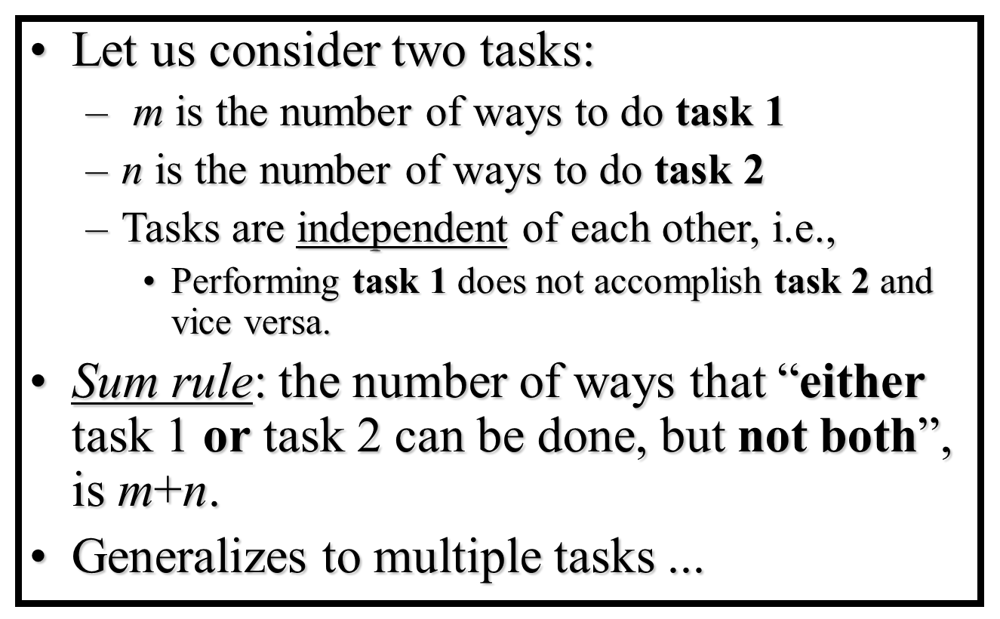
Combinatorics
Basic of Counting:
There are two rules:
Sum Rule

Slide 11
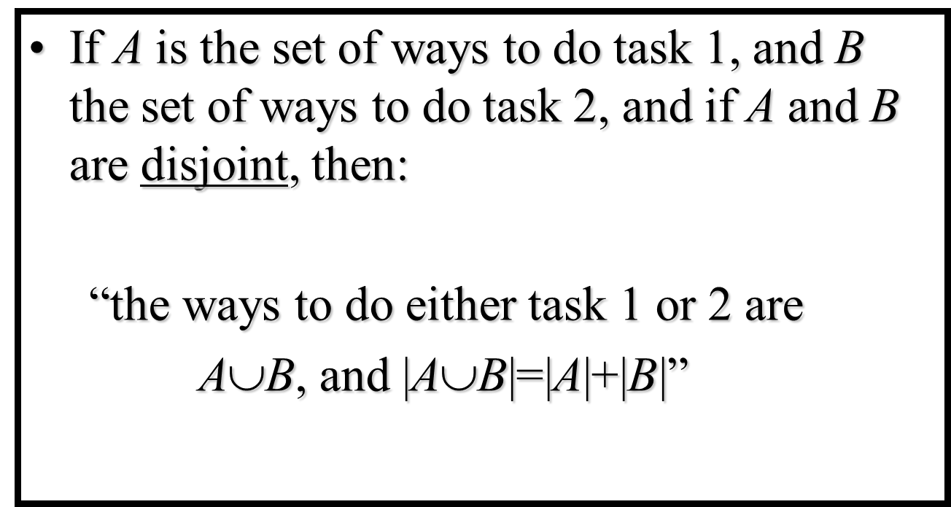
Combinatorics
Basic of Counting:
Examples:
A student can choose a computer project from one of three lists. The three lists contain 23, 15, and 19 possible projects respectively. How many possible projects are there to choose from?

Slide 12
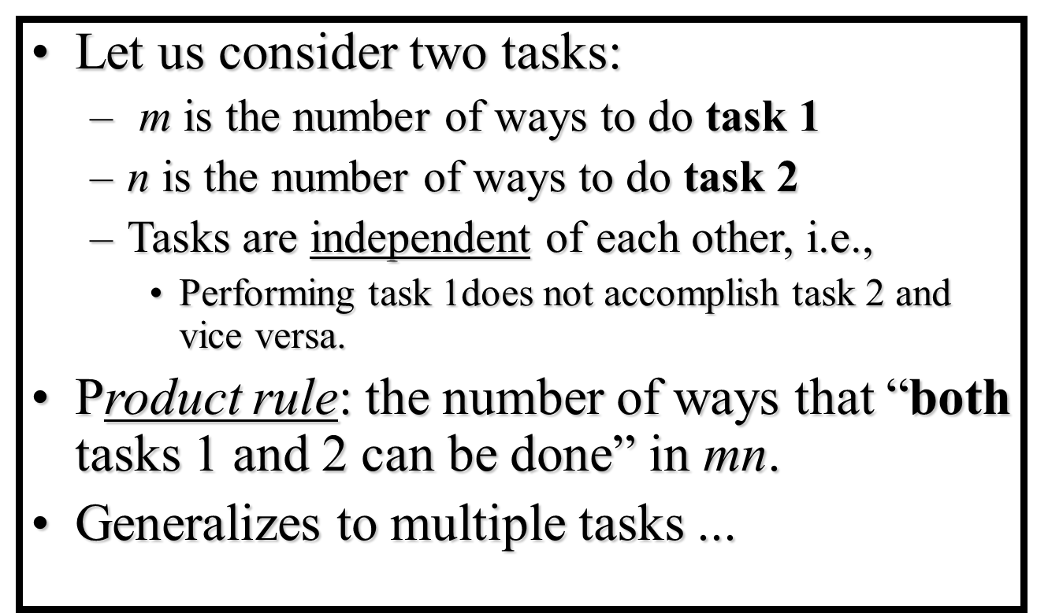
Combinatorics
Basic of Counting:
There are two rules:
Product Rule

Slide 13
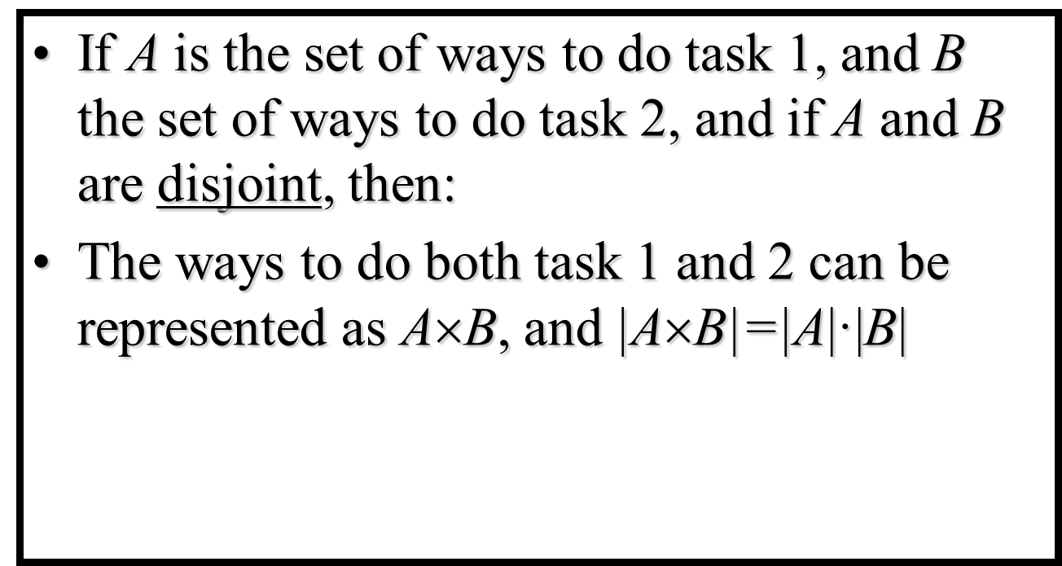
Combinatorics
Basic of Counting:
There are two rules:
Product Rule (Example)
The chairs of an auditorium are to be labeled with a letter and a positive integer not to exceed 100. What is the largest number of chairs that can be labeled differently?

Slide 14
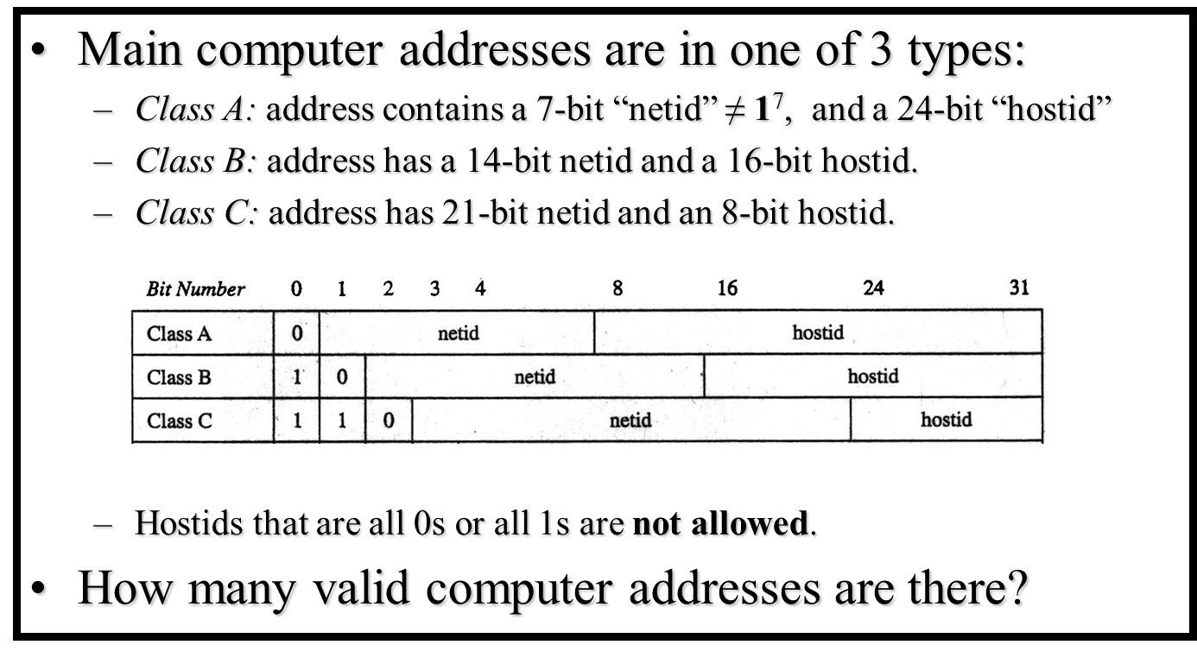
Combinatorics
Basic of Counting:

Slide 15
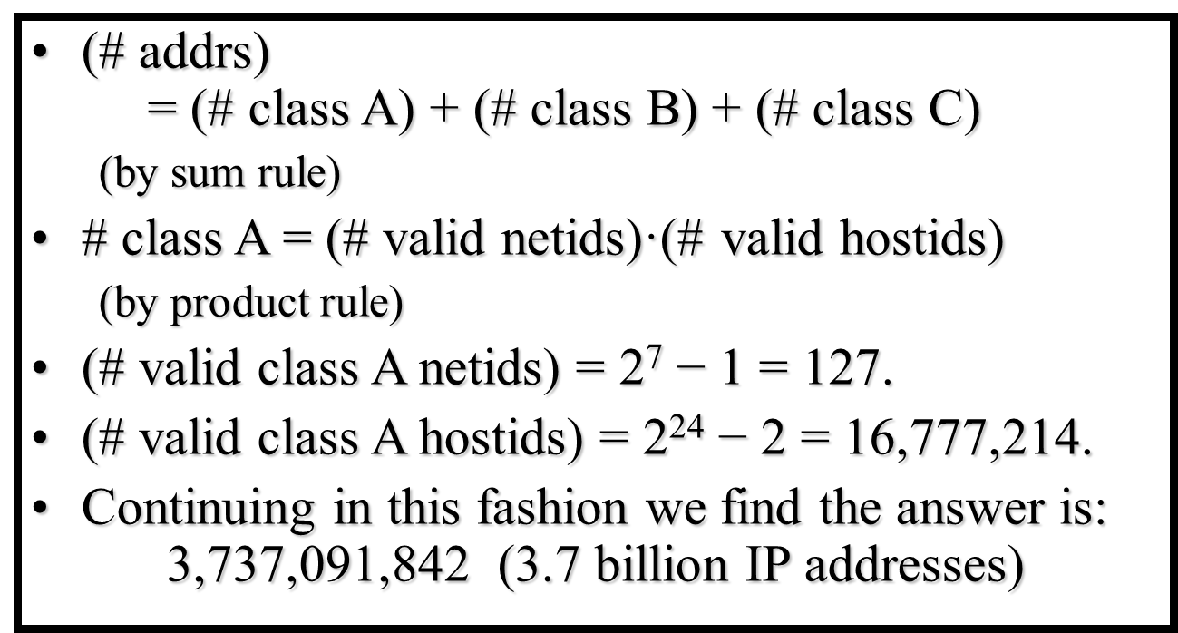
Combinatorics
Basic of Counting:

Slide 16
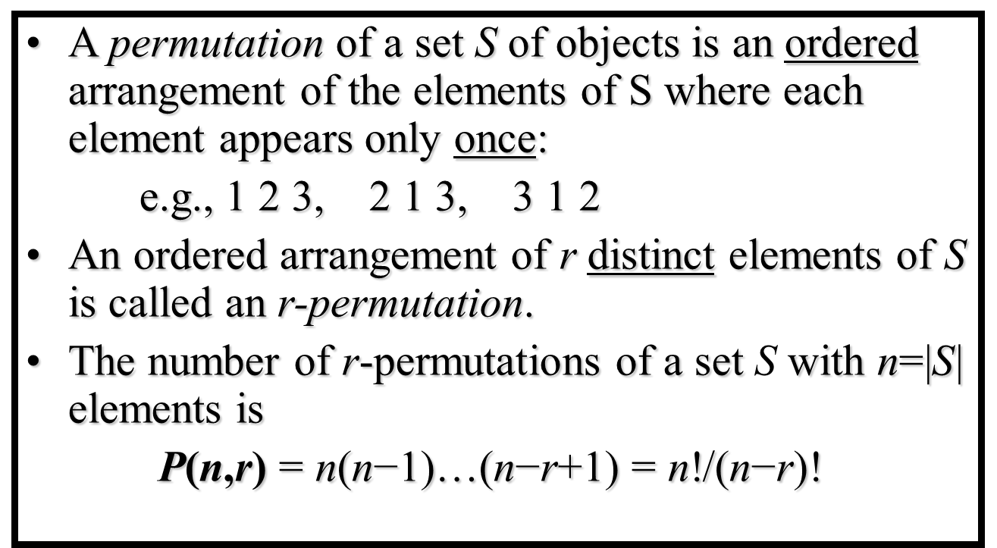
Combinatorics
Permutations:

Slide 17
Combinatorics
Permutations with repetitions:
Frequently we want to know the number of permutations of a multiset, that is, a set of objects some of which are alike. We will
Let denote the number of permutations of n objects of which n₁ are alike, n₂ are alike, . . ., n_{r} are alike. The general formula follows:

Slide 18
Combinatorics
Permutations with repetitions:

Slide 19
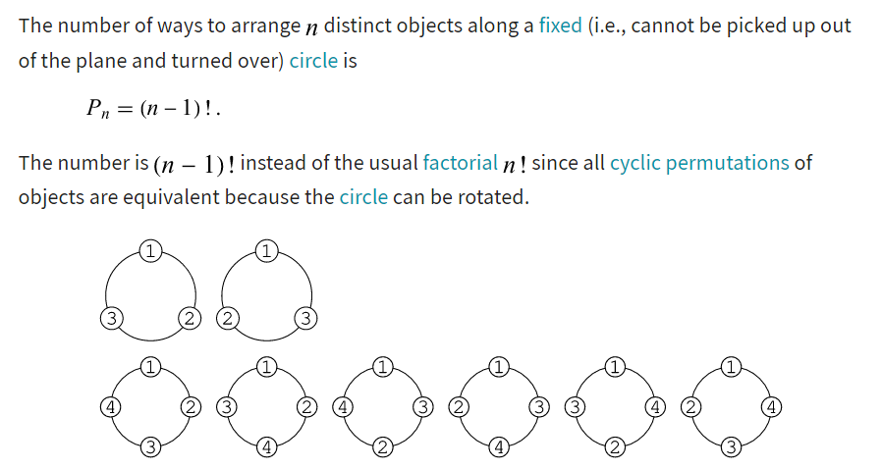
Combinatorics
Circular Permutations:

Slide 20
Combinatorics
Circular Permutations:
In how many ways 8 students be seated in a circle and in a line.
In a circle is (8-1)!=7!=5070
In a line is 8! = 40320

Slide 21
Combinatorics
Restricted Permutations:
The permutation is a way of filtering and selecting a set of objects, where the arrangement of objects does matter. However, the arrangement of objects may be done by imposing certain restrictions in the order of selection. For instance, the order of arrangement of articles, such that an article is always included or excluded from the set of given objects. Imposing the restrictions implies that not all the objects from the given set need to be ordered. There are different types of common restrictions that may be imposed on the permutation:
Inclusion of a set of objects
Exclusion of a set of objects
Certain objects that always occur together
Certain objects that stay apart

Slide 22
Combinatorics
Restricted Permutations:
The common types of restricted permutations are:
Formation of numbers with digits with some digits at fixed positions.
Word building with some letters with a fixed position.
Vowels or consonants in the set of alphabets occur together.
A set of objects always occurring together
A set of objects that never occur together
Restrictions for circular permutations
The choice of dress to wear from a set of dresses
The order of eating
The combinations of the colors to make

Slide 23
Combinatorics
Restricted Permutations:
The permutation is a way of filtering and selecting a set of objects, where the arrangement of objects does matter. However, the arrangement of objects may be done by imposing certain restrictions in the order of selection. For instance, the order of arrangement of articles, such that an article is always included or excluded from the set of given objects. Imposing the restrictions implies that not all the objects from the given set need to be ordered. There are different types of common restrictions that may be imposed on the permutation:
Inclusion of a set of objects
Exclusion of a set of objects
Certain objects that always occur together
Certain objects that stay apart

Slide 24
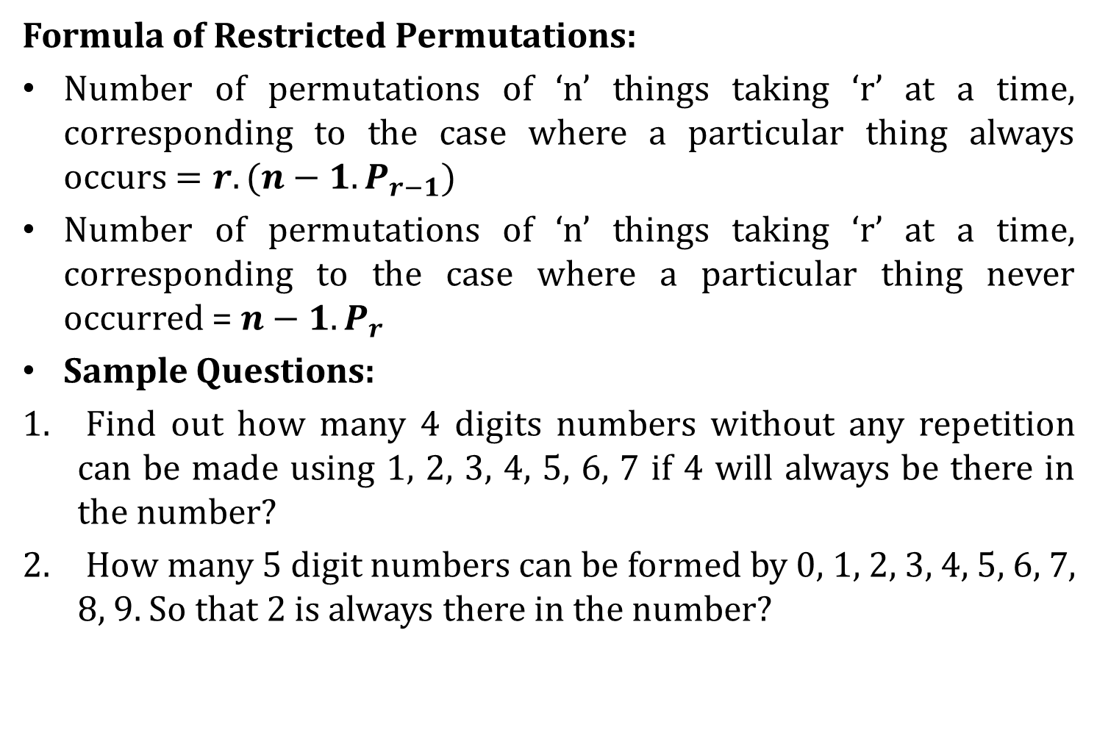
Combinatorics
Formula of Restricted Permutations:
Number of permutations of ‘n’ things taking ‘r’ at a time, corresponding to the case where a particular thing always occurs $=r.(n−1.P_{r−1})$
Number of permutations of ‘n’ things taking ‘r’ at a time, corresponding to the case where a particular thing never occurred = $n−1. P_{r}$
Sample Questions:
Find out how many 4 digits numbers without any repetition can be made using 1, 2, 3, 4, 5, 6, 7 if 4 will always be there in the number?
How many 5 digit numbers can be formed by 0, 1, 2, 3, 4, 5, 6, 7, 8, 9. So that 2 is always there in the number?

Slide 25
Combinatorics
Formula of Restricted Permutations:
Sample Questions:
Find out how many 4 digits numbers without any repetition can be made using 1, 2, 3, 4, 5, 6, 7 if 4 will always be there in the number?
How many 5 digit numbers can be formed by 0, 1, 2, 3, 4, 5, 6, 7, 8, 9. So that 2 is always there in the number?
How many different three-letter words can be made by 5 vowels if ‘a’ is never included?
. How many four-digit numbers without any repetition can be made by using 1, 2, 3, 4, 5, 6, 7 if 4 will never be included?

Slide 26
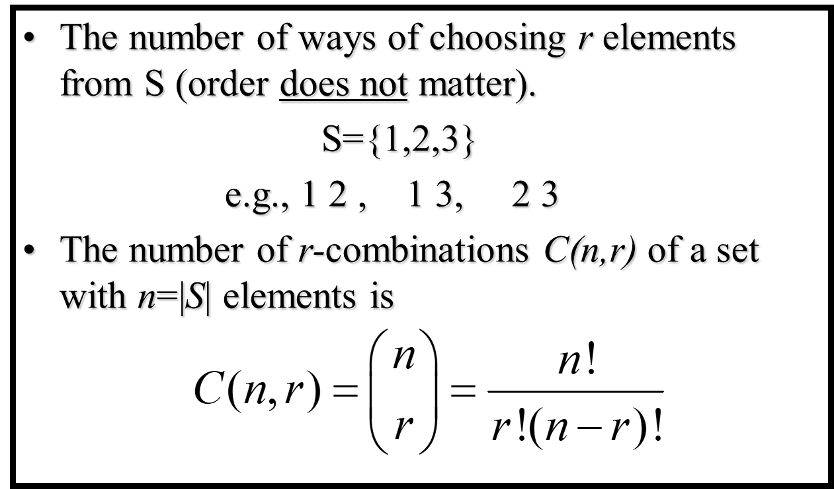
Combinatorics
Combinations:

Slide 27
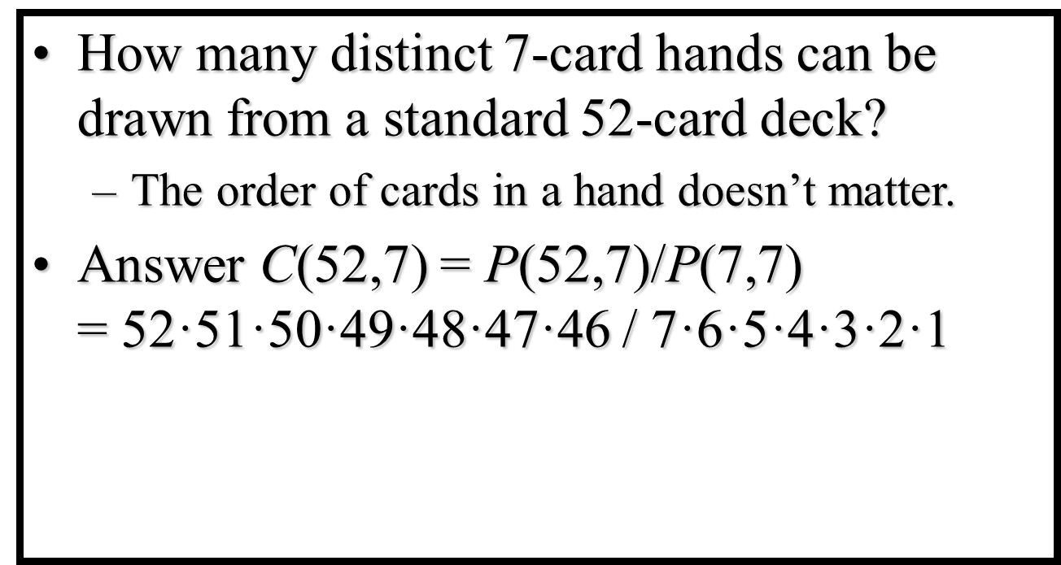
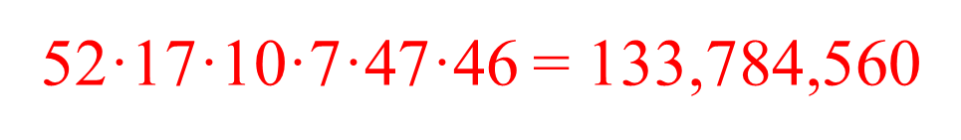
Combinatorics
Combinations:Example

Slide 28
Combinatorics
Combinations: Example
Suppose that there are 9 faculty members in the mathematics department and 11 in the computer science department. How many ways are there to select a committee to develop a discrete mathematics course at a school if the committee is to consist of three faculty members from the mathematics department and four from the computer science department?

Slide 29
Combinatorics
Restricted Combinations:
(a) Number of combinations of ‘n’ different things taken ‘r’ at a time, when ‘p’ particular things are always included = ^{n-p}C_{r-p.}
Number of combination of ‘n’ different things, taken ‘r’ at a time, when ‘p’ particular things are always to be excluded = ^{n-p}C_{r}
Example:
In how many ways can a cricket-eleven be chosen out of 15 players? if
(i) A particular player is always chosen,
(ii) A particular is never chosen.

Slide 30
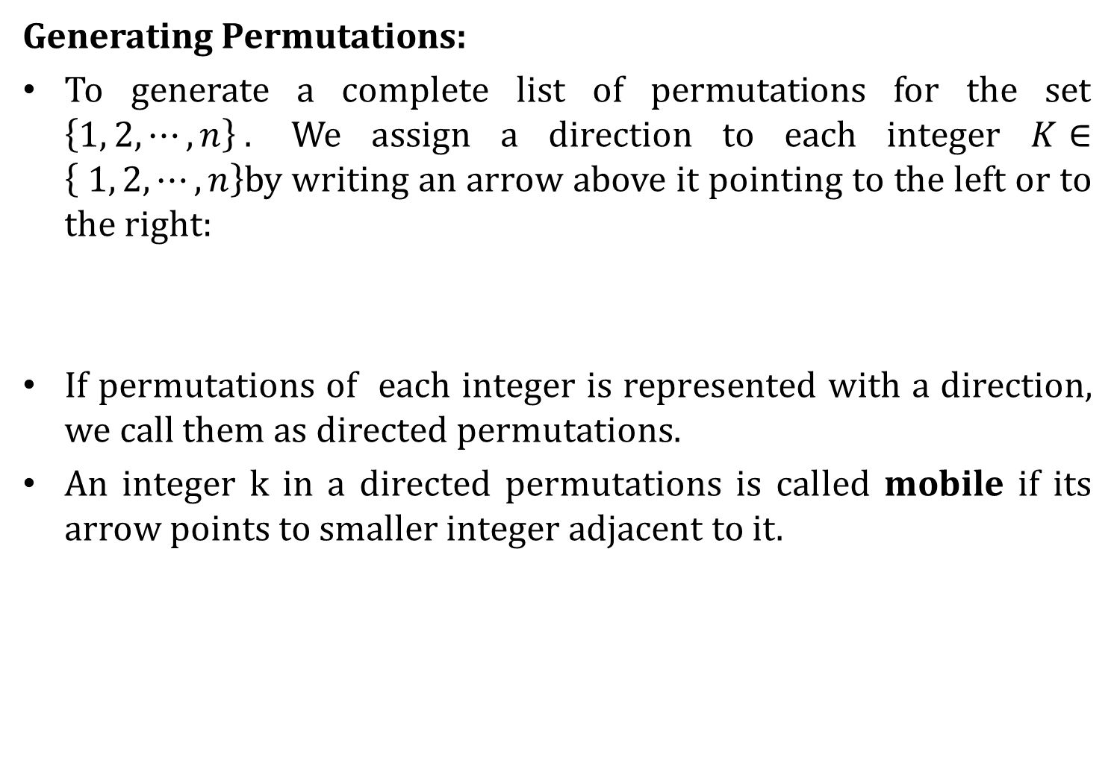
Combinatorics
Generating Permutations:
To generate a complete list of permutations for the set $\left\{1, 2, ⋯, n\right\} .$ We assign a direction to each integer $K∈\left\{ 1, 2, ⋯, n\right\}$by writing an arrow above it pointing to the left or to the right:
If permutations of each integer is represented with a direction, we call them as directed permutations.
An integer k in a directed permutations is called mobile if its arrow points to smaller integer adjacent to it.

Slide 31
Combinatorics
Generating Permutations:
The integer n is mobile, except two cases:

Slide 32
Combinatorics
Generating Permutations:

Slide 33
Combinatorics
Generating Permutations:

Slide 34
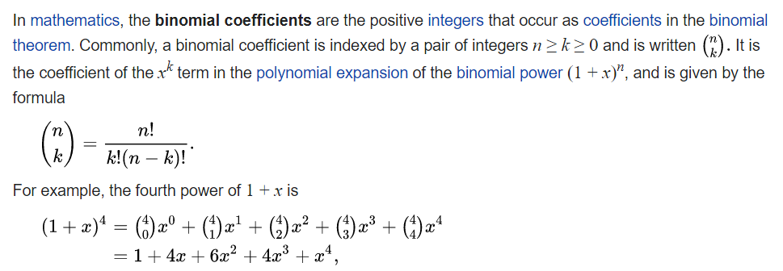
Combinatorics
Binomial and Multinomial Coefficients:

Slide 35
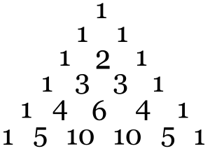
Combinatorics
Binomial and Multinomial Coefficients:

Slide 36
Combinatorics
Binomial and Multinomial Coefficients:

Slide 37
Combinatorics
Binomial and Multinomial Coefficients:

Slide 38
Combinatorics
Binomial and Multinomial Theorem:
Find out the coefficient of x9y3 in the expansion of (x+2y)12 using binomial theorem.

Slide 39
Combinatorics
Binomial and Multinomial Theorem:
Find out the coefficient of a2b3c2d5 in the expansion of (a+2b-3c+2d+5)16 using multinomial theorem.

Slide 40

Combinatorics
Principle of Inclusion and Exclusion
If the sets are not disjoint we must refine the sum rule called Principles of inclusion-Exclusion. Sometimes called Sieve method.
Theorem 1: if A and B are subsets of some universe set U, then$\left|AUB\right|=\left|A\right|+\left|B\right|−\left|A∩B\right|$

Slide 41
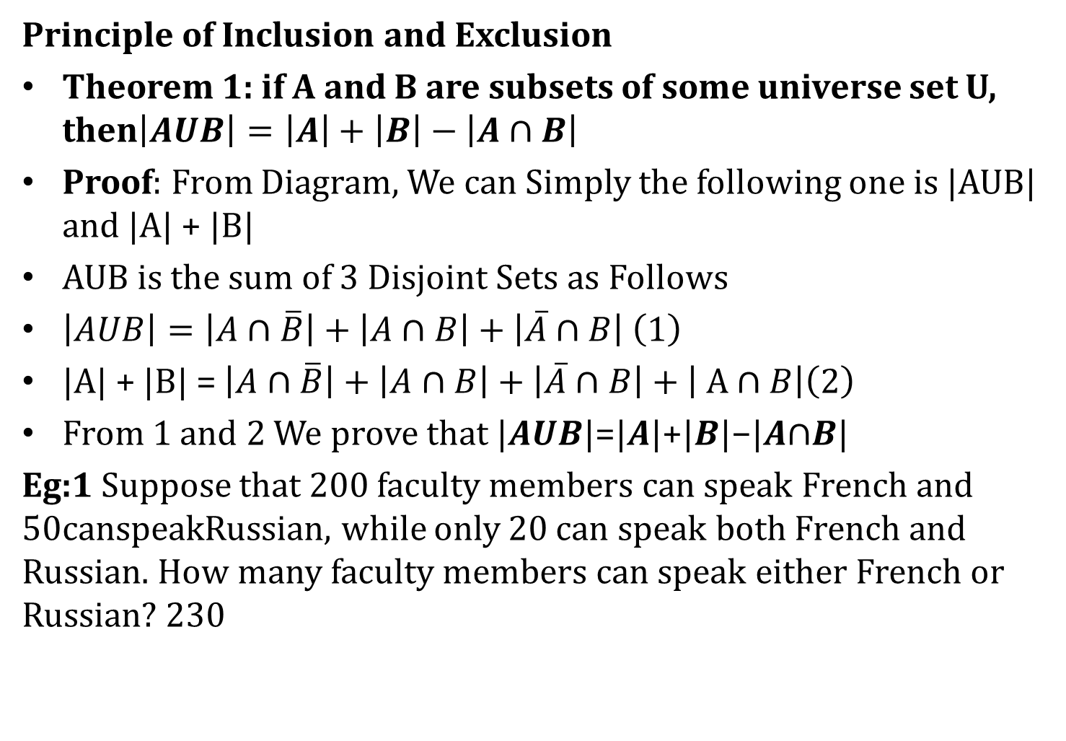
Combinatorics
Principle of Inclusion and Exclusion
Theorem 1: if A and B are subsets of some universe set U, then$\left|AUB\right|=\left|A\right|+\left|B\right|−\left|A∩B\right|$
Proof: From Diagram, We can Simply the following one is |AUB| and |A| + |B|
AUB is the sum of 3 Disjoint Sets as Follows
$\left|AUB\right|=\left|A∩\overline{B}\right|+\left|A∩B\right|+\left|\overline{A}∩B\right| \left(1\right)$
|A| + |B| = $\left|A∩\overline{B}\right|+\left|A∩B\right|+\left|\overline{A}∩B\right|+\left| A∩B\right|\left(2\right)$
From 1 and 2 We prove that |𝑨𝑼𝑩|=|𝑨|+|𝑩|−|𝑨∩𝑩|
Eg:1 Suppose that 200 faculty members can speak French and 50canspeakRussian, while only 20 can speak both French and Russian. How many faculty members can speak either French or Russian? 230

Slide 42
Combinatorics
Principle of Inclusion -Exclusion
Eg: 2 From a group of 10 professors how many ways can a committee of 5 members be formed so that at least one of Professor A and Professor B will be included?
Sum rule: C(8,3) + 2C(8,4)
Indirect Counting: C(10,5) – C(8,5)
Principle of Inclusion and Exclusion: C(9,4) + C(9,4) – C(8,3)
Theorem 2: If A, B, C are finite sets,

Slide 43
Combinatorics
Proof: From Diagram we Calculate the Following things

Slide 44
Combinatorics
Proof: From Diagram we Calculate the Following things

Slide 45
Combinatorics
If there are 200 faculty members that speak
Eg: French, 50 that speak Russian,100 that speak Spanish, 20 that speak French and Russian, 60 that speak French and Spanish, 35 that speak Russian and Spanish, while only 10 speak French, Russian, and Spanish, how many speak either French or Russian or Spanish?

Slide 46
Combinatorics

Slide 47
Combinatorics
Pigeonhole Principle and its Application:
In Discrete Mathematics, the pigeonhole principle states that if we must put N + 1 or more pigeons into N Pigeon Holes, then some pigeonholes must contain two or more pigeons.
Generalized Pigeonhole Principle
If Kn + 1 (where k is a positive integer) pigeons are distributed among n holes than some hole contains at least k + 1 pigeons.
This principle is applicable in many fields like Number Theory, Probability, Algorithms, Geometry, etc.

Slide 48
Combinatorics
Pigeonhole Principle and its Application:
If 6 color are used to paint 37 home. Show that at least 7 home of them will be of same colour.
A bag contains 10 red marbles, 10 white marbles, and 10 blue marbles. What is the minimum no. of marbles you have to choose randomly from the bag to ensure that we get 4 marbles of same color?
Find the minimum number of teachers in a college to be sure that four of them are born in the same month,

Slide 49
Combinatorics
Pigeonhole Principle and its Application:
A box contain 10 blue ball, 20 red balls, 8 green balls, 15 yellow balls and 25 white balls. How many ball we have chosen to ensure that we have 12 balls of the same color.
Prove that among 1, 00, 000 there are two who are born on the same time.

Slide 50
Combinatorics
Pigeonhole Principle and its Application:
Theorem: Let q1, q2, . . . , qn be positive integers. If q1+ q2+ . . . + qn – n + 1 objects are put into n boxes, then either the 1st box contains at least q1 objects, or the 2nd box contains at least q2 objects, . . ., the nth box contains at least qn objects.

Slide 51
Combinatorics
Pigeonhole Principle and its Application:
In a computer science department, a student club can be formed with either 10 members from first year or 8 members from second year or 6 from third year or 4 from final year. What is the minimum no. of students we have to choose randomly from department to ensure that a student club is formed?

Slide 52
Combinatorics
Pigeonhole Principle and its Application:
The following are the applications of the pigeonhole principle.
Common Properties in Large Groups:
According to this application, at any given time in India, at least two people have the same number of hairs on their heads.

Slide 53
Combinatorics
Pigeonhole Principle and its Application:
The following are the applications of the pigeonhole principle.
Subset Cardinalities:
According to this application, if P is any set of ten integers between 1 and 100, there must be two distinct subsets Q and R where the sum of the elements in Q equals the sum of the elements in R.

Slide 54
Combinatorics
Pigeonhole Principle and its Application:
The following are the applications of the pigeonhole principle.
The Chinese Remainder Theorem
According to this application, let r and s be relatively prime positive integers. Then there is a solution for the system x=p(modr) , x=q(mods)
.

Slide 55
Combinatorics
Pigeonhole Principle and its Application:
The following are the applications of the pigeonhole principle.
Constructive vs Non-Constructive Proofs
Pigeonhole proofs are non-constructive in the sense that, while they prove the existence of something, they fail to provide an explicit example that proves the theorem..
Consider two proofs of the same statement to demonstrate the distinction.

Slide 56
Combinatorics
Pigeonhole Principle and its Application:
Statement: There are irrational numbers x, and y where x^{y} is rational.

