Slide 1
Discrete Mathematics R204GA05401
Narasimhulu M_{M. Tech.}
Assistant Professor
Department of Computer Science & Engineering

Slide 2
Objectives
Narasimhulu M_{M. Tech.}
Assistant Professor
Department of Computer Science & Engineering

Slide 3
Objectives
This course will introduce and illustrate in the elementary discrete mathematics for computer science and engineering students.
To equip the students with standard concepts like formal logic notation, methods of proof, induction, sets, relations, graph theory, permutations and combinations, counting principles.

Slide 4
Course Outcomes
Narasimhulu M_{M. Tech.}
Assistant Professor
Department of Computer Science & Engineering

Slide 5
Course Outcomes
Illustrate discrete mathematic components like statements, logic, sets, structures, numbers and combinatorics.
Evaluate and simplify propositional and predicate calculus using inference theory.
Perform the operations on Sets, Relations and functions and their properties.
Identify algebraic systems and use general properties on number theory.
Use combinatorics solving the counting problems.
Use graph algorithms for representing, identifying, generating and evaluating the Graphs.

Slide 6
Unit V Graph Theory
Narasimhulu M_{M. Tech.}
Assistant Professor
Department of Computer Science & Engineering

Slide 7
Unit V
Graph Theory: Basic Concepts of Graphs, Sub graphs, Matrix Representation of Graphs: Adjacency Matrices, Incidence Matrices, Isomorphic Graphs, Paths and Circuits, Eulerian and Hamiltonian Graphs, Multigraphs, Planar Graphs, Euler‘s Formula, Graph Coloring and Covering, Chromatic Number, Spanning Trees, Algorithms for Spanning Trees.

Slide 8
Graph Theory
Narasimhulu M_{M. Tech.}
Assistant Professor
Department of Computer Science & Engineering

Slide 9
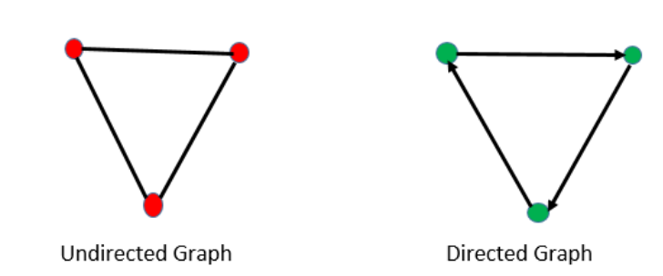
Graph Theory
Basic Concepts of Graphs:
A Graph G is a pair of sets (V, E) where V = A set of vertices (nodes) and E = A set of edges (lines) V(G) = Set of vertices in G. E(G) = Set of edges in G. |V(G)| = Number of vertices in graph G = Order of G. |E(G)| = Number of edges in graph G = Size of G .
Types of graphs:

Slide 10
Graph Theory
Basic Concepts of Graphs:

Slide 11
Graph Theory
Graph Terminology:
Order of Graph:
Size of Graph:
Degree: Degree of a vertex in an undirected graph is the number of edges incident with it, except that a loop at a vertex contributes twice to the degree of that vertex. The degree of the vertex ‘v’ is denoted by deg(v).
In-degree and Out-degree: In a digraph, the number of edges incident to a vertex is called the in-degree of the vertex and the number of vertices incident from a vertex is called its out-degree.
The in-degree of a vertex ‘v’ in a graph G is denoted by deg+(v) .
The out-degree of a vertex v is denoted by deg -(v).

Slide 12
Graph Theory
Graph Terminology:
δ(G) = minimum of all the degrees of vertices in a graph G.
Δ(G) = Maximum of all the degrees of vertices in a graph G.
A loop at a vertex in a digraph is counted as one edge for both
in-degree and out-degree of that vertex.
Neighbors: If there is an edge incident from u to v, or incident on u and v, then u and v are said to be adjacent ( neighbors).
Degree Sequence: If v1, v2, ……, vn are the vertices of a graph G, then the sequence{d1, d2,….., dn} where di = degree of vi is called the degree sequence of G.
Usually we order the degree sequence so that the degree sequence is monotonically decreasing.

Slide 13
Graph Theory
Other types of graphs:
Loop: An edge drawn from a vertex to itself.
Multi Graph: If one allows more than one edge to join a pair of vertices, the result is then called a multi graph.
Simple Graph: A graph with no loops and no parallel edges.
Null Graph: A graph that does not have edges.
Connected graph: A graph where any two vertices are connected by a path.
Disconnected graph: A graph where any two vertices or nodes are disconnected by a path.
Cycle Graph: A graph that completes a cycle.
Complete Graph: When each pair of vertices are connected by an edge then such graph is called a complete graph
Planar graph: When no two edges of a graph intersect and are all the vertices and edges are drawn in a single plane, then such a graph is called a planar graph

Slide 14
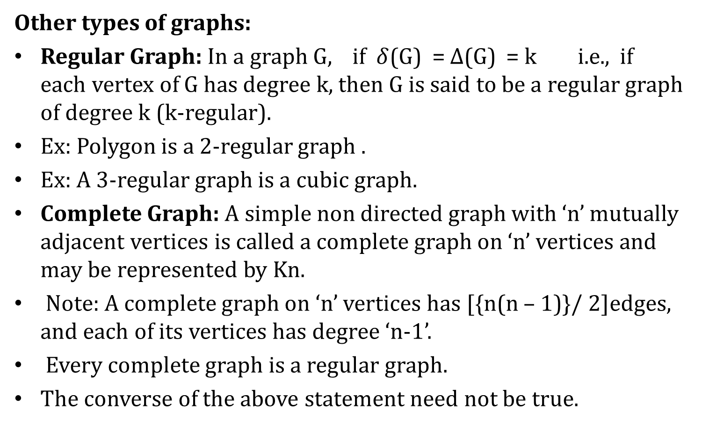
Graph Theory
Other types of graphs:
Regular Graph: In a graph G, if $δ$(G) = $∆$(G) = k i.e., if each vertex of G has degree k, then G is said to be a regular graph of degree k (k-regular).
Ex: Polygon is a 2-regular graph .
Ex: A 3-regular graph is a cubic graph.
Complete Graph: A simple non directed graph with ‘n’ mutually adjacent vertices is called a complete graph on ‘n’ vertices and may be represented by Kn.
Note: A complete graph on ‘n’ vertices has [{n(n – 1)}/ 2]edges, and each of its vertices has degree ‘n-1’.
Every complete graph is a regular graph.
The converse of the above statement need not be true.

Slide 15
Graph Theory
Other types of graphs:
Cycle Graph: A cycle graph of order ‘n’ is a connected graph whose edges form a cycle of length n.
Note: A cycle graph ‘C_{n}’ of order n has n vertices and n edges.
Null Graph: A null graph of order n is a graph with n vertices and no edges.
Wheel Graph: A wheel graph of order ‘n’ is obtained by adding a single new vertex (the hub) to each vertex of a cycle graph of order n.
Note: A wheel graph W_{n} has ‘n +1’ vertices and 2n edges.
Bipartite Graph: A Bipartite graph is a non directed graph whose set of vertices can be partitioned in to two sets M and N in such a way that each edge joins a vertex in M to a vertex in N.

Slide 16
Graph Theory
Other types of graphs:
Complete Bipartite Graph: A complete Bipartite graph is a Bipartite graph in which every vertex of M is adjacent to every vertex of N.
If |M|= m and |N| = n then the complete Bipartite graph is denoted by K_{m , n}. It has ‘m n’ edges.
The number of edges in a bipartite graph is less than or equal to (n²/4).

Slide 17
Graph Theory
Graph Theorems:

Slide 18
Graph Theory
Graph Theorems:

Slide 19
Graph Theory
Graph Theorems:

Slide 20
Graph Theory
Graph Theorems:
Is there a graph with degree sequence (1, 3, 3, 3, 5, 6, 6)
Is there a simple graph with degree sequence (1, 1, 3, 3, 3, 4, 6, 7)
Is there a non-simple graph G with the degree sequence (1, 1, 3, 3, 4, 6, 7)
If a simple graph, G, has m edges and n vertices:
If G is also directed then m ≤ n(n-1) If G is also undirected then m ≤ n(n-1)/2
So a simple graph with n vertices has O(n²) edges at most

Slide 21
Graph Theory
Sub graphs:
A graph G1 = (V1, E1) is called subgraph of a graph G(V, E) if V1(G) is a subset of V(G) and E1(G) is a subset of E(G) such that each edge of G1 has same end vertices as in G.
Types of Subgraph:
Vertex disjoint subgraph: Any two graph G1 = (V1, E1) and G2 = (V2, E2) are said to be vertex disjoint of a graph G = (V, E) if V1(G1) intersection V2(G2) = null. In figure there is no common vertex between G1 and G2.
Edge disjoint subgraph: A subgraph is said to be edge disjoint if E1(G1) intersection E2(G2) = null. In figure there is no common edge between G1 and G2.
Note: Edge disjoint subgraph may have vertices in common but vertex disjoint graph cannot have common edge, so vertex disjoint subgraph will always be an edge disjoint subgraph.

Slide 22
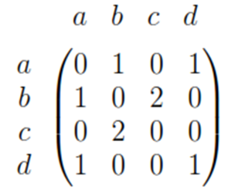
Graph Theory
Representation of Graphs:
Adjacency list: One way to represent a graph with no multiple edges is to use adjacency lists, which specify the vertices that are adjacent to each vertex of the graph.
1) Adjacency matrix: The adjacency matrix of a graph is a
matrix with rows and columns labeled by the vertices and such that its entry in row I, column j is 1 if the number of edges incident on i and j. For instance the following is the adjacency matrix of the graph of ﬁgure

Slide 23
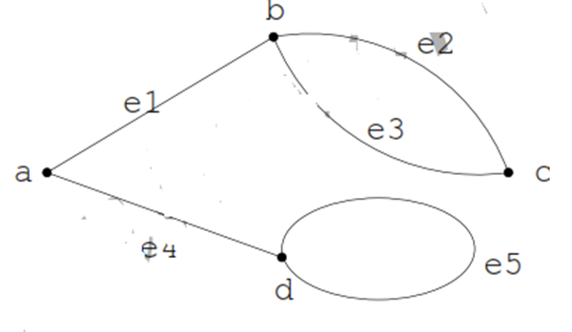
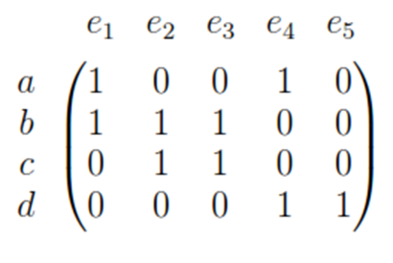
Graph Theory
Representation of Graphs:
2) Incidence matrix: The incidence matrix of a graph G is a matrix with rows labeled by vertices and columns labeled by edges, so that entry for row v column e is 1 if e is incident on v, and 0 otherwise. As an example, the following is the incidence matrix of graph of ﬁgure

Slide 24
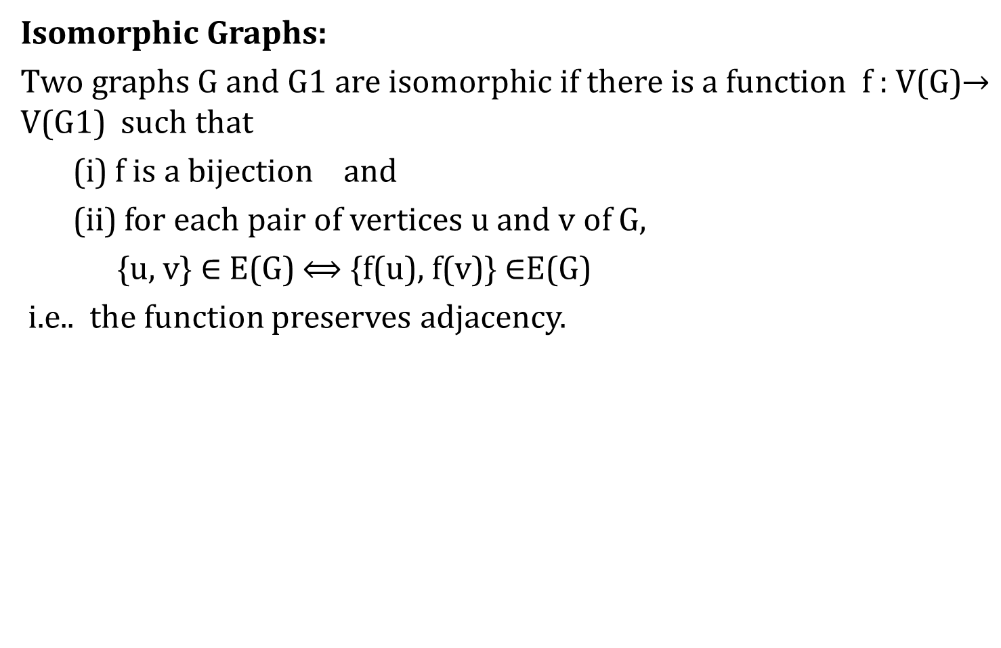
Graph Theory
Isomorphic Graphs:
Two graphs G and G1 are isomorphic if there is a function f : V(G)$→$ V(G1) such that
(i) f is a bijection and
(ii) for each pair of vertices u and v of G,
{u, v} $∈$ E(G) $⟺$ {f(u), f(v)} $∈$E(G)
i.e.. the function preserves adjacency.

Slide 25
Graph Theory
Isomorphic Graphs:
Note: If G is isomorphic to G1 then
a) | V(G)| = | V(G¹)|
b) | E(G)| = |E(G¹)|
c) The degree sequences of G and G1 are same.
d) If {v, v} is a cycle in G, then {f(v), f(v)} is a loop in G1, and more generally, if v0 – v1 – v2 – …. – vk – v0 is a cycle of length k in G, then f(v0)– f(v1)– f(v2) – … – f(vk) – f(v0) is a cycle of length k in G1.

Slide 26
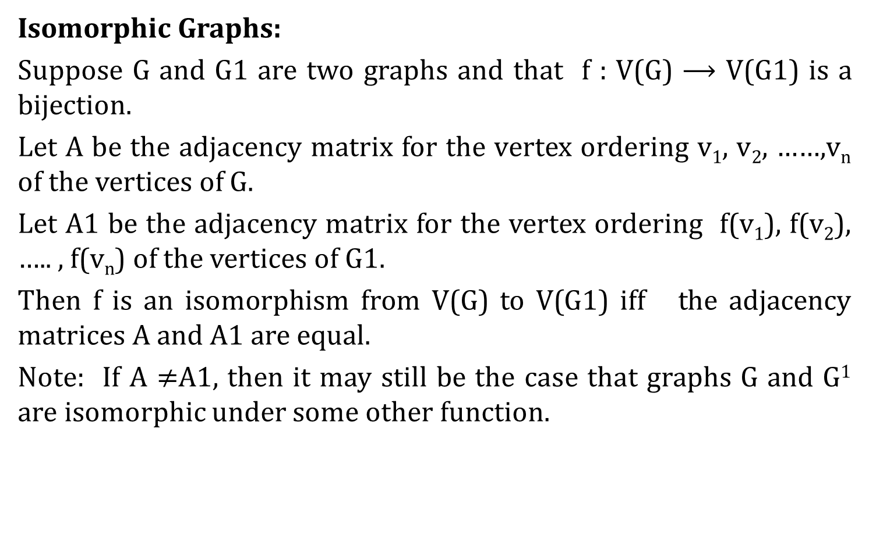
Graph Theory
Isomorphic Graphs:
Suppose G and G1 are two graphs and that f : V(G) $⟶$ V(G1) is a bijection.
Let A be the adjacency matrix for the vertex ordering v₁, v₂, ……,v_{n} of the vertices of G.
Let A1 be the adjacency matrix for the vertex ordering f(v₁), f(v₂), ….. , f(v_{n}) of the vertices of G1.
Then f is an isomorphism from V(G) to V(G1) iff the adjacency matrices A and A1 are equal.
Note: If A $≠$A1, then it may still be the case that graphs G and G¹ are isomorphic under some other function.

Slide 27
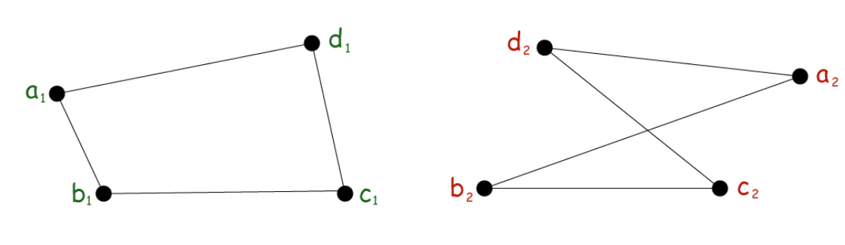
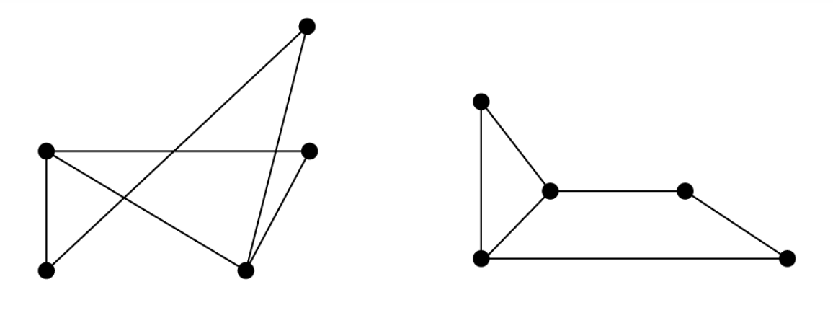
Graph Theory
Isomorphic Graphs:

Slide 28
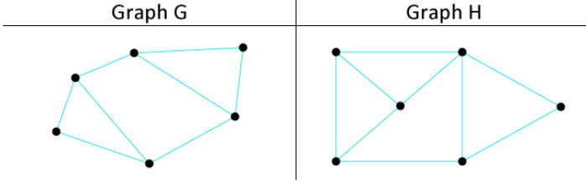
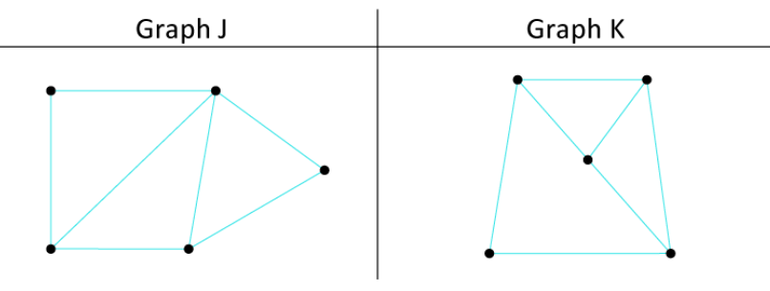
Graph Theory
Isomorphic Graphs:

Slide 29
Graph Theory
Paths and Circuit:
A walk can be defined as a sequence of edges and vertices of a graph. When we have a graph and traverse it, then that traverse will be known as a walk. In a walk, there can be repeated edges and vertices. The number of edges which is covered in a walk will be known as the Length of the walk. In a graph, there can be more than one walk.
Types of Walks: Open Walk, Closed Walk
A walk will be known as an open walk in the graph theory if the vertices at which the walk starts and ends are different. That means for an open walk, the starting vertex and ending vertex must be different. In an open walk, the length of the walk must be more than 0.

Slide 30
Graph Theory
Paths and Circuit:
A walk will be known as a closed walk in the graph theory if the vertices at which the walk starts and ends are identical. That means for a closed walk, the starting vertex and ending vertex must be the same. In a closed walk, the length of the walk must be more than 0.
A trail can be described as an open walk where no edge is allowed to repeat. In the trails, the vertex can be repeated.
A circuit can be described as a closed walk where no edge is allowed to repeat. In the circuit, the vertex can be repeated. A closed trail in the graph theory is also known as a circuit.
A closed path in the graph theory is also known as a Cycle. A cycle is a type of closed walk where neither edges nor vertices are allowed to repeat. There is a possibility that only the starting vertex and ending vertex are the same in a cycle.

Slide 31
Graph Theory
Paths and Circuit:
A path is a type of open walk where neither edges nor vertices are allowed to repeat. There is a possibility that only the starting vertex and ending vertex are the same in a path. In an open walk, the length of the walk must be more than 0.
Important Points:
Every path can be a trail, but it is not possible that every trail is a path.
Every cycle can be a circuit, but it is not important that every circuit is a cycle.

Slide 32
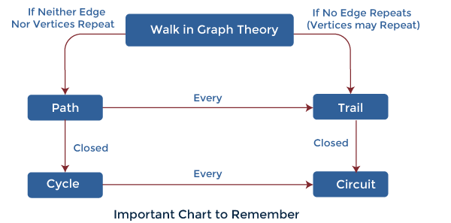
Graph Theory
Paths and Circuit:

Slide 33
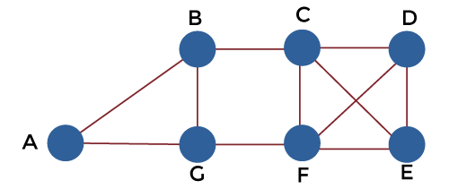
Graph Theory
Paths and Circuit:
A, B, G, F, C, D
B, G, F, C, B, G, A
C, E, F, C
C, E, F, C, E
A, B, F, A
F, D, E, C, B
Find out which sequence is a walk, trail, cycle, path and Circuit.

Slide 34
Graph Theory
Eulerian and Hamiltonian Graphs:
Eulerian trail: An Eulerian trail is a trail that visits every edge of the graph once and only once. It can end on a vertex different from the one on which it began. A graph of this kind is said to be traversable.
Eulerian Circuit: An Eulerian circuit is an Eulerian trail that is a circuit. That is, it begins and ends on the same vertex.
Eulerian Graph: A graph is called Eulerian when it contains an Eulerian circuit.
Theorem: An Eulerian trail exists in a connected graph if and only if there are either no odd degree vertices or two odd degree vertices

Slide 35
Graph Theory
Eulerian and Hamiltonian Graphs:
For the case of no odd vertices, the path can begin at any vertex and will end there;
for the case of two odd vertices, the path must begin at one odd vertex and end at the other. Any finite connected graph with two odd vertices is traversable.
A traversable trail may begin at either odd vertex and will end at the other odd vertex.
An example of an Eulerian trial. The actual graph is on the left with a possible solution trail on the right - starting bottom left corner.

Slide 36
Graph Theory
Eulerian and Hamiltonian Graphs:
Find whether the given graph is traversable. If so specify the solution.

Slide 37
Graph Theory
Eulerian and Hamiltonian Graphs:
Hamiltonian Circuit: A Hamiltonian circuit in a graph is a closed path that visits every vertex in the graph exactly once. (Such a closed loop must be a cycle.)
A Hamiltonian circuit ends up at the vertex from where it started.
If a graph has a Hamiltonian circuit, then the graph is called a Hamiltonian graph.
Note: An Eulerian circuit traverses every edge in a graph exactly once, but may repeat vertices, while a Hamiltonian circuit visits each vertex in a graph exactly once but may repeat edges.
Hamiltonian graphs are named after the nineteenth-century Irish mathematician Sir William Rowan Hamilton(1805-1865). This type of problem is often referred to as the traveling salesman or postman problem.

Slide 38
Graph Theory
Eulerian and Hamiltonian Graphs:
On the left a graph which is Hamiltonian and non-Eulerian and on the right a graph which is Eulerian and non-Hamiltonian.

Slide 39
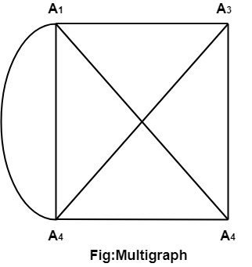
Graph Theory
Multigraphs :
If in a graph multiple edges between the same set of vertices are allowed, it is known as Multigraph.
In other words, it is a graph having at least one loop or multiple edges.

Slide 40
Graph Theory
Planar Graphs:
A graph or a multi graph that can be drawn in a plane or on a sphere so that its edges do not cross is called a planer graph.
Ex : A complete graph on 4 vertices K4 is a planar graph.
Ex : Tree is a planar graph.
Map, Connected map : A particular planar representation of a finite planer multi graph is called a map. We say that the map is connected if the under lying multi graph is connected.
Region : A given map (planar graph) divide the plane into connected areas called regions
Degree of a region : The boundary of each region of a map consists of a sequence of edges forming a closed path. The degree of region ‘r’ denoted by deg (r) is the length of the closed path bordering r .

Slide 41
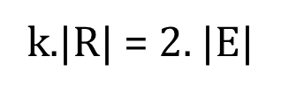


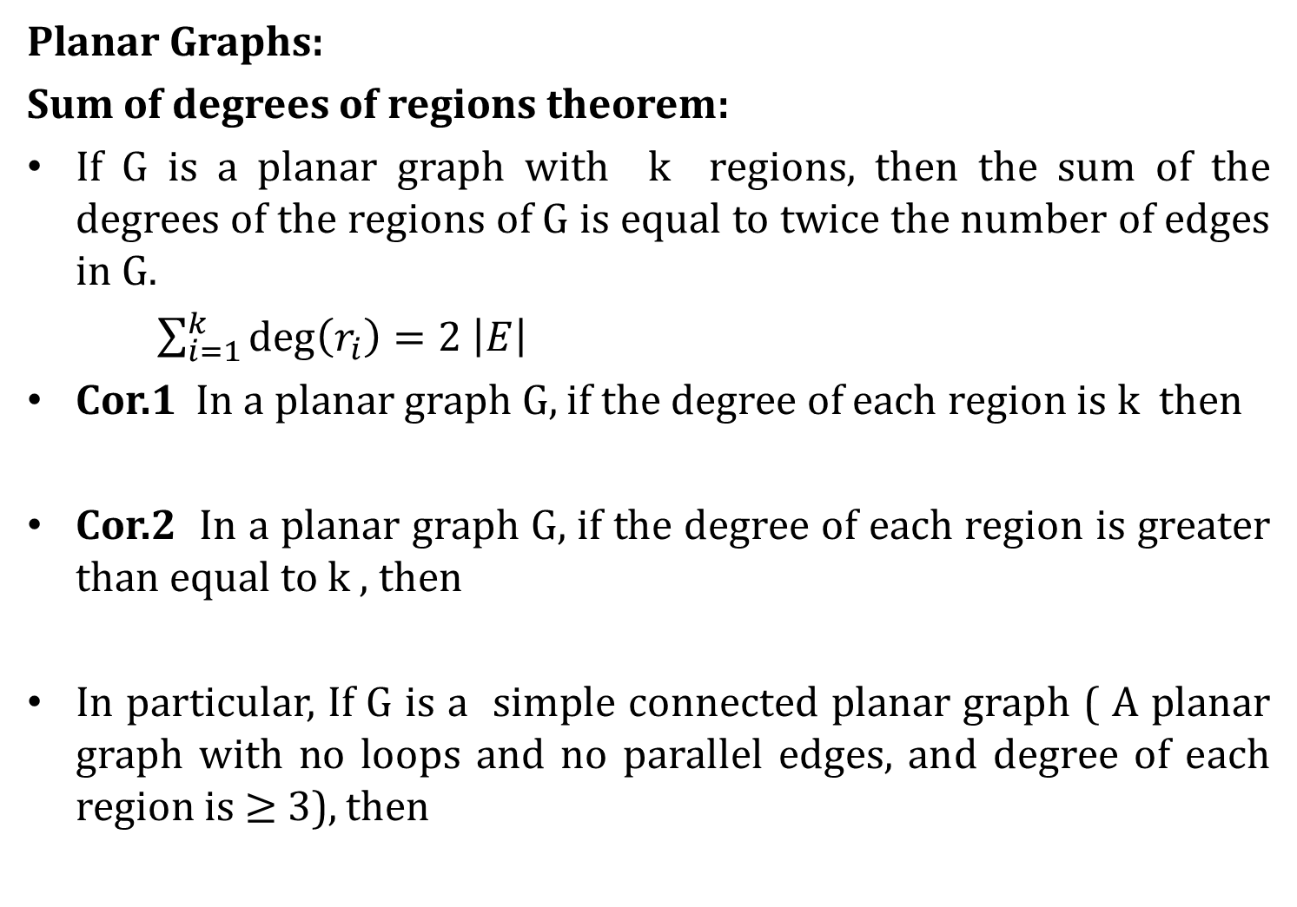
Graph Theory
Planar Graphs:
Sum of degrees of regions theorem:
If G is a planar graph with k regions, then the sum of the degrees of the regions of G is equal to twice the number of edges in G.
$\sum_{i=1}^{k}{\deg\left(r_{i}\right)=2 \left|E\right|}$
Cor.1 In a planar graph G, if the degree of each region is k then
Cor.2 In a planar graph G, if the degree of each region is greater than equal to k , then
In particular, If G is a simple connected planar graph ( A planar graph with no loops and no parallel edges, and degree of each region is $≥$ 3), then

Slide 42
Graph Theory
Euler‘s Formula:
Theorem: : If G is a connected planar graph, then⎥ V⎥ – ⎥ E⎥ + ⎢R ⎢ = 2.
Proof:

Slide 43
Graph Theory
Euler‘s Formula:

Slide 44
Graph Theory
Euler‘s Formula:
Theorem: : If G is a simple connected planar graph with ⎥ E⎥ > 1 then,
⎥ E⎥ ≤ {3.⎥ V⎥ – 6}.
There exists at least one vertex v of G such that deg(v) ≤ 5
Proof:

Slide 45
Graph Theory
Euler‘s Formula:
Theorem: If G is a simple connected planar graph with ⎥ v⎥ > 3 then, | R⎥ ≤ {2.⎥ V⎥ – 4}.
Proof:
Neglect the Proof

Slide 46
Graph Theory
Examples:
Let G is a connected planar graph with 35 regions and degree of each region is 6. Find the number of vertices in G ?.
Suppose G is a polyhedral graph with 12 vertices and 30 edges prove that degree of each region is 3.
Show that there does not exist a polyhedral graph with exactly seven edges.
Show that there does not exist a polyhedral graph with exactly 30 edges and 11 regions.
Prove that a complete graph K_{n} is planar iff n ≤ 4.
Prove that a complete Bipartite graph K_{m, n} is planar. iff m ≤ 2 or n ≤ 2.

Slide 47
Graph Theory
Graph Coloring:
Graph coloring is the procedure of assignment of colors to each vertex of a graph G such that no adjacent vertices get same color. The objective is to minimize the number of colors while coloring a graph. The smallest number of colors required to color a graph G is called its chromatic number of that graph. Graph coloring problem is a NP Complete problem.
Applications:
Register Allocation
Map Coloring
Bipartite Graph Checking
Mobile Radio Frequency Assignment
Making time table, etc.

Slide 48
Graph Theory
Graph Coloring:
Method to Color a Graph:
The steps required to color a graph G with n number of vertices are as follows −
Step 1 − Arrange the vertices of the graph in some order.
Step 2 − Choose the first vertex and color it with the first color.
Step 3 − Choose the next vertex and color it with the lowest numbered color that has not been colored on any vertices adjacent to it. If all the adjacent vertices are colored with this color, assign a new color to it. Repeat this step until all the vertices are colored.

Slide 49
Graph Theory
Graph Covering:
A covering graph is a subgraph which contains either all the vertices or all the edges corresponding to some other graph. A subgraph which contains all the vertices is called a line/edge covering. A subgraph which contains all the edges is called a vertex covering.
Line Covering:
Let G = (V, E) be a graph. A subset C(E) is called a line covering of G if every vertex of G is incident with at least one edge in C,
i.e., deg(V) ≥ 1 ∀ V ∈ G
because each vertex is connected with another vertex by an edge. Hence it has a minimum degree of 1.

Slide 50
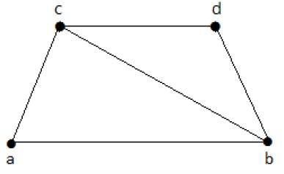
Graph Theory
Graph Covering:
Line covering of ‘G’ does not exist if and only if ‘G’ has an isolated vertex. Line covering of a graph with ‘n’ vertices has at least [n/2] edges.
C1 = {{a, b}, {c, d}}
C2 = {{a, d}, {b, c}}
C3 = {{a, b}, {b, c}, {b, d}}
C4 = {{a, b}, {b, c}, {c, d}}

Slide 51
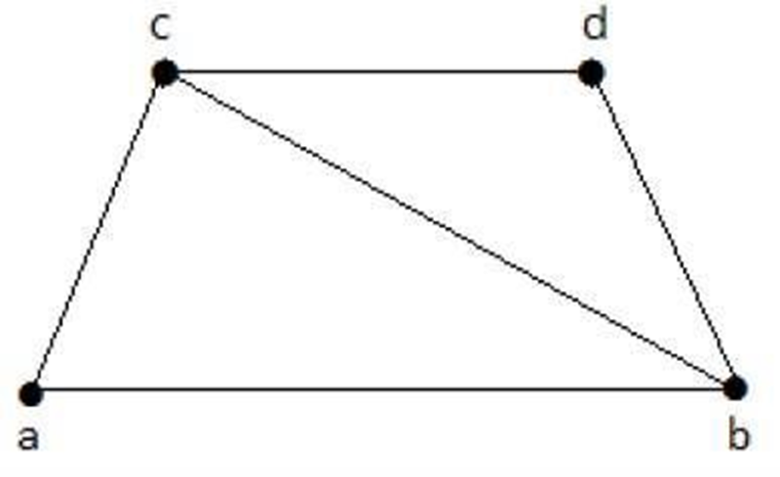
Graph Theory
Graph Covering:
Minimal Line Covering:
A line covering C of a graph G is said to be minimal if no edge can be deleted from C.
Here, C1, C2, C3 are minimal line coverings, while C4 is not because we can delete {b, c}.
C1 = {{a, b}, {c, d}}
C2 = {{a, c}, {b, d}}
C3 = {{a, b}, {b, c}, {b, d}}
C4 = {{a, b}, {b, c}, {c, d}}

Slide 52
Graph Theory
Graph Covering:
Minimal Line Covering:
It is also known as Smallest Minimal Line Covering. A minimal line covering with minimum number of edges is called a minimum line covering of ‘G’. The number of edges in a minimum line covering in ‘G’ is called the line covering number of ‘G’ (α1).
Important Points:
Every line covering contains a minimal line covering.
Every line covering does not contain a minimum line covering
No minimal line covering contains a cycle
If a line covering ‘C’ contains no paths of length 3 or more, then ‘C’ is a minimal line covering because all the components of ‘C’ are star graph and from a star graph, no edge can be deleted.

Slide 53
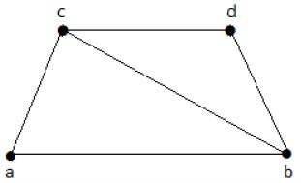
Graph Theory
Graph Covering:
Vertex Covering:
Let ‘G’ = (V, E) be a graph. A subset K of V is called a vertex covering of ‘G’, if every edge of ‘G’ is incident with or covered by a vertex in ‘K’.
K1 = {b, c}
K2 = {a, c, d}
K3 = {b, c, d}
K4 = {a, d}
Here, K1, K2, and K3 have vertex covering, whereas K4 does not have any vertex covering as it does not cover the edge {bc}.

Slide 54
Graph Theory
Graph Covering:
Minimal Vertex Covering
A vertex ‘K’ of graph ‘G’ is said to be minimal vertex covering if no vertex can be deleted from ‘K’.
K1 = {b, c}
K2 = {a, d, c}
K3 = {b, c, d}
Here, K₁ and K₂ are minimal vertex coverings, whereas in K₃, vertex ‘d’ can be deleted.

Slide 55
Graph Theory
Graph Covering:
Minimal Vertex Covering:
It is also known as the smallest minimal vertex covering. A minimal vertex covering of graph ‘G’ with minimum number of vertices is called the minimum vertex covering.
The number of vertices in a minimum vertex covering of ‘G’ is called the vertex covering number of G (α2).
K1 = {b, c}
K2 = {a, b, c}
K3 = {b, c, d}
Here, K₁ is a minimum vertex cover of G, as it has only two vertices. α₂ = 2.

Slide 56
Graph Theory
Chromatic Number:
Vertex coloring: A coloring of a simple graph is the assignment of color to each vertex of the graph so that no two adjacent vertices are assigned the same color.
Chromatic Number: The minimum number of colors needed to paint a graph G is called the chromatic number of G , denoted by χ(G)
Adjacent Regions: In a planar graph two regions are adjacent if they share a common vertex.
Map coloring: An assignment of colors to the regions of a map such that adjacent regions have different colors.
A map ‘M’ is n – colorable if there exists a coloring of M which uses n colors.
A planar graph is 5 – colorable .

Slide 57
Graph Theory
Chromatic Number:
Four color Theorem: If the regions of a planar graph are colored so that adjacent regions have different colors, then no more than 4 colors are required.
i.e., χ(G) ≤ 4.
Examples:
Prove that the chromatic number of a complete graph K_{n} is n.
Prove that the chromatic number of a complete Bipartite graph K_{m, n} is 2.
Prove that the chromatic number of cyclic graph C_{n} is 2 if n is even and 3 if n is odd.
If every cycle of G has even length then show that its chromatic number is 2.
Prove that the chromatic number of a tree on n vertices is 2.

Slide 58
Graph Theory
Spanning Tree:
Tree: A connected graph with no cycles is called a tree.
A tree with ‘n’ vertices has (n – 1) edges.
A tree with n vertices (n>1) has at least two vertices of degree 1.
A sub graph H of a graph G is called a spanning tree of G if
i) H is a tree and
ii) H contains all vertices of G
Note: In general, if G is a connected graph with n vertices and m edges, a spanning tree of G must have (n – 1) edges. Therefore, the number of edges that must be removed before a spanning tee is obtained must be m – (n – 1). This number is called circuit rank of G.
A non directed graph G is connected iff G contains a spanning tree.
The complete graph K_{n} has n^{n – 2} different spanning trees.
(Caley’s formula)

Slide 59
Graph Theory
Spanning Tree:
Minimal Spanning Tree: Let G be a connected graph where each edge of G is labeled with a non negative cost. A spanning tree T where the total cost C(T) is minimum is called a minimal spanning tree.

Slide 60
Graph Theory
Algorithms for Spanning Tree:
Kruskal’s Algorithm: (For finding minimal spanning tree of a connected weighted graph)
Input: A connected graph G with non negative values assigned to each edge.
Output: A minimal spanning tree for G.
Method:
1) Select any edge of minimal value that is not a loop. This is the first edge of T(if there is more than one edge of minimal value, arbitrary choose one of these edges)
2) Select any remaining edge of G of having minimal value that does not form a circuit with the edges already included in T.
3) Continue step 2 until T contain (n – 1) edges when n = |V(G)|

Slide 61
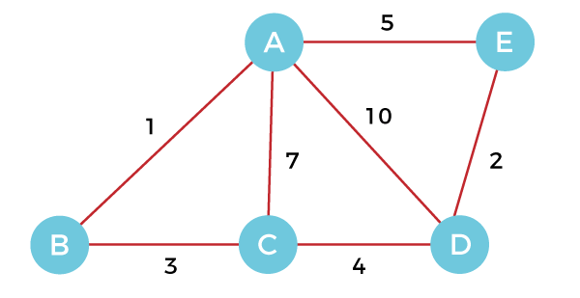
Graph Theory
Algorithms for Spanning Tree:
Construct minimal spanning tree using Kruskal's algorithm

Slide 62
Graph Theory
Algorithms for Spanning Tree:
Prim’s Algorithm: (For finding a minimal spanning tree)
Method:
1) Let G be a connected graph with non negative values assigned to each edge. First let T be the tree consisting of any vertex V1 of G.
2) Among all the edges not in T, that are incident on a vertex in T and do not form a circuit when added to T, Select one of minimal cost and add it to T.
3) The process terminates after we have added (n – 1) edges
where n = |V(G)|.

Slide 63
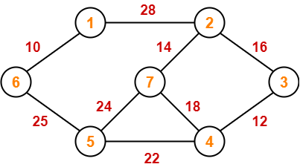
Graph Theory
Algorithms for Spanning Tree:
Construct the minimum spanning tree (MST) for the given graph using Prim’s Algorithm

Slide 64
END-UNIT-5

Slide 65
Graph Theory
Graph Coloring:
Graph coloring is the procedure of assignment of colors to each vertex of a graph G such that no adjacent vertices get same color. The objective is to minimize the number of colors while coloring a graph. The smallest number of colors required to color a graph G is called its chromatic number of that graph. Graph coloring problem is a NP Complete problem.
Applications:
Register Allocation
Map Coloring
Bipartite Graph Checking
Mobile Radio Frequency Assignment
Making time table, etc.

Slide 66
Graph Theory
Graph Coloring:
Method to Color a Graph:
The steps required to color a graph G with n number of vertices are as follows −
Step 1 − Arrange the vertices of the graph in some order.
Step 2 − Choose the first vertex and color it with the first color.
Step 3 − Choose the next vertex and color it with the lowest numbered color that has not been colored on any vertices adjacent to it. If all the adjacent vertices are colored with this color, assign a new color to it. Repeat this step until all the vertices are colored.

Slide 67
Graph Theory
Graph Covering:
A covering graph is a subgraph which contains either all the vertices or all the edges corresponding to some other graph. A subgraph which contains all the vertices is called a line/edge covering. A subgraph which contains all the edges is called a vertex covering.
Line Covering:
Let G = (V, E) be a graph. A subset C(E) is called a line covering of G if every vertex of G is incident with at least one edge in C,
i.e., deg(V) ≥ 1 ∀ V ∈ G
because each vertex is connected with another vertex by an edge. Hence it has a minimum degree of 1.

Slide 68
Graph Theory
Graph Covering:
Line covering of ‘G’ does not exist if and only if ‘G’ has an isolated vertex. Line covering of a graph with ‘n’ vertices has at least [n/2] edges.
C1 = {{a, b}, {c, d}}
C2 = {{a, d}, {b, c}}
C3 = {{a, b}, {b, c}, {b, d}}
C4 = {{a, b}, {b, c}, {c, d}}

Slide 69
Graph Theory
Graph Covering:
Minimal Line Covering:
A line covering C of a graph G is said to be minimal if no edge can be deleted from C.
Here, C1, C2, C3 are minimal line coverings, while C4 is not because we can delete {b, c}.
C1 = {{a, b}, {c, d}}
C2 = {{a, d}, {b, c}}
C3 = {{a, b}, {b, c}, {b, d}}
C4 = {{a, b}, {b, c}, {c, d}}

Slide 70
Graph Theory
Graph Covering:
Minimal Line Covering:
It is also known as Smallest Minimal Line Covering. A minimal line covering with minimum number of edges is called a minimum line covering of ‘G’. The number of edges in a minimum line covering in ‘G’ is called the line covering number of ‘G’ (α1).
Important Points:
Every line covering contains a minimal line covering.
Every line covering does not contain a minimum line covering
No minimal line covering contains a cycle
If a line covering ‘C’ contains no paths of length 3 or more, then ‘C’ is a minimal line covering because all the components of ‘C’ are star graph and from a star graph, no edge can be deleted.

Slide 71
Graph Theory
Graph Covering:
Vertex Covering:
Let ‘G’ = (V, E) be a graph. A subset K of V is called a vertex covering of ‘G’, if every edge of ‘G’ is incident with or covered by a vertex in ‘K’.
K1 = {b, c}
K2 = {a, b, c}
K3 = {b, c, d}
K4 = {a, d}
Here, K1, K2, and K3 have vertex covering, whereas K4 does not have any vertex covering as it does not cover the edge {bc}.

Slide 72
Graph Theory
Graph Covering:
Minimal Vertex Covering
A vertex ‘K’ of graph ‘G’ is said to be minimal vertex covering if no vertex can be deleted from ‘K’.
K1 = {b, c}
K2 = {a, b, c}
K3 = {b, c, d}
Here, K₁ and K₂ are minimal vertex coverings, whereas in K₃, vertex ‘d’ can be deleted.

Slide 73
Graph Theory
Graph Covering:
Minimal Vertex Covering:
It is also known as the smallest minimal vertex covering. A minimal vertex covering of graph ‘G’ with minimum number of vertices is called the minimum vertex covering.
The number of vertices in a minimum vertex covering of ‘G’ is called the vertex covering number of G (α2).
K1 = {b, c}
K2 = {a, b, c}
K3 = {b, c, d}
Here, K₁ is a minimum vertex cover of G, as it has only two vertices. α₂ = 2.

