Slide 1
Unit IV – Relational databases
Fundamentals of Transaction: Transaction Concept, A simple Transaction Model, storage Structure, Transaction Atomicity and Durability, Transaction Isolation, Serializability, Transactional Isolation and Atomicity, Transaction Isolation levels, Implementation of Isolation Levels, Transactions as SQL Statements..
Concurrency Control in Transactions: Lock-Based Protocols, Deadlock Handling, Multiple Granularity, Timestamp-Based Protocols, Validation Protocols, Multiversion Schemes.
Recovery system: Failure Classification, Storage, Recovery and Atomicity, Recovery Algorithm, Buffer Management and Failure with Loss of Non-volatile

Slide 2
Chapter 14: Transactions

Slide 3
Outline
Transaction Concept
A Simple Transaction Model
Storage Structure
Transaction Atomicity and Durability
Transaction State
Transaction Isolation
Concurrent Executions
Serializability
Transaction Isolation and Atomicity
Recoverability
Implementation of Isolation
Transaction Isolations Levels
Transaction Definition in SQL
Testing for Serializability.

Slide 4
Transaction Concept
A transaction is a unit of program execution that accesses and possibly updates various data items.
E.g., transaction to transfer $50 from account A to account B:
1. read(A)
2. A := A – 50
3. write(A)
4. read(B)
5. B := B + 50
6. write(B)
Two main issues to deal with:
Failures of various kinds, such as hardware failures and system crashes
Concurrent execution of multiple transactions

Slide 5
ACID Properties
A transaction is a unit of program execution that accesses and possibly updates various data items. To preserve the integrity of data the database system must ensure:
Atomicity. Either all operations of the transaction are properly reflected in the database or none are.
Consistency. Execution of a transaction in isolation preserves the consistency of the database.
Isolation. Although multiple transactions may execute concurrently, each transaction must be unaware of other concurrently executing transactions. Intermediate transaction results must be hidden from other concurrently executed transactions.
That is, for every pair of transactions T_{i} and T_{j}, it appears to T_{i} that either T_{j}, finished execution before T_{i} started, or T_{j} started execution after T_{i} finished.
Durability. After a transaction completes successfully, the changes it has made to the database persist, even if there are system failures.

Slide 6
A Simple Transaction Model
Consider a transaction to transfer $50 from account A to account B:
1. read(A)
2. A := A – 50
3. write(A)
4. read(B)
5. B := B + 50
6. write(B)
Atomicity requirement
If the transaction fails after step 3 and before step 6, money will be “lost” leading to an inconsistent database state
Failure could be due to software or hardware
The system should ensure that updates of a partially executed transaction are not reflected in the database
Durability requirement — once the user has been notified that the transaction has completed (i.e., the transfer of the $50 has taken place), the updates to the database by the transaction must persist even if there are software or hardware failures.

Slide 7
A Simple Transaction Model(cont.)
Consistency requirement in above example:
The sum of A and B is unchanged by the execution of the transaction
In general, consistency requirements include
Explicitly specified integrity constraints such as primary keys and foreign keys
Implicit integrity constraints
e.g., sum of balances of all accounts, minus sum of loan amounts must equal value of cash-in-hand
A transaction, when starting to execute, must see a consistent database.
During transaction execution the database may be temporarily inconsistent.
When the transaction completes successfully the database must be consistent
Erroneous transaction logic can lead to inconsistency

Slide 8
A Simple Transaction Model(cont.)
Isolation requirement — if between steps 3 and 6 (of the fund transfer transaction) , another transaction T2 is allowed to access the partially updated database, it will see an inconsistent database (the sum A + B will be less than it should be).
T1 T2
1. read(A)
2. A := A – 50
3. write(A) read(A), read(B), print(A+B)
4. read(B)
5. B := B + 50
6. write(B
Isolation can be ensured trivially by running transactions serially
That is, one after the other.
However, executing multiple transactions concurrently has significant benefits, as we will see later.

Slide 9
Transaction Atomicity and Durability
Active – the initial state; the transaction stays in this state while it is executing
Partially committed – after the final statement has been executed.
Failed -- after the discovery that normal execution can no longer proceed.
Aborted – after the transaction has been rolled back and the database restored to its state prior to the start of the transaction. Two options after it has been aborted:
Restart the transaction
can be done only if no internal logical error
Kill the transaction
Committed – after successful completion.

Slide 10
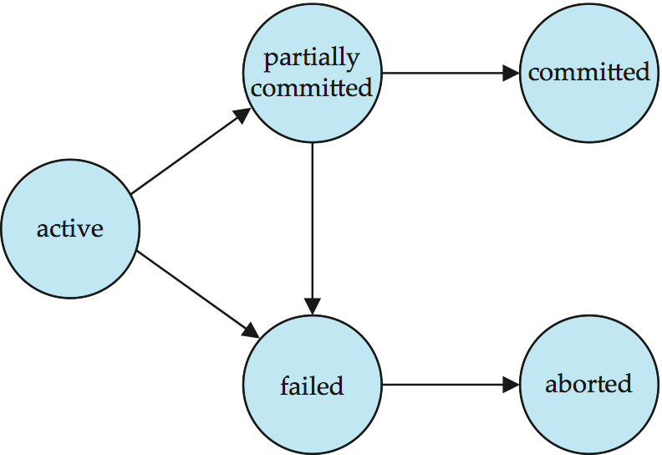
Transaction State (Cont.)

Slide 11
Transaction Isolation
Multiple transactions are allowed to run concurrently in the system. Advantages are:
Increased processor and disk utilization, leading to better transaction throughput
E.g. one transaction can be using the CPU while another is reading from or writing to the disk
Reduced average response time for transactions: short transactions need not wait behind long ones.
Concurrency control schemes – mechanisms to achieve isolation
That is, to control the interaction among the concurrent transactions in order to prevent them from destroying the consistency of the database
Will study in Chapter 15, after studying notion of correctness of concurrent executions.

Slide 12
Schedules
Schedule – a sequences of instructions that specify the chronological order in which instructions of concurrent transactions are executed
A schedule for a set of transactions must consist of all instructions of those transactions
Must preserve the order in which the instructions appear in each individual transaction.
A transaction that successfully completes its execution will have a commit instructions as the last statement
By default transaction assumed to execute commit instruction as its last step
A transaction that fails to successfully complete its execution will have an abort instruction as the last statement .

Slide 13
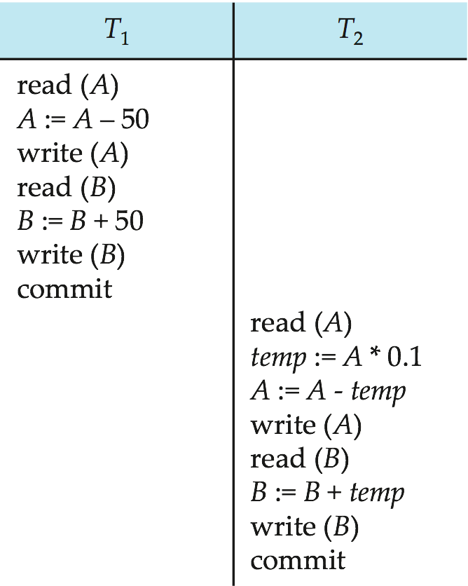
Schedule 1
Let T₁ transfer $50 from A to B, and T₂ transfer 10% of the balance from A to B.
An example of a serial schedule in which T₁ is followed by T₂ :

Slide 14
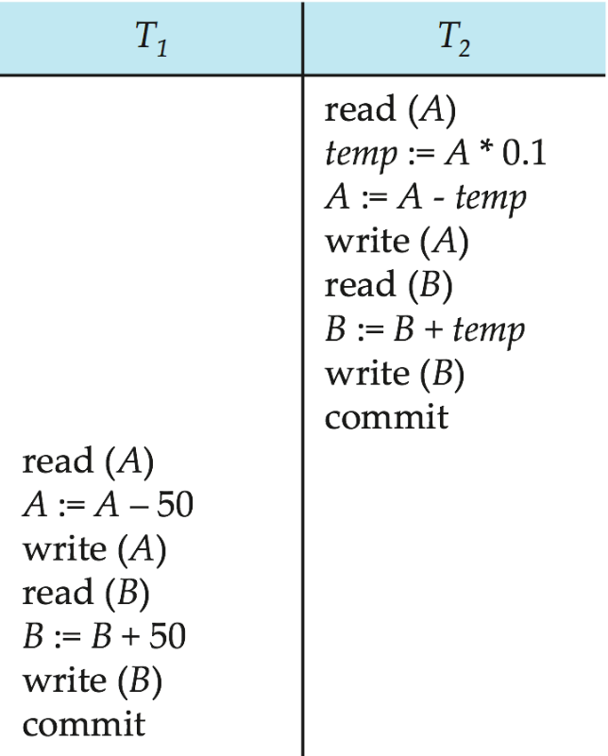
Schedule 2
A serial schedule in which T₂ is followed by T₁ :

Slide 15
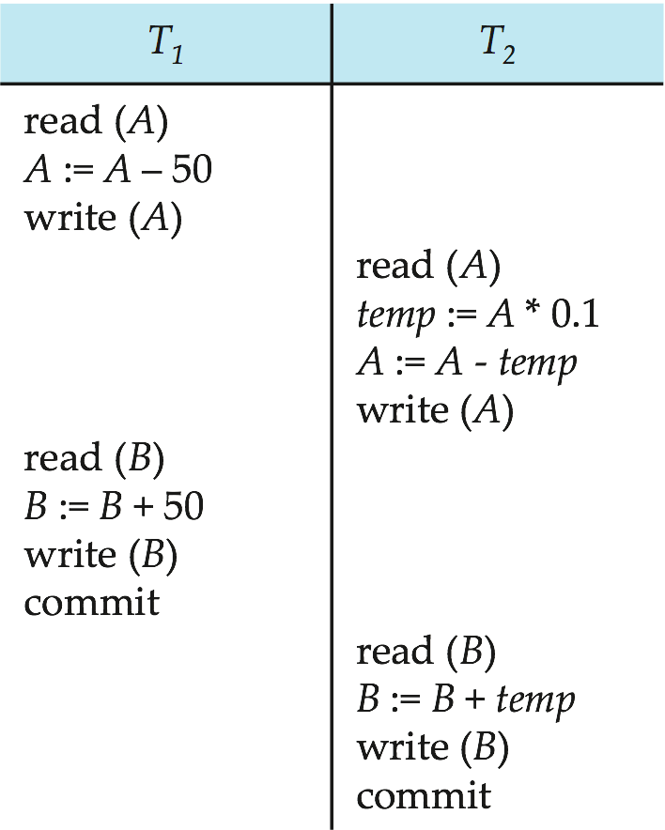
Schedule 3
Let T₁ and T₂ be the transactions defined previously. The following schedule is not a serial schedule, but it is equivalent to Schedule 1.
Note -- In schedules 1, 2 and 3, the sum “A + B” is preserved.

Slide 16
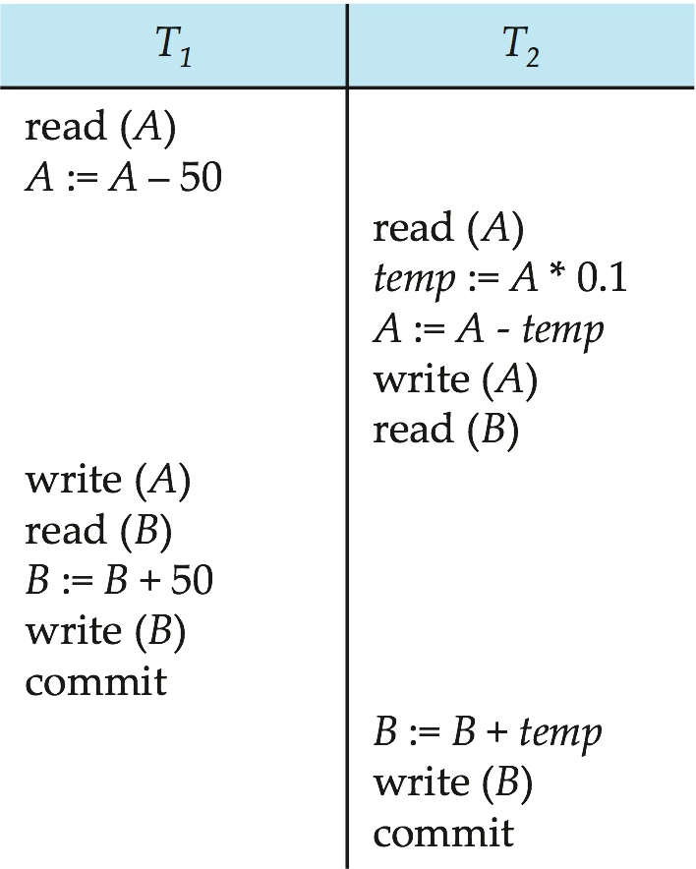
Schedule 4
The following concurrent schedule does not preserve the sum of “A + B”

Slide 17
Serializability
Basic Assumption – Each transaction preserves database consistency.
Thus, serial execution of a set of transactions preserves database consistency.
A (possibly concurrent) schedule is serializable if it is equivalent to a serial schedule. Different forms of schedule equivalence give rise to the notions of:
1. conflict serializability
2. view serializability

Slide 18
Simplified view of transactions
We ignore operations other than read and write instructions
We assume that transactions may perform arbitrary computations on data in local buffers in between reads and writes.
Our simplified schedules consist of only read and write instructions.

Slide 19
Conflicting Instructions
Let l_{i} and l_{j} be two Instructions of transactions T_{i} and T_{j} respectively. Instructions l_{i} and l_{j} conflict if and only if there exists some item Q accessed by both l_{i} and l_{j}, and at least one of these instructions wrote Q.
1. l_{i} = read(Q), l_{j} = read(Q). l_{i} and l_{j} don’t conflict. 2. l_{i} = read(Q), l_{j} = write(Q). They conflict. 3. l_{i} = write(Q), l_{j} = read(Q). They conflict 4. l_{i} = write(Q), l_{j} = write(Q). They conflict
Intuitively, a conflict between l_{i} and l_{j} forces a (logical) temporal order between them.
If l_{i} and l_{j} are consecutive in a schedule and they do not conflict, their results would remain the same even if they had been interchanged in the schedule.

Slide 20
Conflict Serializability
If a schedule S can be transformed into a schedule S´ by a series of swaps of non-conflicting instructions, we say that S and S´ are conflict equivalent.
We say that a schedule S is conflict serializable if it is conflict equivalent to a serial schedule

Slide 21
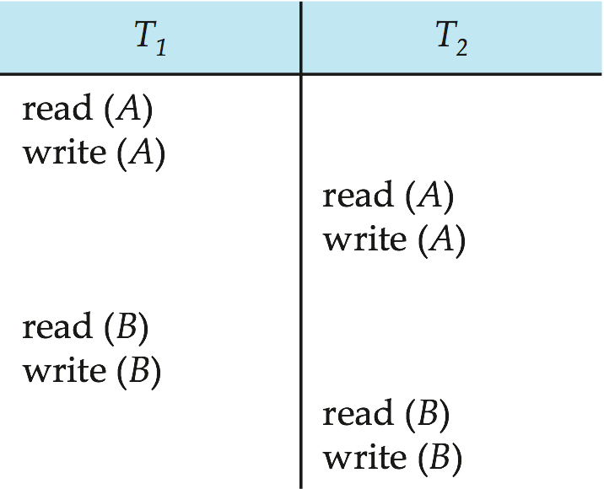
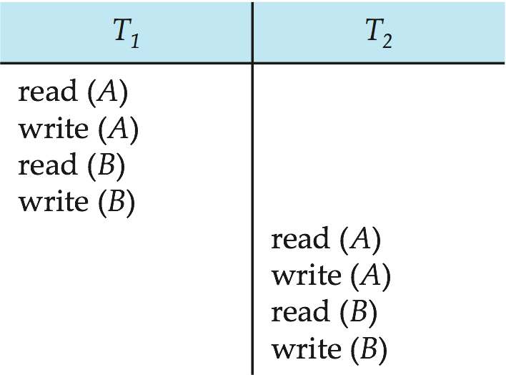
Conflict Serializability (Cont.)
Schedule 3 can be transformed into Schedule 6 -- a serial schedule where T₂ follows T₁, by a series of swaps of non-conflicting instructions. Therefore, Schedule 3 is conflict serializable.
Schedule 3
Schedule 6

Slide 22
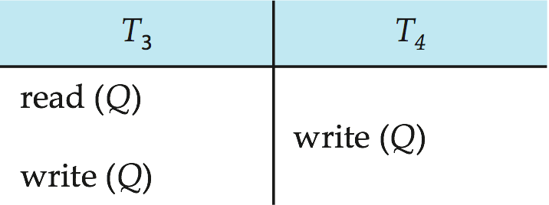
Conflict Serializability (Cont.)
Example of a schedule that is not conflict serializable:
We are unable to swap instructions in the above schedule to obtain either the serial schedule < T₃, T₄ >, or the serial schedule < T₄, T₃ >.

Slide 23
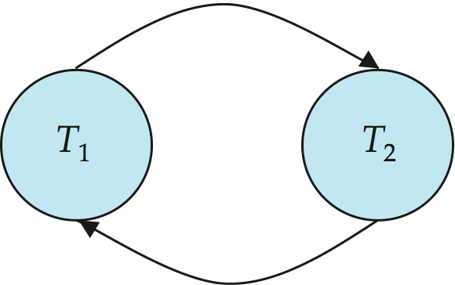
Precedence Graph
Consider some schedule of a set of transactions T₁, T₂, ..., T_{n}
Precedence graph — a direct graph where the vertices are the transactions (names).
We draw an arc from T_{i} to T_{j} if the two transaction conflict, and T_{i} accessed the data item on which the conflict arose earlier.
We may label the arc by the item that was accessed.
Example

Slide 24
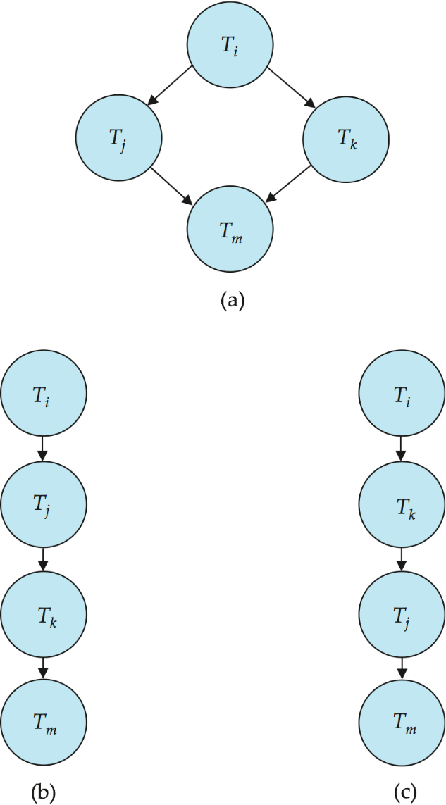
Testing for Conflict Serializability
A schedule is conflict serializable if and only if its precedence graph is acyclic.
Cycle-detection algorithms exist which take order n² time, where n is the number of vertices in the graph.
(Better algorithms take order n + e where e is the number of edges.)
If precedence graph is acyclic, the serializability order can be obtained by a topological sorting of the graph.
That is, a linear order consistent with the partial order of the graph.
For example, a serializability order for the schedule (a) would be one of either (b) or (c)

Slide 25
Other Notions of Serializability

Slide 26
View Serializability
Let S and S´ be two schedules with the same set of transactions. S and S´ are view equivalent if the following three conditions are met, for each data item Q,
If in schedule S, transaction T_{i} reads the initial value of Q, then in schedule S’ also transaction T_{i} must read the initial value of Q.
If in schedule S transaction T_{i} executes read(Q), and that value was produced by transaction T_{j} (if any), then in schedule S’ also transaction T_{i} must read the value of Q that was produced by the same write(Q) operation of transaction T_{j} .
The transaction (if any) that performs the final write(Q) operation in schedule S must also perform the final write(Q) operation in schedule S’.
As can be seen, view equivalence is also based purely on reads and writes alone.

Slide 27
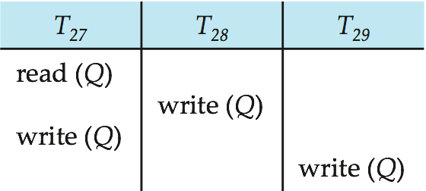
View Serializability (Cont.)
A schedule S is view serializable if it is view equivalent to a serial schedule.
Every conflict serializable schedule is also view serializable.
Below is a schedule which is view-serializable but not conflict serializable.
What serial schedule is above equivalent to?
Every view serializable schedule that is not conflict serializable has blind writes.

Slide 28
Test for View Serializability
The precedence graph test for conflict serializability cannot be used directly to test for view serializability.
Extension to test for view serializability has cost exponential in the size of the precedence graph.
The problem of checking if a schedule is view serializable falls in the class of NP-complete problems.
Thus, existence of an efficient algorithm is extremely unlikely.
However ,practical algorithms that just check some sufficient conditions for view serializability can still be used.

Slide 29
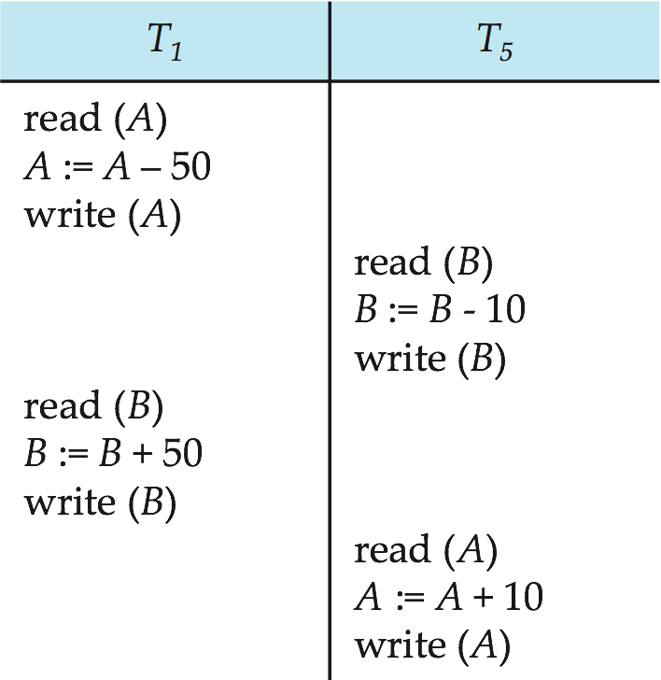
More Complex Notions of Serializability
The schedule below produces the same outcome as the serial schedule < T₁, T₅ >, yet is not conflict equivalent or view equivalent to it.
If we start with A = 1000 and B = 2000, the final result is 960 and 2040
Determining such equivalence requires analysis of operations other than read and write.

Slide 30
Transaction Isolation and Atomicity

Slide 31
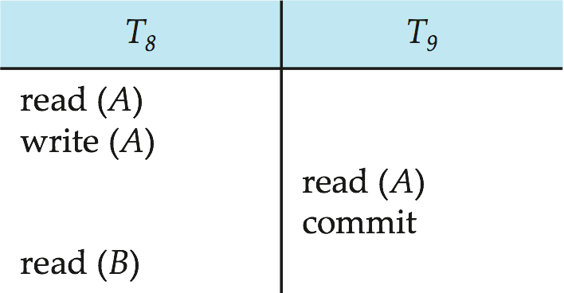
Recoverable Schedules
Recoverable schedule — if a transaction T_{j} reads a data item previously written by a transaction T_{i} , then the commit operation of T_{i} must appear before the commit operation of T_{j}.
The following schedule is not recoverable if T₉ commits immediately after the read(A) operation.
If T₈ should abort, T₉ would have read (and possibly shown to the user) an inconsistent database state. Hence, database must ensure that schedules are recoverable.

Slide 32
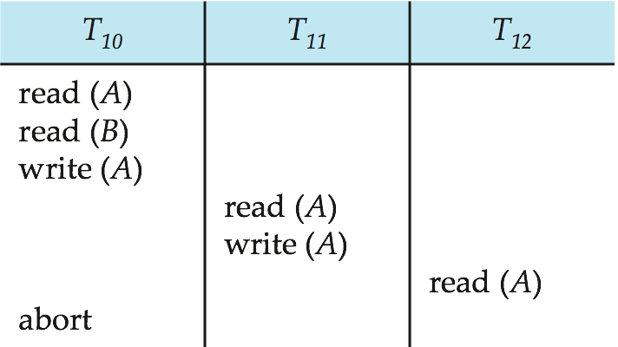
Cascading Rollbacks
Cascading rollback – a single transaction failure leads to a series of transaction rollbacks. Consider the following schedule where none of the transactions has yet committed (so the schedule is recoverable) If T₁₀ fails, T₁₁ and T₁₂ must also be rolled back.
Can lead to the undoing of a significant amount of work

Slide 33
Cascadeless Schedules
Cascadeless schedules — for each pair of transactions T_{i} and T_{j} such that T_{j} reads a data item previously written by T_{i}, the commit operation of T_{i} appears before the read operation of T_{j}.
Every cascadeless schedule is also recoverable
It is desirable to restrict the schedules to those that are cascadeless
Example of a schedule that is NOT cascadeless

Slide 34
Concurrency Control
A database must provide a mechanism that will ensure that all possible schedules are both:
Conflict serializable.
Recoverable and preferably cascadeless
A policy in which only one transaction can execute at a time generates serial schedules, but provides a poor degree of concurrency
Concurrency-control schemes tradeoff between the amount of concurrency they allow and the amount of overhead that they incur
Testing a schedule for serializability after it has executed is a little too late!
Tests for serializability help us understand why a concurrency control protocol is correct
Goal – to develop concurrency control protocols that will assure serializability.

Slide 35
Weak Levels of Consistency
Some applications are willing to live with weak levels of consistency, allowing schedules that are not serializable
E.g., a read-only transaction that wants to get an approximate total balance of all accounts
E.g., database statistics computed for query optimization can be approximate (why?)
Such transactions need not be serializable with respect to other transactions
Tradeoff accuracy for performance

Slide 36
Transaction Isolation Levels

Slide 37
Isolation levels specified by SQL standards
Serializable — default
Repeatable read — only committed records to be read, repeated reads of same record must return same value. However, a transaction may not be serializable – it may find some records inserted by a transaction but not find others.
Read committed — only committed records can be read, but successive reads of record may return different (but committed) values.
Read uncommitted — even uncommitted records may be read.
Lower degrees of consistency useful for gathering approximate information about the database
Warning: some database systems do not ensure serializable schedules by default
E.g., Oracle and PostgreSQL by default support a level of consistency called snapshot isolation (not part of the SQL standard)

Slide 38
Transaction Definition in SQL
Data manipulation language must include a construct for specifying the set of actions that comprise a transaction.
In SQL, a transaction begins implicitly.
A transaction in SQL ends by:
Commit work commits current transaction and begins a new one.
Rollback work causes current transaction to abort.
In almost all database systems, by default, every SQL statement also commits implicitly if it executes successfully
Implicit commit can be turned off by a database directive
E.g. in JDBC, connection.setAutoCommit(false);

Slide 39
End of Chapter 14

Slide 40
Chapter 15 : Concurrency Control

Slide 41
Outline
Lock-Based Protocols
Deadlock Handling
Multiple Granularity
Timestamp-Based Protocols
Validation-Based Protocols
Multiversion Schemes
Snapshot Schemes
Insert and Delete Operations
Concurrency in Index Structures

Slide 42
Lock-Based Protocols
A lock is a mechanism to control concurrent access to a data item
Data items can be locked in two modes :
1. exclusive (X) mode. Data item can be both read as well as
written. X-lock is requested using lock-X instruction.
2. shared (S) mode. Data item can only be read. S-lock is
requested using lock-S instruction.
Lock requests are made to the concurrency-control manager by the programmer. Transaction can proceed only after request is granted.

Slide 43
Lock-Based Protocols (Cont.)
Lock-compatibility matrix
A transaction may be granted a lock on an item if the requested lock is compatible with locks already held on the item by other transactions
Any number of transactions can hold shared locks on an item,
But if any transaction holds an exclusive on the item no other transaction may hold any lock on the item.
If a lock cannot be granted, the requesting transaction is made to wait till all incompatible locks held by other transactions have been released. The lock is then granted.

Slide 44
Lock-Based Protocols (Cont.)
Example of a transaction performing locking:
T₂: lock-S(A);
read (A);
unlock(A);
lock-S(B);
read (B);
unlock(B);
display(A+B)
Locking as above is not sufficient to guarantee serializability — if A and B get updated in-between the read of A and B, the displayed sum would be wrong.
A locking protocol is a set of rules followed by all transactions while requesting and releasing locks. Locking protocols restrict the set of possible schedules.

Slide 45
The Two-Phase Locking Protocol
This protocol ensures conflict-serializable schedules.
Phase 1: Growing Phase
Transaction may obtain locks
Transaction may not release locks
Phase 2: Shrinking Phase
Transaction may release locks
Transaction may not obtain locks
The protocol assures serializability. It can be proved that the transactions can be serialized in the order of their lock points (i.e., the point where a transaction acquired its final lock).

Slide 46
The Two-Phase Locking Protocol (Cont.)
There can be conflict serializable schedules that cannot be obtained if two-phase locking is used.
However, in the absence of extra information (e.g., ordering of access to data), two-phase locking is needed for conflict serializability in the following sense:
Given a transaction T_{i} that does not follow two-phase locking, we can find a transaction T_{j} that uses two-phase locking, and a schedule for T_{i} and T_{j} that is not conflict serializable.

Slide 47
Lock Conversions
Two-phase locking with lock conversions:
– First Phase:
can acquire a lock-S on item
can acquire a lock-X on item
can convert a lock-S to a lock-X (upgrade)
– Second Phase:
can release a lock-S
can release a lock-X
can convert a lock-X to a lock-S (downgrade)
This protocol assures serializability. But still relies on the programmer to insert the various locking instructions.

Slide 48
Automatic Acquisition of Locks
A transaction T_{i} issues the standard read/write instruction, without explicit locking calls.
The operation read(D) is processed as:
if T_{i} has a S-lock on D
then
read(D)
else begin
if necessary wait until no other
transaction has a lock-X on D
grant T_{i} a lock-S on D;
read(D)
end

Slide 49
Automatic Acquisition of Locks (Cont.)
write(D) is processed as:
if T_{i} has a lock-X on D
then
write(D)
else begin
if necessary wait until no other transaction has any lock on D,
if T_{i} has a lock-S on D
then
upgrade lock on D to lock-X
else
grant T_{i} a lock-X on D
write(D)
end;
All locks are released after commit or abort

Slide 50
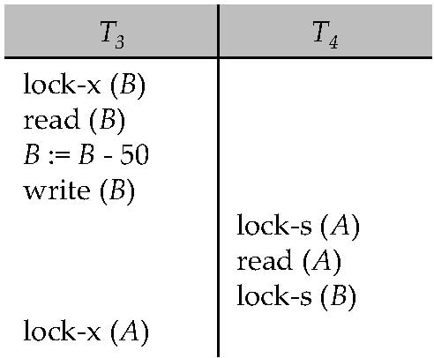
Deadlocks
Consider the partial schedule
Neither T₃ nor T₄ can make progress — executing lock-S(B) causes T₄ to wait for T₃ to release its lock on B, while executing lock-X(A) causes T₃ to wait for T₄ to release its lock on A.
Such a situation is called a deadlock.
To handle a deadlock one of T₃ or T₄ must be rolled back and its locks released.

Slide 51
Deadlocks (Cont.)
Two-phase locking does not ensure freedom from deadlocks.
In addition to deadlocks, there is a possibility of starvation.
Starvation occurs if the concurrency control manager is badly designed. For example:
A transaction may be waiting for an X-lock on an item, while a sequence of other transactions request and are granted an S-lock on the same item.
The same transaction is repeatedly rolled back due to deadlocks.
Concurrency control manager can be designed to prevent starvation.

Slide 52
Deadlocks (Cont.)
The potential for deadlock exists in most locking protocols. Deadlocks are a necessary evil.
When a deadlock occurs there is a possibility of cascading roll-backs.
Cascading roll-back is possible under two-phase locking. To avoid this, follow a modified protocol called strict two-phase locking -- a transaction must hold all its exclusive locks till it commits/aborts.
Rigorous two-phase locking is even stricter. Here, all locks are held till commit/abort. In this protocol transactions can be serialized in the order in which they commit.

Slide 53
Implementation of Locking
A lock manager can be implemented as a separate process to which transactions send lock and unlock requests
The lock manager replies to a lock request by sending a lock grant messages (or a message asking the transaction to roll back, in case of a deadlock)
The requesting transaction waits until its request is answered
The lock manager maintains a data-structure called a lock table to record granted locks and pending requests
The lock table is usually implemented as an in-memory hash table indexed on the name of the data item being locked

Slide 54
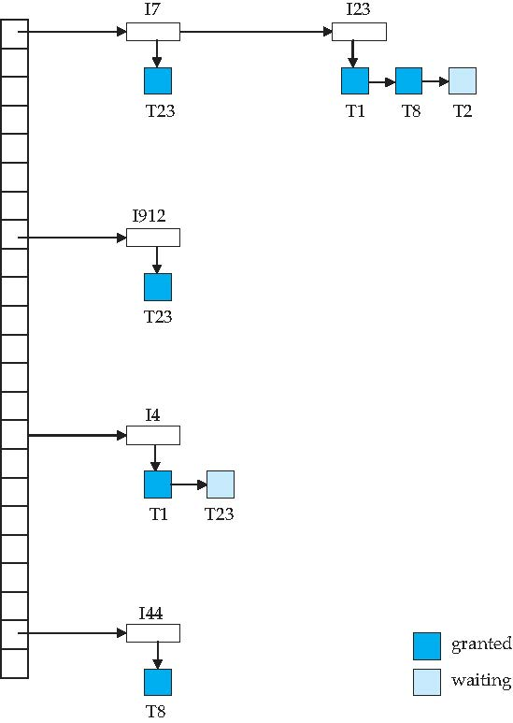
Lock Table
Dark blue rectangles indicate granted locks; light blue indicate waiting requests
Lock table also records the type of lock granted or requested
New request is added to the end of the queue of requests for the data item, and granted if it is compatible with all earlier locks
Unlock requests result in the request being deleted, and later requests are checked to see if they can now be granted
If transaction aborts, all waiting or granted requests of the transaction are deleted
lock manager may keep a list of locks held by each transaction, to implement this efficiently

Slide 55
Deadlock Handling
System is deadlocked if there is a set of transactions such that every transaction in the set is waiting for another transaction in the set.
Deadlock prevention protocols ensure that the system will never enter into a deadlock state. Some prevention strategies :
Require that each transaction locks all its data items before it begins execution (predeclaration).
Impose partial ordering of all data items and require that a transaction can lock data items only in the order specified by the partial order.

Slide 56
More Deadlock Prevention Strategies
Following schemes use transaction timestamps for the sake of deadlock prevention alone.
wait-die scheme — non-preemptive
older transaction may wait for younger one to release data item. (older means smaller timestamp) Younger transactions never wait for older ones; they are rolled back instead.
a transaction may die several times before acquiring needed data item
wound-wait scheme — preemptive
older transaction wounds (forces rollback) of younger transaction instead of waiting for it. Younger transactions may wait for older ones.
may be fewer rollbacks than wait-die scheme.

Slide 57
Deadlock prevention (Cont.)
Both in wait-die and in wound-wait schemes, a rolled back transactions is restarted with its original timestamp. Older transactions thus have precedence over newer ones, and starvation is hence avoided.
Timeout-Based Schemes:
a transaction waits for a lock only for a specified amount of time. If the lock has not been granted within that time, the transaction is rolled back and restarted,
Thus, deadlocks are not possible
simple to implement; but starvation is possible. Also difficult to determine good value of the timeout interval.

Slide 58
Deadlock Detection
Deadlocks can be described as a wait-for graph, which consists of a pair G = (V,E),
V is a set of vertices (all the transactions in the system)
E is a set of edges; each element is an ordered pair T_{i} →T_{j}.
If T_{i} → T_{j} is in E, then there is a directed edge from T_{i} to T_{j}, implying that T_{i} is waiting for T_{j} to release a data item.
When T_{i} requests a data item currently being held by T_{j}, then the edge T_{i} → T_{j} is inserted in the wait-for graph. This edge is removed only when T_{j} is no longer holding a data item needed by T_{i}.
The system is in a deadlock state if and only if the wait-for graph has a cycle. Must invoke a deadlock-detection algorithm periodically to look for cycles.

Slide 59
Deadlock Detection (Cont.)
Wait-for graph without a cycle
Wait-for graph with a cycle

Slide 60
Deadlock Recovery
When deadlock is detected :
Some transaction will have to rolled back (made a victim) to break deadlock. Select that transaction as victim that will incur minimum cost.
Rollback -- determine how far to roll back transaction
Total rollback: Abort the transaction and then restart it.
More effective to roll back transaction only as far as necessary to break deadlock.
Starvation happens if same transaction is always chosen as victim. Include the number of rollbacks in the cost factor to avoid starvation

Slide 61
Multiple Granularity
Allow data items to be of various sizes and define a hierarchy of data granularities, where the small granularities are nested within larger ones
Can be represented graphically as a tree.
When a transaction locks a node in the tree explicitly, it implicitly locks all the node's descendents in the same mode.
Granularity of locking (level in tree where locking is done):
fine granularity (lower in tree): high concurrency, high locking overhead
coarse granularity (higher in tree): low locking overhead, low concurrency

Slide 62
Example of Granularity Hierarchy
The levels, starting from the coarsest (top) level are
database
area
file
record

Slide 63
Intention Lock Modes
In addition to S and X lock modes, there are three additional lock modes with multiple granularity:
intention-shared (IS): indicates explicit locking at a lower level of the tree but only with shared locks.
intention-exclusive (IX): indicates explicit locking at a lower level with exclusive or shared locks
shared and intention-exclusive (SIX): the subtree rooted by that node is locked explicitly in shared mode and explicit locking is being done at a lower level with exclusive-mode locks.
intention locks allow a higher level node to be locked in S or X mode without having to check all descendent nodes.

Slide 64
Compatibility Matrix with Intention Lock Modes
The compatibility matrix for all lock modes is:

Slide 65
Multiple Granularity Locking Scheme
Transaction T_{i} can lock a node Q, using the following rules:
The lock compatibility matrix must be observed.
The root of the tree must be locked first, and may be locked in any mode.
A node Q can be locked by T_{i} in S or IS mode only if the parent of Q is currently locked by T_{i} in either IX or IS mode.
A node Q can be locked by T_{i} in X, SIX, or IX mode only if the parent of Q is currently locked by T_{i} in either IX or SIX mode.
T_{i} can lock a node only if it has not previously unlocked any node (that is, T_{i} is two-phase).
T_{i} can unlock a node Q only if none of the children of Q are currently locked by T_{i}.
Observe that locks are acquired in root-to-leaf order, whereas they are released in leaf-to-root order.
Lock granularity escalation: in case there are too many locks at a particular level, switch to higher granularity S or X lock

Slide 66
Timestamp-Based Protocols
Each transaction is issued a timestamp when it enters the system. If an old transaction T_{i} has time-stamp TS(T_{i}), a new transaction T_{j} is assigned time-stamp TS(T_{j}) such that TS(T_{i}) <TS(T_{j}).
The protocol manages concurrent execution such that the time-stamps determine the serializability order.
In order to assure such behavior, the protocol maintains for each data Q two timestamp values:
W-timestamp(Q) is the largest time-stamp of any transaction that executed write(Q) successfully.
R-timestamp(Q) is the largest time-stamp of any transaction that executed read(Q) successfully.

Slide 67
Timestamp-Based Protocols (Cont.)
The timestamp ordering protocol ensures that any conflicting read and write operations are executed in timestamp order.
Suppose a transaction T_{i} issues a read(Q)
If TS(T_{i}) ≤ W-timestamp(Q), then T_{i} needs to read a value of Q that was already overwritten.
Hence, the read operation is rejected, and T_{i} is rolled back.
If TS(T_{i}) ≥ W-timestamp(Q), then the read operation is executed, and R-timestamp(Q) is set to max(R-timestamp(Q), TS(T_{i})).

Slide 68
Timestamp-Based Protocols (Cont.)
Suppose that transaction T_{i} issues write(Q).
If TS(T_{i}) < R-timestamp(Q), then the value of Q that T_{i} is producing was needed previously, and the system assumed that that value would never be produced.
Hence, the write operation is rejected, and T_{i} is rolled back.
If TS(T_{i}) < W-timestamp(Q), then T_{i} is attempting to write an obsolete value of Q.
Hence, this write operation is rejected, and T_{i} is rolled back.
Otherwise, the write operation is executed, and W-timestamp(Q) is set to TS(T_{i}).

Slide 69
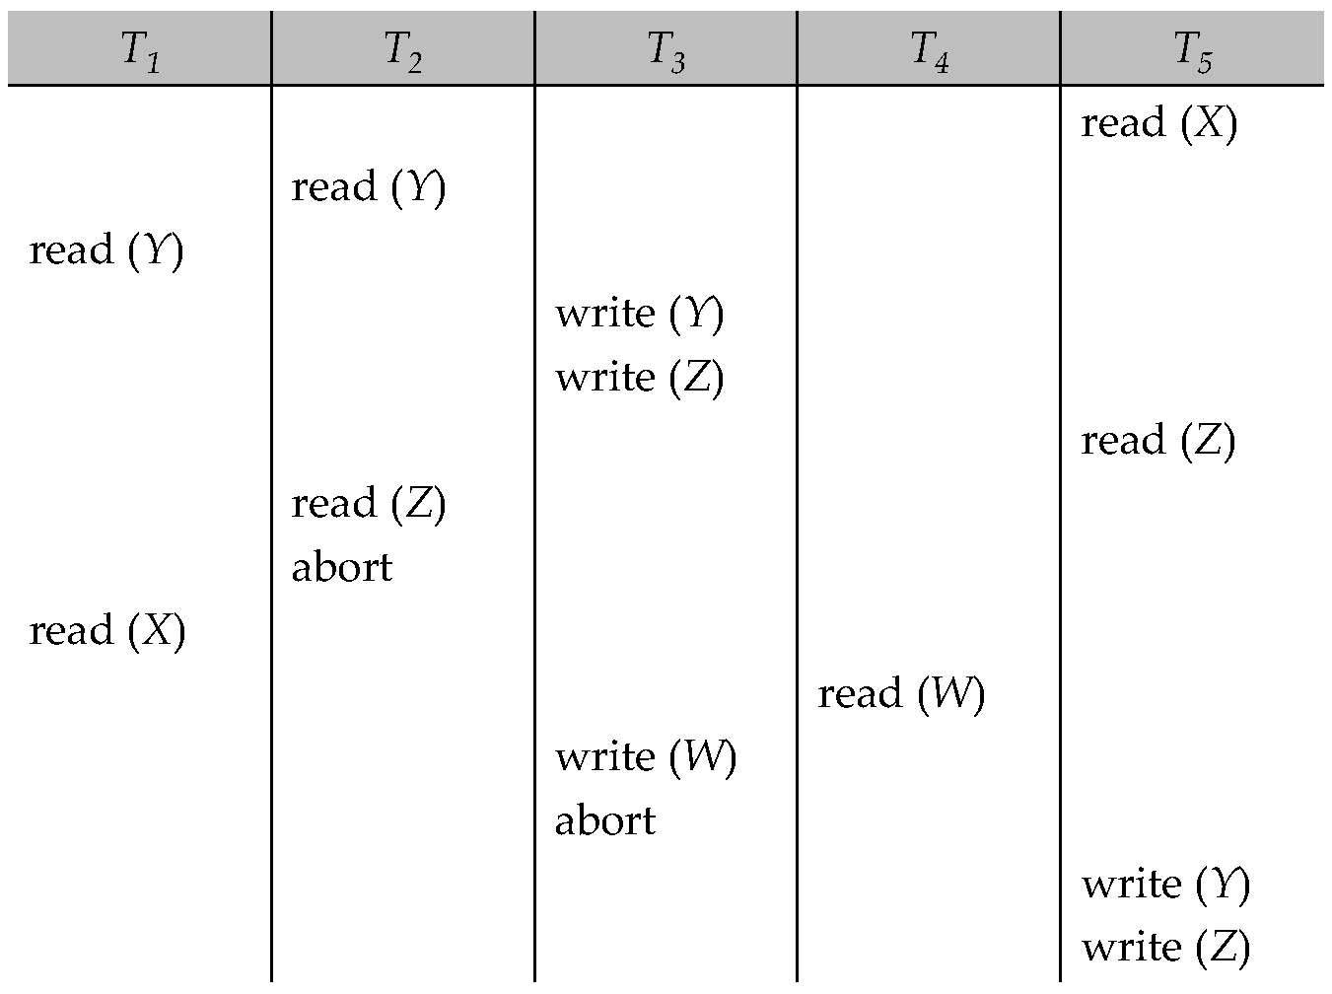
Example Use of the Protocol
A partial schedule for several data items for transactions with timestamps 1, 2, 3, 4, 5

Slide 70
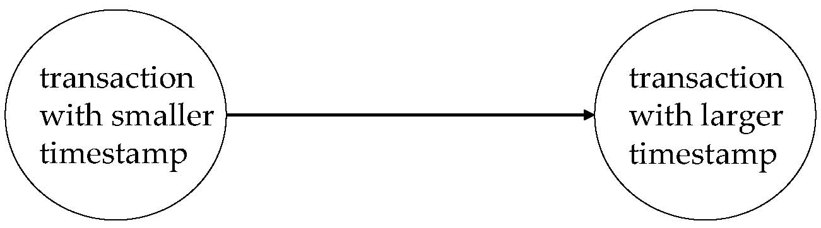
Correctness of Timestamp-Ordering Protocol
The timestamp-ordering protocol guarantees serializability since all the arcs in the precedence graph are of the form:
Thus, there will be no cycles in the precedence graph
Timestamp protocol ensures freedom from deadlock as no transaction ever waits.
But the schedule may not be cascade-free, and may not even be recoverable.

Slide 71
Recoverability and Cascade Freedom
Problem with timestamp-ordering protocol:
Suppose T_{i} aborts, but T_{j} has read a data item written by T_{i}
Then T_{j} must abort; if T_{j} had been allowed to commit earlier, the schedule is not recoverable.
Further, any transaction that has read a data item written by T_{j} must abort
This can lead to cascading rollback --- that is, a chain of rollbacks
Solution 1:
A transaction is structured such that its writes are all performed at the end of its processing
All writes of a transaction form an atomic action; no transaction may execute while a transaction is being written
A transaction that aborts is restarted with a new timestamp
Solution 2: Limited form of locking: wait for data to be committed before reading it
Solution 3: Use commit dependencies to ensure recoverability

Slide 72
Thomas’Write Rule
Modified version of the timestamp-ordering protocol in which obsolete write operations may be ignored under certain circumstances.
When T_{i} attempts to write data item Q, if TS(T_{i}) < W-timestamp(Q), then T_{i} is attempting to write an obsolete value of {Q}.
Rather than rolling back T_{i} as the timestamp ordering protocol would have done, this {write} operation can be ignored.
Otherwise this protocol is the same as the timestamp ordering protocol.
Thomas' Write Rule allows greater potential concurrency.
Allows some view-serializable schedules that are not conflict-serializable.

Slide 73
Validation-Based Protocol
Execution of transaction T_{i} is done in three phases.
1. Read and execution phase: Transaction T_{i} writes only to
temporary local variables
2. Validation phase: Transaction T_{i} performs a ''validation test''
to determine if local variables can be written without violating
serializability.
3. Write phase: If T_{i} is validated, the updates are applied to the
database; otherwise, T_{i} is rolled back.
The three phases of concurrently executing transactions can be interleaved, but each transaction must go through the three phases in that order.
Assume for simplicity that the validation and write phase occur together, atomically and serially
I.e., only one transaction executes validation/write at a time.
Also called as optimistic concurrency control since transaction executes fully in the hope that all will go well during validation

Slide 74
Validation-Based Protocol (Cont.)
Each transaction T_{i} has 3 timestamps
Start(T_{i}) : the time when T_{i} started its execution
Validation(T_{i}): the time when T_{i} entered its validation phase
Finish(T_{i}) : the time when T_{i} finished its write phase
Serializability order is determined by timestamp given at validation time; this is done to increase concurrency.
Thus, TS(T_{i}) is given the value of Validation(T_{i}).
This protocol is useful and gives greater degree of concurrency if probability of conflicts is low.
because the serializability order is not pre-decided, and
relatively few transactions will have to be rolled back.

Slide 75
Validation Test for Transaction T_{j}
If for all T_{i} with TS (T_{i}) < TS (T_{j}) either one of the following condition holds:
finish(T_{i}) < start(T_{j})
start(T_{j}) < finish(T_{i}) < validation(T_{j}) and the set of data items written by T_{i} does not intersect with the set of data items read by T_{j}.
then validation succeeds and T_{j} can be committed. Otherwise, validation fails and T_{j} is aborted.
Justification: Either the first condition is satisfied, and there is no overlapped execution, or the second condition is satisfied and
the writes of T_{j} do not affect reads of T_{i} since they occur after T_{i} has finished its reads.
the writes of T_{i} do not affect reads of T_{j} since T_{j} does not read any item written by T_{i}.

Slide 76
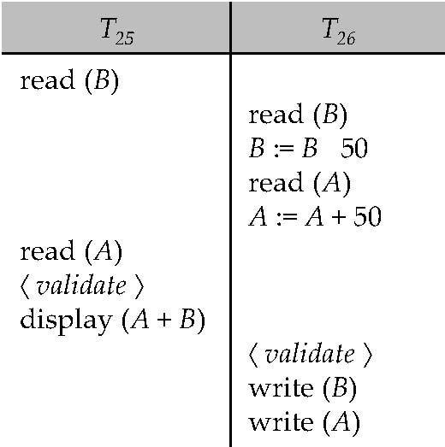
Schedule Produced by Validation
Example of schedule produced using validation

Slide 77
Multiversion Schemes
Multiversion schemes keep old versions of data item to increase concurrency.
Multiversion Timestamp Ordering
Multiversion Two-Phase Locking
Each successful write results in the creation of a new version of the data item written.
Use timestamps to label versions.
When a read(Q) operation is issued, select an appropriate version of Q based on the timestamp of the transaction, and return the value of the selected version.
reads never have to wait as an appropriate version is returned immediately.

Slide 78
Multiversion Timestamp Ordering
Each data item Q has a sequence of versions <Q₁, Q₂,...., Q_{m}>. Each version Q_{k} contains three data fields:
Content -- the value of version Q_{k}.
W-timestamp(Q_{k}) -- timestamp of the transaction that created (wrote) version Q_{k}
R-timestamp(Q_{k}) -- largest timestamp of a transaction that successfully read version Q_{k}
When a transaction T_{i} creates a new version Q_{k} of Q, Q_{k}'s W-timestamp and R-timestamp are initialized to TS(T_{i}).
R-timestamp of Q_{k} is updated whenever a transaction T_{j} reads Q_{k}, and TS(T_{j}) > R-timestamp(Q_{k}).

Slide 79
Multiversion Timestamp Ordering (Cont)
Suppose that transaction T_{i} issues a read(Q) or write(Q) operation. Let Q_{k} denote the version of Q whose write timestamp is the largest write timestamp less than or equal to TS(T_{i}).
If transaction T_{i} issues a read(Q), then the value returned is the content of version Q_{k}.
If transaction T_{i} issues a write(Q)
if TS(T_{i}) < R-timestamp(Q_{k}), then transaction T_{i} is rolled back.
if TS(T_{i}) = W-timestamp(Q_{k}), the contents of Q_{k} are overwritten
else a new version of Q is created.
Observe that
Reads always succeed
A write by T_{i} is rejected if some other transaction T_{j} that (in the serialization order defined by the timestamp values) should read T_{i}'s write, has already read a version created by a transaction older than T_{i}.
Protocol guarantees serializability

Slide 80
Multiversion Two-Phase Locking
Differentiates between read-only transactions and update transactions
Update transactions acquire read and write locks, and hold all locks up to the end of the transaction. That is, update transactions follow rigorous two-phase locking.
Each successful write results in the creation of a new version of the data item written.
Each version of a data item has a single timestamp whose value is obtained from a counter ts-counter that is incremented during commit processing.
Read-only transactions are assigned a timestamp by reading the current value of ts-counter before they start execution; they follow the multiversion timestamp-ordering protocol for performing reads.

Slide 81
Multiversion Two-Phase Locking (Cont.)
When an update transaction wants to read a data item:
it obtains a shared lock on it, and reads the latest version.
When it wants to write an item
it obtains X lock on; it then creates a new version of the item and sets this version's timestamp to ∞.
When update transaction T_{i} completes, commit processing occurs:
T_{i} sets timestamp on the versions it has created to ts-counter + 1
T_{i} increments ts-counter by 1
Read-only transactions that start after T_{i} increments ts-counter will see the values updated by T_{i}.
Read-only transactions that start before T_{i} increments the ts-counter will see the value before the updates by T_{i}.
Only serializable schedules are produced.

Slide 82
MVCC: Implementation Issues
Creation of multiple versions increases storage overhead
Extra tuples
Extra space in each tuple for storing version information
Versions can, however, be garbage collected
E.g. if Q has two versions Q5 and Q9, and the oldest active transaction has timestamp > 9, than Q5 will never be required again

Slide 83
Snapshot Isolation
Motivation: Decision support queries that read large amounts of data have concurrency conflicts with OLTP transactions that update a few rows
Poor performance results
Solution 1: Give logical “snapshot” of database state to read only transactions, read-write transactions use normal locking
Multiversion 2-phase locking
Works well, but how does system know a transaction is read only?
Solution 2: Give snapshot of database state to every transaction, updates alone use 2-phase locking to guard against concurrent updates
Problem: variety of anomalies such as lost update can result
Partial solution: snapshot isolation level (next slide)
Proposed by Berenson et al, SIGMOD 1995
Variants implemented in many database systems
E.g. Oracle, PostgreSQL, SQL Server 2005

Slide 84
Snapshot Isolation
A transaction T1 executing with Snapshot Isolation
takes snapshot of committed data at start
always reads/modifies data in its own snapshot
updates of concurrent transactions are not visible to T1
writes of T1 complete when it commits
First-committer-wins rule:
Commits only if no other concurrent transaction has already written data that T1 intends to write.
T1 | T2 | T3
W(Y := 1) Commit
 | Start R(X) → 0 R(Y)→ 1
 |  | W(X:=2) W(Z:=3) Commit
 | R(Z) → 0 R(Y) → 1 W(X:=3) Commit-Req Abort
Concurrent updates not visible
Own updates are visible
Not first-committer of X
Serialization error, T2 is rolled back

Slide 85
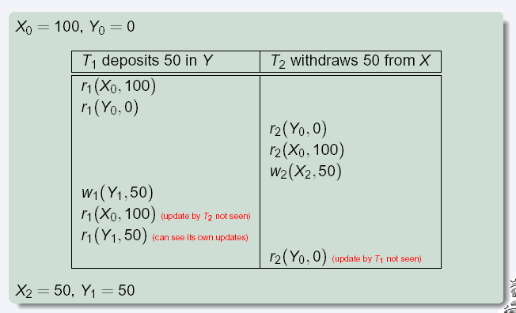
Snapshot Read
Concurrent updates invisible to snapshot read
Notes:
85

Slide 86
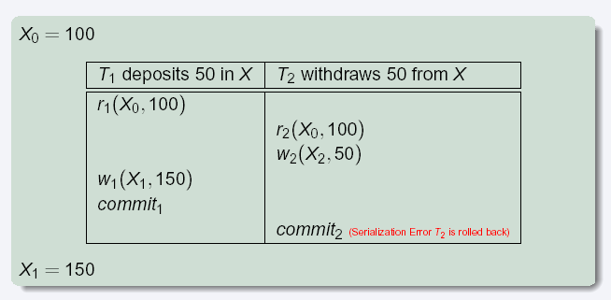
Snapshot Write: First Committer Wins
Variant: “First-updater-wins”
Check for concurrent updates when write occurs by locking item
But lock should be held till all concurrent transactions have finished
(Oracle uses this plus some extra features)
Differs only in when abort occurs, otherwise equivalent
Notes:
86

Slide 87
Benefits of SI
Reading is never blocked,
and also doesn’t block other txns activities
Performance similar to Read Committed
Avoids the usual anomalies
No dirty read
No lost update
No non-repeatable read
Predicate based selects are repeatable (no phantoms)
Problems with SI
SI does not always give serializable executions
Serializable: among two concurrent txns, one sees the effects of the other
In SI: neither sees the effects of the other
Result: Integrity constraints can be violated

Slide 88
Snapshot Isolation
E.g. of problem with SI
T1: x:=y
T2: y:= x
Initially x = 3 and y = 17
Serial execution: x = ??, y = ??
if both transactions start at the same time, with snapshot isolation: x = ?? , y = ??
Called skew write
Skew also occurs with inserts
E.g:
Find max order number among all orders
Create a new order with order number = previous max + 1

Slide 89
Snapshot Isolation Anomalies
SI breaks serializability when txns modify different items, each based on a previous state of the item the other modified
Not very common in practice
E.g., the TPC-C benchmark runs correctly under SI
when txns conflict due to modifying different data, there is usually also a shared item they both modify too (like a total quantity) so SI will abort one of them
But does occur
Application developers should be careful about write skew
SI can also cause a read-only transaction anomaly, where read-only transaction may see an inconsistent state even if updaters are serializable
We omit details
Using snapshots to verify primary/foreign key integrity can lead to inconsistency
Integrity constraint checking usually done outside of snapshot

Slide 90
SI In Oracle and PostgreSQL
Warning: SI used when isolation level is set to serializable, by Oracle, and PostgreSQL versions prior to 9.1
PostgreSQL’s implementation of SI (versions prior to 9.1) described in Section 26.4.1.3
Oracle implements “first updater wins” rule (variant of “first committer wins”)
concurrent writer check is done at time of write, not at commit time
Allows transactions to be rolled back earlier
Oracle and PostgreSQL < 9.1 do not support true serializable execution
PostgreSQL 9.1 introduced new protocol called “Serializable Snapshot Isolation” (SSI)
Which guarantees true serializabilty including handling predicate reads (coming up)

Slide 91
SI In Oracle and PostgreSQL
Can sidestep SI for specific queries by using select .. for update in Oracle and PostgreSQL
E.g.,
select max(orderno) from orders for update
read value into local variable maxorder
insert into orders (maxorder+1, …)
Select for update (SFU) treats all data read by the query as if it were also updated, preventing concurrent updates
Does not always ensure serializability since phantom phenomena can occur (coming up)
In PostgreSQL versions < 9.1, SFU locks the data item, but releases locks when the transaction completes, even if other concurrent transactions are active
Not quite same as SFU in Oracle, which keeps locks until all
concurrent transactions have completed
Notes:
91

Slide 92
Insert and Delete Operations
If two-phase locking is used :
A delete operation may be performed only if the transaction deleting the tuple has an exclusive lock on the tuple to be deleted.
A transaction that inserts a new tuple into the database is given an X-mode lock on the tuple
Insertions and deletions can lead to the phantom phenomenon.
A transaction that scans a relation
(e.g., find sum of balances of all accounts in Perryridge)
and a transaction that inserts a tuple in the relation
(e.g., insert a new account at Perryridge)
(conceptually) conflict in spite of not accessing any tuple in common.
If only tuple locks are used, non-serializable schedules can result
E.g. the scan transaction does not see the new account, but reads some other tuple written by the update transaction

Slide 93
Insert and Delete Operations (Cont.)
The transaction scanning the relation is reading information that indicates what tuples the relation contains, while a transaction inserting a tuple updates the same information.
The conflict should be detected, e.g. by locking the information.
One solution:
Associate a data item with the relation, to represent the information about what tuples the relation contains.
Transactions scanning the relation acquire a shared lock in the data item,
Transactions inserting or deleting a tuple acquire an exclusive lock on the data item. (Note: locks on the data item do not conflict with locks on individual tuples.)
Above protocol provides very low concurrency for insertions/deletions.
Index locking protocols provide higher concurrency while preventing the phantom phenomenon, by requiring locks on certain index buckets.

Slide 94
Index Locking Protocol
Index locking protocol:
Every relation must have at least one index.
A transaction can access tuples only after finding them through one or more indices on the relation
A transaction T_{i} that performs a lookup must lock all the index leaf nodes that it accesses, in S-mode
Even if the leaf node does not contain any tuple satisfying the index lookup (e.g. for a range query, no tuple in a leaf is in the range)
A transaction T_{i} that inserts, updates or deletes a tuple t_{i} in a relation r
must update all indices to r
must obtain exclusive locks on all index leaf nodes affected by the insert/update/delete
The rules of the two-phase locking protocol must be observed
Guarantees that phantom phenomenon won’t occur

Slide 95
Next-Key Locking
Index-locking protocol to prevent phantoms required locking entire leaf
Can result in poor concurrency if there are many inserts
Alternative: for an index lookup
Lock all values that satisfy index lookup (match lookup value, or fall in lookup range)
Also lock next key value in index
Lock mode: S for lookups, X for insert/delete/update
Ensures that range queries will conflict with inserts/deletes/updates
Regardless of which happens first, as long as both are concurrent

Slide 96
Concurrency in Index Structures
Indices are unlike other database items in that their only job is to help in accessing data.
Index-structures are typically accessed very often, much more than other database items.
Treating index-structures like other database items, e.g. by 2-phase locking of index nodes can lead to low concurrency.
There are several index concurrency protocols where locks on internal nodes are released early, and not in a two-phase fashion.
It is acceptable to have nonserializable concurrent access to an index as long as the accuracy of the index is maintained.
In particular, the exact values read in an internal node of a B⁺-tree are irrelevant so long as we land up in the correct leaf node.

Slide 97
Concurrency in Index Structures (Cont.)
Example of index concurrency protocol:
Use crabbing instead of two-phase locking on the nodes of the B⁺-tree, as follows. During search/insertion/deletion:
First lock the root node in shared mode.
After locking all required children of a node in shared mode, release the lock on the node.
During insertion/deletion, upgrade leaf node locks to exclusive mode.
When splitting or coalescing requires changes to a parent, lock the parent in exclusive mode.
Above protocol can cause excessive deadlocks
Searches coming down the tree deadlock with updates going up the tree
Can abort and restart search, without affecting transaction
Better protocols are available; see Section 16.9 for one such protocol, the B-link tree protocol
Intuition: release lock on parent before acquiring lock on child
And deal with changes that may have happened between lock release and acquire

Slide 98
Weak Levels of Consistency
Degree-two consistency: differs from two-phase locking in that S-locks may be released at any time, and locks may be acquired at any time
X-locks must be held till end of transaction
Serializability is not guaranteed, programmer must ensure that no erroneous database state will occur]
Cursor stability:
For reads, each tuple is locked, read, and lock is immediately released
X-locks are held till end of transaction
Special case of degree-two consistency

Slide 99
Weak Levels of Consistency in SQL
SQL allows non-serializable executions
Serializable: is the default
Repeatable read: allows only committed records to be read, and repeating a read should return the same value (so read locks should be retained)
However, the phantom phenomenon need not be prevented
T1 may see some records inserted by T2, but may not see others inserted by T2
Read committed: same as degree two consistency, but most systems implement it as cursor-stability
Read uncommitted: allows even uncommitted data to be read
In many database systems, read committed is the default consistency level
has to be explicitly changed to serializable when required
set isolation level serializable

Slide 100
Transactions across User Interaction
Many applications need transaction support across user interactions
Can’t use locking
Don’t want to reserve database connection per user
Application level concurrency control
Each tuple has a version number
Transaction notes version number when reading tuple
select r.balance, r.version into :A, :version from r where acctId =23
When writing tuple, check that current version number is same as the version when tuple was read
update r set r.balance = r.balance + :deposit where acctId = 23 and r.version = :version
Equivalent to optimistic concurrency control without validating read set
Used internally in Hibernate ORM system, and manually in many applications
Version numbering can also be used to support first committer wins check of snapshot isolation
Unlike SI, reads are not guaranteed to be from a single snapshot

Slide 101
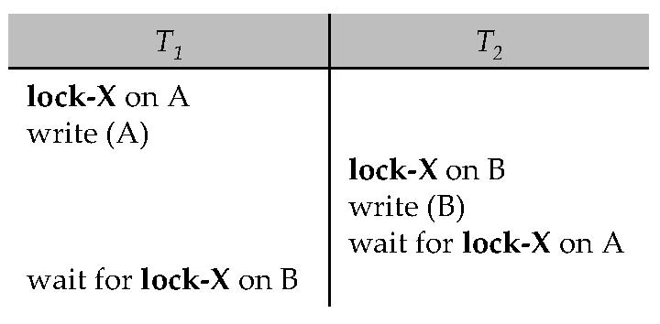
Deadlocks
Consider the following two transactions:
T₁: write (X) T₂: write(Y)
write(Y) write(X)
Schedule with deadlock

Slide 102
End of Chapter 15
Notes:
102

Slide 103
Chapter 16: Recovery System

Slide 104
Chapter 16: Recovery System
Failure Classification
Storage Structure
Recovery and Atomicity
Log-Based Recovery
Remote Backup Systems

Slide 105
Failure Classification
Transaction failure :
Logical errors: transaction cannot complete due to some internal error condition
System errors: the database system must terminate an active transaction due to an error condition (e.g., deadlock)
System crash: a power failure or other hardware or software failure causes the system to crash.
Fail-stop assumption: non-volatile storage contents are assumed to not be corrupted by system crash
Database systems have numerous integrity checks to prevent corruption of disk data
Disk failure: a head crash or similar disk failure destroys all or part of disk storage
Destruction is assumed to be detectable: disk drives use checksums to detect failures

Slide 106
Recovery Algorithms
Consider transaction T_{i} that transfers $50 from account A to account B
Two updates: subtract 50 from A and add 50 to B
Transaction T_{i} requires updates to A and B to be output to the database.
A failure may occur after one of these modifications have been made but before both of them are made.
Modifying the database without ensuring that the transaction will commit may leave the database in an inconsistent state
Not modifying the database may result in lost updates if failure occurs just after transaction commits
Recovery algorithms have two parts
Actions taken during normal transaction processing to ensure enough information exists to recover from failures
Actions taken after a failure to recover the database contents to a state that ensures atomicity, consistency and durability

Slide 107
Storage Structure
Volatile storage:
does not survive system crashes
examples: main memory, cache memory
Nonvolatile storage:
survives system crashes
examples: disk, tape, flash memory, non-volatile (battery backed up) RAM
but may still fail, losing data
Stable storage:
a mythical form of storage that survives all failures
approximated by maintaining multiple copies on distinct nonvolatile media

Slide 108
Stable-Storage Implementation
Maintain multiple copies of each block on separate disks
copies can be at remote sites to protect against disasters such as fire or flooding.
Failure during data transfer can still result in inconsistent copies: Block transfer can result in
Successful completion
Partial failure: destination block has incorrect information
Total failure: destination block was never updated
Protecting storage media from failure during data transfer (one solution):
Execute output operation as follows (assuming two copies of each block):
Write the information onto the first physical block.
When the first write successfully completes, write the same information onto the second physical block.
The output is completed only after the second write successfully completes.
Notes:
108

Slide 109
Stable-Storage Implementation (Cont.)
Protecting storage media from failure during data transfer (cont.):
Copies of a block may differ due to failure during output operation. To recover from failure:
First find inconsistent blocks:
Expensive solution: Compare the two copies of every disk block.
Better solution:
Record in-progress disk writes on non-volatile storage (Non-volatile RAM or special area of disk).
Use this information during recovery to find blocks that may be inconsistent, and only compare copies of these.
Used in hardware RAID systems
If either copy of an inconsistent block is detected to have an error (bad checksum), overwrite it by the other copy. If both have no error, but are different, overwrite the second block by the first block.
Notes:
109

Slide 110
Data Access
Physical blocks are those blocks residing on the disk.
Buffer blocks are the blocks residing temporarily in main memory.
Block movements between disk and main memory are initiated through the following two operations:
input(B) transfers the physical block B to main memory.
output(B) transfers the buffer block B to the disk, and replaces the appropriate physical block there.
We assume, for simplicity, that each data item fits in, and is stored inside, a single block.

Slide 111
Example of Data Access
buffer
Buffer Block A
input(A)
X
A
Buffer Block B
Y
B
output(B)
read(X)
write(Y)
x₂
x₁
y₁
work area
of T₁
work area
of T₂
memory
disk

Slide 112
Data Access (Cont.)
Each transaction T_{i} has its private work-area in which local copies of all data items accessed and updated by it are kept.
T_{i}'s local copy of a data item X is called x_{i}.
Transferring data items between system buffer blocks and its private work-area done by:
read(X) assigns the value of data item X to the local variable x_{i}.
write(X) assigns the value of local variable x_{i} to data item {X} in the buffer block.
Note: output(B_{X}) need not immediately follow write(X). System can perform the output operation when it deems fit.
Transactions
Must perform read(X) before accessing X for the first time (subsequent reads can be from local copy)
write(X) can be executed at any time before the transaction commits

Slide 113
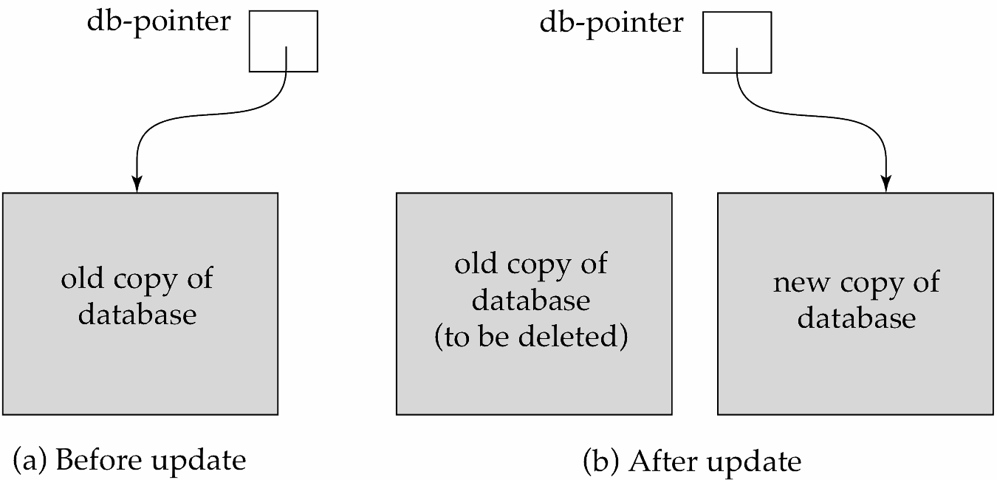
Recovery and Atomicity
To ensure atomicity despite failures, we first output information describing the modifications to stable storage without modifying the database itself.
We study log-based recovery mechanisms in detail
We first present key concepts
And then present the actual recovery algorithm
Less used alternative: shadow-copy and shadow-paging (brief details in book)
shadow-copy

Slide 114
Log-Based Recovery
A log is kept on stable storage.
The log is a sequence of log records, and maintains a record of update activities on the database.
When transaction T_{i} starts, it registers itself by writing a <T_{i} start>log record
Before T_{i} executes write(X), a log record <T_{i}, X, V₁, V₂> is written, where V₁ is the value of X before the write (the old value), and V₂ is the value to be written to X (the new value).
When T_{i} finishes it last statement, the log record <T_{i} commit> is written.
Two approaches using logs
Deferred database modification
Immediate database modification

Slide 115
Immediate Database Modification
The immediate-modification scheme allows updates of an uncommitted transaction to be made to the buffer, or the disk itself, before the transaction commits
Update log record must be written before database item is written
We assume that the log record is output directly to stable storage
(Will see later that how to postpone log record output to some extent)
Output of updated blocks to stable storage can take place at any time before or after transaction commit
Order in which blocks are output can be different from the order in which they are written.
The deferred-modification scheme performs updates to buffer/disk only at the time of transaction commit
Simplifies some aspects of recovery
But has overhead of storing local copy

Slide 116
Transaction Commit
A transaction is said to have committed when its commit log record is output to stable storage
all previous log records of the transaction must have been output already
Writes performed by a transaction may still be in the buffer when the transaction commits, and may be output later

Slide 117
Immediate Database Modification Example
Log Write Output
<T₀ start>
<T₀, A, 1000, 950>
<T_{o}, B, 2000, 2050
A = 950
B = 2050
<T₀ commit>
<T₁ start>
<T₁, C, 700, 600>
C = 600
B_{B} , B_{C}
<T₁ commit>
B_{A}
Note: B_{X} denotes block containing X.
B_{C} output before T₁ commits
B_{A} output after T₀ commits

Slide 118
Concurrency Control and Recovery
With concurrent transactions, all transactions share a single disk buffer and a single log
A buffer block can have data items updated by one or more transactions
We assume that if a transaction T_{i} has modified an item, no other transaction can modify the same item until T_{i} has committed or aborted
i.e. the updates of uncommitted transactions should not be visible to other transactions
Otherwise how to perform undo if T1 updates A, then T2 updates A and commits, and finally T1 has to abort?
Can be ensured by obtaining exclusive locks on updated items and holding the locks till end of transaction (strict two-phase locking)
Log records of different transactions may be interspersed in the log.

Slide 119
Undo and Redo Operations
Undo of a log record <T_{i}, X, V₁, V₂> writes the old value V₁ to X
Redo of a log record <T_{i}, X, V₁, V₂> writes the new value V₂ to X
Undo and Redo of Transactions
undo(T_{i}) restores the value of all data items updated by T_{i} to their old values, going backwards from the last log record for T_{i}
each time a data item X is restored to its old value V a special log record <T_{i} , X, V> is written out
when undo of a transaction is complete, a log record <T_{i} abort> is written out.
redo(T_{i}) sets the value of all data items updated by T_{i} to the new values, going forward from the first log record for T_{i}
No logging is done in this case

Slide 120
Undo and Redo on Recovering from Failure
When recovering after failure:
Transaction T_{i} needs to be undone if the log
contains the record <T_{i} start>,
but does not contain either the record <T_{i} commit> or <T_{i} abort>.
Transaction T_{i} needs to be redone if the log
contains the records <T_{i} start>
and contains the record <T_{i} commit> or <T_{i} abort>
Note that If transaction T_{i} was undone earlier and the <T_{i} abort> record written to the log, and then a failure occurs, on recovery from failure T_{i} is redone
such a redo redoes all the original actions including the steps that restored old values
Known as repeating history
Seems wasteful, but simplifies recovery greatly

Slide 121
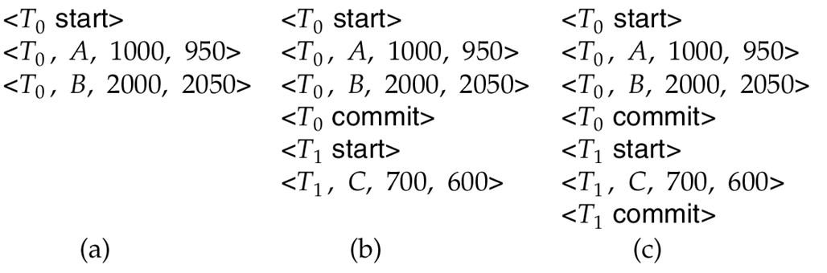
Immediate DB Modification Recovery Example
Below we show the log as it appears at three instances of time.
Recovery actions in each case above are:
(a) undo (T₀): B is restored to 2000 and A to 1000, and log records <T₀, B, 2000>, <T₀, A, 1000>, <T₀, abort> are written out
(b) redo (T₀) and undo (T₁): A and B are set to 950 and 2050 and C is restored to 700. Log records <T₁, C, 700>, <T₁, abort> are written out.
(c) redo (T₀) and redo (T₁): A and B are set to 950 and 2050
respectively. Then C is set to 600

Slide 122
Checkpoints
Redoing/undoing all transactions recorded in the log can be very slow
processing the entire log is time-consuming if the system has run for a long time
we might unnecessarily redo transactions which have already output their updates to the database.
Streamline recovery procedure by periodically performing check pointing
Output all log records currently residing in main memory onto stable storage.
Output all modified buffer blocks to the disk.
Write a log record < checkpoint L> onto stable storage where L is a list of all transactions active at the time of checkpoint.
All updates are stopped while doing checkpointing

Slide 123
Checkpoints (Cont.)
During recovery we need to consider only the most recent transaction T_{i} that started before the checkpoint, and transactions that started after T_{i}.
Scan backwards from end of log to find the most recent <checkpoint L> record
Only transactions that are in L or started after the checkpoint need to be redone or undone
Transactions that committed or aborted before the checkpoint already have all their updates output to stable storage.
Some earlier part of the log may be needed for undo operations
Continue scanning backwards till a record <T_{i} start> is found for every transaction T_{i} in L.
Parts of log prior to earliest <T_{i} start> record above are not needed for recovery, and can be erased whenever desired.

Slide 124
Example of Checkpoints
T_{c}
T_{f}
T₁
T₂
T₃
T₄
checkpoint
system failure
T₁ can be ignored (updates already output to disk due to checkpoint)
T₂ and T₃ redone.
T₄ undone

Slide 125
Recovery Algorithm
So far: we covered key concepts
Now: we present the components of the basic recovery algorithm
Later: we present extensions to allow more concurrency

Slide 126
Recovery Algorithm
Logging (during normal operation):
<T_{i} start> at transaction start
<T_{i}, X_{j}, V₁, V₂> for each update, and
<T_{i} commit> at transaction end
Transaction rollback (during normal operation)
Let T_{i} be the transaction to be rolled back
Scan log backwards from the end, and for each log record of T_{i} of the form <T_{i}, X_{j}, V₁, V₂>
perform the undo by writing V₁ to X_{j},
write a log record <T_{i} , X_{j}, V₁>
such log records are called compensation log records
Once the record <T_{i} start> is found stop the scan and write the log record <T_{i} abort>

Slide 127
Recovery Algorithm (Cont.)
Recovery from failure: Two phases
Redo phase: replay updates of all transactions, whether they committed, aborted, or are incomplete
Undo phase: undo all incomplete transactions
Redo phase:
Find last <checkpoint L> record, and set undo-list to L.
Scan forward from above <checkpoint L> record
Whenever a record <T_{i}, X_{j}, V₁, V₂> or <T_{i}, X_{j}, V₂> is found, redo it by writing V₂ to X_{j}
Whenever a log record <T_{i} start> is found, add T_{i} to undo-list
Whenever a log record <T_{i} commit> or <T_{i} abort> is found, remove T_{i} from undo-list

Slide 128
Recovery Algorithm (Cont.)
Undo phase:
Scan log backwards from end
Whenever a log record <T_{i}, X_{j}, V₁, V₂> is found where T_{i} is in undo-list perform same actions as for transaction rollback:
perform undo by writing V₁ to X_{j}.
write a log record <T_{i} , X_{j}, V₁>
Whenever a log record <T_{i} start> is found where T_{i} is in undo-list,
Write a log record <T_{i} abort>
Remove T_{i} from undo-list
Stop when undo-list is empty
i.e. <T_{i} start> has been found for every transaction in undo-list
After undo phase completes, normal transaction processing can commence

Slide 129
Example of Recovery

Slide 130
Log Record Buffering
Log record buffering: log records are buffered in main memory, instead of of being output directly to stable storage.
Log records are output to stable storage when a block of log records in the buffer is full, or a log force operation is executed.
Log force is performed to commit a transaction by forcing all its log records (including the commit record) to stable storage.
Several log records can thus be output using a single output operation, reducing the I/O cost.

Slide 131
Log Record Buffering (Cont.)
The rules below must be followed if log records are buffered:
Log records are output to stable storage in the order in which they are created.
Transaction T_{i} enters the commit state only when the log record <T_{i} commit> has been output to stable storage.
Before a block of data in main memory is output to the database, all log records pertaining to data in that block must have been output to stable storage.
This rule is called the write-ahead logging or WAL rule
Strictly speaking WAL only requires undo information to be output

Slide 132
Database Buffering
Database maintains an in-memory buffer of data blocks
When a new block is needed, if buffer is full an existing block needs to be removed from buffer
If the block chosen for removal has been updated, it must be output to disk
The recovery algorithm supports the no-force policy: i.e., updated blocks need not be written to disk when transaction commits
force policy: requires updated blocks to be written at commit
More expensive commit
The recovery algorithm supports the steal policy:i.e., blocks containing updates of uncommitted transactions can be written to disk, even before the transaction commits

Slide 133
Database Buffering (Cont.)
If a block with uncommitted updates is output to disk, log records with undo information for the updates are output to the log on stable storage first
(Write ahead logging)
No updates should be in progress on a block when it is output to disk. Can be ensured as follows.
Before writing a data item, transaction acquires exclusive lock on block containing the data item
Lock can be released once the write is completed.
Such locks held for short duration are called latches.
To output a block to disk
First acquire an exclusive latch on the block
Ensures no update can be in progress on the block
Then perform a log flush
Then output the block to disk
Finally release the latch on the block
Notes:
133

Slide 134
Buffer Management (Cont.)
Database buffer can be implemented either
in an area of real main-memory reserved for the database, or
in virtual memory
Implementing buffer in reserved main-memory has drawbacks:
Memory is partitioned before-hand between database buffer and applications, limiting flexibility.
Needs may change, and although operating system knows best how memory should be divided up at any time, it cannot change the partitioning of memory.

Slide 135
Buffer Management (Cont.)
Database buffers are generally implemented in virtual memory in spite of some drawbacks:
When operating system needs to evict a page that has been modified, the page is written to swap space on disk.
When database decides to write buffer page to disk, buffer page may be in swap space, and may have to be read from swap space on disk and output to the database on disk, resulting in extra I/O!
Known as dual paging problem.
Ideally when OS needs to evict a page from the buffer, it should pass control to database, which in turn should
Output the page to database instead of to swap space (making sure to output log records first), if it is modified
Release the page from the buffer, for the OS to use
Dual paging can thus be avoided, but common operating systems do not support such functionality.

Slide 136
Fuzzy Checkpointing
To avoid long interruption of normal processing during checkpointing, allow updates to happen during checkpointing
Fuzzy checkpointing is done as follows:
Temporarily stop all updates by transactions
Write a <checkpoint L> log record and force log to stable storage
Note list M of modified buffer blocks
Now permit transactions to proceed with their actions
Output to disk all modified buffer blocks in list M
blocks should not be updated while being output
Follow WAL: all log records pertaining to a block must be output before the block is output
Store a pointer to the checkpoint record in a fixed position last_checkpoint on disk
Notes:
136

Slide 137
Fuzzy Checkpointing (Cont.)
When recovering using a fuzzy checkpoint, start scan from the checkpoint record pointed to by last_checkpoint
Log records before last_checkpoint have their updates reflected in database on disk, and need not be redone.
Incomplete checkpoints, where system had crashed while performing checkpoint, are handled safely
……
<checkpoint L>
…..
<checkpoint L>
…..
last_checkpoint
Log
Notes:
137

Slide 138
Failure with Loss of Nonvolatile Storage
So far we assumed no loss of non-volatile storage
Technique similar to checkpointing used to deal with loss of non-volatile storage
Periodically dump the entire content of the database to stable storage
No transaction may be active during the dump procedure; a procedure similar to checkpointing must take place
Output all log records currently residing in main memory onto stable storage.
Output all buffer blocks onto the disk.
Copy the contents of the database to stable storage.
Output a record <dump> to log on stable storage.

Slide 139
Recovering from Failure of Non-Volatile Storage
To recover from disk failure
restore database from most recent dump.
Consult the log and redo all transactions that committed after the dump
Can be extended to allow transactions to be active during dump; known as fuzzy dump or online dump
Similar to fuzzy checkpointing

Slide 140
Recovery with Early Lock Release and Logical Undo Operations

Slide 141
Recovery with Early Lock Release
Support for high-concurrency locking techniques, such as those used for B⁺-tree concurrency control, which release locks early
Supports “logical undo”
Recovery based on “repeating history”, whereby recovery executes exactly the same actions as normal processing

Slide 142
Logical Undo Logging
Operations like B⁺-tree insertions and deletions release locks early.
They cannot be undone by restoring old values (physical undo), since once a lock is released, other transactions may have updated the B⁺-tree.
Instead, insertions (resp. deletions) are undone by executing a deletion (resp. insertion) operation (known as logical undo).
For such operations, undo log records should contain the undo operation to be executed
Such logging is called logical undo logging, in contrast to physical undo logging
Operations are called logical operations
Other examples:
delete of tuple, to undo insert of tuple
allows early lock release on space allocation information
subtract amount deposited, to undo deposit
allows early lock release on bank balance

Slide 143
Physical Redo
Redo information is logged physically (that is, new value for each write) even for operations with logical undo
Logical redo is very complicated since database state on disk may not be “operation consistent” when recovery starts
Physical redo logging does not conflict with early lock release

Slide 144
Operation Logging
Operation logging is done as follows:
When operation starts, log <T_{i}, O_{j}, operation-begin>. Here O_{j} is a unique identifier of the operation instance.
While operation is executing, normal log records with physical redo and physical undo information are logged.
When operation completes, <T_{i}, O_{j}, operation-end, U> is logged, where U contains information needed to perform a logical undo information.
Example: insert of (key, record-id) pair (K5, RID7) into index I9
<T1, O1, operation-begin>
….
<T1, X, 10, K5>
<T1, Y, 45, RID7>
<T1, O1, operation-end, (delete I9, K5, RID7)>
Physical redo of steps in insert

Slide 145
Operation Logging (Cont.)
If crash/rollback occurs before operation completes:
the operation-end log record is not found, and
the physical undo information is used to undo operation.
If crash/rollback occurs after the operation completes:
the operation-end log record is found, and in this case
logical undo is performed using U; the physical undo information for the operation is ignored.
Redo of operation (after crash) still uses physical redo information.

Slide 146
Transaction Rollback with Logical Undo
Rollback of transaction T_{i} is done as follows:
Scan the log backwards
If a log record <T_{i}, X, V₁, V₂> is found, perform the undo and log a al <T_{i}, X, V₁>.
If a <T_{i}, O_{j}, operation-end, U> record is found
Rollback the operation logically using the undo information U.
Updates performed during roll back are logged just like during normal operation execution.
At the end of the operation rollback, instead of logging an operation-end record, generate a record
<T_{i}, O_{j}, operation-abort>.
Skip all preceding log records for T_{i} until the record <T_{i}, O_{j} operation-begin> is found

Slide 147
Transaction Rollback with Logical Undo (Cont.)
Transaction rollback, scanning the log backwards (cont.):
If a redo-only record is found ignore it
If a <T_{i}, O_{j}, operation-abort> record is found:
skip all preceding log records for T_{i} until the record <T_{i}, O_{j}, operation-begin> is found.
Stop the scan when the record <T_{i}, start> is found
Add a <T_{i}, abort> record to the log
Some points to note:
Cases 3 and 4 above can occur only if the database crashes while a transaction is being rolled back.
Skipping of log records as in case 4 is important to prevent multiple rollback of the same operation.

Slide 148
Transaction Rollback with Logical Undo
Transaction rollback during normal operation

Slide 149
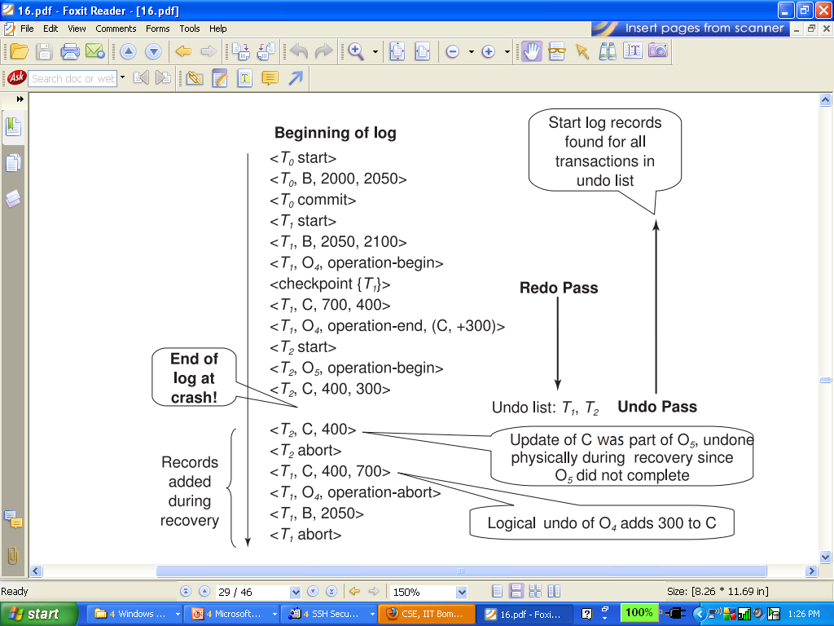
Failure Recovery with Logical Undo

Slide 150
Transaction Rollback: Another Example
Example with a complete and an incomplete operation
<T1, start>
<T1, O1, operation-begin>
….
<T1, X, 10, K5>
<T1, Y, 45, RID7>
<T1, O1, operation-end, (delete I9, K5, RID7)>
<T1, O2, operation-begin>
<T1, Z, 45, 70> ← T1 Rollback begins here
<T1, Z, 45> ← redo-only log record during physical undo (of incomplete O2)
<T1, Y, .., ..> ← Normal redo records for logical undo of O1
…
<T1, O1, operation-abort> ← What if crash occurred immediately after this?
<T1, abort>

Slide 151
Recovery Algorithm with Logical Undo
Basically same as earlier algorithm, except for changes described earlier for transaction rollback
(Redo phase): Scan log forward from last < checkpoint L> record till end of log
Repeat history by physically redoing all updates of all transactions,
Create an undo-list during the scan as follows
undo-list is set to L initially
Whenever <T_{i} start> is found T_{i} is added to undo-list
Whenever <T_{i} commit> or <T_{i} abort> is found, T_{i} is deleted from undo-list
This brings database to state as of crash, with committed as well as uncommitted transactions having been redone.
Now undo-list contains transactions that are incomplete, that is, have neither committed nor been fully rolled back.

Slide 152
Recovery with Logical Undo (Cont.)
Recovery from system crash (cont.)
(Undo phase): Scan log backwards, performing undo on log records of transactions found in undo-list.
Log records of transactions being rolled back are processed as described earlier, as they are found
Single shared scan for all transactions being undone
When <T_{i} start> is found for a transaction T_{i} in undo-list, write a <T_{i} abort> log record.
Stop scan when <T_{i} start> records have been found for all T_{i} in undo-list
This undoes the effects of incomplete transactions (those with neither commit nor abort log records). Recovery is now complete.

Slide 153
ARIES Recovery Algorithm

Slide 154
ARIES
ARIES is a state of the art recovery method
Incorporates numerous optimizations to reduce overheads during normal processing and to speed up recovery
The recovery algorithm we studied earlier is modeled after ARIES, but greatly simplified by removing optimizations
Unlike the recovery algorithm described earlier, ARIES
Uses log sequence number (LSN) to identify log records
Stores LSNs in pages to identify what updates have already been applied to a database page
Physiological redo
Dirty page table to avoid unnecessary redos during recovery
Fuzzy checkpointing that only records information about dirty pages, and does not require dirty pages to be written out at checkpoint time
More coming up on each of the above …

Slide 155
ARIES Optimizations
Physiological redo
Affected page is physically identified, action within page can be logical
Used to reduce logging overheads
e.g. when a record is deleted and all other records have to be moved to fill hole
Physiological redo can log just the record deletion
Physical redo would require logging of old and new values for much of the page
Requires page to be output to disk atomically
Easy to achieve with hardware RAID, also supported by some disk systems
Incomplete page output can be detected by checksum techniques,
But extra actions are required for recovery
Treated as a media failure

Slide 156
ARIES Data Structures
ARIES uses several data structures
Log sequence number (LSN) identifies each log record
Must be sequentially increasing
Typically an offset from beginning of log file to allow fast access
Easily extended to handle multiple log files
Page LSN
Log records of several different types
Dirty page table

Slide 157
ARIES Data Structures: Page LSN
Each page contains a PageLSN which is the LSN of the last log record whose effects are reflected on the page
To update a page:
X-latch the page, and write the log record
Update the page
Record the LSN of the log record in PageLSN
Unlock page
To flush page to disk, must first S-latch page
Thus page state on disk is operation consistent
Required to support physiological redo
PageLSN is used during recovery to prevent repeated redo
Thus ensuring idempotence

Slide 158
ARIES Data Structures: Log Record
Each log record contains LSN of previous log record of the same transaction
LSN in log record may be implicit
Special redo-only log record called compensation log record (CLR) used to log actions taken during recovery that never need to be undone
Serves the role of operation-abort log records used in earlier recovery algorithm
Has a field UndoNextLSN to note next (earlier) record to be undone
Records in between would have already been undone
Required to avoid repeated undo of already undone actions
LSN TransID PrevLSN RedoInfo UndoInfo
LSN TransID UndoNextLSN RedoInfo
1
2
3
4
4'
3'
2'
1'

Slide 159
ARIES Data Structures: DirtyPage Table
DirtyPageTable
List of pages in the buffer that have been updated
Contains, for each such page
PageLSN of the page
RecLSN is an LSN such that log records before this LSN have already been applied to the page version on disk
Set to current end of log when a page is inserted into dirty page table (just before being updated)
Recorded in checkpoints, helps to minimize redo work

Slide 160
ARIES Data Structures

Slide 161
ARIES Data Structures: Checkpoint Log
Checkpoint log record
Contains:
DirtyPageTable and list of active transactions
For each active transaction, LastLSN, the LSN of the last log record written by the transaction
Fixed position on disk notes LSN of last completed checkpoint log record
Dirty pages are not written out at checkpoint time
Instead, they are flushed out continuously, in the background
Checkpoint is thus very low overhead
can be done frequently

Slide 162
ARIES Recovery Algorithm
ARIES recovery involves three passes
Analysis pass: Determines
Which transactions to undo
Which pages were dirty (disk version not up to date) at time of crash
RedoLSN: LSN from which redo should start
Redo pass:
Repeats history, redoing all actions from RedoLSN
RecLSN and PageLSNs are used to avoid redoing actions already reflected on page
Undo pass:
Rolls back all incomplete transactions
Transactions whose abort was complete earlier are not undone
Key idea: no need to undo these transactions: earlier undo actions were logged, and are redone as required

Slide 163
Aries Recovery: 3 Passes
Analysis, redo and undo passes
Analysis determines where redo should start
Undo has to go back till start of earliest incomplete transaction
Last checkpoint
End of Log
Time
Log
Analysis pass
Redo pass
Undo pass

Slide 164
ARIES Recovery: Analysis
Analysis pass
Starts from last complete checkpoint log record
Reads DirtyPageTable from log record
Sets RedoLSN = min of RecLSNs of all pages in DirtyPageTable
In case no pages are dirty, RedoLSN = checkpoint record’s LSN
Sets undo-list = list of transactions in checkpoint log record
Reads LSN of last log record for each transaction in undo-list from checkpoint log record
Scans forward from checkpoint
.. Cont. on next page …

Slide 165
ARIES Recovery: Analysis (Cont.)
Analysis pass (cont.)
Scans forward from checkpoint
If any log record found for transaction not in undo-list, adds transaction to undo-list
Whenever an update log record is found
If page is not in DirtyPageTable, it is added with RecLSN set to LSN of the update log record
If transaction end log record found, delete transaction from undo-list
Keeps track of last log record for each transaction in undo-list
May be needed for later undo
At end of analysis pass:
RedoLSN determines where to start redo pass
RecLSN for each page in DirtyPageTable used to minimize redo work
All transactions in undo-list need to be rolled back

Slide 166
ARIES Redo Pass
Redo Pass: Repeats history by replaying every action not already reflected in the page on disk, as follows:
Scans forward from RedoLSN. Whenever an update log record is found:
If the page is not in DirtyPageTable or the LSN of the log record is less than the RecLSN of the page in DirtyPageTable, then skip the log record
Otherwise fetch the page from disk. If the PageLSN of the page fetched from disk is less than the LSN of the log record, redo the log record
NOTE: if either test is negative the effects of the log record have already appeared on the page. First test avoids even fetching the page from disk!

Slide 167
ARIES Undo Actions
When an undo is performed for an update log record
Generate a CLR containing the undo action performed (actions performed during undo are logged physicaly or physiologically).
CLR for record n noted as n’ in figure below
Set UndoNextLSN of the CLR to the PrevLSN value of the update log record
Arrows indicate UndoNextLSN value
ARIES supports partial rollback
Used e.g. to handle deadlocks by rolling back just enough to release reqd. locks
Figure indicates forward actions after partial rollbacks
records 3 and 4 initially, later 5 and 6, then full rollback
1
2
3
4
4'
3'
5
6
6'
5'
1'
2'

Slide 168
ARIES: Undo Pass
Undo pass:
Performs backward scan on log undoing all transaction in undo-list
Backward scan optimized by skipping unneeded log records as follows:
Next LSN to be undone for each transaction set to LSN of last log record for transaction found by analysis pass.
At each step pick largest of these LSNs to undo, skip back to it and undo it
After undoing a log record
For ordinary log records, set next LSN to be undone for transaction to PrevLSN noted in the log record
For compensation log records (CLRs) set next LSN to be undo to UndoNextLSN noted in the log record
All intervening records are skipped since they would have been undone already
Undos performed as described earlier

Slide 169
Recovery Actions in ARIES

Slide 170
Other ARIES Features
Recovery Independence
Pages can be recovered independently of others
E.g. if some disk pages fail they can be recovered from a backup while other pages are being used
Savepoints:
Transactions can record savepoints and roll back to a savepoint
Useful for complex transactions
Also used to rollback just enough to release locks on deadlock

Slide 171
Other ARIES Features (Cont.)
Fine-grained locking:
Index concurrency algorithms that permit tuple level locking on indices can be used
These require logical undo, rather than physical undo, as in earlier recovery algorithm
Recovery optimizations: For example:
Dirty page table can be used to prefetch pages during redo
Out of order redo is possible:
redo can be postponed on a page being fetched from disk, and performed when page is fetched.
Meanwhile other log records can continue to be processed

Slide 172
Remote Backup Systems

Slide 173
Remote Backup Systems
Remote backup systems provide high availability by allowing transaction processing to continue even if the primary site is destroyed.

Slide 174
Remote Backup Systems (Cont.)
Detection of failure: Backup site must detect when primary site has failed
to distinguish primary site failure from link failure maintain several communication links between the primary and the remote backup.
Heart-beat messages
Transfer of control:
To take over control backup site first perform recovery using its copy of the database and all the long records it has received from the primary.
Thus, completed transactions are redone and incomplete transactions are rolled back.
When the backup site takes over processing it becomes the new primary
To transfer control back to old primary when it recovers, old primary must receive redo logs from the old backup and apply all updates locally.

Slide 175
Remote Backup Systems (Cont.)
Time to recover: To reduce delay in takeover, backup site periodically proceses the redo log records (in effect, performing recovery from previous database state), performs a checkpoint, and can then delete earlier parts of the log.
Hot-Spare configuration permits very fast takeover:
Backup continually processes redo log record as they arrive, applying the updates locally.
When failure of the primary is detected the backup rolls back incomplete transactions, and is ready to process new transactions.
Alternative to remote backup: distributed database with replicated data
Remote backup is faster and cheaper, but less tolerant to failure
more on this in Chapter 19

Slide 176
Remote Backup Systems (Cont.)
Ensure durability of updates by delaying transaction commit until update is logged at backup; avoid this delay by permitting lower degrees of durability.
One-safe: commit as soon as transaction’s commit log record is written at primary
Problem: updates may not arrive at backup before it takes over.
Two-very-safe: commit when transaction’s commit log record is written at primary and backup
Reduces availability since transactions cannot commit if either site fails.
Two-safe: proceed as in two-very-safe if both primary and backup are active. If only the primary is active, the transaction commits as soon as is commit log record is written at the primary.
Better availability than two-very-safe; avoids problem of lost transactions in one-safe.

Slide 177
End of Chapter 16

Slide 178
Figure 16.01

Slide 179
Figure 16.02

Slide 180
Figure 16.03

Slide 181
Figure 16.04

Slide 182
Figure 16.05

Slide 183
Figure 16.06

Slide 184
Figure 16.08

Slide 185
Figure 16.09

Slide 186
Figure 16.10

Slide 187
Extra

Slide 188
Shadow Paging
Shadow paging is an alternative to log-based recovery; this scheme is useful if transactions execute serially
Idea: maintain two page tables during the lifetime of a transaction –the current page table, and the shadow page table
Store the shadow page table in nonvolatile storage, such that state of the database prior to transaction execution may be recovered.
Shadow page table is never modified during execution
To start with, both the page tables are identical. Only current page table is used for data item accesses during execution of the transaction.
Whenever any page is about to be written for the first time
A copy of this page is made onto an unused page.
The current page table is then made to point to the copy
The update is performed on the copy

Slide 189
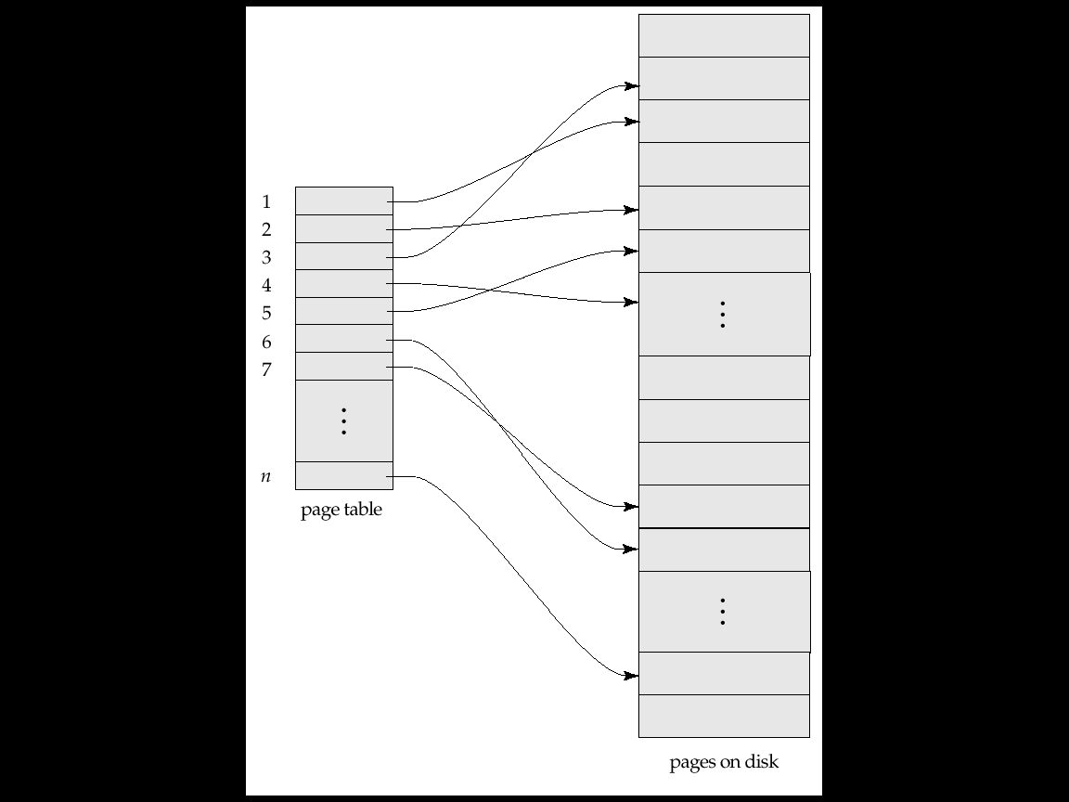
Sample Page Table

Slide 190
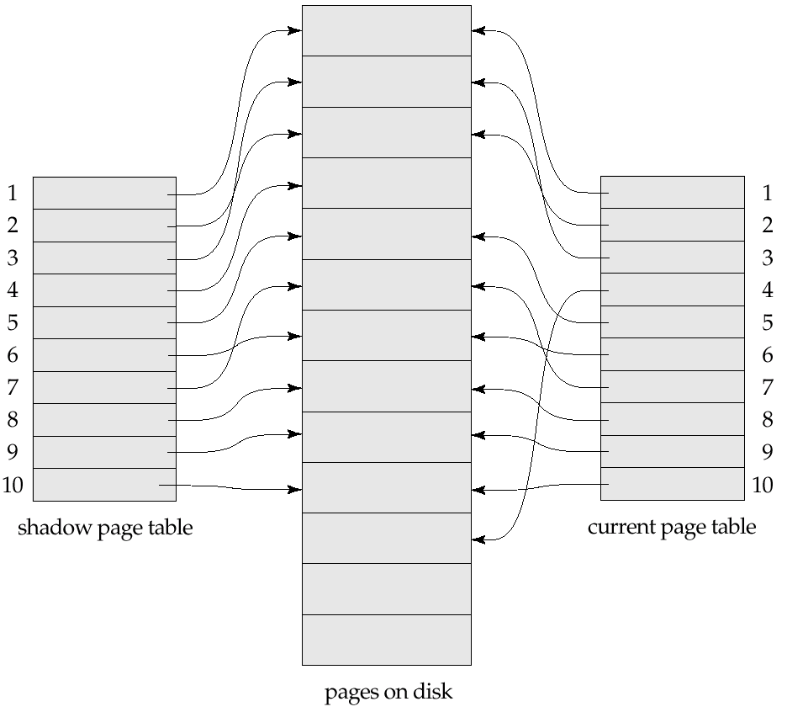
Example of Shadow Paging
Shadow and current page tables after write to page 4

Slide 191
Shadow Paging (Cont.)
To commit a transaction :
1. Flush all modified pages in main memory to disk
2. Output current page table to disk
3. Make the current page table the new shadow page table, as follows:
keep a pointer to the shadow page table at a fixed (known) location on disk.
to make the current page table the new shadow page table, simply update the pointer to point to current page table on disk
Once pointer to shadow page table has been written, transaction is committed.
No recovery is needed after a crash — new transactions can start right away, using the shadow page table.
Pages not pointed to from current/shadow page table should be freed (garbage collected).

Slide 192
Show Paging (Cont.)
Advantages of shadow-paging over log-based schemes
no overhead of writing log records
recovery is trivial
Disadvantages :
Copying the entire page table is very expensive
Can be reduced by using a page table structured like a B⁺-tree
No need to copy entire tree, only need to copy paths in the tree that lead to updated leaf nodes
Commit overhead is high even with above extension
Need to flush every updated page, and page table
Data gets fragmented (related pages get separated on disk)
After every transaction completion, the database pages containing old versions of modified data need to be garbage collected
Hard to extend algorithm to allow transactions to run concurrently
Easier to extend log based schemes

Slide 193
Block Storage Operations

Slide 194
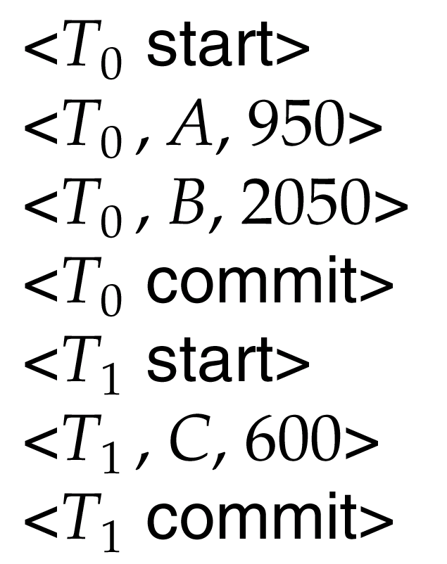
Portion of the Database Log Corresponding to T₀ and T₁

Slide 195
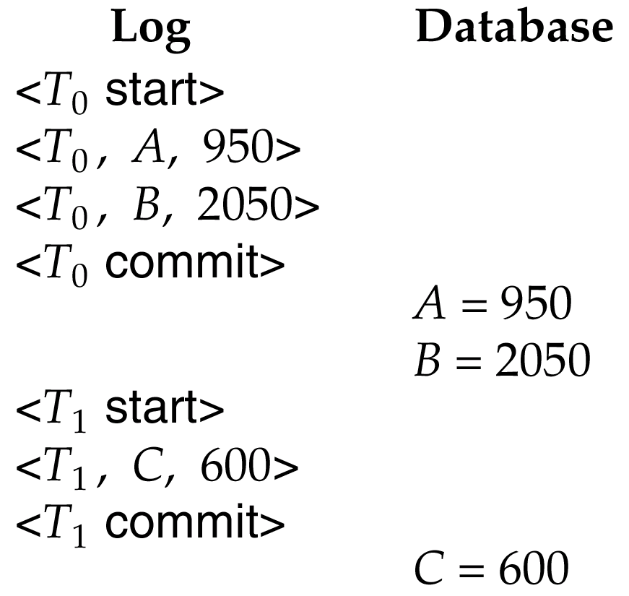
State of the Log and Database Corresponding to T₀ and T₁

Slide 196
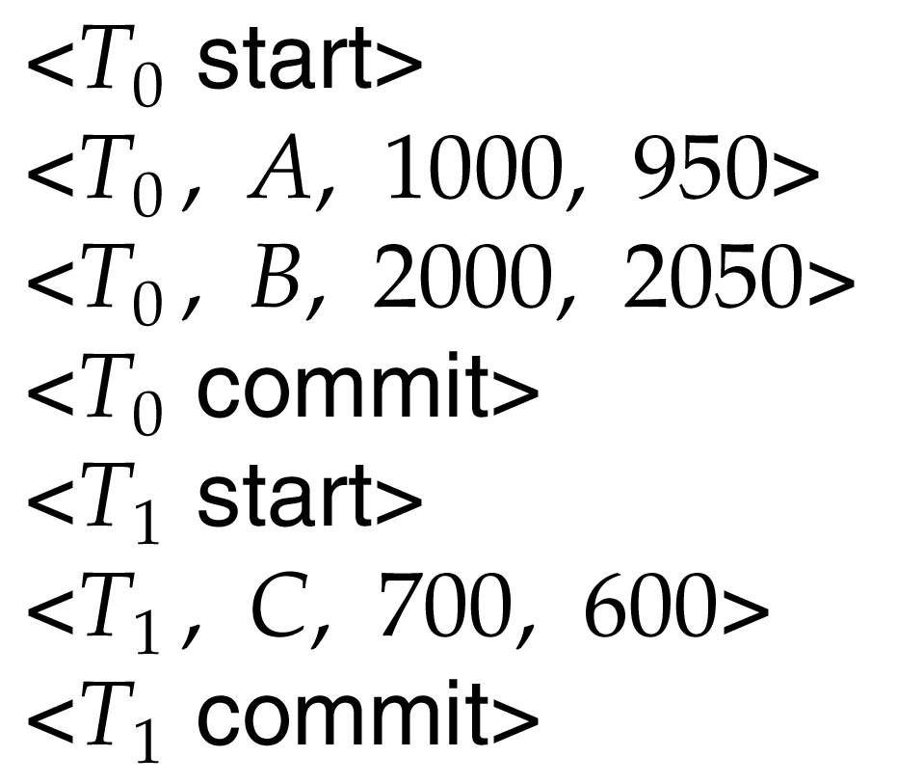
Portion of the System Log Corresponding to T₀ and T₁

Slide 197
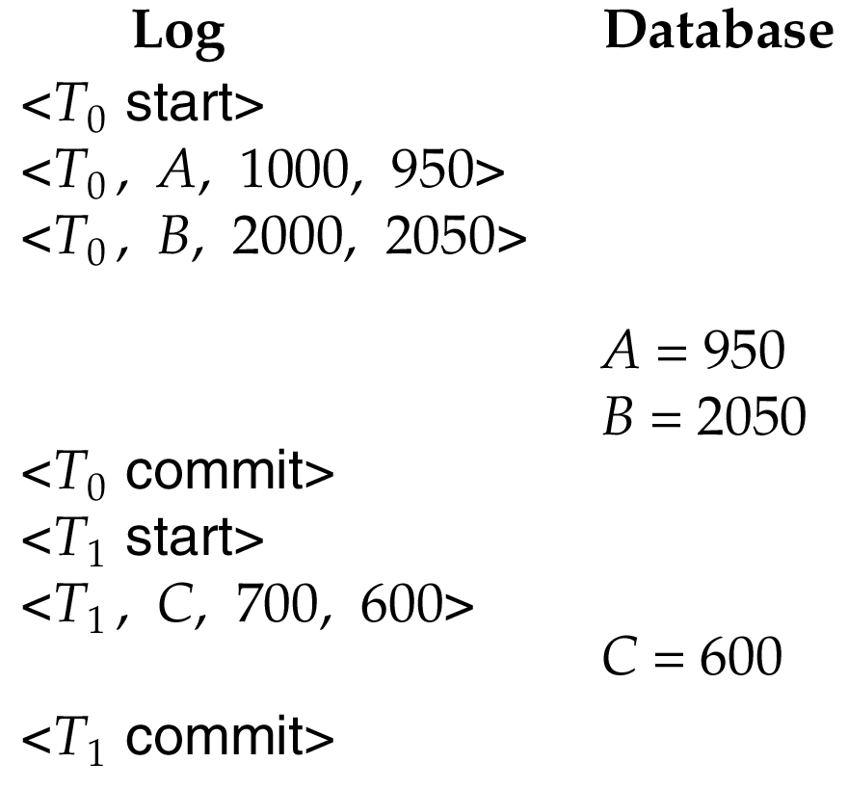
State of System Log and Database Corresponding to T₀ and T₁

