Slide 1

Market Basket Analysis
Atla Narsimha Reddy-20BCD7085 - narsimha.20bcd7085@vitap.ac.in
Under the Guidance of
DR. Sachi Nandan Mohanty
SCHOOL OF COMPUTER SCIENCE AND ENGINEERING
VIT-AP UNIVERSITY
AMARAVATI- 522237

Slide 2
Abstract:
Market Basket Analysis also known as association rule learning or affinity analysis. It is a data mining method that may be applied to a variety of industries, including marketing, bioinformatics, the field of education, nuclear physics, etc. The fundamental goal of market basket analysis in marketing is to give the merchant or an e-commerce website the knowledge they need to comprehend the customer's purchasing habits and make informed decisions, such as recommending related products. Market basket analysis can be done using a variety of algorithms. The current algorithms only process static data and do not account for changes in data over time. There are numerous algorithms for mining association rules. Apriori algorithm is one of the most widely used methods for extracting frequent item sets from huge databases and obtaining the association rule for knowledge discovery.
Key words:
Market Basket Analysis, Data Mining, Association rule, Apriori Algorithm, Data base, Frequent Item-sets, support, confidence, lift, conviction, frequent pattern set.

Slide 3
Introduction:
Machine learning is currently providing numerous benefits to the retail sector. You might anticipate that machine learning (ML) has various uses in the retail sector, ranging from predicting sales performance to identifying the buyers. One of the best uses of machine learning in the retail sector is "Market Basket Analysis." We can determine which products people commonly buy together by looking at their historical purchasing patterns.
The art of merchandise arrangement in a store is motivated by market basket analysis. Product placement should be done in a way that keeps things that are regularly purchased together close together, encouraging people to purchase them and increasing sales. If we enjoy shopping or have ever purchased goods in person or online, we should have come across the term "market basket analysis." When you visit a fast-food restaurant like McDonald's, Burger King or any other, they typically ask whether you would like to order french fries, a milkshake, or other items that go well with the items you buy.
Literature Survey:
An important step in association mining that uncovers frequent item sets in transactional databases is the mining of frequent item sets. It serves as the foundation for many data mining activities that aim to extract interesting patterns from datasets, including association rules, episodes, classifier, grouping, and correlation, among others. There are several proposed algorithms for finding common item sets, but they may all be categorized into one of two categories: candidate generation or pattern growth. A representative of the candidate generating strategy is Apriori. Based on length (k) frequent item sets, it generates length (k+1) candidate item sets. The number of times an itemset appears in transactions determines its frequency. Han proposed FP-growth in 2000 as a pattern growth approach and used a particular data format (FP-tree). The condition pattern base is efficiently produced based on the link of node structure that associations with FP-tree, and FP-growth identify the frequent item sets by discovering all frequent in 1-itemsets. The generation of candidate item sets by FP-growth is implicit

Slide 4
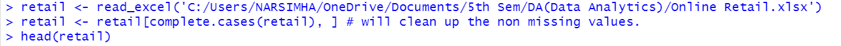
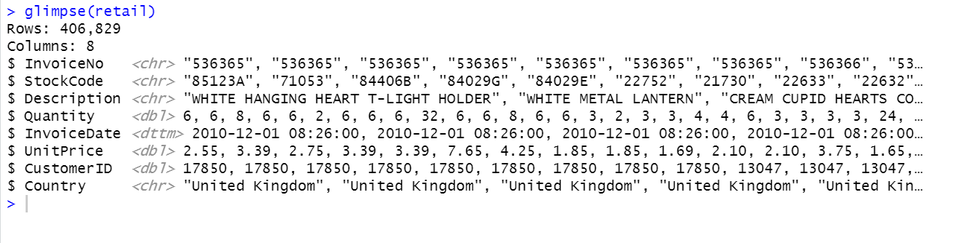
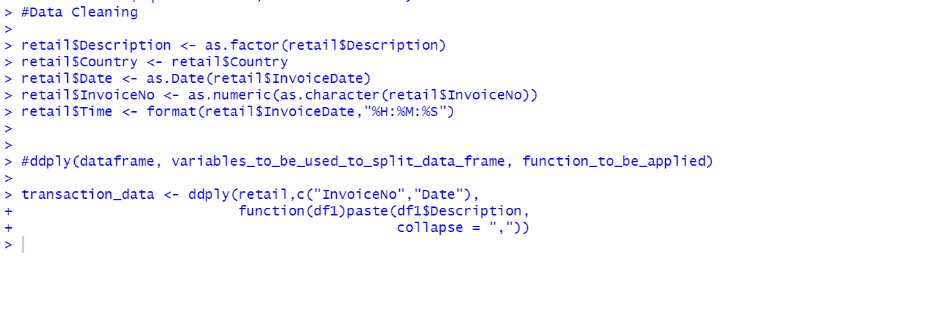
Methodology and Procedure:
Data collection:
The data was downloaded from http://archive.ics.uci.edu/ml/machine-learning-databases/00352/
Data Cleaning:

Slide 5
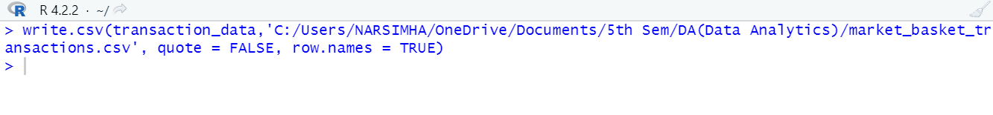
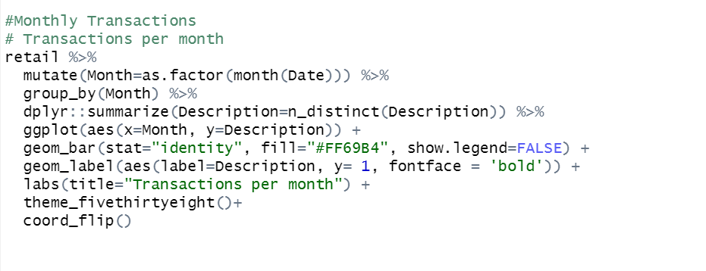
Write csv
Transaction Analysis:
Monthly Transactions:

Slide 6
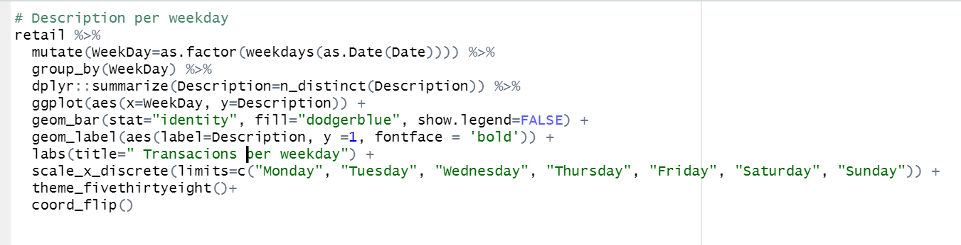
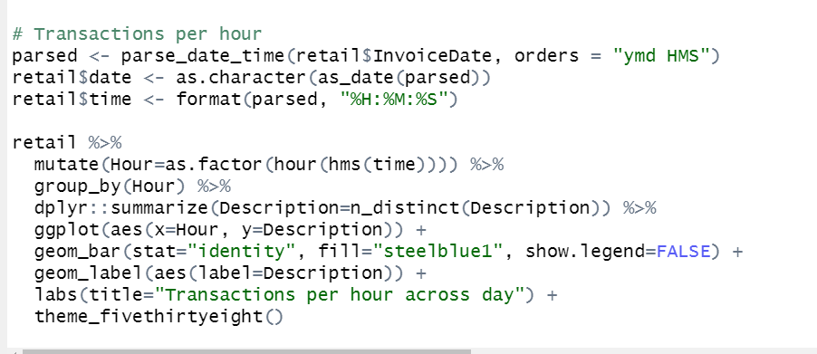
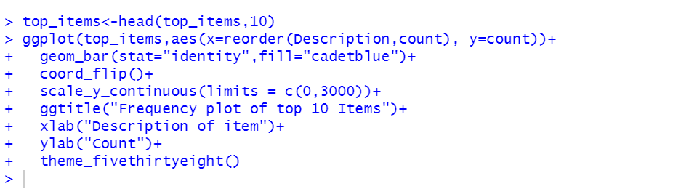
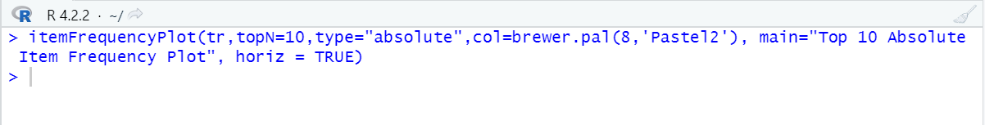
Transactions per weekday:
Transactions per hour:
Frequency plot of top 10 Items
Plotting Item Frequency Bar Plot to view distribution.

Slide 7
Apriori algorithm:
In a huge set of data items, association rule mining identifies intriguing linkages and/or correlation relationships. Association rules highlight attribute value situations in a dataset that commonly co-occur. Market Basket Analysis is a common and frequently used illustration of association rule mining. For instance, information is gathered from supermarkets. These market basket databases include many transaction records. Each record contains a list of all the things a consumer has purchased in a single transaction.
This kind of information is provided by association rules in the form of "IF-THEN" statements.
An association rule has 3 values that represent the degree of uncertainty regarding the rule and is computed from the data.
Support:
For item-sets X and Y, the support of an item-set measures how frequently it appears in the data:
supp(X⇒Y)=|X∪Y|N
support(X)=count(X) / N
Confidence:
For a rule X→Y, the rule's confidence measures the relative accuracy of the rule:
confidence(X→Y) =support (X, Y) / support(X)
conf(X⇒Y) =supp(X∪Y) / supp(X)
Lift:
The ratio of the observed support to that expected if X and Y were independent.
lift(X⇒Y) = supp(X∪Y) / (supp(X)*supp(Y))

Slide 8
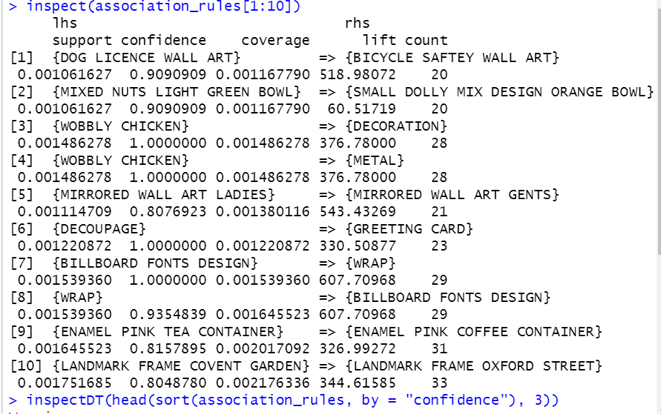
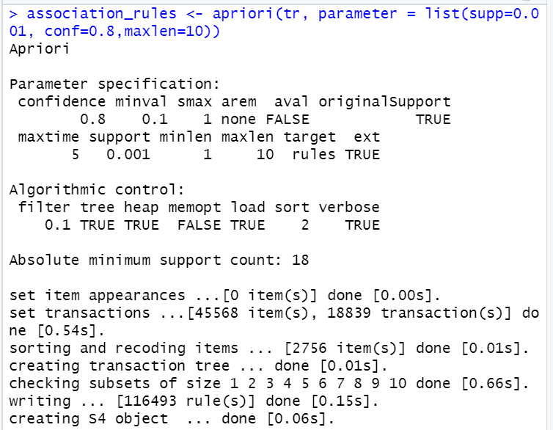
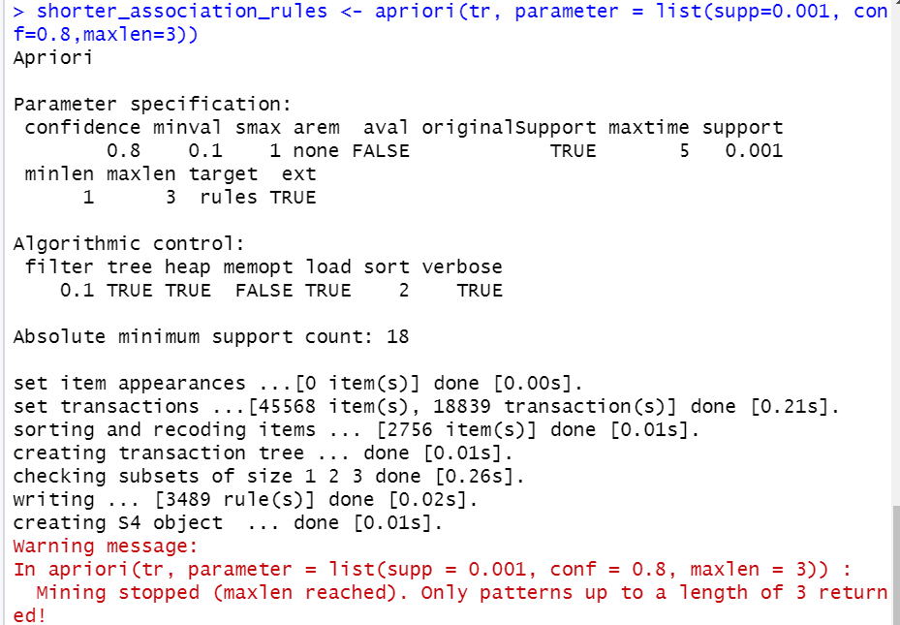
Association Rules:
Shorter Association Rules:

Slide 9
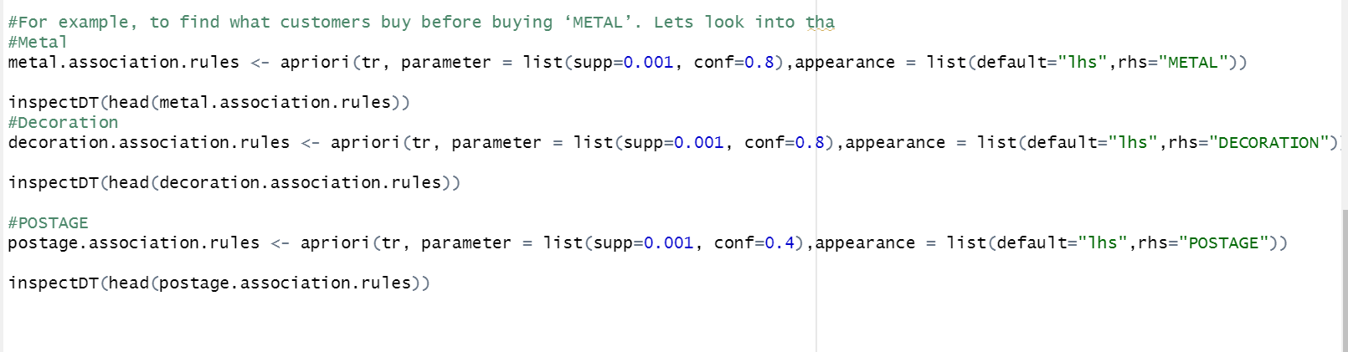
Subset rules:
Association Rules for products:
Visualization:

Slide 10
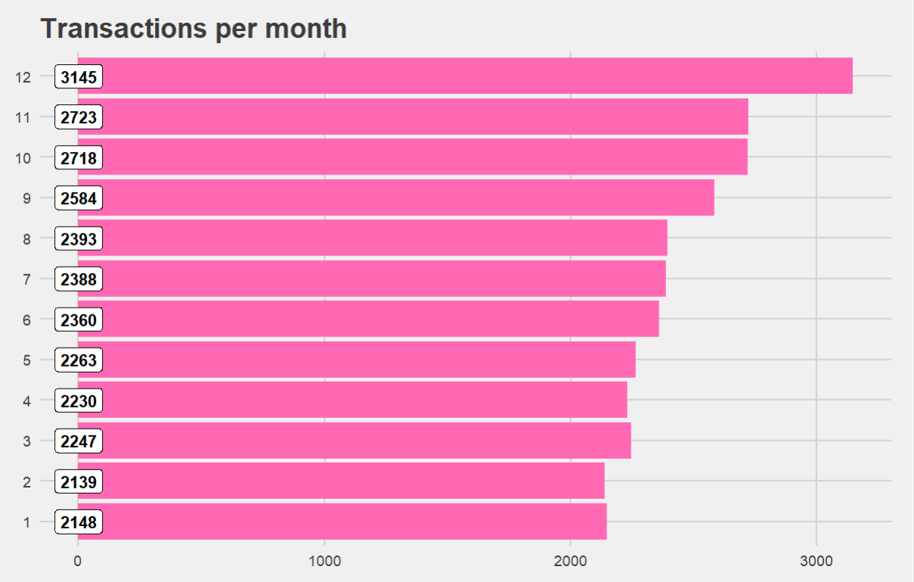
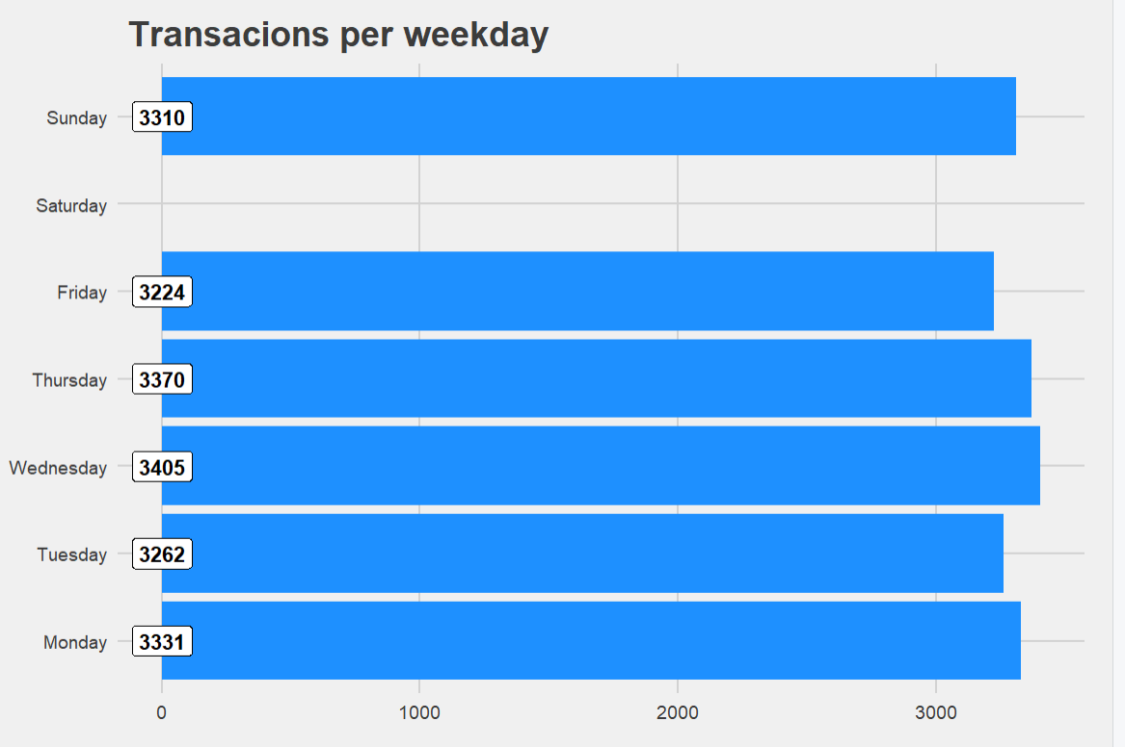
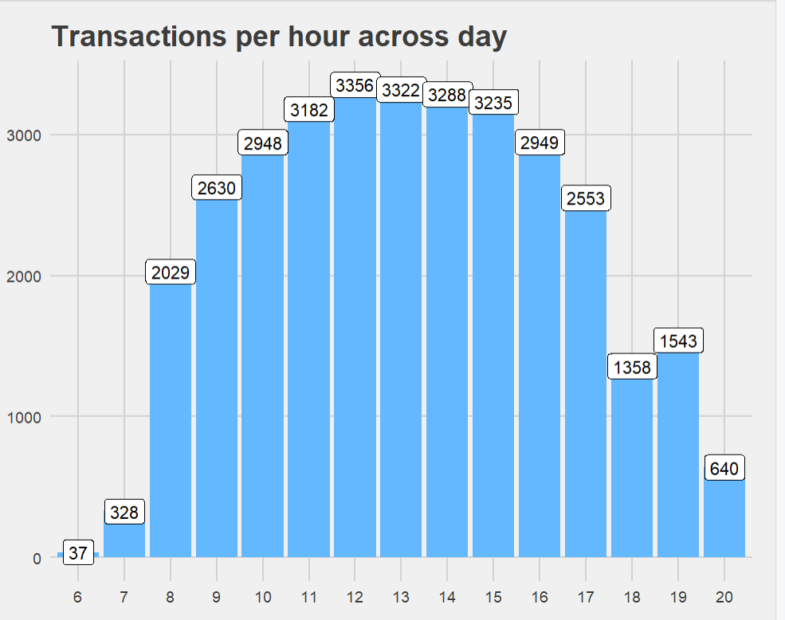
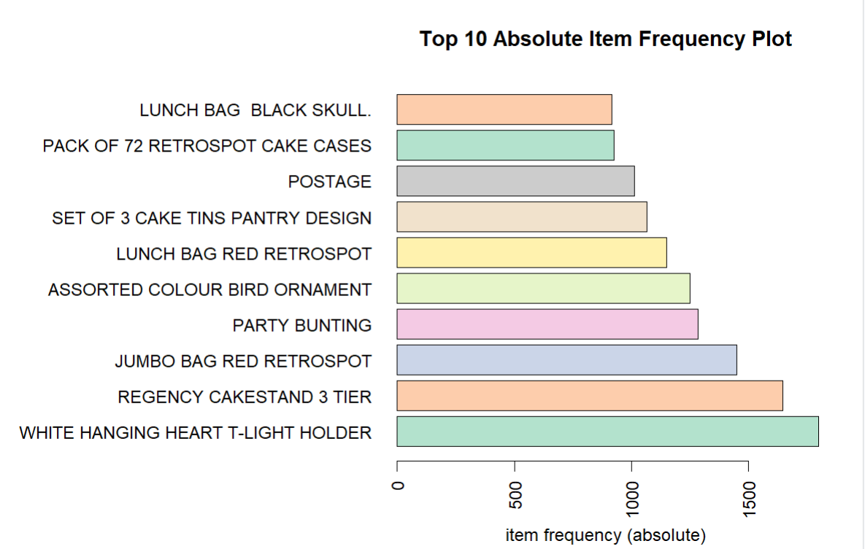
Results and discussion:
Frequency Pattern:

Slide 11
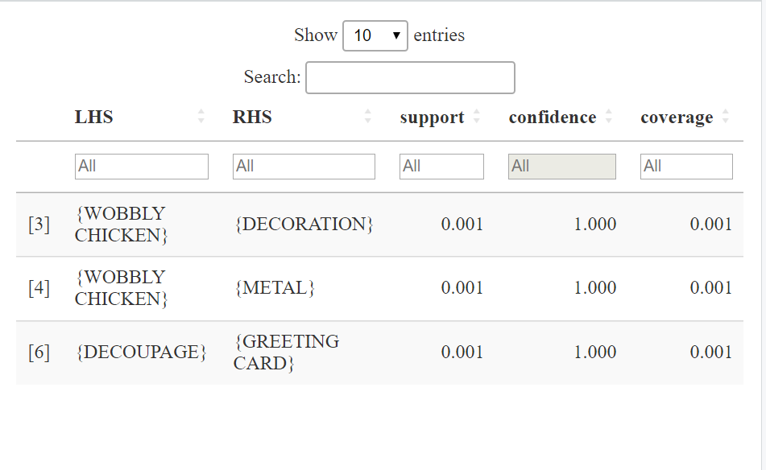
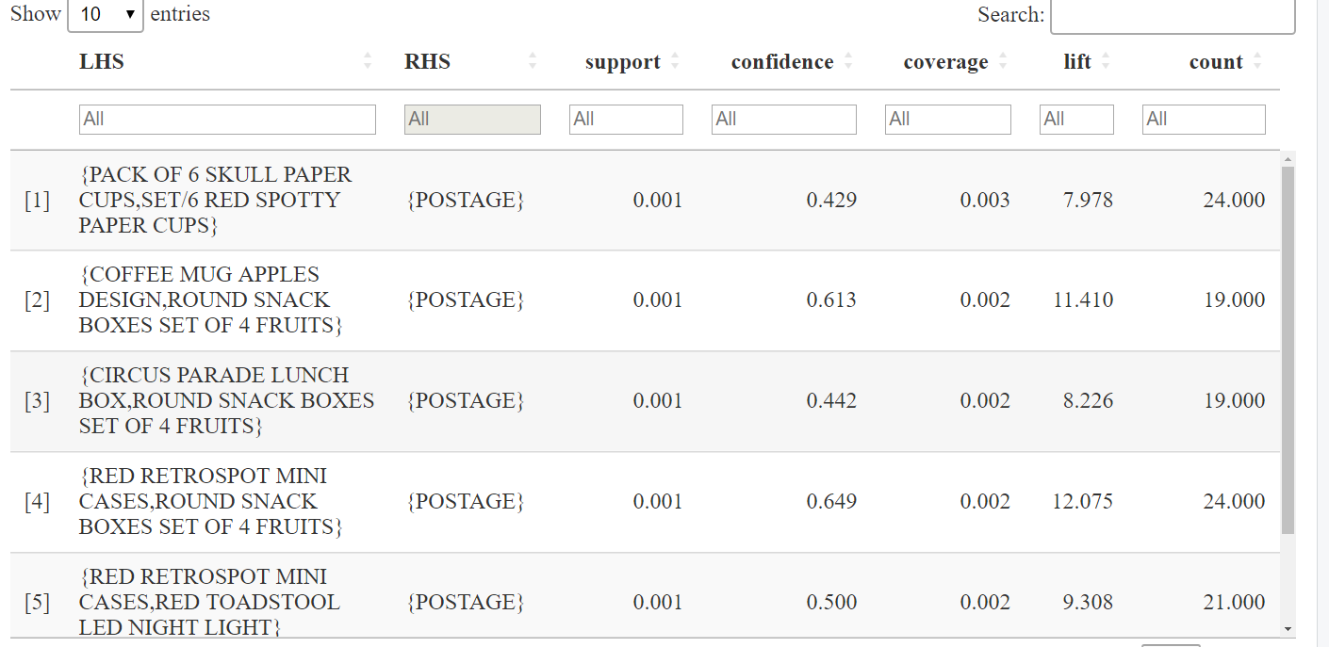
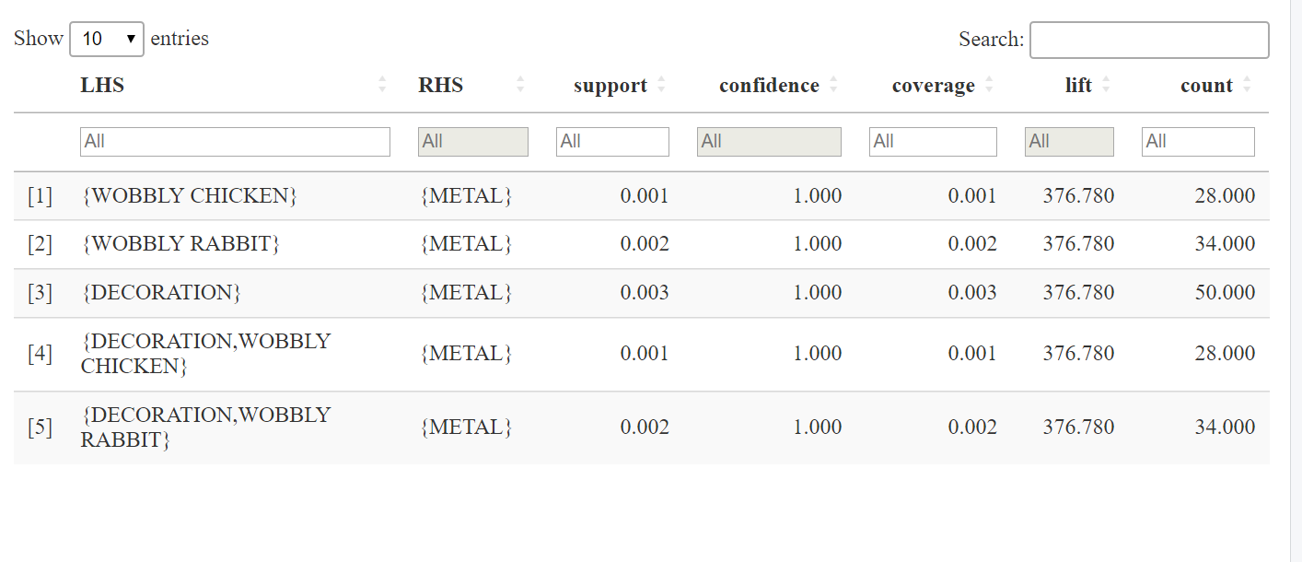
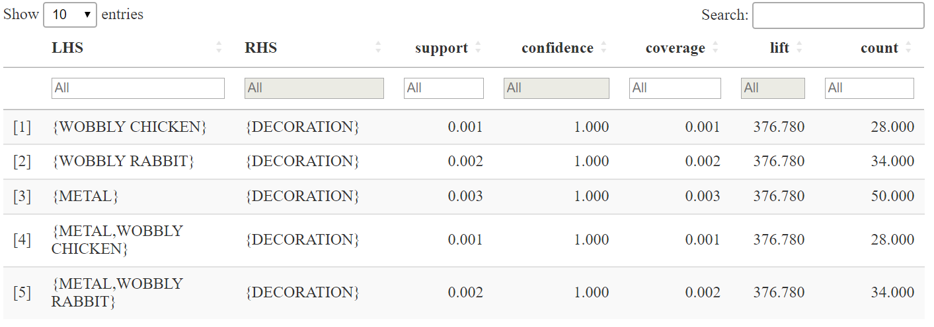
Association Rules:
Association rules for the product “POSTAGE”.
Association rules for the product “METAL” .
Association rules for the product “DECORATION” .

Slide 12
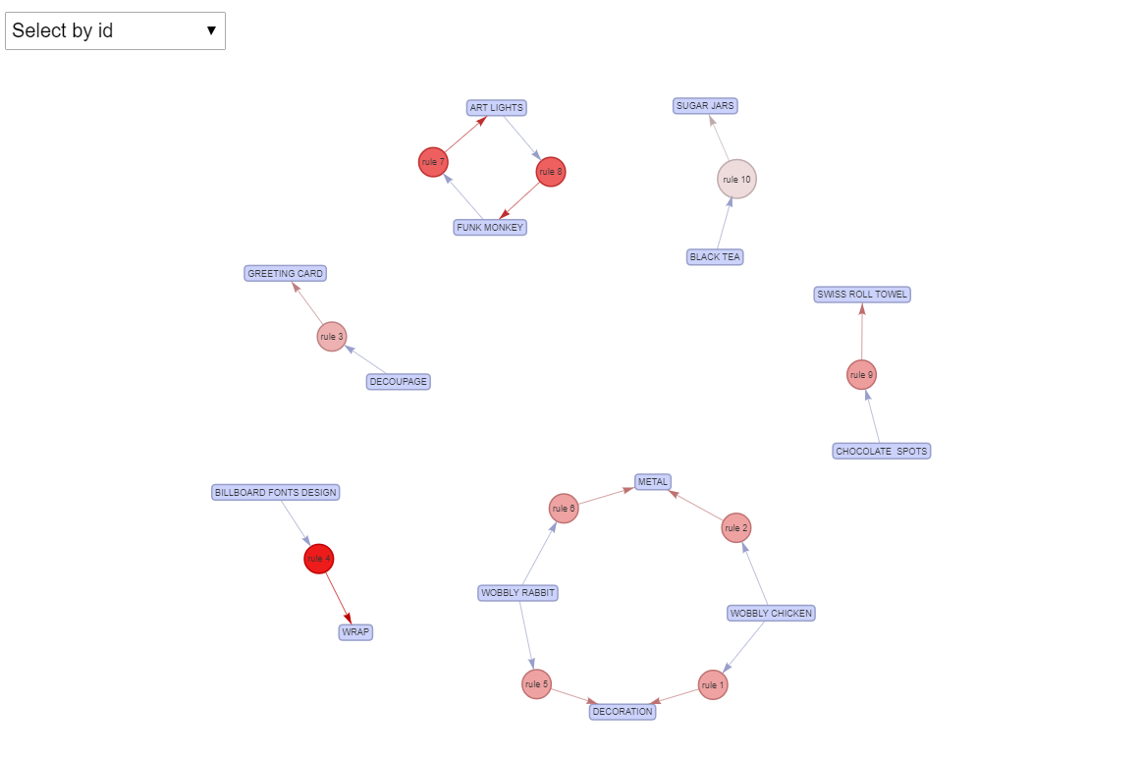
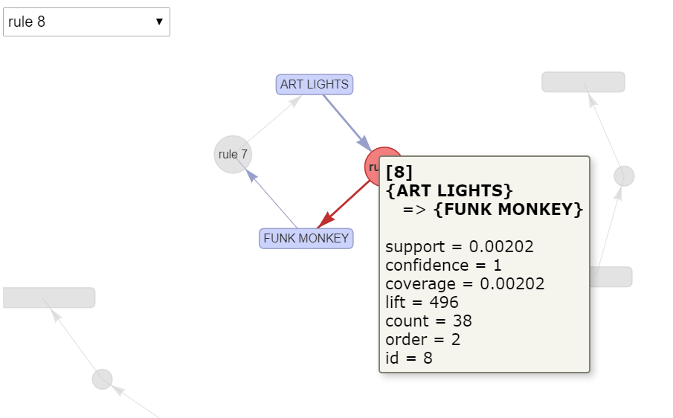
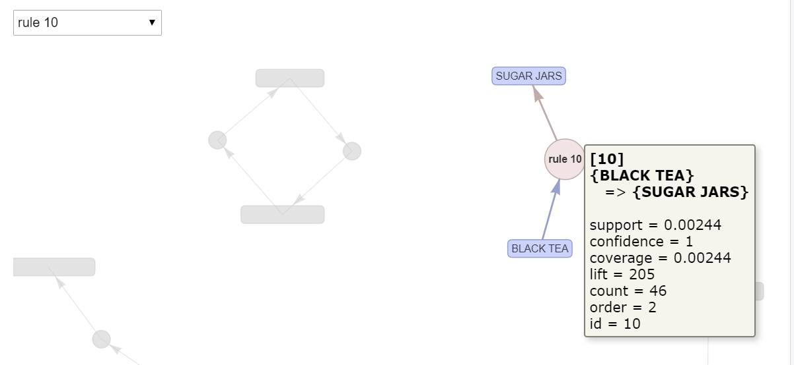
10 TOP Rules (based on confidence)

Slide 13
Conclusion:
Businesses can create dozens of data-driven strategies to increase their revenue and profitability by adopting the Apriori Algorithm and studying the association measurements. The analysis of customer purchasing behavior through data mining is dependent on these association rules. Association rule mining can provide useful insights for several of a retailer's most crucial tactics, including Customer analytics, Market Basket analysis, and Product Clustering. By analyzing the data, association rules determine the relationships between the items and give the merchant a precise answer to help them make more profitable business decisions.
Future scope and limitations:
Implementing innovative and cutting-edge mining algorithms, together with Apriori, FP growth for higher performance and quick results for sparse datasets, might improve a project. In the current strategy, we solely use association rules to take advantage of the collective knowledge, i.e., constructing a model by identifying similarities between consumers' affiliations with products and advising another client to buy an associated item that is similarly priced. In future work, association rules can also be used to take advantage of content-based information, such as detecting product similarities and proposing products based on the interest in related products. This application can be expanded to include other features like tracking sales, tracking products, calculating discounts, and more. In the future, this technique can be used with very large databases where memory space is valuable and needs to be improved. It can be tweaked further for better performance and efficiency.
The Apriori Algorithm's slowness is one of its greatest flaws. The dataset for the Apriori method contains a lot of item sets. As a result, it is ineffective when utilised with massive amounts of datasets.

Slide 14
References:
[1]
A.A. Raorane, R.V. Kulkarni, B.D. Jitkar
Association Rule – Extracting Knowledge Using Market Basket Analysis
Research Journal of Recent Sciences, 1 (2) (2012), pp. 19-27
[2] Verma Sheenu, Bhatnagar, Sakshi
An Effective Dynamic Unsupervised Clustering Algorithmic Approach for Market Basket Analysis
International Journal of Enterprise Computing and Business Systems, 4 (2) (2014)
[3] Verma Dipti, Nashine, Rakesh, Data Mining
Next Generation Challenges and Future Directions
International Journal of Modelling and Optimization, 2 (5) (2012), pp. 603-608
[4] D.H. Goh, R.P. Ang. An introduction to association rule mining: An application in counseling and help-seeking behavior of adolescents. (2007). Behavior Research Methods 39, 259–26

