Slide 1
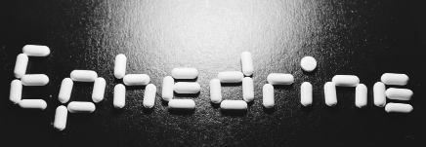
Ephedrine
Presentation
By
Marc Bouchard

Slide 2

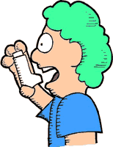
History
Also known as Ma-Huang
Ephedra has been used as medicine for over 60,000 years
Used in Chinese medicine for more than 5,000 years
Originally prescribed to treat asthma, congestion and allergies

Slide 3


Ephedra equisetina
Ephedrine is a naturally occurring central nervous system stimulant obtained from the plant Ephedra equisetina
The stem of the ephedra plant contains 1-2% of alkaloids that contain up to 90 percent of ephedrine
Found in the United States and sections of Asia

Slide 4
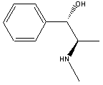
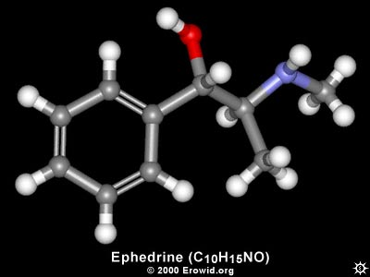
Chemical Structure
Chemical Formula: C₁₀H₁₅NO
Molecular Weight: 165.23 grams/mole
Melting Point: 37-39°C
Boiling Point: 253-255°C

Slide 5
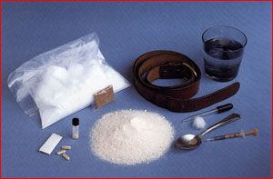
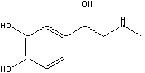
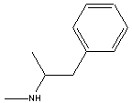
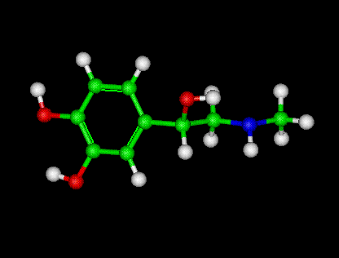
Similar Alkaloid Structures
Methamphetamines
Epinephrine (adrenaline)

Slide 6
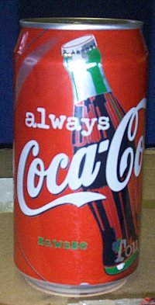

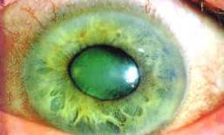
Other Related Alkaloids
Caffeine - Increases alertness and perception
Pseudoephedrine – A nasal decongestant. has less effect on
the heart and blood pressure
Phenylpropanolamine - Another nasal decongestant. Constricts
blood vessels, increases blood pressure and is an appetite
suppressant.
Amphetamines - Pump adrenaline into the body, stimulate the
CNS causing blood pressure to increase, suppress appetite,
dilate pupils, and cause hallucination

Slide 7
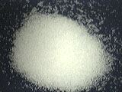
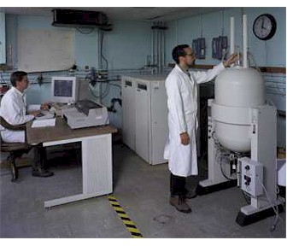
Chemical Synthesis
In 1911, scientists obtained racemic ephedrine and pseudoephedrine by hydrogenation of alpha-methylaminopropiophenone.
In its pure form, ephedrine is marketed as a salt, ephedrine sulfate
White crystalline powder with a
bitter taste, soluble in water and
very soluble in alcohol

Slide 8
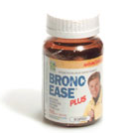
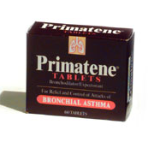
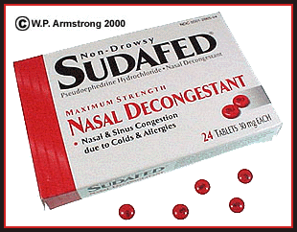
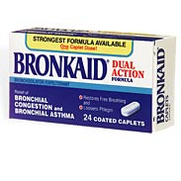
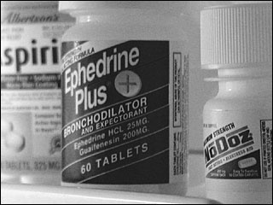
Medicines
Many medicines include
Ephedrine as an active
ingredient to aid in
alertness and asthma
relief

Slide 9


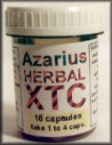
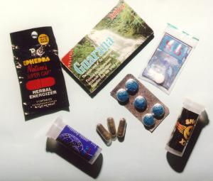
“Herbal XTC”
Ephedrine often used as a drug at raves
Acts as a mild alternative to speed
Heightens mood and causes a “tingling sensation” all over the scalp and body

Slide 10
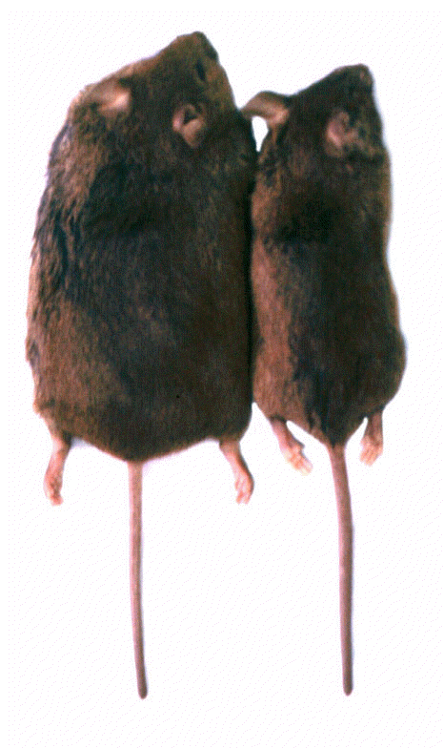

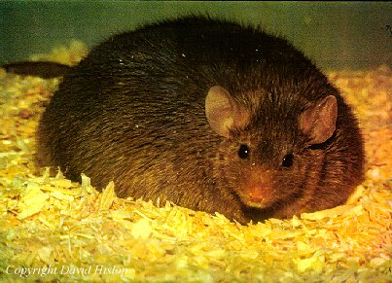
Use in Weight Loss
1. Increases fat loss.
2. Maintains muscle mass.
3. Prevents the fall of HDL cholesterol during weight loss.
4. Increases insulin sensitivity.
5. Reduces lipogenesis (the conversion of carbohydrates to fat).

Slide 11

Use in Bodybuilding
Increases metabolism, leading the body to more efficient fat and sugar burning
Helps maintain muscle-mass while decreasing fat
Used in supplements such as Ripped Fuel, Hydroxycut, Xenadrine, etc.

Slide 12
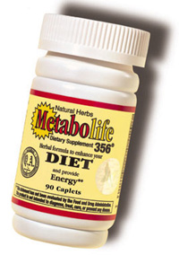
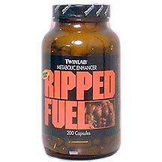
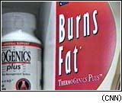
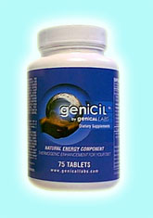
Supplements
Many weight loss and bodybuilding supplements contain ephedrine

Slide 13
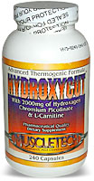

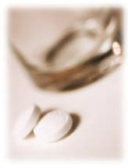
Supplement Composition
Fat burning supplements containing ephedrine also contain caffeine and aspirin-like ingredients
Pure ephedrine has shown to be less effective when taken alone
If taken in pure form,
Ephedrine is commonly
combined with a cup of
coffee and an aspirin

Slide 14
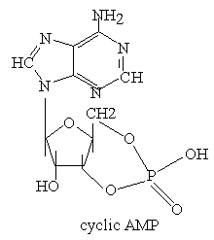
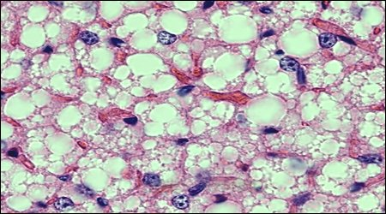
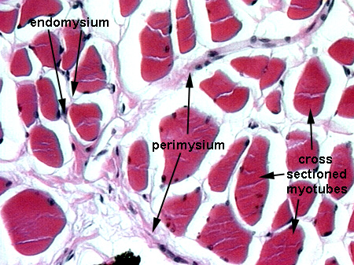
Supplement Chemistry
C-AMP
On the surface of fat and muscle cells there are b-receptors
B-receptors bind with b-agonists (adrenaline) causing chemical reactions that produce the chemical messenger C-AMP
C-AMP activates enzymes which induce lipolysis (fat breakdown) in fat cells and increase metabolism in muscle cells.
In supplements containing the ephedrine-caffeine-aspirin mix, ephedrine enhances b-agonist production. Caffeine inhibits the breakdown of C-AMP. Aspirin inhibits the reduction of b-agonist production.
Fat cells
Muscle cells

Slide 15

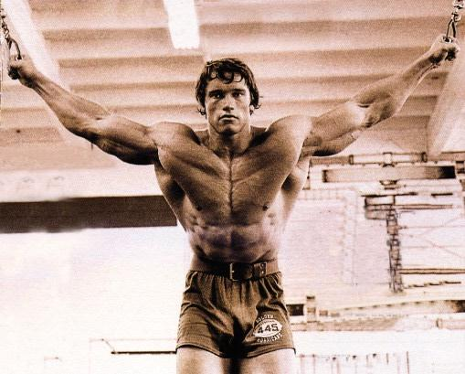
Benefits of Modern Ephedrine Use
Helps to retain muscle during weight loss
Maintains levels of HDL cholesterol
May reduce the risk of cardiovascular disease
No signs of long term toxicity
May increase life expectancy in women

Slide 16
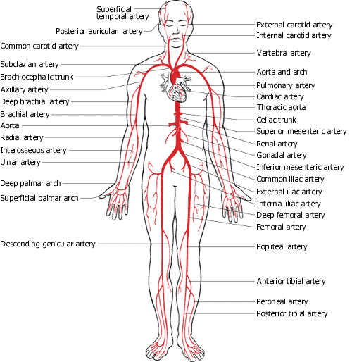
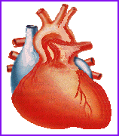
Side Effects
Abnormally high blood pressure
Rapid, irregular heartbeat
Anxiety
Dizziness
Insomnia
Tremor
Rapid pulse
Sweating
Respiratory difficulties
Confusion
Hallucinations
Delirium
Convulsions.

Slide 17


Individual Cases
The New England Journal of medicine links at least 54 deaths to ephedrine
Since 1994 the FDA has had over 800 reported cases of side effects from ephedrine. 273 resulted in death
Death of NFL player Korey Stringer tied to ephedrine use.
Numerous college athlete deaths also linked
Athletic deaths linked
to ephedrine result from
rise in body temperature

Slide 18


Proposed FDA Guidelines
1. Product potency would be limited to less than 8 mg of ephedrine alkaloids per serving, and daily intake would be limited to less than 24 mg.
2. The product label would be required to include the statement "Do not use this product for more than 7 days."
3. The combination of ma huang with other stimulants, including caffeine, would be prohibited.
4. Labeling claims such as weight loss and body building that encourage long-term use would be prohibited.
5. For products with claims for short-term effects such as increased energy, the product label must include the warning: "Taking more than the recommended serving may result in heart attack, stroke, seizure or death."

Slide 19
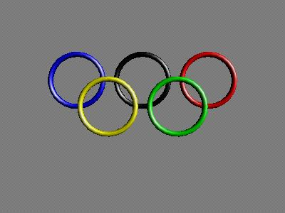

Regulations
Banned by the Olympic Committee, NFL & NCAA
Pending decision in several states, illegal in Nevada
Banned in sanctioned powerlifting events
FDA unsuccessfully tried to ban ephedrine in 1997

Slide 20

Conclusion
Ephedrine should be used intelligently and with caution
Consult a doctor before starting supplementation

