Slide 1
Definition: Organic Compound which is :
With limited distribution in nature.
Present in; Plant, Fungi, Bacteria, Marine
It has physiological action or Poisonous effect.
Biosynthetic pathway amino acid.
Hagnauer system of classification:
True alkaloids.
Proto alkaloids.
Pseudo alkaloids

Slide 2
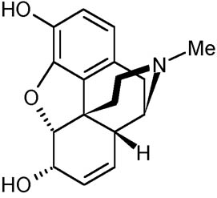
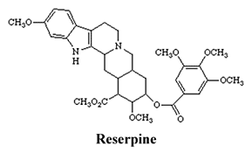
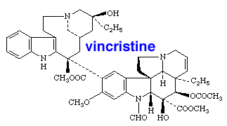
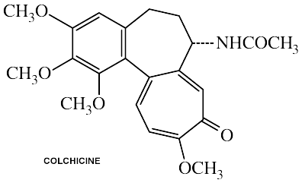
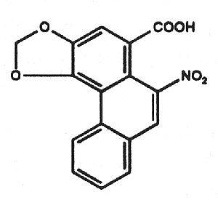
Morphine
Aristolochic acid

Slide 3
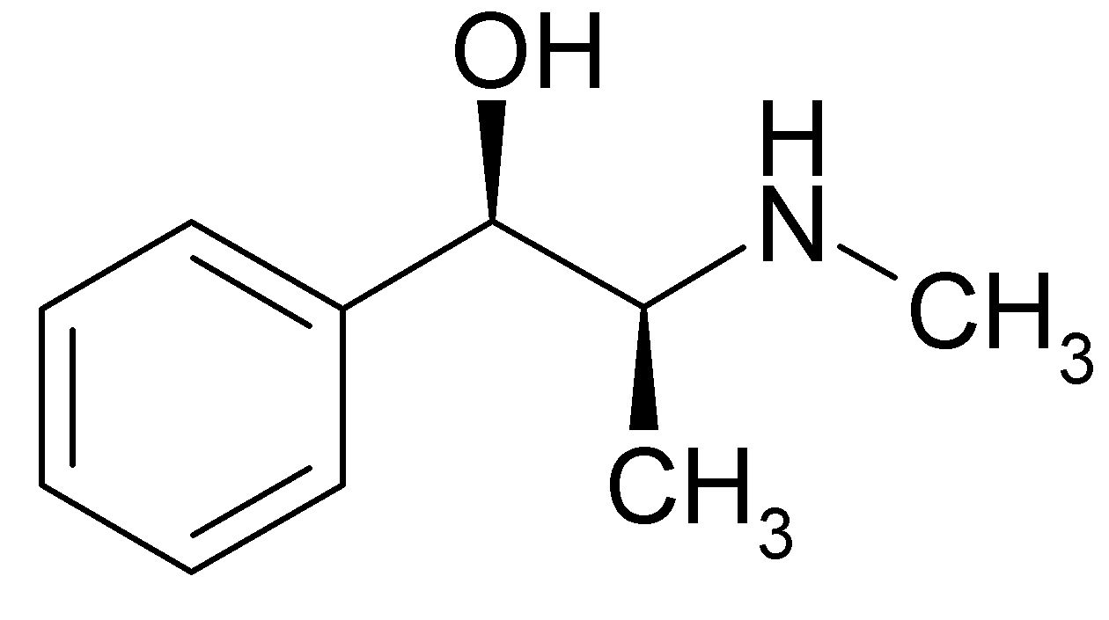
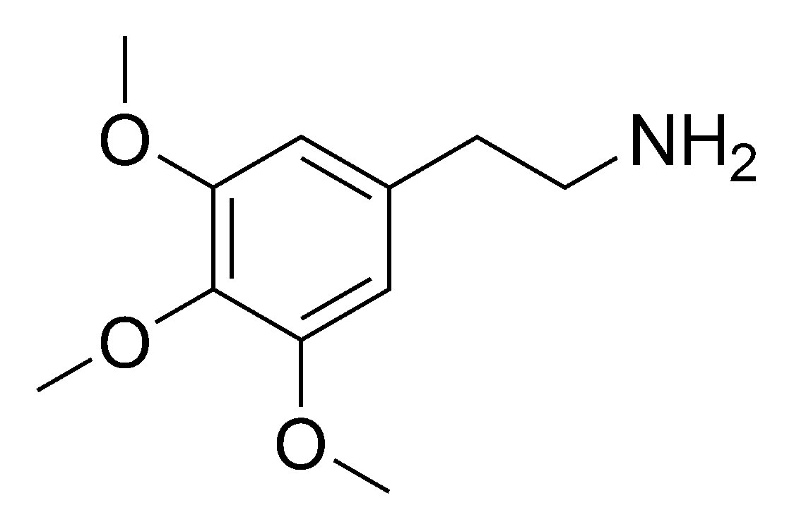
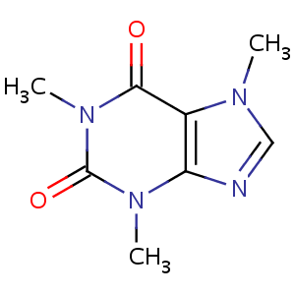
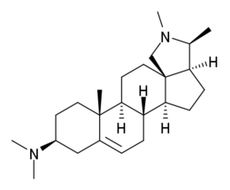
Proto alkaloids:
Ephedrine
Mescaline
Conessine
Caffeine

Slide 4
Nomenclature:
-It according to;
Genus e.g. Atropine.
Species e.g. Cochin.
Physiological .activity e.g. Morphine.
Discoverer e.g. pellertreine.
It should generally end with suffix: ~ine

Slide 5
-Chemical properties of alkaloids:
-Present in the Plant as-
Salt, ester, N-oxide, quaternary compound.)
Generally very toxic compound.
-Have bitter taste.
-unstable compound in (Heat, Light, pH changes ”some of”

Slide 6
-Physicochemical properties:
-Solid crystalline compound (exception are: coniine and Nicotine are liquid (It doesn't have Oxygen in their structure).
-Colorless compound (exception are berberine (yellow), Betaine (red).
-Sharp melting Point because it’s pure compound in crystal form.
-Can be either 1º, 2º, 3º or 4⁰ alkaloid:
-Basicity depends on availability of lone pair of electrons:
1. Electron donating or electron withdrawing neighbors.
2. Type of hybridization.
3. Aromaticity.

Slide 7
-Detection of alkaloid:-
-Wagner's test: (I₂/kI):Reddish brown precipitate .
-Mayer’s: (HgCl₂ Creamy precipitate with True alkaloid.
-Hagger's test: (Picric acid) Yellow precipitate with True alkaloid.
-Dragendroff: (Potassium Bismuth Iodide) Reddish Brown precipitate .
-Tannic acid solution: different alkaloid colored
precipitate .

Slide 8
Extraction:
-The extraction is fractional extraction (From less Polar to more Polar).
-Defeating by non polar solvent (Petroleum Ether, benzene, alkane,….) To get red of Chlorophyll, Wax, Volatile oil, Fixed oil.
-Filtration, For marc use methanol or ethanol 95%
Evaporate by rotary evaporator (to Concentrate)
-Add Tartaric acid 2% and Ethyl acetate will separate into two layer:
-Organic layer (For week or neutral alkaloid )
-Aqueous layer (acidic layer, Tartaric acid) which have alkaloidal salt. To break the salt add NH3 or Sodium bicarbonate. then add ethyl acetate again so will it separate into two layer again:
Aqueous layer (Quaternary alkaloids 4º )
Organic layer (For basic alkaloid 1⁰,2º,3º)

Slide 9
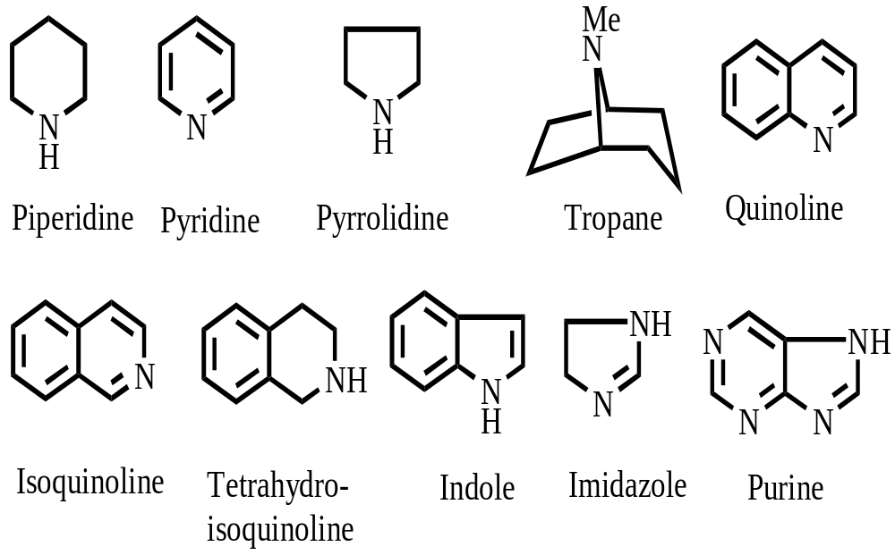
Classification of Alkaloids

Slide 10
Structural Characterization of Natural Products
How to obtain Molecular formula?
Elemental Analysis: Oxidation (Burning)
CO2, H2O, NO2, etc
Average mass:
H 1.008; C 12.011; N 14.007; O 15.999
e.g. Compound A
Analysis: 66.7% C; 7.9% H
O: (100-66.7-7.9)%= 25.4%
Formula: 66.7/12.011: 7.9/1.008: 25.4/15.999
= 5.553: 7.837: 1.5876= 3.5: 4.94: 1~ 7: 10: 2 => C7H10O2
MS: 126.067

Slide 11
High Resolution Mass Spectrum
Electron Impact (HR-EI-MS)
Fast Atom Bombardment (HR-FAB-MS)
Accurate Mass:
H 1.0078; C 12.000; N 14.003; O 15.9949
How to distinguish CO and C2H4?
CO: 27.9949; C2H4: 28.0312
Structural Fragments: Mass fragmentation (MS)
NMR Spectra for estimating the composition of C and H.
BB Decoupled CMR for all types of carbon signals (1o , 2o , 3o , 4o )
DEPT-90 for CH (methine);
DEPT-135:
CH/CH3 (methyl) (positive or upward);
CH2 (methylene) (negative or downward)

Slide 12
How to verify Functional Groups?
.IR:
carbonyl, amide, ester, substituted phenyl, hydroxy, amine, alkyl, ether, etc
Optical property
Specific optical rotation: similar skeleton and conformation
Circular dichroic spectroscopy (CD): absolute stereochemistry

Slide 13
How to identify Chromophores?
Chromophore: UV-VIS spectrum
n-p* and p-p* electron transition
Enone: p-p* 215 nm
Diene: homoannular 253 nm
Heteroannular 214 nm
Aromatic componds: p-p*
Carbonyl: n-p* (low e)
Substitution effect

Slide 14
Hyphenated Techniques
GC-MS: gas chromatography-Mass spectroscopy
LC-MS: liquid chromatography-Mass spectroscopy
LC-NMR: LC-nuclear magnetic resonance
LC-SPE-NMR: LC-solid phase extract- NMR
LC-MS-NMR
CE-NMR: capillary electrophoresis- NMR

Slide 15
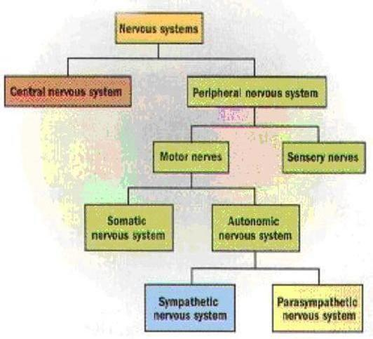

Slide 16
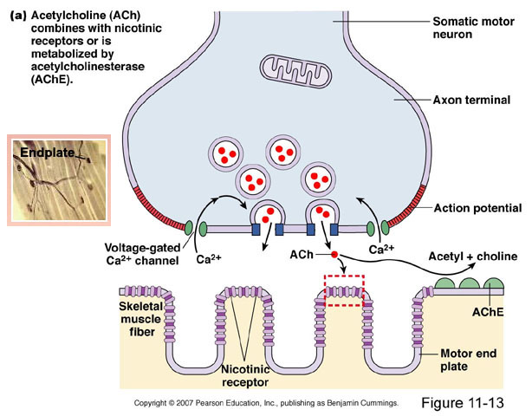

Slide 17
Tropane alkaloids

Slide 18
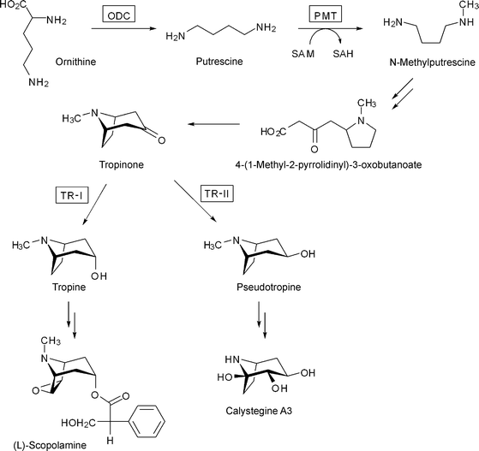

Slide 19
1- Solanaceous Tropane Alkaloids
Occurrence:
Atropa, Datura, Hyoscyamus, Duboisia spp.
Main Alkaloids are:
1- Atropine.
2- Hyoscyamine.
3. Hyoscine (Scopolamine).

Slide 20
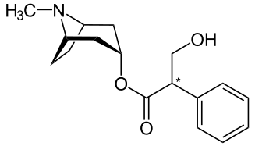
Hyoscyamine is the major natural alkaloid with negative optical rotation (l- form).
During extraction hyoscyamine racemizes to the optically inactive dl Atropine.
Both alkaloids composed of tropine base and tropic acid.
Hyoscyamine

Slide 21
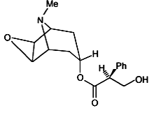
Hyoscine (Scopolamine)
Hyoscine is an ester of l-tropic acid with scopoline base.
Hyoscine is a syrupy liquid.
Hyoscine

Slide 22
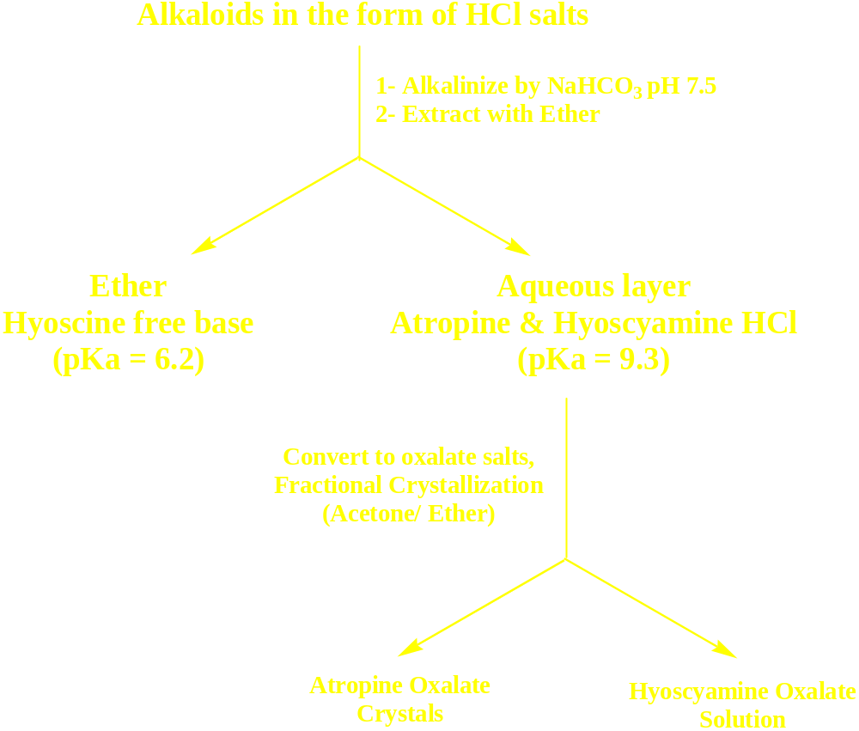

Slide 23
Vitali-Morin’s test:
Solid alkaloid + fuming HNO3 → Evaporate to dryness, dissolve residue in acetoVitali-Morin’s test:
Solid alkaloid + fuming HNO3 → Evaporate to dryness, dissolve residue in acetone, add methanolic solution of KOH → Violet colour.
P-dimethylaminobenzaldehyde:
Alkaloid + reagent in porcelain dish and heat on boiling water path → Intense Red Colour → Cherry Red after cooling.
Gerrard’s test:
Alkaloid + 2% HgCl2 in 50% Ethanol →
Red colour Atropine
Red after warming Hyoscyamine
White ppt Hyoscine

Slide 24
Pharmacological actions and uses:
The three Alkaloids are anticholinergic agents:
-Decrease saliva and GIT secretions so used preoperative.
-Decrease motility of smooth muscles so used as antispasmodics.
-Stimulate respiratory system.
-A mydriatic (causes dilatation of the eye pupil).
-An antidote to organophosphorus insecticides.
-Hyoscine has more central effect so it is sedative and hypnotic.
-Hyoscine is mainly used as antiemetic.

Slide 25
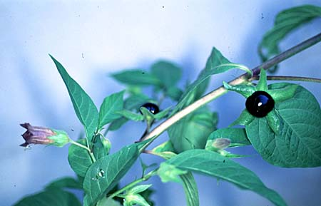
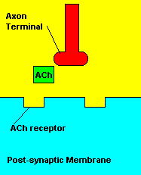
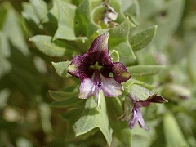
Atropa belladona Solanaceae

Slide 26
Cocaine alkaloids
Occurrence:
Coca leaves contain about 2% total alkaloids
It is the major Alkaloid in Coca leaves.
Cocaine is diester Alkaloid.
Heating at 160 0C in conc. HCl leads to hydrolyses of cacaine to MeOH, Benzoic acid and Ecogonine base.
Main Alkaloids are:
1- Cocaine.
2- Cinnamylcocaine.
3. a- truxilline.
The base for Coca Alakloid is called “Ecogonine”

Slide 27
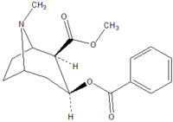
Uses:
Cocaine was used as local anesthetic.
Cocaine has a CNS stimulant activity so is one of the widely abused drugs.
Cocaine

Slide 28
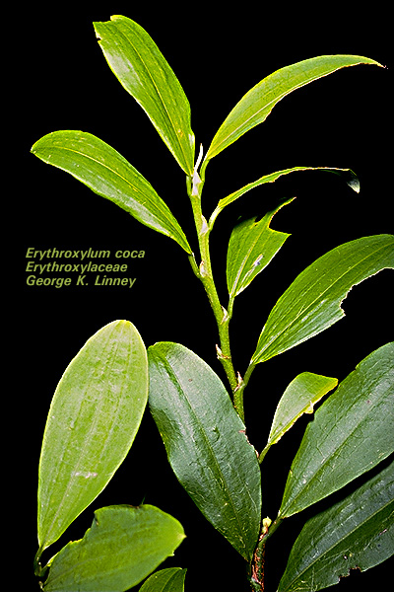
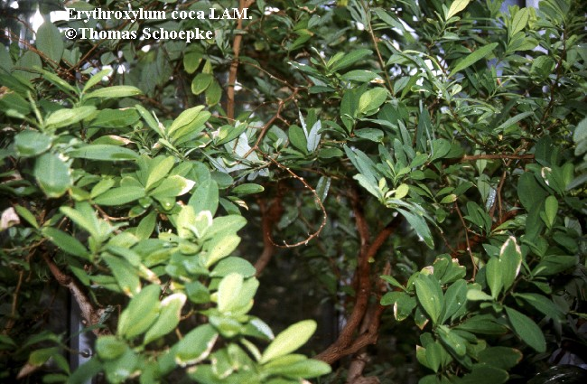

Slide 29
Quinoline alkaloids

Slide 30
Quinoline alkaloid:
Cinchona Alkaloid :
    It diverting to 4 main compound:
  Quinine. Cinchonine.
  Cinchonidine. Quinidine
Biosynthetic origin:
Botanical source: dried barks
of (Cinchona succirubra Rubeaceae).
Pharmacological effect:
Antimalaria antiarhythmitic
    Detection under U.V 366nm blue fluorescent with
    sulfuric acid.
    .

Slide 31
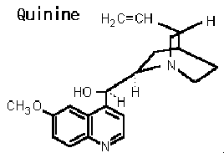
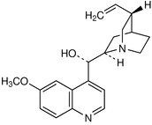
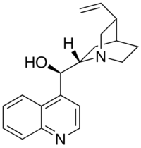
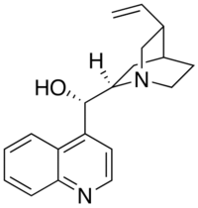
Quinidine
Cinchonidine
Cinchonine

Slide 32
Pyridine piperidine alkaloids

Slide 33
Pyridine alkaloids and Nicotinic acid derivatives:
Biosynthetic origin:
1)- Nicotine: very toxic compound
-Botanical source: leaves Nicotiana tobacum Solanaceae
-Pharmacological effect:
-It works on nicotinic receptor (start by stimulation then inhibition.
-Highly hydrophobic, so can cross blood brain barrier.
    Uses as: Vehicle on CNS (stimulant), dental carries, Alzheimer ????
    It's liquid compound, yellowish.
    Oxidized by light and will form brown color.
    Toxicity: Cancer which give nitrous amine (very nuclephilic) lead to change in DNA structure, Pulmonary and cardiac disease, Effect in hepatic system lead to increase metabolite
    .

Slide 34
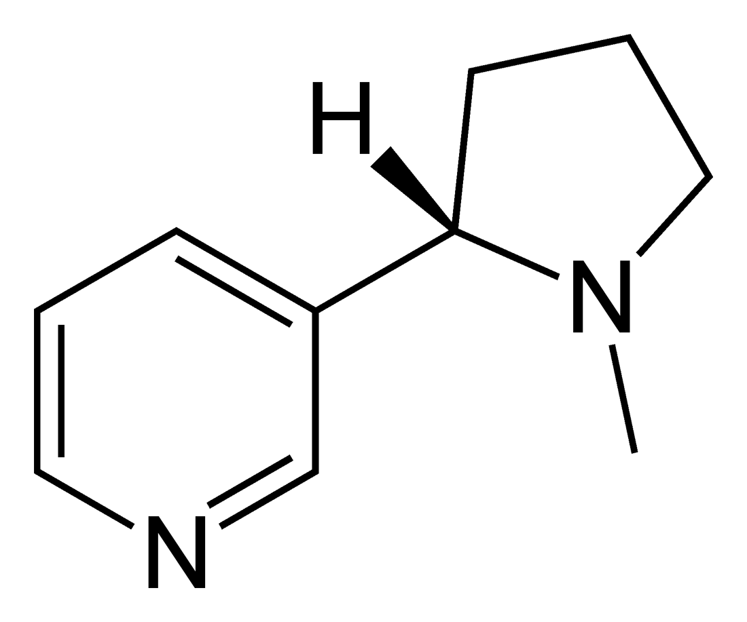
Nicotine

Slide 35
Piperdine Alkaloid :
(Lobelia).
Biosynthetic origin:
Botanical sours form Lobelia inflata Lobeliaece.
Pharmacological effect:
    CNS Stimulant (cholinergic agonist).
    Uses: For premature babies (has Problem in respiration) so give cortisone to dilution lung.
    High dose cause tonic spasm for skeletal and smooth muscle.

Slide 36

Lobeline

Slide 37
Arecoline Alkaloid :
    Botanical sours are seed of Areca catechu Arecaceae.
    Pharmacological action: Parasympathomimetic work on messianic receptor and in high dose work on nicotinic receptor
    Uses:, Alzheimer disease, has Psychocyco active effect “Cigarette as cocaine in malaise”.
    It causes redness of mouth, teeth an saliva, when use for long time cause buccal cancer.

Slide 38
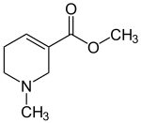
Arecoline

Slide 39
Imidazole alkaloids

Slide 40
Imidazole Alkaloid
Biosynthetic origin:
Examples: Pilocarpine
Botanical sours are Pilocarpus jaborandi Rutaceae.
Pharmacological effect: Parasympathomimetic
    Uses: in Glaucoma (wide and narrow angle Glaucoma) and myosis of the eye.
    Keep away from light.
    Side effect: bronco contraction, brady cardiac, not first choice for glaucoma because headache and increase in lacrimation.

Slide 41
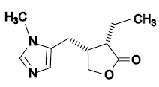
Imidazole alkaloid

Slide 42
Indole alkaloids

Slide 43
Indole alkaloid:
( Periwincle, Rauwolfia, Nux-vomica, physostigma, Ergot)
Biosynthetic origin:
    Ergot: fungus grow on Rye and Cereals.
- Botanical sours are fungus of Claceveceps purpurea Clavecpetaceae
Sant antony fire→ inflammation → redness then vasoconstriction (cyanosis) → loss limbs and extremities the death.
Convulsion and delirium.

Slide 44
    Erogtamine:
    It has low D.O.A, introduction of of double bound (9-10) lead to increase D.O.A.
    Ergotamine and Ergometrine:
    & dopamine and Serotonin.
    & Lysergic acid (LSD)
    Uses of Ergotamine:
    Migraine (at low dose has agonist adrenergic).
Make vasoconstriction.
Oxytocic (stimulate or induce labor).
Postpartum hemorrhage (vasoconstriction).

Slide 45
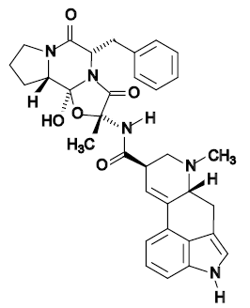
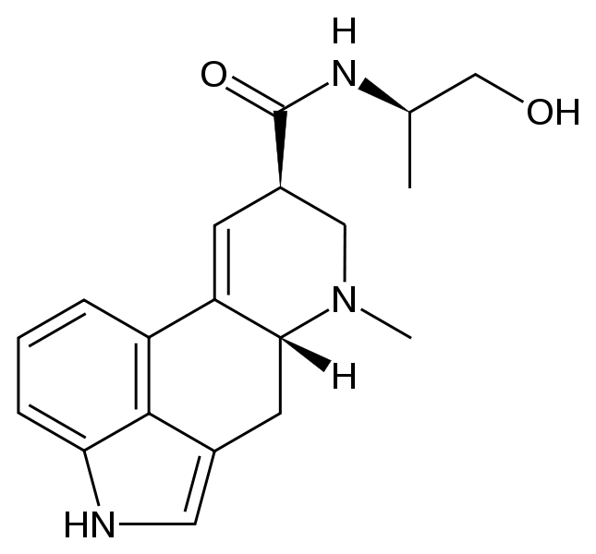
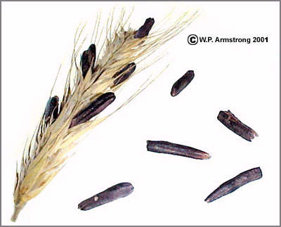
Ergotamine
Ergometrine

Slide 46
    Strychnine and Brucine:
        Nux-vomica
        Botanical source:
        Seed of Strychnus nux-vomica Loganiaceae.
        Very toxic compound which block Neurotransmission from the spinal cord to the brain.
        Used only for study the sympathetic and parasympathetic action of drug.
        Detection :
    Nitric acid: strychnine will give yellow PPT.
    Brucine will give red PPT.
    Chemical microscope:

Slide 47
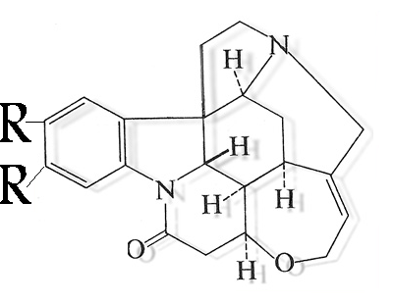
R= H: Strychnine
R= OCH3: Brucine

Slide 48
: Physostigmine and Neostigmine Alkaloid :
Biosynthetic origin:
Botanical source Botanical sours are seed of Physostigma vensum Fabaceae.
    Common name (Calaber been).
    :Pharmacological effect:
Irreversible chorine esterase inhibitor (parasympathomimmtic).
    Used in acute open angle glaucoma will increase the contraction of ciliary's
    muscle and increase excretion of aqueous hummer and will decrease IOP.
    Give I.V or I.M for it toxicity, has unstable compound (ester and amide).

Slide 49
Neostgmine: not indol alkaloid.
    action normalize contraction of striated muscle by facilities nerve imbuls.
    Has positive charge (4° alkaloid).
    Soluble in water so can use be given S.C.
    Used:
For diagnosis of myasthenia gravis.
Post operation Bladder surgery.
    Side effect: Miosis, Convolution, Respiratory arrest, Brady cardiac.

Slide 50
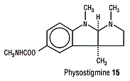
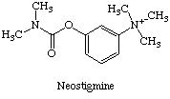

Slide 51
Vicristine and vinblastine:
    Botanical sours are Arial part of Catharanthus roseus (Vinca rosa) Apocynaceae.
    It's cytotoxic used for hodgkins and non hodgkins disease.
Biosynthetic origin:
Pharmacological effect:
    Used: Anticancer single or combination therapy.
    M.O.A: bind to protein (tubulin) which inhibits mitosis in microtubules.
    Side effect: Alopecia, Gastrointestinal (Nausea, vomiting, ulcer). Aspermia

Slide 52
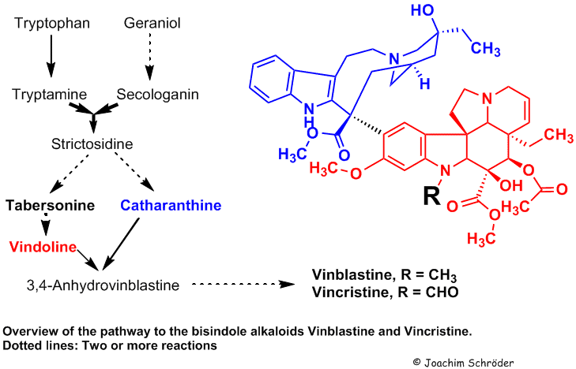

Slide 53
Rauwlfia Alkaloid:
    Botanical sours are Root of Rauwlfia serpentine Apocyneceae.
    Examples: Reserpine and Rescinnamine.
    M.O.A: anti hypertensive, depletion of catecholamine peripherally (decrease ephedrine and nor ephedrine), depletion of central neurotransmitter(mainly serotonin so neuroleptic )
    Unstable compound ester linkage
Biosynthetic origin:
Botanical source:
Pharmacological effect:
Hydrolytic product for both reserpine:
Trimethoxybenzoic acid + Methanol + Reserpic acid
and ressinamine
Trimethoxycinnamic acid + Methanol + reserpic acid.

Slide 54
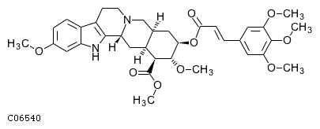
Ressenamine

Slide 55
Isoquinoline alkaloids

Slide 56
Morphinane type alkaloids:
Opium alkloaid:
Botanical source:
dried latex of Pappaver somniferum papaveraceae
Pharmacological action:
Medecinal uses :
Morphine:
Codeine:
Thebaine:
Papaverine:
Heroin:
Noscapine:

Slide 57
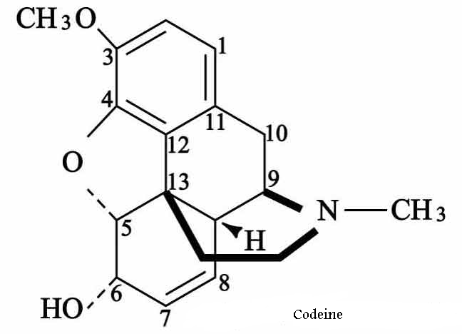
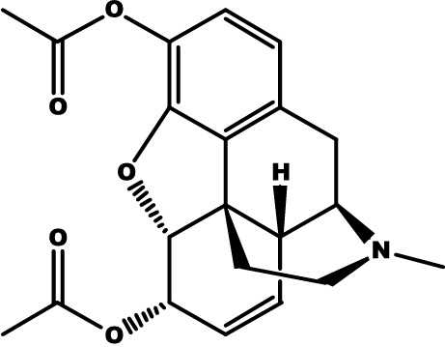
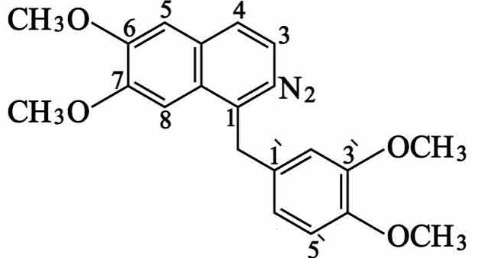
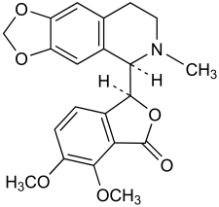
Codeine
Heroine
Morphine
Pappaverine
Thebaine:
6-methoxy codeine
Noscapine
(Narcotine)

Slide 58
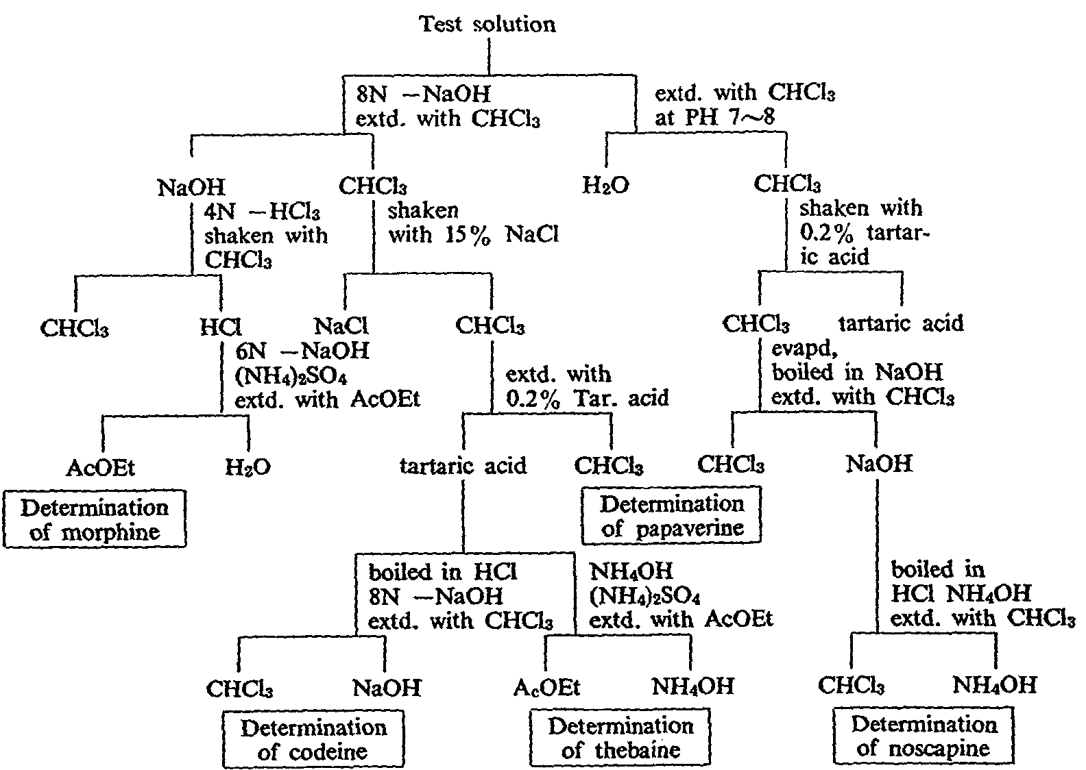

Slide 59
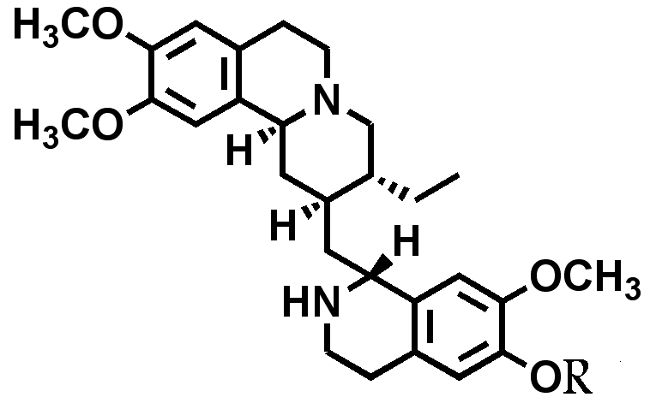
Ipecacuahna alkaloids:
Rhizome of Cephalis ipecacuhana Rubiaceae
Emetine alkaloid:
Cephaline alkaloid:
R= CH₃: Emetine
R= H: Cepheline

Slide 60
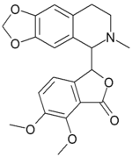
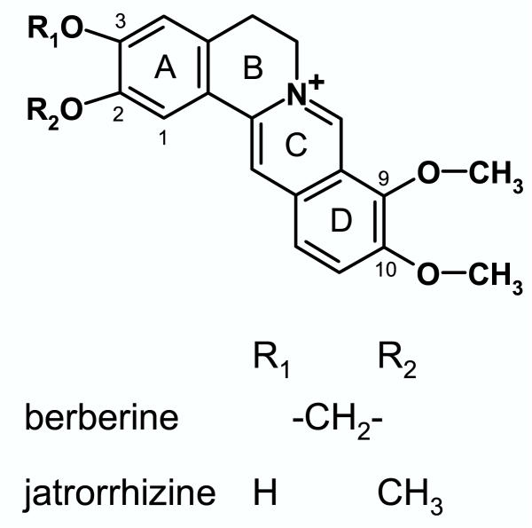
Goldenseal:
Root and rhizomes Hydrastis canadensis
Ranunculaceae
Hydrastine

Slide 61
Curare alkaloids:
Botanical source:
Action uses:
Synthetic analogue:

Slide 62
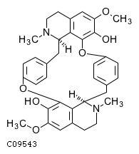
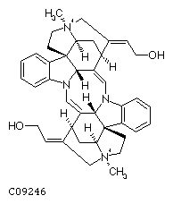
Toxiferine
Tubucurarine

Slide 63
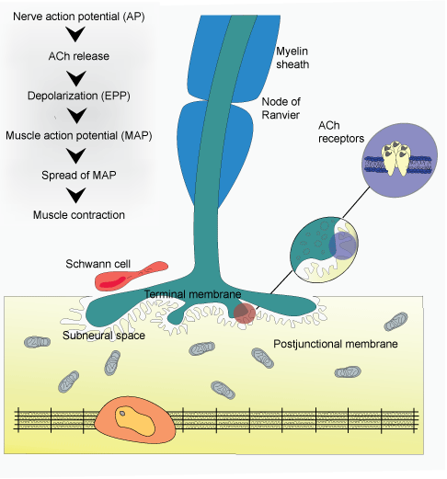

Slide 64
Proto alkaloids

Slide 65
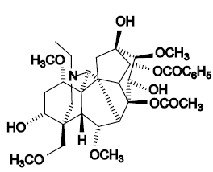
Aconite root
Aconitum napellus Ranunculaceae
Aconitine

Slide 66
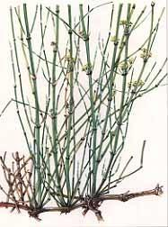

Proto alkaloids:
Ephedra sinica Ephedraceae

Slide 67


Slide 68

Colchicum autumnale Liliaceae
Pharmacological action:
Uses:
Colchicine

Slide 69
Pseudo Alkaloids

Slide 70


Slide 71


Pseudo alkaloids
Caffeine
Theobromine
Thyophyline

