Slide 1
Regression testing
Monkey Testing?
Frust

Slide 2
Test Automation Frameworks and tools

Slide 3





Why Test Automation Framework?
There has to be common way to communicate with test environment. Test Automation Framework provides it
Test Team communicates with
common language
Test Automation Framework provides a way to
Control testing environment with common way

Slide 4
STAF as foundation for test automation
The Software Testing Automation Framework (STAF) is an open source, multi-platform, multi-language framework designed around the idea of reusable components, called services
STAF removes the tedium of building an automation infrastructure, thus enabling you to focus on building your automation solution
The STAF framework provides the foundation upon which to build higher level solutions, and provides a pluggable approach supported across a large variety of platforms and languages.
http://staf.sourceforge.net/

Slide 5
Test Environment Example
TED = Test Environment Device
Test Environment Devices are ”lego” bricks of for test scenario building.
TED’s can be used as service intefaces to DUT (Design/Device under test)
TED service has to be programmed to use DUT API/interface
Test Automation needs support for virtual ”eyes” and ”arms”. TED’s can be also used such a way
All TED ’s are communicating using STAF Network

Slide 6


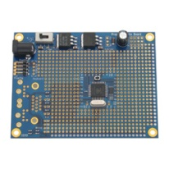
TED ”virtual hand” ☺
Service examples:
Press Key
Connect Power
Read Led State
Rasberry PI?
HW interface
STAF Service
http://www.raspberrypi.org/

Slide 7

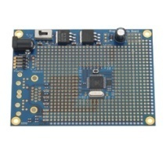

Using STAF/STAX in PMR testing
Observer TED
Web Cam SW
STAF Service
DUT TED
Host PC/Virtual machine
STAF Service Network
Virtual Phone
STAF Service
STAX
STAF Service
Host PC/Virtual machine
Contoller TED
HW control
STAF Service
Host PC/Virtual machine
Infrastructure TED
Base Station
STAF Service
Host PC/Virtual machine

Slide 8
#Presettings
Case_Passed=False
PMRRadioA.Select DMO_Mode
PMRRadioB.Select DMO_Mode
PMRRadioA.Select DMO_Channel( 10)
PMRRadioB.Select DMO_Channel (10)
#Case start
PMRRadioB ResetDMOCallCounter
PMRRadioB CountDMOCall
Do while call_count < 100
{
PMRRadioB MakeDMOCall(5, 5)
call_count ++
}
If (PMRRadioB .CallCounter = 100)
{
Case_Passed= True
}
# Case End
DUT TED
STAX
STAF Service
STAF Service Network
Virtual machine
Virtual Phone
STAF Service
Host PC
STAX executes test script using PMRRadio virtual phone service interface
Virtual phone implementation is DUT specific

Slide 9
Ideas?
There is need for hardware to control keypad with machine
It’s just a one small part of whole test automation
How to control screen? You will need another test tool?

