Slide 2
Error Management Course Agenda
Learn basic concepts to under stand error management process and work
Requirement engineering and management
Agile methods and testing
Test design & execution & error reporting
Test Planning & Management
Test Automation
Continous Integration & Testing
Understand how and why testing is important

Slide 3
This material if for general training for Test Design and management
Material is more supportive in class room
Material will be updated during courses
FreeNest Portable Project Platform is used to demonstrate things only in practice. This is not limiting usage for material for other training environments (I hope ☺)

Slide 4
Verification & Validation
Validation = Are we building the right product?
Verification = Are we building the product right?

Slide 5

Test Execution and results
Verdict ? PASS/FAIL
Test Engineer
TOOLS
SUT/DUT
Log files
PASS
?
FAIL
TEST CASE ID XXXXX
Step1
Step2
Step3.
Step4.
Executes
Comments
Images/videos
ENVIRONMENT/
EMULATOR
SUT = System Under Test
DUT = Device Under Test

Slide 6

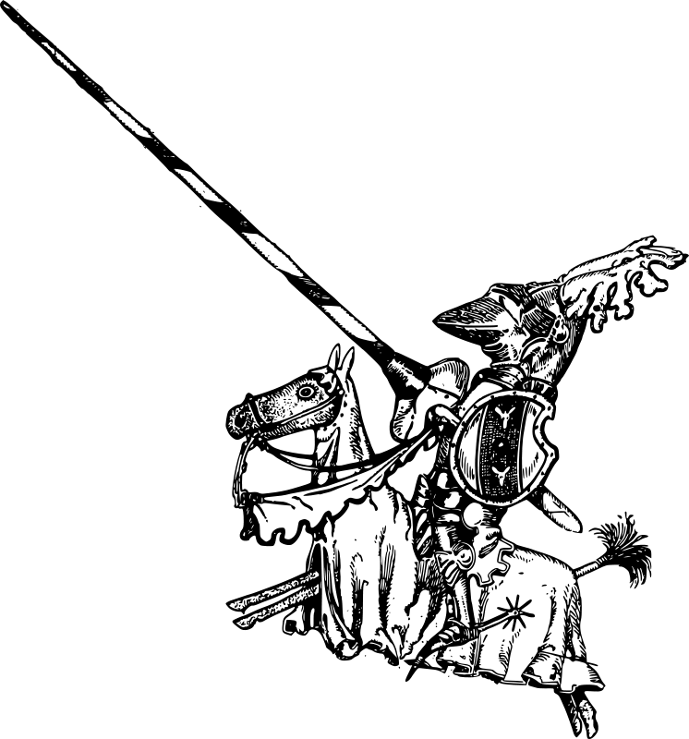
Bug ?

Slide 7
Anomaly / Poikkeama
Mikä tahansa tilanne, joka poikkeaa odotuksista, määrityksistä,
suunnitteluasiakirjoista, käyttäjävaatimuksista, standardeista yms. tai jonkun näkemyksestä tai aikaisemmista kokemuksista.
Poikkeamia voi löytyä katselmoinnin, testauksen, analyysin tai käännöksen aikana tai vasta ohjelmistotuotteen käytön aikana.
Poikkeamia voi esiintyä myös tuotteeseen liittyvissä asiakirjoissa.
Muut käsitteet vika [defect] , poikkeama [deviation], virhe [error], vika [fault], häiriö [failure], havainto ja ongelma [problem].

Slide 8
Defect / Vika (ISTQB)
A flaw in a component or system that can cause the component or system to fail to perform its required function, e.g. an incorrect statement or data definition. A defect, if encountered during executeon, may cause a failure of the component or system
Bug = Defect

Slide 9
Concepts
Failure – Fault – Defect - Bug - Incident – Failure - Error
Example forum thread:
http://www.allinterview.com/showanswers/36257.html
Take a look for ISTQB syllabus:

Slide 10
Worst Bugs ?
http://en.wikipedia.org/wiki/List_of_software_bugs

Slide 11
Test Case execution and error reporting?
INCIDENT 1
INCIDENT 2
EXECUTE TEST !
INCIDENT 3
TEST CASE ID XXXXX
Step1
Step2
Step3.
Step4.
Collects notes…
Test Engineer
Can lead to
Writes report and provides evidences
Bug/Defect
Report
Database
TARGET under
test
?

Slide 12
Sources for error report
N x Incidents
Customer
Feedback /
Field Testing
Testing Process
Error Report
Change
Request?
CRM

Slide 13
Change Management
Sometimes founded defect during testing can lead to change requests
Feature ?
Not Clear
Requirements
Change Request?
Bug?

Slide 14
Error/Bug/Defect Report
Defect/Burg/Error ID
Reporter
Time
Founded where
Which way?
Test Case
Test Setup/Configuration
Describe scenario?
Attachements? Picture/Log/etc..
Error
Database
Id1
Id2
Id3
Id4
Id5

Slide 15
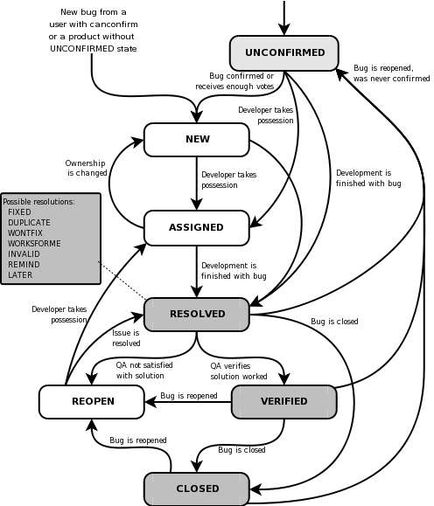
Management Process

Slide 16

Issue/Defect/Bug metadata
Bug XYZ
Status?
New, Fixed, Tested, Closed
Origin/location?
Priority?
Severity?
Target?

Slide 17
Error/Defect/Issue/Bug Management
http://www.glpi-project.org/?lang=en
Bug Database

Slide 18
Bugs and product
UI
Interfaces
Bug
GENERAL
Bug
Bug
Bug
Bug
Bug
Bug
Bug
Bug
Bug
Bug
CORE
DATABASE
Bug
Bug

Slide 19
Duplicates… and root cause bug
Bug
Root Cause Bug
Bug
Bug
Bug
Bug

Slide 20
Finding and Fixing bugs
Defects Found
Future ?
Defects Found
Fix
Defects Found
Defect Found
Defects Found
Defects Found
Fix
Fix
Fix
REL 0.1
Fix
REL 0.2
Fix
REL 0.5
REL 1.0
Week 0
Week 26
Week 52

Slide 21
Release & Configuration Management and Bugs ?
Version 0.1
Version 0.2
Version 0.3
Version 0.4
Trunk
Release 1.0
Features
Customer 1
Version 0.2.1
Version 0.2.2
Version 0.2.3
Release 1.0
Features
Customer 1
SAME BUG ?
Version 0.2.2.1
Version 0.2.2.2
Version 0.2.2.3
Features

Slide 22
Common Issue/Bug/Defect Trackers
Serveral open source and commersial versions on market
http://en.wikipedia.org/wiki/Comparison_of_issue_tracking_systems
You should know JIRA ☺ https://www.atlassian.com/software/jira
http://www.softwaretestingclass.com/top-10-free-open-source-bug-tracking-systems/

Slide 23
Test & Error Management
Feature
Implementation
TestCase
PASS
TestCase
TestCase
TestCase
TestCase
FAIL
Bug Report
Test Plan/Suite
SourceCode
Version
Control
Test
Management
Database
Error
Database
VC + Implementation
TESTLINK
BUGZILLA

Slide 24

Mantis
http://www.mantisbt.org/

Slide 25

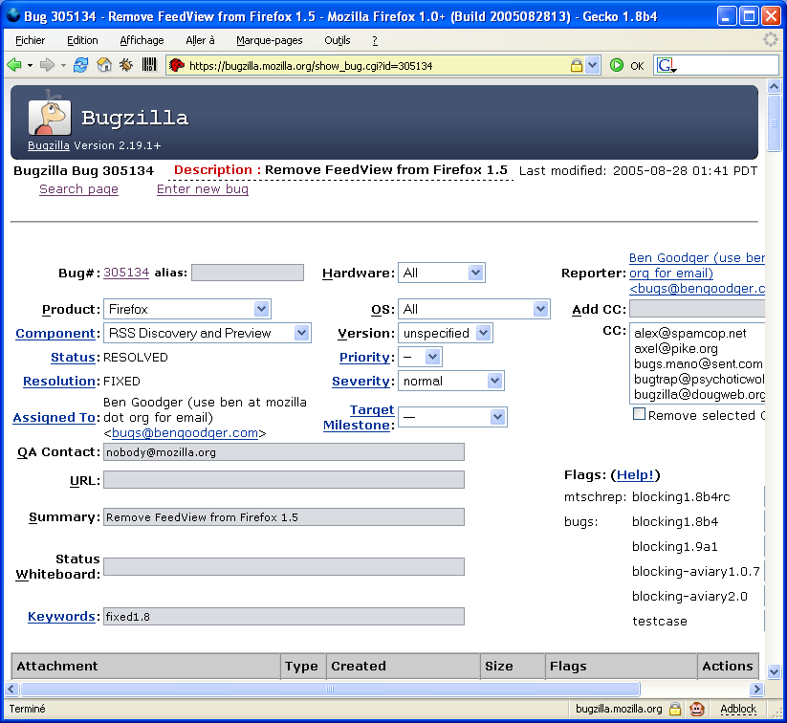
Bugzilla
http://www.bugzilla.org/

Slide 26
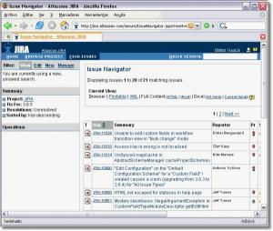
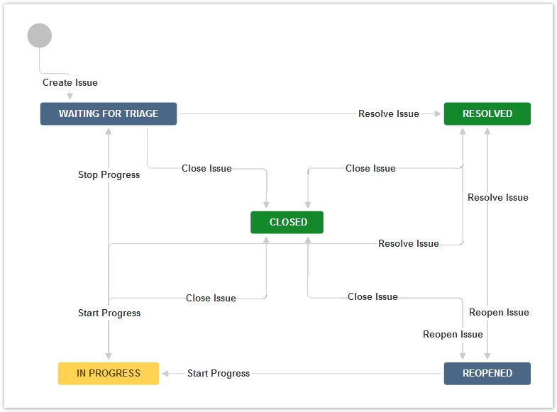
Jira
https://confluence.atlassian.com/display/JIRA/JIRA+Documentation

Slide 27
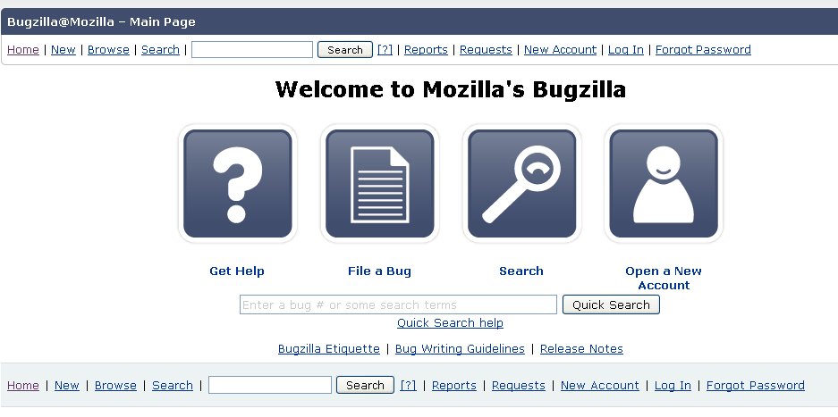
Bugzilla as example
What is Bugzilla?
Bugzilla is a "Defect Tracking System" or "Bug-Tracking System". Defect Tracking Systems allow individual or groups of developers to keep track of outstanding bugs in their product effectively. Most commercial defect-tracking software vendors charge enormous licensing fees. Despite being "free", Bugzilla has many features its expensive counterparts lack. Consequently, Bugzilla has quickly become a favorite of thousands of organizations across the globe.
http://www.bugzilla.org/
http://www.bugzilla.org/installation-list/

Slide 28
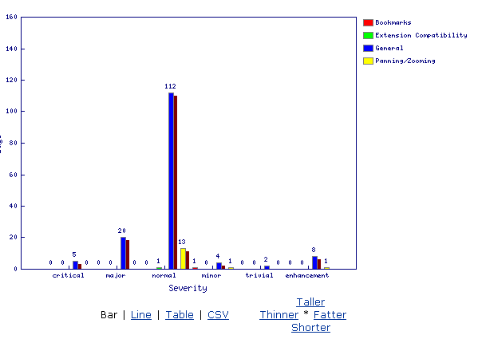
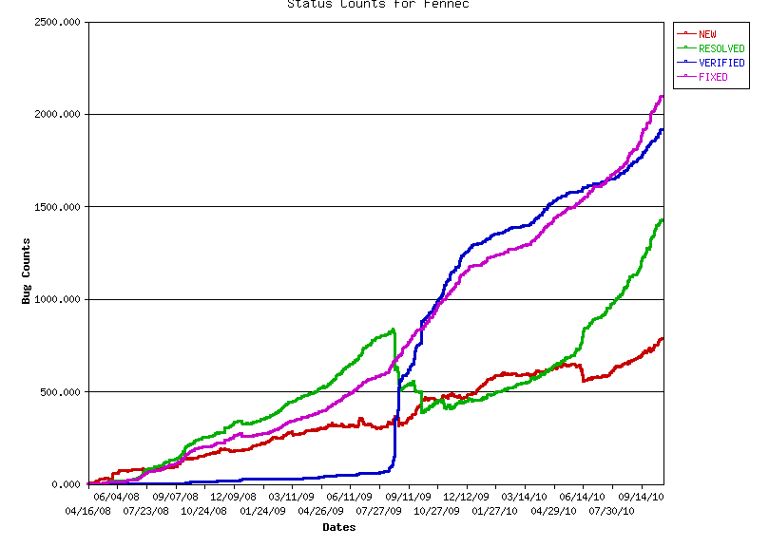
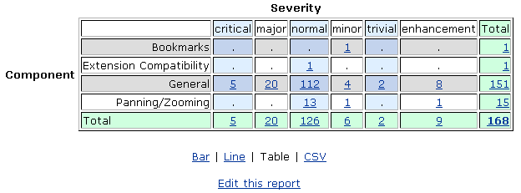
Reporting and metrics

Slide 29
CMMI Process Framework
CMMI – covers ”error management” in several process areas
SP3.2 Analyze Verification results
Typical Work Products: Trouble reports
- Analyze the verificationd ata on defects
- Record all results of the analysis in a report
- Provide infromation on how defects can be resolved (including verfiocation methods, criteria, and verification environment) and initiate corrective action
Project Monitoring and Control
SG2 Manage Corrective Action to Closure
SP2.1 Analyze Issues
SP2.2 Take corrective Action
SP2.3 Manage corrective Action
SG2 Validate Product or Product Components
SP2.2 Analyze Validation Results. Change request management & Configuration Management process
SG2 Track and Control Changes
SP2.1 Track Change Requests
SP2.2 Control Configuration Items

Slide 30
SW Project vs Open Source
Open Source – Crowd Sourcing
SW Relase tested without coordination by group of volunteers
Release tested by customer
Field Testing
Test Group

Slide 31
Release Management
http://en.wikipedia.org/wiki/Configuration_management
http://en.wikipedia.org/wiki/Release_management

Slide 32

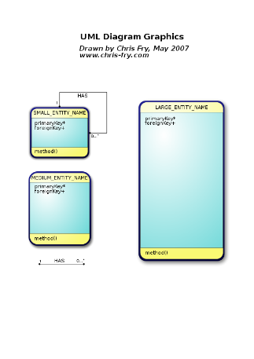
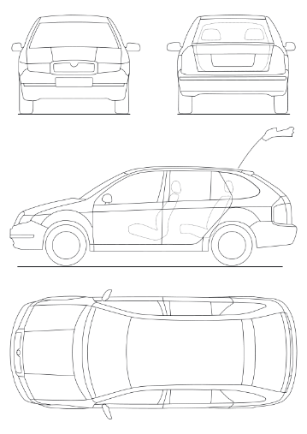
Test Designer ?
Desiger for test cases (has substance knowledge)
Test Case
Step 1
Step 2
Step 3
Defines

Slide 33
Tester ?
Executes testing
Creates reports and defect/bug/incident reports
Test Case
Step 1
Step 2
Step 3
PASS / FAIL ?
Any Bugs?
Executes

Slide 34

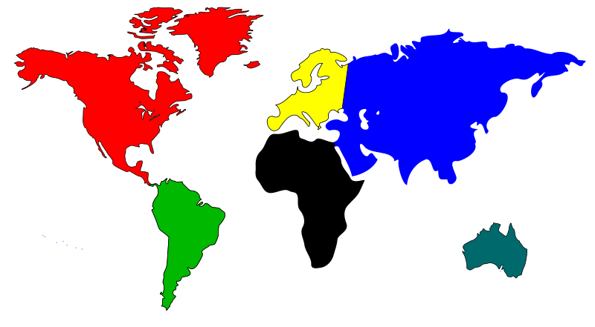
Test Manager ?
Has control ower testing process and resources
This role exists in large projects and product lines
Testing Strategy
Management
Master Test Planning

Slide 35
Test Management
Reporting
Executed Test case
Not executed
Blocked
Who / Where / What?
Founded bugs

Slide 36
Test Engineer ?

Slide 37




Example Product verification & validation organization
Acceptance
Test Engineer
System Acceptance Testing
System
Test Engineer
Acceptance Testing
Test Manager
System Testing
Project Manager
Functional System Testing
Load, Stress,
performance
Designer/Coder
Integration
Test Engineer
Regression Testing
Test Automation
Engineer
Feature Unit/Integration Testing
Integration Testing
Component Integration Testing
Feature
Component
Validation
Unit Testing
Verification

Slide 38
Agile Team and testing
Developer / Tester
Acceptance
Test Engineer
Developer
Scrum Master
Product Owner

Slide 39
Large Agile organization

Slide 40
Testlink in brief
TESTLINK
Feature
Implementation
TestCase
TestCase
TestCase
Test Plan/Suite
Note
Verdict
Bug Report
FAIL
SourceCode
Version
Control
Database
Error
Database

Slide 41
What we can do with Testlink Tool

Slide 42
Agile methods and testing
We take branding seriously, The FreeNest Brand is our pride and joy.
It is the message we want to send to the developer teams, customers and stakeholders.
These guidelines must be followed in all FreeNest’s print and electronic communications, marketing and informing.
Documentation defines logo guidelines, typography and the use of colors.

Slide 43
Regression Testing
Testing of a previously tested program following modification to ensure that defects have not been introduced or uncovered in unchanged areas of the software, as a result of the changes made. It is performed when the software or its environment is Changed.
(ISTQB Syllabus)

Slide 44


Logo
The main logo consists of two elements, the leaf and the text laying horizontally.
You can also use the logo with the FreeNest text under the leaf, if you need. Don’t do this often, the main logo should be the horizontal one.

Slide 45


Logo
You can also use the logo with dark background and white text.
You can use the logo with the “Product Platform” text under the FreeNest if the logo itself does not open up in the context.

Slide 46
Logo
Do …
Don’t …
observe the free space around tho logo.
use the logo with black text when the background color is lite.
use the logo with white text when the background color is dark.
use white, black or neutral backgrounds.
respect our logos.
keep the logo readable.
squash or stretch the logo.
alter the proportion of the logo.
alter the layout of the logo.
put anything over the logo.
change the colors of the logo.

Slide 47
Brand colors
TMNT and Leaf Green are the main colors of the brand. You can find the colors from the FreeNest logos leaf. Logos typography has the color called 666. Use these green colors with light or dark background, but do not use TMNT color behind the logo.
TMNT
Hex: #5f8029
CMYK: C67 M30 Y100 K15
Leaf Green
Hex: #8ec03d
CMYK: C52 M0 Y90 K0

Slide 48
Brand colors
Kissa can be used as a background color for some elements. It must also be used as a text color if the background is gray (Toolbox for example).
Gandalf is meant to be used as a text color if the background is light (Steven Seagull).
Steven Seagull is a main background color for everything in FreeNest. It can be also used as a text color if the background is dark (Kissa for example).
Kissa
Hex: #1a1a1a
CMYK: C76 M67 Y0 K0
Steven Seagull
Hex: #fafafc
CMYK: C2 M2 Y1 K0
Gandalf
Hex: #454545
CMYK: C65 M55 Y52 K53

Slide 49
Brand colors
Sad Cloud, Happy Cloud and Hazy Morning are meant to be used for other visual elements in layouts, buttons, images, illustrations etc. Use them carefully, do not let the blue shades dominate the green shades!
Sad Cloud
Hex: #3b5975
CMYK: C81 M57 Y34 K21
Hazy Morning
Hex: #c5dff7
CMYK: C26 M6 Y0 K0
Happy Cloud
Hex: #7abaf5
CMYK: C53 M16 Y0 K0

Slide 50
Web colors
Great success, Doing It Wrong and Fatal error are utility colors. They are used to give feedback for the user. Great Success means that everything’s good. Doing It Wrong is a notice colour for noticing the user. Fatal Error is used for errors.
Great Success
Hex: #7fb34b
Fatal Error
Hex: #ad2a20
Doing It Wrong
Hex: #ffc30f

Slide 51
Web colors
666 is the darkest shade you can use anywhere. 666 is near black. If there is necessary to use black, this color is the one.
Toolbox and Team Board are used as a background for some elements (a toolbox or web site element background for example).
Toolbox
Hex: #ebebeb
666
Hex: #060606
Team Board
Hex: #c8c8c8

Slide 52
Typography
The Roboto family
The brand font is called Roboto. Always maintain the consistency in FreeNest software, web media, print media etc! If it’s not possible to use Roboto in web, use Arial.
Roboto Condensed, Roboto Condensed Italic
Roboto Bold Condensed, Roboto Bold Condensed Italic
Roboto Thin, Roboto Thin Italic
Roboto Light, Roboto Light Italic
Roboto Regular, Roboto Regular Italic
Roboto Bold, Roboto Bold Italic
Roboto Black, Roboto Black Italic

Slide 53
Typography
Using Roboto
In body text you should use Thin or Light. Light can be used if Thin gets too thin and stuffy. This text is written with Roboto Light. For highlighting etc. you can use Bold or Black. Never use Italic for anything else than just short quotations and such. See the text colors in the Colors section to select right color for the right background when writing text.
FreeNest (Roboto Thin and Roboto Black)

Slide 55
FreeNest Brand

Slide 56
What is The FreeNest Brand?
We take branding seriously, The FreeNest Brand is our pride and joy.
It is the message we want to send to the developer teams, customers and stakeholders.
These guidelines must be followed in all FreeNest’s print and electronic communications, marketing and informing.
Documentation defines logo guidelines, typography and the use of colors.

Slide 57
Logo
The main logo consists of two elements, the leaf and the text laying horizontally.
You can also use the logo with the FreeNest text under the leaf, if you need. Don’t do this often, the main logo should be the horizontal one.

Slide 58
Logo
You can also use the logo with dark background and white text.
You can use the logo with the “Product Platform” text under the FreeNest if the logo itself does not open up in the context.

Slide 59
Logo
Do …
Don’t …
observe the free space around tho logo.
use the logo with black text when the background color is lite.
use the logo with white text when the background color is dark.
use white, black or neutral backgrounds.
respect our logos.
keep the logo readable.
squash or stretch the logo.
alter the proportion of the logo.
alter the layout of the logo.
put anything over the logo.
change the colors of the logo.

Slide 60
Brand colors
TMNT and Leaf Green are the main colors of the brand. You can find the colors from the FreeNest logos leaf. Logos typography has the color called 666. Use these green colors with light or dark background, but do not use TMNT color behind the logo.
TMNT
Hex: #5f8029
CMYK: C67 M30 Y100 K15
Leaf Green
Hex: #8ec03d
CMYK: C52 M0 Y90 K0

Slide 61
Brand colors
Kissa can be used as a background color for some elements. It must also be used as a text color if the background is gray (Toolbox for example).
Gandalf is meant to be used as a text color if the background is light (Steven Seagull).
Steven Seagull is a main background color for everything in FreeNest. It can be also used as a text color if the background is dark (Kissa for example).
Kissa
Hex: #1a1a1a
CMYK: C76 M67 Y0 K0
Steven Seagull
Hex: #fafafc
CMYK: C2 M2 Y1 K0
Gandalf
Hex: #454545
CMYK: C65 M55 Y52 K53

Slide 62
Brand colors
Sad Cloud, Happy Cloud and Hazy Morning are meant to be used for other visual elements in layouts, buttons, images, illustrations etc. Use them carefully, do not let the blue shades dominate the green shades!
Sad Cloud
Hex: #3b5975
CMYK: C81 M57 Y34 K21
Hazy Morning
Hex: #c5dff7
CMYK: C26 M6 Y0 K0
Happy Cloud
Hex: #7abaf5
CMYK: C53 M16 Y0 K0

Slide 63
Web colors
Great success, Doing It Wrong and Fatal error are utility colors. They are used to give feedback for the user. Great Success means that everything’s good. Doing It Wrong is a notice colour for noticing the user. Fatal Error is used for errors.
Great Success
Hex: #7fb34b
Fatal Error
Hex: #ad2a20
Doing It Wrong
Hex: #ffc30f

Slide 64
Web colors
666 is the darkest shade you can use anywhere. 666 is near black. If there is necessary to use black, this color is the one.
Toolbox and Team Board are used as a background for some elements (a toolbox or web site element background for example).
Toolbox
Hex: #ebebeb
666
Hex: #060606
Team Board
Hex: #c8c8c8

Slide 65
Typography
The Roboto family
The brand font is called Roboto. Always maintain the consistency in FreeNest software, web media, print media etc! If it’s not possible to use Roboto in web, use Arial.
Roboto Condensed, Roboto Condensed Italic
Roboto Bold Condensed, Roboto Bold Condensed Italic
Roboto Thin, Roboto Thin Italic
Roboto Light, Roboto Light Italic
Roboto Regular, Roboto Regular Italic
Roboto Bold, Roboto Bold Italic
Roboto Black, Roboto Black Italic

Slide 66
Typography
Using Roboto
In body text you should use Thin or Light. Light can be used if Thin gets too thin and stuffy. This text is written with Roboto Light. For highlighting etc. you can use Bold or Black. Never use Italic for anything else than just short quotations and such. See the text colors in the Colors section to select right color for the right background when writing text.
FreeNest (Roboto Thin and Roboto Black)

