Slide 1
About Material
This material if for general training for Test Design and Management
Material is set of support slides for lectures kept in the class room
Material will be updated during courses

Slide 2
What is test desing?
REQ
REQ-O
What I should check ?
REQ-Z
REQ-Y
IDEAL

Slide 3
Test Case ?
Add Information about case
Test Case Name:
Test Case Id:
Test Case owner/writer:
Date
comments
Verify what?
Using configuration?
With tools?
Verify drum track player pause mode functionality.
Do this with IFDK software release X and playing song ”Show must go on by Freddy Mercury”
Test should be done using android emulator environment and using your hands, ears and eyes”
Pre State:
Android emulator is running
Release X is installed on emulator
Test Case Steps:
1. Open drum kit player application
2. Select song ”Show must go on”
3. Start to play
4. Press Pause and check song is paused
5. Check memory usage from system application
….. More steps ….
End State:
IFDK Kit in main screen mode
Define pre-state
Define Steps
Define end-state
If Pause is working result is PASS. If Pause mode failed result is FAIL
What is verdict?

Slide 4
Why we need test design and test cases!!?
Stupid work! This takes ages! This Test Case documentation is already old after I coders have changed implementation ?
Why you should do such documentation?
Google about: Ad Hoc and Expoloratory testing

Slide 5
Agile Thinking?
We have to automate all tests!! No sense to create test case documentation ?
Who does automation without a design?

Slide 6
Checklist vs Test Case?
Check UI is working Working?
Check color change Working?
Check Counter value after 50 logins Working?
Check disable mode for counter Working?
Checklist can be working great in small team! ☺
What happens if team is disbanded to other projects? And you are new maintainer for this project?

Slide 7
Sources for test design
Mixed
Specification based Testing design
Negative Testing
Design based test desing
Test Case
Step
Step
Step
Write
Test Engineer’s
Daily Job?
Requirement based test design
Test Design Method
Defect based test design
Functional test design
Customer's Idea
Brainstorm
Intitution
Exploratory
NonFunctional test design

Slide 8

Mechanical route to design
Functional Test Case:
Verify functionality of XXXX
Check also.....
Correct functionality path
Miss-usage of functionality
Boundary Check
Requirement
Use Case
Feature
User Story
Write a Case
Functional?
Which Type?
Create a Test Case!
Your Sources
For Test Case
Regression Test Case??
Non-Functional?
Customer's Idea
Brainstorm
Intitution
Exploratory
Non-Functional Test Cases
Verify Stability of XXXX
Verify Performance of XXX
Verify Security of XXXX
Verify Usability of XXXX
Verify Scalability of XXXX
etc...
Check also.....
Check Possiblity to automated testing?
Write a Case
Yläotsikko

Slide 9
Acceptance Test Case
Choose Case Type
Functional Test Case
Check different sources & strategy
for Test Case design
Non-Functional Test Cases
WRITE
A
Test
Case!
What is
Testing level
Field Test Case
Interoperability Test Case
Conformance Test Case
Regression Test Case

Slide 10


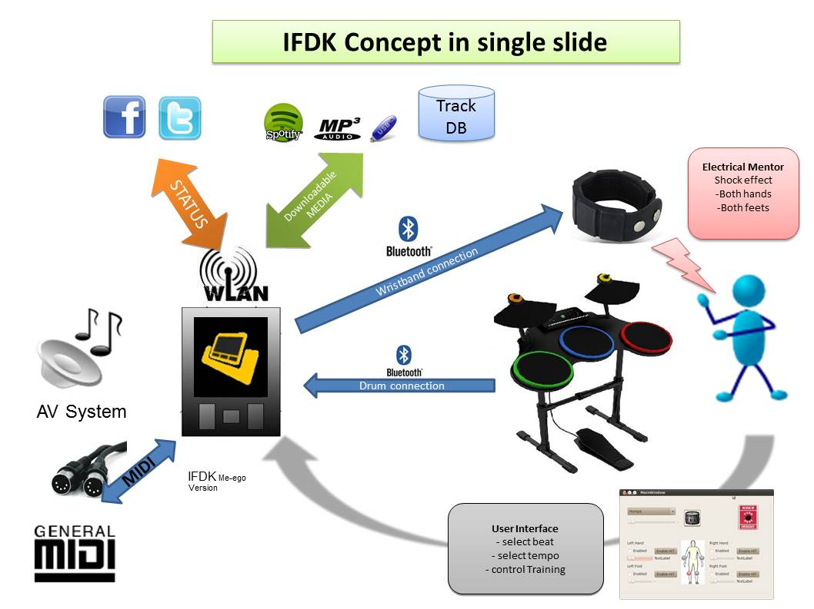


Testing in brief?
Desing & implementation
ready for test
Acceptance
Testing
FEATURE 1
deliver
FEATURE 2
Test Case
Test Case
FEATURE 3
Test Case
FEATURE 4
? Nope!

Slide 11
V-Model for testing
Customer Requirements
Acceptance Testing
System Requirements
System Testing
Sub System Requirements
Integration Testing
Component Requirements
Unit Testing

Slide 12
Developer vs Tester???
Customer Requirements
Acceptance Testing
System Requirements
System Testing
Sub System Requirements
Integration Testing
Component Requirements
Unit Testing

Slide 13
Testing Orientation
Black Box Testing
”System Testing”- perspective
Grey Box Testing
White Box Testing
”Code level testing”- perspective
http://en.wikipedia.org/wiki/Software_testing

Slide 14
Verification & Validation
FEATURES
Validation
Use Cases
Validation = Are we building the right product?
User Story
Verification = Are we building the product right?
Verification
Requirement
Validation VS verification?

Slide 15
Testing Orientation
”System Testing”- perspective
Black Box Testing
White Box Testing
”Code level testing”- perspective
http://en.wikipedia.org/wiki/Software_testing

Slide 16
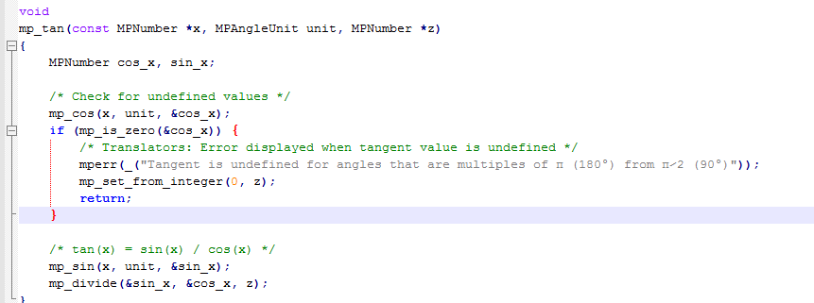
How to test?
What should be tested? How?

Slide 17

Component/ Unit Testing
Developer
xUnit Test Framework
Test Method Call
Test Class
Class
Attributes
Method Call result
Attributes
TestMethodCall
Methods
a=1; b= 2
C=Class.TestCountValues(1,2)
C <> 3 = Fail
C = 3 PASS
MethodCountValues( int x ,int y)
z = x+y+1
Return z

Slide 18
Ideal project team and unit testing
Integration Team
Integration test engineer
Component Sandbox
Developer #1
Developer #2
Developer #3
Developer #4
TESTS
TESTS
TESTS
TESTS
Implemented
Software Component
#1
Implemented
Software Component
#2
Implemented
Software Component
#3
Implemented
Software Component
#4

Slide 19
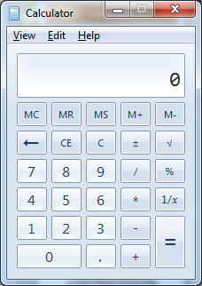
How to test?
What should be tested?
How ?

Slide 20
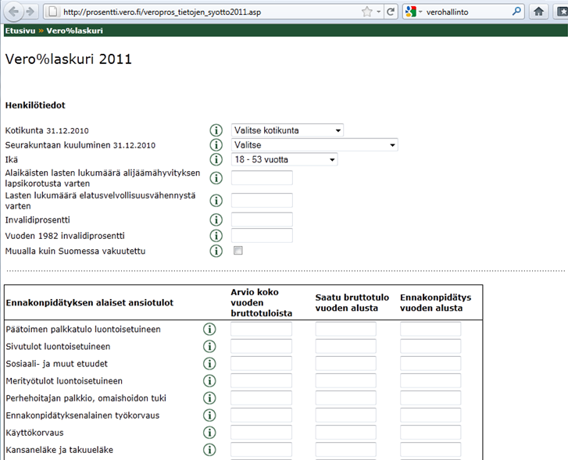
How to test ?
What should be tested?
How ?
http://prosentti.vero.fi/veropros_tietojen_syotto2011.asp

Slide 21

How to test?
What should be tested?
How ?

Slide 22
Integration Testing

Slide 23
System Testing in Large
What should be tested?
How ?

Slide 24


Acceptance Testing
What should be tested before so customer could be so happy ?
How ?

Slide 25
What should be tested?
Input ?
Output?

Slide 26
Test Driven Development?
DEFINE
TEST
CASE
FIRST!!!
IMPLEMENT
CODE
AGAINST
TESTS

Slide 27
Integrate early! Avoid Big Bang
Hardware
Web Service
50 %
10 %
Mobile Application
Data Base
10 %
90 %
Other Services
99%+90%+10%+50%+10% =?
99%

Slide 28
Integration Testing with stubs
STUB/MOCK
Component #1
STUB/MOCK
Component #2
Interfaces
Target Control interface
Test target
(Component, part of solution)
Logs
Messages/Events
Execution environment control interface
Execution Environment
Logs

Slide 29
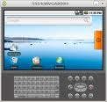
Integration Testing with stubs
STUB/MOCK
Component #1
STUB/MOCK
Component #2
Interfaces
Target Control interface
Logs
Messages/Events
Execution environment control interface
Logs

Slide 30

System Testing in Large
DB ?
Sales DB
Application
& Gateways
Application
& Gateways
Application
What should be tested?
How ?
Cabin Reservation DB
CRM DB

Slide 31
Test design & execution
Discuss about reasons for test design?
Why we need to do design?
Stupid work ☺ ! I wan’t to progress!??

Slide 32
Test Driven Development in all testing levels?
Design Draft System
Acceptance Test Cases
Define System Architecture & Design?
Design Tests
Implement Code

