Slide 1
Agenda
Learn basic concepts to under stand testing process and work
Requirement engineering and management
Agile methods and testing
Test design & execution
Test Planning & Management
Test Automation
Continous Integration & Testing
Understand how and why testing is important

Slide 2
This material if for general training for Test Design and management
Material is more supportive in class room
Material will be updated during courses
FreeNest Portable Project Platform is used to demonstrate things only in practice. This is not limiting usage for material for other training environments (I hope ☺)

Slide 3

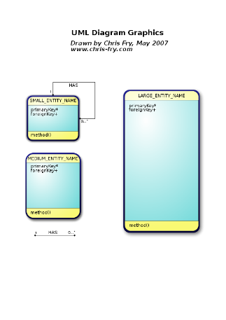
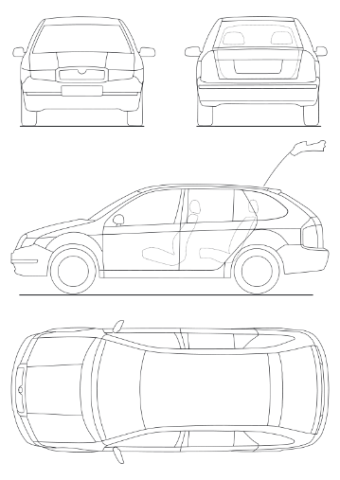
Test Designer ?
Desiger for test cases (has substance knowledge)
Test Case
Step 1
Step 2
Step 3
Defines

Slide 4

Tester ?
Executes testing
Creates reports and defect/bug/incident reports
Test Case
Step 1
Step 2
Step 3
PASS / FAIL ?
Any Bugs?
Executes

Slide 5

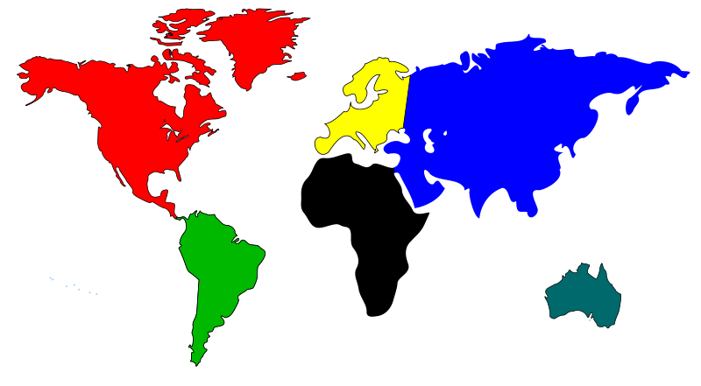
Test Manager ?
Has control ower testing process and resources
This role exists in large projects and product lines
Testing Strategy
Management
Master Test Planning

Slide 6
Test Management
Reporting
Executed Test case
Not executed
Blocked
Who / Where / What?
Founded bugs

Slide 7
Test Engineer ?

Slide 8




Example Product verification & validation organization
Acceptance
Test Engineer
System Acceptance Testing
System
Test Engineer
Acceptance Testing
Test Manager
System Testing
Project Manager
Functional System Testing
Load, Stress,
performance
Designer/Coder
Integration
Test Engineer
Regression Testing
Test Automation
Engineer
Feature Unit/Integration Testing
Integration Testing
Component Integration Testing
Feature
Component
Validation
Unit Testing
Verification

Slide 9
Agile Team and testing
Developer / Tester
Acceptance
Test Engineer
Developer
Scrum Master
Product Owner

Slide 10
Large Agile organization

Slide 11
ISTQB
http://www.rbcs-us.com/images/documents/The-ISTQB-Advanced-Syllabus.pdf

Slide 12
Verification & Validation
Validation = Are we building the right product?
Verification = Are we building the product right?

Slide 13


What is feature?
Calory Counter:
Player can measure calories during training session. This can be seen as exercise result in web service eg. Facebook application
Feature X * n
Energy usage

Slide 14
Is product a combinatio of features?
Standby Mode
Table Drum Mode
MIDI Support
Calory Counter
Touch Screen with single tap
Drum Metronome

Slide 15
Is product a combination of features
Table Drum Mode
Standby Mode
Core Software
Calory Counter
MIDI Support
Drum Metronome
Touch Screen with single tap

Slide 16





Customer/Business Requirements
Touch Screen with single tap
Simple Training Mode
Drum Metronome
Calory Counter
MIDI Support
Table Drum Mode
Customer Type 1
Customer Type 2
Customer Type 3
Customer Type 4
Who are our target customers?

Slide 17
Customer strategy
Touch Screen with single tap
Simple Training Mode
Calory Counter
Drum Metronome
Table Drum Mode
MIDI Support
Primary Target
Secondary Target
Customer Type 1
Customer Type 2
Customer Type 3
Customer Type 4
What is our key customer?

Slide 18

Features and roadmap
TIME TO MARKET!! For Target Group 1
Feature: Simple Training Mode
Requirement
Requirement
Requirement
Requirement
USE CASE #1
USE CASE #1
USE CASE #1
USE CASE #1
User Story #1
User Story #1
Requirement
Requirement
Requirement
Requirement
USE CASE #2
USE CASE #2
User Story #2
User Story #2
Requirement
Requirement
Requirement
Requirement
USE CASE #3
USE CASE #3
User Story #3
User Story #3
TIME TO MARKET!! For Target Group 2
Feature Touch Screen with single tap
CORE/Platform Software Development
Requirement
Requirement
Requirement
Requirement
USE CASE #1
USE CASE #1
USE CASE #1
USE CASE #1
User Story #1
User Story #1
Requirement
Requirement
Requirement
USE CASE #2
USE CASE #2
User Story #2
Requirement
Requirement
USE CASE #3
USE CASE #3
User Story #3
TIME TO MARKET!! For Target Group 3
Feature: Table Drum mode
Requirement
Requirement
Requirement
Requirement
USE CASE #1
USE CASE #1
USE CASE #1
USE CASE #1
Requirement
Requirement
Requirement
Requirement
USE CASE #2
Release 1.0
USE CASE #2
Requirement
Requirement
USE CASE #3
Release 1.1
Release 0.1
Release 1.2

Slide 19
Release plan for large system
Unstable Released Edge
Unit & Testing
Day 1
Day 2
Day …
Day 1
Day 2
Day …
Day 1
Day 2
Day …
Fix Released
Integration Testing
Quartal
Release
Monthly
Release
Monthly
Release
Monthly
Release
Stable Released
System Acceptance Testing
6 month
Release

Slide 20
SW Project vs Open Source
Open Source – Crowd Sourcing
SW Relase tested without coordination by group of volunteers
Release tested by customer
Field Testing
Test Group

Slide 21
Discussion
Do some study about Ubuntu release testing process?

Slide 22
V-Model for testing
Customer Requirements
Acceptance Testing
System Requirements
System Testing
Sub System Requirements
Integration Testing
Component Requirements
Unit Testing

Slide 23
Developer vs Tester???
Customer Requirements
Acceptance Testing
System Requirements
System Testing
Sub System Requirements
Integration Testing
Component Requirements
Unit Testing

Slide 24
Verification & Validation
FEATURES
Validation
Use Cases
Validation = Are we building the right product?
User Story
Verification = Are we building the product right?
Verification
Requirement
Validation VS verification?

Slide 25

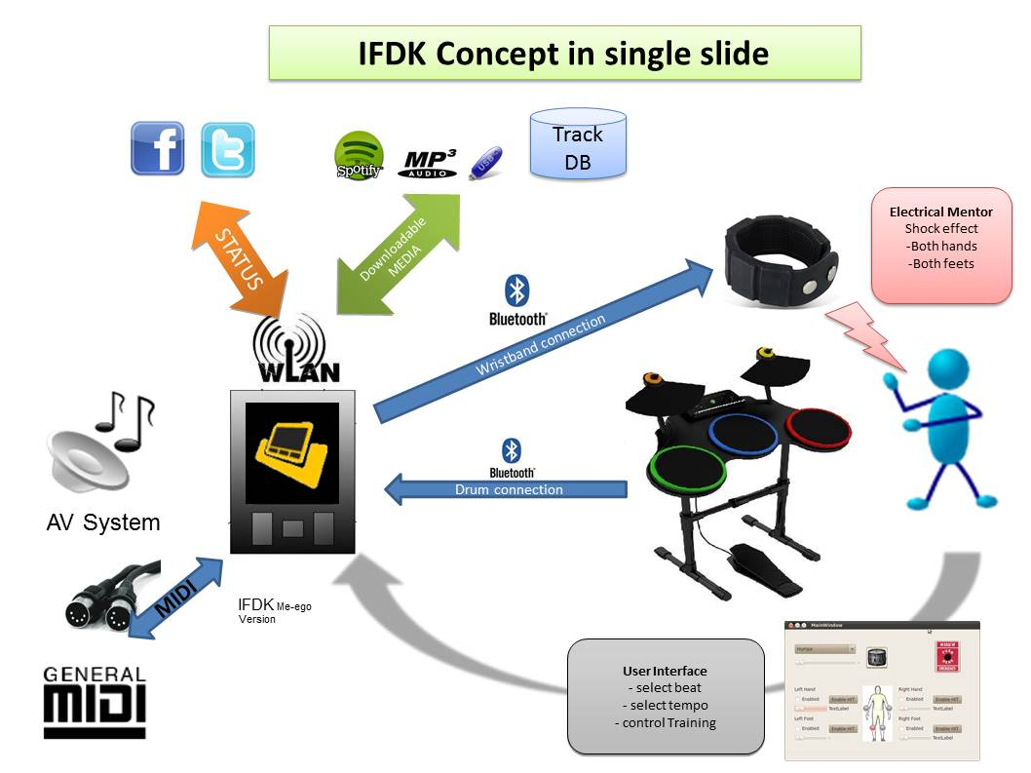

Testing in brief?
Desing & implementation
ready for test
Acceptance
Testing
FEATURE 1
deliver
FEATURE 2
Test Case
Test Case
FEATURE 3
Test Case
FEATURE 4
? Nope!

Slide 26
Testing Orientation
Black Box Testing
”System Testing”- perspective
Grey Box Testing
White Box Testing
”Code level testing”- perspective
http://en.wikipedia.org/wiki/Software_testing

Slide 27
Testing Orientation
”System Testing”- perspective
Black Box Testing
White Box Testing
”Code level testing”- perspective
http://en.wikipedia.org/wiki/Software_testing

Slide 28
Development Process (Waterfall)
Requirement Gathering
Design
Implementation
Verification
Validation
Maintenance
Milestone 1
Milestone 2
Milestone 3
Milestone 4
Milestone 5

Slide 29
Development Process (Agile)
Product Backlog
Task4
User Story X
Task5
Task1
Task6
User Story Y
Task7
Task2
Task8
User Story Z
Task3
Task9
User Story Z
Sprint
Sprint
Sprint
Sprint
Design
Implementation
Verification
Design
Implementation
Verification
Design
Implementation
Verification
Design
Implementation
Verification

Slide 30
Testing levels
We take branding seriously, The FreeNest Brand is our pride and joy.
It is the message we want to send to the developer teams, customers and stakeholders.
These guidelines must be followed in all FreeNest’s print and electronic communications, marketing and informing.
Documentation defines logo guidelines, typography and the use of colors.

Slide 31
Test Planning & Management
Why Test Management is needed ?

Slide 32
What should be tested first?
Test Case 1
Test Case 2
V2.0
Test Case 3
V2.0
P4
P1
P3

Slide 33
What is a test target
Product
RELEASE/BUILD
VERSION 1.1
Test Plan V 0.1
Executes
Test Case 1
Product
RELEASE/BUILD
VERSION 1.2
Test Case 2
V2.0
Executes
PASS / FAIL
Test Case 3
V2.0
Executes
Product
RELEASE/BUILD
VERSION 1.3
PASS / FAIL

Slide 34

Who executes test cases and when
Test Plan V 0.1
Test Case 1
Test Case 2
V2.0
Test Case 2
V2.0

Slide 35
Group of Test Cases = Test Plan
Test Plan V 0.1
Test Case 1
Test Case 1
Test Case 2
V2.0
Test Case 2
V2.0
Test Case 3
V2.0
Test Case 3
V2.0

Slide 36
Test plan life cycle
Test
Plan 1.0
Test
Plan 2.x
Needs
Still
Work Effort
Routine Test
REL 0.1
REL 0.2
REL 0.5
REL 1.0
Week 0
Week 26
Week 52

Slide 37
Test Case Pool and version control
Test Case 1
Test Case 2
V1.0
Test Case 3
V1.0
Test Case 4
Draft
Test Case 2
V2.0
Test Case 2
V2.0
Test Case 2
V3.0

Slide 38
Test Management
Using Testlink
How to write test case?
Creating a test plan
TestLink is a web based Test Management tool. The application provides Test specification, Test plans and execution, Reporting, Requirements specification and collaborate with well-known bug trackers.

Slide 39
Execution of Test Case
Test Engineer daily job ?

Slide 40
Different Roles in Testing
Test Designer
Acceptance
Test Engineer
Project Manager
System
Test Engineer
Test Manager
Test Automation
Engineer
Developer

Slide 41
Testlink in brief
TESTLINK
Feature
Implementation
TestCase
TestCase
TestCase
Test Plan/Suite
Note
Verdict
Bug Report
FAIL
SourceCode
Version
Control
Database
Error
Database

Slide 42
What we can do with Testlink Tool

Slide 43
Selecting Configuration
Tested Release/configuration
Version 0.4
Test Plan
Test Cases
For
Features
Error/Defect
Report
Version 0.2.2
Error/Defect
Report
Error/Defect
Report
Version 0.2.2.2

Slide 44
TOOLS
LOG FILE
TEST CASE
Test Case
SUT/DUT
Indications Events
NOTIFICATIONS
ENVIRONMENT/
EMULATOR
SUT = System Under Test
DUT = Device Under Test

Slide 45
Agile methods and testing
We take branding seriously, The FreeNest Brand is our pride and joy.
It is the message we want to send to the developer teams, customers and stakeholders.
These guidelines must be followed in all FreeNest’s print and electronic communications, marketing and informing.
Documentation defines logo guidelines, typography and the use of colors.

Slide 46
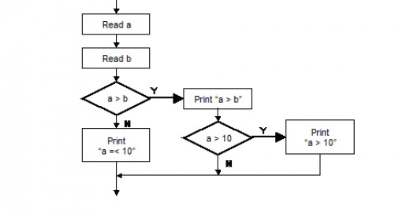
Test Automation
We take branding seriously, The FreeNest Brand is our pride and joy.
It is the message we want to send to the developer teams, customers and stakeholders.
These guidelines must be followed in all FreeNest’s print and electronic communications, marketing and informing.
Documentation defines logo guidelines, typography and the use of colors.

Slide 47
Test Automation Frameworks

Slide 48





Why Test Automation Framework?
There has to be common way to communicate with test environment. Test Automation Framework provides it
Test Team communicates with
common language
Test Automation Framework provides a way to
Control testing environment with common way

Slide 49
STAF as foundation for test automation
The Software Testing Automation Framework (STAF) is an open source, multi-platform, multi-language framework designed around the idea of reusable components, called services
STAF removes the tedium of building an automation infrastructure, thus enabling you to focus on building your automation solution
The STAF framework provides the foundation upon which to build higher level solutions, and provides a pluggable approach supported across a large variety of platforms and languages.
http://staf.sourceforge.net/

Slide 50
Test Environment Example
TED = Test Environment Device
Test Environment Devices are ”lego” bricks of for test scenario building.
TED’s can be used as service intefaces to DUT (Design/Device under test)
TED service has to be programmed to use DUT API/interface
Test Automation needs support for virtual ”eyes” and ”arms”. TED’s can be also used such a way
All TED ’s are communicating using STAF Network

Slide 51


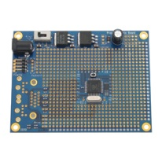
TED ”virtual hand” ☺
Service examples:
Press Key
Connect Power
Read Led State
Rasberry PI?
HW interface
STAF Service
http://www.raspberrypi.org/

Slide 52

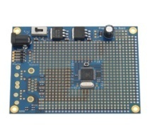

Using STAF/STAX in PMR testing
Observer TED
Web Cam SW
STAF Service
DUT TED
Host PC/Virtual machine
STAF Service Network
Virtual Phone
STAF Service
STAX
STAF Service
Host PC/Virtual machine
Contoller TED
HW control
STAF Service
Host PC/Virtual machine
Infrastructure TED
Base Station
STAF Service
Host PC/Virtual machine

Slide 53
#Presettings
Case_Passed=False
PMRRadioA.Select DMO_Mode
PMRRadioB.Select DMO_Mode
PMRRadioA.Select DMO_Channel( 10)
PMRRadioB.Select DMO_Channel (10)
#Case start
PMRRadioB ResetDMOCallCounter
PMRRadioB CountDMOCall
Do while call_count < 100
{
PMRRadioB MakeDMOCall(5, 5)
call_count ++
}
If (PMRRadioB .CallCounter = 100)
{
Case_Passed= True
}
# Case End
DUT TED
STAX
STAF Service
STAF Service Network
Virtual machine
Virtual Phone
STAF Service
Host PC
STAX executes test script using PMRRadio virtual phone service interface
Virtual phone implementation is DUT specific

Slide 54
Ideas?
There is need for hardware to control keypad with machine
It’s just a one small part of whole test automation
How to control screen? You will need another test tool?

Slide 55
Code Analyzing

Slide 56
Code Complexity
Example tool CCCC
https://wiki.jenkins-ci.org/display/JENKINS/CCCC+Plugin
http://sourceforge.net/projects/codeanalyze-gpl/?source=recommended

Slide 57
Static Code Analyze
10 CLS: PRINT TAB(15); "Polysons': PRINT
20 PI=3. 14159: TP=PI*2
30 INPUT "Number of Sides';SD
40 INPUT "Size (5 to 80)';SZ
50 SP=TP/SD
60 SCREEN 1
70 FOR A=0 TO TP+SP/2 STEP SP
90 X=SZ*SIN(A)+100
100 Y=SZ OS(A)+96
110 IF A=0 THEN 130
120 LINE (X0, Y0)-(X, Y)
130 X0=X:Y0=Y
140 NEXT
150 GOTO 150
?
http://www.atarimagazines.com/creative/v10n5/158_Simple_screen_graphics_wi.php

Slide 58
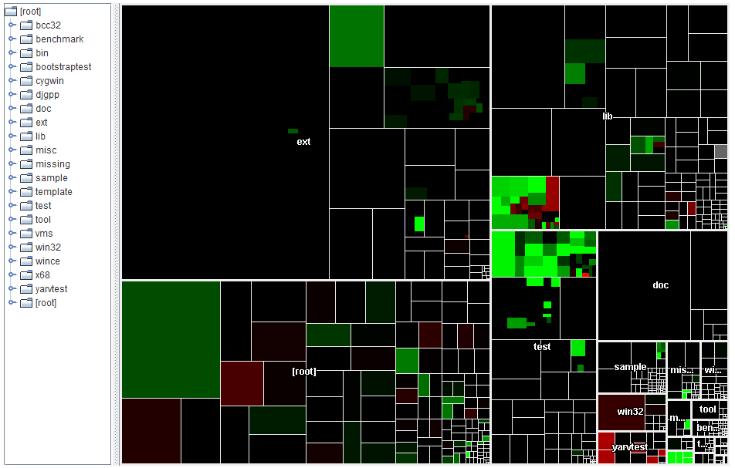
Static Code Analyze – Heat Map
http://www.statsvn.org/demo/ruby/

Slide 59
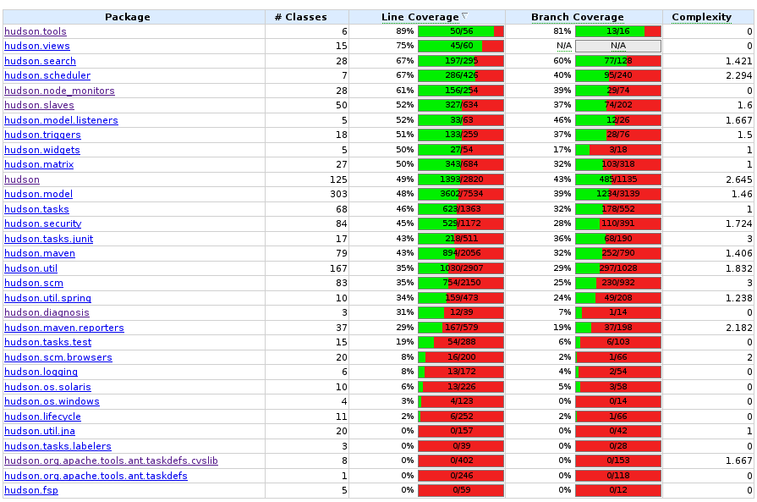
Code Coverage

Slide 60
Code Coverage – Branch Coverage
The percentage of branches that have been
exercised by a test suite. 100% branch coverage
implies both 100% decision coverage and 100%
statement coverage.
http://booster911.hubpages.com/hub/BranchDecisionTesting

Slide 61
Code Analyze – Cyclomatic Complexity
?
http://en.wikipedia.org/wiki/Cyclomatic_complexity

Slide 62
Build server ?
http://buildbot.twistedmatrix.com/waterfall

Slide 63

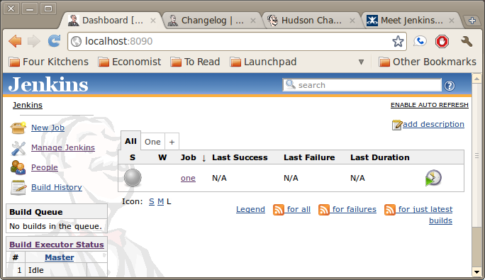
Jenkins as build server
Test report
Version
Control
Build
Server
SVN
GIT
Mercurial
Etc.
If Unit Tests are passed – Jenkins will build whole product package
Execute Unit Tests for specific components
http://www.youtube.com/watch?v=Ago7hpp6xZI&feature=related
Youtube Jenkins CI

Slide 64
Simple continuous integration
Build service
Build Job 1
Build Job 3
Report
8. Show
Build Job 2
2. Trigger/Hook
7. Create report
9. Inform developer
3. Execute Build
Build Slave
Source
Code
Repository
1. Code commit
4. Fetch source
6. Generates
Build
5. Generates
TestBuild

Slide 65
Continuous Integration and code analyze?
Builder
Make / Ant
Gcc
Javac
Code Checker
Unit Tester
Source
Code
Complexity
Analyze
Integration Tester
Heat Map
Interface Tester

Slide 66
Advanced Continous Integration
Build service
Build Slave
Report
9. Show
Build Job 1
10. Inform developer
2. Trigger/Hook
8. Create report
3. Execute Build
Code
Analyze
8 Analyze
Build Slave
Source
Code
Repository
7. Generates
1. Code commit
4. Fetch source
Build
6 Executes
TestBuild
Test Bench

Slide 67
Multiple release targets
Build Slave
Build service
Windows
Build Slave
Linux
Source
Code
Repository
Commits
Build Slave
Mac

Slide 68
Build Service and FreeNest
FreeNest Instance
GIT Repository
(master)
Jenkins
CI server
Build
Slave
(optional)
Developer
Workstation
GIT
(local)
Push to master

Slide 69
Cloud as scalable CI enviroment
Create, start, stop and destroy
Build Slave
instance
Cloud
API
Test Target
Build Slave
instance
Test Target
Build Slave
instance
Test Target
Test Target
Test Target

Slide 70

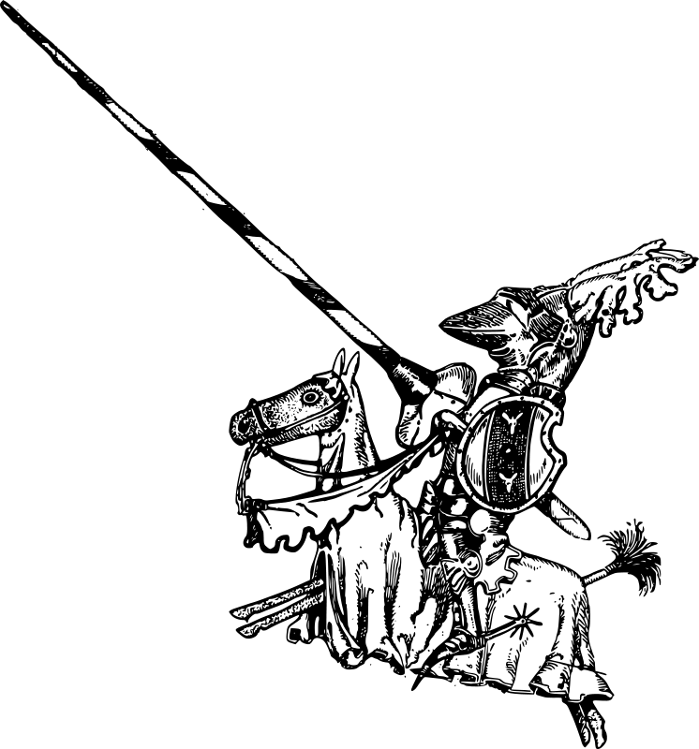
Error Management

Slide 71
Concepts
Failure – Fault – Defect - Bug -
Incident – Failure - Error
Example forum thread: http://www.allinterview.com/showanswers/36257.html
ISTQB syllabus

Slide 72
Error/Bug/Defect Report
Defect/Burg/Error ID
Reporter
Time
Founded where
Which way?
Test Case
Test Setup/Configuration
Describe scenario?
Attachements? Picture/Log/etc..

Slide 73
Sources for error report
N x Incidents
Customer
Feedback /
Field Testing
Testing Process
Error Report
Change
Request?
CRM

Slide 74
Defect/Burg/Error ID
Reporter
Time
Founded where
Which way?
Test Case
Test Setup/Configuration
Describe scenario?
Attachements? Picture/Log/etc..
Error
Database
Id1
Id2
Id5
Id3
Id4

Slide 75
Nature of bug
Location?
Priority?
Severity?
Where is the bug is found?
Which one should fixed first?
How fatal is the bug?
Id2
Id2
Id2
Id2
Id2
Id1
Id3
Id2
Id4
Id2
ID N
Target?
When the bug should be fixed and verified ?

Slide 76
Test Case execution and error reporting?
INCIDENTS
TEST CASE ID XXXXX
Step1
Step2
Step3.
Step4.
INCIDENTS
INCIDENTS
Collects
EXECUTE TEST !
Test Engineer
Can lead to
Writes report and provides evidences
Bug/Defect
Report
Error Database
System Under
Test

Slide 77
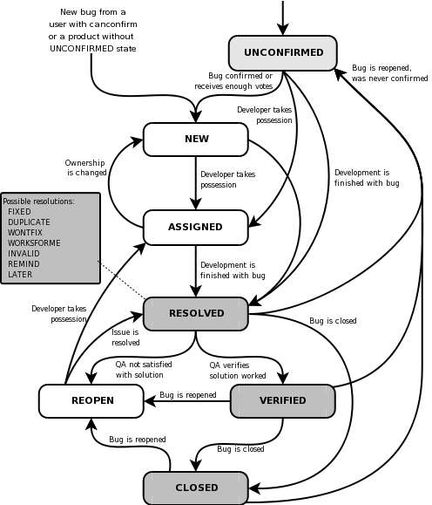
Example of error process

Slide 78
Defects Found
Future ?
Defects Found
Defects Found
Defect Found
Defects Found
Defects Found
REL 0.1
REL 0.2
REL 0.5
REL 1.0
Week 0
Week 26
Week 52

Slide 79
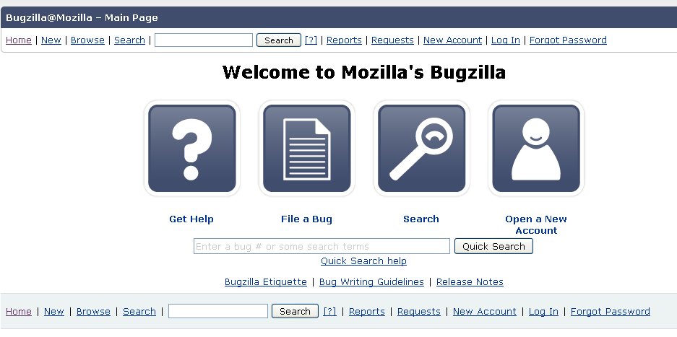
Bugzilla as example
What is Bugzilla?
Bugzilla is a "Defect Tracking System" or "Bug-Tracking System". Defect Tracking Systems allow individual or groups of developers to keep track of outstanding bugs in their product effectively. Most commercial defect-tracking software vendors charge enormous licensing fees. Despite being "free", Bugzilla has many features its expensive counterparts lack. Consequently, Bugzilla has quickly become a favorite of thousands of organizations across the globe.
http://www.bugzilla.org/
http://www.bugzilla.org/installation-list/

Slide 80
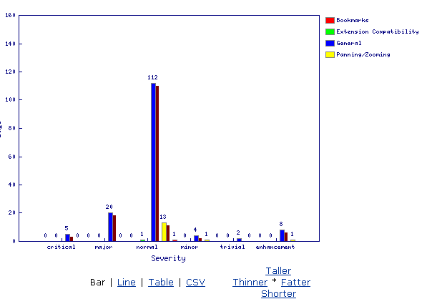
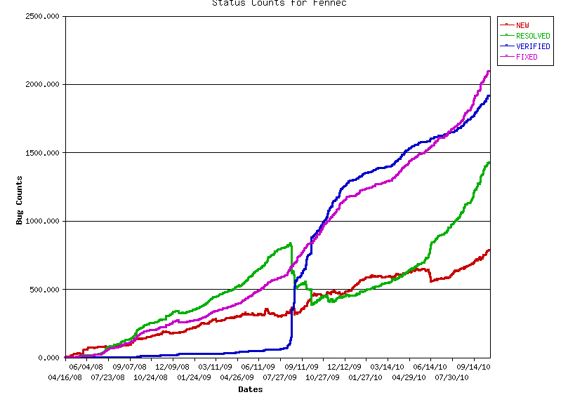
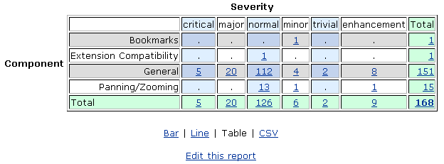
Reporting and metrics

Slide 81
Error Management and unit testing
Bug
Report
I should create new unit tests
Error Database
Implementation

Slide 82
Error Management and integration testing
Bug
Report
Implementation
Error Database
Integration
Test Plan
Implementation
Bug
Report

Slide 83
Error Management
Integration
Test Plan
Implementation
Implementation
Implementation
Implementation
System
Integration
Test Plan
Platform
Integration
Test Plan
Hardware

