Slide 1
About Material
This material if for general training for Test Design and Management
Material is set of support slides for lectures kept in the class room
Material will be updated during courses

Slide 2
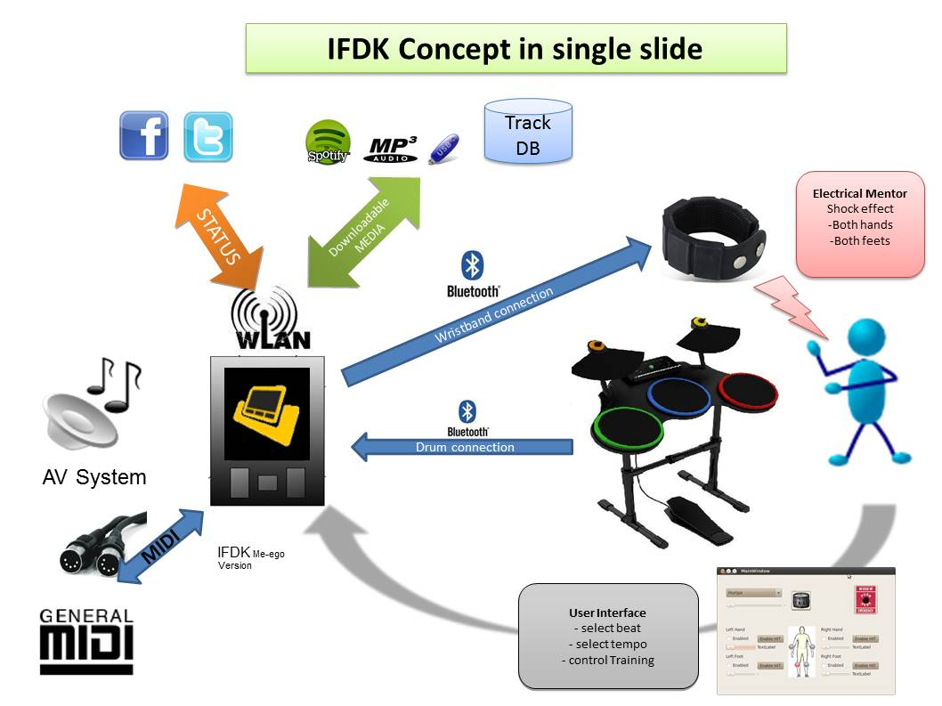
Different points of view on the product
Hacker
Customer
Seller
Developer

Slide 3

Different levels of requirements
Customer/Business/Stakeholder Needs
System requirements
Design requirements
component
Implementation

Slide 4
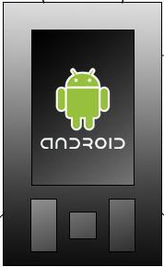

What is feature?
Calory Counter:
Player can measure calories during training session. This can be seen as exercise result in web service eg. Facebook application
Feature X * n
Energy usage

Slide 5
Is product a combinatio of features?
Standby Mode
Table Drum Mode
MIDI Support
Calory Counter
Touch Screen with single tap
Drum Metronome

Slide 6
Is product a combination of features
Table Drum Mode
Standby Mode
Core Software
Calory Counter
MIDI Support
Drum Metronome
Touch Screen with single tap

Slide 7





Customer/Business Requirements
Touch Screen with single tap
Simple Training Mode
Drum Metronome
Calory Counter
MIDI Support
Table Drum Mode
Customer Type 1
Customer Type 2
Customer Type 3
Customer Type 4
Who are our target customers?

Slide 8
Customer strategy
Touch Screen with single tap
Simple Training Mode
Calory Counter
Drum Metronome
Table Drum Mode
MIDI Support
Primary Target
Secondary Target
Customer Type 1
Customer Type 2
Customer Type 3
Customer Type 4
What is our key customer?

Slide 9
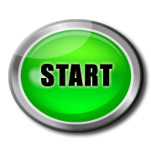
Features and roadmap
TIME TO MARKET!! For Target Group 1
Feature: Simple Training Mode
Requirement
Requirement
Requirement
Requirement
USE CASE #1
USE CASE #1
USE CASE #1
USE CASE #1
User Story #1
User Story #1
Requirement
Requirement
Requirement
Requirement
USE CASE #2
USE CASE #2
User Story #2
User Story #2
Requirement
Requirement
Requirement
Requirement
USE CASE #3
USE CASE #3
User Story #3
User Story #3
TIME TO MARKET!! For Target Group 2
Feature Touch Screen with single tap
CORE/Platform Software Development
Requirement
Requirement
Requirement
Requirement
USE CASE #1
USE CASE #1
USE CASE #1
USE CASE #1
User Story #1
User Story #1
Requirement
Requirement
Requirement
USE CASE #2
USE CASE #2
User Story #2
Requirement
Requirement
USE CASE #3
USE CASE #3
User Story #3
TIME TO MARKET!! For Target Group 3
Feature: Table Drum mode
Requirement
Requirement
Requirement
Requirement
USE CASE #1
USE CASE #1
USE CASE #1
USE CASE #1
Requirement
Requirement
Requirement
Requirement
USE CASE #2
Release 1.0
USE CASE #2
Requirement
Requirement
USE CASE #3
Release 1.1
Release 0.1
Release 1.2

Slide 10
Release & Configuration Management
http://en.wikipedia.org/wiki/Configuration_management
http://en.wikipedia.org/wiki/Release_management

Slide 11
Release Management
Version 0.1
Version 0.2
Version 0.3
Version 0.4
Trunk
Customer 1
Version 0.2.1
Version 0.2.2
Version 0.2.3
Customer 1
Version 0.2.2.1
Version 0.2.2.2
Version 0.2.2.3

Slide 12
Release & Configuration Management
Version 0.1
Version 0.2
Version 0.3
Version 0.4
Trunk
Release 1.0
Features
Customer 1
Version 0.2.1
Version 0.2.2
Version 0.2.3
Release 1.0
Features
Customer 1
Version 0.2.2.1
Version 0.2.2.2
Version 0.2.2.3
Features

Slide 13
Release Management and integration testing
First System Test
With all components
Facebook Web Service
Stubs
needed
HW Component
Calore Meter
Enabled Drum Stick
Calore Meter SW Component
10% tested
Stubs
needed
Stubs
needed
Data Base Schema Design
IFDK Application
Stubs
needed

Slide 14
Release plan for large system (current)
Unstable Released Edge
Unit & Testing
Day 1
Day 2
Day …
Day 1
Day 2
Day …
Day 1
Day 2
Day …
Fix Released
Integration Testing
Quartal
Release
Monthly
Release
Monthly
Release
Monthly
Release
Stable Released
System Acceptance Testing
6 month
Release

Slide 15
Open Source product testing ?
Open Source –> crowd sourced testing ?
Relase tested ”without” coordination by group of volunteers

Slide 16
V-Model for testing
Customer Requirements
Acceptance Testing
System Requirements
System Testing
Sub System Requirements
Integration Testing
Component Requirements
Unit Testing

Slide 17
Developer vs Tester???
Customer Requirements
Acceptance Testing
System Requirements
System Testing
Sub System Requirements
Integration Testing
Component Requirements
Unit Testing

Slide 18



Testing in brief?
Desing & implementation
ready for test
Acceptance
Testing
FEATURE 1
deliver
FEATURE 2
Test Case
Test Case
FEATURE 3
Test Case
FEATURE 4
? Nope!

Slide 19
Verification & Validation
FEATURES
Validation
Use Cases
Validation = Are we building the right product?
User Story
Verification = Are we building the product right?
Verification
Requirement
Validation VS verification?

Slide 20
Testing Orientation
Black Box Testing
”System Testing”- perspective
Grey Box Testing
White Box Testing
”Code level testing”- perspective
http://en.wikipedia.org/wiki/Software_testing

Slide 21
Testing Orientation
”System Testing”- perspective
Black Box Testing
White Box Testing
”Code level testing”- perspective
http://en.wikipedia.org/wiki/Software_testing

Slide 22
Development Process (Waterfall)
Requirement Gathering
Design
Implementation
Verification
Validation
Maintenance
Milestone 1
Milestone 2
Milestone 3
Milestone 4
Milestone 5

Slide 23
Development Process (Agile)
Milestone ?
Sprint 1
Sprint 2
Sprint 3
Sprint 4
Product Backlog
Task4
User Story X
Task5
Task1
Task6
User Story Y
Task7
Task2
Task8
User Story Z
Task3
Task9
User Story Z
Design
Implementation
Verification
Design
Implementation
Verification
Design
Implementation
Verification
Design
Implementation
Verification

Slide 24
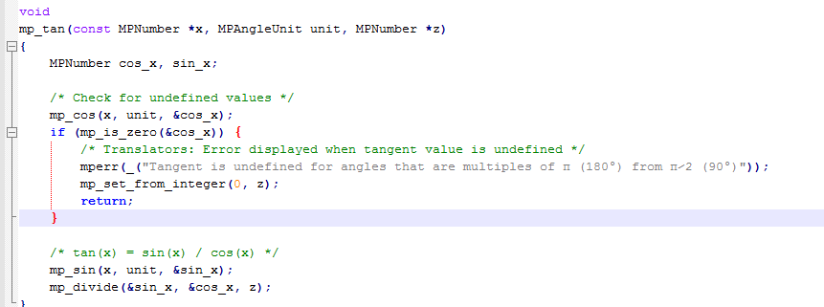
How to test?
What should be tested? How?

Slide 25
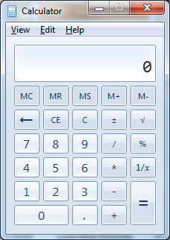
How to test?
What should be tested?
How ?

Slide 26
Verification of implementation
Unit Testing
Static Analyze
Dynamic Analyze

Slide 27
What should be tested?
Input ?
Output?

Slide 28
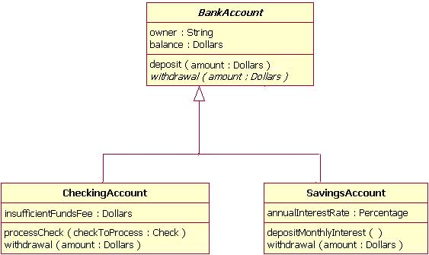
Class model ?
http://www.ibm.com/developerworks/rational/library/content/RationalEdge/sep04/bell/

Slide 29
xUnit Framework
xUnit Framework
Implementation

Slide 30

Component/ Unit Testing
Developer
xUnit Test Framework
Test Method Call
Test Class
Class
Attributes
Method Call result
Attributes
TestMethodCall
Methods
a=1; b= 2
C=Class.TestCountValues(1,2)
C <> 3 = Fail
C = 3 PASS
MethodCountValues( int x ,int y)
z = x+y+1
Return z

Slide 31
Test Driven Development?
DEFINE
TEST
CASE
FIRST!!!
IMPLEMENT
CODE
AGAINST
TESTS

Slide 32
Ideal project team and unit testing
Integration Team
Integration test engineer
Component Sandbox
Developer #1
Developer #2
Developer #3
Developer #4
TESTS
TESTS
TESTS
TESTS
Implemented
Software Component
#1
Implemented
Software Component
#2
Implemented
Software Component
#3
Implemented
Software Component
#4

Slide 33
Integration Testing

Slide 34
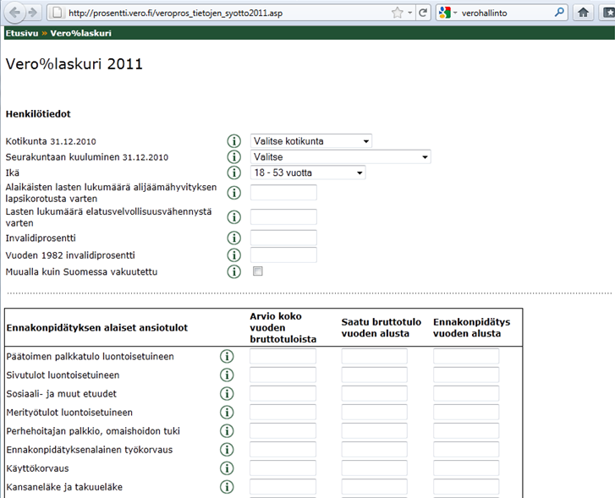
How to test ?
What should be tested?
How ?
http://prosentti.vero.fi/veropros_tietojen_syotto2011.asp

Slide 35
Integrate early! Avoid Big Bang
Hardware
Web Service
50 %
10 %
Mobile Application
Data Base
10 %
90 %
Other Services
99%+90%+10%+50%+10% =?
99%

Slide 36
Integration Testing with stubs
STUB/MOCK
Component #1
STUB/MOCK
Component #2
Interfaces
Target Control interface
Test target
(Component, part of solution)
Logs
Messages/Events
Execution environment control interface
Execution Environment
Logs

Slide 37
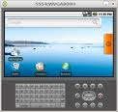
Integration Testing with stubs
STUB/MOCK
Component #1
STUB/MOCK
Component #2
Interfaces
Target Control interface
Logs
Messages/Events
Execution environment control interface
Logs

Slide 38

How to test?
What should be tested?
How ?

Slide 39
System Testing in Large
What should be tested?
How ?

Slide 40

System Testing in Large
DB ?
Sales DB
Application
& Gateways
Application
& Gateways
Application
What should be tested?
How ?
Cabin Reservation DB
CRM DB

Slide 41


Acceptance Testing
What should be tested before so customer could be so happy ?
How ?

Slide 42
Test design & execution
Discuss about reasons for test design?
Why we need to do design?
Stupid work ☺ ! I wan’t to progress!??

Slide 43
What is test desing?
REQ
REQ-O
What I should check ?
REQ-Z
REQ-Y
IDEAL

Slide 44
Test Case ?
Add Information about case
Test Case Name:
Test Case Id:
Test Case owner/writer:
Date
comments
Verify what?
Using configuration?
With tools?
Verify drum track player pause mode functionality.
Do this with IFDK software release X and playing song ”Show must go on by Freddy Mercury”
Test should be done using android emulator environment and using your hands, ears and eyes”
Pre State:
Android emulator is running
Release X is installed on emulator
Test Case Steps:
1. Open drum kit player application
2. Select song ”Show must go on”
3. Start to play
4. Press Pause and check song is paused
5. Check memory usage from system application
6. Press Play
7. jump to 4 several time (<10)
8. Listen song to the end
9. Exit player using ”exit button”
End State:
IFDK Kit in main screen mode
Define pre-state
Define Steps
Define end-state
What is verdict?
If Pause is working result is PASS. If Pause mode failed result is FAIL

Slide 45
Why we need test design ????
Stupid work! This takes ages! This Test Case documentation is old as soon I have changed some implementation? Why you need to do so hard documentation? Give me a one good reason!

Slide 46
Agile Thinking?
We have to automate all tests!! No sense to create test case documentation ?
Who does automation without a design?

Slide 47
Checklist vs Test Case?
Check UI is working Working?
Check color change Working?
Check Counter value after 50 logins Working?
Check disable mode for counter Working?
Checklist can be working great in small team! ☺
What happens if team is disbanded to other projects? And you are new maintainer for this project?

Slide 48
Sources for test design
Mixed
Specification based Testing design
Negative Testing
Design based test desing
Test Case
Step
Step
Step
Write
Test Engineer’s
Daily Job?
Requirement based test design
Test Design Method
Defect based test design
Functional test design
Customer's Idea
Brainstorm
Intitution
Exploratory
NonFunctional test design

Slide 49

Mechanical route to design
Functional Test Case:
Verify functionality of XXXX
Check also.....
Correct functionality path
Miss-usage of functionality
Boundary Check
Requirement
Use Case
Feature
User Story
Write a Case
Functional?
Which Type?
Create a Test Case!
Your Sources
For Test Case
Regression Test Case??
Non-Functional?
Customer's Idea
Brainstorm
Intitution
Exploratory
Non-Functional Test Cases
Verify Stability of XXXX
Verify Performance of XXX
Verify Security of XXXX
Verify Usability of XXXX
Verify Scalability of XXXX
etc...
Check also.....
Check Possiblity to automated testing?
Write a Case
Yläotsikko

Slide 50
Acceptance Test Case
Choose Case Type
Functional Test Case
Check different sources & strategy
for Test Case design
Non-Functional Test Cases
WRITE
A
Test
Case!
What is
Testing level
Field Test Case
Interoperability Test Case
Conformance Test Case
Regression Test Case

Slide 51
Test Driven Development in all testing levels?
Design Draft System
Acceptance Test Cases
Define System Architecture & Design?
Design Tests
Implement Code

