Slide 1
About Material
This material if for general training purposes
Material is set of support slides for lectures kept in the class room
Material will be updated during courses

Slide 2





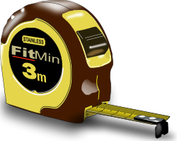
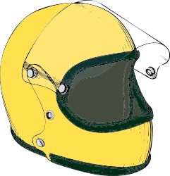
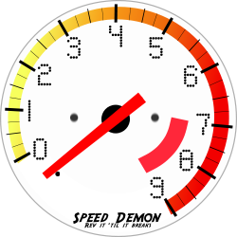
Collection 1
Functional Requirement
Non-Functional Requirement
Non-Functional Requirement
Non-Functional Requirement
NON FUNCTIONAL
LOAD
SECURITY
MAINTENANCE
RECOVERY?
FUNCTION
Non-Functional Requirement
Agile
Epic / Theme
Non-Functional Requirement
Non-Functional Requirement
NON FUNCTIONAL
Main {
….
}
?
IMPLEMENTATION
SCALING
SAFETY
PERFORMANCE?

Slide 3




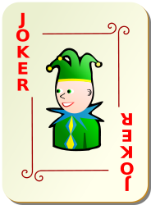
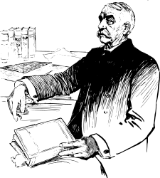

Collection 2
SCALING
Stake Holders?
Customer / User ?
Business Request ?
USABILITY
User Story ?
NON FUNCTIONAL
User Story Addition +
NON FUNCTIONAL
Traditional
Feature
Use Case
?
UC
Acceptance
Criteria?
PERFORMANCE?
RECOVERY?
SCENARIO ?

Slide 4

Pet Capsule Concept
Bring
Cat to safe house
Pet Capsule Service
Service
30€/day Food, drinks and internet connection
included
Web portal login
Get
Cat back home
Live Cam
feed

