Slide 1

Writing Clearly Publications Work
Episode 1/5

Slide 2
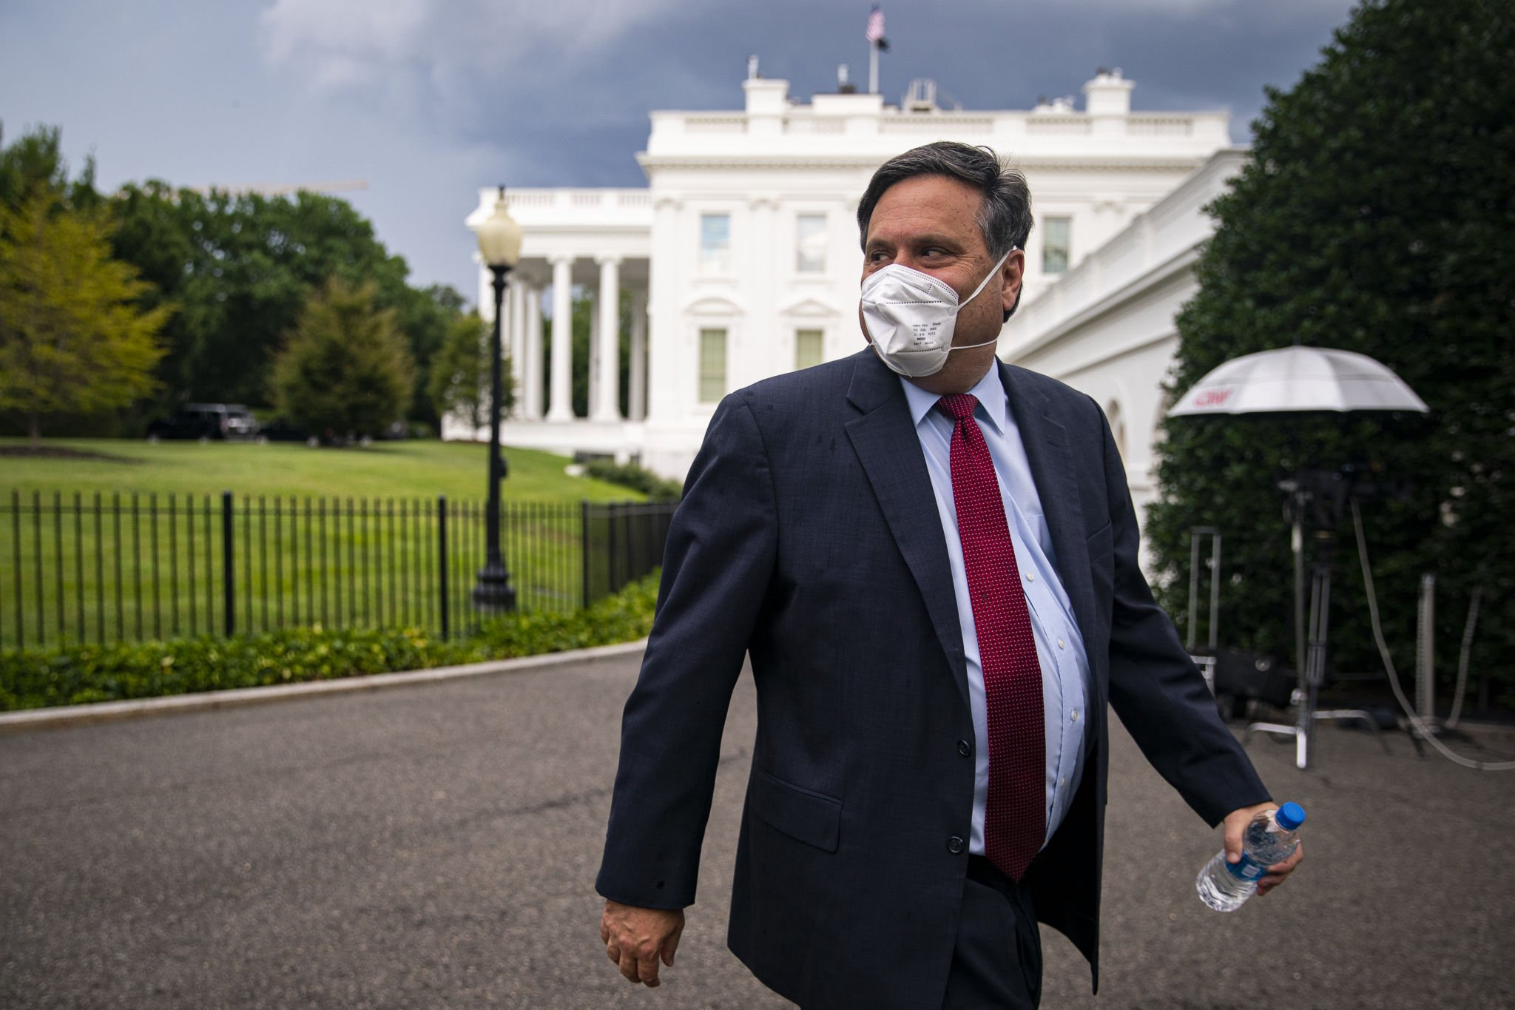
Salary Negotiation How To Negotiate A Raise Or Promotion
Full Episode

