Slide 1

Go Programming Tutorial for Beginners
Episode 1/2

Slide 2
Go Programming Tutorial for Beginners
Episode 2/2

Slide 3
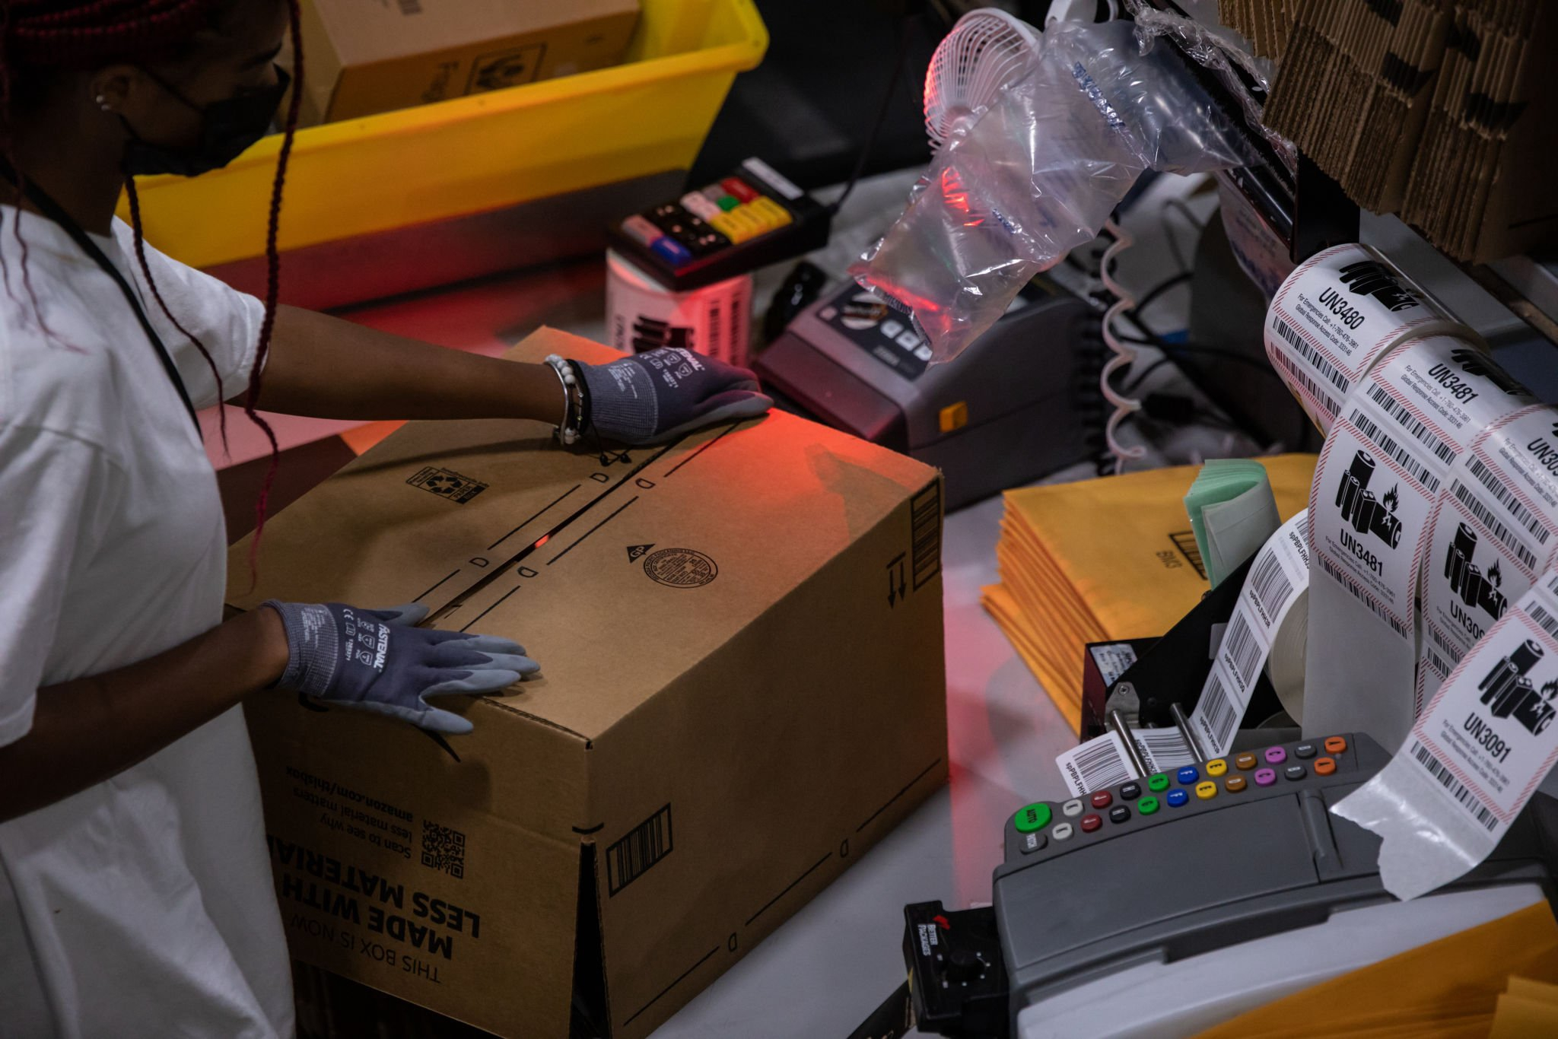
Amazon Business Model How Amazon Makes Money
Full Episode

Slide 4

Shopify Business Model How Shopify Makes Money
Full Episode

