Slide 1
CodeVS
Information System Design Laboratory
Agile Scrum · Jira Cloud · GitHub Integration · Zephyr Scale
Team Members & Roles
Agile Scrum
Rafsan Riasat 2207006 — Scrum Master (Project Scaffolding, Deployment, QA Coordination)
Utsa Roy 2207027 — Backend & Game Engine (Firebase, Matchmaking, WPM Engine)
Md Adib Raian 2207020 — Frontend & UI (Layouts, Theming, Mobile Responsiveness)
3 Sprints 5 Epics 113 Jira Issues

Slide 2
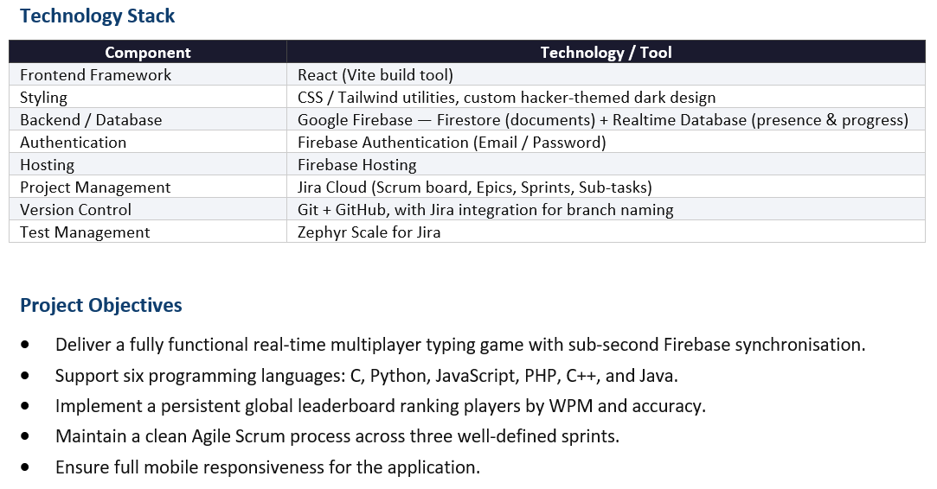
Introduction

Slide 3
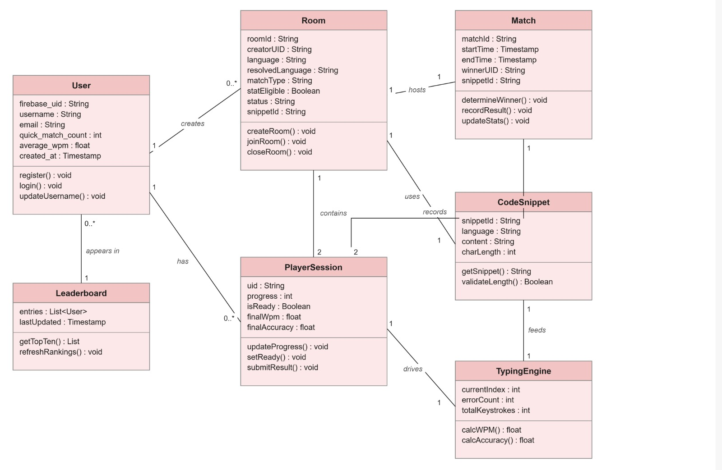
UML Class Diagram

Slide 4
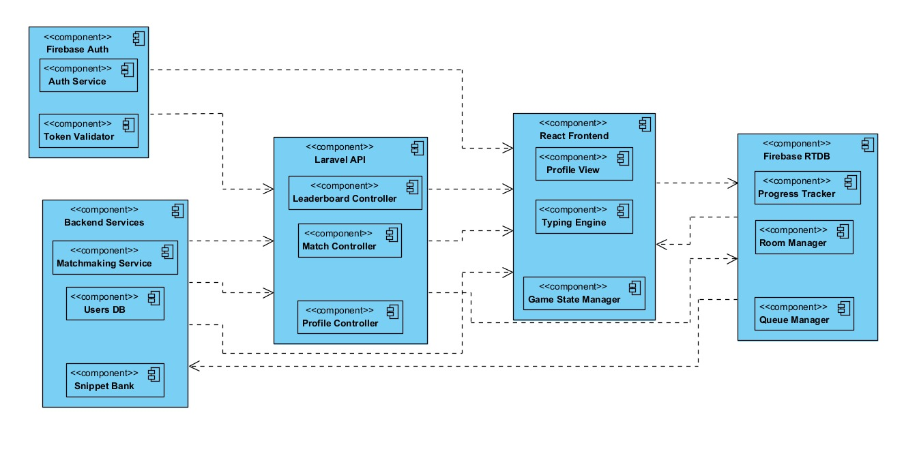


Component Diagram

Slide 5
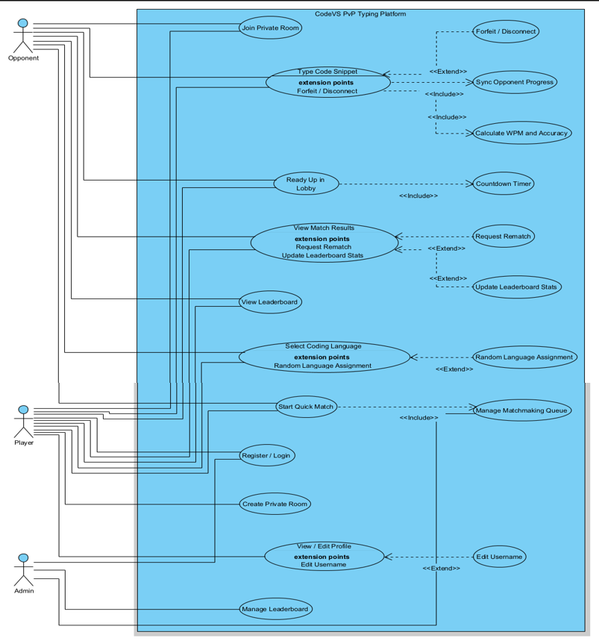
Use-case Diagram

Slide 6
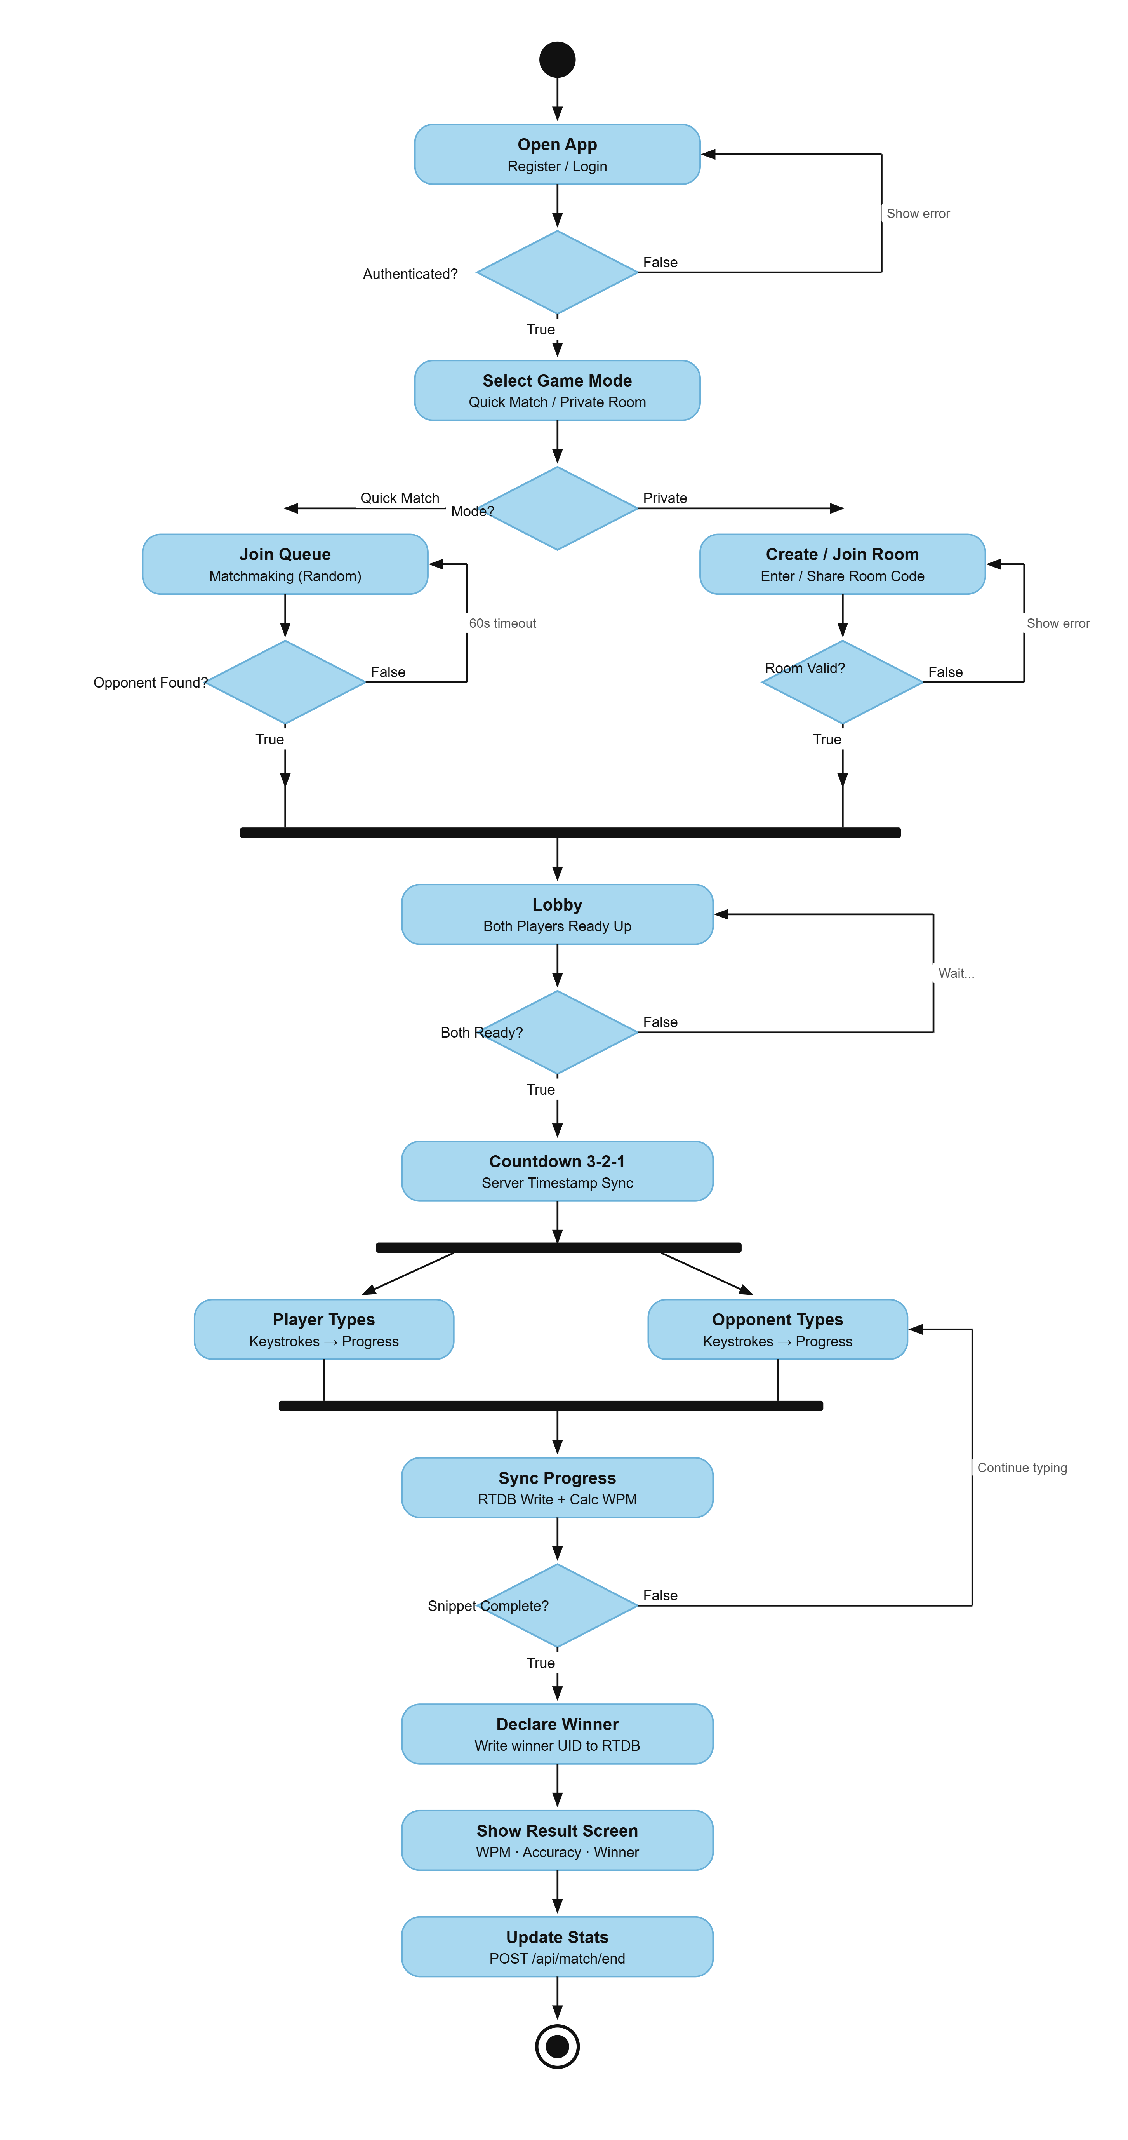
Activity Diagram

Slide 7
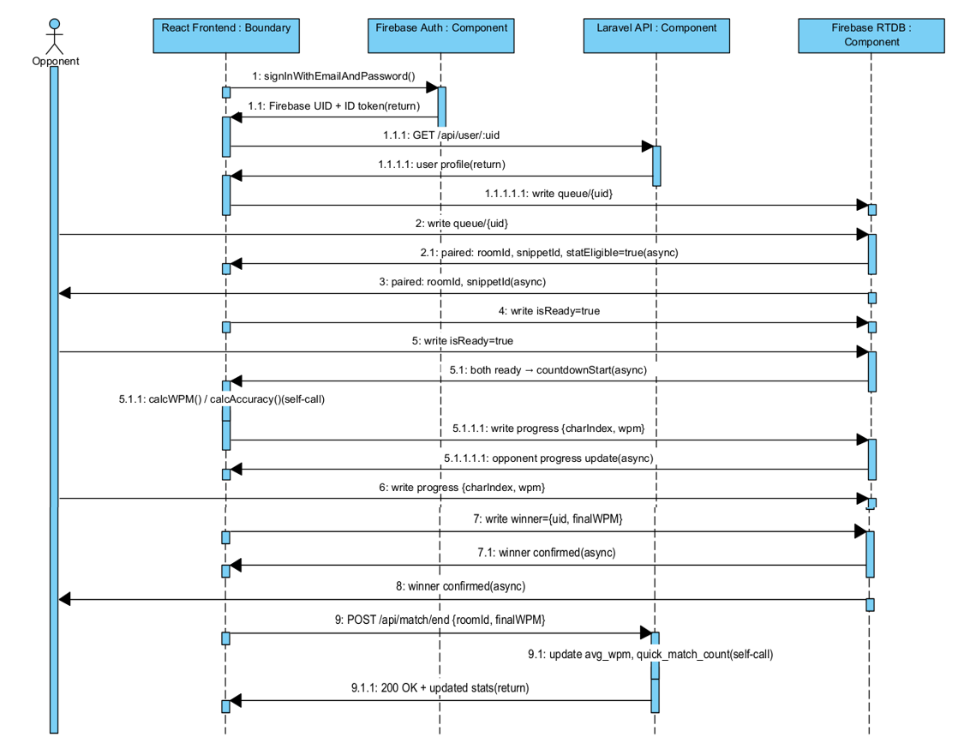
Sequence Diagram

Slide 8
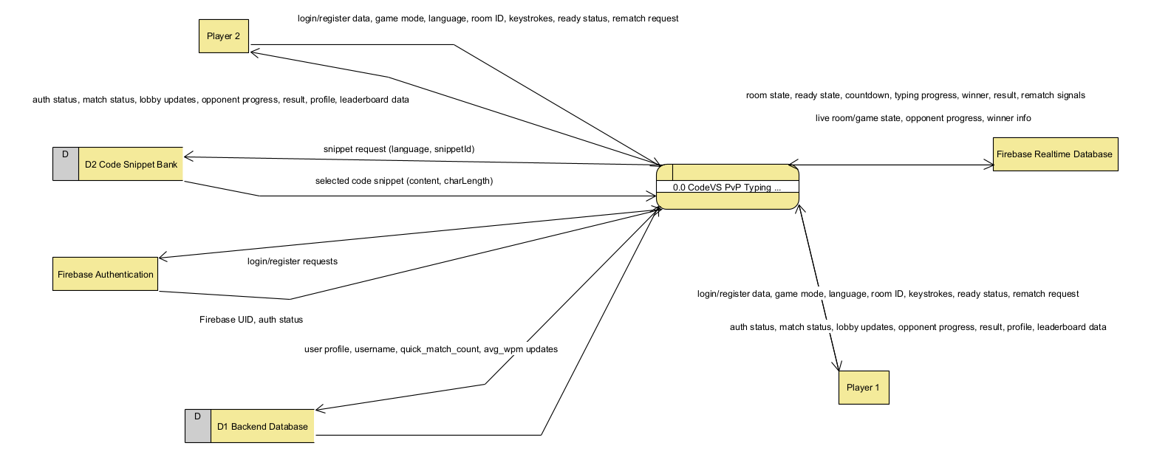
Context Level (Level 0) DFD

Slide 9
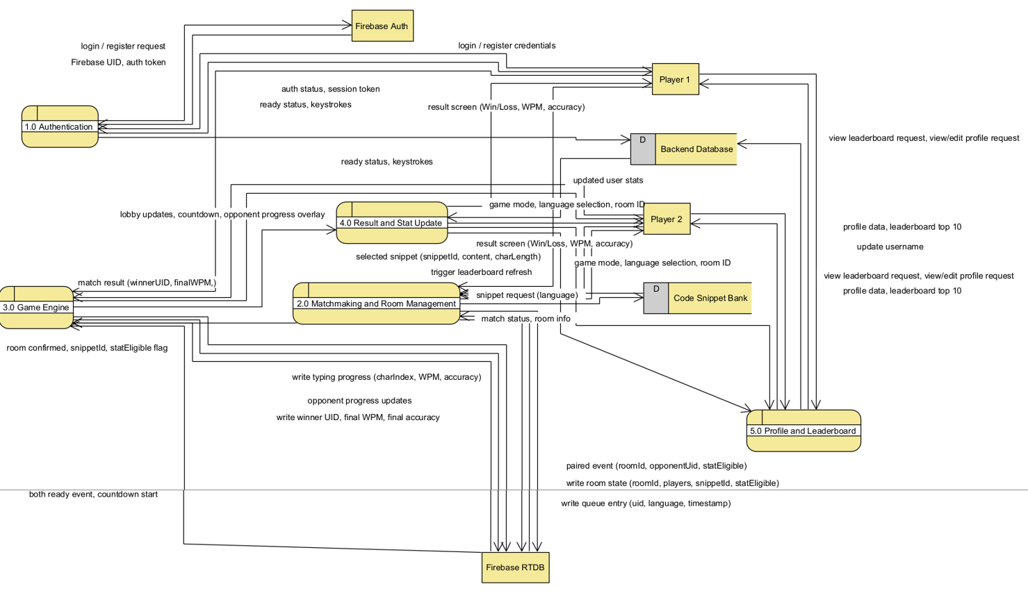
Level 1 DFD – Main Processes

Slide 10
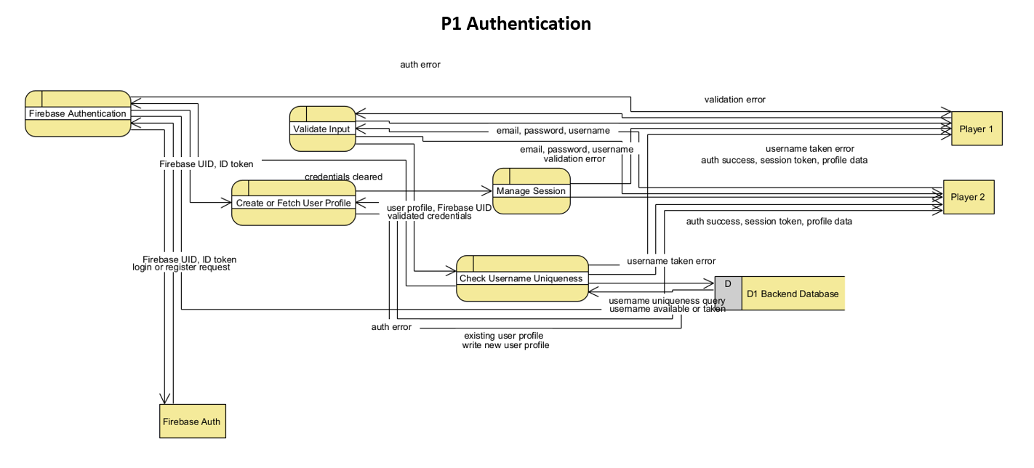
Level 2 DFD – Sub Process Details

Slide 11
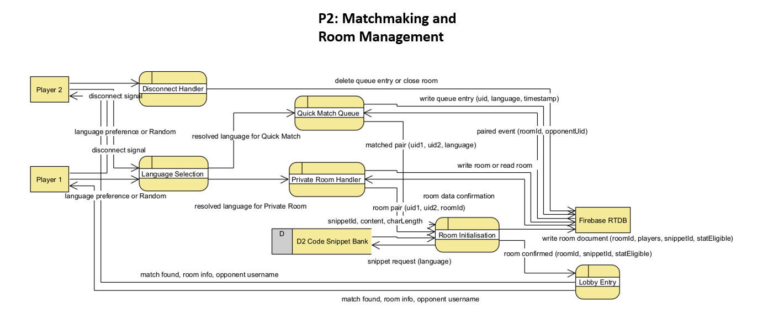
Level 2 DFD – Sub Process Details

Slide 12
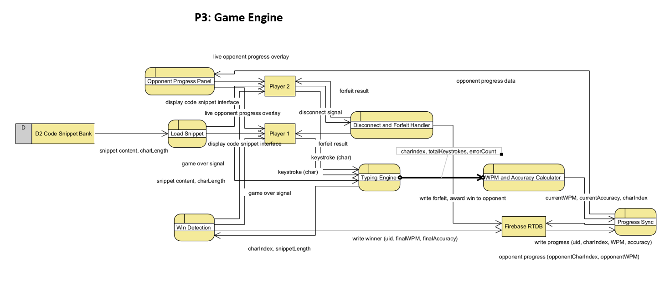
Level 2 DFD – Sub Process Details

Slide 13
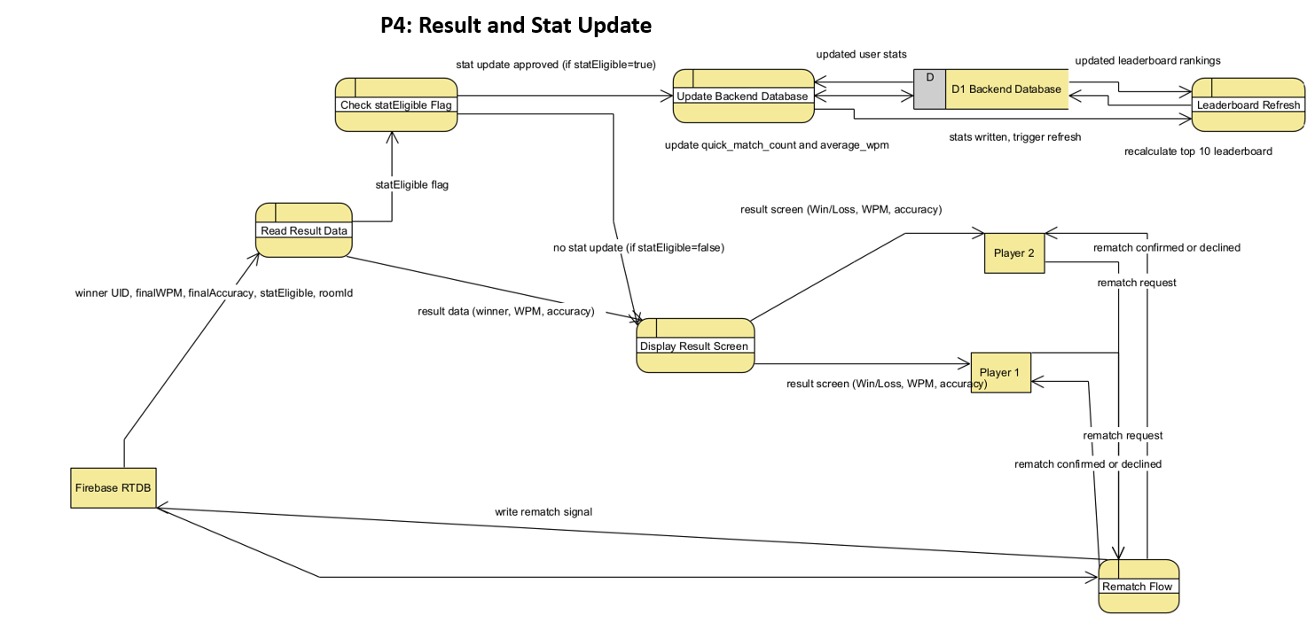
Level 2 DFD – Sub Process Details

Slide 14
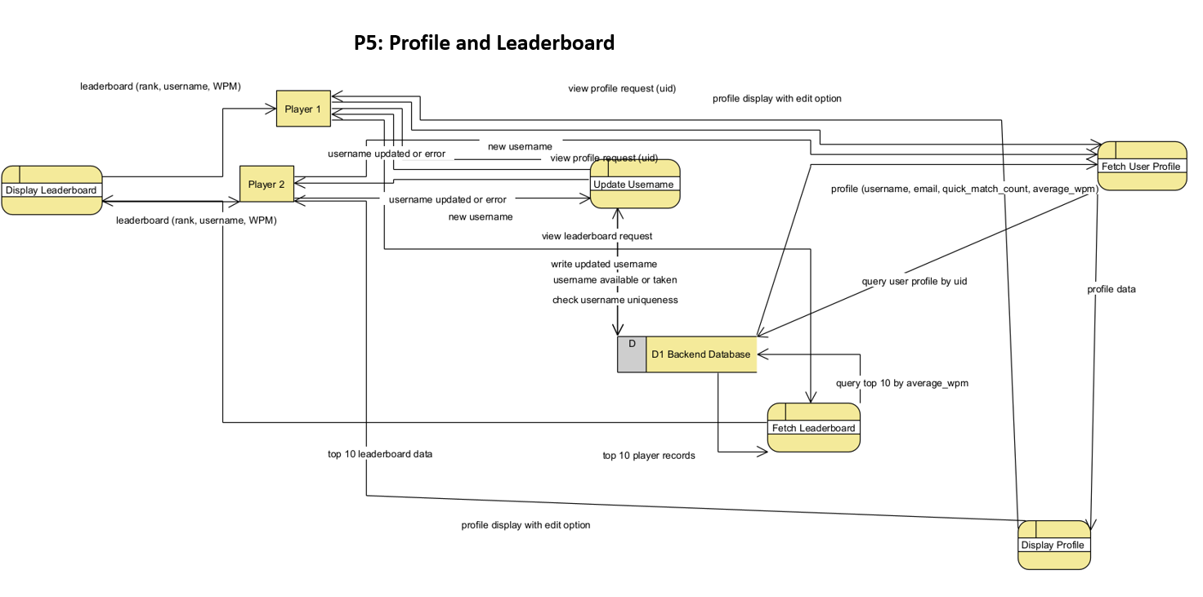
Level 2 DFD – Sub Process Details

Slide 15
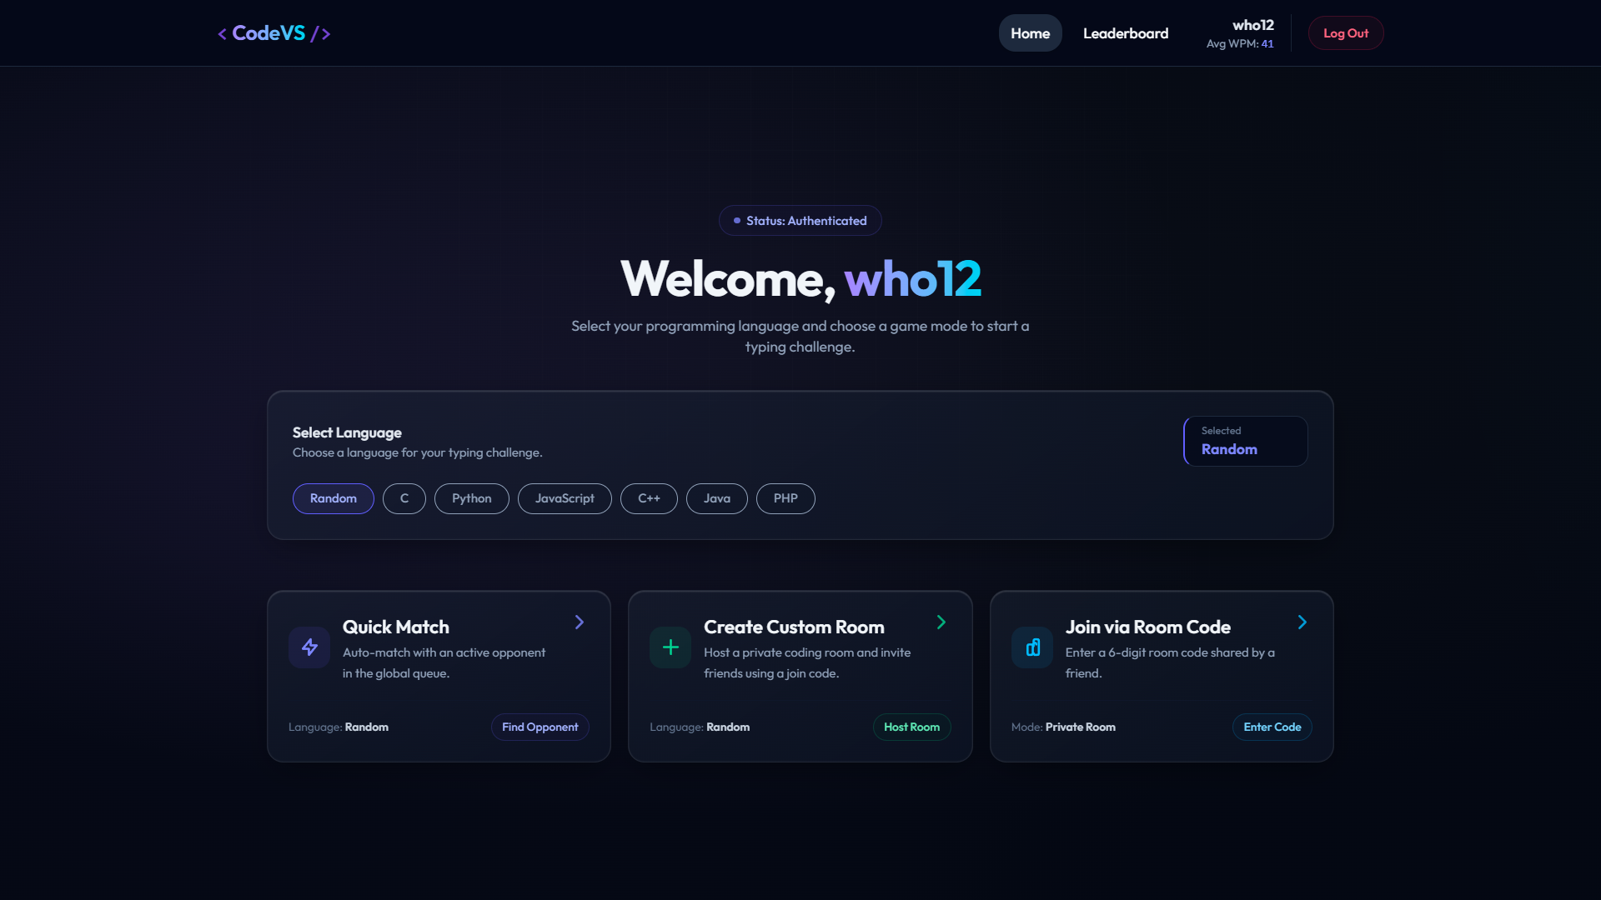
Landing Page

Slide 16
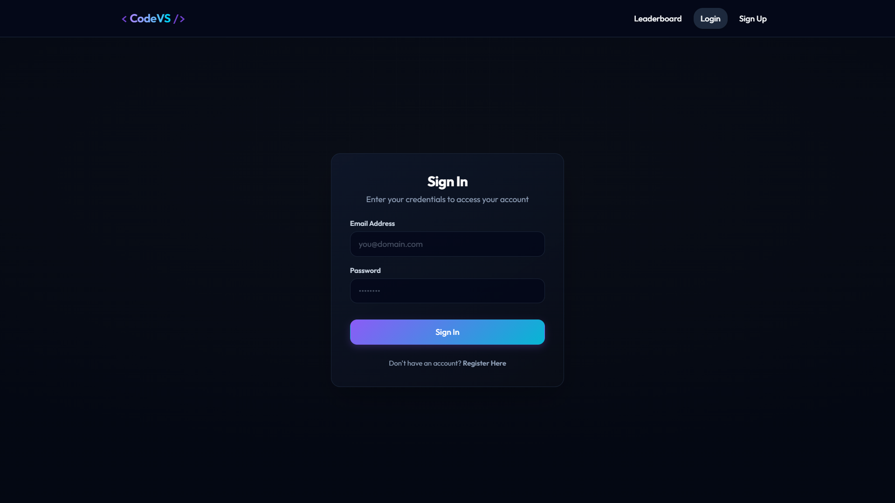
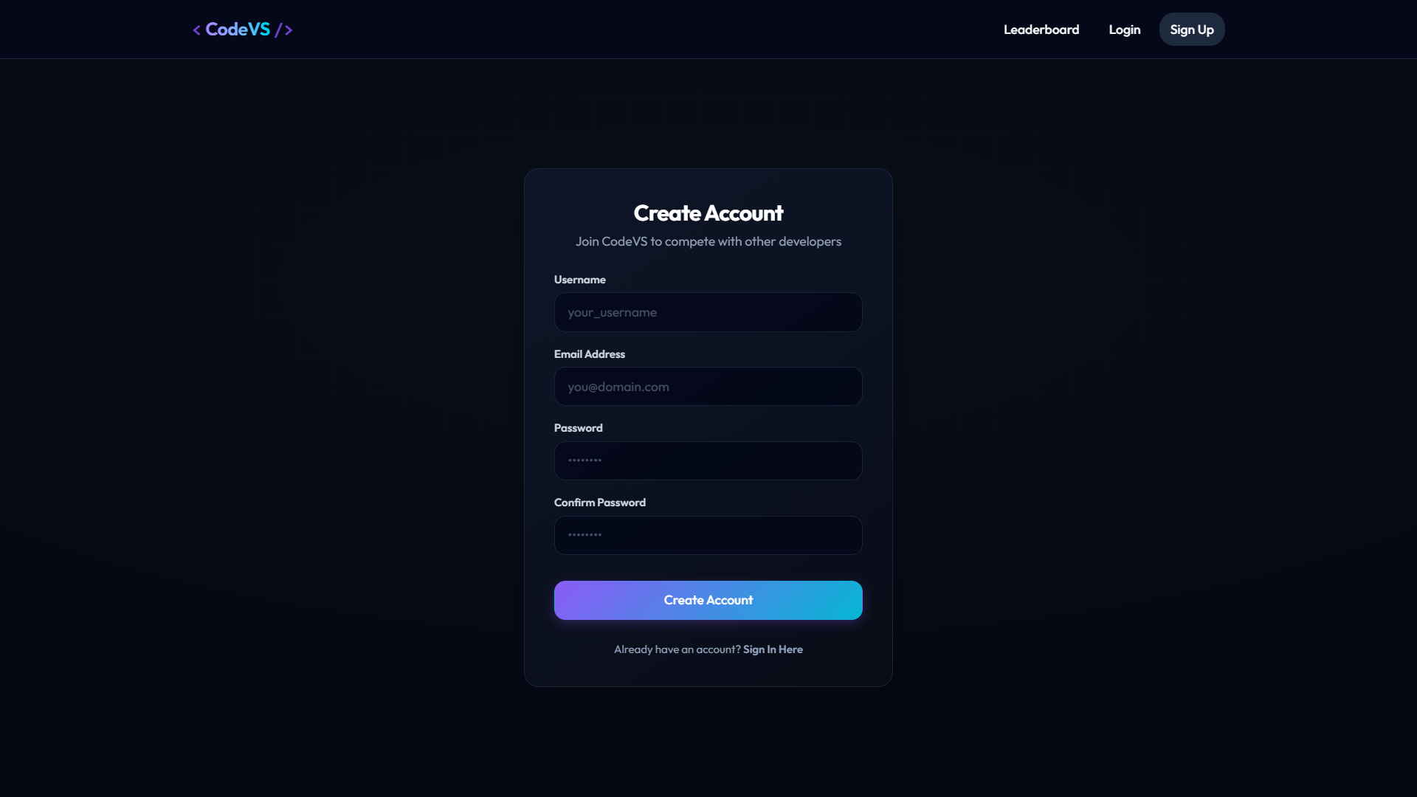
Sign-Up & Log-In

Slide 17
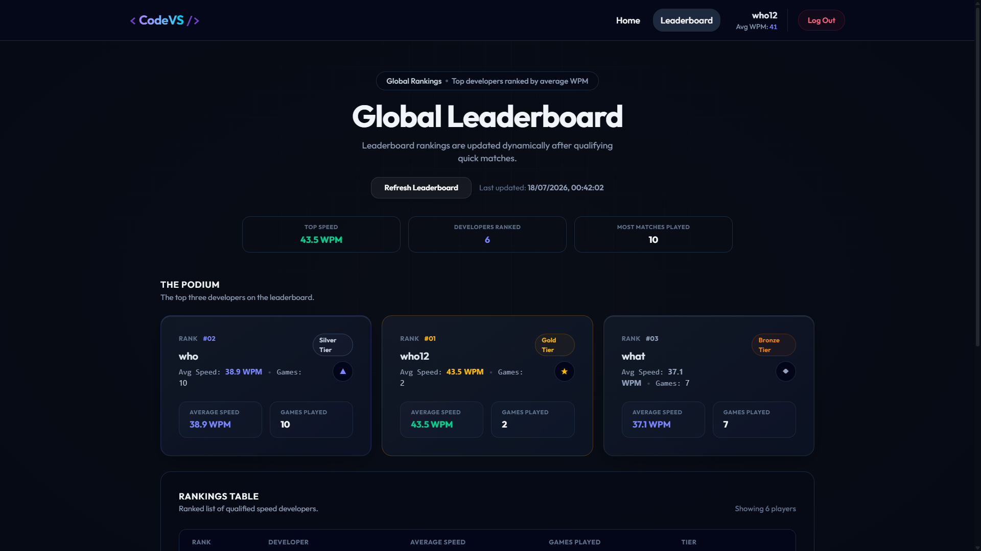
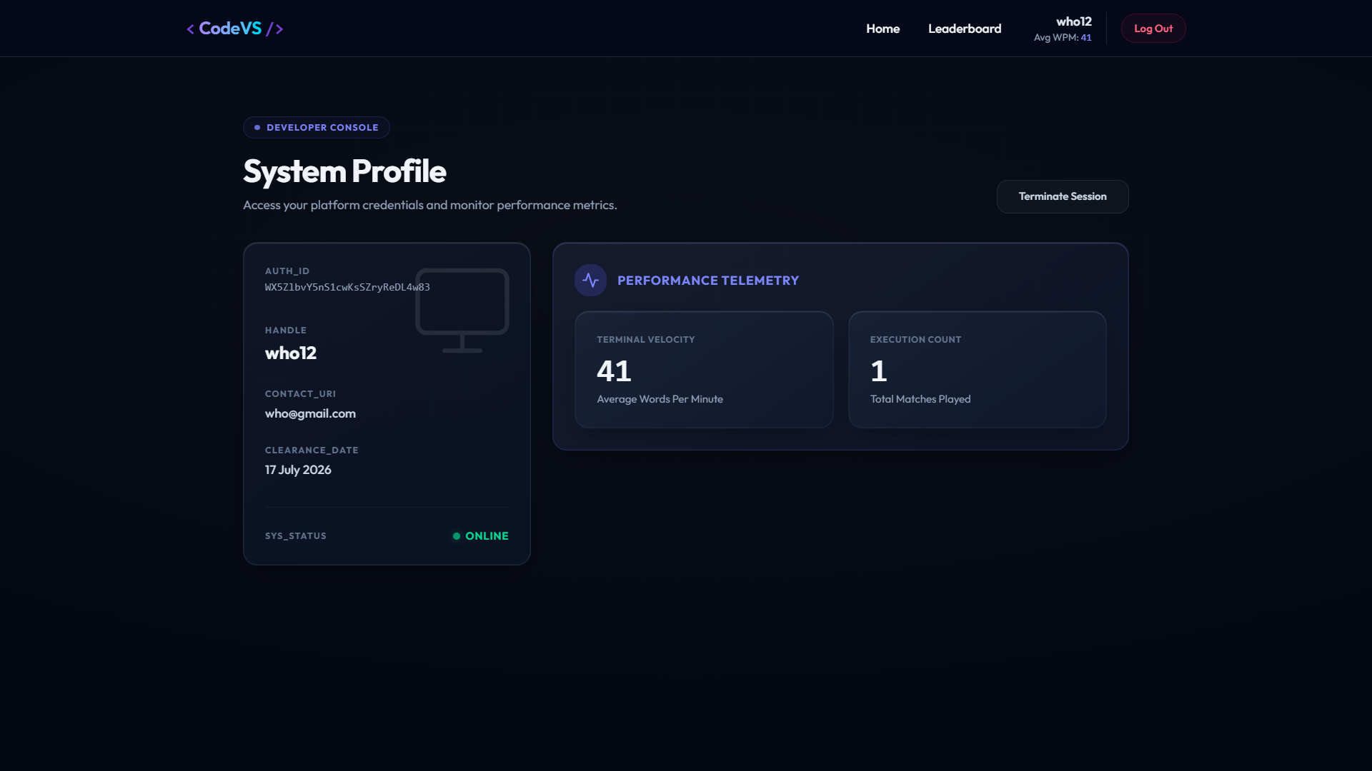
User Profile & Leaderboard

Slide 18
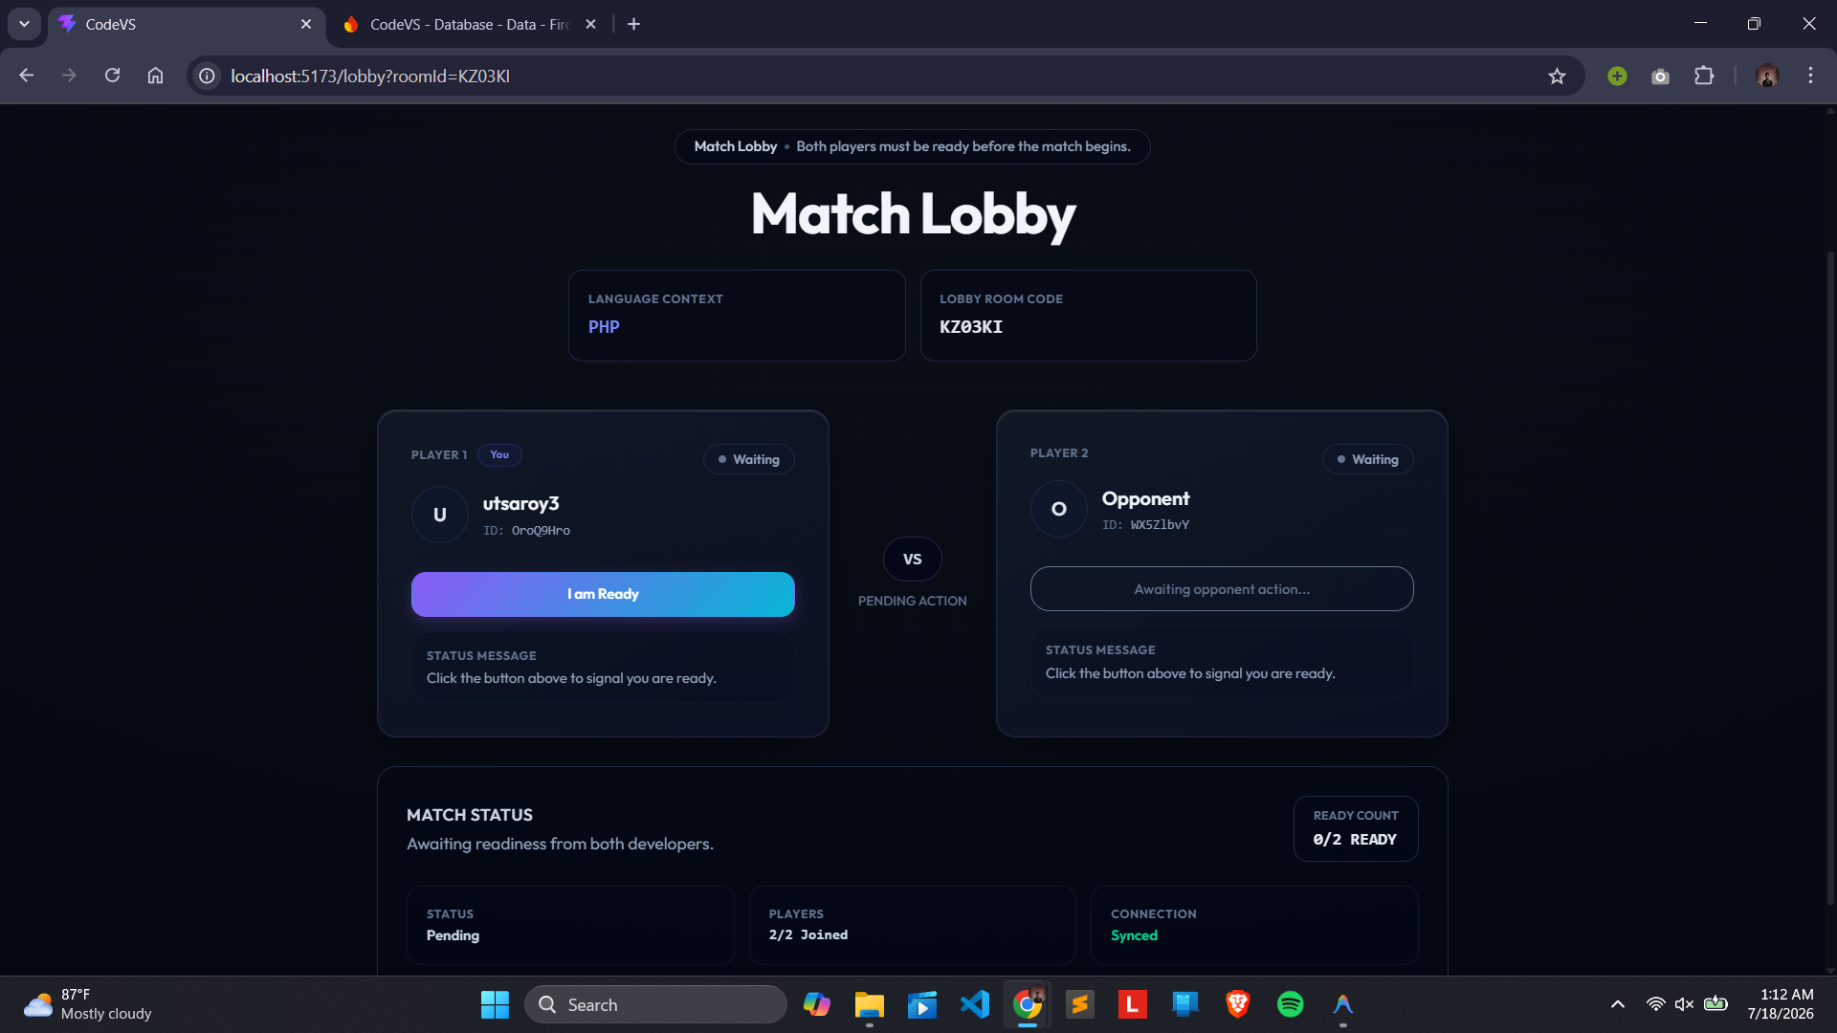
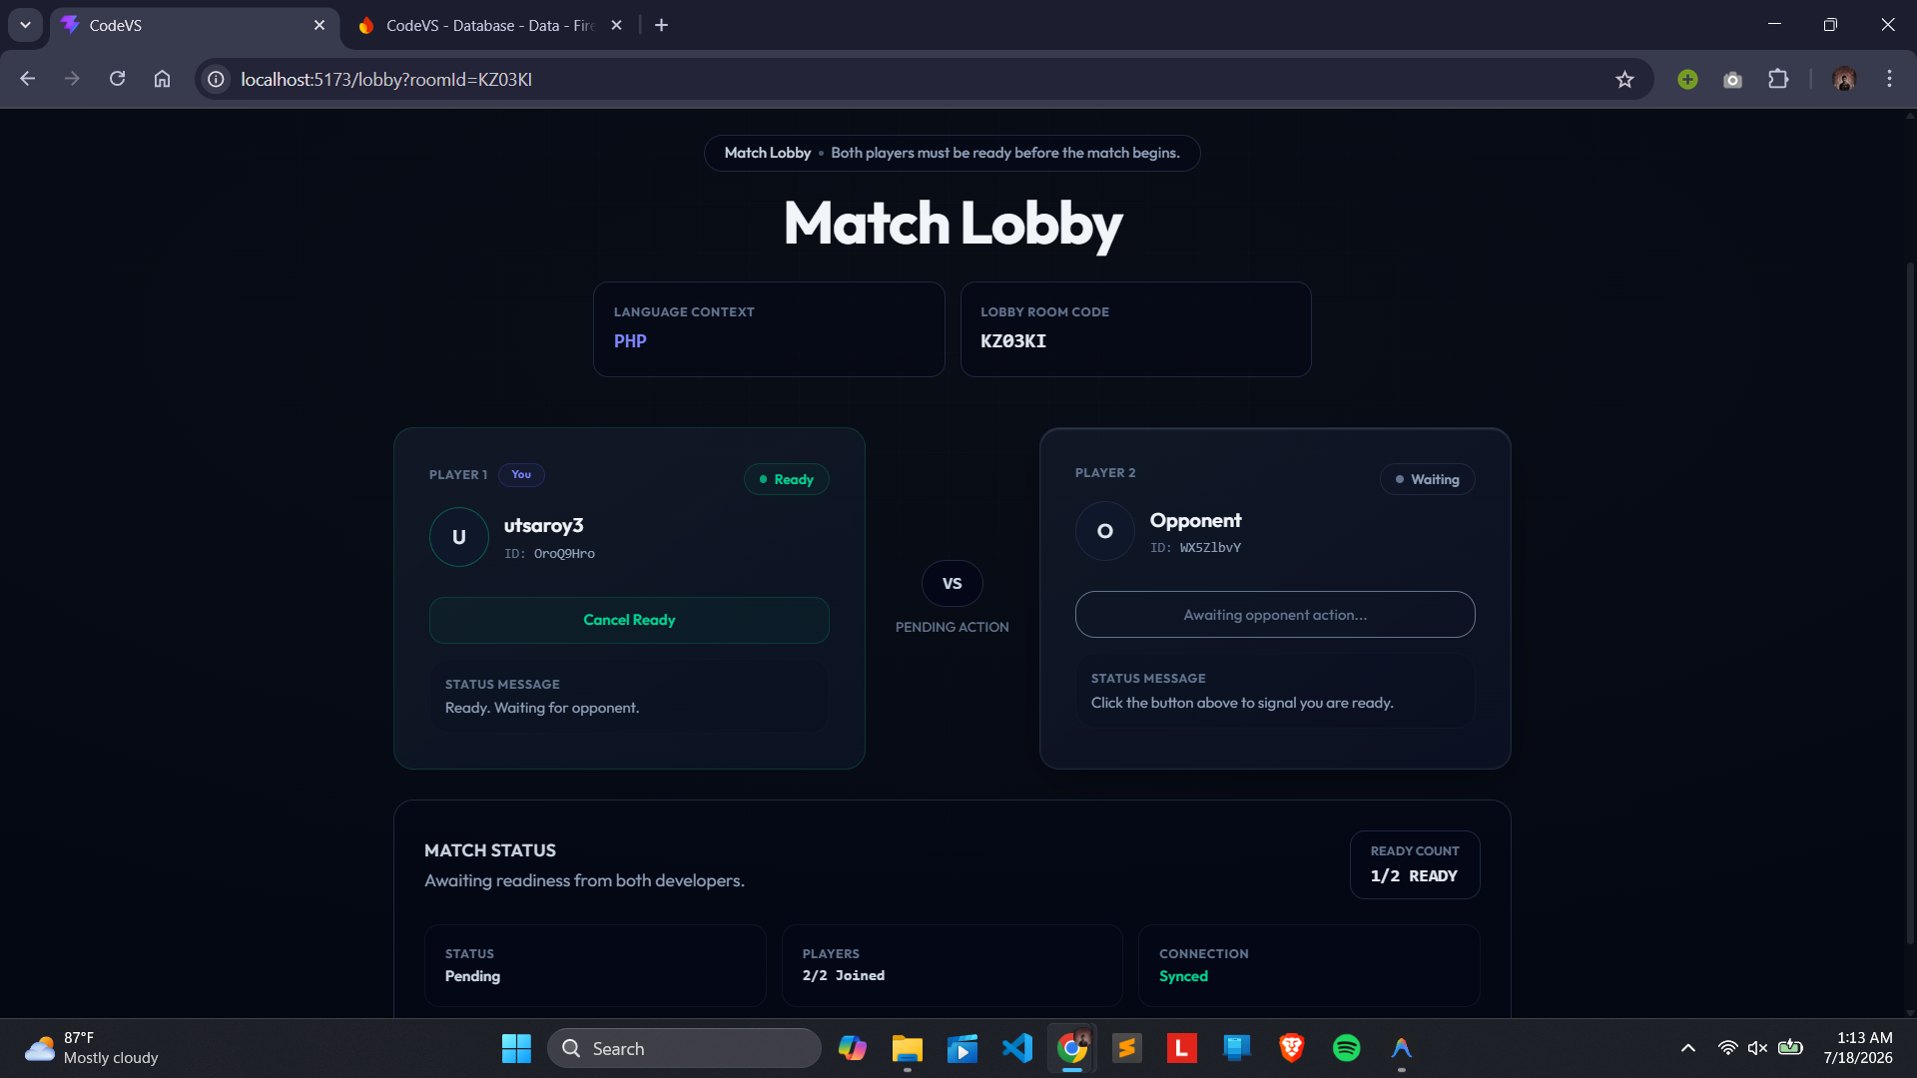
Matchmaking

Slide 19
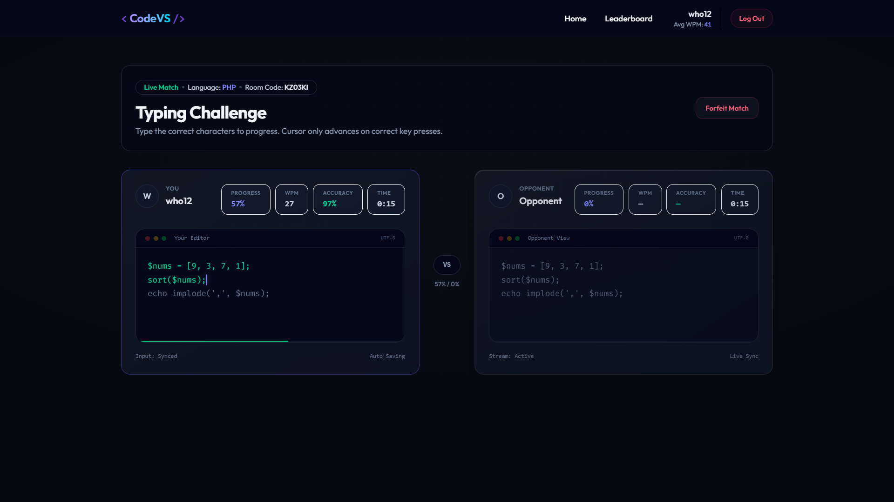
Typing Contest

Slide 20
Team & Roles
Rafsan Riasat
Utsa Roy
Md Adib Raian
Scrum Master
Backend & Game Engine Dev
Frontend & UI Dev
• Project scaffolding & Firebase setup
• Firebase Auth integration
• Home, Lobby, Game, Result screen UIs
• Page routing config (React Router)
• Firestore schema & data models
• Leaderboard visual overhaul
• Scrum ceremony facilitation
• Matchmaking queue & logic
• Global theme & typography system
• Cross-cutting QA coordination
• Room creation & join workflows
• Mobile responsiveness & layout
• Firebase security rules audit
• WPM & Accuracy calculator
• Snippet bank data (6 languages)
• Final production deployment
• Real-time opponent sync database
• Rematch & language picker state
Jira Ticket Breakdown: Rafsan Riasat — 16 Issues | Utsa Roy — 45 Issues | Md Adib Raian — 52 Issues

Slide 21
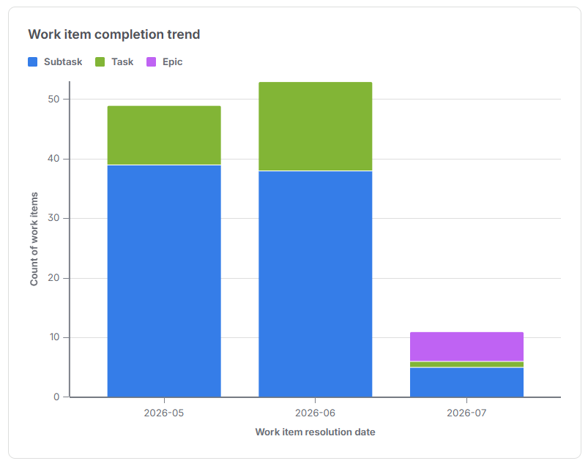
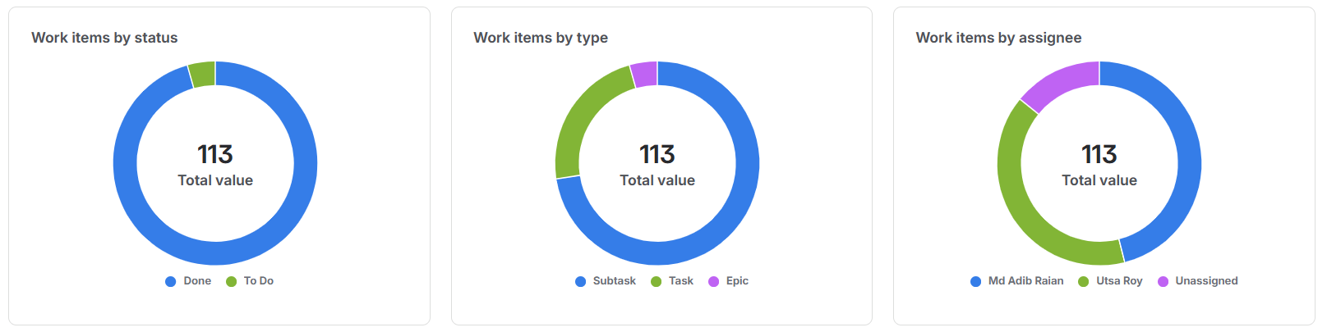
Agile Scrum Overview
5
26
82
3
113
Epics
Tasks
Subtasks
Sprints
Total Issues
Project Epics
Epic
Name
Tasks
Sprints
SCRUM-1
Project Setup & Auth
4 Tasks
Sprint 1
SCRUM-2
Matchmaking System
3 Tasks
Sprint 1-2
SCRUM-3
Game Engine
6 Tasks
Sprint 2-3
SCRUM-4
UI & Frontend
8 Tasks
Sprint 1-3
SCRUM-5
Code Snippet Bank & Leaderboard
5 Tasks
Sprint 1-3

Slide 22
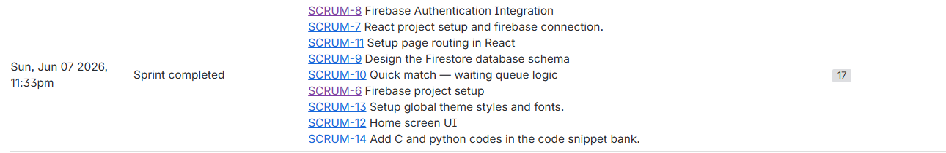
Sprint 1 — Project Foundation
Sprint Goal: Establish initial structure, configure Routing, database schemas, Authentication logic, and build initial layout.
Ticket
Task Description
Assignee
SCRUM-6
Firebase project setup
Rafsan
SCRUM-7
React project setup and firebase connection.
Rafsan
SCRUM-8
Firebase Authentication Integration
Utsa Roy
SCRUM-9
Design the Firestore database schema
Utsa Roy
SCRUM-10
Quick match — waiting queue logic
Utsa Roy
SCRUM-11
Setup page routing in React
Rafsan
SCRUM-12
Home screen UI
Adib Raian
SCRUM-13
Setup global theme styles and fonts.
Adib Raian
SCRUM-14
Add C and python codes in snippet bank.
Adib Raian
Story Points

Slide 23
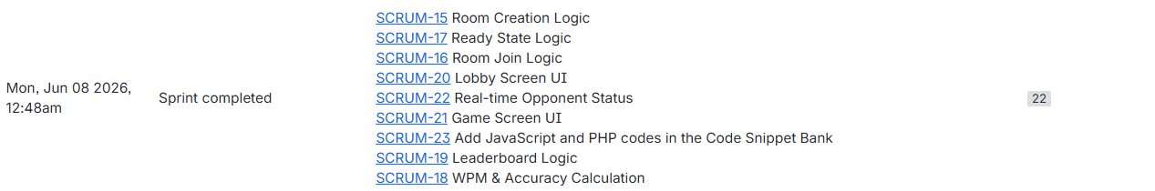
Sprint 2 — Core Multiplayer Engine
Sprint Goal: Implement real-time game logic, matchmaking queues, room creation, opponent tracking, and core stats calculations.
Ticket
Task Description
Assignee
SCRUM-15
Room Creation Logic (+5 subtasks)
Utsa Roy
SCRUM-16
Room Join Logic (+5 subtasks)
Utsa Roy
SCRUM-17
Ready State Logic (+5 subtasks)
Utsa Roy
SCRUM-18
WPM & Accuracy Calculation
Utsa Roy
SCRUM-19
Leaderboard Logic (+5 subtasks)
Utsa Roy
SCRUM-20
Lobby Screen UI (+3 subtasks)
Adib Raian
SCRUM-21
Game Screen UI (+5 subtasks)
Adib Raian
SCRUM-22
Real-time Opponent Status (+4 subtasks)
Utsa Roy
SCRUM-23
Add JS and PHP snippets to bank (+4 sub)
Adib Raian
Story Points

Slide 24
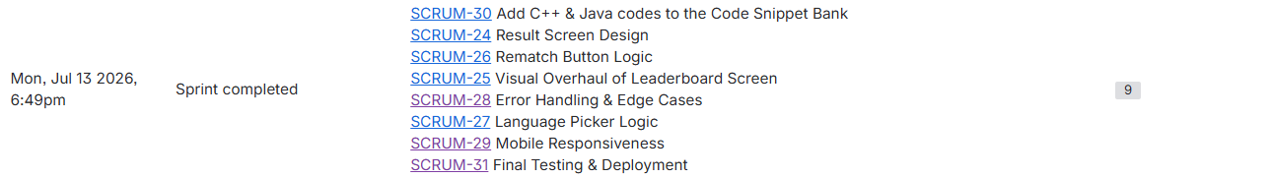
Sprint 3 — Polish, Testing & Deployment
Sprint Goal: Focus on rematch mechanisms, language selectors, visual polishing, mobile testing, and final hosting deployment.
Ticket
Task Description
Assignee
SCRUM-24
Result Screen Design (+4 subtasks)
Adib Raian
SCRUM-25
Visual Overhaul of Leaderboard (+4 subtasks)
Adib Raian
SCRUM-26
Rematch Button Logic (+5 subtasks)
Utsa Roy
SCRUM-27
Language Picker Logic (+5 subtasks)
Utsa Roy
SCRUM-28
Error Handling & Edge Cases (+5 subtasks)
Utsa Roy
SCRUM-29
Mobile Responsiveness (+4 subtasks)
Adib Raian
SCRUM-30
Add C++ & Java snippets (+4 subtasks)
Adib Raian
SCRUM-31
Final Testing & Deployment (+4 subtasks)
Rafsan
Story Points

Slide 25
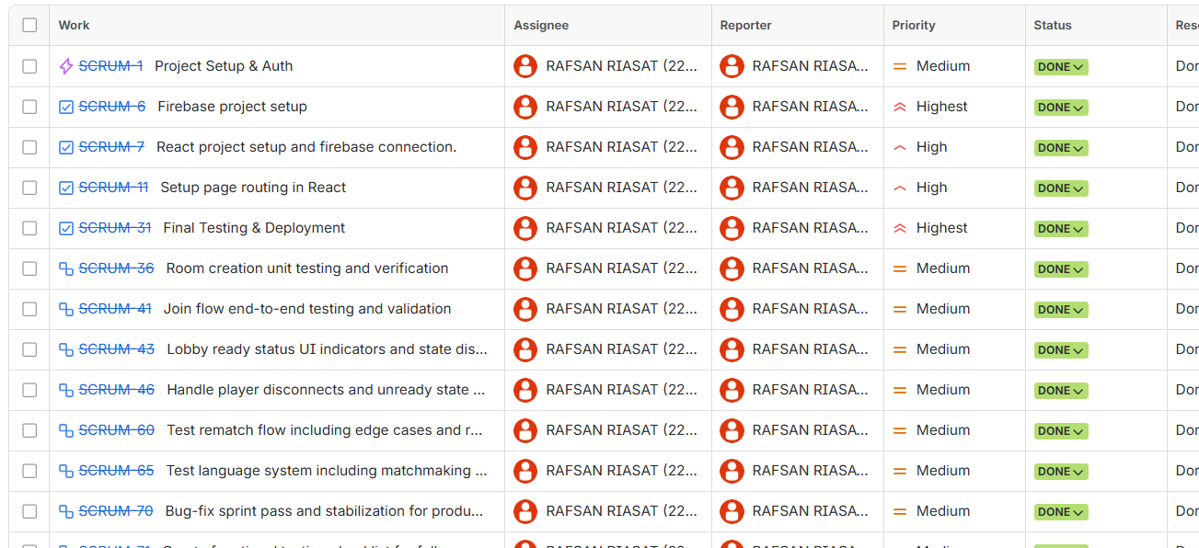
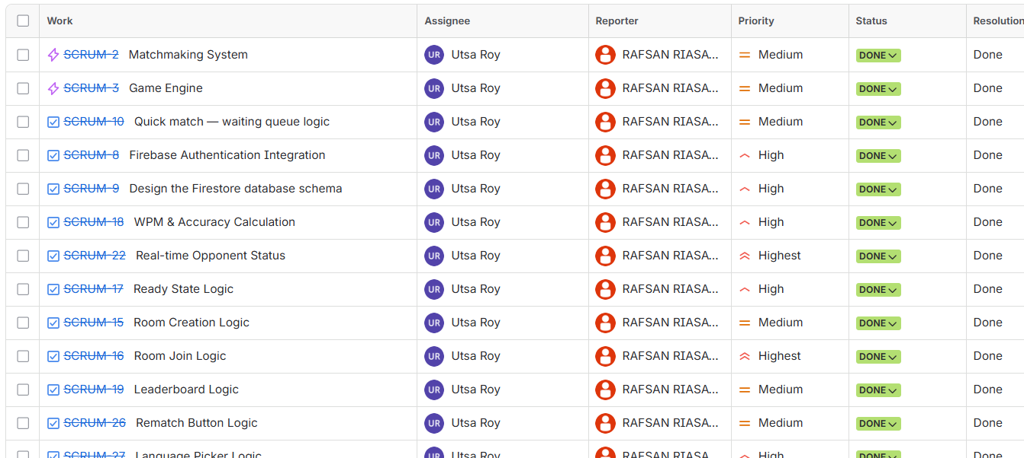
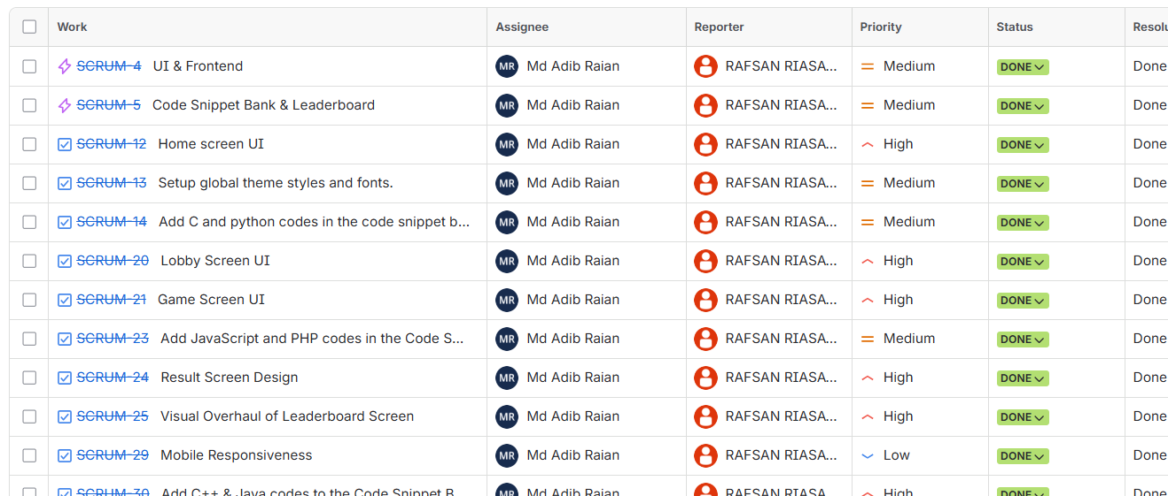
Task Division & Contributions
16 Issues
45 Issues
52 Issues
Rafsan Riasat Scrum Master
Utsa Roy Backend Developer
Md Adib Raian Frontend Developer
Rafsan Riasat (Scrum Master)
Utsa Roy (Backend Dev)
Md Adib Raian (Frontend Dev)
• Firebase configuration & project scaffolding
• Setup page routing in React (React Router v6)
• Lobby ready status UI indicators logic
• Created functional testing checklist E2E
• Conducted E2E multiplayer test sessions
• Security audit of Firestore & Realtime DB rules
• Created hosting deployment via Firebase CLI
• Firebase Authentication login/signup flows
• Firestore database schemas design
• Matchmaking queue state logic (Realtime DB)
• Room creation & room validation (6-character IDs)
• Typing accuracy & WPM calculation logic
• Realtime opponent progress synchronizer
• Post-match rematch engine & languages matchmaking
• Designed hacker/dark theme styled UI
• Global CSS configuration & Typography rules
• Home, Lobby, Game & Result screen components
• Leaderboard overlay animations & UI polish
• Completed responsiveness across all viewports
• Curated and integrated snippets bank (6 langs)
• Built language selection UI dropdowns

Slide 26
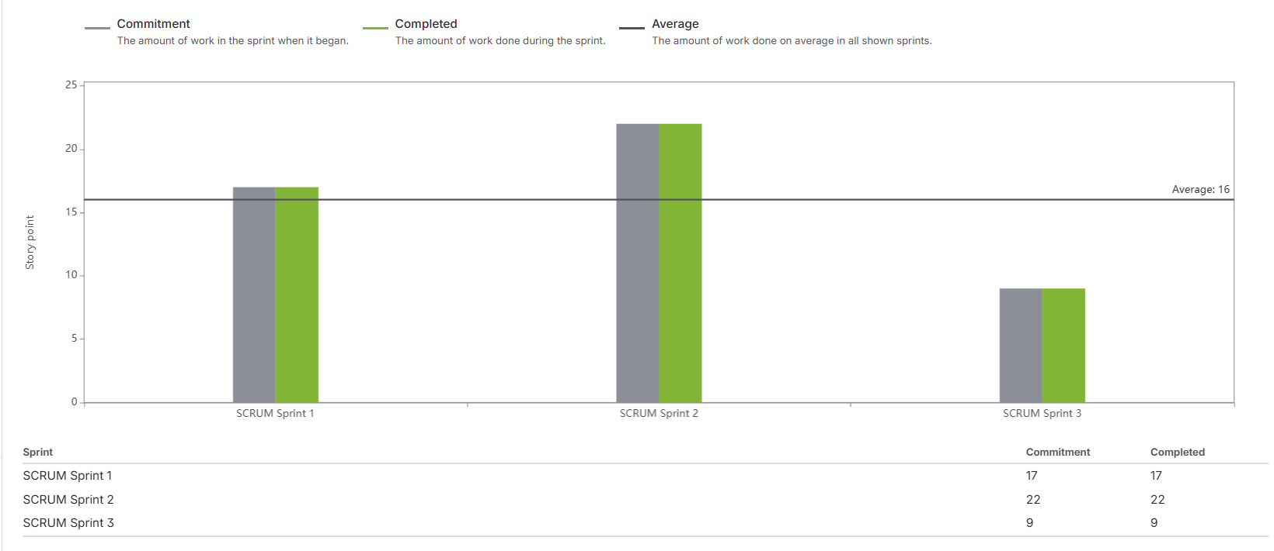
Jira Workflow
Jira Methodology
Jira Issue Hierarchy
• Sprints were time-boxed to 1-2 weeks
• Backlog partitioned into 5 Epics
• Tasks broke down large requirements
• Subtasks defined atomic coder actions
• Estimates assigned to developers
• Work progressed through standard columns:
• To Do → In Progress → Done
• Sprint reviews determined carry-overs
Epic
High-Level Product Goals (5)
Task
Feature Deliverables (26)
Subtask
Developer Actions (82)

Slide 27
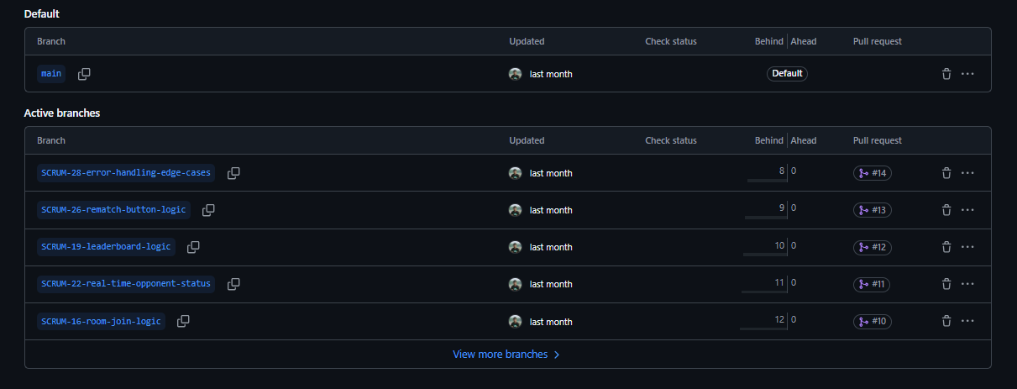
Git / GitHub Workflow & Branching
Branching Strategy
Feature Branches (13)
• main — production release branch (protected)
• Feature branches mapped to Jira IDs:
• SCRUM-{number}-{slug}
• No direct commits allowed to main branch
• Code changes isolated inside feature branch
• Pull Requests opened for code reviews
• PR merged to main updates Jira issue status
SCRUM-8-firebase-authentication-integration
SCRUM-16-room-join-logic
SCRUM-19-leaderboard-logic
SCRUM-20-lobby-screen-ui
SCRUM-21-game-screen-ui
SCRUM-22-real-time-opponent-status
SCRUM-23-add-js-php-snippets
SCRUM-24-result-screen-design
SCRUM-25-leaderboard-visual-overhaul
SCRUM-26-rematch-button-logic
SCRUM-28-error-handling-edge-cases
SCRUM-29-mobile-responsiveness
SCRUM-30-add-cpp-java-snippets

Slide 28
Commit Traceability & History
31
14
68%
3
Total Commits
Pull Requests
Commits with Jira ID
Active Contributors
Key Chronological Commits
Date
Author
Commit Message
2026-05-22
Rafsan
feat: add initial project structure with React, routing, Firebase
2026-05-31
Adib
SCRUM-20 feat: add lobby screen UI
2026-05-31
Adib
SCRUM-21 feat: add game screen UI
2026-05-31
Adib
SCRUM-25 feat: overhaul leaderboard screen UI
2026-06-07
Utsa
Implemented Login and Registration features
2026-06-07
Utsa
Implemented Room creation and room joining logic
2026-06-08
Utsa
Implemented Live status, WPM calculation and ready states
2026-06-08
Utsa
SCRUM-31 Final Testing & Deployment — bug fix on match exit
2026-06-10
Utsa
Fixed a bug (post-sprint hotfix)

Slide 29
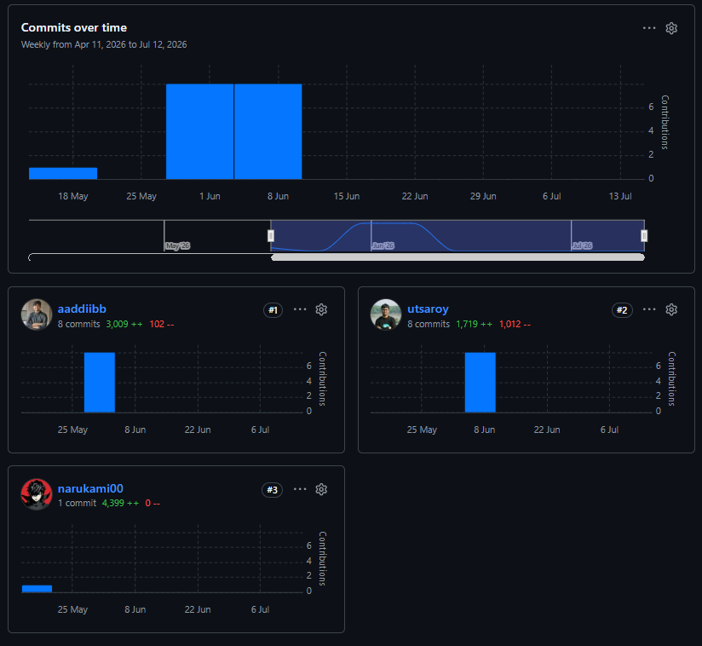
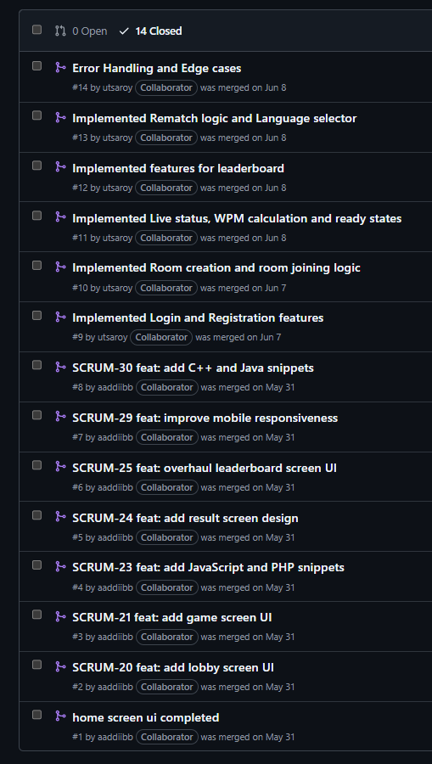
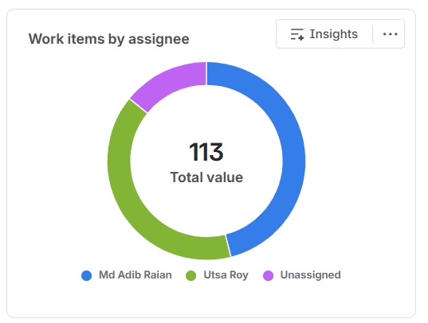
Contribution & Pull Requests

Slide 30
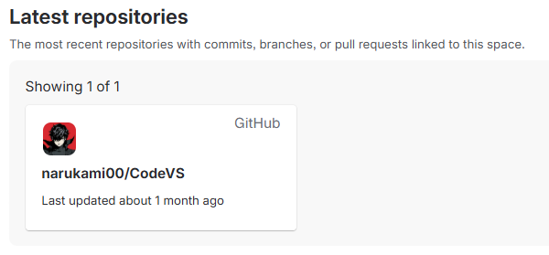
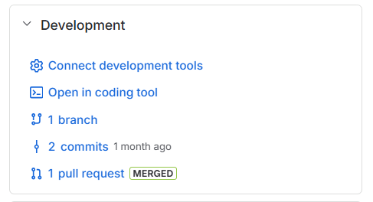
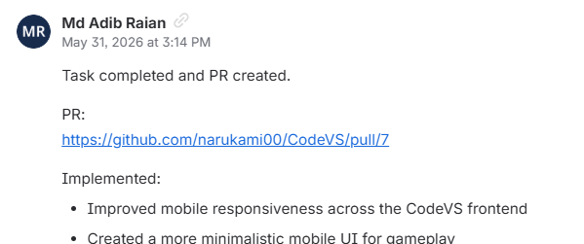
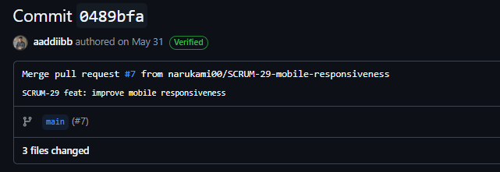
Jira–GitHub Integration
1. Jira Ticket
2. Git Branch
3. GitHub PR
4. Jira Status Auto-Done
Backlog item allocated e.g., SCRUM-22
Branch named with ID SCRUM-22-opponent-sync
Commits pushed PR raised & reviewed
PR merges, linking updates ticket column to Done

Slide 31
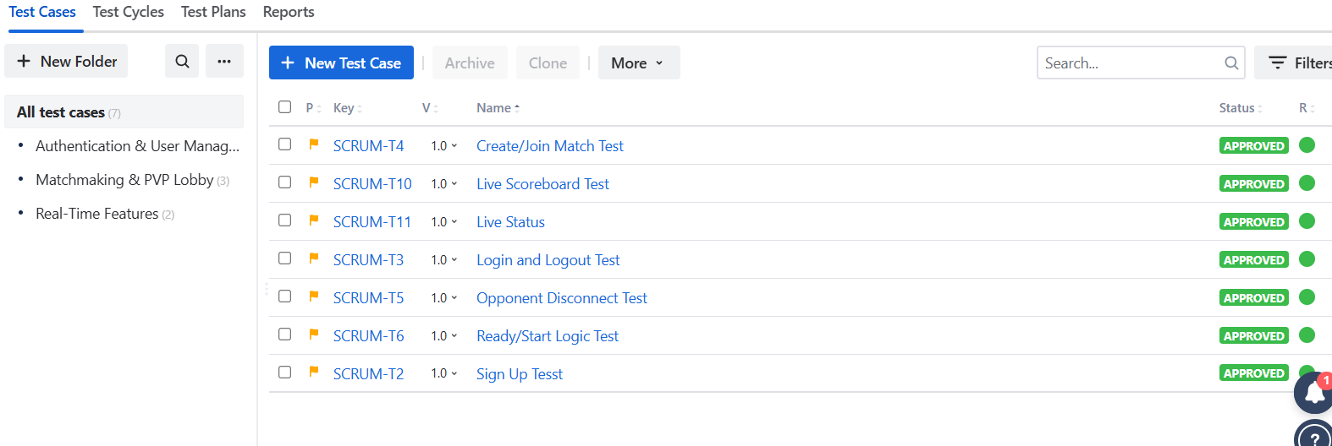
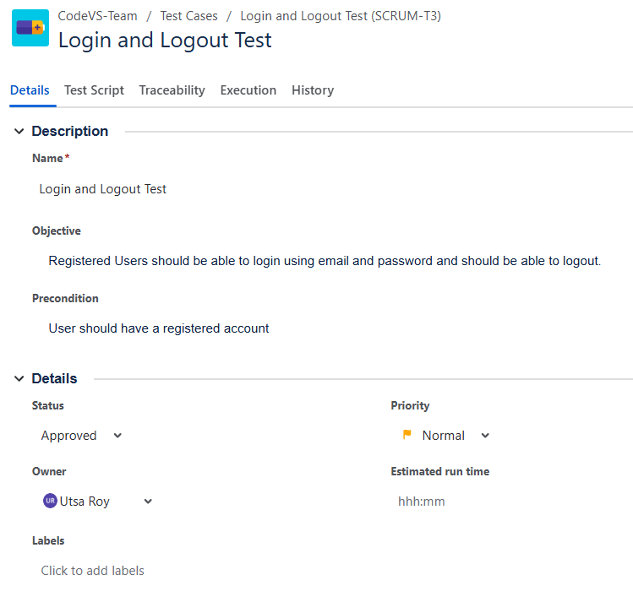
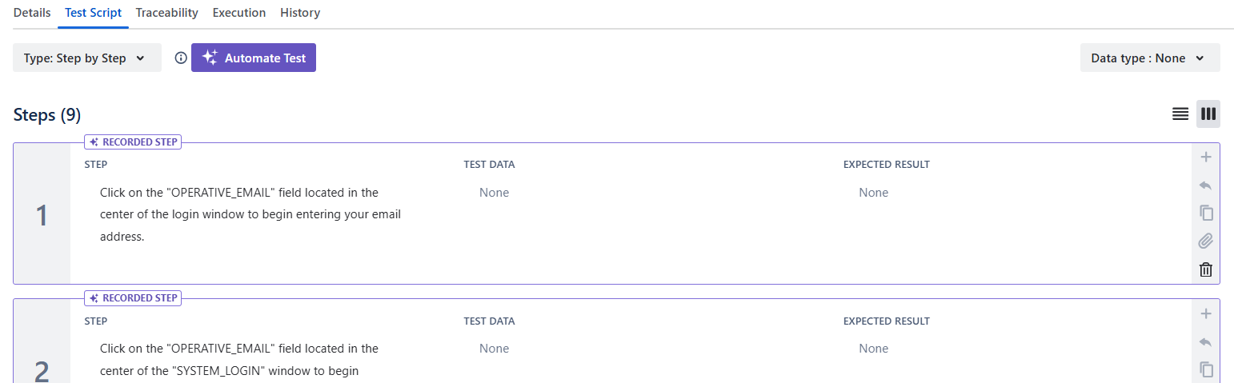
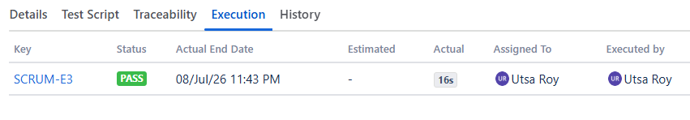
QA & Test Cycle Management (Zephyr)

Slide 32
Epic & Task Hierarchy Breakdown
SCRUM-1 Project Setup & Auth
SCRUM-2 Matchmaking System
SCRUM-3 Game Engine
SCRUM-4 UI & Frontend
SCRUM-5 Snippet Bank & Leader- board
Firebase setup (Rafsan)
Queue state logic (Utsa)
Ready state +5 subs (Utsa)
React routing (Rafsan)
C & Py Snippets +4 (Adib)
React bootstrap (Rafsan)
Room Create +5 subs (Utsa)
WPM Engine logic (Utsa)
Home layout +3 subs (Adib)
Leaderboard logic +5 (Utsa)
Firebase Auth logic (Utsa)
Room Join +5 subs (Utsa)
Opponent Sync +4 sub (Utsa)
Theme styles +4 sub (Adib)
JS & PHP Snippets +4 (Adib)
Firestore schemas (Utsa)
Rematch Logic +5 sub (Utsa)
Lobby layout +3 sub (Adib)
C++ & Java Snips +4 (Adib)
Lang Picker +5 sub (Utsa)
Game layouts +5 sub (Adib)
QA Deployment +4 (Rafsan)
Error cases +5 sub (Utsa)
Result view +4 sub (Adib)
Leaderboard UI +4 (Adib)
Mobile polish +4 sub (Adib)

Slide 33
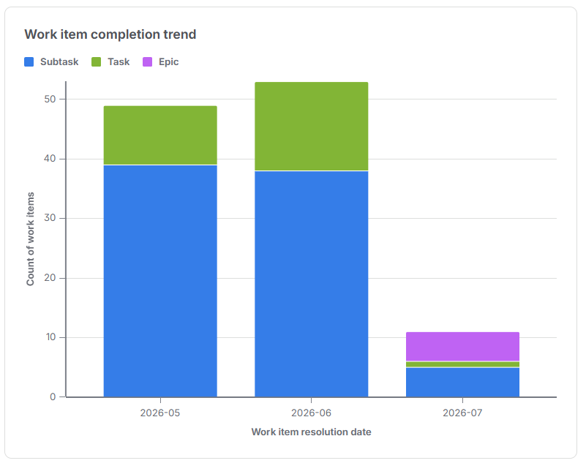
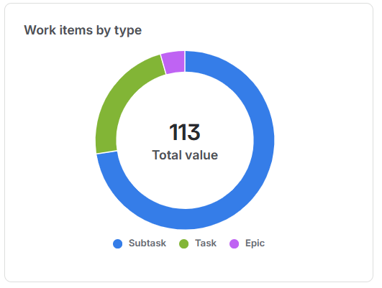
Project Outcomes & Performance Metrics
113
100%
3
31
Total Jira Issues
Resolution Rate
Sprints Delivered
Production Commits
14
13
6
7
Pull Requests Merged
Jira-Linked Branches
Supported Languages
QA Test Cases Run

Slide 34
Thank You
Github repository: https://github.com/narukami00/CodeVS
Website: https://codevs-a9bf1.web.app/

