Slide 1

LibreOffice: the current status of the most powerful OSS office suite
Naruhiko Ogasawara (Twitter: @naru0ga)
LibreOffice Japanese community,
The Document Foundation

Slide 2



Who am I
小笠原(OGASAWARA) 徳彦 (Naruhiko)
FLOSS lover from Japan
Live in Chiba, near by Tokyo
LibreOffice Japanese community
  Japanese UI/Help translation coordinator, JP event coordinator
  Now trying to development
The Document Foundation member

Slide 3
Topics
What is LibreOffice?
Notable LibreOffice Features
LibreOffice Online
LibreOffice for mobile?
LibreOffice Asia League

Slide 4
What is LibreOffice?
The most powerful OSS office suite

Slide 5
Outline
Full-featured OSS office suite
Only one active successor of OpenOffice.org
2 billions estimated users worldwide
Mozilla Public License v2+
C++11 7 millions of code
Windows / macOS / Linux official build
Time based release

Slide 6







Components
Writer – wordprocessor
Calc – spreadsheet
Impress – presentations
Draw – diagrams
Base – database
Math – formula editor

Slide 7

2020 is NOT COVID-19 year… 10/20 Celebration!
LibreOffice was announced on
Sep. 28, 2010
OpenOffice.org, the predecessor of LibreOffice, was launched on
July 19, 2000

Slide 8
Open Document Format (ODF)
LibreOffice native format
Real Open Standard for office documents
  OASIS OpenDocument TC Committee Standard
  ISO/IEC 26300
Simple, human readable, easy to machine-manipulate XML
Keep up with the evolution of the application
  Not as the “pseudo standard,” which is essentially unrevised from the proprietary application document format released in 2007

Slide 9
Notable LibreOffice features
(considering good note...)

Slide 10

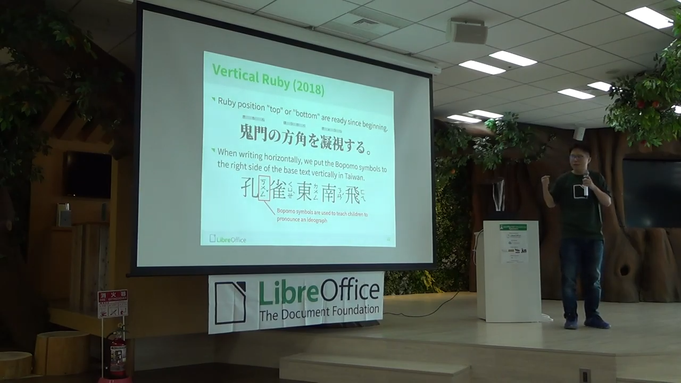
CJK Features
LibreOffice has several CJK specific features like…
  Asian Typography
  Grid Layout
  Input Method Support
  Mixing Western and Asian Scripts
  Non-BMP Unicode Character support
  …
“LibreOffice CJK Bugs, Fixes,
and Stories” by Mark Hung
  https://www.youtube.com/watch?v=FvOkLdTEguo

Slide 11
Notable features ...
OOXML interoperability
Notebookbar
Document Signing
Redaction
QR Code insertion
… (anything else?)
(will write slides for each features)

Slide 12
LibreOffice Online
You can host collaboration office suite in your environment,
And even integrate it into your own app!

Slide 13
UNDER CONSTRUCTION… outline
Demo
Overview
  NOT a service, BUT a way of host your own sevice
  NOT a whole software, BUT a component to add office-edit feature in your app
Typical integration
  Owncloud / Nextcloud, Moodle, …
Implementation

Slide 14
LibreOffice Mobile?
Little far from production, but we are trying to do more

Slide 15
UNDER CONSTRUCTION… outline
Android Viewer
Collabora Office for iOS/Android
  Focus on implementation rather than the product itself
  (I'm not trying to promote Collabora :P

Slide 16
LibreOffice Asia League
Here in Asia, we can make LibreOffice better together!

Slide 17
(TO BE WRITTEN...)

Slide 18
Conclusion
...

Slide 19
Thank you for listening!
… If you haven’t use LibreOffice, just try!
… If you already use LibreOffice, join our Asia League!

