Slide 1
LibreOffice Asia Conference 2019 Tokyo; what we had achieved, and what's next
Naruhiko Ogasawara
naruoga@gmail.com / @naru0ga
/w: Shinji Enoki & Jun Nogata
ALMERIA | 12th Sept. 2019

Slide 2

Agenda
Who we are?
Why “Asia Conference”?
What we have achieved
And… what’s next?
Conclusion

Slide 3
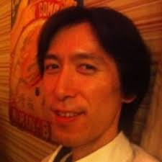
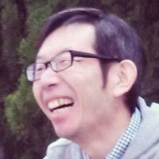
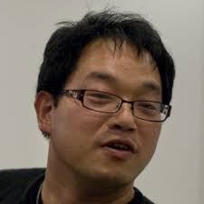
Who we are?
From LibreOffice Japanese Team (Japanese NLP)
Shinji Enoki
  Certified LibO migration specialist
  Host / exhibit so many Japanese local events
Jun Nogata
  Certified LibO training specialist
  The designer of Impress theme “Alizarin” & “Midnight Blue”
  Social network marketing (Twitter, Facebook)
Naruhiko Ogasawara (me!)
  JA translation co-coordinator

Slide 4
Why “Asia Conference”?

Slide 5
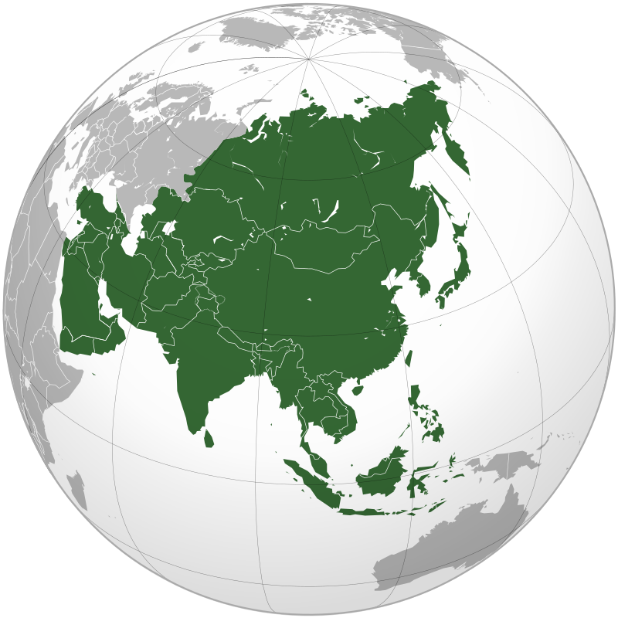
We are All Asian, but NOT unified
No common languages
  Less similarity
If we, Asian, have to talk each other in English, we already have LibOCon, is it enough… yes?
But little hard to participate for everyone
  Have to take lots of vacation
  High travel cost (may spend much TDF budget)
  Long long flight…
  Visa

Slide 6
And we have something to do together
Because we are:
Geographically close
Less timezone difference
(In East Asia) needs common CJK features
Sharing similar cultures than Europians (…?)
  not sure personally, but at least Italo says that

Slide 7
So we need our regional event!
Forerunners
  GNOME.Asia Summit (Since 2008)
  openSUSE.Asia Summit (Since 2014)
From the perspective of a local organizer of openSUSE.Asia 2017 Tokyo, I felt that these events were meaningful for strengthening collaboration among communities in Asia.
We want something like that! Named “Asia Conference!”

Slide 8
Previous AsiaCon year, 2018
LibreOffice Conference Indonesia 2018
LibreOffice Asia Meetup @ Taipei, Taiwan
LibreOffice Conference 2018 Tirana
Kyushu LibreOffice meetup 201 @ Fukuoka, Japan
Notes:
Throughout 2018, this idea had been materialized for realization.
In Indonesia conference early this year, Indonesia people, Franklin and Italo gathered.
Then we had a meetup at Taipei in August. At this time we are discussed holding a LibreOffice Asia Conference. Sorry for absense at that time due of my flight cancellation…
And in the last libocon, Italo asked me if we could call a TDF member to create an opportunity to talk with Japanese community members, not Shinji or me
December 2018, we invited Franklin and DaeHyun from Korea to our small meetup in Fukuoka, and we talked we can something interest while LibO kaigi 2019 planned May 25.
holding a LibreOffice Asia Conference.

Slide 9
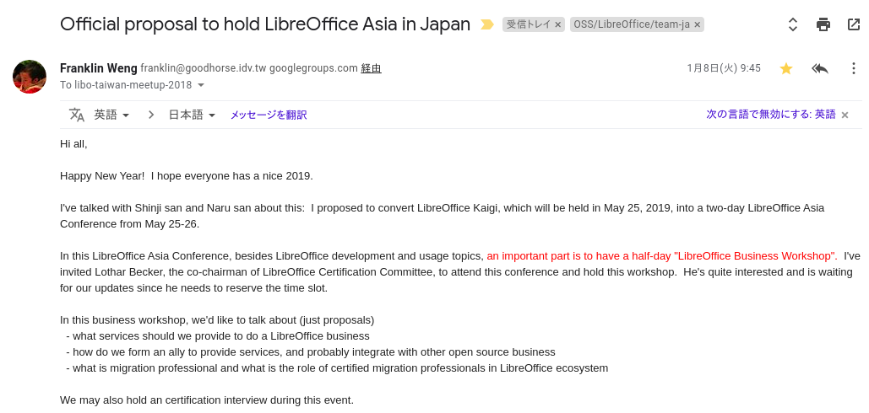
Franklin’s proposal

Slide 10
Division of roles
Franklin Weng (He is the our King!)
  As BoD, inviting Italo and Lothar, TDF certification interviews preparation, and ask something to spend TDF budget
  Bring some Taiwanese youth
  We couldn’t do without you, much appreciated!
Ahmad Haris
  Ask FANS, Indonesia local company to become a sponsor
JP team worked remains :)

Slide 11
What we have achived?

Slide 12
Event schedule
Day 0: May 24th (Fri): Welcome party
Day 1: May 25th (Sat): Conference Day
Day 2: May 26th (Sun): Business workshop & CJK Hackfest
Day extra: May 27th (Mon): Official Tokyo tour

Slide 13
Statictics
Participates 80 people (counted Day 1)
From 10 countries
  Japan, Taiwan, China, South Korea, Indonesia, India, Italy, Germany, Albania, Nigeria

Slide 14
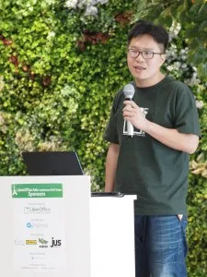
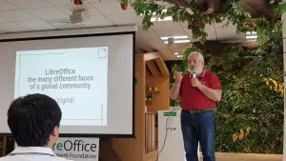
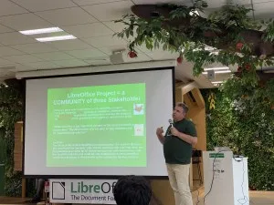
Keynotes
Mark Hung: LibreOffice CJK Bugs, Fixes, and Stories.
Italo Vignoli: LibreOffice, the many different faces of a global community
Lothar Becker: Certified as a LibreOffice professional - a win/win/win situation for the community
Notes:
We had three keynotes
Mark’s story was what I personally dreamed. He has continued his approach to surely solving the CJK problem in front of him and expanding the area involved. I believed that the experience had a positive impact on Japanese users.
And of course, Italo and Lothar always give us interesting talks :)

Slide 15
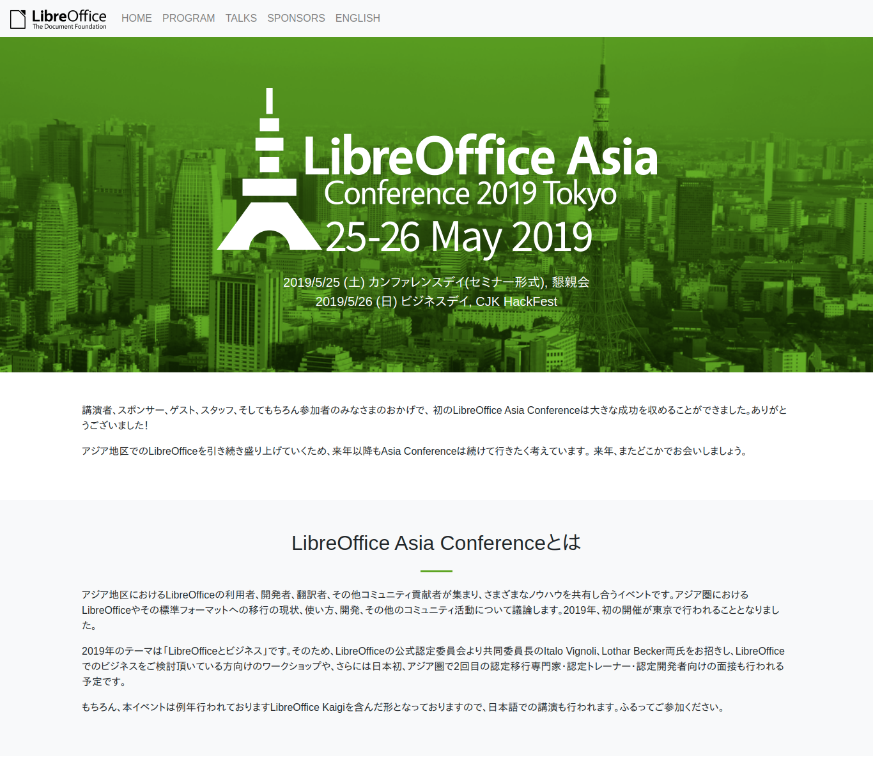
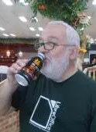
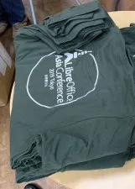
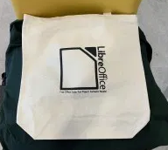
Design works
by Jun Nogata … well done!

Slide 16
Business workshop
Could discuss very interesting topics about LibO / OSS business in Asia
Franklin proposed the idea of “ODF certification,” about ODF and best ODFware’s functionality to create a great documents
  It would be useful for corporate recruitment at least in Asia

Slide 17
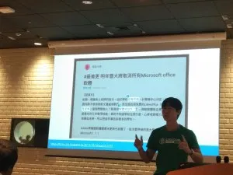
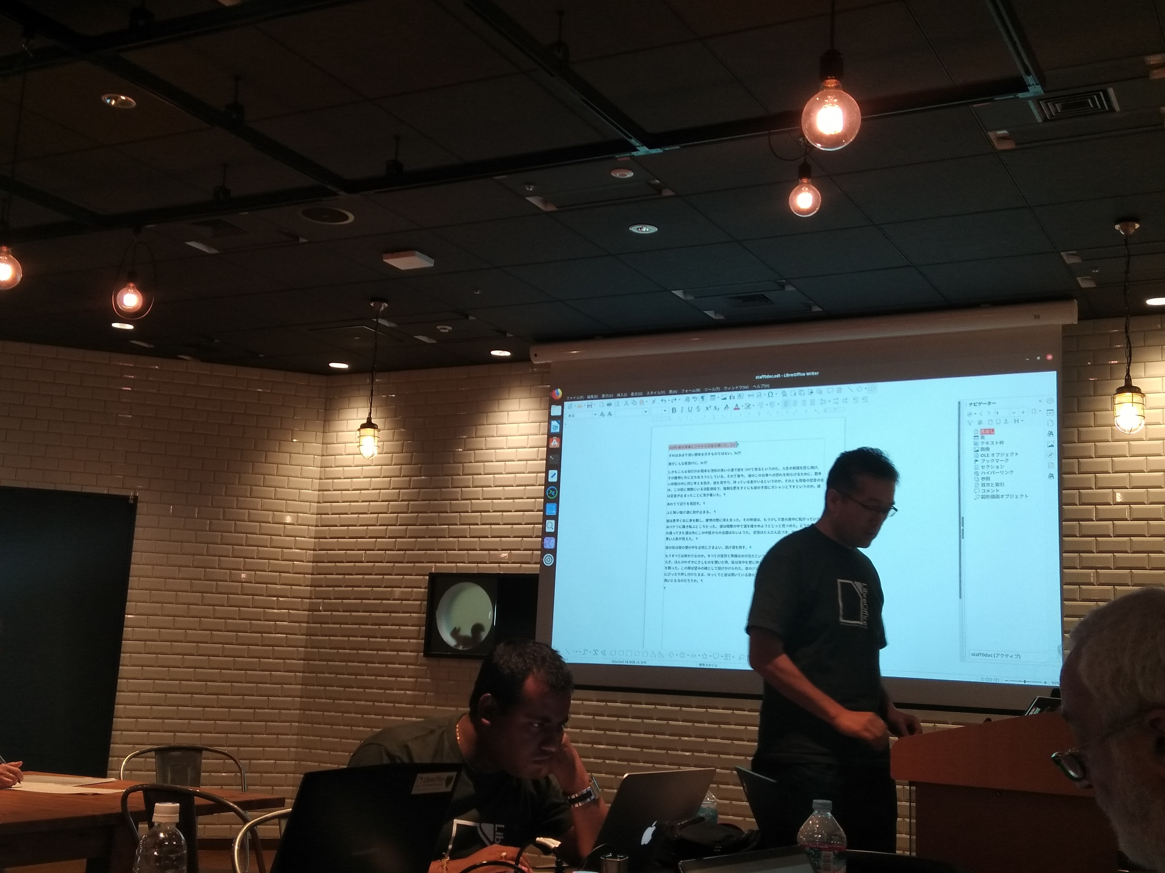
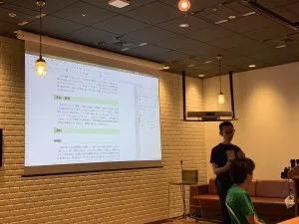
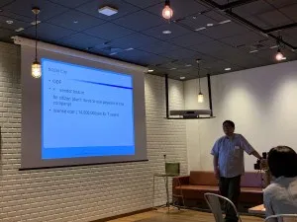
Certification
4 candidate had applied
And we now have 4 new certified specialist!
  Eric Sun (TW)
  Jun Meguro (JP)
  Jun Nogata (JP)
  Hitoshi Sugimoto (JP)

Slide 18
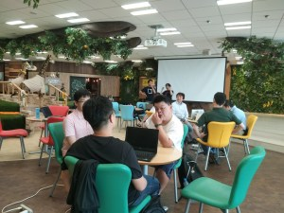
CJK Hackfest
Hack LibO to improve CJK features!
CJK hero Mark Hung kindly helped us
  Other LibO hackers, like Takeshi Abe, had gathered to help participants
10 people had attended
DaeHyun Sung (KR) solved Korean font problem at this time tdf#125481
But honestly, JP community couldn’t attract developer candidates who want to try a “real” problem (not just trying to EasyHack)

Slide 19
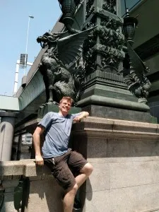
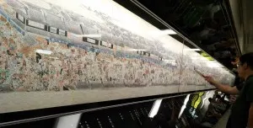
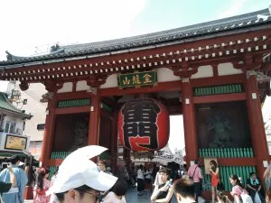
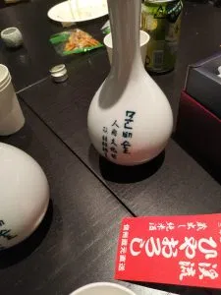
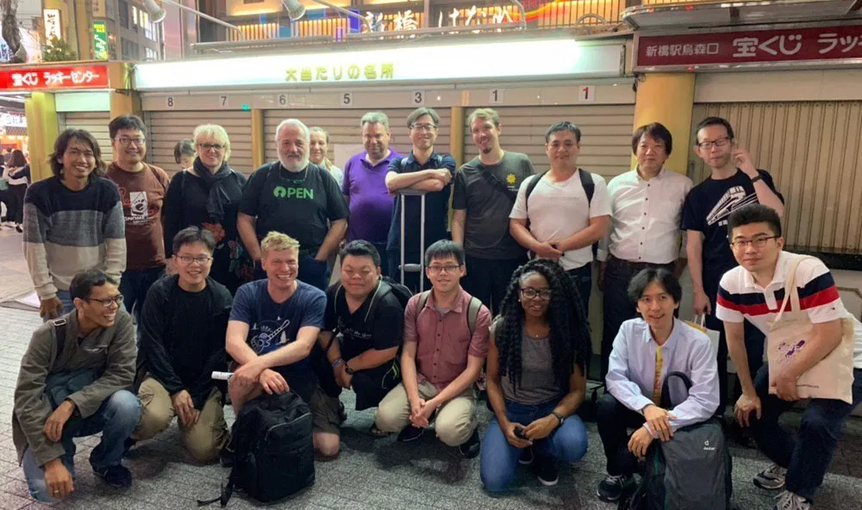
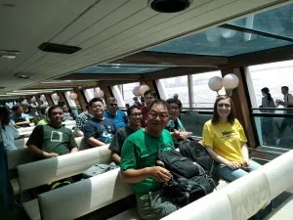
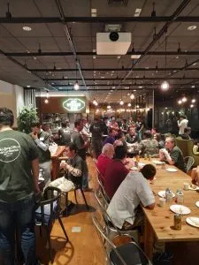
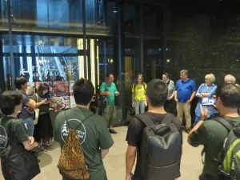
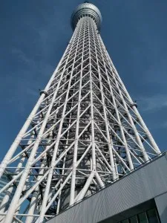
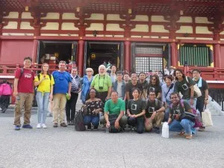
Party, Tokyo Tour

Slide 20

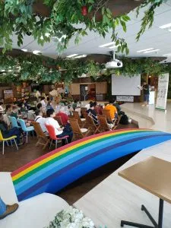
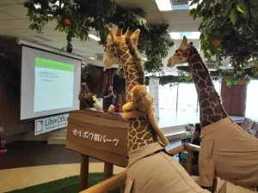

Sponsorship
Keep continuously contact with OSS-friendly local companies
  like Cyboze, Inc.; our venue sponsor
Ask foreign companies to support their countries’ speakers travel cost
  To reduce international money transaction
  FANS, the shoes manufacturer from Indonesia, kindly supported the speaker Kukuh Syafaat

Slide 21
Made JP community stronger
Attracted more contributors to encourage JP community
  Who haven’t active recently
  Who have active other OSS but were not part of us
Associate more Japanese people with the world by preparing the Japanese track even though the official language had been English

Slide 22
And we became little more global
The relationship between each Asian community, at least Taiwan, Korea, Indonesia and Japan, was strengthened
And we could build a bridge from Asia to the grobal!

Slide 23
And… what’s next?

Slide 24
Reach out more people in Japan
Attract developer candidates for HackFest
  Not only for AsiaCon but also Japanese community problem
  CJK issues are easier to solve by ourselves
Attract younger generation (students!)
  As Taiwan community does
  Make some strategy to touch with

Slide 25
Money is always matter
More local sponsors!
  Would be nice if we have interpreter at least for keynotes; which is extremely expensive
Cache control
  Who should control whole amount of money?

Slide 26
Long term issues...
Visa support
  Our legal entities by each countries’ law is needed?
  It is hard to support visa without it
  For a while, find OSS-friendly domestic organizations to get support
Expand to other Asian communities
  To make Asian area map more green
    Should DaeHyun Sung bring more Korean?
  Strong Asia Conference committee? CFH? Or else?

Slide 27
Conclusion

Slide 28
Conclusion
The Asian Conference had been hoped to strengthen the relationship between Asian communities and to build a bridge with the global community
This year, we were able to successfully hosted AsiaCon not only with the efforts of the out but also with the help of TDF and other Asian communities
  Thanks again, Franklin! We couldn’t done without you!
There are some future issues, but it was good that they became clear

Slide 29
Thank you for your attention!
And we’d like to extend a huge thank you for our speakers, sponsors, volunteers and all our delegates for making our AsiaCon 2019 possible.

Slide 30
Credit
Photos (explicitly not credited) are taken by Asia Conference attendees, licensed under CC BY-SA 4.0, published in TDF NextCloud
  https://nextcloud.documentfoundation.org/s/zpRgHjMqt48W3Jq
p.5 “Asia (orthographic projection).svg” by Koyos + Ssolbergj, licensed under CC BY_SA 4.0
  https://commons.wikimedia.org/wiki/File:Asia_(orthographic_projection).svg
p.20 “Cyboze” logo and “FANS” logo made by themselves, all rights reserved
Asia (orthographic projection).svg

Slide 31
Materials (1)
Our official site
  http://conf.libreoffice.jp
YouTube list
  https://www.youtube.com/watch?v=FvOkLdTEguo&list=PLaQzK7Tg6raZqFkSteARV7J_RkRtukYO6
Peertube (thanks to Franklin!)
  https://peertube.slat.org/video-channels/liboasia.2019/videos
Slides
  https://conf.libreoffice.jp/program.html

Slide 32
Materials (2)
Reports (English)
  https://blog.documentfoundation.org/blog/2019/08/01/libreoffice-asia-conference-report-part-1/
  https://blog.documentfoundation.org/blog/2019/08/15/libreoffice-asia-conference-report-part-2/
Reports (Japanese)
  https://ja.blog.documentfoundation.org/2019/07/29/libreoffice-asia-conference-2019/
  https://gihyo.jp/news/report/2019/06/2001
Reports (Photos)
  https://ja.blog.documentfoundation.org/2019/07/21/libreoffice-asiaconf-2019-photo-welcome-party/
  https://ja.blog.documentfoundation.org/2019/07/21/libreoffice-asiaconf-2019-photo-day1/
  https://ja.blog.documentfoundation.org/2019/07/21/libreoffice-asiaconf-2019-photo-day2/
  https://ja.blog.documentfoundation.org/2019/07/21/libreoffice-asiaconf-2019-photo-daytrip/

Slide 33
Materials (3)
Reports by participants
  https://sepatufans.wordpress.com/2019/06/04/trip-to-libreoffice-asia-conference-2019-tokyo/
  https://blog.kukuh.syafaat.id/2019/LibreOffice-Asia-Conference-2019/
  https://medium.com/libreoffice-korean-team/my-libreoffice-asia-conference-2019-day2-cjk-hackfest-report-785cea73dda6
Gift from Ahmad Haris
  https://www.youtube.com/watch?v=G0NJ1ztGc-8&feature=youtu.be

