Slide 1

Vertical Writing: typical use-cases and current status in LibreOffice
Naruhiko Ogasawara
LibreOffice Japanese Team

Slide 2

Agenda
Japanese vertical writing basics and use-cases
Current implementation of LibreOffice vertical writing
Deeper look from the end-user point of view
Conclusion

Slide 3
Japanese vertical writing basics and use-cases

Slide 4
LibreOffice for Japanese
Translations
  UI / Help
  Release Notes / Annoucements
  Documents...
Functions
  Basic CJK text rendering (CTL Support)
  Japanese specific rendering (see next slide)
  JP locale specific features
    e.g. Japanese Calender

Slide 5
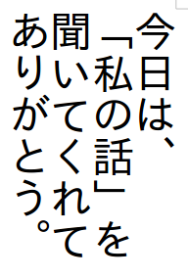

Japanese specific text rendering
Vertical Writing (TTB)
  Top to bottom, right to left
  Used by Chinese, Japanese
  Only for text writing, NOT UI
Ruby
  Pronounciation expression
See:
Requirements for Japanese Text Layout
ｂｙ W3C Working Group Note 3 April 2012
http://www.w3.org/TR/jlreq/

Slide 6
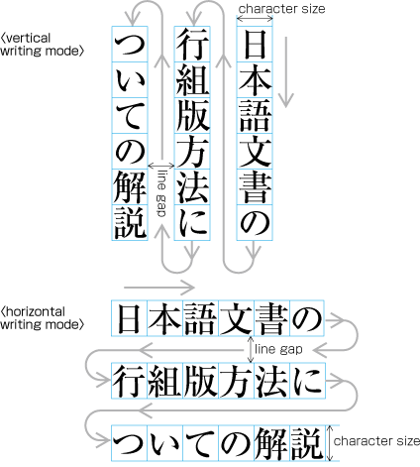
Vertical Writing Basic (from the W3C document)
Vertical Writing
縦組；tate gumi
The process or the result of arranging characters on a line from top to bottom, of lines on a page from right to left, and/or of columns on a page from top to bottom. (JIS Z 8125)
Requirements for Japanese Text Layout
Appendix G Terminology
http://www.w3.org/TR/jlreq/#term.vertical-writing-mode
http://www.w3.org/TR/jlreq/#vertical_writing_
mode_and_horizontal_writing_mode

Slide 7
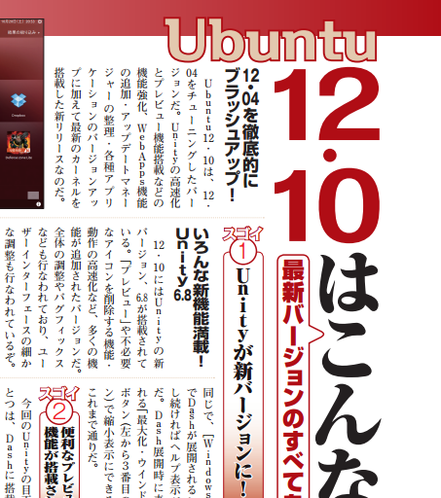
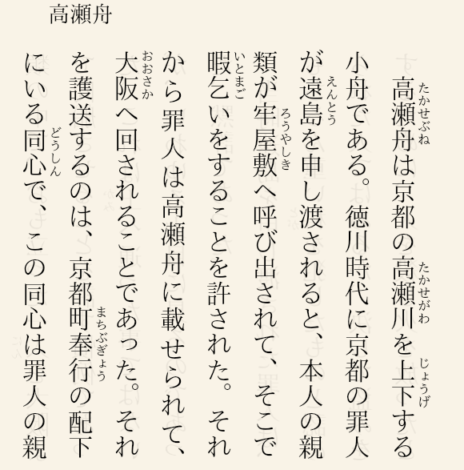
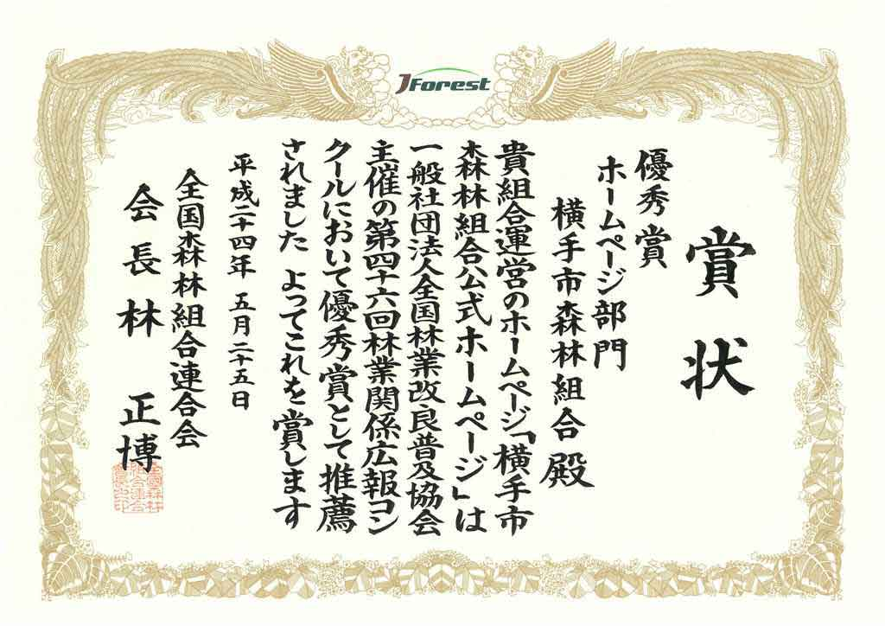
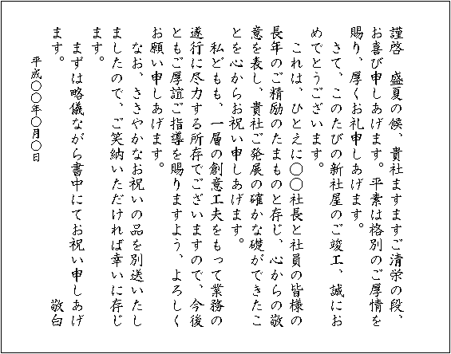
Typical use-cases of vertical writing
②
Non-technical / Scientific publications
  Novels①
  Magazine②
  Papers
  Business/Popular
  Science books
  School Education
Letter③
Diploma④
①
④
③
See “Credits” page for copyright informatoins of each images

Slide 8
Vertical Writing is key feature for...
(non-professional) Novel writers
  … to publish their novels personally
Teachers
  … to make drills / exams / subtexts
Public Organizations
  … to make “FORMAL” letters
    Elder people thought vertical writing letter is more formal in our culture
  … to create their own magazine / papers

Slide 9
Current implementation of LibreOffice vertical writing

Slide 10
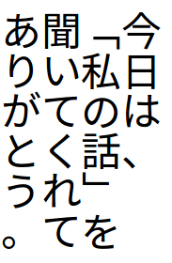
Functionality
IPA Gothic
Noto Sans CJS
Format ▶ Page ▶ Text Direction
(in Writer)
“Vertical Text” box
Basically works well
  Even vertical-writing support fonts are needed
Several “corner-case” bugs
  … will discussed later

Slide 11

Implementation
Starting point:
b14861e1dfb9f83d26d6032ae96b664845528f2a
  Fix tdf#77514 CJK ruby text in RTL( vertical ) base line issue.
  Thanks Mark Hung to his great works about CJK!!!
Looking into this…
  IsVertical() function tell us it's in vertical writing mode
  git grep “IsVertical()” sw
    Many many many…
    X-(
if (xxx->IsVertical()) {
...

Slide 12
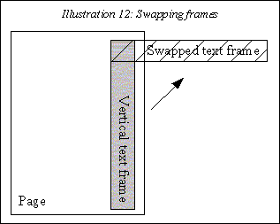
Implementation (cont.d)
Back to the document and found the “swapped frame”
“The three main tasks of the text formatting (formatting paragraphs, painting of text and cursor travelling) are performed on swapped frames and afterwards the results are translated back.”
“Writer/Text Formatting” - “Vertical formatting”
https://wiki.openoffice.org/wiki/Writer/
Text_Formatting#Vertical_Formatting

Slide 13
Implementation (cont.d)
Back to the document and found the “swapped frame”
“The three main tasks of the text formatting (formatting paragraphs, painting of text and cursor travelling) are performed on swapped frames and afterwards the results are translated back.”
“Writer/Text Formatting” - “Vertical formatting”
https://wiki.openoffice.org/wiki/Writer/
Text_Formatting#Vertical_Formatting
Time up!

Slide 14
Deeper look of LibreOffice vertical writing
… Functional (end-users) view
Note: the goal of this talk is NOT reporting bugs,
my point is there are many “corner case” specifications that should be cared by us (Japanese users / developers)

Slide 15
Rendering bug in Mac OS X
Problem with input method…?
  Seems the effect of font metrics
  e.g., IPA Gothic vs. Hiragino

Slide 16


Proportional fonts
5.0 Ubuntu
Basically, non-proportional fonts should be used in vertical writing mode
However, default font sets of Writer are
proportional
  Easy to make a mistake
There are several rendering issues with proportional fonts
  Wrong usage but MS Word seems OK
  Having a specific default font for vertical writing is considerable option

Slide 17
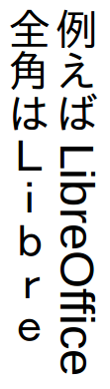
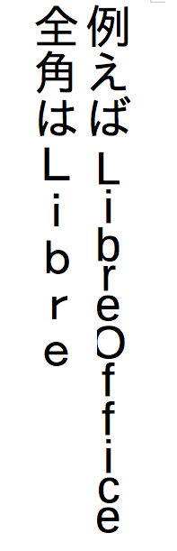
Western characters
↓5.0 Ubuntu
IPA Gothic +
Liberatioon Sans
Basically, western characters should rotate 90° clockwize
  If you won't, use FULLWIDTH LATIN (U+FF21-FF3A, U+FF41-FF5A)
In OS X, the rotating doesn't work if we combined Western font
  IPA Gothic + Liberation Sans
  Using Hiragino to both is fine
  Need to check BZ…
5.0 OS X↑
IPA Gothic +
Liberatioon Sans

Slide 18
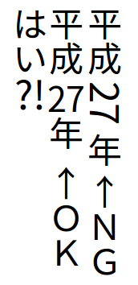
Horizontal-in-vertical composition
Horizontal-in-vertical composition
(縦中横； tate-chu-yoko)
  Format ▶ Character... ▶Position
  Rotation / Scaling: 90 degrees
Hard do find for end users
  Any shortcut?
  (could be an extension??)

Slide 19

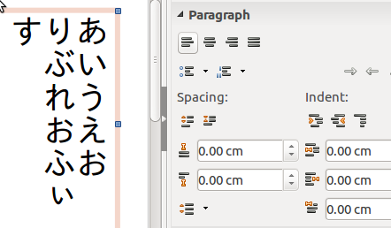

Minor UI Issues
Common:
Some images indicate a form of
document should be rotated
Tool Bars
  Icons are OK, but tooltips aren't
Side Bars
  Icons don't rotate
  “text direction” icons doesn't
  exist even the “text formatting”
  toolbar has

Slide 20
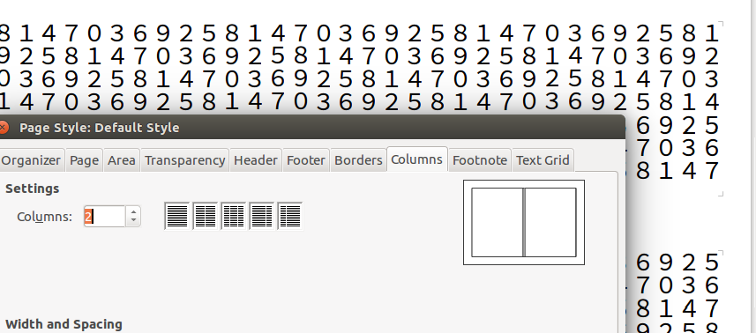
Minor UI Issues (cont'd)
Format ▶Page, “Columns” tab
  Image preview tells columns split vertically,
  But actually split horizontally

Slide 21
Conclusion

Slide 22
Vertical Writing is...
Vertical Writing in LibreOffice is...
Used in normal documents, in usual business scene
Key feature for some kind of people
Works well in generally use, but there is some room to improve
To fix rendering problems, deep dive into Writer's (complex) rendering code
  But we, Japanese, must try because we know how vertical writing should work
Some UI improvements are good exercises for development newbie (like me!)

Slide 23
Thank you … for using this template!
See you at the LibreOffice Aarhus Conference
Find out more at http://conference.libreoffice.org

Slide 24
Credits
① Mori Ōgai, “Takasebune,” Aozora-bunko
http://www.aozora.gr.jp/cards/000129/card45245.html
Public Domain
②ASCII Media Works, Ubuntu Magazine Japan vol.10
http://ubuntu.asciimw.jp/elem/000/000/010/10558/UM10_P4-7.pdf
Creative Commons 3.0 BY-NC-SA
③お礼状、案内状、手紙の書き方と例文
(Writing how-to and examples of thanks letters, invitation letters and other letters)
http://letter.sincerite-shop.com/sub38.html
④Wikipedia「賞状」(Diploma)
https://ja.wikipedia.org/wiki/%E8%B3%9E%E7%8A%B6

