Slide 1

LibreOffice: outline, and what we're doing in Japan
OGASAWARA, Naruhiko
LibreOffice Japanese Team

Slide 2




About Naruhiko
A member of Japanese Team
  LibreOffice regional group to evolve Japanese community
    to be discussed later
NOT a member of The Document Foundation :)
CUPS ja translator
Wrote some articles in
Japanese media
  Ubuntu, LibreOffice,
  printing solutions in FLOSS world

Slide 3

What's ?

Slide 4
has two meaning
Product:
Free office productive suite
Community:
World wide, transparent, open community
To provide LibreOffice office suite

Slide 5
as a great office productive suite

Slide 6
Overview
Libre (French) ~= Free
Multi platform
  Windows, Mac OS X, Linux
  Might be used as cloud services (coming soon)
  LibreOffice OnTablet will come (iOS and Android)
Portable version (Windows only)
  Carry in a USB stick, use without installation
LGPLv3+ / MPL
Repos of Extensions and Templates

Slide 7
Open Document Format (ODF) and interoperability
Default file format of LibreOffice
  standardized in OASIS
    recent version is 1.2 (now proposed to ISO/IEC)
  totally vendor-free
    LibO, AOO, MSO, Google Drv, Abiword and Gnumeric support ODF
  ensured interoperability by PlugFest
Great interoperability features
  Hybrid PDF exporter (can embed ODF itself)
  OOXML and legacy MS Office importer / exporter
  many other formats can be imported

Slide 8
Are we developing a Microsoft Office compatible software?
NO. LibreOffice is NOT a Microsoft Office compatible
  DO NOT say “poorman's MS Office” ;)
But people can migrate their office suite
from MS Office to LibreOffice
  Top features and interoperability
  Such as migrate database Oracle to PostgreSQL
No free lunch we have
But we can let our intellectual properties (documents) free from a vendor

Slide 9
Time-based release
Conservative
.4++
See:
http://wiki.documentfoundation.org
/ReleasePlan
Recom-
mended
.2 or .3
Early
adopters
.0
RCs
beta
SOL = Start of Life
EOL = End of Life
SOL: Nov 2013
master
3.6
EOL: 3.6.7
(08/15/2013)
4.0
EOL: 4.0.6
(11/21/2013)
4.1
EOL: 4.1.6
(05/28/2014)
4.2
EOL: 4.2.6
(11/19/2014)
4.3 → SOL:
May 2014
now
2013-09
time
Faster is better we believe :)
  rapid development is good for developers
  Problem: QA, too short lifecycle for enterprise

Slide 10
as a open, transparent, free community

Slide 11
LibreOffice, OpenOffice.org and Apache OpenOffice
LibreOffice is:
  a son of OpenOffice.org
  an elder brother of Apache OpenOffice
Code base had been same (OOo),
But totally different project
fork
LibreOffice
OpenOffice.org
Apache
OpenOffice
contributed
from Oracle

Slide 12
LibreOffice, OpenOffice.org and Apache OpenOffice (cont'd)
Common misunderstanding: Oracle is evil
  generally, I can say nothing
  but about us, it's NOT true
Which is do you want; open project,
or strict controlled project?
In Sun era, OOo team's governance had been very closed
  so open-oriented developers had left from OOo and created TDF
  then OOo had contributed to Apache
    I don't know how they are right now ;)

Slide 13
The Document Foundation (TDF)
What's TDF?
  legal backing for the community
  charitable foundation under German law
  Mission statement/objective: to nurture and to develop office software that is free to use by everyone and that is based on open standards
Vendor independence:
  advisory board(※) gives advice, but can NOT vote
Everything is open
  everyone can read any discussions and judgements
(※) AMD, CloudOn, Collabora, FRODEV, FSF, Google, Intel, KACST, Lanedo, MIMO, RedHat, SPI, SUSE

Slide 14
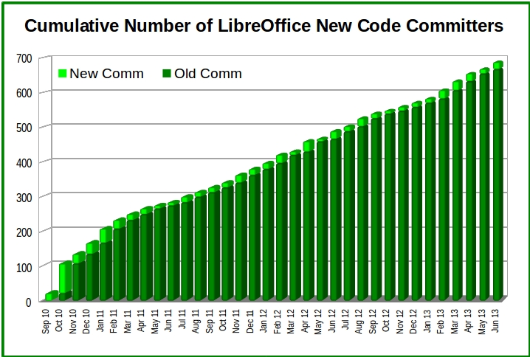
Fast growing community

Slide 15
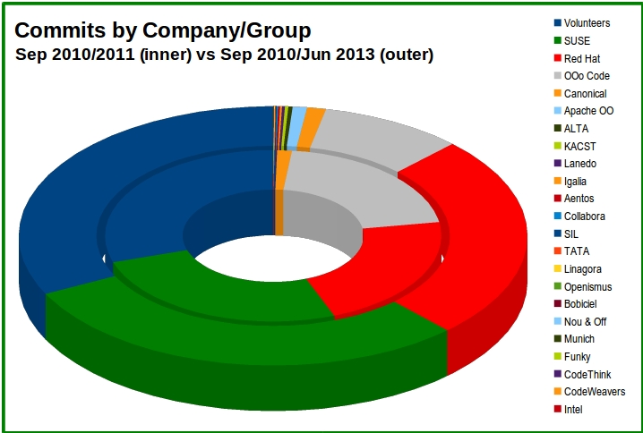
Well-balanced voluntary / profession development

Slide 16
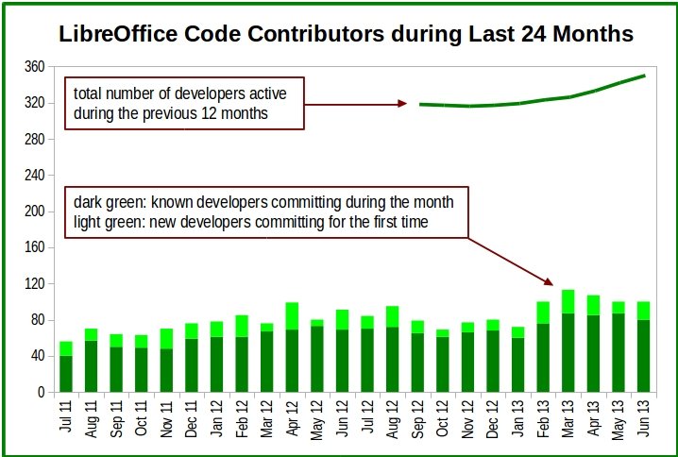
The door for new comer is always open

Slide 17
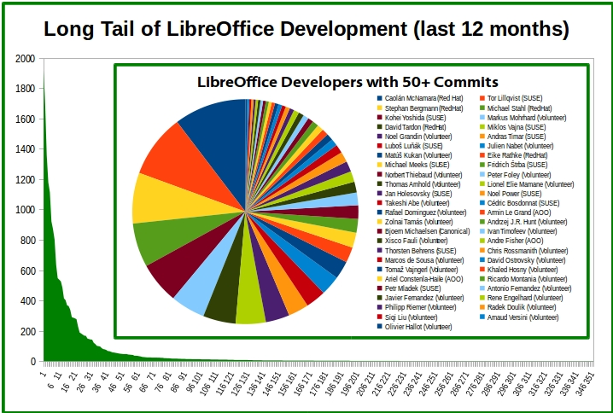
You can choose full time work, or send a small patch to LibreOffice

Slide 18

Open, active, speedy development
Open technical discussion in ML, IRC, …
Fast code review by Gerrit
Easy to localize by Pootle web system
Lots of unit tests instead of long QA terms
Cleanup old/unused codes and German comments
Easy to join to develop via Easy Hacks
  Collection of bugs to fix easily for novice developers
  https://wiki.documentfoundation.org/Development/Easy_Hacks

Slide 19
: The open community(6)
Open technical discussion in ML, IRC, …
Fast code review by Gerrit
Easy to localize by Pootle web system
Lots of unit tests instead of long QA terms
Cleanup old/unused codes, German comments
Easy to join to develop via Easy Hacks
  Collection of bugs to fix easily for novice developers
  https://wiki.documentfoundation.org/Development/Easy_Hacks

Slide 20
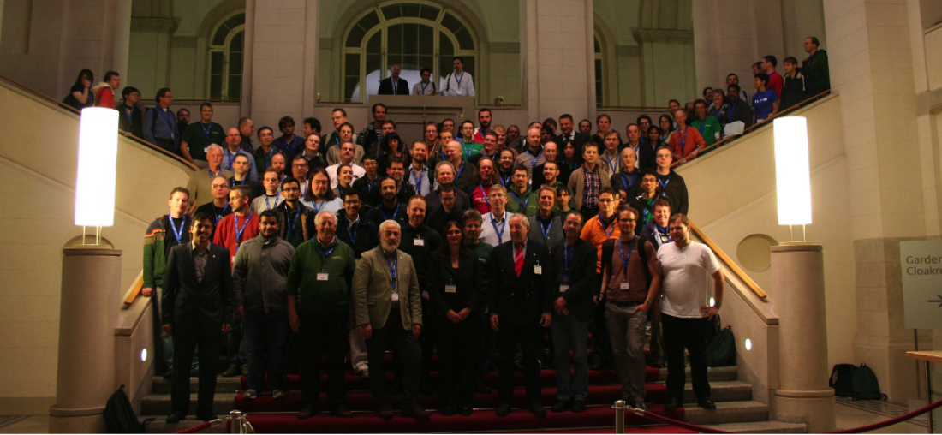
Happy community!
Thanks for Florian Effenberger and his nice slide:
https://speakerdeck.com/floeff/
the-document-foundation-the-open-transparent-and-meritocratic-future-of-free-office-software

Slide 21
in Japan

Slide 22
What's Japanese Team?
A team to work in backyard of Japanese local communities
Which backyard jobs we have:
  promotion / marketing for Japanese users
  translation of TDF official announcements
  making rules / guideline in Japanese community work (mainly translations of UI / Web)
LibreOffice
Global
Community
LibreOffice
Japanese Community
Japanese
LibreOffice
end users
Japanese Team

Slide 23
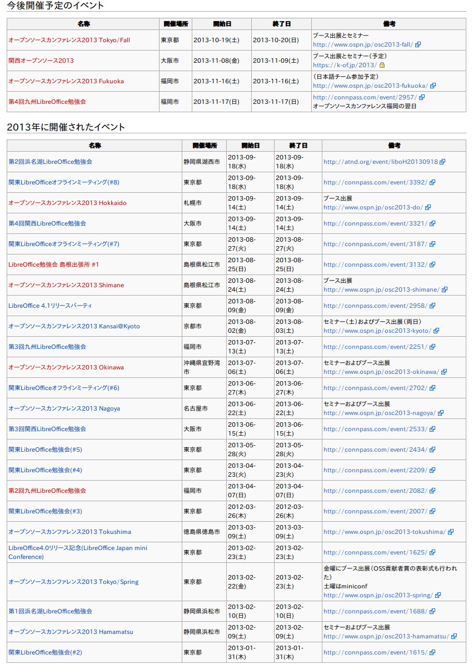
Lots of events!

Slide 24
Lots of events!

Slide 25
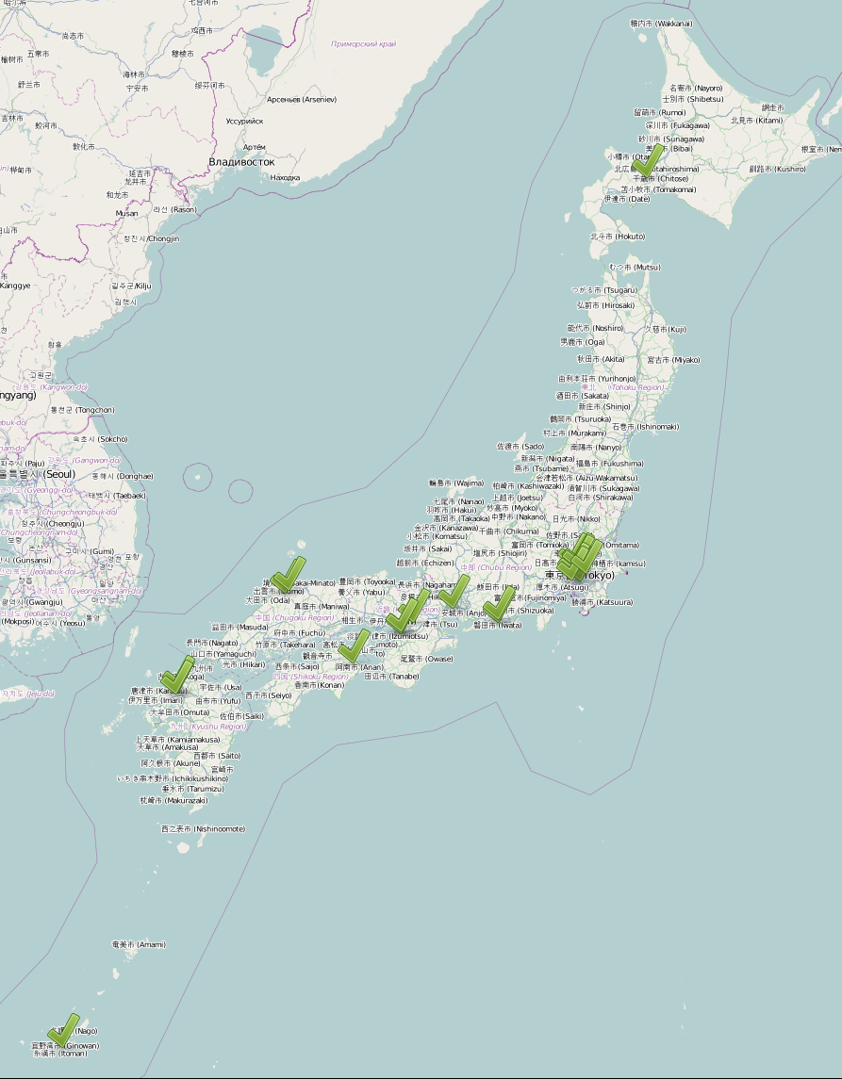
Lots of events!
from OpenStreetMap http://osm.jp/map

Slide 26
Lots of events!

Slide 27

Other activities
Translations
  every official announcements are translated within few days (mostly a day)
  everyone can join UI, help & wiki translation
    UI keeps >99% translation ratio
      and keep effort to fix incorrect translations since OOo era
    help... painful problem...
      high level knowledge about office suite itself needed
      (especially Calc; our spreadsheet)
Huge homework - Local QA
  CJK issues – can we work together?
  special type docs in Japanese culture
Excel
Ho-gan Shi
(方眼紙）

Slide 28
Off topic: great world of Excel Ho-gan shi

Slide 29
How LibreOffice popular in Japan?
I feel name of LibreOffice is getting populer
Thoug “OpenOffice” is still strong
  they will google “OpenOffice” when they need a fee-free office suite...
    result of a research by
    Japanese web media
Attending/organizing
events is NOT enough
  we have to talk with
  non-FLOSS people
  time to consider how
  to reach them
http://itpro.nikkeibp.co.jp/article/COLUMN/20130326/466042/

Slide 30
Good News!
LibreOffice won best users' satisfaction in “non-MS” office suite in Japan
  same research in previous slide
Because of our rapid development strategy

Slide 31
Major LibreOffice users in Japan
Local Goverments
  Aizu-Wakamatsu City (Fukushima Pref.)
  Tokushima Pref.
  Kuki City (Saitama Pref.)
  Kosai City (Shizuoka Pref.)
Companies, Groups
  NTT Comware Corp. (system integrator)
  Sumitomo Electric Industries Ltd.
  (electronics equipment manufacturer & sales)
  Japan Agricultural Cooperative (JA) Fukuoka-city
  (Fukuoka-city's regional organization of farmers)

Slide 32
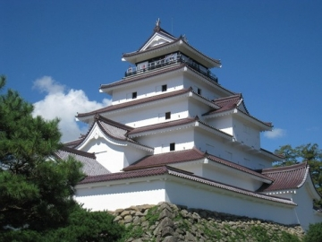

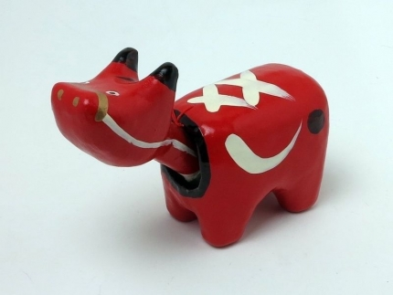
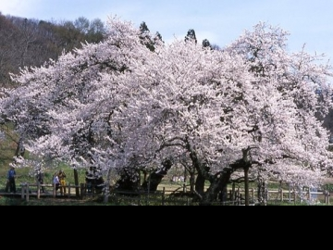
Case Study 1. Aizu-Wakamatsu City
In Fukushima Pref.
Population: 123,000
pictures from: http://www.aizukanko.com/

Slide 33
Case Study 1. Aizu-Wakamatsu City (cont'd)
Start from OOo (2008)
IT manager have joined OOo community
  feedback bugs, suggest translation wording, ...
  NOT just an end-user, BUT a community member – Mr. Meguro is our great fellow
Migrated to LibreOffice at Jan 2012
  migration process is published in their web site
  all documents inside the local gov. are ODF
  most of all document forms to residences of the city are provided as ODF (and PDF, MS Office)

Slide 34
Case Study 2. JA Fukuoka-city
Japan Agricultural

Slide 35
In addition...
NTT Comware has Japanese team members also
Sumitomo Eletric Industries is in very community side
  support our activities to rent their meeting space for our offline meeting
Some companies provide L1 commercial support (but it's not our activity)
Microsoft threat

Slide 36
Conclusion
LibreOffice is fantastic, free office suite
LibreOffice community is open, transparent, free and really active
LibreOffice Japanese team are having lots of events to promote LibreOffice in Japan
  different kind of efforts are needed to let LibreOffice popular
Some local gov., groups and companies are keep good relationship with us

Slide 37
Join LibreOffice community and collaborate eastern asian locals
… Thanks!
… Meet at my booth :)

