Slide 1

Using latest LibreOffice on openSUSE Leap 15
Naruhiko Ogasawara
LibreOffice Japanese Team

Slide 2


Who am I?
Naruhiko Ogasawara
小笠原 徳彦 おがさわら なるひこ
The Document Foundation Member
LibreOffice Japanese Team Member
  LibreOffice Japanese Team
  = Japanese LibreOffice Native Language Project (NLP)
  UI/Help translation coordinator

Slide 3
Agenda
Introduction
  What’s LibreOffice?
  openSUSE and LibreOffice
Modern Packaging Systems
  Flatpak
  Snap
  AppImage
Conclusion

Slide 4

What’s LibreOffice?
Full-feature office productive suite
Open source softwre (MPLv2)
The critical part of desktop *nix distributions like openSUSE

Slide 5
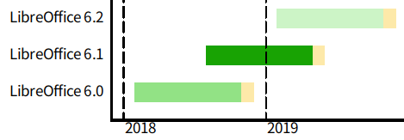

Timebase release
Major release every 6 months
Minor release every 1 months
Last 2 Major versions are supported
  “Fresh” and “Still”
6.1.0.3
MAJOR
MINOR
SUFFIX
Fresh
Still
Under development
EOL

Slide 6
openSUSE and LibreOffice
openSUSE officially provides LibreOffice package
  https://software.opensuse.org/package/libreoffice
Pre-installed with KDE / GNOME desktop

Slide 7
openSUSE and LibreOffice
Leap 15.0 has been shipped with LibreOffice 6.0, the latest “Fresh” release at the release date
  Security backports will be provided
How to use latest Fresh (6.1.x) on Leap 15?
Traditional way: use TDF build
  No need to describe
Or, use modern packaging systems

Slide 8
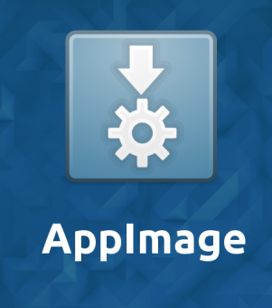


Modern packaging system
Sandboxed, all-in-one
  Packaged with all dependent libraries, like Android apps
  No worry about original system dependencies
Distribution Independent

Slide 9
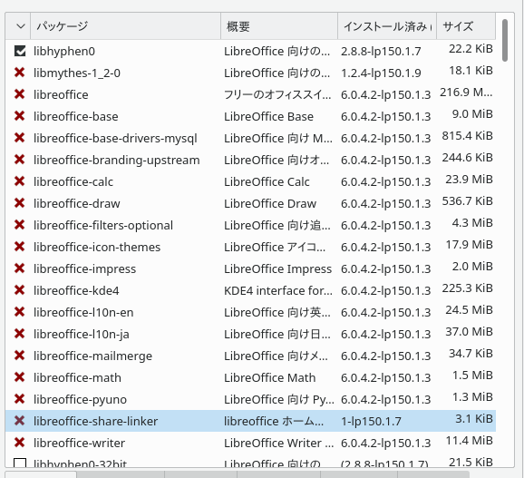
Prep: Uninstalling pre-installed LibreOffice
Not mandatory, but
recommended
YaST – Software
Management
Search “libreoffice”
and remove all, except
libhyphen0
  Has dependency to libwebkit* or several important libs
  The description “for LibreOffice” is misleading I think

Slide 10
Flatpak

Slide 11
Flatpak – What is this?
https://flatpak.org
“Linux application sandboxing and distribution framework”
Leap 15 is released with Flatpak available
  No special installation needed!
FlatHub: App store / build service for Flatpak
  https://flathub.org/home

Slide 12
Flatpak – LibreOffice package
TDF officially provides their Flatpak package via FlatHub
  https://www.libreoffice.org/download/flatpak/
  https://flathub.org/apps/details/org.libreoffice.LibreOffice
NOTE: Can’t select Fresh or Still ATM

Slide 13
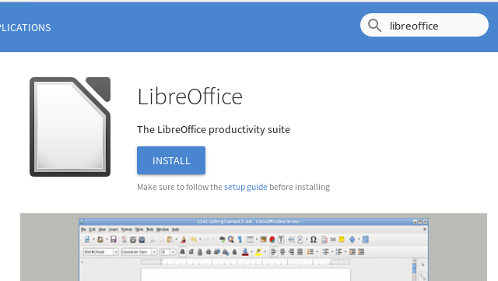
Flatpak – Installation
In browser, go to FlatHub – search LibreOffice
Then press “INSTALL”

Slide 14
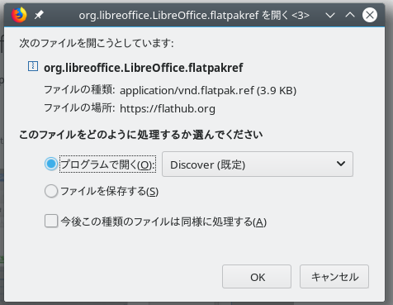
Flatpak – Installation
Open with program “Discover”

Slide 15
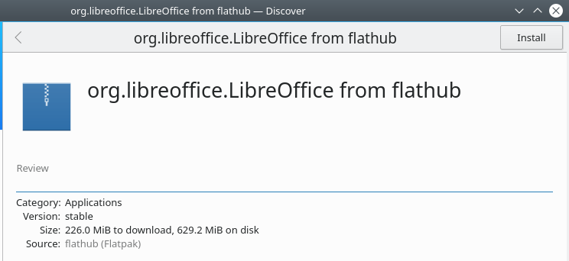
Flatpak – Installation
In Discover, press “Install” again
  … then type root password several times
That’s all!

Slide 16
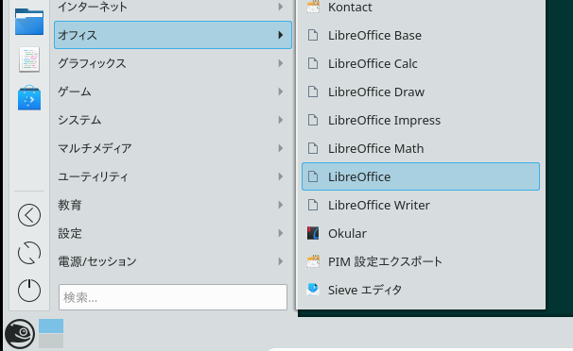
Flatpak – Usage
You can see LibreOffice via KDE launcher

Slide 17
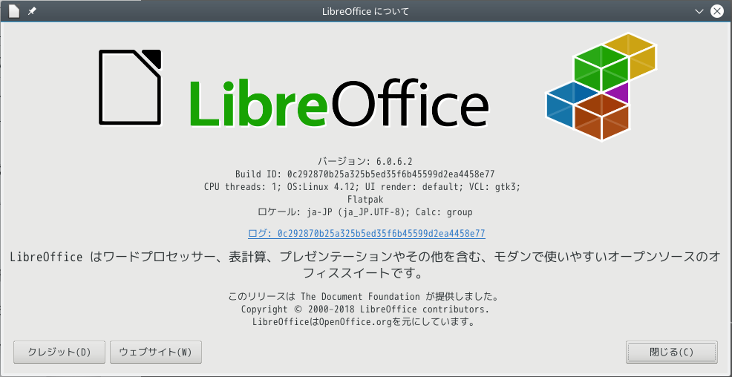
Flatpak – Usage

Slide 18
Flatpak – Features
All system fonts / Input Method available
System integration; KDE launcher, ext-type rel.
Includes langpacks
  Japanese, Traditional Chinese, Simplified Chinese, Korean, Indonesian, … or else
No helppack
  You can use online help instead
Useful for primary office productive suite

Slide 19
Snaps

Slide 20
Snaps – What is this?
https://snapcraft.io/
“Snaps are containerised software packages that are simple to create and install on all major Linux systems without modification.”
Developed by Canonical, but you can use it with openSUSE
SnapCraft: AppStore for Snaps

Slide 21
Snaps – What is this? (cont’d)
Channel
  https://docs.snapcraft.io/reference/channels
  “allow users to subscribe to different release cadences for an app”
  stable, candidate, beta, edge
Revision
  Snaps has all revisions installed, with container technology (squashfs)
  Users can switch easily between each revisions

Slide 22
Snaps – LibreOffice package
Ubuntu LibreOffice team provides Snap package via SnapCraft
  https://www.libreoffice.org/download/snap/
  https://snapcraft.io/libreoffice
All channels now provides 6.1.0.3

Slide 23
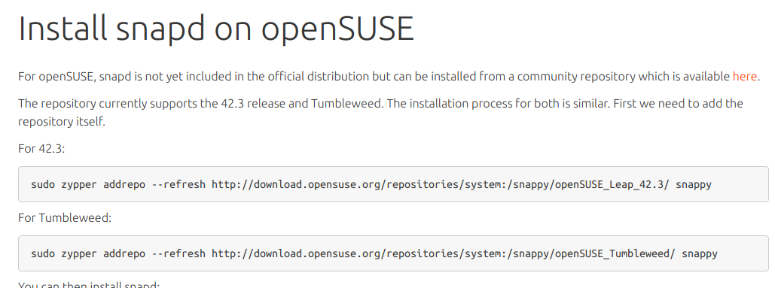
Snaps – Installation
Installing Snapd (Snap daemon) into Leap 15
Follow this instruction
  Install snapd on openSUSE
  https://docs.snapcraft.io/core/install-opensuse
  ... even though it haven’t be mentioned Leap 15 yet

Slide 24
Snaps – Installation
Add repo, install
Enable snapd.socket
Set environment variables (like PATH)
$ sudo zypper addrepo --refresh http://download.opensuse.org/repositories/system:/snappy/openSUSE_Leap_15.0/ snappy
$ sudo zypper install snapd
$ sudo systemctl enable --now snapd.socket
$ source /etc/profile

Slide 25
Snaps – Installation
Install LibreOffice (latest Fresh)
If you want, switch the channel to “candidate”
$ sudo snap install libreoffice
$ sudo snap refresh --candidate libreoffice
NOTE: this error is affected
https://bugs.launchpad.net/snapd/+bug/1782106

Slide 26
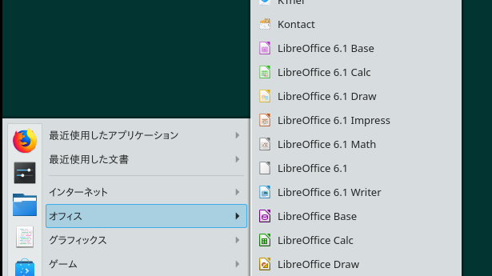
Snaps – Usage
You can see LibreOffice again via KDE launcher

Slide 27
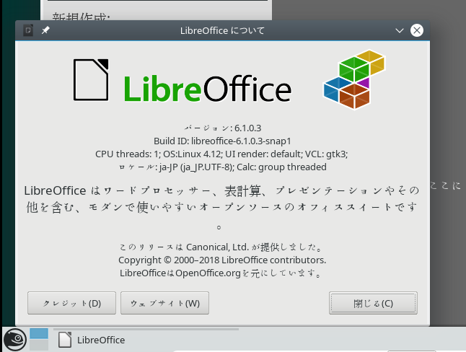
Snaps – Usage

Slide 28
Snaps – Features
Mostly same as Flatpak
Ugly UI font rendering (at least in ja-JP env.)
Powerful channel / revision support
Includes “limited” langpacks
  10 languages includes Japanese and Traditional Chinese

Slide 29
AppImage

Slide 30
AppImage – What is this?
https://appimage.org/
“Download an application, make it executable, and run! No need to install. No system libraries or system preferences are altered”

Slide 31
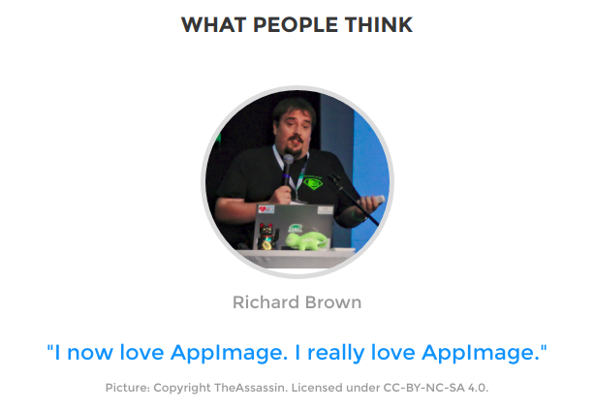
AppImage – What is this?

Slide 32
AppImage – LibreOffice package
TDF provides AppImage packages
  https://www.libreoffice.org/download/appimage/
  https://libreoffice.soluzioniopen.com/
Three “versions” (included langpacks)
  Single language: English only
  Standard: limited (ja-JP, zh-TW, zh-CN, ko-KR, ...)
  Full: all
You can choose Fresh, Still, Pre-release (Beta or RC), daily, whatever you want!

Slide 33
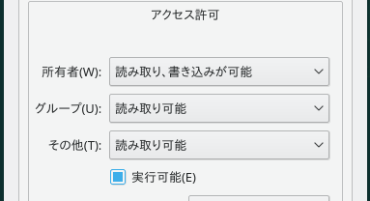
AppImage – Installation
Just download it,
Put it somewhere you like (I prefer Desktop),
Then add executable permission
That’s it!

Slide 34
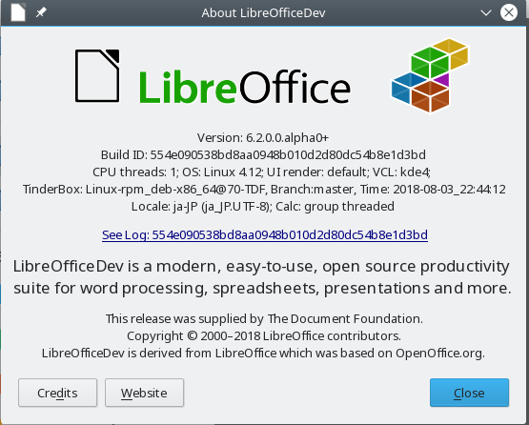
AppImage - Usage

Slide 35
AppImage - Features
IMHO, AppImage is NOT replacement of openSUSE official, Flatpak or Snaps
For people who want to run several versions LibO concurrently
  Quality assurance
  Test the upcoming version in enterprise organizations
  Help desk
  Documentation

Slide 36
Conclusion

Slide 37
Conclusion
If you prefer newer LibO, Flatpak is the best
Snaps has interesting features like channels / revisions, but not suitable for usual openSUSE users
AppImage is really powerful for testing purpose
If you are conservative and need support from openSUSE project, use the official packages ;)

Slide 38
Thank you!
… Use newer LibreOffice in Leap 15
… and enjoy your openSUSE life!

