Slide 1

LibreOffice in Japan: Quick Look
Naruhiko (NARU) Ogasawara
LibreOffice Japanese Team
Notes:
Hi, in this talk, let's quick look LibreOffice in Japan.

Slide 2

LibreOffice is major in Japan?
Now getting major
...but we need more effort to promote ;)
Download counts in “Mado no mori”, Japanese well-known fee-free softwares distribution site
Thanks Mr. Matsumiya for nice blog post:
http://openoffice.sblo.jp/article/
99462187.html
Notes:
First, LibreOffice is major in Japan?
Right now, getting major I feel. Here is one evidence. This graph shows a download counts of Japanese famous fee-free software distribution site. NOT official downloads.
This indicates LibreOffice is getting major than 1 years ago, but still need to promote to beat Office suite A.

Slide 3



Users
Some local goverments / organizations / big companies uses LibreOffice

Slide 4
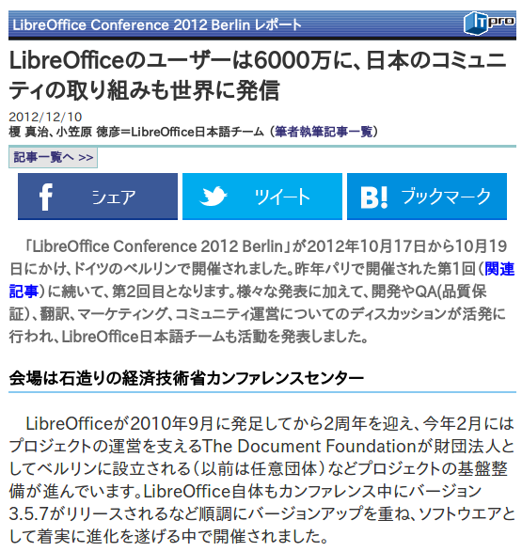

Media / Books
Berlin conference report
http://itpro.nikkeibp.co.jp/article/COLUMN/20121207/442767/
Articles
  ...to paper magazines
  ...to web media
  This conference
  reports will be published
8 books can buy in
Amazon.co.jp

Slide 5
Our activities: Translations
UI
  99% in 4.3.0 (well done!)
  continuous improvement
Help
  80% in 4.3.0 (but no activity now...)
Webpage
  Good for end users
Wiki
  Keep on going

Slide 6
Our activities: Development
We have only 3 active developers in Japan
  Takeshi Abe
  Isamu Mogi
  Tomofumi Yagi
Now getting started to growth new developers
  Includes myself :)
    Now I'm just trying an EasyHack

Slide 7
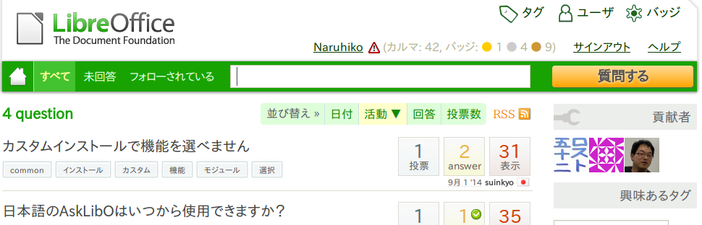
Our activities: End users suport
Bug report assistance
  Receive problem reports via ML or Askbot
    Thanks to infra team, now we have Japanese AskBot!
  Reproduce, check fdo, file bugs in English
    Need to educate users to report bugs well

Slide 8

Our activities: Events
Our own events
  Annual LibreOffice mini Conference
  Meetups
    Tokyo – monthly, several styles (seminar, hack, just party)
      Also we hosted HackFests twice
    Osaka – 3-4 month each, seminar style
Others
  Open Source Conference – have talks and booths
  openSUSE Asia Summit 2014 – have a talk about LibO

Slide 9
Our activities: Future
Growth more developers
  to fix CJK related / regional bugs
  to enhance features requested by Japanese users
HELP translation
  Crowdsourcing can be useful?
Host LibreOffice Asia Conference in Japan!
  Asian countries might have same problems to share
  Anyone want to come as guest speakers? :)
  Currently it's my personal dream, sorry...

Slide 10
Thank you for listening the talk
And please forgive my bad English ;)
Bad is better than nothing I believe

