Slide 1
Building a bridge between Japanese LibreOffice community and the world
Naruhiko Ogasawara
naruoga@gmail.com
TIRANA | 27th Sept. 2018

Slide 2

Agenda
Background: LibreOffice in Japan
LibreOffice Japanese Community
Japanese LibreOffice Events
  LibreOffice mini-conference
  LibreOffice Kaigi
Why we need a bridge?
How to make the bridge?
Our next challenge
Conclusion

Slide 3

Who am I?
Naruhiko NARU Ogasawara
From Tokyo, Japan
TDF member #337
LibreOffice Japenese Team (JA NLP) member
Ubuntu as private usage
Automation testing architect @ 3rd-party testing vendor

Slide 4
LibreOffice in Japan

Slide 5
Enterprise
Local government
  Tokushima-pref, Aizu-wakamatsu-city, Kosai-city
Companies
  NTT Comware (dual standard with MSO), JA Fukuoka
less active for some years
… no step back to MSO, but no any new implementation

Slide 6
Consumer Market
“PC bundled Office” culture
  Microsoft Office ↘ WPS Office ↗
Still less subscription (means not move to Office365)
  MS Japan also seems confusing…
Limited people choices their office suite by themselves
Under the development for majority of PC users

Slide 7

Business
Can’t say huge success at this time
is struggling now to change that situation

Slide 8
Japanese LibreOffice community

Slide 9


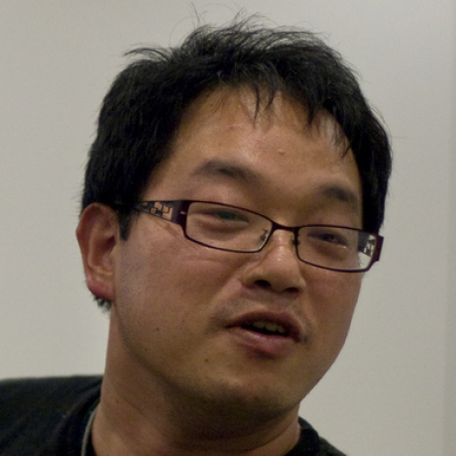
People
Three TDF members
LibreOffice Japanese Team(JA NLP ) has 19 members
  Spread wide area in Japan
  But few actives (less than a half…?)
NO paid worker
  Voluntary base

Slide 10
Activities
No strategy, “Do anything what the member(s) want to do” model
UI / Help / Wiki / Web translation
Organize events
  Discuss later
Exhibit / participate events (in Japan | Global)
Write articles for Japanese media (Magazine, web)
SNS marketing (Facebook, Twitter)

Slide 11
Communication
Mailing List
  Announce, Users, Discuss
Askbot
Telegram (#libreoffice-ja)

Slide 12
LibreOffice Events in Japan

Slide 13
Two events in Japan
LibreOffice mini-conference
Regional but Global
Focus on contributors
LibreOffice Kaigi
For Japanese speakers,
By Japanese speakers
Focus on end-users
Kaigi is taken from a Japanese word “会議” means “conference”

Slide 14
Beginning is mini-conference
First goal at 2014 (1st):
And improve our community strength to host global events
  Like “Mini DebConf 2009 Taipei,” which is taken from the event name
Then, became “regional but global” event at 2017
  Not only for Japan residences, but also for other areas
of course, could be remove “mini-” as Indonesian does ;)
“Make a place to meet LibreOffice contributors
from anywhere in Japan each other”

Slide 15
Why “Kaigi”?
Because we have the manifest:
Kaigi aims “encouraging all people,” not only contributors, with our mother tongue (Japanese)
WE COMMIT OURSELVES:
to support the preservation of mother tongues by encouraging all peoples to translate, document, support, and promote our office productivity tools in their mother tongue
https://wiki.documentfoundation.org/TDF/Next_Decade_Manifesto

Slide 16
Why we need a bridge?

Slide 17
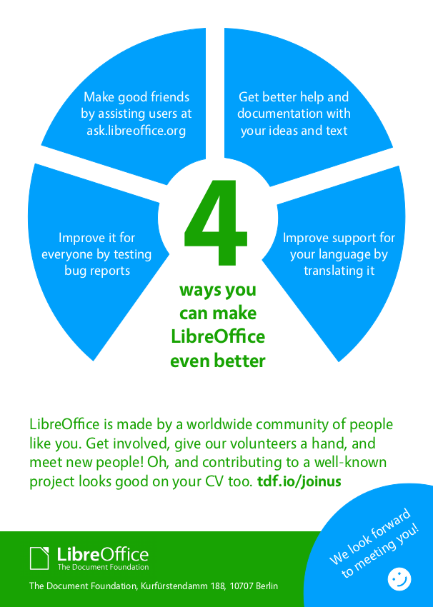
Anyway, why LibreOffice?
Personally, because we have opportunities to make world (through LibreOffice) better together
Together? With who?

Slide 18
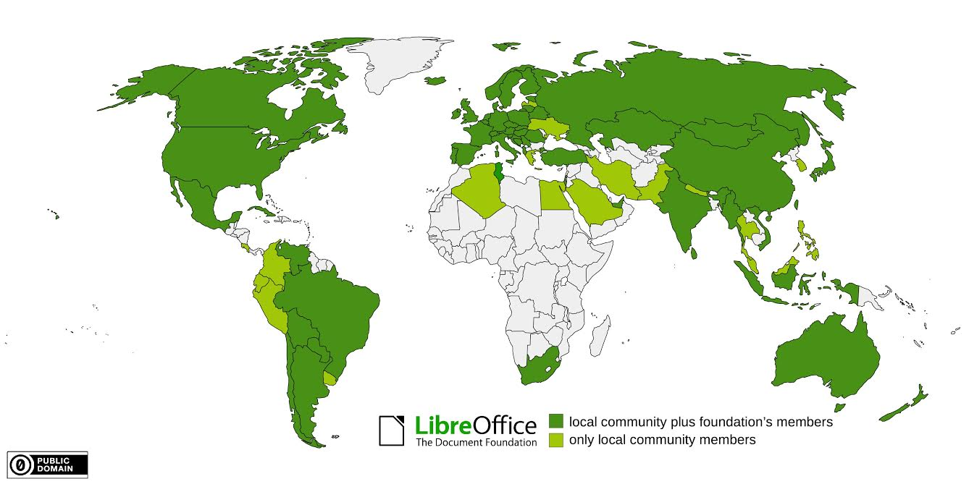
Yes, we are worldwide community!

Slide 19

Deep ”Language Valley”
In the global collaboration, we generally use English
Most Japanese learned English several years, but many of them don’t want to use it
You may know I’m not a typical Japanese ;)
My English is really bad, so I might be laughed
by others if I use English at public space...

Slide 20
So, we need to build a bridge over the language valley

Slide 21
How to build a bridge?

Slide 22
Solution 1: core team approach
Core NLP members become translators / interpreters (bridge)
… Doesn’t work well in JP
  Limited resource
  Hard to keep our motivation
    “You guys are good at English, I’m not, so it’s not my job”

Slide 23

Solution 2: “pier” approach
We core team isn’t a bridge, just “piers”
NLP core team do NOT everything
Instead, encourage
others and help them
JP community itself
become a bridge

Slide 24
Make “Kaigi” to “little global”
Our Kaigi aims for end-users, but sometimes we invited foreign guest speakers, without interpreters
  2016 Tokyo: Franklin Weng
    Taiwan ODF migration
  2018 Osaka: Tomaž Vajngerl
    LibreOffice 6.0 / 6.1 / 6.x features from developer POV
  2019 ???: Under the discussion

Slide 25
”Opportunity” is the keyword
We would like to provide end-users the “opportunity” to:
  Communicate non-Japanese speakers directly in English (if some translator is there or not) to ask their own interest
  See how we (core team) communicate with non-Japanese speakers with (broken) English
    You all are smart enough to understand our wrong English!
To encourage people who want to communicate global project!

Slide 26
Another trials to build a bridge
Offline collaborative events
  Translation Sprint
  Bug-Hunting day
  LibreOffice Day (run by Shinji Enoki)
    Gathering 3rd Wednesday in each month
    (now I plans to do same thing in Tokyo)
Connect several place (Tokyo / Osaka / …) via net (IRC / Telegram)
To attract people who have interest to get involved our community

Slide 27
Our next challenge

Slide 28
Just imagine ATM, anyway...
Annual Asian Conference????
  Like GNOME and openSUSE people do
  Gather people from other communities like Taiwan, Indonesia, China, Korea, or else
  Asia has no common language but geographically close (timezone, travel costs)
Attract more people in Japanese events and do multi-track (global track and local language track)
  How?
  Need to reach more enterprise / non-geek people (outside FLOSS world)

Slide 29
Conclusion

Slide 30
Conclusion
Japanese LibreOffice market is under the development (especially for non-geek users)
We have events: “miniconf” and “Kaigi”, which has different targets
“Using LibreOffice with our mother tongue” is important, but global collaboration is also important
Thus we, JP NLP core team, NOT ONLY communicate globally by ourselves, BUT ALSO encourage others to do so
That’s why our Kaigi is “little global”

Slide 31
Questions?

