Slide 1
The Document Foundation
– History, Statutes & Organization
Franklin Weng
Member, BoD, The Document Foundation
Dec. 9, 2018

Slide 2
History
This story is based on Italo Vignoli's document: Why LibreOffice is the sole heir to OpenOffice, 2015

Slide 3
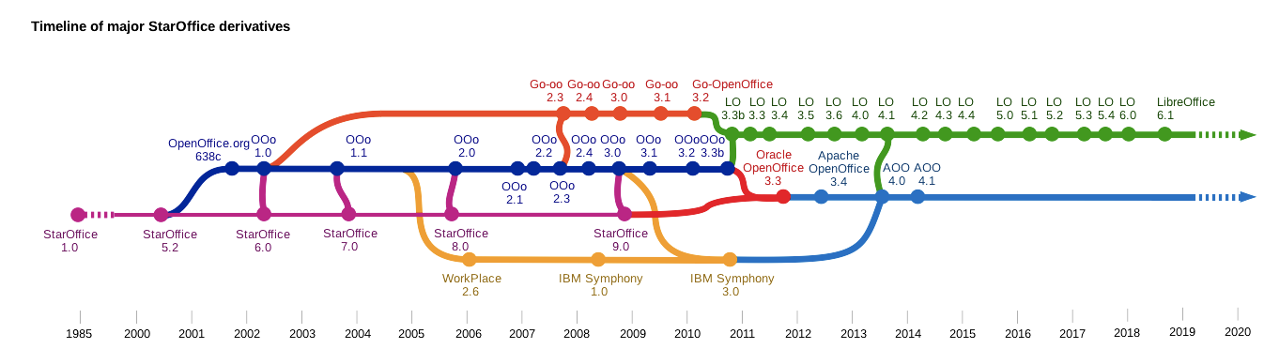
Customized from Wikipedia: LibreOffice history

Slide 4
Customized from Wikipedia: LibreOffice history

Slide 5
Lyon Conference (2006)
Customized from Wikipedia: LibreOffice history
Notes:
Michael Bemmer’s presentation:
The contributions between paid and volunteer developers were treated in an unbalanced way

Slide 6
IBM chose the
pemissive license of OOo
and transformed the
source into proprietary
code of Symphony
IBM signed the contract
with Sun, allowing it
to draw on OOo 3.0.
Symphony was released
as freeware, instead
of free software.
Customized from Wikipedia: LibreOffice history
Notes:
IBM claimed that the permissive license is one that will attract dozens of companies in the orbit of OOo. It was then proved not.

Slide 7
Oracle wasn't interested in
OOo at all. The leaders of
OOo community decided to
accelerate the process of
forking and the birth of
an independent foundation.
Oracle acquired Sun
in 2009.
The real goal of Oracle
was MySQL, not OOo.
Customized from Wikipedia: LibreOffice history

Slide 8
The Document Foundation
was founded on
Sep. 28, 2010.
Customized from Wikipedia: LibreOffice history

Slide 9

?
Customized from Wikipedia: LibreOffice history
Notes:
IBM convinces Oracle to transfer the OpenOffice brand and the application source code to the Apache Software Foundation, with the secret hope that the majority of the LibreOffice community will switch to Apache OpenOffice, in order to "eliminate" LibreOffice and block the process of establishing the Document Foundation.

Slide 10
The Key Point of
TDF's Statutes

Slide 11
Before Joining the Board
Marketing and Public Relationship
Certification Committee
LibreOffice community is a more "balanced" one

Slide 12
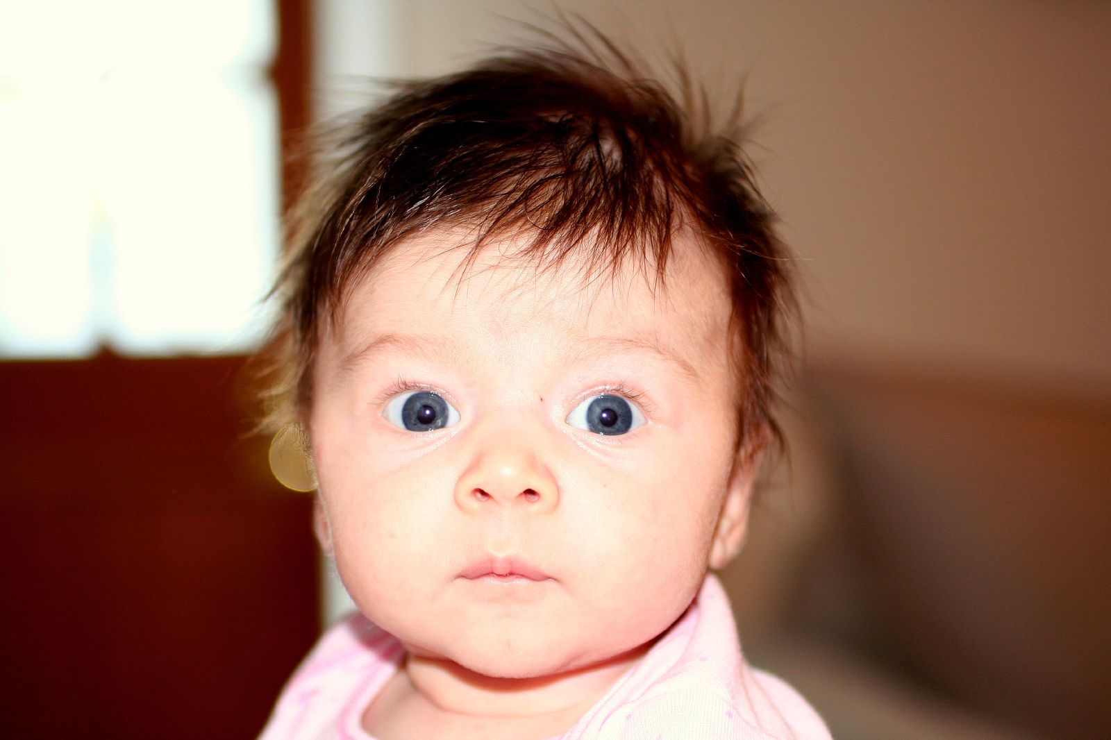
After Joining the Board
Source: https://goo.gl/bNGVEC
Photo by Mark Borcherding

Slide 13
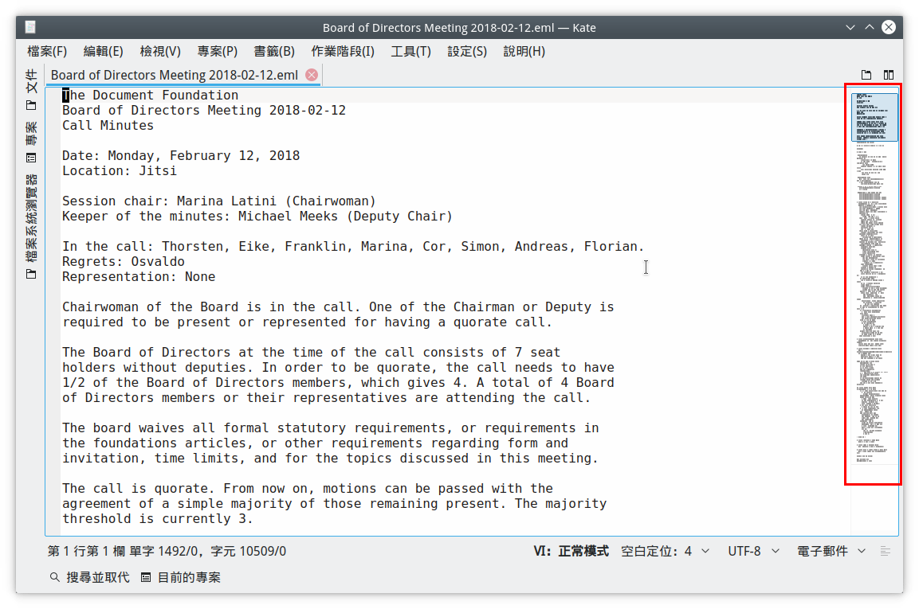
Board Meeting Minutes

Slide 14
Most Important Things I Learned
Because of the past, the founders focused on these things when writing statutes of TDF:
  Legitimacy: Registered in Berlin, following the Germany Law. Every action must be examined.
  Transparency: Decision making, foundation running
  Avoid CoI (Conflict of Interest): Avoid being affected by certain company/organization.

Slide 15
Organizations

Slide 16
Formal Bodies in TDF
Board of Directors
  Executive Director
  Certification committee
  Marketing and Public Relationship
Membership Committee
Board of Trustees (TDF Members)
Engineering Steering Committee (Developers)
  Design team
  Documentation team
  QA team
Advisory Board (Sponsors)

Slide 17
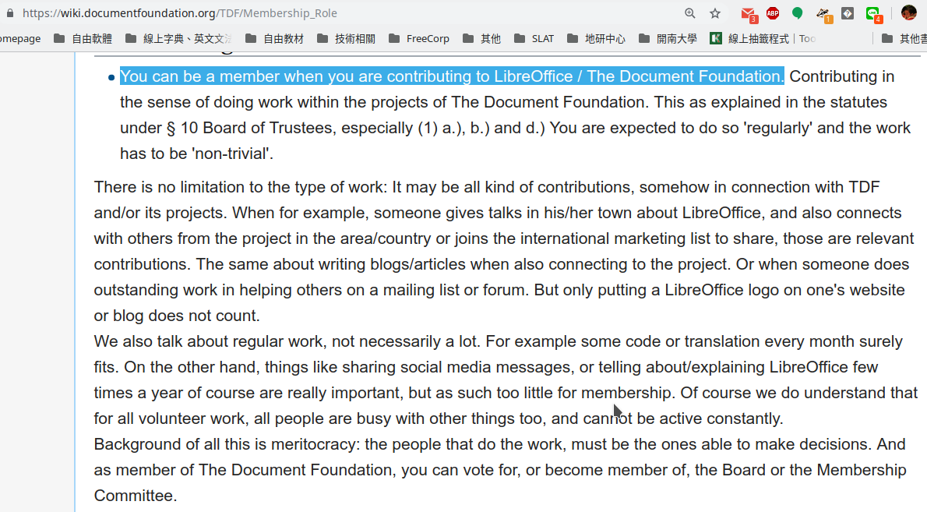
TDF Members

Slide 18
You don't need to contribute a lot
to join as TDF members.
Just contribute in a regular basis.

Slide 19
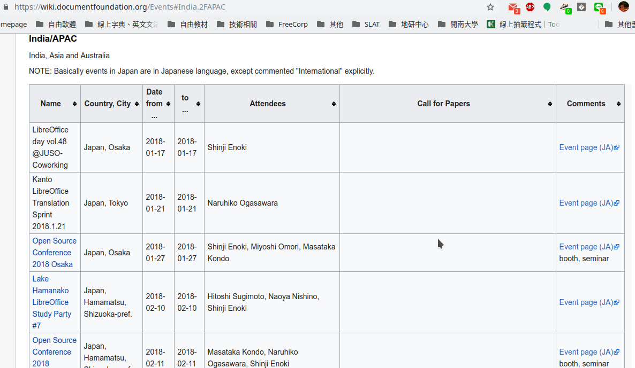

Slide 20
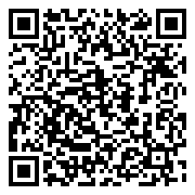
Fill out the application form
NOW!

Slide 21
Donations

Slide 22
Do you know that...
More than half of TDF's yearly income
is from small donations from people

Slide 23
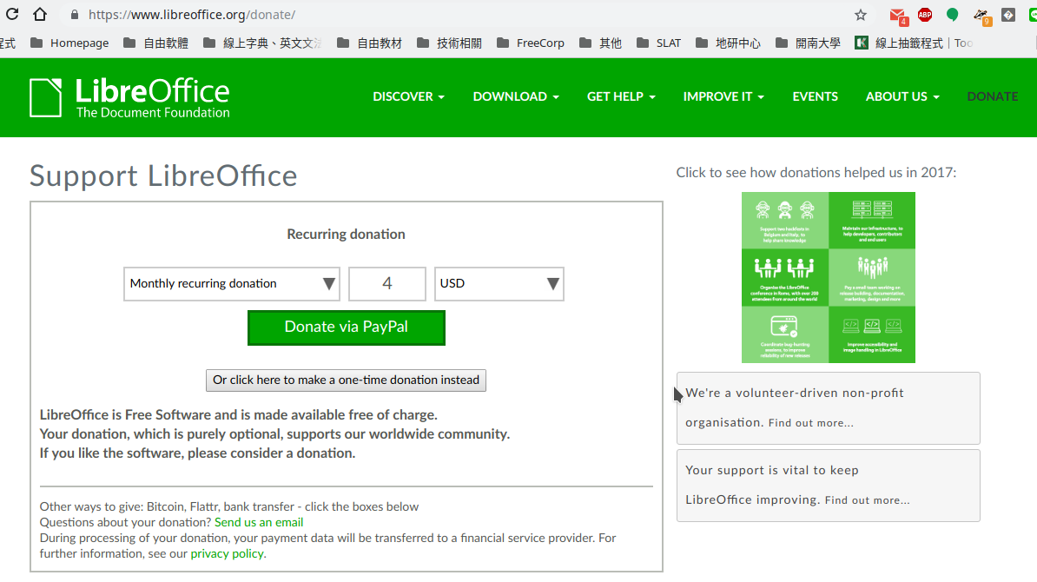
Recurring Donation

Slide 24
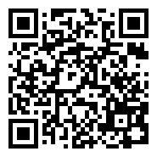
Recurring Donation
Just small amount, but donate monthly.
Paypal is needed
Small donation, Big help!

Slide 25
If there is any question, the answer is no.
Just kidding.
Any question?

