Slide 1



Welcome!
Welcome to Tokyo!
... openSUSE.Asia Summit 2017 Tokyo!
... LibreOffice mini-conference 2017 Japan!
mini-conference 2017 Japan

Slide 2


Program
Main Room (~ Tea break)
  LibreOffice: The Office Suite with Mixing Bowl Culture
  by Naruhiko Ogasawara
  War of File Format by Franklin Weng
  State of CJK issues of LibreOffice by Shinji Enoki
  Introduction to Japanese Darkness "Excel Houganshi" by Rin Nakamura
Room 1 (Tea break ~)
  Write Your Story with OpenSource by umulsidikoh
  How to build LibreOffice on your desktop by MasatakaKondo

Slide 3

So… what is 'mini-conference' ?
Regional (in Asia), but international
  easily attract neighbors than LibreOffice Conference, which has been held in Europe
  same reason of openSUSE.Asia Summit
  I hope someone will continue mini-conference in Asia ;)
Ref. LibreOffice Kaigi
  The annual event in Japanese LibreOffice community
  for Japanese speakers, by Japanese speakers
  会議 means “conference” in Japanese

Slide 4
LibreOffice:
The Office Suite with Mixing Bowl Culture
Naruhiko NARU Ogasawara
LibreOffice Japanese Team

Slide 5

Who am I?
Naruhiko NARU Ogasawara
  In Japanese style, 小笠原 徳彦
A member of LibreOffice Japanese Team
A member of The Document Foundation
UI/Help translation coordinator

Slide 6
What is LibreOffice?

Slide 7
Two aspect of LibreOffice
Product:
  Leading FLOSS office productive suite
Project:
  Worldwide, open and passionate project
  to develop the product of LibreOffice

Slide 8
LibreOffice: the leading FLOSS office productive suite
Full-function office productive suite
  word processor, spreadsheet, presentation, drawing, database, formula editor
Multi-platform
  Windows, Mac, Linux (and some unofficial ports)
  Online (LOOL), Android Viewer, Impress Remote
Free/Libre Open Source Software
  under MPLv2
Multilingual

Slide 9
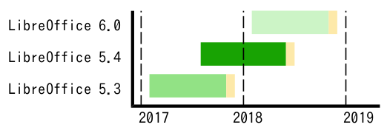
Timebase release
Major release every 6 months
Minor release every 1 months
Last 2 Major versions are supported
  “Fresh” and “Still”
5.4.2.2
MAJOR
MINOR
SUFFIX
Fresh
Still
Under development
EOL

Slide 10
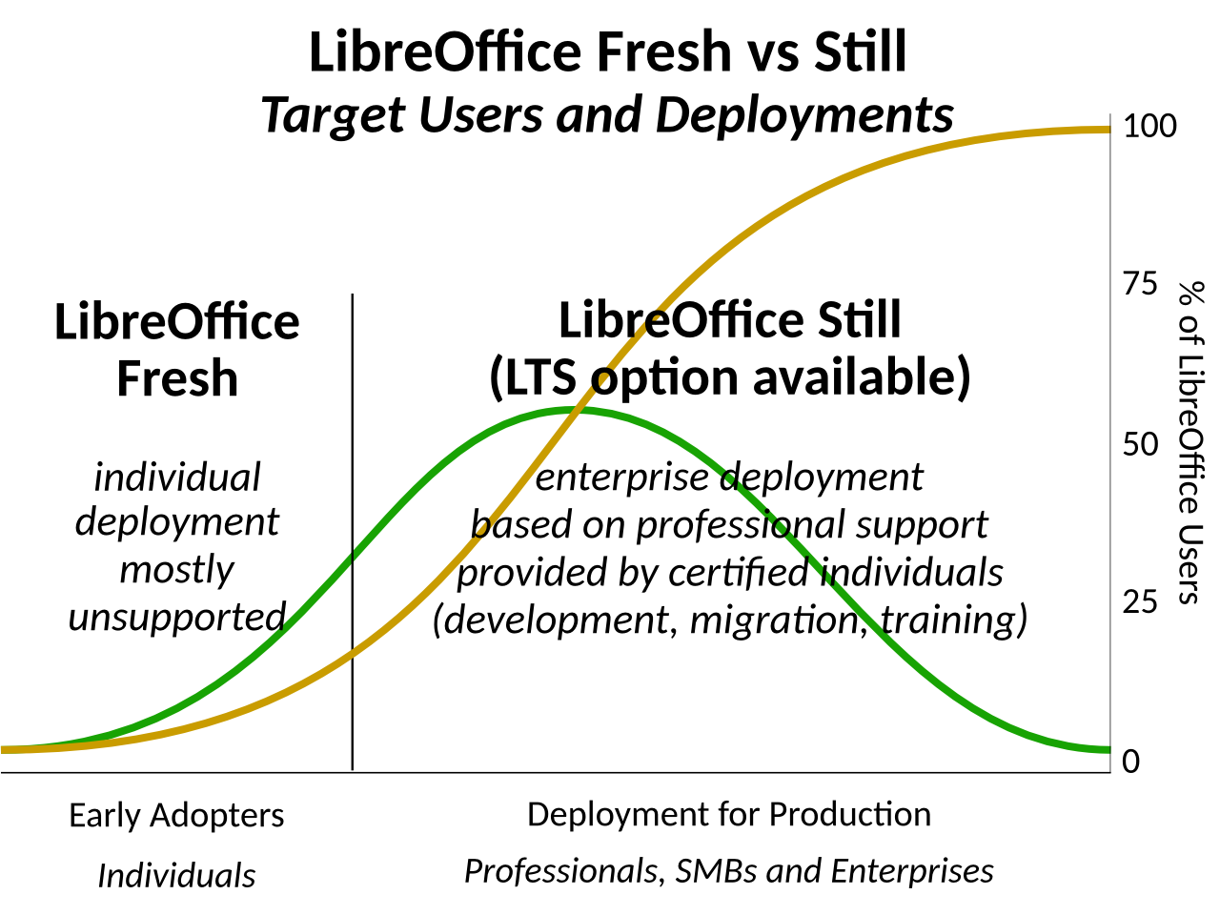
Fresh vs Still

Slide 11

LibreOffice in openSUSE
Leap 42.3
  LibreOffice 5.3
    https://build.opensuse.org/package/show/LibreOffice:5.3/libreoffice
    5.4 will be backported, but ATM there isn't
Tumbleweed (Factory)
  LibreOffice 5.4 (at 22nd Oct, 2017)
    https://build.opensuse.org/package/show/LibreOffice:Factory/libreoffice
You may use TDF build rpm or Flatpak
  http://www.libreoffice.org/download/download/
  http://www.libreoffice.org/download/flatpak/

Slide 12
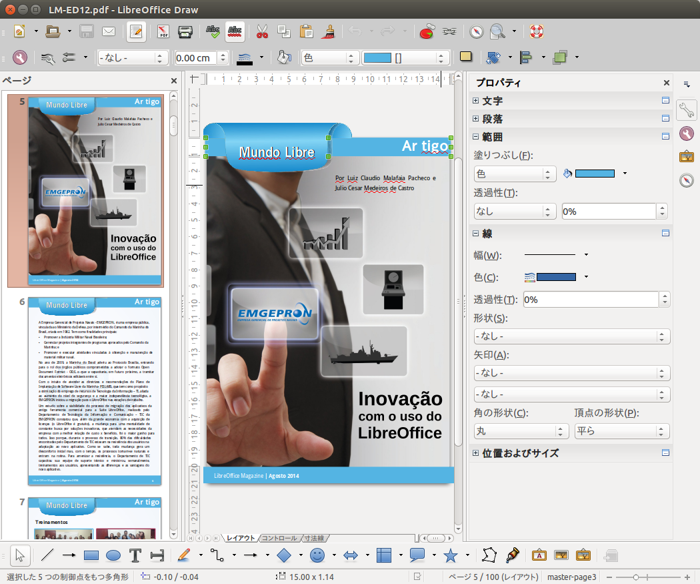
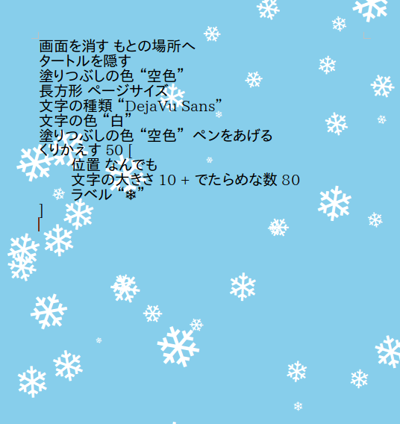
Notable functions
Draw
  Office-ish vector drawing software
  multi layer support
LibreLogo in Writer
  Logo language interpreter
  as Writer python extension
  Good for education
and many more...

Slide 13

OpenDocument Format
LibreOffice primary document format
  http://opendocumentformat.org/
Simple, well-documented, human-readable
Easy to manipulate by program code
Standarized by OASIS OpenDocument TC
ISO/IEC 26300

Slide 14
Interoperability
Say interoperable, NOT to say compatible
OOXML / Traditional MS Office format support
  Very important functionality
  Getting better rapidly thanks to timebase release
Document Liberation Project
  includes tons of import filters for proprietary document formats

Slide 15
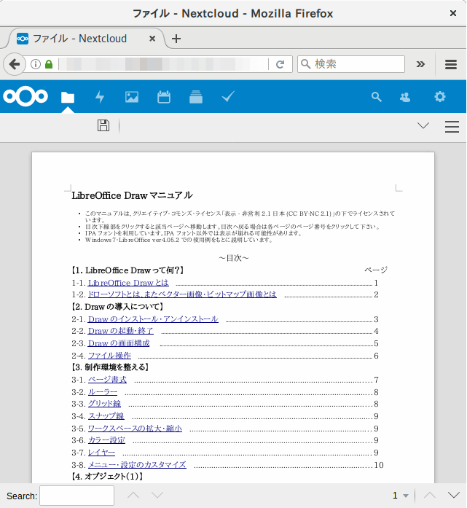
LibreOffice Online
You can edit LibreOffice document via modern Web Browser
NOT an Application but a runtime library
  You can add a document edit functionality in your own webapp

Slide 16
LibreOffice Development Statistics
9,000,000 | lines of code (mostly written in C++)
300 | active committers per year
30,000 | commits per year
400,000 | bugs already closed
0.00 | defect density of Coverity Scan
https://dashboard.documentfoundation.org

Slide 17
LibreOffice Development Statistics
9,000,000 | lines of code (mostly written in C++)
300 | active committers per year
30,000 | commits per year
400,000 | bugs already closed
0.00 | defect density of Coverity Scan
https://dashboard.documentfoundation.org

Slide 18
LibreOffice Development Statistics
9,000,000 | lines of code (mostly written in C++)
300 | active committers per year
30,000 | commits per year
400,000 | bugs already closed
0.00 | defect density of Coverity Scan
https://dashboard.documentfoundation.org

Slide 19
LibreOffice Development Statistics
9,000,000 | lines of code (mostly written in C++)
300 | active committers per year
30,000 | commits per year
400,000 | bugs already closed
0.00 | defect density of Coverity Scan
https://dashboard.documentfoundation.org

Slide 20
LibreOffice Development Statistics
9,000,000 | lines of code (mostly written in C++)
300 | active committers per year
30,000 | commits per year
400,000 | bugs already closed
0.00 | defect density of Coverity Scan
https://dashboard.documentfoundation.org

Slide 21
LibreOffice Development Statistics
9,000,000 | lines of code (mostly written in C++)
300 | active committers per year
30,000 | commits per year
400,000 | bugs already closed
0.00 | defect density of Coverity Scan
https://dashboard.documentfoundation.org

Slide 22
LibreOffce: as the worldwide, open, passionate project
100 millions userbase
7 years old project
  A Son of OpenOfice.org (10 years old, but dead), and
  An Elder Brother of Apache OpenOffice
Fork
LibreOffice
OpenOffice.org
Endowed
by Oracle
Apache
OpenOffice

Slide 23
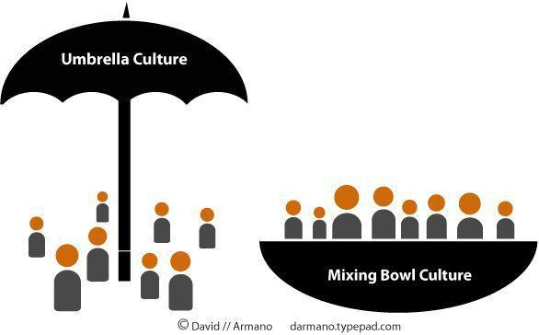
We choose “Mixing Bowl” culture

Slide 24

The Document Foundation
The charitable Foundation under German law
LibreOffice and Document Liberation Project’s home
Support cost for infrastructures, employees and freelances, travel expense for FLOSS events

Slide 25
TDF develops LibreOffice?
They don't
  NOT employ full-time developers
  testers
  UI/help translators
Instead,
  TDF provides the “Mixing Bowl”
  They employ Full-time development support mentor
  QA team, handles bug triage
  UI/UX team
  Infra team

Slide 26
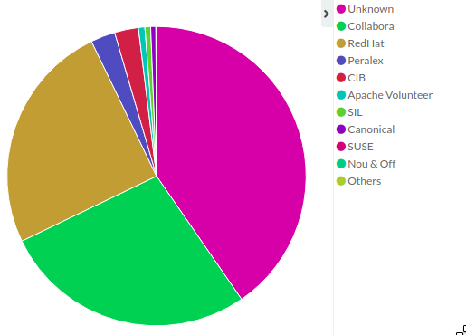
Everyone can dive into the “Mixing Bowl”
Employees of LibreOffice support vendors
Linux distributors
System integrators
Individuals
You can join!!

Slide 27
What can I do?
Marketing
Coding, Debugging
Documentation
Translation
Quality Assurance
… and become a TDF member ;)

Slide 28
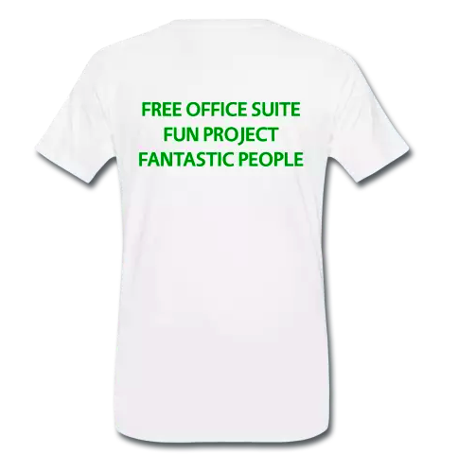
Join us!
LibreOffice Merchandising Shop
https://shop.spreadshirt.de/documentfoundation/

Slide 29
LibreOffice 5.4

Slide 30
Overviews
Current “Fresh” release
Last 5.x release
5.4.0 released 28th July, 2017
Latest version is 5.4.2 (3rd release of 5.4 family)
NOT a giant leap, but some enterprise-ready functions has been added

Slide 31
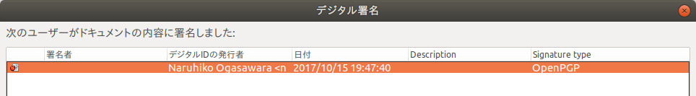
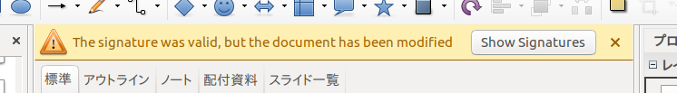
New Features: Document Signing
ODF format document can be signed by OpenPGP keys

Slide 32
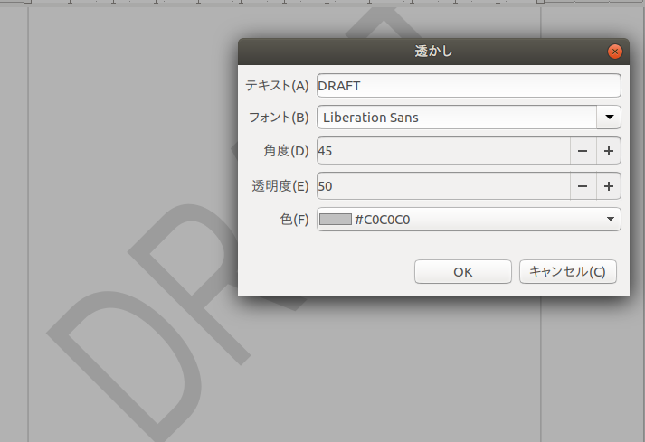
New Features: Writer: Watermark
Watermark can be added easily via Menu Format > Watermark

Slide 33
I hope
5.4 will be backported to Leap 42.3 soon ;)
(or you may use Tumbleweed)

Slide 34
Upcoming 6.0

Slide 35
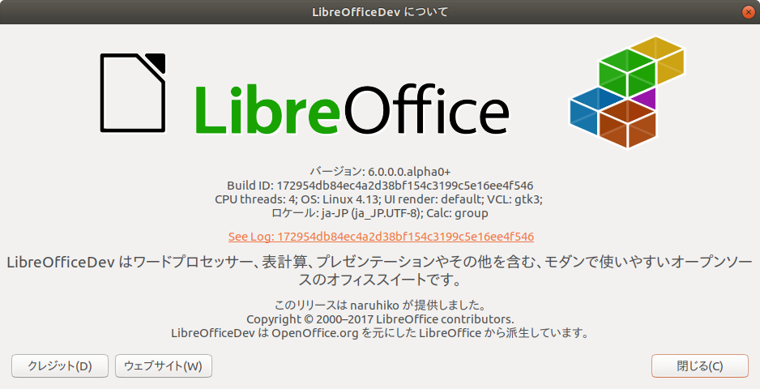
5.x to 6.x – Giant leap?
… will release Jan 29, 2018 - Feb 4, 2018

Slide 36
6.0 should be… ?
3.x – code refactoring
4.x – improvement functionality / perfomance
5.x – improve user experience
6.x – ???

Slide 37
Conclusion

Slide 38
Conclusion
LibreOffice is a full-featured open source office suite
  ships with openSUSE :)
The Document Foundation supports LibreOffice
  provides the “mixing bowl”
Everyone can dive into the “mixing bowl”
Free office suite, Fun Project, Fantastic People

Slide 39
Thank you for listening!
… Questions?
… naruoga@gmail.com

Slide 40
References
The Document Foundation
http://www.documentfoundation.org/
LibreOffice introduction: Presentations: Marketing Materials
https://wiki.documentfoundation.org/File:Final-libreofficeintro.odp
The Document Foundation Annual Report 2016
https://blog.documentfoundation.org/blog/2017/07/21/annual-report-2016/
LibreOffice Release Plan
https://wiki.documentfoundation.org/ReleasePlan
LibreOffice dashboard
https://dashboard.documentfoundation.org
The LibreOffice Open Source Project on OpenHub
https://www.openhub.net/p/libreoffice
Coverity Scan: LibreOffice
https://scan.coverity.com/projects/libreoffice

