Slide 1
Let's tackle open-source supply chain issues with open source
COSCUP 2024
OSPN Japan Special Track
2024/08/04
Naruhiko Ogasawara

Slide 2


Who am I
Naruhiko Ogasawara (小笠原 徳彦)
Japanese Security Vendor's Employee
Desktop Open Source Enthusiast
Ubuntu, LibreOffice, Printing
River Kayak lover

Slide 3

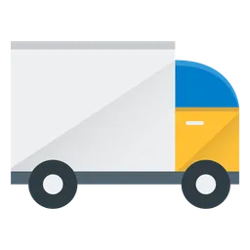


Supply Chain
From Wikipedia
A supply chain, sometimes expressed as a "supply-chain", is a complex logistics system that consists of facilities that convert raw materials into finished products and distribute them to end consumers or end customers. Meanwhile, supply chain management deals with the flow of goods within the supply chain in the most efficient manner.

Slide 4
”Software” Supply Chain
Library
Library
Library
From Wikipedia
Application
A software supply chain is composed of the components, libraries, tools, and processes used to develop, build, and publish a software artifact.
OS
Middleware
Container
Service

Slide 5
Software Supply Chain Risk
Vulnerable software components
The injection of a backdoor by a malicious attacker

Slide 6
Software Supply Chain Risk
Vulnerable software components
The injection of a backdoor by a malicious attacker

Slide 7

Vulnerable software components
You remember “log4shell” issue
How can we identify vulnerable software within the vast web of software dependencies?
https://xkcd.com/2347/

Slide 8
Vulnerable software components
You remember “log4shell” issue
How can we identify vulnerable software within the vast web of software dependencies?
  SBOM!
https://xkcd.com/2347/

Slide 9


SBOM
Supplier Name
Component Name
Component Version
Identifier
Dependency
SBOM Creator
Timestamp
Software Bill of Materials
Company A
Company B
Software vendors often create products by assembling open source and proprietary software components. A software bill of materials (SBOM) declares the inventory of components used to build a software artifact such as a software application. It is analogous to a list of ingredients on food packaging: where you might consult a label to avoid foods that may cause allergies, SBOMs can help organizations or persons avoid consumption of software that could harm them.
SBOM
SBOM
Composition
Final Assemble
Company
SBOM

Slide 10
Two major SBOM formats
SPDX (System Package Data Exchange)
  https://spdx.dev/
  Developed by The Linux Foundation
CycloneDX
  https://cyclonedx.org/
  Developed by OWASP

Slide 11
How to create SBOM
Software Composition Analysis (SCA)
  Software composition analysis (SCA) is a practice in the fields of Information technology and software engineering for analyzing custom-built software applications to detect embedded open-source software and detect if they are up-to-date, contain security flaws, or have licensing requirements. (wikipedia)

Slide 12
SCA Tools common work
Create SBOM by source code dependencies analysis
  Java Maven, JavaScript NPM, Python PyPI, Ruby Gem, …
Some commercial (proprietary) tools can handle source code snippets or embedded components

Slide 13
CycloneDX SCA families
Go to https://cyclonedx.org/tool-center/, or just googling “CycloneDX <langname>”
CycloneDX for Maven
  https://github.com/CycloneDX/cyclonedx-maven-plugin
CycloneDX for NPM
  https://github.com/CycloneDX/cyclonedx-node-npm
CycloneDX for Python
  https://github.com/CycloneDX/cyclonedx-python
CycloneDX for Ruby Gems
  https://github.com/CycloneDX/cyclonedx-ruby-gem

Slide 14
OWASP Dependency Track
OWASP Dependency Track
  https://dependencytrack.org/
  https://owasp.org/www-project-dependency-track/
  https://github.com/DependencyTrack/dependency-track
Project made by OWASP
Visualization tool of CycloneDX SBOM
Open Source licensed under Apache License 2.0

Slide 15
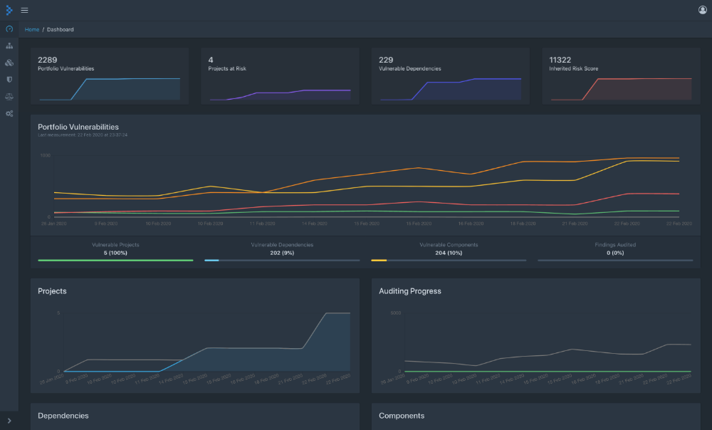
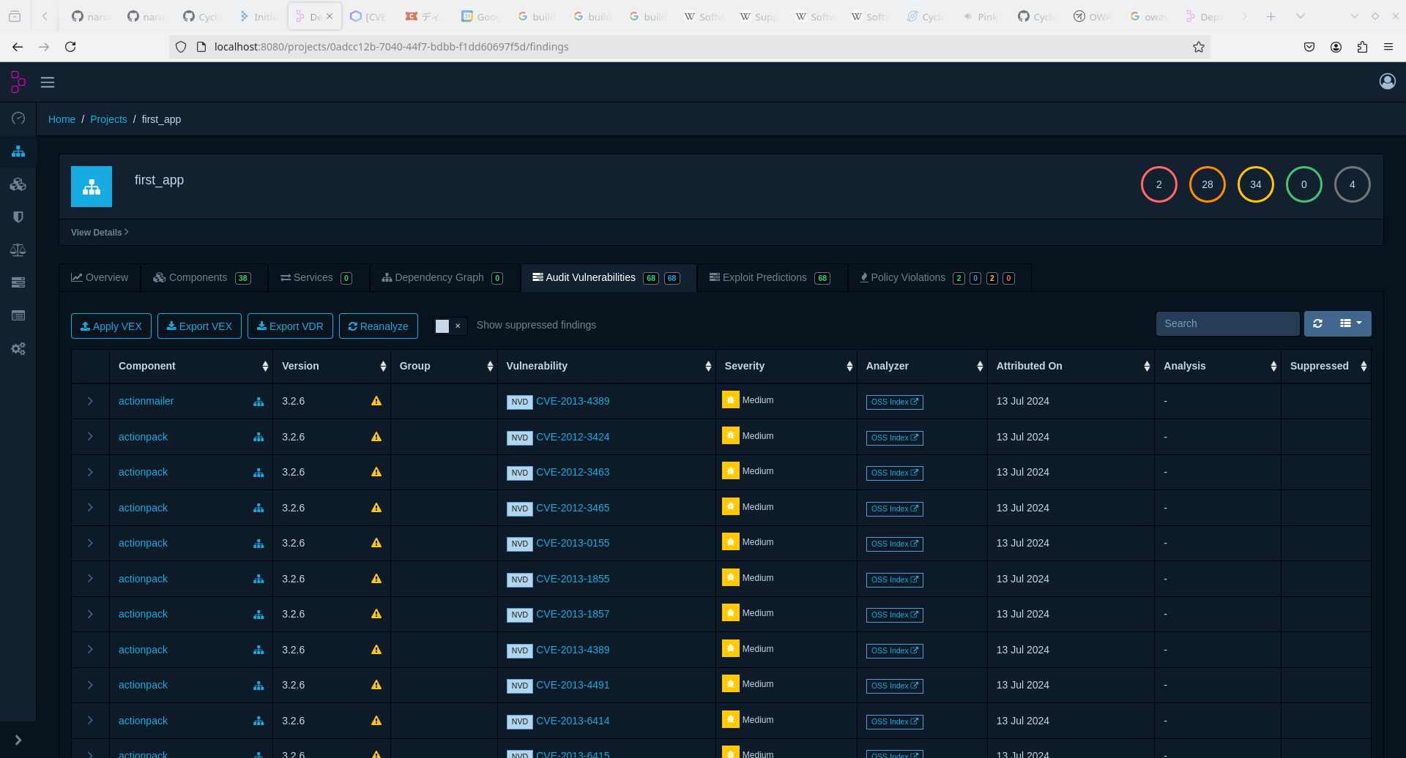

Slide 16
Quick Setup: Using Docker Compose
curl -LO https://dependencytrack.org/docker-compose.yml docker compose up -d

Slide 17
Creating SBOM from Ruby code
sudo gem install cyclonedx-ruby cyclonedx-ruby -p /path/to/rubyproject
*) Of course, the ruby project should manage dependencies with gemfile.lock

Slide 18
Live Demo Time...

