Slide 1


2022’s Ubuntu Desktop Printing Technology
Naruhiko Ogasawara
naruoga@gmail.com

Slide 2
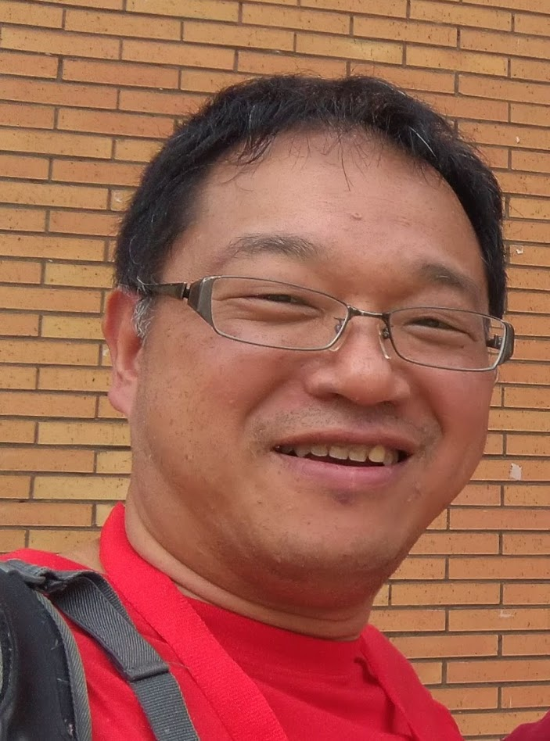

Who am I
Naruhiko Ogasawara (小笠原 徳彦)
Desktop FLOSS enthusiast from Chiba, Japan
(Printing, LibreOffice, ...)
former member of OpenPrinting Japan
former an employee of a Japanese printer vendor
Amateur kayaker
UbuCon Asia 2022 | 2020's Ubuntu Desktop Printing Technology

Slide 3
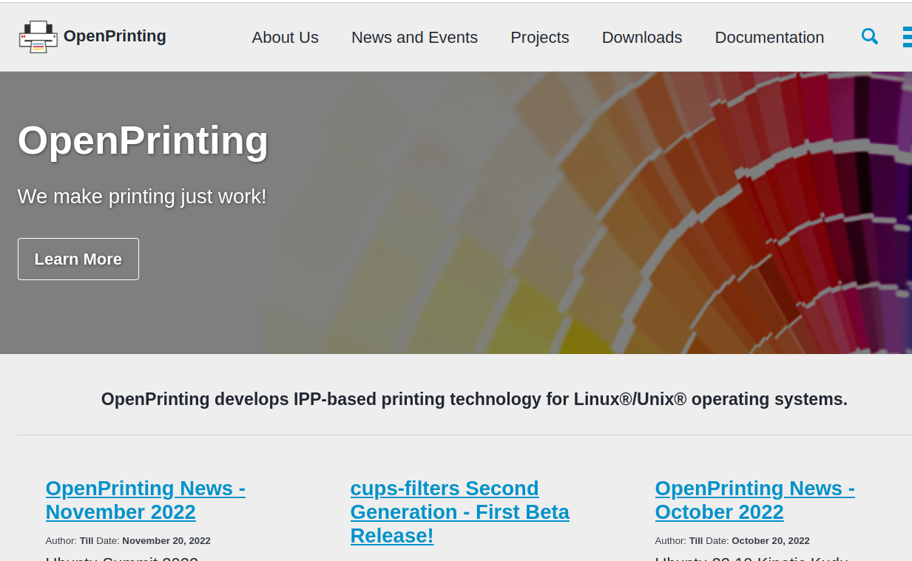
OpenPrinting
https://openprinting.github.io/
Develops IPP-based
printing technology
for Linux/Unix
Operating System
UbuCon Asia 2022 | 2020's Ubuntu Desktop Printing Technology

Slide 4


How printers “driven”
Printer is quite different from other peripherals
PDL = Page (or Printer) Description Language
Job Control
QTY=1, Color=B/W,
Size=A4, ...
PDL
UbuCon Asia 2022 | 2020's Ubuntu Desktop Printing Technology

Slide 5
CUPS
Common Unix Printing System
The core module of Linux printing system
It handles:
* Job control and its user interface
* Data filter pipeline to create PDL
No “kernel-land” modules
Now developed by OpenPrinting
UbuCon Asia 2022 | 2020's Ubuntu Desktop Printing Technology

Slide 6
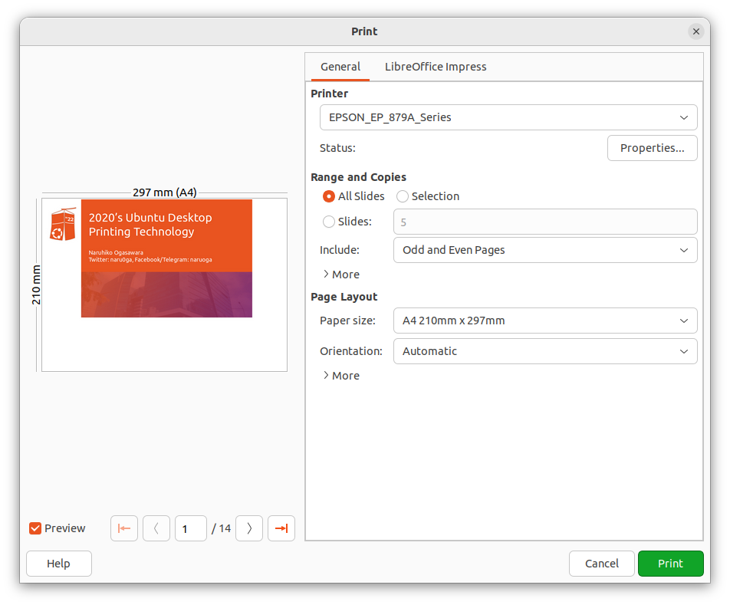
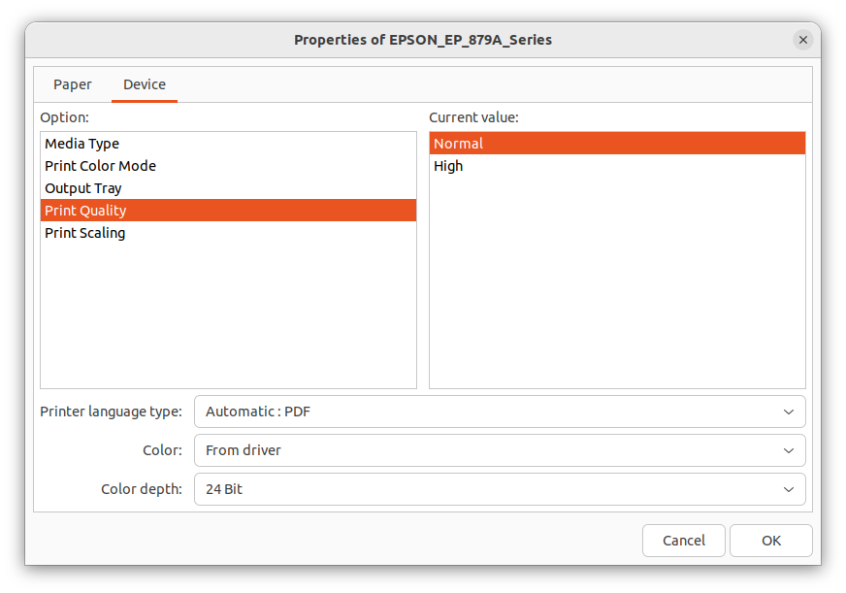
CUPS
CUPS
filter pipeline
Application
Spooler
PDF
Generation
back
-end
send
pdftopdf
Language
filter
Configuration
Ghostscript
PPD
printer
driver
Poppler
UbuCon Asia 2022 | 2020's Ubuntu Desktop Printing Technology

Slide 7
Job control: PPD
PPD: Postscript Printer Description
The name is came from historical reason, not limited to Postscript
Describe printer capabilities
* Color/Monochrome
* Supported media size
* Supported media type
* Finishing feature (duplex, stapling, ...)
UbuCon Asia 2022 | 2020's Ubuntu Desktop Printing Technology

Slide 8
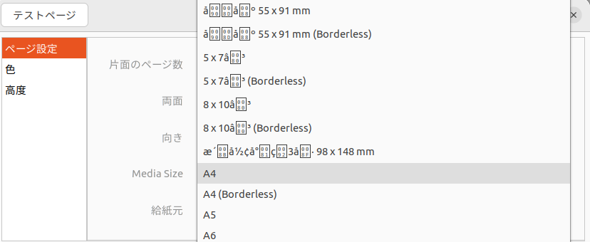
Job control: PPD
*PPD-Adobe: "4.3"
*FormatVersion: "4.3"
*FileVersion: "1.28.15"
...
*OpenUI *PageSize/Media Size: PickOne
*OrderDependency: 10 AnySetup *PageSize
*DefaultPageSize: A4
...
*PageSize A4/A4: "<</PageSize[595.275590551181 841.889763779528]>>setpagedevice"
*PageSize A4.Borderless/A4 (Borderless): "<</PageSize[595.275590551181 841.889763779528]>>setpagedevice"
...
*CloseUI
UbuCon Asia 2022 | 2020's Ubuntu Desktop Printing Technology

Slide 9
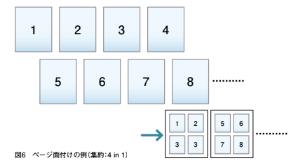
pdftopdf
CUPS semi-builtin filter (in the package “cups-filters”)
Used for page layout of PDF (like N-in-one or N-up)
UbuCon Asia 2022 | 2020's Ubuntu Desktop Printing Technology

Slide 10
Language filter
The “Last” filter of the filter pipeline
To generate the printer-specific data format (PDL; Printer or Page Description Language)
Which draws pictures onto papers
Vector / Raster
UbuCon Asia 2022 | 2020's Ubuntu Desktop Printing Technology

Slide 11
This was a painful era...
Who provides the “printer driver” for a particular printer?
According to the market share of desktop OSes, do printer vendors want to develop their printers’ drivers for Linux?
Can printer vendors support continuously?
(Linux desktop, like Ubuntu, evolves so fast)
Many of PDLs are proprietary, so development of fully-open-sourced drivers is difficult (except PostScript, PCL5e/PCL6)
UbuCon Asia 2022 | 2020's Ubuntu Desktop Printing Technology

Slide 12

Driverless Printing!
Now we don’t need to install “printer drivers”
Instead, connect via Wi-Fi or USB then just work
If the printer support “Apple AirPrint” (or “IPP Everywhere”)
UbuCon Asia 2022 | 2020's Ubuntu Desktop Printing Technology

Slide 13
How it works
When a printer turns on, it let same networks devices know “I’m here, I can print” via mDDNS (Avahi)
Ubuntu
I’m here,
I can print
CUPS-browsed
CUPS
filter pipeline
Spooler
pdftopdf
Raster
filter
UbuCon Asia 2022 | 2020's Ubuntu Desktop Printing Technology

Slide 14
How it works
CUPS-browsed receive the message, then let CUPS know new printer coming
Hey CUPS, new printer coming
Ubuntu
CUPS-browsed
CUPS
filter pipeline
Spooler
pdftopdf
Raster
filter
UbuCon Asia 2022 | 2020's Ubuntu Desktop Printing Technology

Slide 15
How it works
CUPS asks to the printer it’s attributes (capabilities) via IPP
Ubuntu
Tell me your attributes
OK!
CUPS-browsed
CUPS
filter pipeline
IPP
Spooler
pdftopdf
Raster
filter
UbuCon Asia 2022 | 2020's Ubuntu Desktop Printing Technology

Slide 16
How it works
CUPS generate PPD file from received printer attributes
Ubuntu
CUPS-browsed
CUPS
filter pipeline
Spooler
pdftopdf
Raster
filter
Here is a new PPD file!
PPD
UbuCon Asia 2022 | 2020's Ubuntu Desktop Printing Technology

Slide 17
How it works
An application can use the PPD to control jobs, and send PDF of page images
Ubuntu
Print this documents with this configuration
CUPS-browsed
CUPS
filter pipeline
Appli-
cation
Spooler
pdftopdf
Raster
filter
PPD
UbuCon Asia 2022 | 2020's Ubuntu Desktop Printing Technology

Slide 18
How it works
The filter pipeline has a raster filter to create raster images from PDF which can be accepted the printer. It is sent via IPP with job control commands
Ubuntu
CUPS-browsed
CUPS
filter pipeline
Appli-
cation
Spooler
pdftopdf
Raster
filter
PPD
I can create raster images which can be accepted you
UbuCon Asia 2022 | 2020's Ubuntu Desktop Printing Technology

Slide 19
IPP: Internet Printing Protocol
A printing protocol over HTTP
RFC 2911 https://datatracker.ietf.org/doc/html/rfc2911
Bi-directional
* Get printer status / capabilities / configurations
* Post printing job with job control commands
UbuCon Asia 2022 | 2020's Ubuntu Desktop Printing Technology

Slide 20
IPP: GetPrinterAttribute and PPD
$ ipptool -tv ipps://EPSON%20EP-879A%20Series._ipps._tcp.local/ get-attributes.test | tee out.txt
...
media-default (keyword) = iso_a4_210x297mm
media-supported (1setOf keyword) = iso_a4_210x297mm,na_index-4x6_4x6in,na_5x7_5x7in,na_govt-letter_8x10in,om_hivision_101.6x180.6mm,iso_a5_148x210mm,iso_a6_105x148mm,na_letter_8.5x11in,na_legal_8.5x14in,oe_photo-l_3.5x5in,jpn_hagaki_100x148mm,jis_b5_182x257mm,jpn_chou3_120x235mm,jpn_chou4_90x205mm,om_you1_120x176mm,om_you3_98x148mm,jpn_you4_105x235mm,iso_c6_114x162mm,om_cardsize_55x91mm,om_creditcardsize_54x86mm,custom_min_89x127mm,custom_max_215.9x1117.6mm
*PPD-Adobe: "4.3"
*FormatVersion: "4.3"
*FileVersion: "1.28.15"
...
*OpenUI *PageSize/Media Size: PickOne
*OrderDependency: 10 AnySetup *PageSize
*DefaultPageSize: A4
...
*PageSize A4/A4: "<</PageSize[595.275590551181 841.889763779528]>>setpagedevice"
*PageSize A4.Borderless/A4 (Borderless): "<</PageSize[595.275590551181 841.889763779528]>>setpagedevice"
...
*CloseUI
UbuCon Asia 2022 | 2020's Ubuntu Desktop Printing Technology

Slide 21
Raster filter(s)
document-format-supported (1setOf mimeMediaType) = application/octet-stream,image/pwg-raster,image/urf,image/jpeg
Printer accepts some raster formats: e.g. RAW (application/octet-stream), PWG Raster, URF (Apple Raster) and JPEG
And you can see the filter pipeline definitions in /usr/share/cups/mime/*.conv files
application/pdf application/vnd.cups-pdf 66 pdftopdf
# if using Ghostscript
application/vnd.cups-pdf image/pwg-raster 99 gstoraster
# if using Poppler
application/vnd.cups-pdf application/vnd.cups-raster 100 pdftoraster
application/vnd.cups-raster image/pwg-raster 100 rastertopwg
UbuCon Asia 2022 | 2020's Ubuntu Desktop Printing Technology

Slide 22
Conclusion
Printer drivers are user-land modules within CUPS
The pair of (a) PPD and (b) Language filter
Some time ago, using printers in Ubuntu required support from the printer vendor
But now we have a driverless printing feature
This allows Ubuntu users to print Apple AirPrint available printers without vendors’ drivers
UbuCon Asia 2022 | 2020's Ubuntu Desktop Printing Technology

Slide 23
Thank you!
Naruhiko NARU Ogasawara
Twitter: naru0ga, Facebook / Telegram: naruoga

