Slide 1
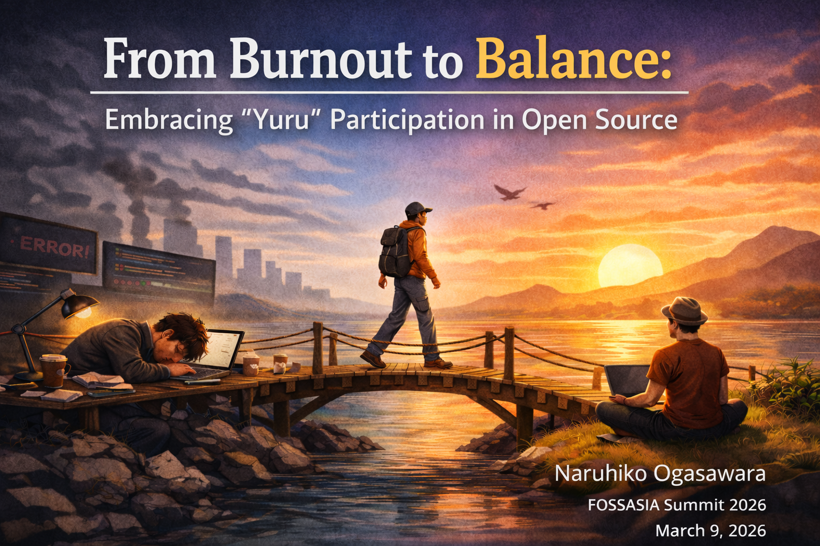
From Burnout to Balance: Embracing "Yuru" Participation in Open Source
Naruhiko Ogasawara
Generated by ChatGPT
Notes:
Hello everyone.
My name is Naruhiko Ogasawara.
I’m a security engineer from Japan, and I’ve been involved in open source communities for many years — especially in the LibreOffice community, where I served as the Japanese translation lead.
Today, I want to talk about something that many of us experience, but rarely speak about openly: burnout in open source — and how I found a way to return without repeating the same mistake.
This talk is personal. But I hope it feels familiar.

Slide 2
Why this talk?
Burnout is widespread but rarely discussed openly
Contributors often disappear quietly
The pandemic amplified stress and isolation
I experienced burnout myself — and struggled to return
This talk explores a healthier, sustainable path back.
Notes:
Open source celebrates passion.
We celebrate maintainers who respond instantly.
Contributors who review dozens of pull requests.
People who sacrifice weekends for releases.
But we don’t often celebrate rest.
During COVID-19, I started noticing something.
Contributors were disappearing quietly.
Not with drama.
Not with announcements.
They just… stopped.
I was one of them.

Slide 3
My Burnout Story
Active contributor in the LibreOffice community for years
COVID-19 removed in-person interactions
Miscommunication increased; relationships became strained
Motivation faded; participation became painful
Eventually stepped away completely
Burnout came not from code, but from people and isolation.
Notes:
Before the pandemic, open source was not only work — it was people.
Conferences.
Hallway conversations.
Dinners after events.
Translation sprints where we laughed together.
Then COVID happened.
Everything moved online.
Text replaces tone.
Chat replaces nuance.
Small misunderstandings linger longer.
Gradually, relationships that once felt natural began to feel strained.
I wasn’t burned out by code.
I was burned out by the loss of human connection.
And eventually, participating felt heavy.
So I stepped away.

Slide 4
Why Burnout Happens in OSS
Endless backlog of issues and PRs
Emotional labor of community work
“Hero maintainer” culture and self-pressure
Remote-only communication increases friction
Lack of safe ways to step back
Burnout is a structural issue, not a personal failure.
Notes:
Later, I realized this wasn’t just my story.
Open source has structural pressures:
There is always more work than people.
Issue trackers never empty.
Maintainers carry invisible emotional labor.
We internalize responsibility.
There is also a cultural element.
In many communities, stepping back feels like failure.
But burnout is not weakness.
It’s what happens when dedication meets imbalance.

Slide 5
The Hard Part: Coming Back
Wanting to return but feeling disconnected
Fear of expectations
Uncertainty about where to restart
The belief that “I must contribute like before”
Recovery requires a new mindset — not a return to the old one.
Notes:
After stepping away, something surprising happened.
I still cared.
I still read mailing lists sometimes.
I still followed discussions.
But I didn’t know how to return.
I felt disconnected.
I worried:
If I come back, will expectations return too?
Will I need to be the same person I was before?
That fear stopped me more than exhaustion did.

Slide 6
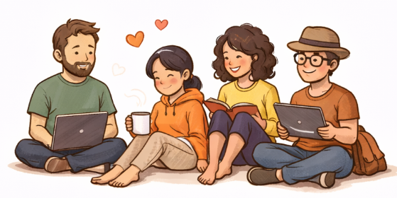
What Is Yuru Participation?
(Yuru;ゆる = “loose,” “low-pressure,” “gentle” in Japanese)
Participate without obligation
Micro-contributions are enough
No fixed schedule
Non-code work is equally valuable
Presence itself is a valid form of contribution
A sustainable way to exist in OSS communities.
Notes:
The shift came when I stopped asking:
“How can I contribute at the same level as before?”
And started asking:
“How can I stay connected sustainably?”
In Japanese, we have a word: yuru.
It means loose. Relaxed. Gentle.
Yuru participation means:
No obligation.
No fixed performance.
Small contributions are enough.
Presence is enough.
It redefines participation as something flexible.

Slide 7
Why Yuru Participation Works
Reduces pressure → increases longevity
Makes communities more welcoming
Highlights essential non-code tasks
Encourages healthier personal boundaries
Allows contributors to return gradually
Light participation strengthens both people and projects.
Notes:
When pressure decreases, longevity increases.
Small contributions are not small when they accumulate.
Fixing a typo helps someone.
Reproducing a bug helps someone.
Translating one sentence helps someone.
Yuru participation also lowers the barrier for newcomers.
When communities only celebrate heroes, newcomers feel inadequate.
When communities normalize gentle participation, more people stay.
Balance is sustainable. Intensity is not.

Slide 8
Practical Examples
Fix a small typo
Leave a comment: “I can reproduce this issue”
Attend a community meeting casually
Contribute to translation or documentation
Join low-pressure groups (e.g., translation cafés)
Share knowledge on Ubuntu or printing technologies
Small actions accumulate — contribution is not binary.
Notes:
What does this look like in practice?
You might:
Comment on one issue.
Translate one paragraph.
Join a meeting and just listen.
Attend an event without volunteering.
Share knowledge casually.
You can even step away for months — and return without apology.
Contribution is not binary.
You are not either “active” or “inactive.”
You exist on a spectrum.

Slide 9
Benefits for Communities
Lower entry barriers for newcomers
Less dependence on a few maintainers
Retains contributors who might otherwise leave permanently
Creates a culture of psychological safety
Sustainable communities welcome all levels of engagement.
Notes:
This is not only about individual well-being.
Communities benefit too.
Lower pressure means fewer permanent departures.
Flexible roles reduce dependency on a few people.
Psychological safety increases.
Sustainable ecosystems require sustainable humans.
If contributors cannot breathe, projects cannot last.

Slide 10
A Message to Those Who Are Tired
It’s okay to step away
It’s okay to return slowly
You don’t need to be who you were before
Your presence alone can make a difference
OSS should be a place where you can breathe.
Notes:
If you are tired:
It is okay.
If you stepped away:
That is okay.
If you return differently:
That is also okay.
You do not need to shine constantly.
Sometimes, staying gently connected is enough.

Slide 11
Key Takeaways
Burnout is common and understandable
Recovery begins with gentle participation
Communities must widen the definition of contribution
Yuru participation benefits everyone
You can return — at your pace, in your way.
Notes:
Burnout does not have to be the end of your open source journey.
It can be a transition.
From intensity to balance.
From obligation to sustainability.
From performance to presence.
Let’s build communities where people can stay — not just burn brightly and disappear.
Thank you.

Slide 12
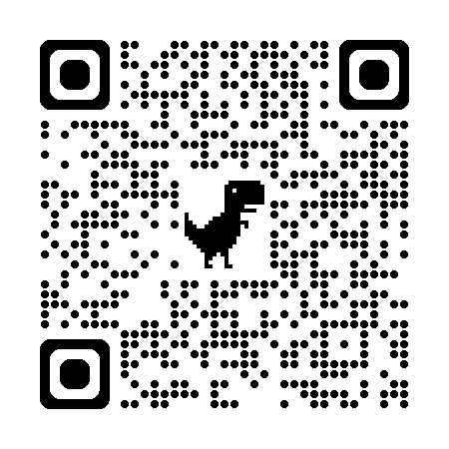
Thank you / Q&A
Thank you for listening!
Questions?
Naruhiko Ogasawara
Shift Security Inc.
LibreOffice community supporter
Ubuntu enthusiast
Printing tech observer
Notes:
Thank you for listening.
If this talk resonates with you, I would be happy to continue the conversation.
Let’s build open source communities where people can stay — not just shine briefly.

