Slide 1
Greeting from Naruhiko - 挨拶二日目
COSCUP 2024
OSPN Japan Special Track
2024/08/04
Naruhiko Ogasawara

Slide 2
Welcome!
To the OSPN Japan Special Track Day 2

Slide 3
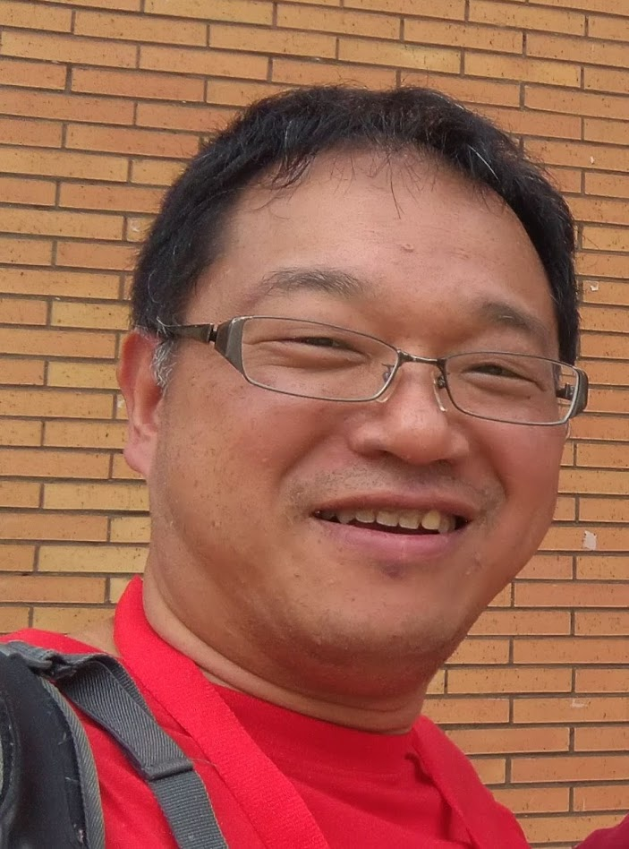

Who am I
Naruhiko Ogasawara (小笠原 徳彦)
OSPN Japan Special Track Day2 handler
OSS enthusiast from Japan
Live in Sakura, Chiba; near by NRT int’l airport
I love river kayaking

Slide 4
OSPN
Open Source People’s Network
Japanese “meta” community of OSS lovers
A large inter-community connecting various OSS communities in Japan
Organizer of Japan's largest OSS event series,
the ”Open Source Conference”

Slide 5


Open Source Conference
From Official Site: https://www.ospn.jp/
オープンソースカンファレンス（OSC）は、オープンソースの今を伝えるイベントです。
東京だけでなく、北は北海道、南は沖縄まで、年間を通じて全国各地で開催しています。
オープンソース関連のコミュニティや協賛企業・後援団体による、セミナーやプロダクトの展示などを入場・参加料が無料でご覧いただけるイベントです。
Open Source Conferences (OSC) are events that showcase the current state of open source.
OSC is held not only in Tokyo, but also throughout Japan throughout the year, from Hokkaido in the north to Okinawa in the south.
The event offers free admission and participation in seminars and product exhibits by the open source community, sponsors, and supporting organizations.

Slide 6
OSPN Japan Special Track
This track is for COSCUP participants who are interested in presentations by Japanese OSS enthusiasts speaking at OSC and other OSS events
This track will be conducted in English with a few exceptions
  all slides are in English, though

Slide 7
OSPN Japanese Special Track Day2
10:00-10:30 (NOW!) | Greetings from Naruhiko - 挨拶 2 日目 | Naruhiko Ogasawara
10:45-11:15 | Learning Mathematics with Lean | Yuki Otsuka
11:30-12:00 | Status of CJK language support in LibreOffice 2024 | Shinji Enoki
13:00-13:40 | Leveraging RISC-V SBCs with Ubuntu (JA) | Mitsuya Shibata
13:55-14:25 | Would you all love to build and operate your own 'server'? - the tips for doing it via my experience running 'MyDNS' (JA) | Takeshi Kaburagi
14:40-15:10 | Enhancing Comic Search with Vector Index. | Koji Annoura
15:25-15:55 | Let's tackle open-source supply chain issues with open source | Naruhiko Ogasawara

Slide 8
Thanks for gathering!
I hope you’ll enjoy our talk
And keep good relationship with COSCUP and OSPN!

