Slide 1

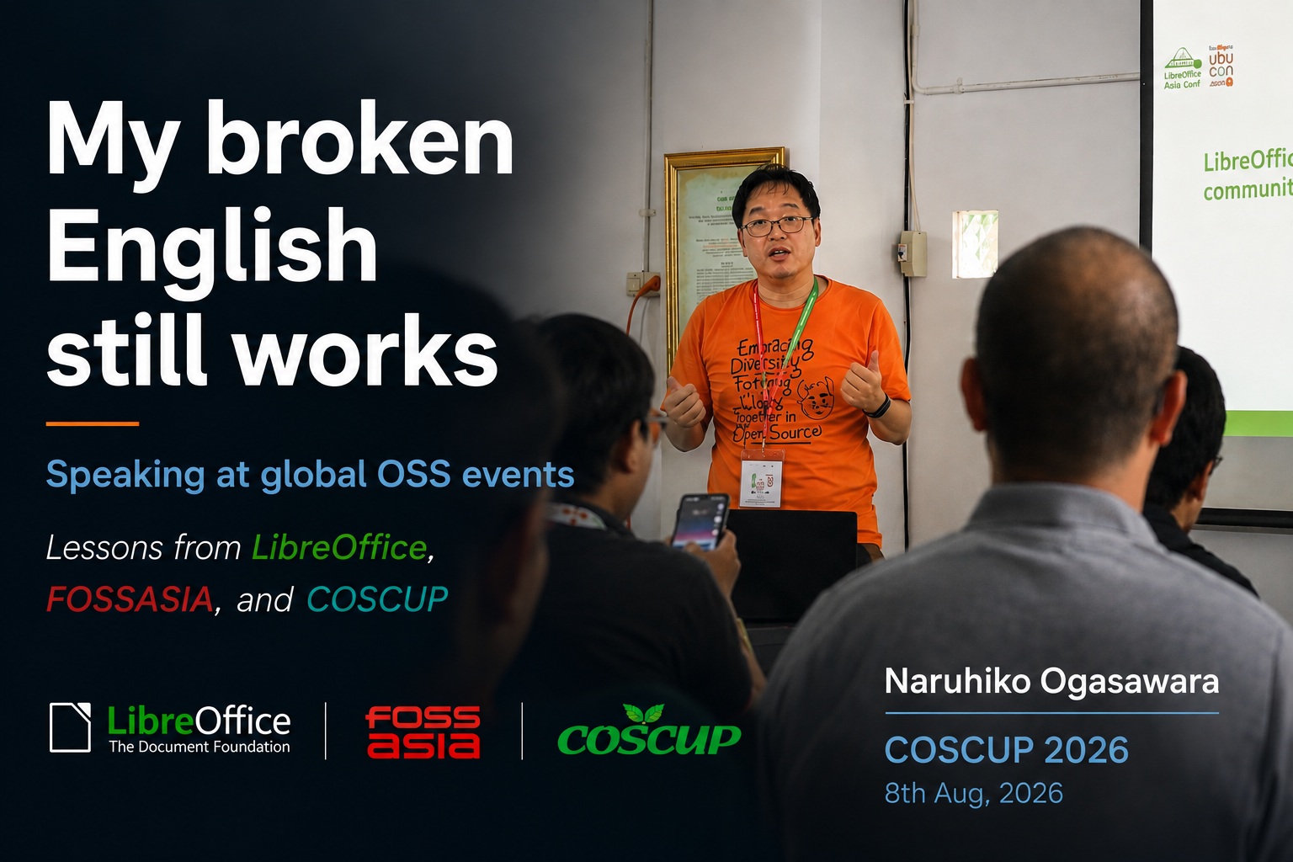

My broken English still works
Speaking at global OSS events
Naruhiko Ogasawara
COSCUP 2026, 8th Aug. 2026
🌐
Lessons from LibreOffice, FOSSASIA and COSCUP
Notes:
Open with a smile. 'This title is true. My English is still broken.'
Hello, everyone.
My name is Naruhiko Ogasawara.
Thank you very much for coming.
Today, I'd like to tell you a story.
It is not a talk about learning English.
It is a talk about joining the global OSS community.
I am not good at English.
Actually... I'm still not good at English.
(smile)
But I keep speaking at international conferences.
Why?
That's what I'd like to share today.

Slide 2

The strange thing I learned
A surprise at international conferences.
💬
Giving talks made international conversations easier for me.
Notes:
Pause after first sentence.
Before I tell you my story,
I'd like to tell you one strange thing I learned.
I didn't expect this at all.
Giving talks made international conferences easier for me.
Not because my English improved.
My English is still not very good.
But conferences became much more enjoyable.
At first, I didn't understand why.
Later, I realized why.
And today I'd like to share that with you.

Slide 3

What changed?
👤❓
Before
Nobody knew me
The Talk
🎤
My talk
After
💬
"I watched your presentation!"
Notes:
Use animation if possible.
Before my talk...
Nobody knew me.
I was just another attendee.
My second international talk was at the LibreOffice Conference in Berlin.
I decided to give a talk for one simple reason.
I thought,
"If I don't give a talk, I'll probably go home as just another attendee."
I wanted people to know who I was.
So I submitted a talk.
（ここで一拍）
After the talk,
something changed.
Sophie came to talk to me.
She coordinated localization work in the LibreOffice community.
We had never met before.
But we already had something to talk about.
My presentation.
Reflection
ここが大事です。
That was the moment I realized something.
A presentation is not only a way to share ideas.
It is also a way to start conversations.
ここはゆっくり。
Closing
But…
Let me go back a little.
My first international talk was very different.

Slide 4
My first international talk
The Delivery
📄
Read my script.
The Q&A Session
💬
Missed the Q&A.
The Realization
💭
I thought:
"I'm not ready."
Notes:
Failure story.
I prepared a script.
A very long script.
I looked at the script almost all the time.
I didn't look at the audience very much.
I was too nervous.
ここで笑い。
Then came the Q&A.
（止まる）
That was...
even worse.
（笑）
ここで
I could understand some words.
But not the whole question.
I was embarrassed.
And…
I lost my confidence.
I thought,
"Maybe I'm not ready for international conferences."
But...
Someone changed my mind.

Slide 5
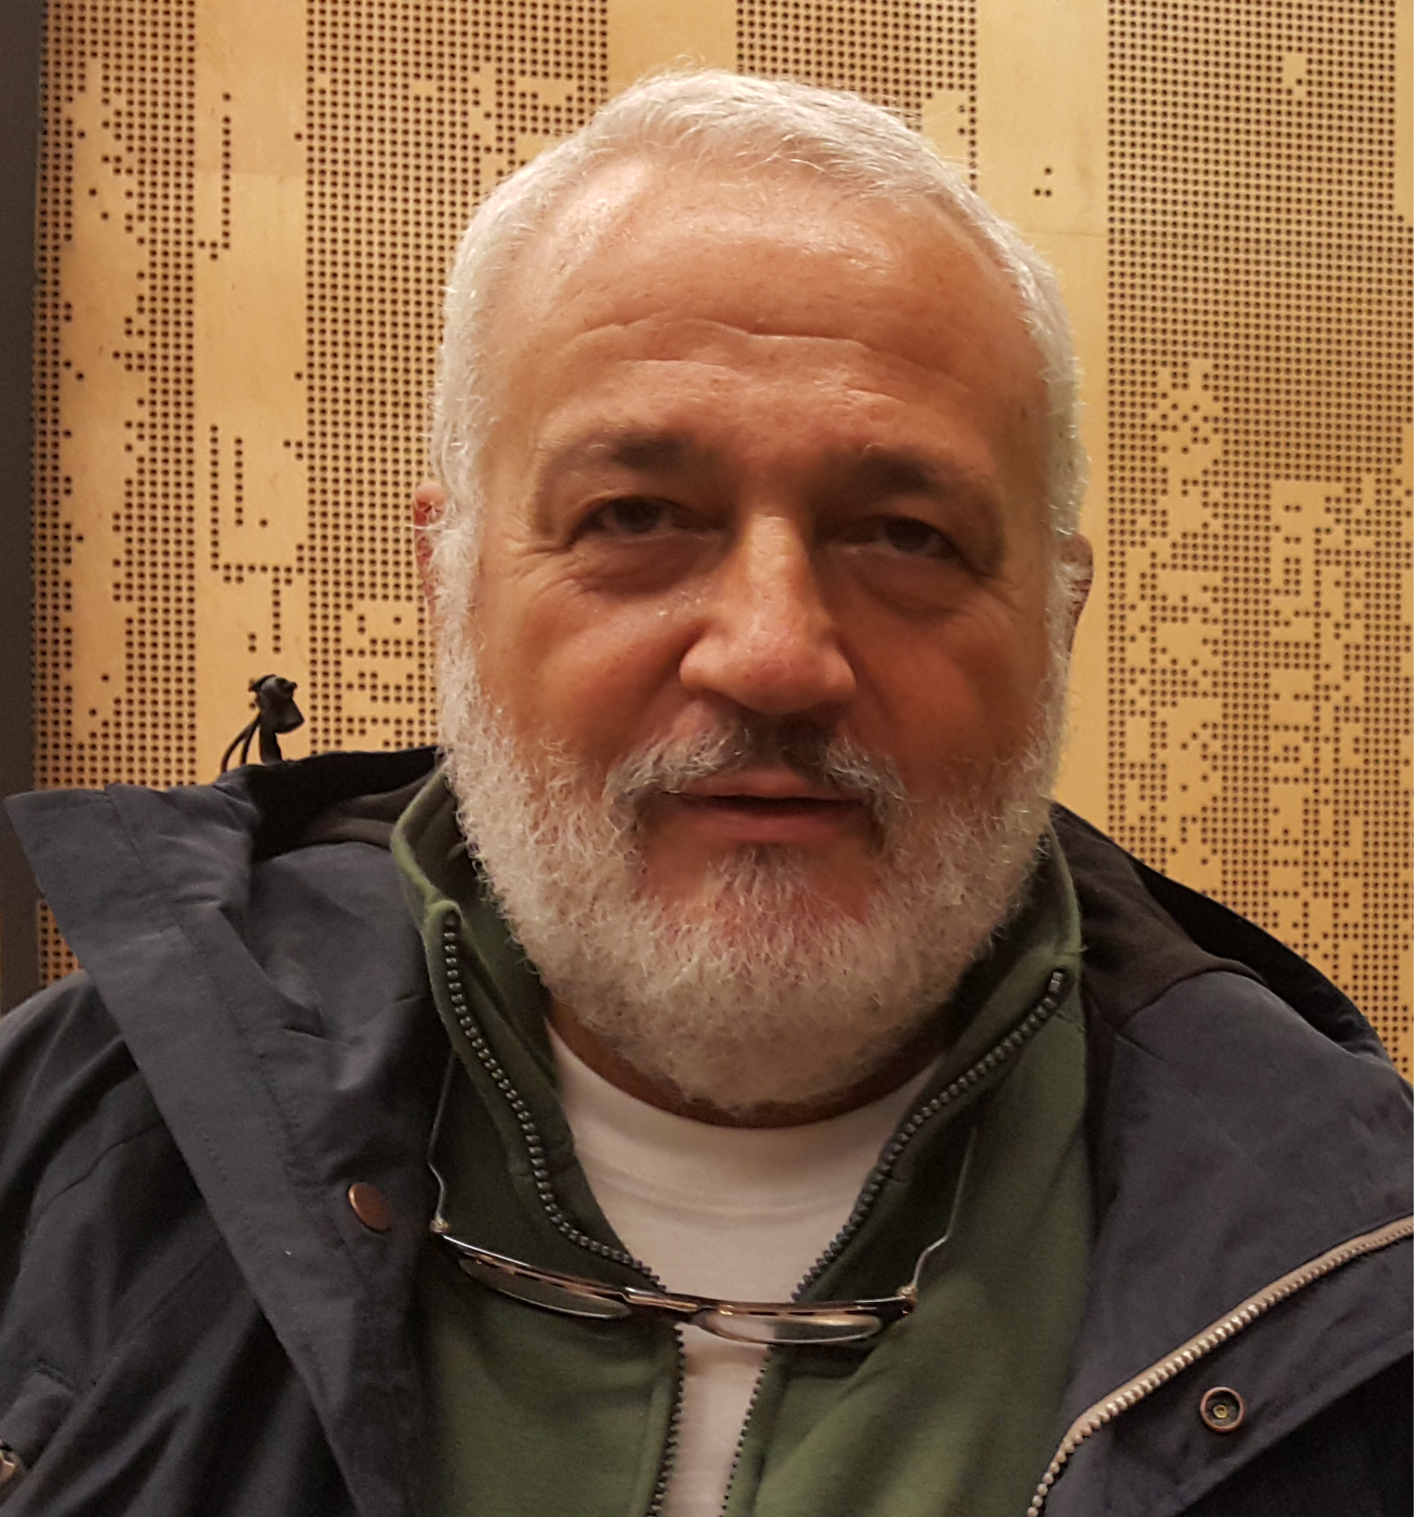
What changed me?
"If you know only three English words, let's have a conversation
with those three words."
-- Italo Vignoli,
The Document Foundation
Notes:
LibreOffice story.
After my first talk,
I almost lost my confidence.
But then I met someone.
His name is Italo Vignoli.
He is one of the founders of The Document Foundation.
（写真を見る）
One day, he told me something I will never forget.
（引用をゆっくり読む）
"If you know only three English words,
let's have a conversation with those three words."
（2秒止まる）
# Main Story
At first,
I thought he was talking about English.
But later...
I realized he wasn't.
He was talking about attitude.
Don't wait until your English becomes perfect.
Start the conversation first.
The point wasn't "three words."
The point was...
start talking.
（ここはゆっくり）
# Reflection
That changed how I think about international conferences.
People weren't waiting for perfect English.
They wanted to hear different experiences.
They wanted to know what I wanted to share.
My English didn't suddenly become better.
But my attitude changed completely.
# Closing
That became my first lesson.
Have something worth sharing.
If your story has value,
people will listen...
even if your English is not perfect.

Slide 6

Lesson 1
💡
Have something
worth sharing.
🔧
English is a tool.
Notes:
This became my first lesson.
I stopped asking myself,
"Is my English good enough?"
Instead, I started asking,
"Do I have something worth sharing?"
# Main Story
I think people don't come to conferences
to hear perfect English.
They come to hear different ideas.
Different experiences.
Different points of view.
（ここで少し間）
Nobody else has your experience.
（少し間を置く）
That's why it is worth sharing.
# Reflection
My English wasn't perfect.
It still isn't.
But I had experiences from the LibreOffice community.
Later, I had experiences from COSCUP, UbuCon Asia and FOSSASIA.
Those experiences were mine.
Nobody else could tell exactly the same story.
# Closing
So...
don't wait until your English becomes perfect.
Start collecting experiences.
And when you have something worth sharing...
share it.

Slide 7
Lesson 2
🔤
Simple English
wins.
🌐
Use words
you know.
Notes:
Show a bad example verbally only.
My second lesson was about English itself.
At first,
I tried to sound like a native speaker.
That didn't work very well.
（笑）
Main Story
Today,
I do the opposite.
I use simple words.
I use short sentences.
And I use words
that I can explain myself.
If I don't understand my own English,
my audience won't understand it either.
（笑）
ここで一拍。
# Concrete Example
I don't say
"utilize."
I say
"use."
（笑）
# Reflection
Most people in the audience
are not native English speakers either.
Simple English helps everyone.
# Closing
My goal isn't perfect English.
My goal
is clear communication.

Slide 8
Lesson 3
🏃
Practice.
🔊
Out aloud.
Notes:
Simple English is important.
But there is one more thing.
You have to practice.
（ここで笑顔）
I know...
Nobody likes this advice.
（笑）
# Main Story
When I prepare a talk,
I don't practice only in my head.
I read my script out loud.
Again.
And again.
Why?
Because speaking English
is different from writing English.
（ここで一拍）
Sometimes I find a sentence
that looks fine...
but I can't say it naturally.
（笑）
Then I don't practice harder.
I change the sentence.
# Reflection
My goal is not
to memorize every word.
My goal is
to make the talk
feel natural.
（ここで少し考える）
I want the audience
to listen to me,
not to my script.
# Closing
When you practice like this,
something interesting happens.
You naturally start speaking...
more slowly.

Slide 9
Lesson 4
🗣
Speak slowly.
👨‍👩‍👦‍👦
Everyone benefits.
Notes:
After practicing,
there is one more thing I always try to remember.
Speak slowly.
This sounds very simple.
But when I become nervous...
I speak much faster.
（笑）
# Main Story
Then I remind myself...
Most people in the audience
are not native English speakers either.
They don't need fast English.
They need clear English.
ここはすごく大事なのでゆっくり。
# Reflection
Speaking slowly
helps the audience.
But it also helps me.
It gives me time to think.
It helps me breathe.
And it helps me smile.
最後、ちょっと笑って言う。
# Practical Tip
ここで一つだけ実演。
早口で
Helloeveryonethankyouforcomingtoday...
（笑）
↓
普通に
Hello, everyone.
Thank you for coming today.
↓
Which one is easier?
これだけで十分。
# Closing
ここは次につなげます。
Even if you do everything well...
one thing is still difficult.
（笑）
Q&A.

Slide 10
Q&A
🔁
Could you repeat that?
👂
Could you speak more slowly?
🤷‍♂️
Could you rephrase that?
Notes:
Mention AI captions.
Finally...
let's talk about Q&A.
This is still the hardest part for me.
（笑）
Even today.
# Main Story
Sometimes...
I don't understand the question.
That still happens.
But now I think differently.
Q&A is not an English test.
It is a conversation.
（ここで一拍）
Reflection
If I don't understand,
I ask.
Could you repeat that?
Could you speak more slowly?
Could you rephrase that?
ここはスライドを見る。
そして、ここが今日一番大事
That's okay.
Because communication
is not about pretending
to understand.
Communication
is about understanding each other.
AIの話
Today,
AI can also help.
Sometimes,
live captions are enough.
Sometimes,
translation helps.
Use every tool you have.
この程度で十分。
# Closing
Don't think of Q&A
as the end of your presentation.
Think of it
as the beginning of a conversation.

Slide 11
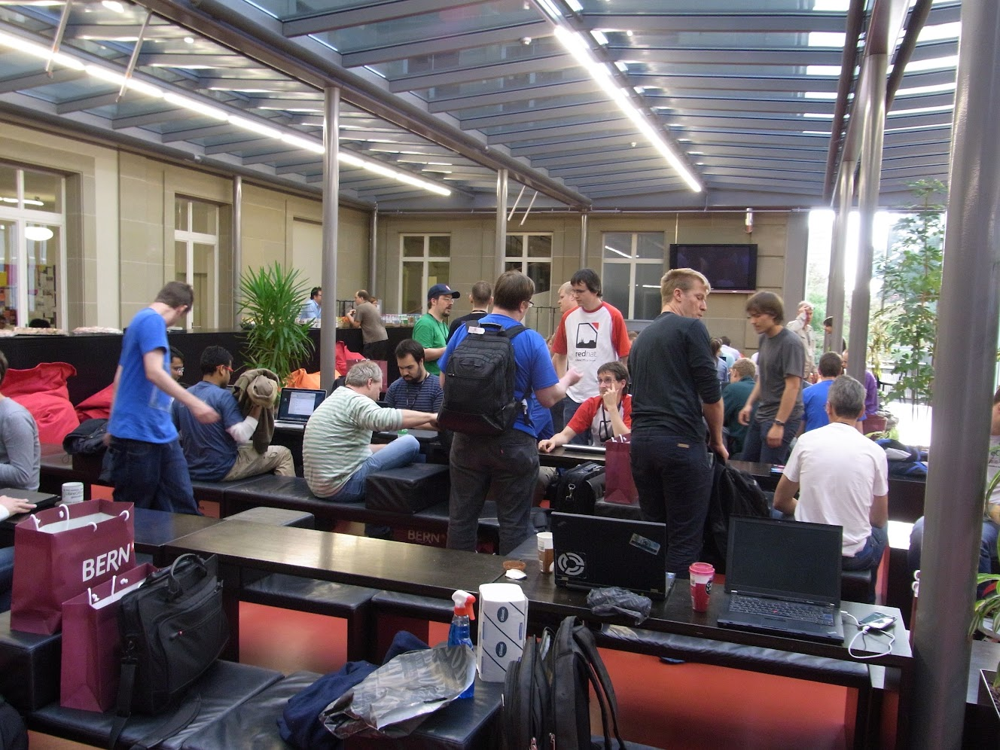
A talk fixed a bug
💻
Step 1
Presentation
👥
Step 2
HackFest
✅
Outcome
'I already fixed it.'
Notes:
Most important evidence slide.
Let me tell you one last story.
This is my favorite story.
（笑顔）
Main Story
At one LibreOffice Conference,
I gave a presentation
about Japanese localization.
I introduced several bugs
that I hoped
someone would fix someday.
（HackFestの写真を見る）
Later that day,
I joined the HackFest.
One of the developers came to me and said,
"Oh...
I already fixed one."
（ここで少し間）
I couldn't believe it.
# Reflection
Of course,
my presentation
didn't fix the bug.
A developer fixed it.
But without the presentation,
we probably wouldn't have had
that conversation.
# Closing
That experience
taught me something.
It wasn't only about that bug.
It helped me understand
why giving talks works.

Slide 12
Why did it work?
🔗
Phase 1
Sharing
🌐
Phase 2
Connections
👥
Phase 3
Collaboration
Notes:
Not about English.
So...
why did all these things happen?
Why did giving talks help me so much?
（1秒間）
I think it was because of these three steps.
# Main Story
（Sharing を指す）
First,
I shared my experience.
ここで
Not perfect English.
My experience.
と言うと、Lesson 1ともつながります。
（Connections を指す）
Then,
people started talking to me.
Sophie.
Questions after my talks.
Conversations at conferences.
ここで今までの話を思い出してもらう。
（Collaboration を指す）
Finally,
those conversations
became collaboration.
Sometimes...
they even fixed bugs.
（笑）
# Reflection
ここがこのスライドの主役です。
I think
this is how
open source communities grow.
We share.
We connect.
We collaborate.
ゆっくり。
# Closing
That's why
I still keep speaking
at international conferences.
Not because my English is perfect.
But because
conversations
can become collaboration.

Slide 13
Takeaways
💡
Have something worth sharing
🔤
Simple English
🗣
Speak slowly
👥
Share anyway
Notes:
Before I finish,
I'd like to leave you
with four ideas.
💡 Have something worth sharing.
Your English
doesn't have to be unique.
Your experience already is.
（ここで "Nobody else has your experience." を入れてもいい。）
🔤 Simple English
Use English
that you can really speak.
If a sentence is difficult to say,
rewrite it.
💬 Speak slowly.
Give yourself time.
And give your audience time.
👥 Share anyway.
ここが一番大事。
Don't wait
until your English
becomes perfect.
Share your ideas.
Start conversations.
The rest
will follow.

Slide 14
Thank you
My English is still broken.
Notes:
Final pause.

Slide 15
Thank you
My English is still broken.
But it still works.
Notes:
Final pause.

Slide 16
Thank you
My English is still broken.
But it still works.
Maybe yours already does, too.
Notes:
Final pause.

