Slide 1
About the Activities of the Language Community:
Activities of the Japanese Community
Naruhiko Ogasawara, from LibreOffice Japanese community
LOUCA 2023

Slide 2

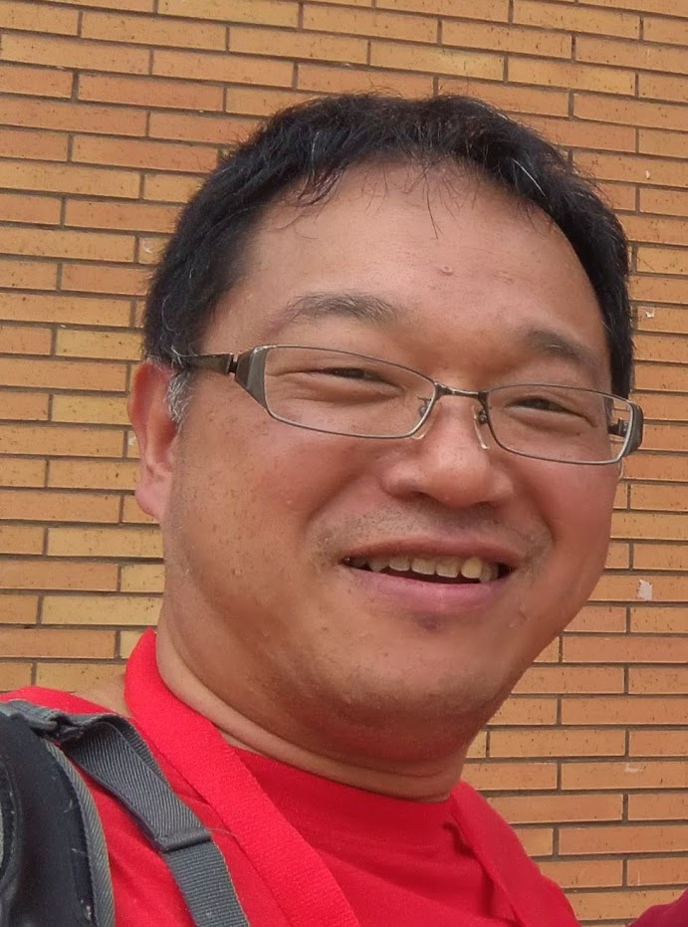

Who am I
Naruhiko Ogasawara (小笠原 徳彦)
Desktop OSS Enthusiast from Japan
  LibreOffice, Ubuntu, Printing, …
Former LibreOffice Japanese Team member
Former The Document Foundation member
Amature kayaker

Slide 3
Agenda
LibreOffice’s NLP and Japanese community
Our activities
  Ask
  Translation of UI and Help
  Japanese Blog
  Documentation
  Extentions
  Social networks
  Events
[OPTION] Open Discussion

Slide 4
LibreOffice’s NLP and Japanese community
LibreOffice’s NLP
  Native Language Project
  Same as Ubuntu’s LoCo
LibreOffice Japanese Team
  Japanese NLP, consist by TDF members
  Core of Japanese community
  Back up any Japanese community’s activities
  Weak-border organization
LibreOffice Japanese community
LibreOffice Japanese Team

Slide 5
Ask
LibreOffice’s official Q&A Site
  https://ask.libreoffice.org/c/japanese/
Entrance of any community activities
  Easy to join because the objective is clear
Question: 1~2 per week, Update (comment et al.): 2~3 per week
Total 682 topics: 8th position of all languages
Some topics become BZ tickets
  Ask is the field of the Japanese local QA

Slide 6
Translation (UI)
https://translations.documentfoundation.org/languages/ja/libo_ui-master/
93%
  Percentage of untranslated found in normal use
Only 4 active suggesters / reviewers
  How to increase them? Please comment :)
Reviewing is sometimes blocker
  Terms that are not known where they are used are difficult to review
  More communication is needed (discuss later)

Slide 7
Translation (Help)
https://translations.documentfoundation.org/languages/ja/libo_help-master/
50%
  Far from perfect
Recently no one could touch it
The volume is too enormous to motivate now

Slide 8
Japanese Blog
https://ja.blog.documentfoundation.org/
Translations of TDF Official blog, mainly in release announce
  Even with machine translation, there are people who don't read English, so it makes a lot of sense to make announcements in Japanese
Original contents are also needed, but not enough man power

Slide 9
Documentation
Wiki translation (like ReleaseNote) is great because of translation plugin is installed
Japanese original Wiki is currently no active

Slide 10
Documentation (cont’d)
LibreOffice User Guide
  https://documentation.libreoffice.org/ja/documentation-in-japanese/
Use the machine translation service via OmegaT
  Japanese research institute NICT offers a freely available machine translation service for OSS translations
  Machine translation results are not checked by humans, so quality is so-so
Web version is already available in English, how about Japanese? Let’s inspect

Slide 11
Extensions
We have released several extensions
  https://extensions.libreoffice.org/en/extensions/show/japan-date-converter-548c66a63092897f66a6306b590963db
  https://extensions.libreoffice.org/en/extensions/show/kanji-to-phoentic-6f225b5730923075308a306a306b590963db
  https://extensions.libreoffice.org/en/extensions/show/27499
One of them was debugged publicly at an online event
  Not by the original author, but by a different person
  Great community work!

Slide 12
Social networks
X (former Twitter)
  https://twitter.com/LibreOffice_Ja
  2,935 followers
  Mainly release announcement in Japanese, Repost of TDF official messages
Facebook
  https://www.facebook.com/search/top?q=libreoffice%20(%E6%97%A5%E6%9C%AC%E8%AA%9E)
  625 followers
  Mainly release announcement in Japanese
Telegram
  https://t.me/liboja
  Small groups for those who want to be more involved in the community
No Instagram and TicTok 😓

Slide 13
Events: HackFest Online
https://libojapan.connpass.com/event/296618/ (example)
  Latest event is #168!
Weekly online events to maintain motivation during the COVID-19 pandemic
Sharing knowledge and know-how
Interaction among community members
  It is better to be able to see faces, even through the camera

Slide 14
Events: HackFest Online (cont’d)
Opportunities to get rid of the sloth and work on something about LibreOffice
1.5h/day, each Thursday
Mostly walkthroughs of ask, and if there is extra time, translations, Bugzilla checks, etc
It's helping to keep me motivated, as we aim to do

Slide 15
Events: Online Study Meetup
Online seminars about LibreOffice held every 3~4 months
  Offline study meetups that was held in the Kansai area prior to COVID-19 and has been converted to an online version
The hard part is getting speakers
  We catch them at Hackfest and such
Not attracting as many people as offline, but it depends on content

Slide 16
Events: LibreOffice Kaigi
The annual conference of LibreOffice Japanese community
Kaigi is from the Japanese word “Kaigi 会議,” means conference
It means conference by Japanese LibO users, for Japanese LibO users
The purpose of this event is to socialize and share knowledge

Slide 17
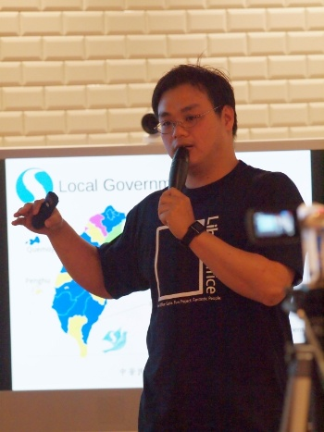
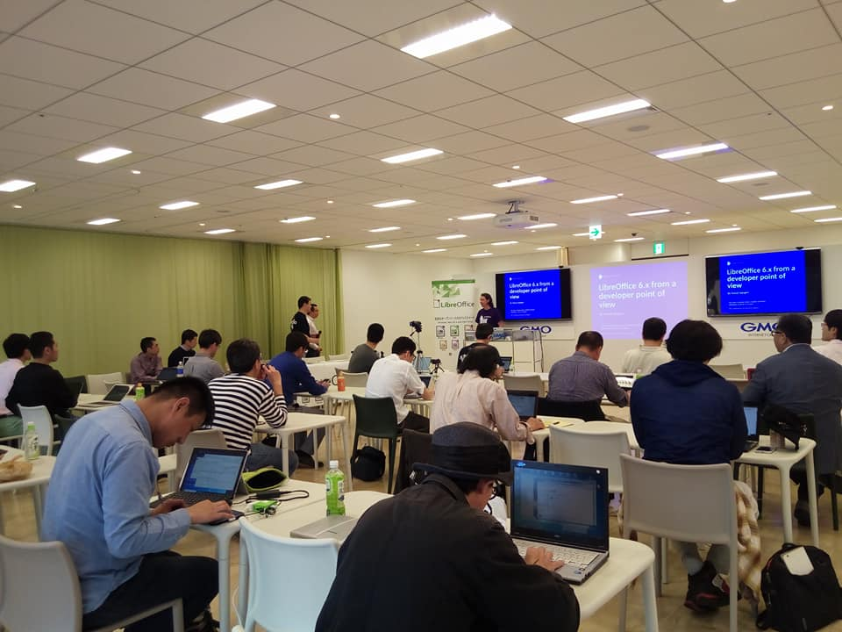
Events: LibreOffice Kaigi (cont’d)
Pre COVID-19, we did it offline

Slide 18
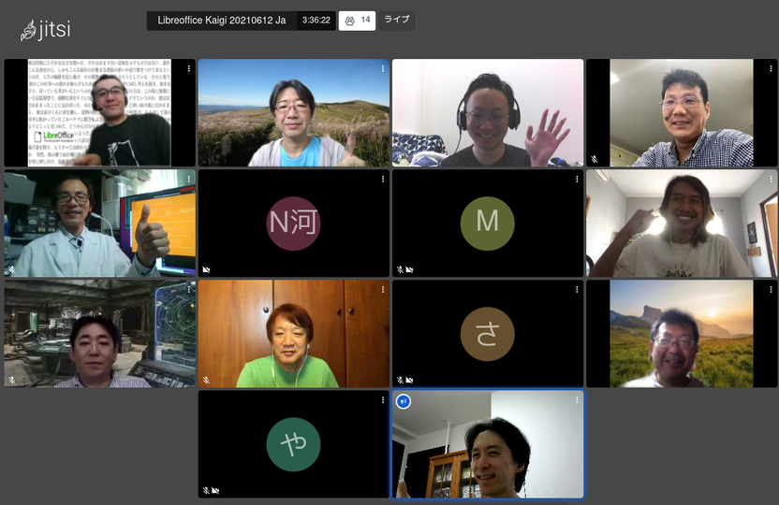
Event: LibreOffice Kaigi (cont’d)
While pandemic, we moved to online
It’s convenient, but less fun (no party…)
I personally back to offline but lack of human resource …

Slide 19
What’s next?
Attract younger generation
  How?
  Can we use Outreacy program? https://www.outreachy.org/
  I guess there is a lot we can learn from the Indonesian community
Back to offline / hybrid

Slide 20
Comments?

