Slide 1

We already have a new, modern and secure print experience
Naruhiko NARU Ogasawara (naruoga@gmail.com)

Slide 2


Who am I
Naruhiko NARU Ogasawara (小笠原 徳彦)
Senior Security Engineer of Shift Security Inc.
Desktop FLOSS enthusiast from Japan
  (Printing, LibreOffice, ...)
former a member of OpenPrinting Japan
former an employee of a Japanese
printer vendor
I love river kayaking

Slide 3
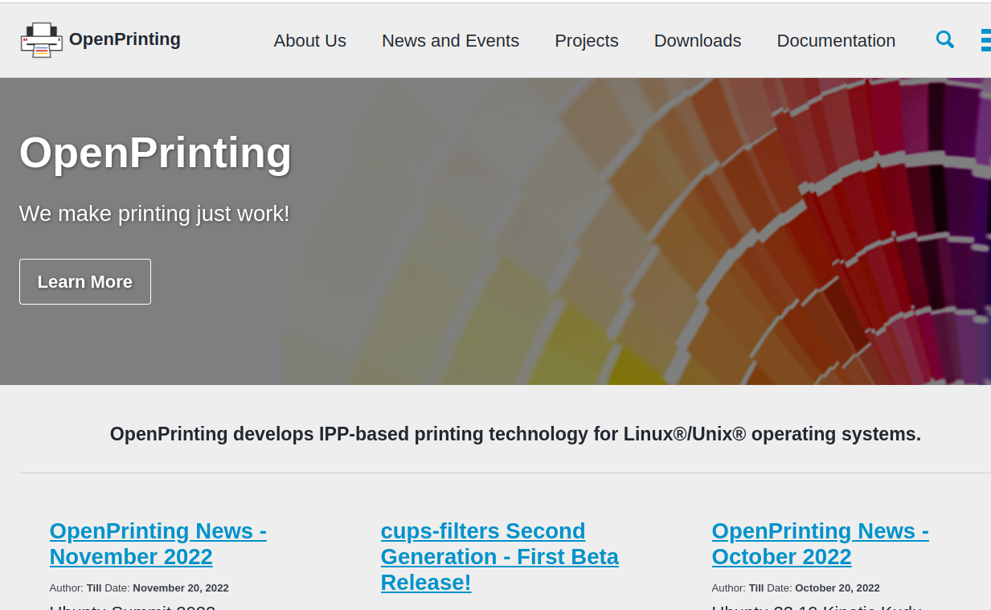
OpenPrinting
https://openprinting.github.io/
Develops IPP-based
printing technology
for Linux/Unix
operating System

Slide 4
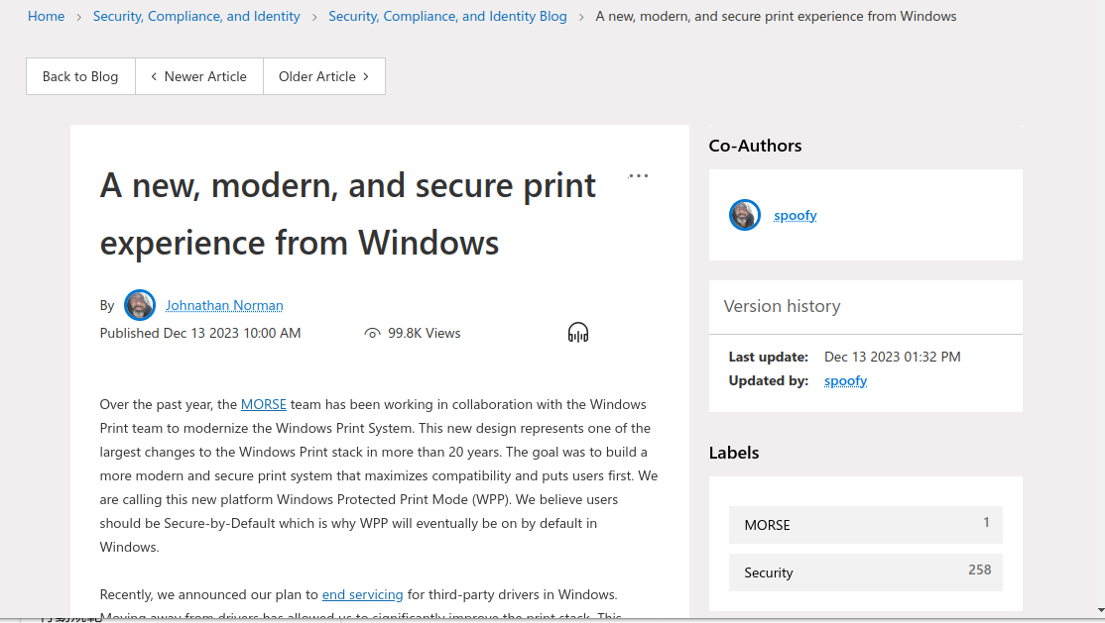
IPP-based Printing?
A new, modern, and secure print experience from Windows
https://techcommunity.microsoft.com/t5/security-compliance-and-identity/a-new-modern-and-secure-print-experience-from-windows/ba-p/4002645
IPP-based printing in Windows today removes the need for third-party drivers, and any third-party code installed to support printing runs within an AppContainer, limiting the risk to users.

Slide 5
Welcome Windows!
To IPP-based driverless printing world which Linux has it
We, Linux users, already have a new, modern and secure print experience for years!
  At least Ubuntu, it introduced at 17.04
In this talk, I’ll describe the traditional Linux print scenario and the modern “driverless” print scenario

Slide 6


How printers are “driven”
Printers are quite different from other peripherals
PDL = Page (or Printer) Description Language
Job Control
QTY=1, Color=B/W,
Size=A4, ...
Well-known i/f
(USB, TCP...)
PDL

Slide 7
CUPS
Common Unix Printing System
The core component of Linux printing system
It handles:
  Job control and its user interface
  Data filter pipeline to create PDL
No “kernel-land” modules
Now developed by OpenPrinting
  https://github.com/openprinting/cups

Slide 8
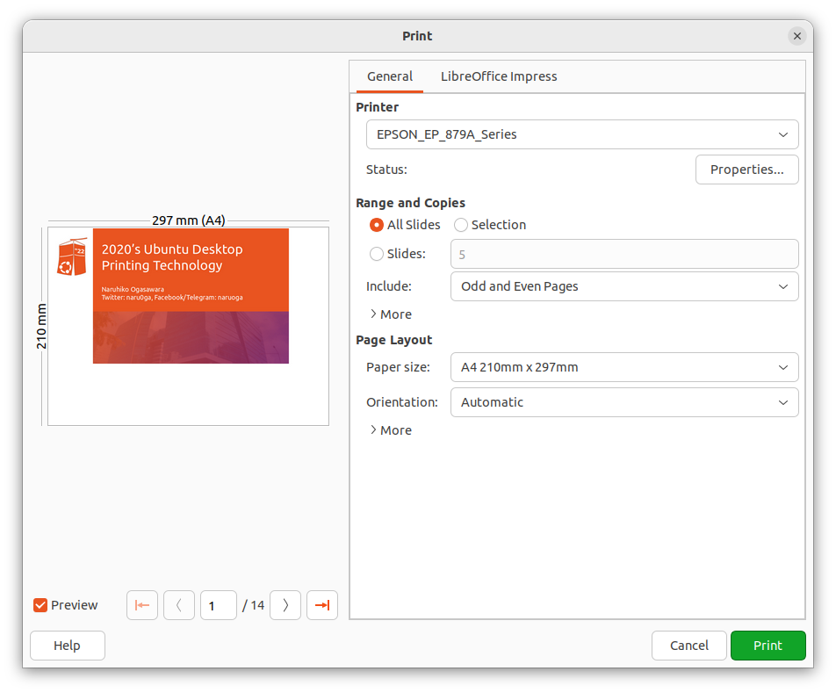
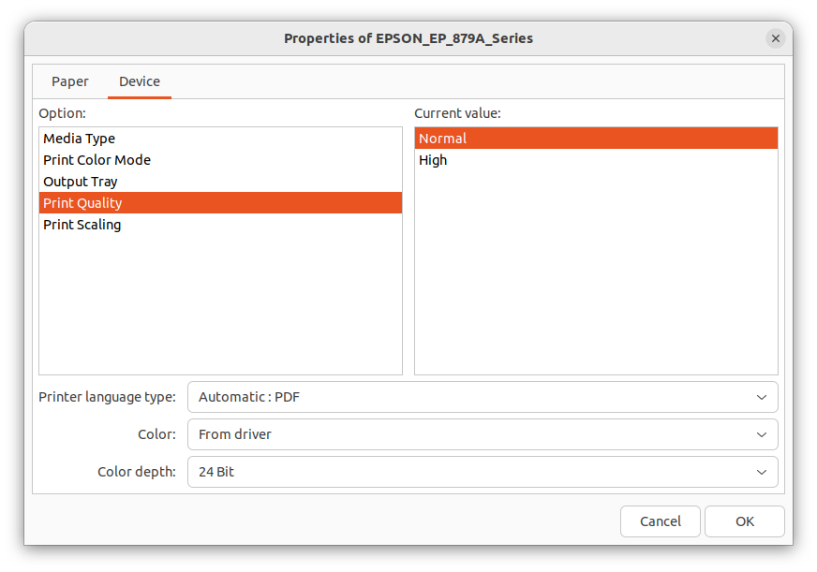
CUPS
filter pipeline
CUPS
Application
Spooler
PDF
Generation
back
-end
send
pdftopdf
Language
filter
Configuration
Ghostscript
PPD
printer
driver
Poppler

Slide 9
PPD: file for job control
PPD: Postscript Printer Description
  The name is came from historical reason, not limited to Postscript
Describe printer capabilities
  Color/Monochrome
  Supported media size
  Supported media type
  Finishing feature (duplex, stapling, ...)

Slide 10
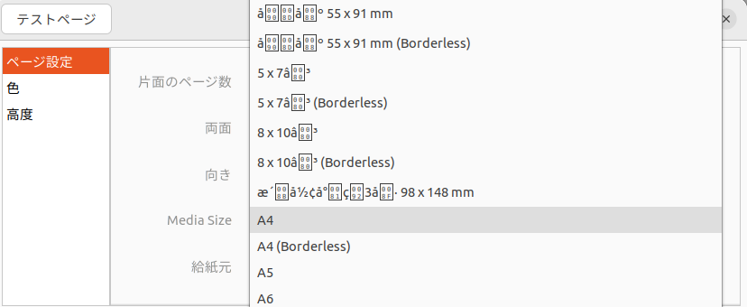
PPD: file for job control
*PPD-Adobe: "4.3"
*FormatVersion: "4.3"
*FileVersion: "1.28.15"
...
*OpenUI *PageSize/Media Size: PickOne
*OrderDependency: 10 AnySetup *PageSize
*DefaultPageSize: A4
...
*PageSize A4/A4: "<</PageSize[595.275590551181 841.889763779528]>>setpagedevice"
*PageSize A4.Borderless/A4 (Borderless): "<</PageSize[595.275590551181 841.889763779528]>>setpagedevice"
...
*CloseUI

Slide 11
Language filter
The “Last” filter of the filter pipeline
To generate the printer-specific data format (PDL; Printer or Page Description Language)
Which draws pictures onto papers
Vector / Raster

Slide 12
This was a painful era...
Who provides the “printer driver” for a particular printer?
According to the market share of desktop OSes, do printer vendors want to provide their printers’ drivers for Linux?
Can printer vendors support continuously?
  (Linux desktop evolves so fast)
Many of PDLs are proprietary, so development of fully-open-sourced drivers is difficult (except PostScript, PCL5e/PCL6)

Slide 13
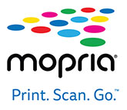

Driverless Printing!
Now we don’t need to install “printer drivers”
Instead, connect via Wi-Fi or USB then just work
If the printer support “Apple AirPrint, ” “mopria” (or “IPP Everywhere”)

Slide 14
How it works
When a printer turns on, it let same networks devices know “I’m here, I can print” via mDDNS (Avahi)
Linux Desktop
I’m here,
I can print
CUPS-browsed
CUPS
Spooler
pdftopdf
Raster
filter
Filter pipeline

Slide 15
How it works
CUPS-browsed receive the message, then let CUPS know new printer coming
Hey CUPS,
New printer coming
Linux Desktop
CUPS-browsed
CUPS
Spooler
pdftopdf
Raster
filter
Filter pipeline

Slide 16
How it works
CUPS asks to the printer it’s attributes (capabilities) via IPP
Linux Desktop
Tell me your attributes
Ok!
CUPS-browsed
CUPS
IPP
Spooler
pdftopdf
Raster
filter
Filter pipeline

Slide 17
How it works
CUPS generate PPD file from received printer attributes
Linux Desktop
CUPS-browsed
CUPS
Spooler
pdftopdf
Raster
filter
Here is a new PPD file!
PPD
Filter pipeline

Slide 18
How it works
An application can use the PPD to control jobs, and send PDF of page images
Linux Desktop
Print this documents with this configuration
CUPS-browsed
CUPS
Appli-
cation
Spooler
pdftopdf
Raster
filter
PPD
Filter pipeline

Slide 19
How it works
The filter pipeline has a raster filter to create raster images from PDF which can be accepted the printer. They are sent via IPP with job control commands
Linux Desktop
CUPS-browsed
CUPS
Appli-
cation
Spooler
pdftopdf
Raster
filter
I can create raster images which you can accept
PPD
Filter pipeline

Slide 20
IPP: Internet Printing Protocol
A printing protocol over HTTP
RFC 2911 https://datatracker.ietf.org/doc/html/rfc2911
Bi-directional
  Get printer status / capabilities / configurations
  Post printing job with job control commands

Slide 21
IPP: GetPrinterAttribute and PPD
$ ipptool -tv ipps://EPSON%20EP-879A%20Series._ipps._tcp.local/ get-attributes.test | tee out.txt
...
media-default (keyword) = iso_a4_210x297mm
media-supported (1setOf keyword) = iso_a4_210x297mm,na_index-4x6_4x6in,na_5x7_5x7in,na_govt-letter_8x10in,om_hivision_101.6x180.6mm,iso_a5_148x210mm,iso_a6_105x148mm,na_letter_8.5x11in,na_legal_8.5x14in,oe_photo-l_3.5x5in,jpn_hagaki_100x148mm,jis_b5_182x257mm,jpn_chou3_120x235mm,jpn_chou4_90x205mm,om_you1_120x176mm,om_you3_98x148mm,jpn_you4_105x235mm,iso_c6_114x162mm,om_cardsize_55x91mm,om_creditcardsize_54x86mm,custom_min_89x127mm,custom_max_215.9x1117.6mm
*PPD-Adobe: "4.3"
*FormatVersion: "4.3"
*FileVersion: "1.28.15"
...
*OpenUI *PageSize/Media Size: PickOne
*OrderDependency: 10 AnySetup *PageSize
*DefaultPageSize: A4
...
*PageSize A4/A4: "<</PageSize[595.275590551181 841.889763779528]>>setpagedevice"
*PageSize A4.Borderless/A4 (Borderless): "<</PageSize[595.275590551181 841.889763779528]>>setpagedevice"
...
*CloseUI

Slide 22
Raster filter(s)
document-format-supported (1setOf mimeMediaType) = application/octet-stream,image/pwg-raster,image/urf,image/jpeg
Printer accepts some raster formats: e.g. RAW (application/octet-stream), PWG Raster, URF (Apple Raster) and JPEG
And you can see the filter pipeline definitions in /usr/share/cups/mime/*.conv files
application/pdf application/vnd.cups-pdf 66 pdftopdf
# if using Ghostscript
application/vnd.cups-pdf image/pwg-raster 99 gstoraster
# if using Poppler
application/vnd.cups-pdf application/vnd.cups-raster 100 pdftoraster
application/vnd.cups-raster image/pwg-raster 100 rastertopwg

Slide 23
Conclusion
Printer drivers are user-land modules within CUPS
The pair of (a) PPD and (b) Language filter
A while ago, using printers in Linux required support from the printer vendor
But now we have a driverless printing feature
This allows Linux users to print Apple AirPrint available printers without vendors’ drivers

Slide 24
Questions?

