Slide 1

Linux Desktop Printing Systems in the 2020s
Naruhiko Ogasawara (naruoga@gmail.com)

Slide 2


Who am I
Naruhiko Ogasawara (小笠原 徳彦)
Desktop FLOSS enthusiast from Chiba, Japan
  (Printing, LibreOffice, ...)
former member of OpenPrinting Japan
former an employee of a Japanese
printer vendor
Amateur kayaker

Slide 3
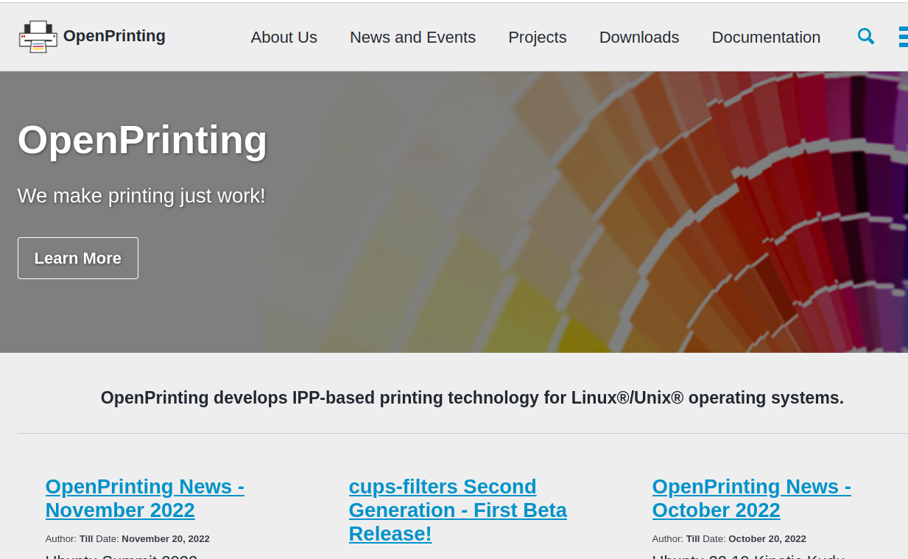
OpenPrinting
https://openprinting.github.io/
Develops IPP-based
printing technology
for Linux/Unix
Operating System

Slide 4


How printers are “driven”
Printers are quite different from other peripherals
PDL = Page (or Printer) Description Language
Job Control
QTY=1, Color=B/W,
Size=A4, ...
PDL

Slide 5
CUPS
Common Unix Printing System
The core module of Linux printing system
It handles:
  Job control and its user interface
  Data filter pipeline to create PDL
No “kernel-land” modules
Now developed by OpenPrinting

Slide 6
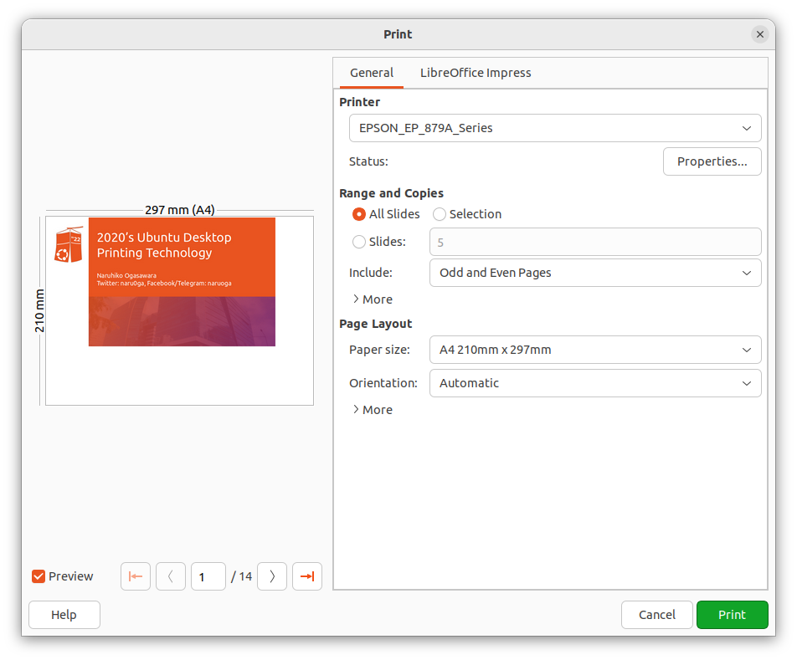
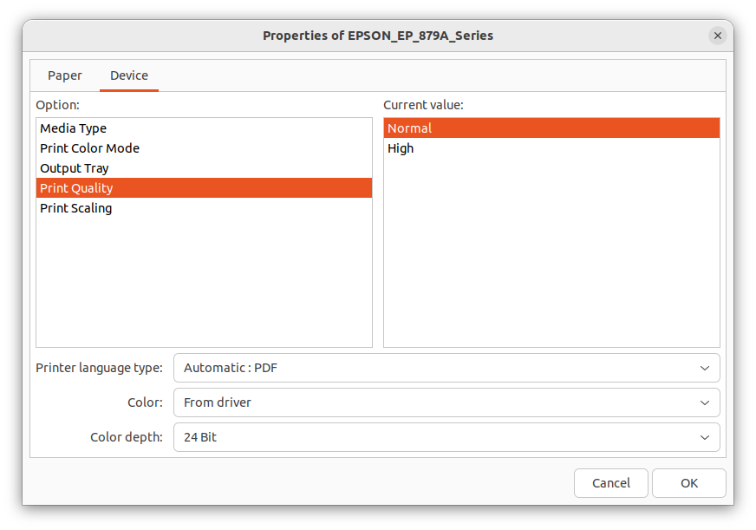
CUPS
filter pipeline
CUPS
Application
Spooler
PDF
Generation
back
-end
send
pdftopdf
Language
filter
Configuration
Ghostscript
PPD
printer
driver
Poppler

Slide 7
Job control: PPD
PPD: Postscript Printer Description
  The name is came from historical reason, not limited to Postscript
Describe printer capabilities
  Color/Monochrome
  Supported media size
  Supported media type
  Finishing feature (duplex, stapling, ...)

Slide 8
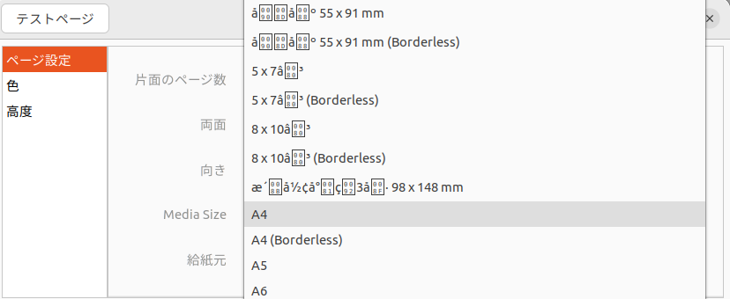
Job control: PPD
*PPD-Adobe: "4.3"
*FormatVersion: "4.3"
*FileVersion: "1.28.15"
...
*OpenUI *PageSize/Media Size: PickOne
*OrderDependency: 10 AnySetup *PageSize
*DefaultPageSize: A4
...
*PageSize A4/A4: "<</PageSize[595.275590551181 841.889763779528]>>setpagedevice"
*PageSize A4.Borderless/A4 (Borderless): "<</PageSize[595.275590551181 841.889763779528]>>setpagedevice"
...
*CloseUI

Slide 9
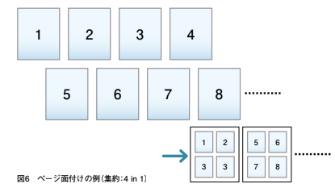
pdftopdf
CUPS semi-builtin filter (in the package “cups-filters”)
Used for page layout of PDF (like N-in-one or N-up)

Slide 10
Language filter
The “Last” filter of the filter pipeline
To generate the printer-specific data format (PDL; Printer or Page Description Language)
Which draws pictures onto papers
Vector / Raster

Slide 11
This was a painful era...
Who provides the “printer driver” for a particular printer?
According to the market share of desktop OSes, do printer vendors want to develop their printers’ drivers for Linux?
Can printer vendors support continuously?
  (Linux desktop, like Ubuntu, evolves so fast)
Many of PDLs are proprietary, so development of fully-open-sourced drivers is difficult (except PostScript, PCL5e/PCL6)

Slide 12

Driverless Printing!
Now we don’t need to install “printer drivers”
Instead, connect via Wi-Fi or USB then just work
If the printer support “Apple AirPrint” (or “IPP Everywhere”)

Slide 13
How it works
When a printer turns on, it let same networks devices know “I’m here, I can print” via mDDNS (Avahi)
Linux Desktop
I’m here,
I can print
CUPS-browsed
CUPS
Spooler
pdftopdf
Raster
filter
Filter pipeline

Slide 14
How it works
CUPS-browsed receive the message, then let CUPS know new printer coming
Hey CUPS,
New printer coming
Linux Desktop
CUPS-browsed
CUPS
Spooler
pdftopdf
Raster
filter
Filter pipeline

Slide 15
How it works
CUPS asks to the printer it’s attributes (capabilities) via IPP
Linux Desktop
Tell me your attributes
Ok!
CUPS-browsed
CUPS
IPP
Spooler
pdftopdf
Raster
filter
Filter pipeline

Slide 16
How it works
CUPS generate PPD file from received printer attributes
Linux Desktop
CUPS-browsed
CUPS
Spooler
pdftopdf
Raster
filter
Here is a new PPD file!
PPD
Filter pipeline

Slide 17
How it works
An application can use the PPD to control jobs, and send PDF of page images
Linux Desktop
Print this documents with this configuration
CUPS-browsed
CUPS
Appli-
cation
Spooler
pdftopdf
Raster
filter
PPD
Filter pipeline

Slide 18
How it works
The filter pipeline has a raster filter to create raster images from PDF which can be accepted the printer. They are sent via IPP with job control commands
Linux Desktop
CUPS-browsed
CUPS
Appli-
cation
Spooler
pdftopdf
Raster
filter
I can create raster images which you can accept
PPD
Filter pipeline

Slide 19
IPP: Internet Printing Protocol
A printing protocol over HTTP
RFC 2911 https://datatracker.ietf.org/doc/html/rfc2911
Bi-directional
  Get printer status / capabilities / configurations
  Post printing job with job control commands

Slide 20
IPP: GetPrinterAttribute and PPD
$ ipptool -tv ipps://EPSON%20EP-879A%20Series._ipps._tcp.local/ get-attributes.test | tee out.txt
...
media-default (keyword) = iso_a4_210x297mm
media-supported (1setOf keyword) = iso_a4_210x297mm,na_index-4x6_4x6in,na_5x7_5x7in,na_govt-letter_8x10in,om_hivision_101.6x180.6mm,iso_a5_148x210mm,iso_a6_105x148mm,na_letter_8.5x11in,na_legal_8.5x14in,oe_photo-l_3.5x5in,jpn_hagaki_100x148mm,jis_b5_182x257mm,jpn_chou3_120x235mm,jpn_chou4_90x205mm,om_you1_120x176mm,om_you3_98x148mm,jpn_you4_105x235mm,iso_c6_114x162mm,om_cardsize_55x91mm,om_creditcardsize_54x86mm,custom_min_89x127mm,custom_max_215.9x1117.6mm
*PPD-Adobe: "4.3"
*FormatVersion: "4.3"
*FileVersion: "1.28.15"
...
*OpenUI *PageSize/Media Size: PickOne
*OrderDependency: 10 AnySetup *PageSize
*DefaultPageSize: A4
...
*PageSize A4/A4: "<</PageSize[595.275590551181 841.889763779528]>>setpagedevice"
*PageSize A4.Borderless/A4 (Borderless): "<</PageSize[595.275590551181 841.889763779528]>>setpagedevice"
...
*CloseUI

Slide 21
Raster filter(s)
document-format-supported (1setOf mimeMediaType) = application/octet-stream,image/pwg-raster,image/urf,image/jpeg
Printer accepts some raster formats: e.g. RAW (application/octet-stream), PWG Raster, URF (Apple Raster) and JPEG
And you can see the filter pipeline definitions in /usr/share/cups/mime/*.conv files
application/pdf application/vnd.cups-pdf 66 pdftopdf
# if using Ghostscript
application/vnd.cups-pdf image/pwg-raster 99 gstoraster
# if using Poppler
application/vnd.cups-pdf application/vnd.cups-raster 100 pdftoraster
application/vnd.cups-raster image/pwg-raster 100 rastertopwg

Slide 22
Conclusion
Printer drivers are user-land modules within CUPS
The pair of (a) PPD and (b) Language filter
A while ago, using printers in Linux required support from the printer vendor
But now we have a driverless printing feature
This allows Linux users to print Apple AirPrint available printers without vendors’ drivers

Slide 23
More news...

Slide 24
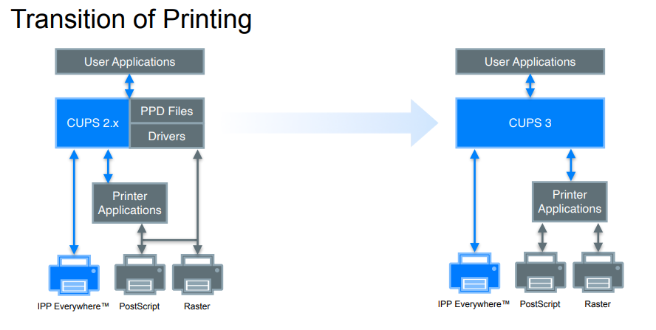
Upcoming CUPS 3: no printer drivers
https://ftp.pwg.org/pub/pwg/liaison/openprinting/presentations/cups-plenary-may-2023.pdf

Slide 25
Printer Application
A Printer Application is a background service, a GUI application, etc. that happens to respond to HTTP and IPP requests. It detects the supported printers and advertises those printers on the localhost as an IPP Everywhere printer. It can also listen on network interfaces (i.e. not just localhost) so provide access to a printer to all client devices on a network. Printer Applications are the recommended architecture for printer drivers.
In short, Virtual IPP-Everywhere Printer
https://openprinting.github.io/documentation/01-printer-application/

Slide 26
PAPPL
Printer APPLication framework
  https://www.msweet.org/pappl/
PAPPL is a simple C-based framework/library for developing CUPS Printer Applications, which are the recommended replacement for printer drivers.

Slide 27
Printer Applications using PAPPL
Ghostscript Printer Application for Ghostscript-supported printers,
Gutenprint Printer Application for Gutenprint-supported printers,
HP Printer Application for HP PCL printers,
HPLIP Printer Application for HPLIP-supported printers,
LPrint for DYMO, EPL, and ZPL label printers, and
PostScript Printer Application for PostScript printers.

Slide 28
When does it come?
Fortunately, CUPS 3.x release postponed at first end of 2024
So you can use same printing system until then
But time to consider to switch from traditional printer-driver-scenario to driverless printing scenario
Because less printer vendors will release their own printer applications

Slide 29
Conclusion (2)
A big change is coming to the Linux printing system
Printer drivers will be moved to printer applications
It is unlikely that each printer vendor will create a printer application, so the importance of driverless printing is increasing

Slide 30
Questions?

