Slide 1

Sharadchandra Pawar College of Engineering and Technology, Someshwarnagar Department of Computer Engineering
Academic Year 2024-25
Department of Computer Engineering A Demo 1 on project :
“Text summarization of news articles using Natural language processing”
Presented by:
Narute Kiran
CO-432
Ranaware Aditya
CO-439
Nagawade Saurav
CO-430
Guide Name : Prof. Ghadge S.V.

Slide 2
CONTENT
Abstract
Problem Statement
Introduction
Objective
Algorithm and methodology
Literature Survey
Existing System
Disadvantages of Existing System
Comparison with Algorithms
Proposed System Architecture
Uml Diagrams
Advantages Of Proposed System
Hardware And Software Requirements
References

Slide 3

“Text summarization of news articles using Natural language processing”

Slide 4
ABSTRACT
This project focuses on building a text summarization system using Python and the PageRank algorithm. The system fetches daily news via APIs and provides concise summaries to users. Additionally, it offers an MP3 audio output of the summary, making it accessible for blind and uneducated individuals.
The proposed solution overcomes the limitations of existing summarization tools by enhancing context retention. This system combines efficient summarization with real-time updates, ensuring a user-friendly experience.

Slide 5
PROBLEM STATEMENT
Text summarization models sometimes produce incorrect or misleading summaries. Our project aims to solve this problem by developing new methods to measure and fix these errors. We will use advanced techniques to improve the accuracy of summaries, making sure they are reliable and correct.

Slide 6
INTRODUCTION
Automatic Text Summarization is one of the most challenging and interesting problem the
field of Natural Language Processing(NLP).
It is a process of generating concise and meaningful summary of text from multiple text resources such as books , news articles.
The need for automatic text summarization is growing quickly because there is a lot of data now.

Slide 7
OBJECTIVE
The main objective of text summarization system is to identify the most important information from the given text and present it to end user.
Wikipedia articles are given as input to system and extractive text summarization is presented by
identifying text feature and scoring the sentences accordingly.

Slide 8
ALGORITHM & METHODOLOGY
ALGORITHM : PageRank Algorithm (Text Rank)
METHODS/ STEPS :
Text Preprocessing:
>Sentence Tokenization: Split the paragraph into sentences.
>Word Tokenization: Break sentences into words
Build Similarity Graph:
Nodes: Represent each sentence as a node.
Edges: Create edges between nodes based on sentence similarity.
Apply PageRank on the Graph:
Sentences with higher ranks will be selected as part of the summary.
Extract Top-Ranked Sentences:
Select the top N sentences to form the summary

Slide 9
LITERATURE SURVEY
Sr.No | Author | Paper | Contribution | Drawbacks
1 | Guangsheng Bao and Yue Zhang | A General Contextualized Rewriting Framework for Text Summarization | Combines extractive and abstractive methods to make summaries more readable and coherent by aligning sentences with the full document context. | Requires a lot of computational resources and relies on pre- trained models.
2 | Surbhi bhatia | A Comparative Study of Opinion Summarization Techniques | Compared extractive and abstractive summarization methods using principal component analysis (PCA) for extractive and graph-based techniques for abstractive summarization. | The graph-based abstractive approach has high complexity and may struggle without pre- existing connectors between sentences.
3 | Yujia Gao, Yang Xu, Haibin Huang, Qiang Liu, Lingyu Wei, and Li Liu | Jointly Learning Topics in Sentence Embedding for Document Summarization | Learns sentence embeddings and topics together, creating summaries that are both coherent and focused on key topics. | Can be slow to train and may not be flexible when handling very diverse content.
4 | Xinnian Liang, Jing Li, Shuangzhi Wu, Mu Li, Zhoujun Li | Improving Unsupervised Extractive Summarization by Jointly Modeling Facet and Redundancy | Developed a model to improve extractive summarization by reducing redundancy and covering more topics in documents | Less effective for short documents or documents with few topics.

Slide 10
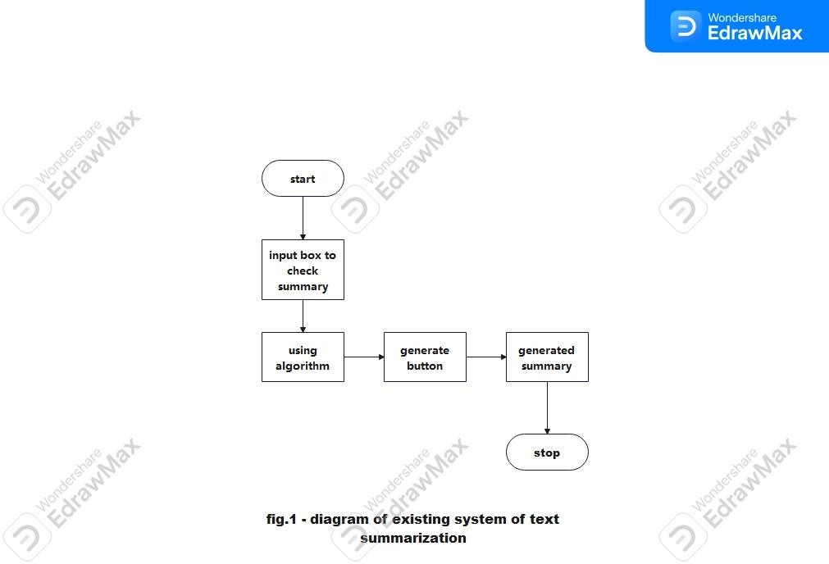
EXISTING SYSTEM

Slide 11
DISADVANTAGES OF EXISTING SYSTEM
Incomplete Summaries: They may overlook important details, leading to incomplete outputs.
Inaccurate Context: Struggle with retaining the context, especially for longer or
complex texts.
Language Limitations: Often fail with idioms, metaphors, or nuanced language.
Limited Accessibility: Lack features like audio output, making them less user- friendly for blind or uneducated individuals.

Slide 12
COMPARISON WITH ALGORITHMS
Sr.no. | Algorithm name | Why not we used these algorithms | Why we used page rank algorithm
1. | Centroid-Based Summarization | Complicated and depends on serval factors. | Simpler and straightforward algorithm.
2. | SumBasic | Doesn’t understand context well. | Understands context better by looking at sentence connections.
3. | Latent Semantic Analysis (LSA) | Requires a lot of computing power and can lose details. | Require Less computing power and keeps more details.
4. | LexRank | Uses a lot of memory and is complex. | Less complex
5. | KL-Sum | Hard to compute and complex. | Easy to run and efficient.

Slide 13
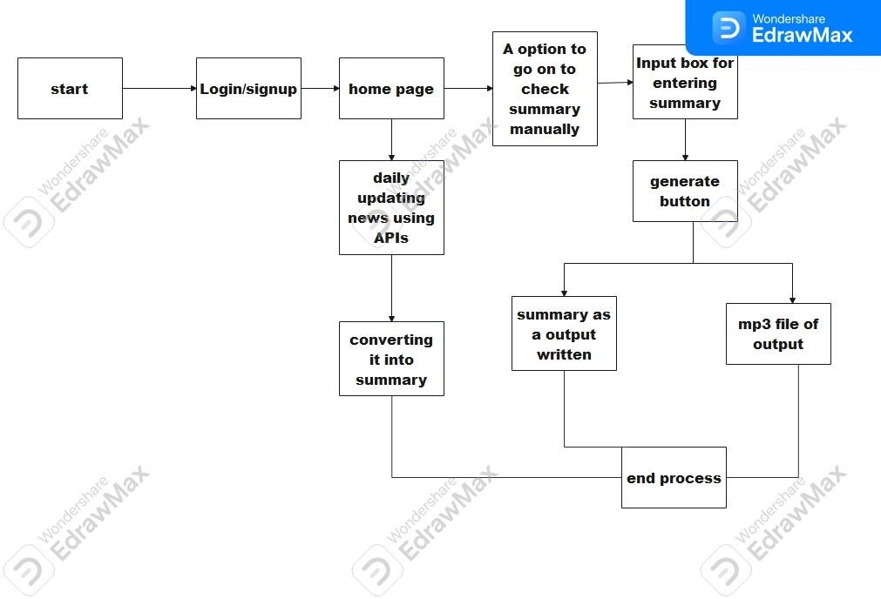
PROPOSED SYSTEM ARCHITECTURE

Slide 14
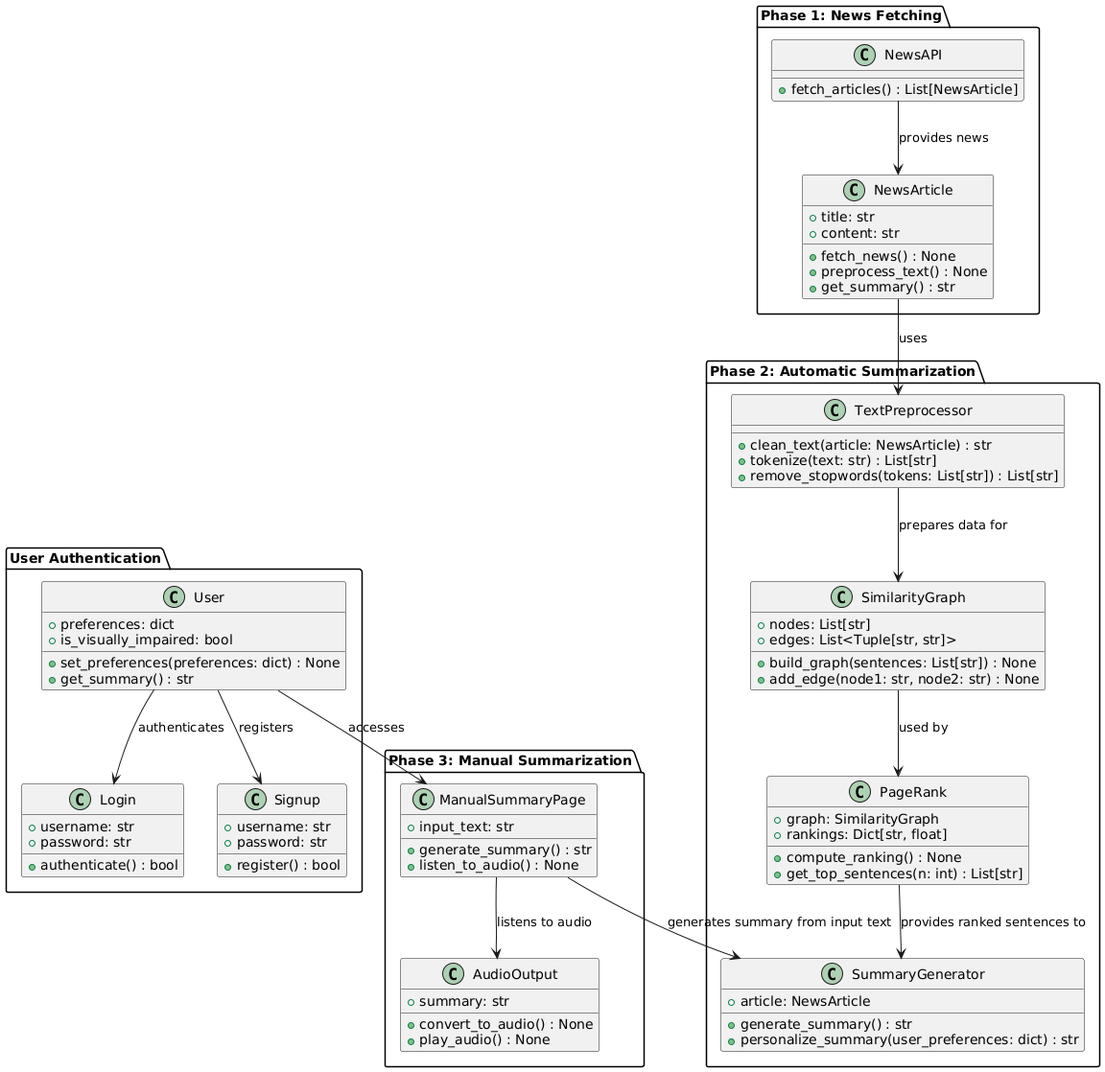
1) CLASS DIAGRAM

Slide 15
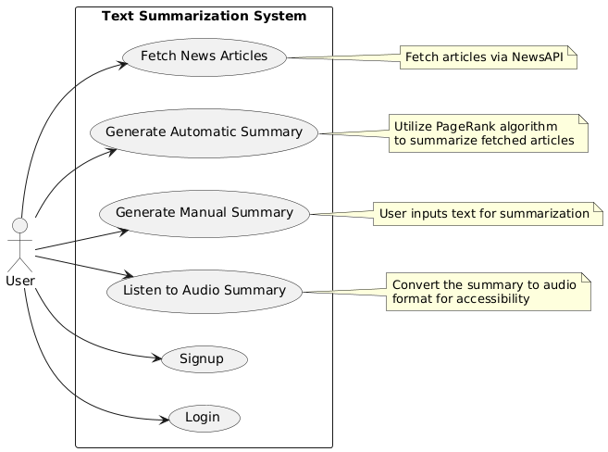
2) USE CASE DIAGRAM

Slide 16
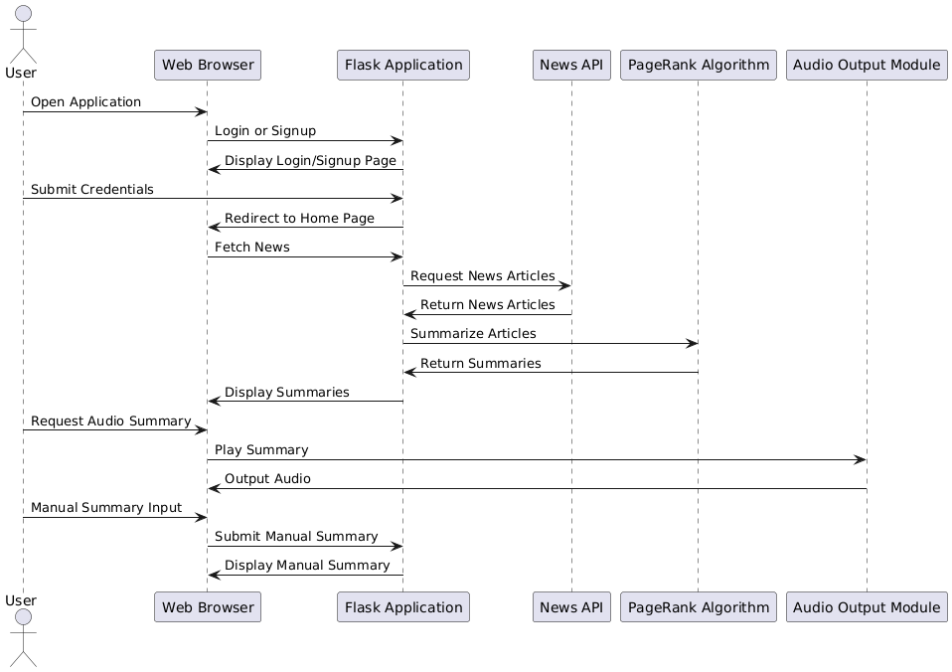
3) SEQUENCE DIAGRAM

Slide 17
4) ACTIVITY DIAGRAM

Slide 18
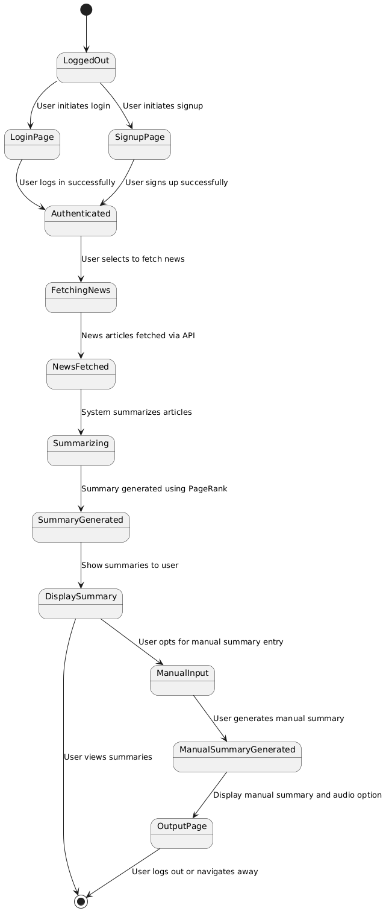
5) STATE DIAGRAM

Slide 19
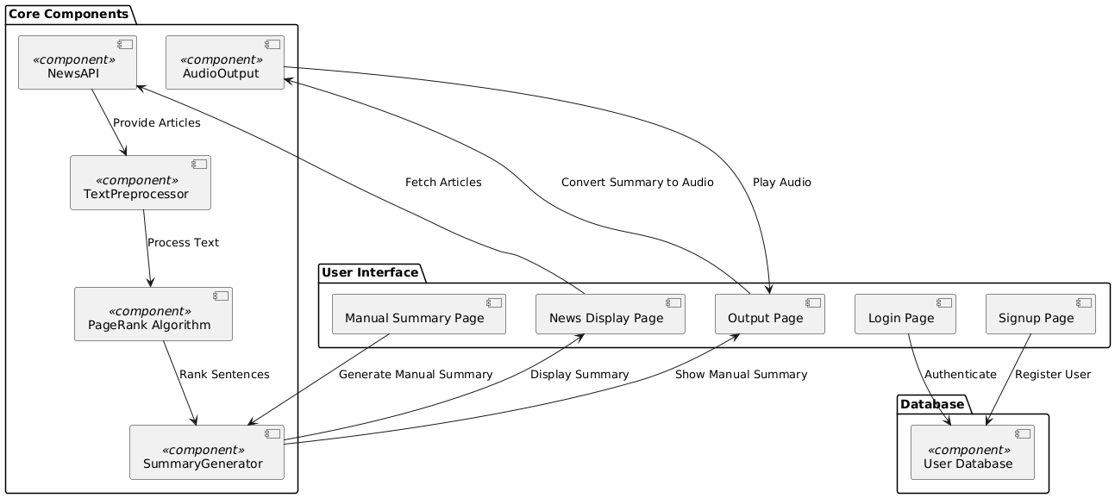
6) COMPONENT DIAGRAM

Slide 20
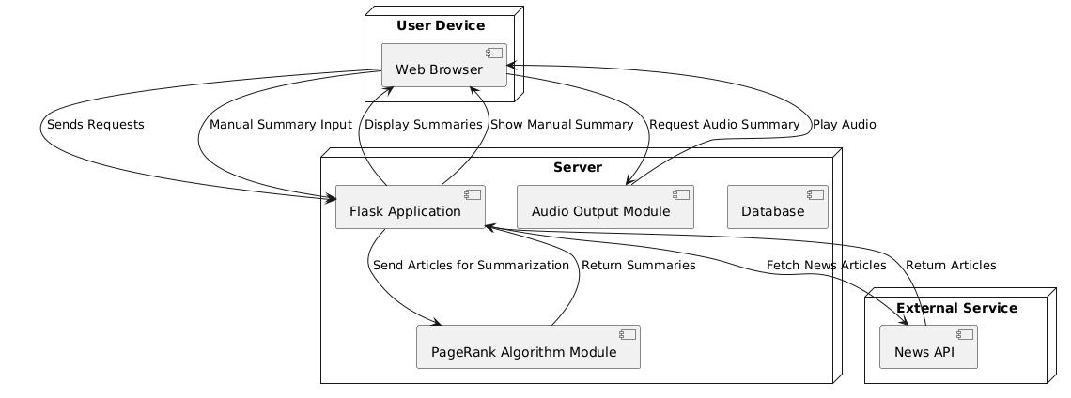
7) DEPLOYMENT DIAGRAM

Slide 21
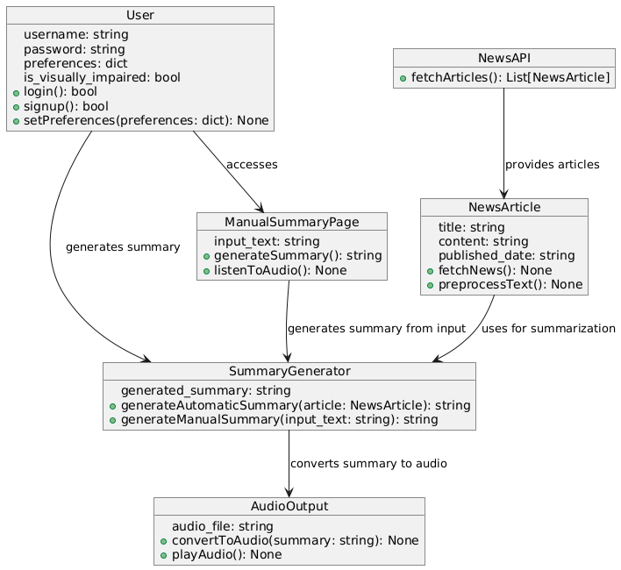
8) OBJECT DIAGRAM

Slide 22
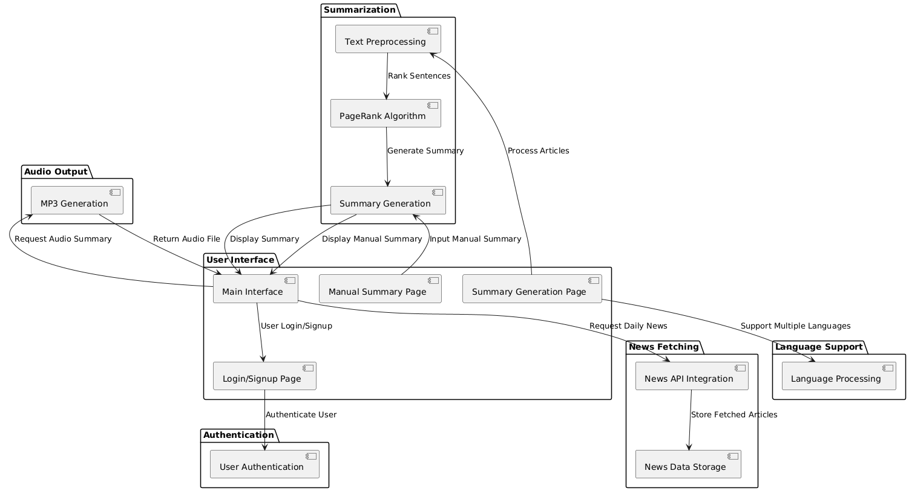
9) PACKAGE DIAGRAM

Slide 23
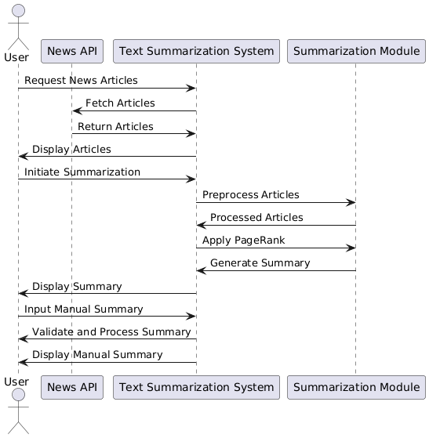
10) COMMUNICATION DIAGRAM

Slide 24
ADVANTAGES OF PROPOSED SYSTEM
Efficient News Consumption: Quickly provides key points of lengthy articles, saving time.
Multi-language Support: Summarizes in any language
User Experience: Features audio playback for summaries and a modern, responsive interface.
Personalization: Allows users to input text for personalized summaries and interactive features.
Accessibility: Audio summaries and responsive design ensure usability for visually impaired users and various devices.
Up-to-Date Information: Daily news updates with real-time summarization

Slide 25
Hardware and Software Requirements
Hardware Requirements:
Processor: Intel Core i3 or higher
RAM: 4GB or more
Storage: 10GB available disk space
Internet Connection: For API access and updates
Software Requirements:
Operating System: Windows 10,11
Python 3.x: For backend development (PageRank algorithm)
Flask: To create the web application
HTML/CSS: For frontend design

Slide 26
REFERENCES
G. Bao and Y. Zhang, “A General Contextualized Rewriting Framework for Text Summarization,” IEEE/ACM Trans. Audio Speech Lang. Process., vol. 31, pp. 1624–1635, 2023.
Y. Gao, Y. Xu, H. Huang, Q. Liu, L. Wei, and L. Liu, “Jointly Learning Topics in Sentence
Embedding for Document Summarization,” IEEE Trans. Knowl. Data Eng., vol. 32, no. 4, pp. 685–
698, Apr. 2020.
P. Wei, J. Zhao, and W. Mao, “A Graph-to-Sequence Learning Framework for Summarizing Opinionated Texts,” IEEE/ACM Trans. Audio Speech Lang. Process., vol. 29, pp. 1650–1661, Apr. 2021.
X. Liang, J. Li, S. Wu, M. Li, and Z. Li, “Improving Unsupervised Extractive Summarization by Jointly Modeling Facet and Redundancy,” IEEE/ACM Trans. Audio, Speech, and Lang. Process., vol. 30, pp. 1546–1557, 2022.
Q. Zhou, N. Yang, F. Wei, S. Huang, M. Zhou, and T. Zhao, “A Joint Sentence Scoring and
Selection Framework for Neural Extractive Document Summarization,” IEEE/ACM Trans. Audio, Speech, and Lang. Process., vol. 28, pp. 671–681, 2020

Slide 27
Thank You….

