Slide 1
Medium Access Sub Layer
Unit-III

Slide 2
OSI
Application
Presentation
Session
LOGICAL LINK sublayer
Transport
Framing
Error control
Flow control
Network
Data Link
Physical
MEDIA ACCESS sublayer
Transmission/reception of frames

Slide 3
The Medium Access Sub layer
deals with
BROADCAST NETWORKS AND THEIR PROTOCOLS
Broadcast channels are sometimes referred to as multi-access channels or random access channels.

Slide 4
Topics
Introduction
Channel Allocation problem
Multiple Access Protocols
IEEE Standard 802 for LANs
Wireless LAN
Bridges & its types.

Slide 5
Introduction
Medium Access Control (MAC) sub layer is part of Data Link layer.
In fact, it is the bottom part of DLL (interfacing with the physical layer)
This chapter deals with broadcast networks

Slide 6
The Channel Allocation Problem
Static Channel Allocation in LANs and MANs
Dynamic Channel Allocation in LANs and MANs

Slide 7
Channel Allocation problem
Static Channel Allocation in LANs and MANs
FDM & TDM
FDM:
1.The traditional way of allocating a single channel, among multiple competing users is Frequency division multiplexing(FDM).
2. If there are N users, the bandwidth is divided into N equal-sized portions, each user being assigned one portion.
3. Here each user has a private frequency band, there is no interference between users.

Slide 8
4.When there is only a small and constant number of users, each of which has heavy load of traffic, FDM is simple and efficient.
5. When number of senders is large and continuously varying, FDM presents few problems.
6.If spectrum is cut up into N regions and <N users are interested in communication, the spectrum is wasted.
7.If more than N users want to communicate, some of them will be denied permission for lack of bandwidth.
8. Assuming that the number of users be held constant at N, dividing the channel into sub-channels is inefficient.
9.The basic problem is, when some users are quiet their bandwidth is simply lost. They are not using it, and no one else is allowed to use it either.

Slide 9
Performance of static FDM from a simple queueing theory is as follows:
Assume that the mean time delay, T, for a channel of capacity C bps, with an arrival rate of λ frames/sec, each frame having a length from an exponential probability density function with 1/μ bits/frame.
With these, the arrival rate is λ frames/sec and the service rate is μC frames/sec.
From queueing theory it can be shown that for Poisson arrival and service times,
T= 1
μC - λ

Slide 10
Now let us divide the single channel into N independent sub-channels, each with capacity C/N bps. The mean input rate on each sub-channels will be λ/N.
Recomputing T we get
T_{FDM} = 1
μ(C/N)-(λ /N)
= N
μC – λ
₌ NT
The mean delay using FDM is N times worse than if all the frames were somehow magically arranged orderly in a big central queue.

Slide 11
TDM:
The same arguments that apply to FDM also apply to TDM.
Each user is statically allocated every N^{th} time slot. If a user does not use the allocated slot, it just lies fallow.
The same holds if we split up the network physically.
Note: None of the traditional static channel allocation methods work well with bursty traffic.

Slide 12
Dynamic Channel Allocation in LANs and MANs
Station Model.
Single Channel Assumption.
Collision Assumption.
(a) Continuous Time.
(b) Slotted Time.
(a) Carrier Sense.(LAN)
(b) No Carrier Sense.(SATELLITE)

Slide 13
1.Station Model:
The model consists of N independent Stations, each with a program or user that generates frames for transmission. Stations are called Terminals.
The probability of a frame being generated in an interval of length Δt is λΔt, where λ is a constant(arrival rate of new frames).
Once a frame is generated the station is blocked and does nothing until the frame has been successfully transmitted.

Slide 14
2. Single Channel Assumption:
A single channel is available for all communication.
All stations can transmit on it and all can receive from it.
3. Collision Assumption:
If two frames are transmitted simultaneously, they overlap in time and the resulting signal is garbled. This event is called a Collision.
All stations can detect collisions.
A collided frame must be transmitted again later.

Slide 15
4a. Continuous Time:
Frame transmission can begin at any instant.
There is no master clock dividing time into discrete intervals.
4b.Slotted Time:
Time is divided into slots. Frame transmission always begins at the start of a slot.
A slot can have 0,1, or more frames, corresponding to an idle slot, a successful transmission, or a collision respectively.

Slide 16
5a. Carrier Sense:
Stations can tell if the channel is in use before trying to use it.
If the channel is sensed as a busy, no station will attempt to use it until it goes idle.
5b. No Carrier Sense:
Stations cannot sense the channel before trying to use it.
They just go ahead and transmit. Only later can they determine whether the transmission was successful.

Slide 17
Multiple Access Protocols
ALOHA
Carrier Sense Multiple Access Protocols
Collision-Free Protocols
Limited-Contention Protocols
Wavelength Division Multiple Access Protocols
Wireless LAN Protocols

Slide 18
Medium Access Sub Layer
ALOHA
Aloha
Pure ALOHA (Mr. Norman Abramson in 1970s)
Slotted ALOHA (Mr.Roberts in 1972)
ALOHA system used to ground based radio broadcasting.

Slide 19
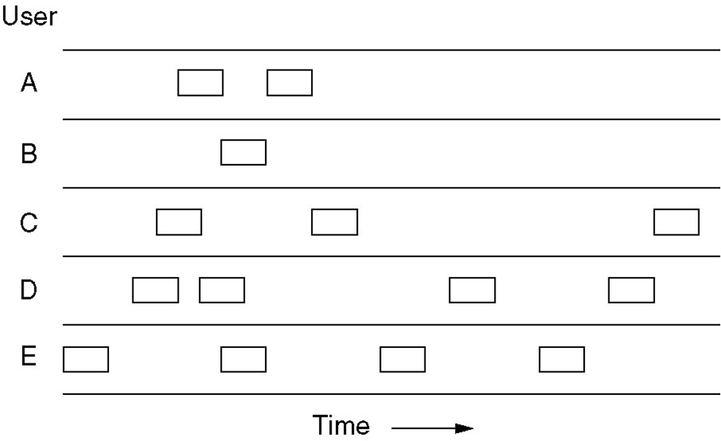
Pure ALOHA
Users transmit whenever they have data to be sent.
Fig. In pure ALOHA, frames are transmitted at completely arbitrary times

Slide 20
Systems in which multiple users share a common channel in a way that can lead to conflicts are widely known as contention system.
The frame size is fixed because the throughput of ALOHA systems is maximized.
We need to resend the frames that have been destroyed during transmission.
A collision involves two or more stations. If all these try to resend their frames after the time-out, the frames will collide again.
Pure ALOHA states that when the time-out period passes, each station waits a random amount of time before resending its frame(T_{B}).

Slide 21
Pure ALOHA has a second method to prevent congesting the channel with retransmitted frames. After a maximum no.of retransmission attempts K_{max}, a station must give up and try later.
The time-out period is equal to maximum possible round-trip propagation delay, which is twice the amount of the time required to send a frame between the two most widely separated stations(2 * T_{p} ).
The back-off time TB is a random value that depends on K.
(binary exponential back-off )

Slide 22
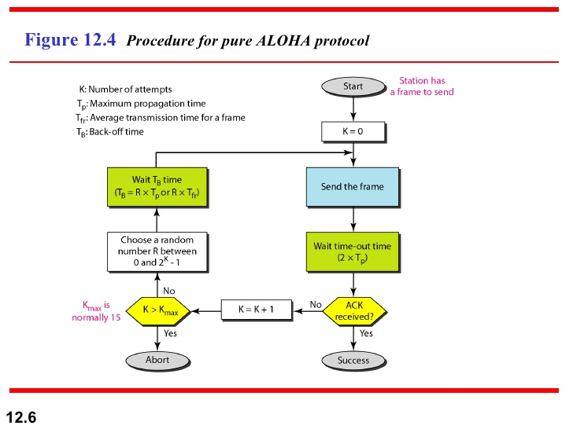

Slide 23
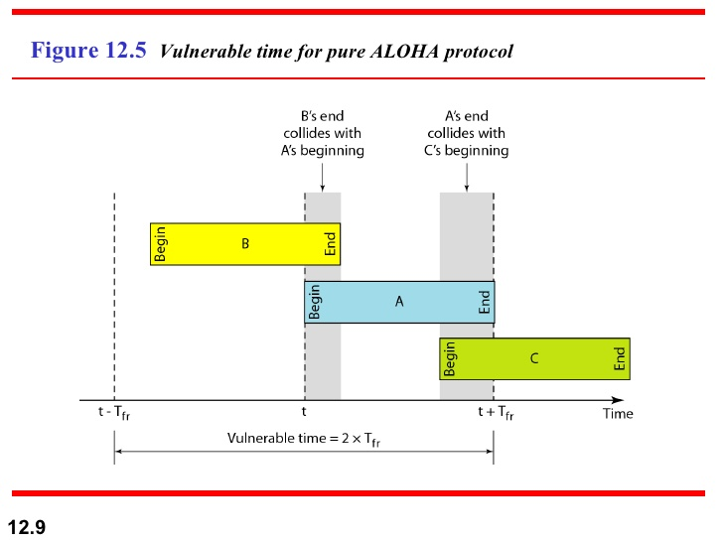

Slide 24
Pure ALOHA
Whenever two frames try to occupy the channel at the same time, there will be a collision and both will be garbled.
If the first bit of the new frame overlaps with the last bit of a frame almost finished , both frames will be totally destroyed, and both will be retransmitted later.
Throughput for pure ALOHA decreases.

Slide 25
Pure ALOHA
Disadvantage
More number of users share common channels in a way that can lead to conflicts.
More number of collisions occur.
Collision detected: stations waits a random amount of time.

Slide 26
Issues with pure aloha
Contention, collision detection, retransmission
Vulnerable period for a frame
If G is the mean number of transmission attempts (old and new) per frame time (offered load), S is the throughput per frame time, then S = Ge^{-2G} for pure ALOHA.
Maximum throughput occurs at G = 0.5 with S=1/(2e)=0.1839. I.e., maximum channel utilization is 18 percent.

Slide 27
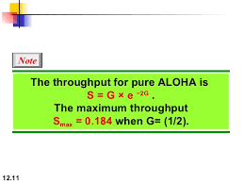
In other words, if one-half a frame is generated during one frame transmission time, then 18.4 percent of these frames reach their destination successfully.
This is an expected results because the vulnerable time is 2 times the frame transmission time.
Therefore, if a station generates only one frame in this vulnerable time, the frame will reach its destination successfully.

Slide 28
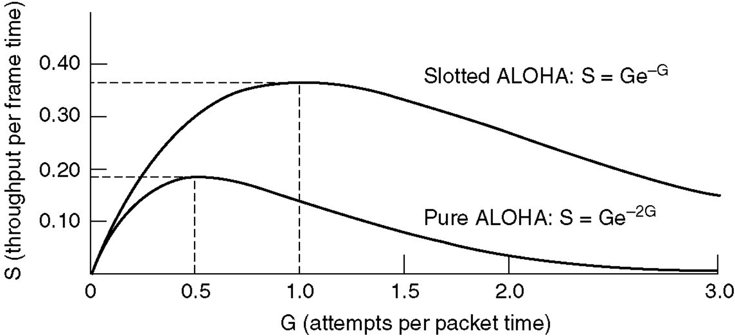
Pure ALOHA
Fig. Throughput versus offered traffic for ALOHA systems

Slide 29
Slotted aloha
Slotted ALOHA: Divide the time into discrete intervals(slots) of Tfr s, and force the station to send only at the beginning of the time slot..
Obviously, there may be a special signal needed to synchronize the clocks at all stations.
Because a station is allowed to send only at the beginning of synchronized time slot, if a station misses this, it must wait until the beginning of next time slot.
This means that the station which started at the beginning of this slot has already finished sending its frame.
Ofcourse, there is still the possibility of collision if two stations try to send at the beginning of the same slot.

Slide 30
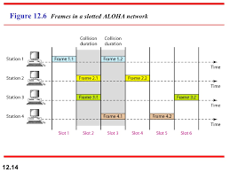

Slide 31
However, the vulnerable time is now reduced to one-half, equal to Tfr.
It can be proved that the average number of successful transmission for the slotted ALOHA is S=G * e^{-G}
Maximum throughput occurs at G=1, S=1/e or 0.368. This is twice that of pure ALOHA protocol.
In other words, if a frame is generated during one frame transmission time, then 36.8 % of these frames reach their destination successfully. This result is expected because vulnerable time is equal to the frame transmission time.
Therefore, if a station generates only one frame in this vulnerable time(and no other station generates a frame during this time), the frame will be reach its destination successfully.

Slide 32
Slotted ALOHA
Divides the time into discrete intervals
A B C D E
Disadvantage: collisions
Throughput for slotted ALOHA increases.

Slide 33
Differences Between Pure ALOHA and Slotted ALOHA
Transmission
  In Pure ALOHA when a frame first arrives, the node immediately transmits the frame in its entirely into the Broadcast Channel.
  In Slotted ALOHA when a node has a fresh frame to send, it waits until the beginning of the next slot and transmits the entire frame in the slot.
Timing
  In Pure ALOHA Nodes can transmit frames at Random Times.
  In Slotted ALOHA Nodes can transmit frames in their respective slot boundaries only at the beginning of the Slot.

Slide 34
Differences Between Pure ALOHA and Slotted ALOHA
Synchronization
  Pure ALOHA does not require Synchronization of slots of any nodes.
  Slotted ALOHA requires synchronization between slots of nodes.
Mode of Transfer
  In Pure ALOHA the Mode of Transfer is Continuous.
  In Slotted ALOHA the mode of transfer is Discrete

Slide 35
Differences Between Pure ALOHA and Slotted ALOHA
Collission
  In Pure ALOHA If a Collision Occurs the nodes will then immediately retransmit the frame with probability P or the frame transmission time for retransmitting the frame.
  In Slotted ALOHA, if a collision occurs, the node detects the collision before the end of the slot the node retransmits its frame in each subsequent slot with probability P until the frame transmitted without a collision.
Efficiency
  In Pure ALOHA Efficiency is Half of Slotted ALOHA.
  In Slotted ALOHA efficiency is more than that of Pure ALOHA.

Slide 36
CSMA: Carrier Sense Multiple Access
Protocols in which stations listen for a carrier (i.e., transmission) and act accordingly are called carrier sense protocols.
Adv:
To minimize the chance of collision
Increases the performance.
  CSMA principle is “sense before transmit” or “listen before talk”.

Slide 37
CSMA Methods
1-persistent CSMA- constant length packets.
non-persistent CSMA- to sense the channel.
p-persistent CSMA

Slide 38
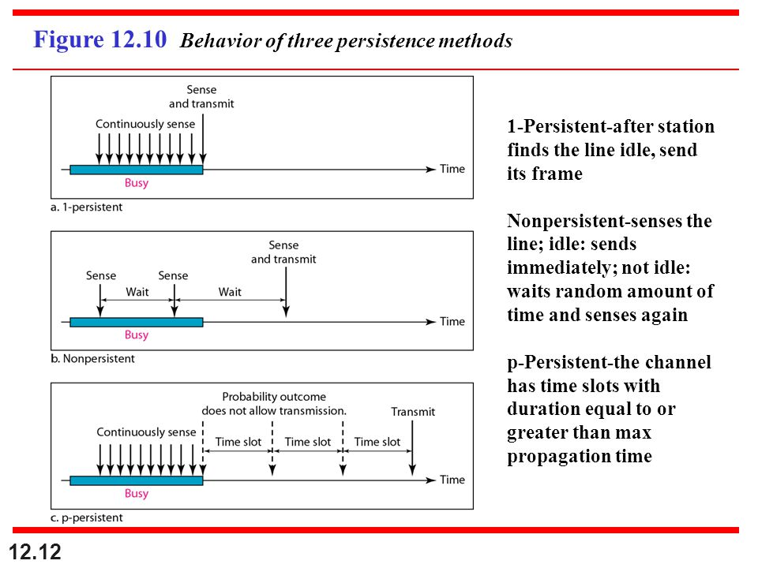

Slide 39
1-persistent
When a station has data to send, it first listens to channel to see if any one else is transmitting at that moment.
If the channel is busy, the station continuously senses the channel until it becomes idle.
When the station detects an idle channel, it transmits a frame.
If a collision occurs, the station waits a random amount of time and starts all over again.
The station transmits with a probability of 1 whenever if finds the channel idle.
This method has highest chance of collision because two or more stations may find the line idle and send their frames immediately.

Slide 40
Non-persistent CSMA
A station that has a frame to send it senses the line.
If the line is idle, it sends immediately.
If the line is not idle, it waits a random amount of time and then senses the line again.
This approach reduces the chance of collision because it is unlikely that two or more stations will wait the same amount of time and retry to send simultaneously.
This algorithm should lead to better channel utilization and longer delays than 1-persistant CSMA.

Slide 41
P-persistent CSMA
This method is used if the channel has time slots with a slot duration equal to or greater than the maximum propogation time.
It combines advantages of the other two strategies.
It reduces the chance of collision and improves efficiency.

Slide 42
P-persistent CSMA
In this method, after station finds the line idle it follows these steps:
1.With probability ‘p’, the station sends its frame.
2.With probability q=1-p, the station waits for the beginning of the next time slot and checks the line again.
a. If the line is idle, it goes to step 1.
b. If the line is busy, it acts as though a collision has occurred
and uses the back-off procedure(which discussed earlier).

Slide 43
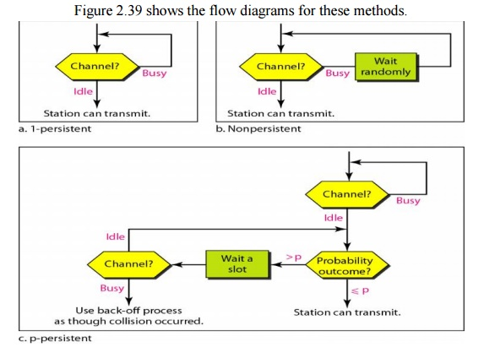

Slide 44
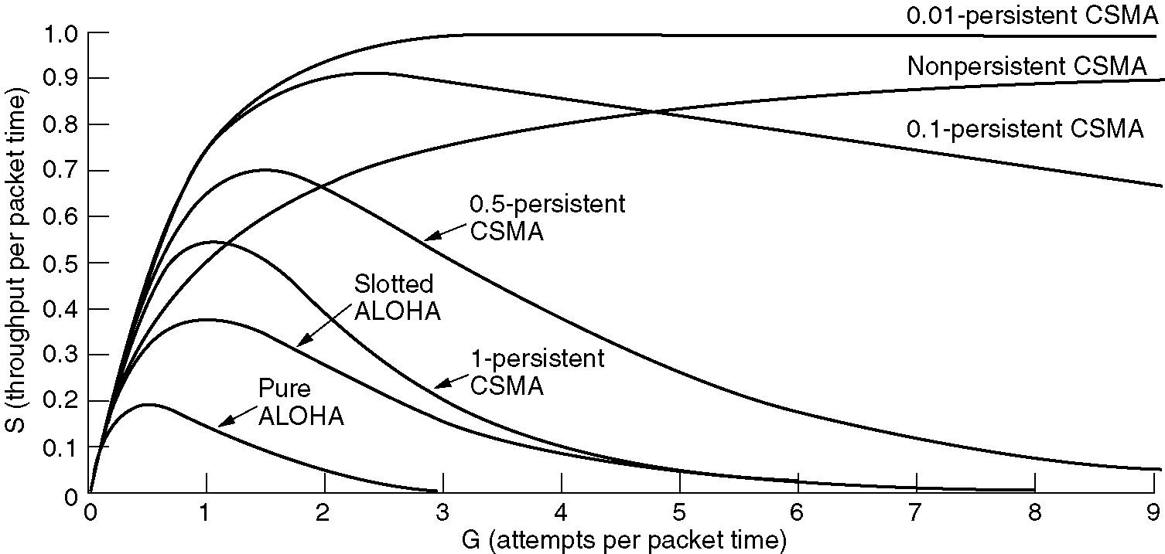
Persistent and Nonpersistent CSMA
Comparison of the channel utilization versus load for various random access protocols.

Slide 45
Carrier Sense Multiple Access with Collision Detection(CSMA/CD)
In this method, a station monitors the medium after it sends a frame to see if the transmission was successful. If so, the station is finished. If, however, there is a collision, the frame is sent again.

Slide 46
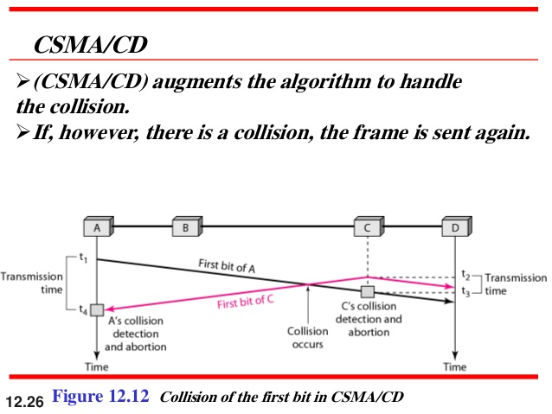

Slide 47
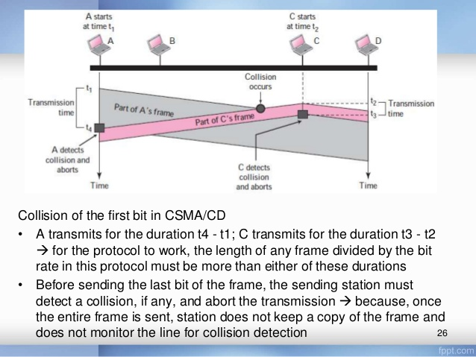

Slide 48
Minimum Frame Size
For CSMA/CD to work, we need restriction on the frame size.
Therefore, the frame transmission time Tfr must be at least two times the maximum propagation time Tp.
To understand the reason, let us think about worst-case scenario. If two stations involved in a collision are the maximum distance apart, the signal from the first takes Tp to reach the second, and the effect of the collision takes another Tp to reach the first.
So the requirement is that the first station must still be transmitting after 2Tp

Slide 49
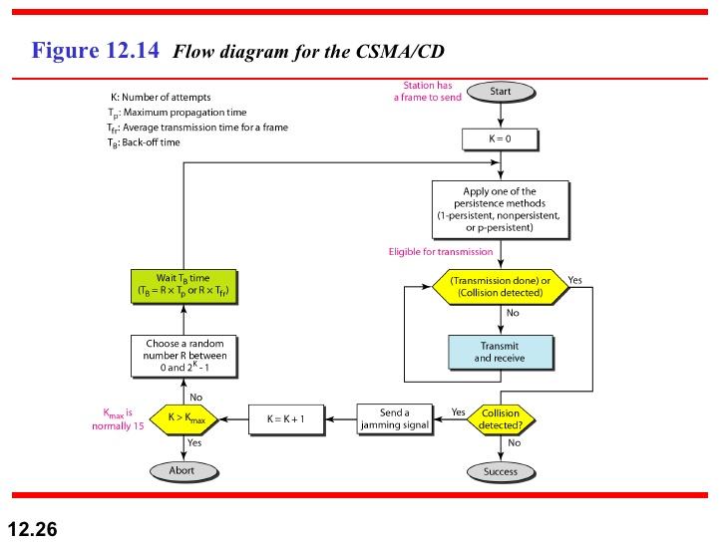

Slide 50
CSMA/CD Vs ALOHA
CSMA/CD is similar to the one for ALOHA protocol, but there are differences which as follows:
Addition of persistence methods
Frame transmission: In ALOHA, we first transmit the entire frame and then wait for an acknowledgment.
In CSMA/CD, transmission and collision is a continuous process. We do not send entire frame and then look for a collision. The station transmits and receives continuously and simultaneously.

Slide 51
Contd..
We use loop to show that transmission is a continuous process.
We constantly monitor in order to detect one of the two conditions: either transmission is finished or a collision is detected. Either event stops transmission.
When we come out of loop, if a collision has not detected, it means that the transmission is complete: the entire frame is transmitted. Otherwise, a collision has occurred.
3. Sends a short Jamming signal that enforces the collision in case other stations have not yet sensed the collision

Slide 52
Energy level in CSMA/CD
Energy
collision
Frame transmission
Frame transmission
Time
Idle

Slide 53
Throughput of CSMA/CD
The throughput of CSMA/CD is greater than that of pure or slotted ALOHA.
The maximum throughput occurs at a different value of G and is based on the persistent method and the value of p in the p-persistent approach.
For 1-persistent method the maximum throughput is around 50 % when G=1.
For non-persistent method, the maximum throughput can go up to 90 % when G is between 3 and 8.

Slide 54
Wired LANs: Ethernet
IEEE Standards
Standard Ethernet
Changes in the Standard
Fast Ethernet
Gigabit Ethernet
Data Communications, Kwangwoon University
13-<number>

Slide 55

IEEE Standards
In 1985, the Computer Society of the IEEE started a project, called Project 802, to set standards to enable intercommunication among equipment from a variety of manufacturers. Project 802 is a way of specifying functions of the physical layer and the data link layer of major LAN protocols.
Data Communications, Kwangwoon University
13-<number>

Slide 56
IEEE 802 Working Group
Active working groups | Inactive or disbanded working groups
802.1 Higher Layer LAN Protocols Working Group 802.3 Ethernet Working Group 802.11 Wireless LAN Working Group 802.15 Wireless Personal Area Network (WPAN) Working Group 802.16 Broadband Wireless Access Working Group 802.17 Resilient Packet Ring Working Group 802.18 Radio Regulatory TAG 802.19 Coexistence TAG 802.20 Mobile Broadband Wireless Access (MBWA) Working Group 802.21 Media Independent Handoff Working Group 802.22 Wireless Regional Area Networks | 802.2 Logical Link Control Working Group 802.4 Token Bus Working Group 802.5 Token Ring Working Group 802.7 Broadband Area Network Working Group 802.8 Fiber Optic TAG 802.9 Integrated Service LAN Working Group 802.10 Security Working Group 802.12 Demand Priority Working Group 802.14 Cable Modem Working Group
Data Communications, Kwangwoon University
13-<number>

Slide 57

Logical Link Control (LLC)
Framing: LLC defines a protocol data unit (PDU) that is similar to that of HDLC
To provide flow and error control for the upper-layer protocols that actually demand these services.
It provides one single data link control protocol for all IEEE LANs.
Data Communications, Kwangwoon University
13-<number>

Slide 58
Medium Access Control(MAC)
IEEE Project 802 has created a sub-layer called MAC that defines specific access methods for each LAN.
In contrast to LLC sub-layer, the MAC sub layer contains a number of distinct modules; each defines the access method and the framing format specific to the LAN protocol.
Physical layer
The physical layer is dependent on the implementation and the type of physical media used.
Data Communications, Kwangwoon University
13-<number>

Slide 59

Standard Ethernet
The original Ethernet was created in 1976 at Xerox’s Palo Alto Research Center (PARC). Since then, it has gone through four generations
Data Communications, Kwangwoon University
13-<number>

Slide 60


MAC Sublayer
Preamble: Alternate 0’s and 1’s that alerts the receiving system to the coming frame and enables it to synchronize its input timing.
Data Communications, Kwangwoon University
13-<number>

Slide 61


Addressing
Ethernet address in hexadecimal notation
The least significant bit of the first byte defines the type of address.
If the bit is 0, the address is unicast; otherwise, it is multicast
The broadcast destination address is a special case of the multicast address in which all bits are 1s
Data Communications, Kwangwoon University
13-<number>

Slide 62
Ethernet
Slot time:
Access method: 1-persistent CSMA/CD
Slot time = round-trip time + time required to send the jam sequence.
The slot in Ethernet is defined in bits. It is time required for a station to send 512 bits. This means that the actual slot time depends on the data rate: for traditional 10-Mbps Ethernet it is 51.2 μs
Slot time and collision:
The choice of a 512-bit slot time was not accidental.
It was chosen for the proper functioning of CSMA/CD.
To understand it, let us consider two cases.
Case-1:
We assume that the sender sends a minimum-size packet of 512 bits.
Before the sender can send the entire packet out, the signal travels through the network and reaches the end of the network.
Data Communications, Kwangwoon University
13-<number>

Slide 63
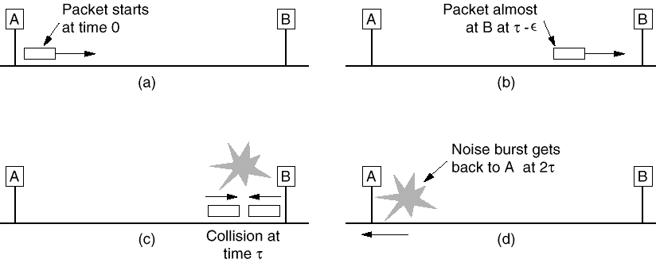
Minimum frame length: 64 bytes

Slide 64
If there is another signal at the end of the network, a collision occurs. The sender has opportunity to abort the sending of the frame and to send a jam sequence to inform other stations of the collision.
(The round-trip time + the time required to send the jam sequence ) < the time needed to send the minimum frame, 512 bits.(the sender need to be aware of the collision before it is too late, that is, before it has sent the entire frame).
Case-2:
Assume that the sender sends a frame larger than the minimum size.
In this case, if station has sent out the first 512 bits and has not heard a collision, it is guaranteed that the collision will never occur during the transmission of this frame. The reason is that the signal will reach the end of the network in less than one-half the slot time.
If they sent a signal before one-half of the slot time expired, a collision can occur during the first half of the slot time, and if it does, it can be sensed by sender during the slot time.

Slide 65
Collisions
Collisions are caused when two adaptors transmit at the same
time (adaptors sense collision based on voltage differences)
  Both found line to be idle
  Both had been waiting to for a busy line to become idle
A starts at
time 0
A
B
Message almost
there at time T when
B starts – collision!
A
B
How can we be sure A knows about the collision?

Slide 66
Collision Detection
How can A know that a collision has taken place?
  There must be a mechanism to insure retransmission on collision
  A’s message reaches B at time T
  B’s message reaches A at time 2T
  So, A must still be transmitting at 2T
IEEE 802.3 specifies max value of 2T to be 51.2us
  This relates to maximum distance of 2500m between hosts
  At 10Mbps it takes 0.1us to transmit one bit so 512 bits (64B) take 51.2us to send
  So, Ethernet frames must be at least 64B long
    14B header, 46B data, 4B CRC
    Padding is used if data is less than 46B
Send jamming signal after collision is detected to insure all hosts see collision
  48 bit signal

Slide 67
Collision Detection contd.
time = 0
A
B
A
B
time = T
A
B
time = 2T

Slide 68
Slot time and maximum network length
  MaxLength = PropagationSpeed x SlotTime/2
  MaxLength = (2 x 10⁸) x (51.2 x 10⁻⁶/2) = 5120 m
  MaxLength = 2500 m 48 % of the theoretical calculation by considering delay times in repeaters and interfaces, and the time required to send the jam sequence

Slide 69


Physical Layer: Ethernet
Data Communications, Kwangwoon University
13-<number>

Slide 70


10Base5: Thick Ethernet
10Base2: Thin Ethernet
Data Communications, Kwangwoon University
13-<number>

Slide 71


10BaseT: Twisted-Pair Ethernet
10Base-F: Fiber Ethernet
Data Communications, Kwangwoon University
13-<number>

Slide 72

Summary of Standard Ethernet
Data Communications, Kwangwoon University
13-<number>

Slide 73


Changes in the Standard
Bridged Ethernet: Raising bandwidth and separating collision domains
Data Communications, Kwangwoon University
13-<number>

Slide 74

Changes in the Standard
Switched Ethernet: N-port bridge
Data Communications, Kwangwoon University
13-<number>

Slide 75

Changes in the Standard
Full-duplex (switched) Ethernet: no need for CSMA/CD
Data Communications, Kwangwoon University
13-<number>

Slide 76
Fast Ethernet
Under the name of IEEE 802.3u
  Upgrade the data rate to 100 Mbps
  Make it compatible with Standard Ethernet
  Keep the same 48-bit address and the same frame format
  Keep the same min. and max. frame length
MAC Sublayer
  CSMA/CD for the half-duplex approach
  No need for CSMA/CD for full-duplex Fast Ethernet
Autonegotiation: allow two devices to negotiate the mode or data rate of operation
Data Communications, Kwangwoon University
13-<number>

Slide 77


Fast Ethernet: Physical Layer
Topology
Implementation
Data Communications, Kwangwoon University
13-<number>

Slide 78

Summary of Fast Ethernet
Data Communications, Kwangwoon University
13-<number>

Slide 79
Gigabit Ethernet
Under the name of IEEE 802.3z
  Upgrade the data rate to 1 Gbps
  Make it compatible with Standard or Fast Ethernet
  Keep the same 48-bit address and the same frame format
  Keep the same min. and max. frame length
  Support autonegotiation as defined in Fast Ethernet
MAC Sublayer
  Most of all implmentations follows full-duplex approach
  In the full-duplex mode of Gigabit Ethernet, there is no collision; the maximum length of the cable is determined by the signal attenuation in the cable.
Half-duplex mode (very rare)
  Traditional: 0.512 μs (25m)
  Carrier Extension: 512 bytes (4096 bits) min. length
  Frame bursting to improve the inefficiency of carrier extension
Data Communications, Kwangwoon University
13-<number>

Slide 80

Gigabit Ethernet: Physical Layer
Topology
Data Communications, Kwangwoon University
13-<number>

Slide 81

Gigabit Ethernet: Physical Layer
Implementation
Data Communications, Kwangwoon University
13-<number>

Slide 82

Gigabit Ethernet: Summary
Data Communications, Kwangwoon University
13-<number>

Slide 83

Ten-Gigabit Ethernet
Under the name of IEEE 802.3ae
  Upgrade the data rate to 10 Gbps
  Make it compatible with Standard, Fast, and Giga Ethernet
  Keep the same 48-bit address and the same frame format
  Keep the same min. and max. frame length
  Allow the interconnection of existing LANs into a MAN or WAN
  Make Ethernet compatible with Frame Relay and ATM
MAC Sublayer: Only in full-duplex mode → no CSMA/CD
Data Communications, Kwangwoon University
13-<number>

Slide 84
Wireless
Local Area Networks

Slide 85
Wireless Local Area Networks
The proliferation of laptop computers and other mobile devices (PDAs and cell phones) created an obvious application level demand for wireless local area networking.
Companies jumped in, quickly developing incompatible wireless products in the 1990’s.
Industry decided to entrust standardization to IEEE committee that dealt with wired LANS – namely, the IEEE 802 committee!!

Slide 86
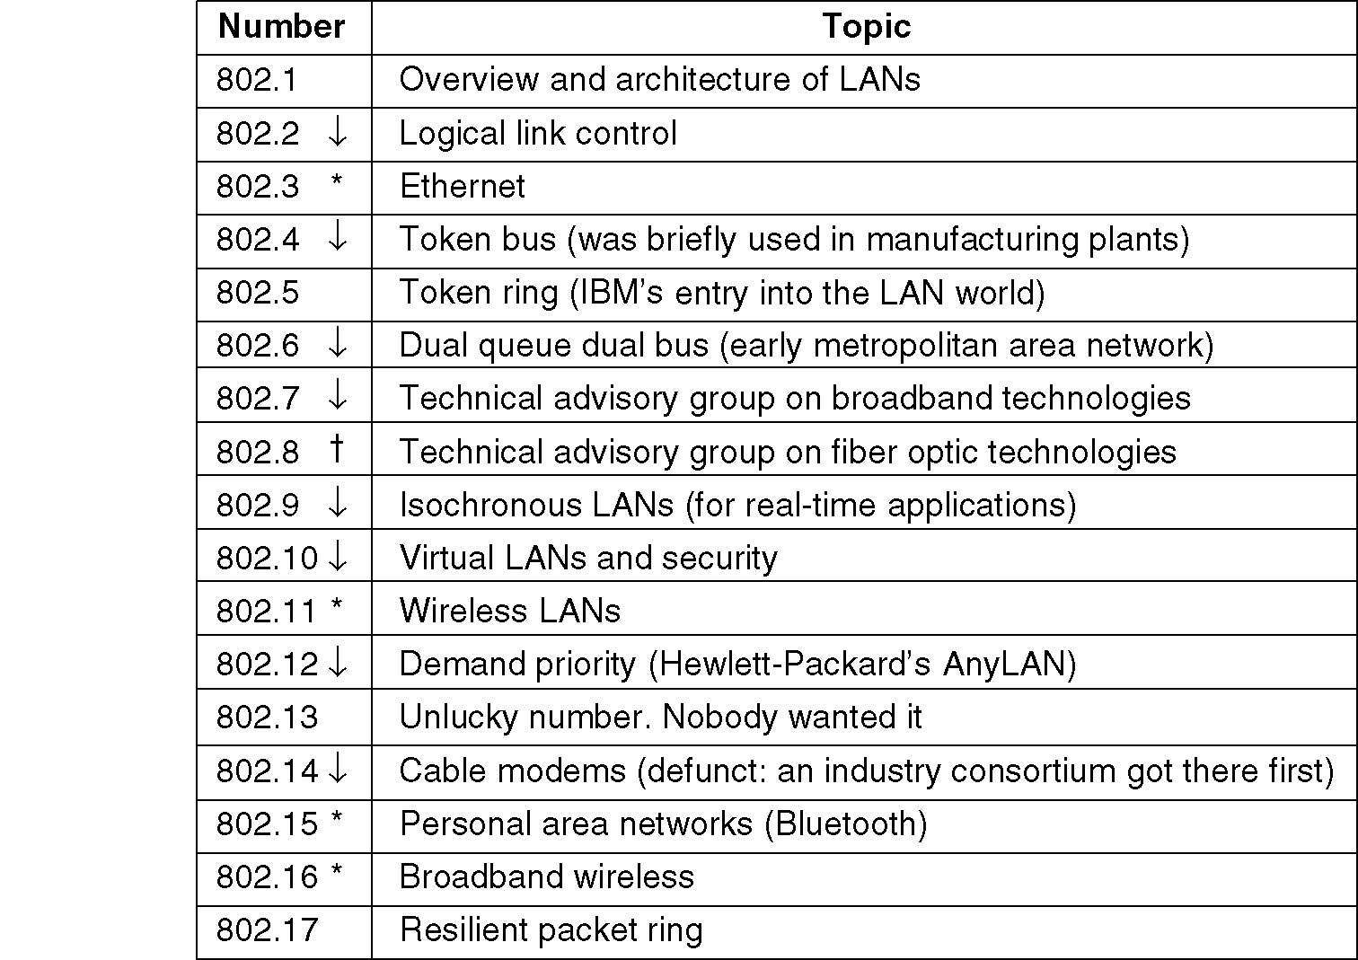
IEEE 802 Standards Working Groups
Figure 1-38. The important ones are marked with *. The ones marked with ↓ are hibernating. The one marked with † gave up.

Slide 87
Categories of Wireless Networks
Base Station :: all communication through an access point {note hub topology}. Other nodes can be fixed or mobile.
Infrastructure Wireless :: base station network is connected to the wired Internet.
Ad hoc Wireless :: wireless nodes communicate directly with one another.
MANETs (Mobile Ad Hoc Networks) :: ad hoc nodes are mobile.

Slide 88
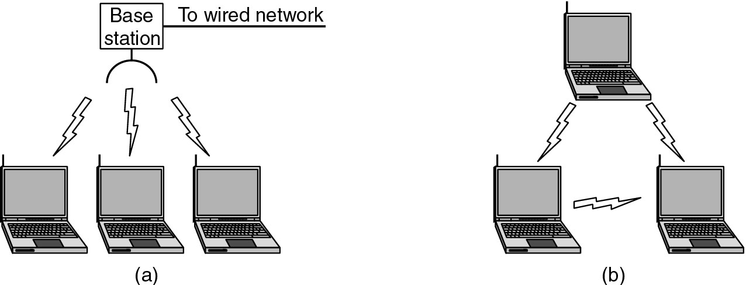
Wireless LANs
Figure 1-36.(a) Wireless networking with a base station. (b) Ad hoc networking.

Slide 89
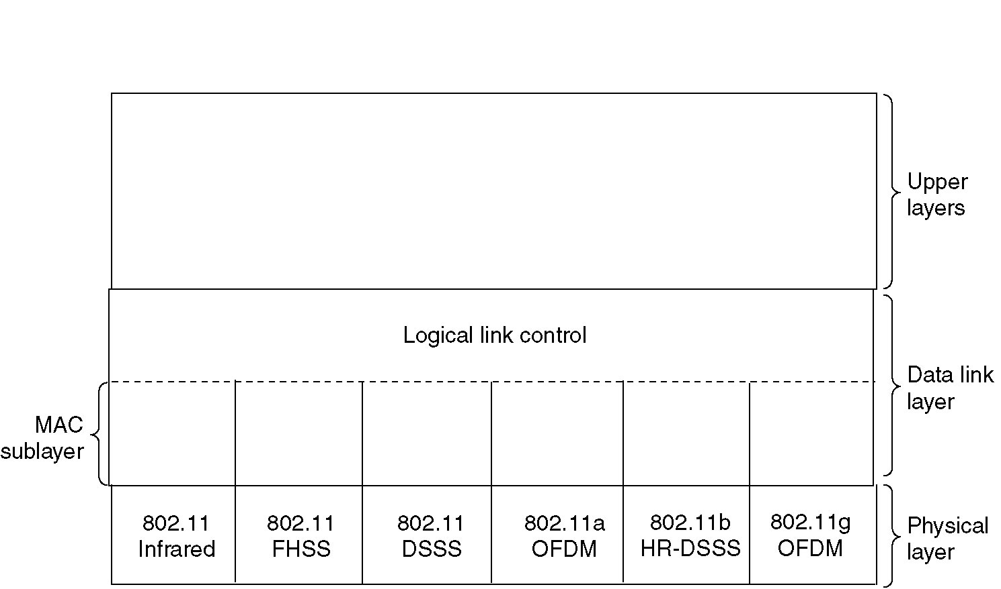
The 802.11 Protocol Stack
Figure 4-25. Part of the 802.11 protocol stack.

Slide 90
Wireless Physical Layer
Physical layer conforms to OSI (five options)
  1997: 802.11 infrared, FHSS, DHSS
  1999: 802.11a OFDM and 802.11b HR-DSSS
  2001: 802.11g OFDM
802.11 Infrared
  Two capacities 1 Mbps or 2 Mbps.
  Range is 10 to 20 meters and cannot penetrate walls.
  Does not work outdoors.
802.11 FHSS (Frequence Hopping Spread Spectrum)
  The main issue is multipath fading.
  79 non-overlapping channels, each 1 Mhz wide at low end of 2.4 GHz ISM band.
  Same pseudo-random number generator used by all stations.
  Dwell time: min. time on channel before hopping (400msec).

Slide 91
Wireless Physical Layer
802.11 DSSS (Direct Sequence Spread Spectrum)
  Spreads signal over entire spectrum using pseudo-random sequence (similar to CDMA see Tanenbaum sec. 2.6.2).
  Each bit transmitted using an 11 chips Barker sequence, PSK at 1Mbaud.
  1 or 2 Mbps.
802.11a OFDM (Orthogonal Frequency Divisional Multiplexing)
  Compatible with European HiperLan2.
  54Mbps in wider 5.5 GHz band ➔ transmission range is limited.
  Uses 52 FDM channels (48 for data; 4 for synchronization).
  Encoding is complex ( PSM up to 18 Mbps and QAM above this capacity).
  E.g., at 54Mbps 216 data bits encoded into into 288-bit symbols.
  More difficulty penetrating walls.

Slide 92
Wireless Physical Layer
802.11b HR-DSSS (High Rate Direct Sequence Spread Spectrum)
  11a and 11b shows a split in the standards committee.
  11b approved and hit the market before 11a.
  Up to 11 Mbps in 2.4 GHz band using 11 million chips/sec.
  Note in this bandwidth all these protocols have to deal with interference from microwave ovens, cordless phones and garage door openers.
  Range is 7 times greater than 11a.

Slide 93
Wireless Physical Layer
802.11g OFDM(Orthogonal Frequency Division Multiplexing)
  An attempt to combine the best of both 802.11a and 802.11b.
  Supports bandwidths up to 54 MBps.
  Uses 2.4 GHz frequency for greater range.
  Is backward compatible with 802.11b.

Slide 94
802.11 MAC Sublayer Protocol
In 802.11 wireless LANs, “seizing channel” does not exist as in 802.3 wired Ethernet.
Two additional problems:
  Hidden Terminal Problem
  Exposed Station Problem
To deal with these two problems 802.11 supports two modes of operation DCF (Distributed Coordination Function) and PCF (Point Coordination Function).
All implementations must support DCF, but PCF is optional.

Slide 95
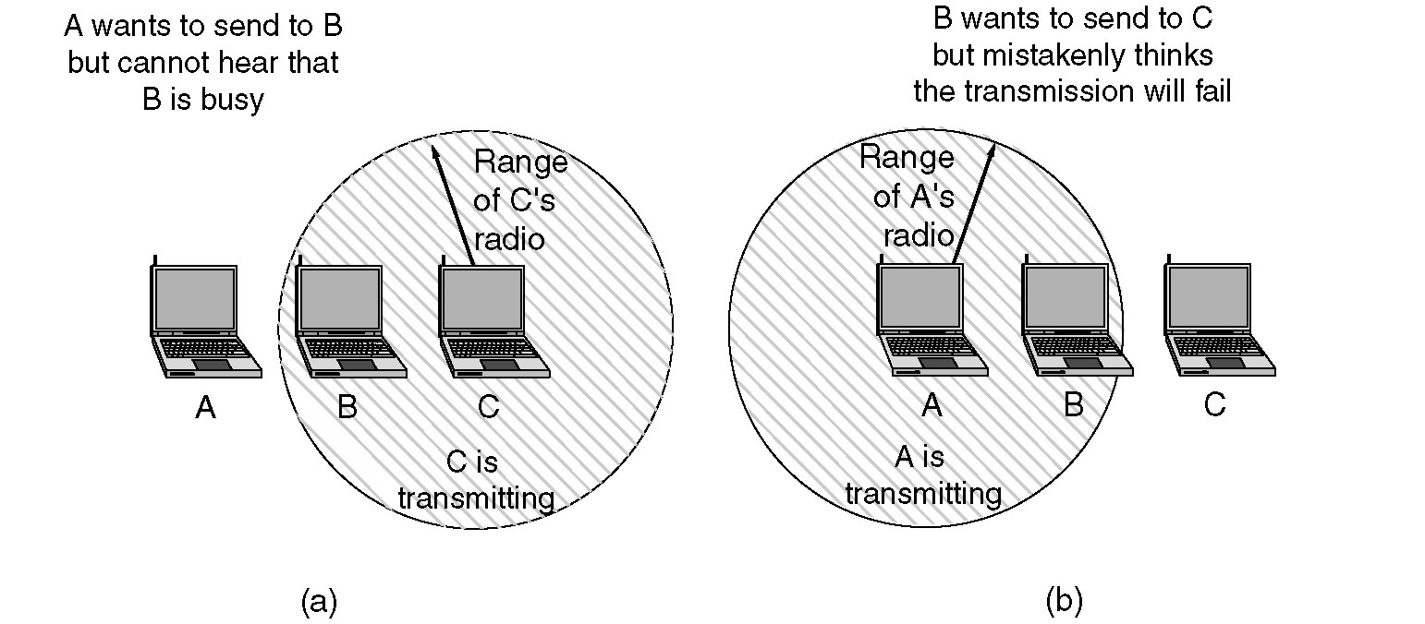
Figure 4-26.(a)The hidden station problem. (b) The exposed station problem.

Slide 96
The Hidden Terminal Problem
Wireless stations have transmission ranges and not all stations are within radio range of each other.
Simple CSMA will not work!
C transmits to B.
If A “senses” the channel, it will not hear C’s transmission and falsely conclude that A can begin a transmission to B.

Slide 97
The Exposed Station Problem
This is the inverse problem.
B wants to send to C and listens to the channel.
When B hears A’s transmission, B falsely assumes that it cannot send to C.

Slide 98
Distribute Coordination Function (DCF)
Uses CSMA/ CA (CSMA with Collision Avoidance).
  Uses both physical and virtual carrier sensing.
  Two methods are supported:
based on MACAW(Multiple Access with Collision Avoidance for Wireless) with virtual carrier sensing.
1-persistent physical carrier sensing.

Slide 99
Wireless LAN Protocols
MACA protocol solved hidden, exposed terminal:
  Send Ready-to-Send (RTS) and Clear-to-Send (CTS) first
  RTS, CTS helps determine who else is in range or busy (Collision avoidance).
  Can a collision still occur?

Slide 100
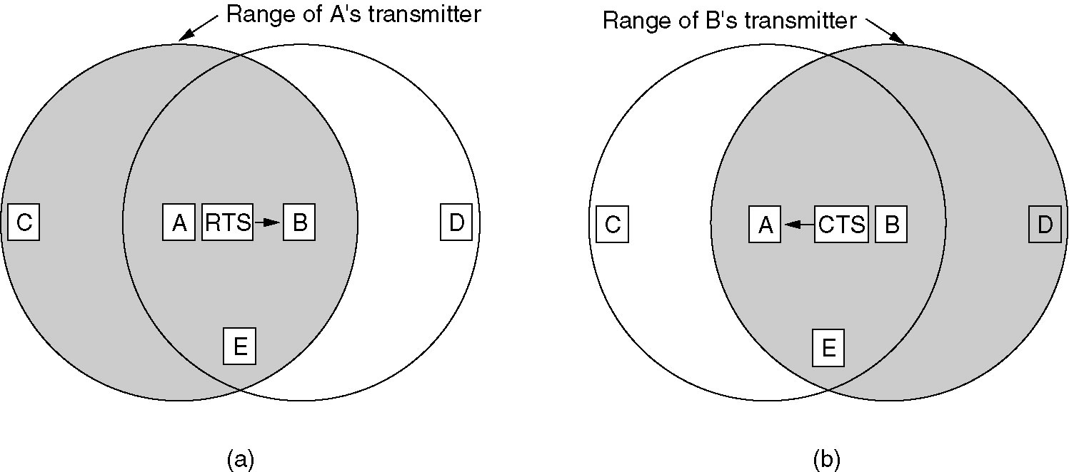
Wireless LAN Protocols
MACAW added ACKs and CSMA (no RTS at same time)
(a) A sending an RTS to B.(b) B responding with a CTS to A.

Slide 101
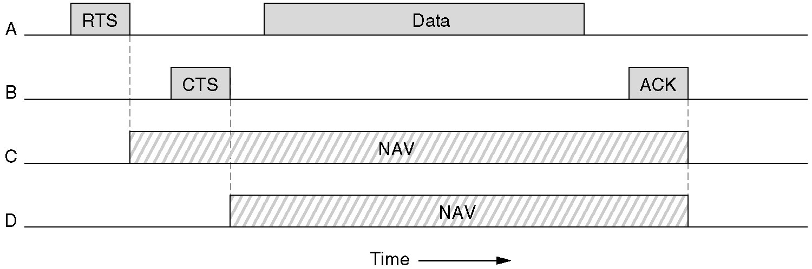
Virtual Channel Sensing in CSMA/CA
Figure 4-27. The use of virtual channel sensing using CSMA/CA.
C (in range of A) receives the RTS and based on information in RTS creates a virtual channel busy NAV(Network Allocation Vector).
D (in range of B) receives the CTS and creates a shorter NAV.

Slide 102
Virtual Channel Sensing in CSMA/CA
What is the advantage of RTS/CTS?
RTS is 20 bytes, and CTS is 14 bytes.
MPDU can be 2300 bytes.
“virtual” implies source station sets duration field in data frame or in RTS and CTS frames.
Stations then adjust their NAV accordingly!

Slide 103
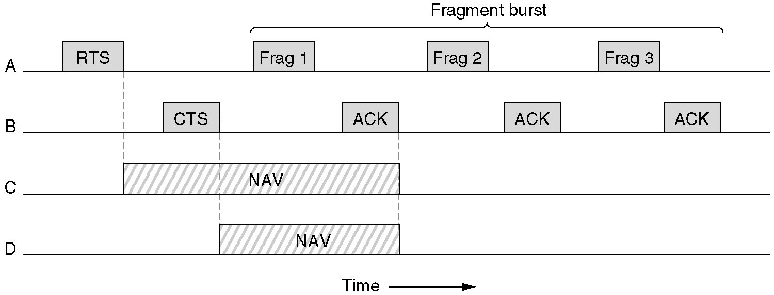
Figure 4-28.Fragmentation in 802.11
High wireless error rates ➔ long packets have less probability of being successfully transmitted.
Solution: MAC layer fragmentation with stop-and-wait protocol on the fragments.

Slide 104
1-Persistent Physical Carrier Sensing
Station senses the channel when it wants to send.
If idle, station transmits.
  Station does not sense channel while transmitting.
If the channel is busy, station defers until idle and then transmits.
Upon collision, wait a random time using binary exponential backoff.

Slide 105
Point Coordinated Function (PCF)
PCF uses a base station to poll other stations to see if they have frames to send.
No collisions occur.
Base station sends beacon frame periodically.
Base station can tell another station to sleep to save on batteries and base stations holds frames for sleeping station.

Slide 106
DCF and PCF Co-Existence
Distributed and centralized control can co-exist using InterFrame Spacing.
SIFS (Short IFS) :: is the time waited between packets in an ongoing dialog (RTS,CTS,data, ACK, next frame)
PIFS (PCF IFS) :: when no SIFS response, base station can issue beacon or poll.
DIFS (DCF IFS) :: when no PIFS, any station can attempt to acquire the channel.
EIFS (Extended IFS) :: lowest priority interval used to report bad or unknown frame.

Slide 107
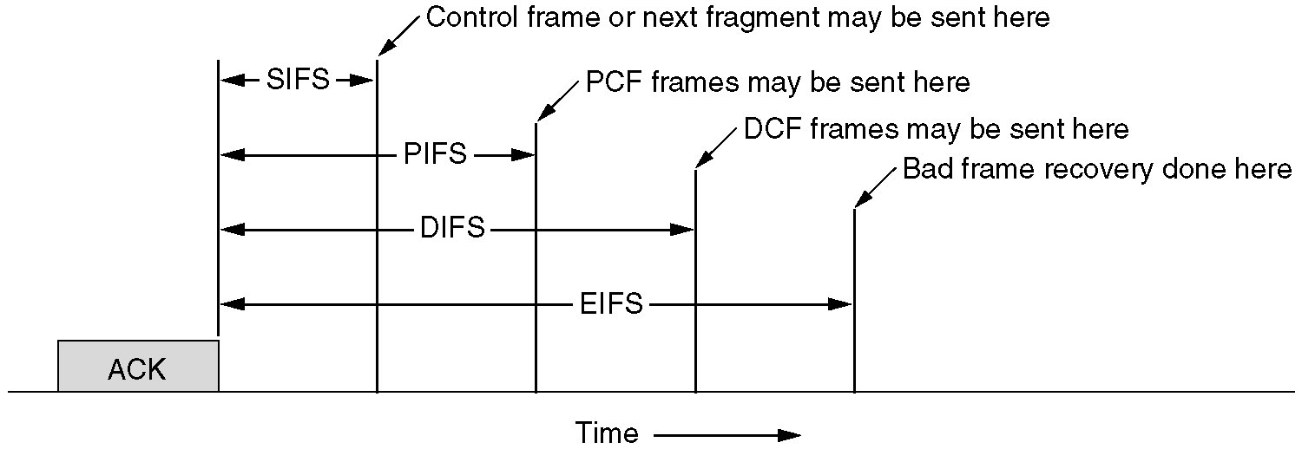
Figure 4-29. Inter-frame Spacing in 802.11.

Slide 108
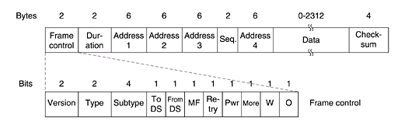
802.11 Frame Structure

Slide 109
Frame Control: It contains 11 sub fields.
Version: which allows two version of protocol to operate at same time in a same cell
Type: It can be data , control or management.
Sub type: RTS or CTS.
To DS & From DS: These bits indicates the frame is going to or coming from the inter cell distribution system(e.g Ethernet)
MF: more fragments will follow
Retry: marks a retransmission of a frame sent earlier

Slide 110
8.Power management: It is used by station to put ‘r’ into sleep & take it out of sleep.
9.More: ‘s’ has additional frames for ‘r’
10. W: Frame body has encrypted using WEP(Wired Equivalent Privacy)
11.O: It tells ‘r’ that sequence of frames with this bit “on” must be processed strictly in order.

Slide 111
Duration:
It tells how long the frame & its ack will occupy the channel.
Address1 to 4:
Source & destination are obviously needed, the other 2 addresses are used for source & destination base stations for intercell traffic(i.e frames may enter or leave a cell via BS)
Sequence: allows fragments to be numbered.
Out of 16 bits,12 identify frame, 4 identify fragment

Slide 112
Data field contains payload upto 2312 bytes followed by checksum.
Management frames have same format as that of data frames, except without one of BS addresses because management frames are restricted to single cell.
Control fields will have only one or two addresses, no data field, no sequence field. The key information is in sub-type field, usually RTS, CTS, or ACK.

Slide 113
Services of 802.11
The five distribution services are provided by the Base station and deals with station mobility as ther enter and leave cells.
They are:
1.Association:
This is used by MS to connect themselves to BS.
When MS moves within the radio range of BS, it announces it’s identity and capabilities(data rates supported, need for PCF service, power management requirements).
The BS may accept or reject the MS. If the MS is accepted, it must then authenticate itself.

Slide 114
2. Disassociation:
Either the station or BS may disassociate, thus breaking the relationship.
A station should use this service before shutting down or leaving, but the BS may also use it before going down for maintenance.
3. Reassociation:
A station may change its preferred BS using this service.
This facility is useful for MSs moving from one cell to another

Slide 115
The remaining four services are intracell.
Authentication
Deauthentication
Privacy
Data Delivery

Slide 116
Bridges
Means to interconnect individual LANs
Operate at the data link layer
Reasons for bridges:
(1)autonomous divisions (2) different buildings (3) logical grouping (4) physical distance (5) Reliability (6) Security( due to Promiscuous mode)
Issues in bridging different LANs:
(i) Different frame format (ii) different data rates (iii) Timers at higher layers (iv) different maximum frame lengths

Slide 117
Bridges
Multiple LANS can be connected by devices called bridges.
If a bridge is added or detected from the system, reconfiguration of the stations is unnecessary(It means that bridges should be fully transparent).

Slide 118

Bridges
Bridge
A
C
LANs can be connected by devices called bridges, which operate in the data link layer. Bridges do not examine the network layer header.

Slide 119
Bridges
Router
A
C
Router
In contrast, a router examines network layer headers.

Slide 120
Why a single organization may end up with multiple LANs? (to need bridges)
1. Autonomy of departments to choose their own types of LANs
2. Cheaper to have separate LANs than to run a single large LANs
3. Load splitting
4. Physical distance is too great. (For example, >2.5km in 802.3)
5. More reliable
6. More secure

Slide 121
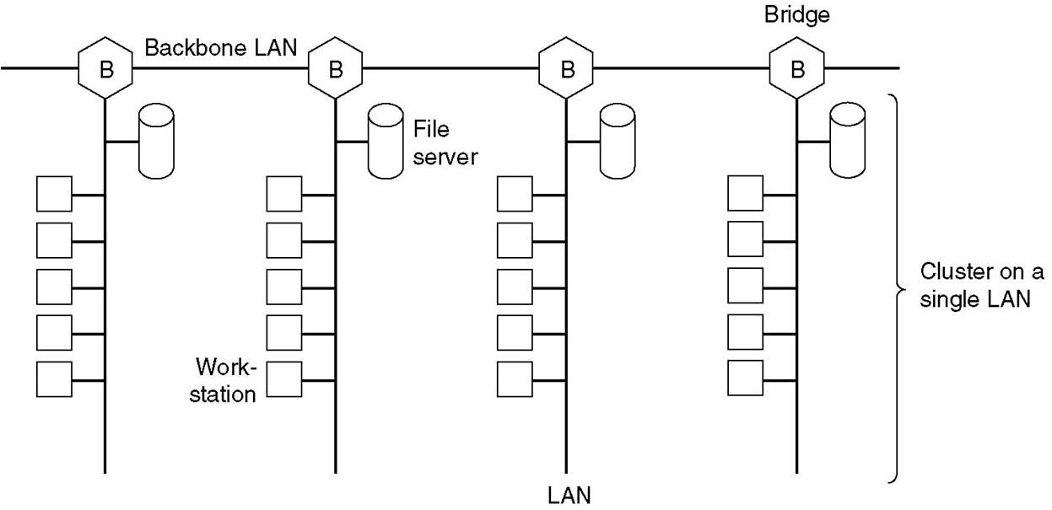
Fig. Multiple LANs connected by a backbone to handle a total load
higher than the capacity of a single LAN.

Slide 122
Bridges
802.x→802.3: Destination LAN heavily loaded
802.4→802.3: Priority vs no priority; ACK bit;
Similar problems for others

Slide 123
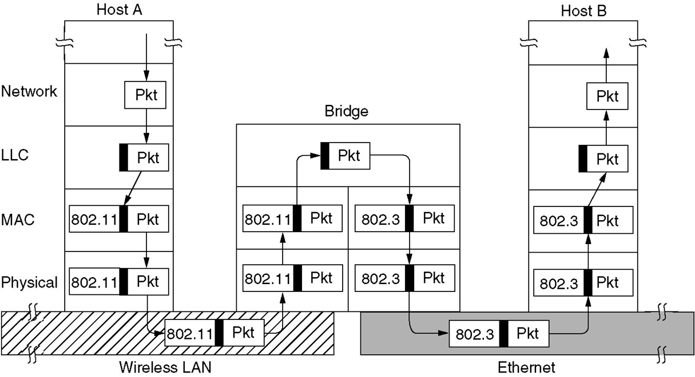
Operation of a LAN bridge from 802.11 to 802.3.

Slide 124
Bridges from 802.x to 802.y
You might naively think that a bridge from 802 LAN to another one would be completely trivial. Such is not the case. Each of the nine combinations of 802.x to 802.y has its own unique set of problems.
General problems:
1. Different frame format
2. Different data rate
3. Different maximum frame length

Slide 125
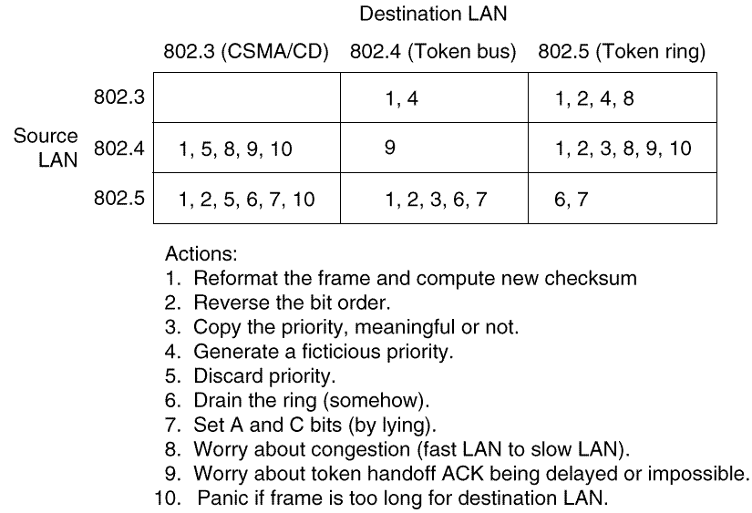
Bridges from 802.x to 802.y

Slide 126
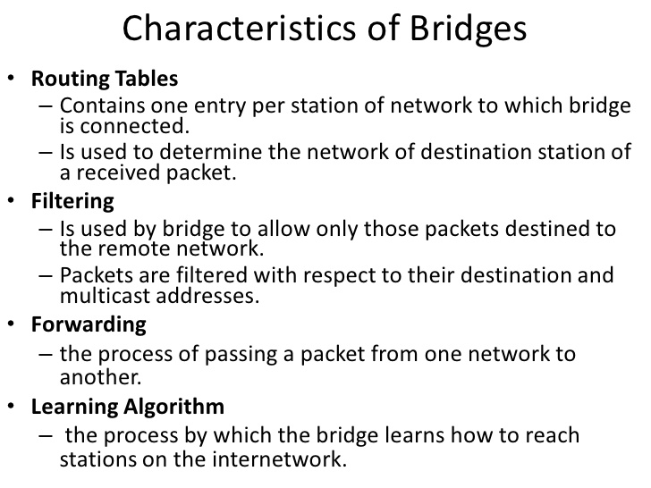

Slide 127
TRANSPARENT BRIDGES
When a frame arrives, a bridge must decide whether to discard or forward it.
Each bridge contains hash tables specifying that destination address.
The table can list each possible destination and tell which output line it belongs on.
When the bridges are first plugged in. all the hash tables are empty.
Few days back they are using flooding algorithm for bridges.
Every incoming frame for an unknown destination is output on all the LANs to which the bridge is connected except the one it arrived on.
The algorithm used by the transparent bridges is Backward-learning ,based on source address bridges can tell which machine is accessible on which LAN.

Slide 128
3 rules for forwarding the frame.
If destination and source LANs are the same discard the frame.
If destination and source LANs are different , forward the frame.
If the destination LAN is unknown, use flooding.

Slide 129
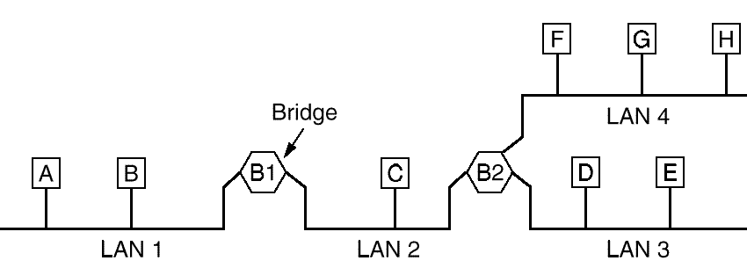
Transparent Bridges
Plug and play bridge
When a frame arrives, a bridge must decide whether to discard or forward it, and if the latter, on which LAN to put the frame. The decision is made by looking up the destination address in a big (hash) table inside the bridge.

Slide 130
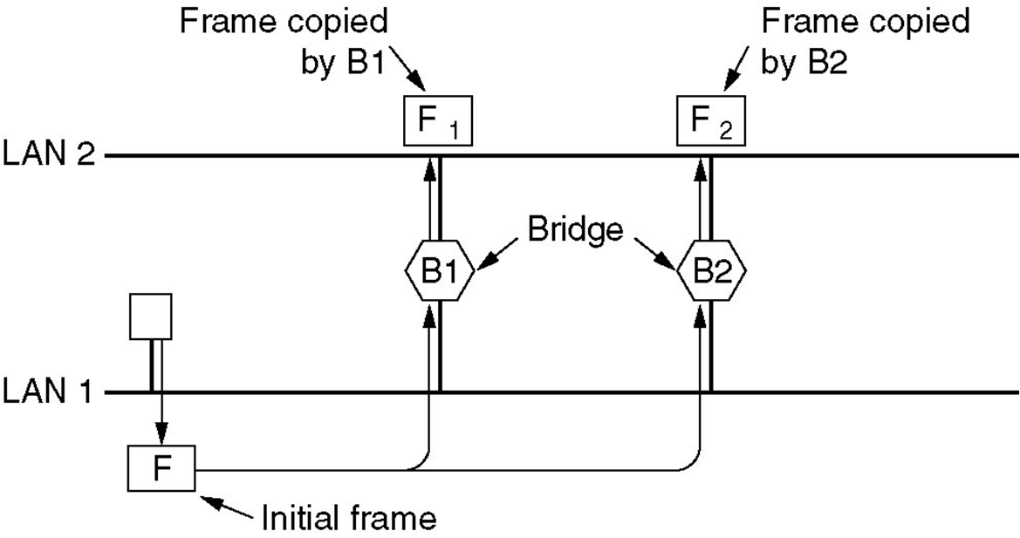
Two parallel transparent bridges

Slide 131
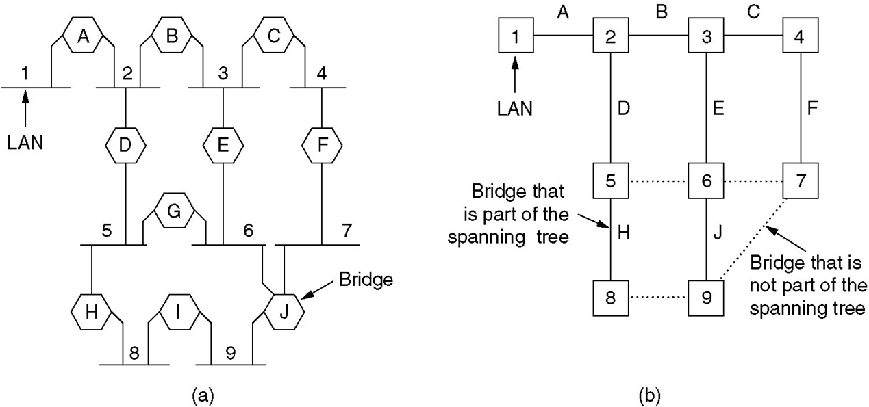
SPANNING TREE BRIDGES
(a) Interconnected LANs. (b) A spanning tree covering the LANs. The dotted lines are not part of the spanning tree.

Slide 132
Spanning Tree Bridges
To build the spanning tree, first the bridges have to choose one bridge to be the root of the tree. They make this choice by having each one broadcast its serial number, installed by the manufacturer, and guaranteed to be unique worldwide. The bridge with the lowest serial number becomes the root. Next, a tree of shortest paths from the root to every bridge and LAN is constructed.

Slide 133
Source Routing Bridges
CSMA/CD and token bus accepted transparent bridges
The token ring community went for source routing bridges
Here, the source determines the path that a message should take
When a destination is unknown, the source issues a discovery frame which is forwarded to every LAN on the internetwork. When the reply comes back, the bridges record their identity in it, so the original sender can know the path.

Slide 134
A source routing bridge is only interested in those frames with the high-order bit of the destination set to 1.
For each such frame, it scans the route looking for the number of the LAN on which the frame arrived.
If this LAN number is followed by its own bridge number, the bridge forwards the frame onto the LAN whose number follows its bridge number in the route.

Slide 135
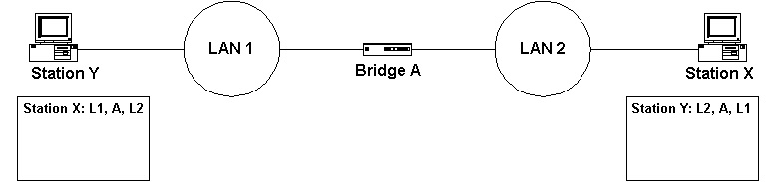

Slide 136
Source routing assumes that the sender of each frame knows whether or not the destination is on its own LAN. When sending a frame to a different LAN, the source machine sets the high-order bit of the destination address to 1, to mark it. Furthermore, it includes in the frame header the exact path that the frame will follow.

Slide 137
Three possible implementations:
1. Software: the bridge runs in promiscuous mode, copying all frames to its memory to see if they have the high-order destination bit set to 1. If so, the frame is inspected further.
2. Hybrid: the bridge’s LAN interface inspects the high-order destination bit and only accepts frame with the bit set. This interface is easy to build into hardware and greatly reduces the number of frames the bridge must inspect.

Slide 138
3. Hardware: the bridge’s LAN interface not only checks the high-order destination bit, but it also scans the route to see if this bridge must do forwarding. Only frames that must actually be forwarded are given to the bridge. This implementation requires the most complex hardware but wastes no bridge CPU cycles because all irrelevant frames are screened out.

Slide 139
Implicit in the design of source routing bridge is that every machine in the internetwork knows, or can find, the best path to every other machine. How these routes are discovered is an important part of the source routing bridge.
The basic idea is that if a destination is unknown, the source issues a broadcast frame asking where it is. This discovery frame is forwarded by every bridge so that it reaches every LAN on the internetwork. When the reply comes back, the bridges record their identity in it, so that the original sender can see the exact route taken and ultimately choose the best route.

Slide 140
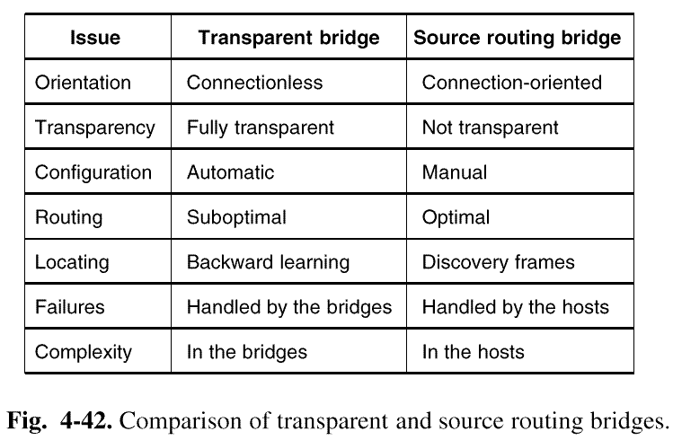
4.4.4 Comparison of 802 Bridges

Slide 141
Remote Bridges
Used when individual LANs are far apart
In this case bridges on each LAN are connected via point-to-point links

Slide 142
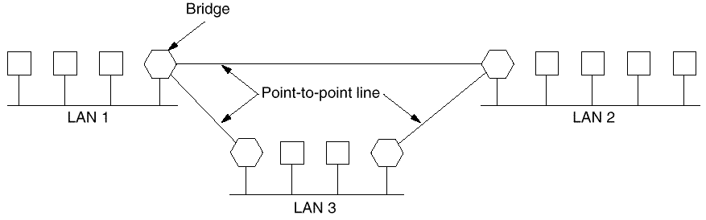
Remote Bridges
Point to point protocol used between bridges( 2 options):
Choose some standard point-to-point data link protocol i.e, PPP, putting complete MAC frames in the payload field (best if all LANs are identical)
2. Strip off the MAC header and trailer at source bridge, put what is left in the payload field of PPP. A new MAC header and trailer can be generated at the destination bridge(can not catch errors caused by bad bridge memory)

