Slide 1
Data Mining:
Concepts and Techniques

Slide 2
Cluster Analysis
What is Cluster Analysis?
Types of Data in Cluster Analysis
A Categorization of Major Clustering Methods
Partitioning Methods
Hierarchical Methods
Density-Based Methods
Grid-Based Methods
Model-Based Clustering Methods
Outlier Analysis
Summary

Slide 3
What is Cluster Analysis?
  The process of grouping a set of physical or abstract objects into classes of similar objects is called clustering.
  A Cluster is a collection of data objects that are similar to one another within the same cluster and are dissimilar to the objects in other cluster.
  A cluster of data objects can be treated collectively as one group in many applications
  Clustering has its roots in many areas, including data mining, statistics, biology and machine learning.

Slide 4
What is Cluster Analysis?
  Cluster analysis is an important human activity. Earlier in childhood, one learns how to distinguish between cats and dogs, or between animals and plants, by continuous improving subconscious clustering schemes.
  Cluster analysis is widely used in numerous applications, including pattern recognition, data analysis, image processing, and market research.
  By clustering one can identify dense and sparse regions, and therefore, discover overall distribution patterns and interesting correlations among data attributes

Slide 5
What are some applications of Clustering
  In business clustering can help marketers discover distinct groups in their customer bases and characterize customer groups based on purchasing patterns.
  In biology, it can be used to derive plant and animal taxonomies, categorize genes with similar functionality.
  Clustering may also help in the identification of areas of land use in an earth observation database, and in the identification of groups of automobile insurance policy holders with a high average claim cost

Slide 6
  As a data mining function, cluster analysis can be used as a stand alone tool to gain insight into the distribution of data, to observe the characteristics of each cluster, and to focus on a particular set of clusters for further analysis.
  Alternatively it may serve as a preprocessing step for other algorithms, such as characterization and classification.

Slide 7
Clustering
Some of the software packages which implement clustering are S-Plus, SPSS and SAS.
In machine learning, clustering is an example of unsupervised learning.
For this reason clustering is a form of learning by observation, rather than learning by examples.
In conceptual clustering, a group of objects forms a class only if it is describable by concept. This differs from conventional clustering, which measures similarity based on geometric distance.
Conceptual clustering consists of two components : 1) it discovers the appropriate classes, and 2) it forms descriptions for each class, as in classification.

Slide 8
General Applications of Clustering
Pattern Recognition
Spatial Data Analysis
  create thematic maps in GIS by clustering feature spaces
  detect spatial clusters and explain them in spatial data mining
Image Processing
Economic Science (especially market research)
WWW
  Document classification
  Cluster Weblog data to discover groups of similar access patterns

Slide 9
Examples of Clustering Applications
Marketing: Help marketers discover distinct groups in their customer bases, and then use this knowledge to develop targeted marketing programs
Land use: Identification of areas of similar land use in an earth observation database
Insurance: Identifying groups of motor insurance policy holders with a high average claim cost
City-planning: Identifying groups of houses according to their house type, value, and geographical location
Earth-quake studies: Observed earth quake epicenters should be clustered.

Slide 10
What Is Good Clustering?
A good clustering method will produce high quality clusters with
  high intra-class similarity
  low inter-class similarity
The quality of a clustering result depends on both the similarity measure used by the method and its implementation.
The quality of a clustering method is also measured by its ability to discover some or all of the hidden patterns.

Slide 11
Requirements of Clustering in Data Mining
Scalability : Many clustering algorithms work well on small data sets containing fewer than 200 data objects, however, a large database may contain millions of objects. Clustering on a sample of a given large data set may lead to biased results. High scalable clustering algorithms are needed
Ability to deal with different types of attributes : Many algorithms are designed to cluster interval-based (numerical) data. However, applications may require clustering other types of data, such as binary, categorical (nominal), and ordinal data, or mixtures of these data types

Slide 12
Discovery of clusters with arbitrary shape : Many clustering algorithms determine clusters based on Euclidean or Manhattan distance measures. Algorithms based on such distance measures tend to find spherical clusters with similar size and density. However, a cluster could be of any shape. It is important to develop algorithms that can detect clusters of arbitrary shape.
Minimal requirements for domain knowledge to determine input parameters : Many clustering algorithms require users to input certain parameters in cluster analysis (such as the number of desired clusters). The clustering results can be quite sensitive to input parameters

Slide 13
Able to deal with noise and outliers : Most real – world databases contain outliers or missing or unknown or erroneous data. Some clustering algorithms are sensitive to such data and may lead clusters of poor quality.
Insensitive to order of input records : Some clustering algorithms are sensitive to the order of input data; for example the same set of data, when presented with different orderings to such an algorithm, may generate dramatically different clusters. It is important to develop algorithms that are insensitive to the order of input.

Slide 14
High dimensionality : A database or a data warehouse can contain several dimensions or attributes. Many clustering algorithms are good at handling low dimensional data, involving only two or three dimensions. Human eyes are good at judging the quality of clustering for up to three dimensions. It is challenging to cluster data objects in high dimensional space, especially considering that such data can be very sparse and highly skewed (misleading data).

Slide 15
Constraint-based clustering : Real world application may need to perform clustering under various constraints. Suppose that your job is to choose the locations for a given number of new automatic cash dispensing machines (i.e. ATMS) in a city. To decide upon this, you may cluster households while considering constraints such as the city’s rivers, highway networks, and customer requirements per region. A challenging task to find groups of data with good clustering behavior that satisfy specified constraints

Slide 16
Interpretability and usability : Users expect clustering results to be interpretable, comprehensive, and usable. That is clustering may need to tied up with specific semantic interpretations and applications. It is important to study how an application goal may influence the selection of clustering methods.

Slide 17
What is Cluster Analysis?
Cluster: a collection of data objects
  Similar to one another within the same cluster
  Dissimilar to the objects in other clusters
Cluster analysis
  Grouping a set of data objects into clusters
Clustering is unsupervised classification: no predefined classes
Typical applications
  As a stand-alone tool to get insight into data distribution
  As a preprocessing step for other algorithms

Slide 18
Cluster Analysis
What is Cluster Analysis?
Types of Data in Cluster Analysis
A Categorization of Major Clustering Methods
Partitioning Methods
Hierarchical Methods
Density-Based Methods
Grid-Based Methods
Model-Based Clustering Methods
Outlier Analysis
Summary

Slide 19
Types of Data in Cluster Analysis
we study the types of data that often occur in cluster analysis and how to preprocess them for such analysis
Suppose that a data set to be clustered contains n objects, which may represent persons, houses, documents, countries, and so on.
Main memory – based clustering algorithms typically operate on either of the following two data structures.
Data Matrix (or object by variable structure)
Dissimilarity Matrix (or object by object structure)

Slide 20
Data Matrix (or object by variable structure)
This represents n objects, such as persons, with p variables (also called measurements or attributes), such as age, height, weight, gender, race and so on. The structure is in the form of a relational table, or n-by-p matrix (n objects x p variables)
The Data Matrix is often called a two-mode matrix, since the rows and columns of this represent the different entities.

Slide 21

Data Structures
Data matrix
  (two modes)

Slide 22
Dissimilarity Matrix (or object by object structure) : This stores a collection of proximities that are available for all pairs of n objects. It is often represented by a n – by – n table, where d(i,j) is the measured difference or dissimilarity between objects i and j. In general, d(i,j) is a nonnegative number that is close to 0 when objects i and j are higher similar or “near” each other and becomes larger the more they differ. Since d(i,j) = d(j,i) and d(i,i) =0, we have the matrix in figure.
This is also called as one mode matrix since the rows and columns of this represent the same entity.

Slide 23

Data Structures
Dissimilarity matrix
  (one mode)

Slide 24
Measure the Quality of Clustering
Dissimilarity/Similarity metric: Similarity is expressed in terms of a distance function, which is typically metric: d(i, j)
There is a separate “quality” function that measures the “goodness” of a cluster.
The definitions of distance functions are usually very different for interval-scaled, boolean, categorical, ordinal and ratio variables.
Weights should be associated with different variables based on applications and data semantics.
It is hard to define “similar enough” or “good enough”
  the answer is typically highly subjective.

Slide 25
Type of data in clustering analysis
Interval-scaled variables:
Binary variables:
Nominal, ordinal, and ratio variables:
Variables of mixed types:

Slide 26
Interval-valued variables
“What are interval-scaled variables?” Interval-scaled variables are continuous measurements of a roughly linear scale.
Typical examples include weight and height, latitude and longitude coordinates (e.g., when clustering houses), and weather temperature.
The measurement unit used can affect the clustering analysis. For example, changing measurement units from meters to inches for height, or from kilograms to pounds for weight, may lead to a very different clustering structure.

Slide 27
Interval-valued variables
In general, expressing a variable in smaller units will lead to a larger range for that variable, and thus a larger effect on the resulting clustering structure.
To help avoid dependence on the choice of measurement units, the data should be standardized. Standardizing measurements attempts to give all variables an equal weight.
This is particularly useful when given no prior knowledge of the data. However, in some applications, users may intentionally want to give more weight to a certain set of variables than to others.
For example, when clustering basketball player candidates, we may prefer to give more weight to the variable height.

Slide 28


Interval-valued variables
Standardize data
  Calculate the mean absolute deviation:
  where
  Calculate the standardized measurement (z-score)
Using mean absolute deviation is more robust than using standard deviation

Slide 29


Similarity and Dissimilarity Between Objects
Distances are normally used to measure the similarity or dissimilarity between two data objects
Some popular ones include: Minkowski distance:
  where i = (x_{i1}, x_{i2}, …, x_{ip}) and j = (x_{j1}, x_{j2}, …, x_{jp}) are two p-dimensional data objects, and q is a positive integer
d is Manhattan (or City Block) distance

Slide 30

Similarity and Dissimilarity Between Objects (Cont.)
d is Euclidean distance:
Both the Euclidean distance and Manhattan distance satisfy the following mathematic requirements of a distance function:
    d(i,j) ≥ 0
    d(i,i) = 0
    d(i,j) = d(j,i)
    d(i,j) ≤ d(i,k) + d(k,j)
Also one can use weighted distance, parametric Pearson product moment correlation, or other disimilarity measures.

Slide 31
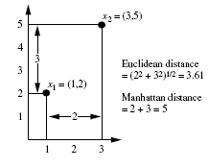
Example
Euclidean distance and Manhattan distance.
Let x1 = (1, 2) and x2 = (3, 5) represent two objects as in Figure . The Euclidean distance between the two is = 3.61.
The Manhattan distance between the two is 2+3 = 5.

Slide 32



Binary Variables
A contingency table for binary data
P= a+b+c+d
Simple matching coefficient (invariant, if the binary variable is symmetric):
Jaccard coefficient (noninvariant if the binary variable is asymmetric):
Object j
Object i

Slide 33


Dissimilarity between Binary Variables
Example
  gender is a symmetric attribute
  the remaining attributes are asymmetric binary
  let the values Y and P be set to 1, and the value N be set to 0

Slide 34

Nominal Variables or Categorical Variables
A generalization of the binary variable in that it can take more than 2 states, e.g., red, yellow, blue, green
Method 1: Simple matching
The dissimilarity between two objects i and j can be computed based on the Simple matching
m: # of matches (i.e., the number of variables for which i and j are in the same state), p: total # of variables
Method 2: use a large number of binary variables
  creating a new binary variable for each of the M nominal states

Slide 35


Ordinal Variables
An ordinal variable can be discrete or continuous
order is important, e.g., rank
Can be treated like interval-scaled
  replacing x_{if} by their rank
  map the range of each variable onto [0, 1] by replacing i-th object in the f-th variable by
  compute the dissimilarity using methods for interval-scaled variables

Slide 36
Ratio-Scaled Variables
Ratio-scaled variable: a positive measurement on a nonlinear scale, approximately at exponential scale, such as Ae^{Bt} or Ae^{-Bt}
Methods:
  treat them like interval-scaled variables — not a good choice! (why?)
  apply logarithmic transformation
y_{if} = log(x_{if})
  treat them as continuous ordinal data treat their rank as interval-scaled.

Slide 37


Variables of Mixed Types
A database may contain all the six types of variables
  symmetric binary, asymmetric binary, nominal, ordinal, interval and ratio.
One may use a weighted formula to combine their effects.
  f is binary or nominal:
    d_{ij}^{(f)} = 0 if x_{if} = x_{jf} , or d_{ij}^{(f)} = 1 o.w.
  f is interval-based: use the normalized distance
  f is ordinal or ratio-scaled
    compute ranks r_{if} and
    and treat z_{if} as interval-scaled

Slide 38
Cluster Analysis
What is Cluster Analysis?
Types of Data in Cluster Analysis
A Categorization of Major Clustering Methods
Partitioning Methods
Hierarchical Methods …x
Density-Based Methods
Grid-Based Methods
Model-Based Clustering Methods
Outlier Analysis
Summary

Slide 39
Major Clustering Approaches
Partitioning algorithms: Construct various partitions and then evaluate them by some criterion
Hierarchy algorithms: Create a hierarchical decomposition of the set of data (or objects) using some criterion
Density-based: based on connectivity and density functions
Grid-based: based on a multiple-level granularity structure
Model-based: A model is hypothesized for each of the clusters and the idea is to find the best fit of that model to each other

Slide 40
Cluster Analysis
What is Cluster Analysis?
Types of Data in Cluster Analysis
A Categorization of Major Clustering Methods
Partitioning Methods
Hierarchical Methods
Density-Based Methods
Grid-Based Methods
Model-Based Clustering Methods
Outlier Analysis
Summary

Slide 41
Partitioning methods:
Given a database of n objects or data tuples, a partitioning method constructs k partitions of the data, where each partition represents a cluster and k <= n.
That is, it classifies the data into k groups, which together satisfy the following requirements
1. Each group must contain at least one object,
2. Each object must belong to exactly one group.
Notice that the second requirement can be relaxed in some fuzzy partitioning techniques.

Slide 42
Given k, the number of partitions to construct, a partitioning method creates an initial partition.
It uses iterative relocation technique that attempts to improve the partitioning by moving objects from one group to another.
The general criterion of a good partitioning is that object in the same cluster are “close” or related to each other, whereas objects of different clusters are “far apart” or very different.
There are various kinds of other criteria for judging the quality of partitions

Slide 43
To achieve global optimality in partitioning – based clustering would require the exhaustive enumeration of all the possible partitions.
1) The k-means algorithm, where each cluster is represented by the mean value of the objects in the cluster and
2) the k-medoids algorithm, where each cluster is represented by one of the objects located near the center of the cluster.
The heuristic clustering methods work well for finding spherical-shaped clusters in small to medium databases
To find clusters with complex shapes and for clustering very large data sets, partitioning based methods need to be extended.

Slide 44
Partitioning Algorithms: Basic Concept
Partitioning method: Construct a partition of a database D of n objects into a set of k clusters
Given a k, find a partition of k clusters that optimizes the chosen partitioning criterion
  Global optimal: exhaustively enumerate all partitions
  Heuristic methods: k-means and k-medoids algorithms
  k-means (MacQueen’67): Each cluster is represented by the center of the cluster
  k-medoids or PAM (Partition around medoids) (Kaufman & Rousseeuw’87): Each cluster is represented by one of the objects in the cluster

Slide 45
How does the K-Means algorithm work
First, it randomly selects k of the objects, each of which initially represents a cluster mean or center.
For each of the remaining objects, an object is assigned to the cluster to which it is the most similar, based on the distance between the object and the cluster mean.
It then computes the new mean for each cluster. This process iterates until the criterion function converges

Slide 46
Algorithm : k-means. The k-means algorithm for partitioning based on the mean value of the objects in the cluster.
Input : The number of clusters k and a database containing n objects
Output : A set of k clusters that minimizes the squared – error condition
Method:
1) Arbitrarily choose k object as the initial cluster centers
2) Repeat
3) (re)assign each object to the cluster to which the object is the most similar based on the mean value of the objects in the cluster;
4) Update the cluster means, i.e. calculate the mean value of the objects for each cluster;
5) Unitil no change ;

Slide 47

The K-Means Clustering Method
Given k, the k-means algorithm is implemented in 4 steps:
  Partition objects into k nonempty subsets
  Compute seed points as the centroids of the clusters of the current partition. The centroid is the center (mean point) of the cluster.
  Assign each object to the cluster with the nearest seed point.
  Go back to Step 2, stop when no more new assignment.
where E is the sum of the square error for all objects in the data set; p is the point in space representing a given object; and mi is the mean of cluster Ci (both p and mi are multidimensional). In other words, for each object in each cluster, the distance from the object to its cluster center is squared, and the distances are summed. This criterion tries to make the resulting k clusters as compact and as separate as possible.

Slide 48
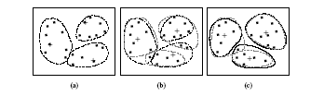
The K-Means Clustering Method
Example

Slide 49
Suppose that there is a set of objects located in space as depicted in the rectangle.
Let k =3; i.e. the user would like to cluster the object into three clusters.
According to the algorithm, we arbitrarily choose three objects as the three initial cluster centers, were cluster centers are marked by a “+”.
Each object is distributed to a cluster based on the cluster center to which it is the nearest.
Such a distribution forms circled by dotted curves.

Slide 50
Comments on the K-Means Method
Strength
  Relatively efficient: O(tkn), where n is # objects, k is # clusters, and t is # iterations. Normally, k, t << n.
Weakness
  Applicable only when mean is defined, then what about categorical data?
  Need to specify k, the number of clusters, in advance
  Unable to handle noisy data and outliers
  Not suitable to discover clusters with non-convex shapes

Slide 51
Variations of the K-Means Method
A few variants of the k-means which differ in
  Selection of the initial k means
  Dissimilarity calculations
  Strategies to calculate cluster means
Handling categorical data: k-modes (Huang’98)
  Replacing means of clusters with modes
  Using new dissimilarity measures to deal with categorical objects
  Using a frequency-based method to update modes of clusters
  A mixture of categorical and numerical data: k-prototype method

Slide 52
What is the problem of k-Means Method?
The k-means algorithm is sensitive to outliers !
  Since an object with an extremely large value may substantially distort the distribution of the data.
K-Medoids: Instead of taking the mean value of the object in a cluster as a reference point, medoids can be used, which is the most centrally located object in a cluster.
10
10
9
9
8
8
7
7
6
6
5
5
4
4
3
3
2
2
1
1
0
0
1
2
3
4
5
6
7
8
9
10
0
0
1
2
3
4
5
6
7
8
9
10

Slide 53
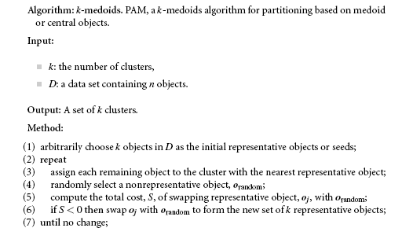
The K-Medoids Clustering Method
A medoid can be defined as that object of a cluster, whose average dissimilarity to all the objects in the cluster is minimal i.e. it is a most centrally located point in the given data set.

Slide 54
The basic strategy of k-medoids clustering algorithms is to find k clusters in n objects by first arbitrarily finding a representative object (the medoid) for each cluster.
Each remaining object is clustered with the medoid to which it is most similar.
The strategy then iteratively replaces one of the medoids by one of the non medoids as long as the quality of the resulting clustering is improved.
This quality is estimated by using a cost function that measures the average dissimilarity between an object and the medoid of its cluster.
To determine whether a nonmedoid object o random is a good replacement for a current medoid oj, the following four cases are examined for each of the nonmedoid objects p.

Slide 55
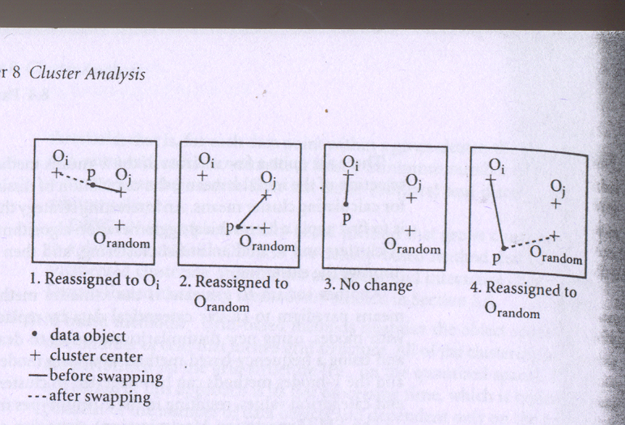

Slide 56
Case 1 : p currently belongs to medoid oj, If oj is replaced by orandom, as a medoid and p is closest to one of oi, I does not belong j, then p is assigned to oi.
Case 2 : p currently belongs to medoid oj. If oj is replaced by orandom as medoid and p is closest to orandom, then p is reassigned to orandom
Case 3 : p currently belongs to medoid oi, I does not belong j. If oj is replaced by o random as a medoid and p is still closest to oi, then the assignment does not change
Case 4 : p currently belongs to medoid oi, I does not belong to j. If oj is replaced by o random as a medoid and p is closest to o random, then p is reassigned to o random.

Slide 57

Typical k-medoids algorithm (PAM)
Total Cost = 20
10
9
8
Arbitrary choose k object as initial medoids
Assign each remaining object to nearest medoids
7
6
5
4
3
2
1
0
0
1
2
3
4
5
6
7
8
9
10
K=2
Randomly select a nonmedoid object,O_{ramdom}
Total Cost = 26
Do loop
Until no change
10
10
9
Compute total cost of swapping
9
Swapping O and O_{ramdom}
If quality is improved.
8
8
7
7
6
6
5
5
4
4
3
3
2
2
1
1
0
0
1
2
3
4
5
6
7
8
9
10
0
0
1
2
3
4
5
6
7
8
9
10

Slide 58
Each time a reassignment occurs, a difference in square error E is contributed to the cost function.
Therefore the cost function calculates the difference in square error value if a current medoid is replaced by nonmedoid object.
The total cost of swapping the sum of costs incurred by all nonmedoid objects.
If the total cost is negative, then oj is replaced or swapped with o random since the actual square – error E would be reduced.
If the total cost is positive, the current medoid oj is considered acceptable, and nothing is change in iteration.

Slide 59
“Which method is more robust—k-means or k-medoids?”
The k-medoids method is more robust than k-means in the presence of noise and outliers, because a medoid is less influenced by outliers or other extreme values than a mean. However, its processing is more costly than the k-means method. Both methods require the user to specify k, the number of clusters.
Aside from using the mean or the medoid as a measure of cluster center, other alternative measures are also commonly used in partitioning clustering methods. The median can be used, resulting in the k-median method, where the median or “middle value” is taken for each ordered attribute. Alternatively, in the k-modes method, the most frequent value for each attribute is used.

Slide 60
Partitioning Methods in Large Databases:
From k-Medoids to CLARANS
“How efficient is the k-medoids algorithm on large data sets?”
A typical k-medoids partitioning algorithm like PAM works effectively for small data sets, but does not scale well for large data sets. To deal with larger data sets, a sampling-based method, called CLARA (Clustering LARge Applications), can be used.
The idea behind CLARA is as follows: Instead of taking the whole set of data into consideration, a small portion of the actual data is chosen as a representative of the data.
Medoids are then chosen from this sample using PAM (partitioning around medoids).
If the sample is selected in a fairly random manner, it should closely represent the original data set.

Slide 61
The representative objects (medoids) chosen will likely be similar to those that would have been chosen from the whole data set. CLARA draws multiple samples of the data set, applies PAM on each sample, and returns its best clustering as the output. As expected, CLARA can deal with larger data sets than PAM.
The complexity of each iteration now becomes O(ks2+k(n-k)) where s is the size of the sample, k is the number of clusters, and n is the total number of objects.
The effectiveness of CLARA depends on the sample size.

Slide 62
“How might we improve the quality and scalability of CLARA?” A k-medoids type algorithm called CLARANS (Clustering Large Applications based upon RANdomized Search) was proposed, which combines the sampling technique with PAM.
However, unlike CLARA, CLARANS does not confine itself to any sample at any given time. While CLARA has a fixed sample at each stage of the search, CLARANS draws a sample with some randomness in each step of the search. Conceptually, the clustering process can be viewed as a search through a graph, where each node is a potential solution (a set of k medoids).The clistering obtained after replacing a single mediods is called the neighbor of the currrent clustering.

Slide 63
CLARANS has been experimentally shown to be more effective than both PAM and CLARA. I
It can be used to find the most “natural” number of clusters using a silhouette coefficient—a property of an object that specifies how much the object truly belongs to the cluster.
CLARANS also enables the detection of outliers. However, the computational complexity of CLARANS is about O(n2), where n is the number of objects.
Furthermore, its clustering quality is dependent on the sampling method used.
The ability of CLARANS to deal with data objects that reside on disk can be further improved by focusing techniques that explore spatial data structures, such as R*-trees.

Slide 64
Cluster Analysis
What is Cluster Analysis?
Types of Data in Cluster Analysis
A Categorization of Major Clustering Methods
Partitioning Methods
Hierarchical Methods
Density-Based Methods
Grid-Based Methods
Model-Based Clustering Methods
Outlier Analysis
Summary

Slide 65
Hierarchical Method
A hierarchical clustering method works by grouping data objects into a tree of clusters.
Hierarchical clustering methods can be further classified into agglomerative and divisive hierarchical clustering, depending on whether the hierarchical decomposition is formed in a bottom up or top down fashion.
Agglomerative hierarchical clustering : This bottom up strategy starts by placing each object in its own cluster and then merges these atomic clusters into larger and larger clusters, until all of the objects are in a single cluster or until certain termination conditions are satisfied.

Slide 66
Divisive hierarchical clustering : This top down strategy does the reverse of agglomerative clustering by starting with all objects in one cluster.
It subdivides the cluster into smaller and smaller pieces, until each object forms a cluster on its own or until it satisfies certain termination conditions such as a desired number of clusters is obtained or the distance between the two closest clusters is above a certain threshold distance.

Slide 67
Hierarchical Clustering
Use distance matrix as clustering criteria. This method does not require the number of clusters k as an input, but needs a termination condition
Step 0
Step 1
Step 2
Step 3
Step 4
agglomerative
(AGNES)
a
a b
b
a b c d e
c
c d e
d
d e
e
divisive
(DIANA)
Step 4
Step 3
Step 2
Step 1
Step 0

Slide 68
Data set of five objects, fa, b, c, d, eg. Initially, AGNES places each object into a cluster of its own.
The clusters are then merged step-by-step according to some criterion.
For example, clusters C1 and C2 may be merged if an object in C1 and an object in C2 form the minimum Euclidean distance between any two objects from different clusters.
This is a single-linkage approach in that each cluster is represented by all of the objects in the cluster, and the similarity between two clusters is measured by the similarity of the closest pair of data points belonging to different clusters.
The cluster merging process repeats until all of the objects are eventually merged to form one cluster.

Slide 69
In DIANA, all of the objects are used to form one initial cluster.
The cluster is split according to some principle, such as the maximum Euclidean distance between the closest neighboring objects in the cluster.
The cluster splitting process repeats until, eventually, each new cluster contains only a single object.

Slide 70
In either agglomerative or divisive hierarchical clustering, the user can specify the desired number of clusters as a termination condition.
A tree structure called a dendrogram is commonly used to represent the process of hierarchical clustering.
It shows how objects are grouped together step by step.
Figure shows a dendrogram for the five objects presented in previous Fig, where l = 0 shows the five objects as singleton clusters at level 0.
At l = 1, objects a and b are grouped together to form the first cluster, and they stay together at all subsequent levels.

Slide 71
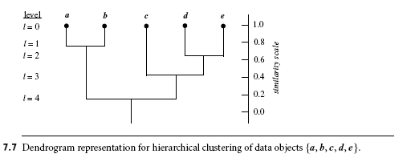
We can also use a vertical axis to show the similarity scale between clusters. For example, when the similarity of two groups of objects, {a, b} and {c, d, e} is roughly 0.16, they are merged together to form a single cluster.

Slide 72
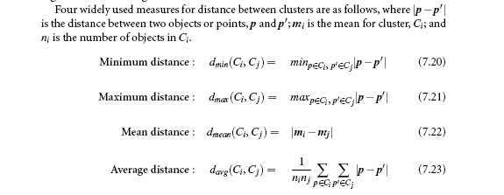

Slide 73

AGNES (Agglomerative Nesting)
Introduced in Kaufmann and Rousseeuw (1990)
Implemented in statistical analysis packages, e.g., Splus
Use the Single-Link method and the dissimilarity matrix.
Merge nodes that have the least dissimilarity
Go on in a non-descending fashion
Eventually all nodes belong to the same cluster

Slide 74
A Dendrogram Shows How the Clusters are Merged Hierarchically
  Decompose data objects into a several levels of nested partitioning (tree of clusters), called a dendrogram.
  A clustering of the data objects is obtained by cutting the dendrogram at the desired level, then each connected component forms a cluster.

Slide 75
DIANA (Divisive Analysis)
Introduced in Kaufmann and Rousseeuw (1990)
Implemented in statistical analysis packages, e.g., Splus
Inverse order of AGNES
Eventually each node forms a cluster on its own

Slide 76
“What are some of the difficulties with hierarchical clustering?”
The hierarchical clustering method, though simple, often encounters difficulties regarding the selection of merge or split points.
Such a decision is critical because once a group of objects is merged or split, the process at the next step will operate on the newly generated clusters.
It will neither undo what was done previously nor perform object swapping between clusters.
Thus merge or split decisions, if not well chosen at some step, may lead to low-quality clusters.
Moreover, the method does not scale well, because each decision to merge or split requires the examination and evaluate a good number of objects or clusters.

Slide 77
More on Hierarchical Clustering Methods
Major weakness of agglomerative clustering methods
  do not scale well: time complexity of at least O(n²), where n is the number of total objects
  can never undo what was done previously
Integration of hierarchical with distance-based clustering
  BIRCH (1996): uses CF-tree and incrementally adjusts the quality of sub-clusters
  CURE (1998): selects well-scattered points from the cluster and then shrinks them towards the center of the cluster by a specified fraction
  CHAMELEON (1999): hierarchical clustering using dynamic modeling

Slide 78
BIRCH (1996)
Birch: Balanced Iterative Reducing and Clustering using Hierarchies, by Zhang, Ramakrishnan, Livny (SIGMOD’96)
BIRCH is designed for clustering a large amount of numerical data by integration of hierarchical clustering (at the initial microclustering stage) and other clustering methods such as iterative partitioning (at the later macroclustering stage).
It overcomes the two difficulties of agglomerative clustering methods: (1) scalability and (2) the inability to undo what was done in the previous step.

Slide 79
BIRCH introduces two concepts, clustering feature and clustering feature tree (CF tree), which are used to summarize cluster representations.
These structures help the clustering method achieve good speed and scalability in large databases and also make it effective for incremental and dynamic clustering of incoming objects.
A clustering feature (CF) is a three-dimensional vector summarizing information about clusters of objects. Given n d-dimensional objects or points in a cluster, {x_{i}}, then the CF of the cluster is defined as

Slide 80
CF = {n, LS, SS}
where n is the number of points in the cluster, LS is the linear sum of the n points, and SS is the square sum of the data points .
A clustering feature is essentially a summary of the statistics for the given cluster: the zeroth, first, and second moments of the cluster from a statistical point of view.
Clustering features are additive. For example, suppose that we have two disjoint clusters, C1 and C2, having the clustering features, CF1 and CF2, respectively.
The clustering feature for the cluster that is formed by merging C1 and C2 is simply CF1 +CF2.

Slide 81
Clustering features are sufficient for calculating all of the measurements that are needed for making clustering decisions in BIRCH.
BIRCH thus utilizes storage efficiently by employing the clustering features to summarize information about the clusters of objects, thereby bypassing the need to store all objects.
A CF tree is a height-balanced tree that stores the clustering features for a hierarchical clustering.
An example is shown in Fig. By definition, a nonleaf node in a tree has descendants or “children.” The nonleaf nodes store sums of the CFs of their children, and thus summarize clustering information about their children.
A CF tree has two parameters: branching factor, B, and threshold, T.

Slide 82
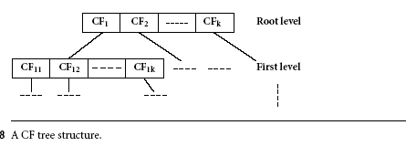
Clustering feature. Suppose that there are three points, (2, 5), (3, 2), and (4, 3), in a cluster, C1. The clustering feature of C1 is
CF1 = {3; (2+3+4;5+2+3); (2²+3²+4²;5²+2²+3²)}= {3; (9;10); (29;38)}
Suppose thatC1 is disjoint to a second cluster,C2, where
CF2 ={3, (35, 36), (417, 440)}
The clustering feature of a newcluster,C3, that is formed by mergingC1 andC2, is derived by adding CF1 and CF2. That is,
CF3 = {3+3; (9+35;10+36); (29+417;38+440)i = {6; (44;46); (446;478)}

Slide 83
The branching factor specifies the maximum number of children per non-leaf node.
The threshold parameter specifies the maximum diameter of subclusters stored at the leaf nodes of the tree.
These two parameters influence the size of the resulting tree.
BIRCH tries to produce the best clusters with the available resources.
Given a limited amount of main memory, an important consideration is to minimize the time required for I/O.
BIRCH applies a multiphase clustering technique: a single scan of the data set yields a basic good clustering, and one or more additional scans can (optionally) be used to further improve the quality.

Slide 84
For Phase 1, the CF tree is built dynamically as objects are inserted.
Thus, the method is incremental. An object is inserted into the closest leaf entry (subcluster).
If the diameter of the subcluster stored in the leaf node after insertion is larger than the threshold value, then the leaf node and possibly other nodes are split.
After the insertion of the new object, information about it is passed toward the root of the tree. The size of the CF tree can be changed by modifying the threshold.
If the size of the memory that is needed for storing the CF tree is larger than the size of the main memory, then a smaller threshold value can be specified and the CF tree is rebuilt.
The rebuild process is performed by building a new tree from the leaf nodes of the old tree.

Slide 85
Thus, the process of rebuilding the tree is done without the necessity of rereading all of the objects or points. This is similar to the insertion and node split in the construction of B+-trees.
Therefore, for building the tree, data has to be read just once. Some heuristics and methods have been introduced to deal with outliers and improve the quality of CF trees by additional scans of the data.
Once the CF tree is built, any clustering algorithm, such as a typical partitioning algorithm, can be used with the CF tree in Phase 2.
Scales linearly: finds a good clustering with a single scan and improves the quality with a few additional scans
Weakness: handles only numeric data, and sensitive to the order of the data record.

Slide 86
Clustering Feature Vector
Clustering Feature: CF = (N, LS, SS)
N: Number of data points
LS: ∑^{N}_{i=1}=X_{i}
SS: ∑^{N}_{i=1}=X_{i}²
CF = (5, (16,30),(54,190))
(3,4)
(2,6)
(4,5)
(4,7)
(3,8)

Slide 87
CF Tree
Root
B = 7
L = 6
CF₁
CF₂
CF₃
CF₆
child₁
child₂
child₃
child₆
Non-leaf node
CF₁
CF₂
CF₃
CF₅
child₁
child₂
child₃
child₅
Leaf node
Leaf node
prev
CF₁
CF₂
CF₆
next
prev
CF₁
CF₂
CF₄
next

Slide 88
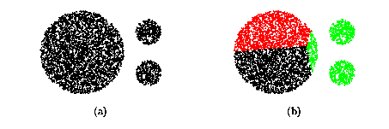
CURE (Clustering Using REpresentatives )
CURE: proposed by Guha, Rastogi & Shim, 1998
  Stops the creation of a cluster hierarchy if a level consists of k clusters
  Uses multiple representative points to evaluate the distance between clusters, adjusts well to arbitrary shaped clusters and avoids single-link effect

Slide 89
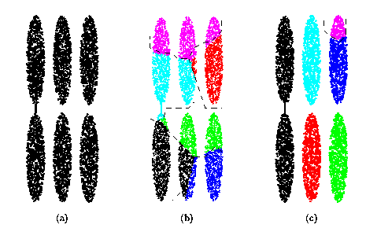
Drawbacks of Distance-Based Method
Drawbacks of square-error based clustering method
  Consider only one point as representative of a cluster
  Good only for convex shaped, similar size and density, and if k can be reasonably estimated

Slide 90
Cure: The Algorithm
  Draw random sample s.
  Partition sample to p partitions with size s/p
  Partially cluster partitions into s/pq clusters
  Eliminate outliers
    By random sampling
    If a cluster grows too slow, eliminate it.
  Cluster partial clusters.
  Label data in disk

Slide 91
Data Partitioning and Clustering
  s = 50
  p = 2
  s/p = 25
  s/pq = 5
y
y
y
x
y
y
x
x
x
x

Slide 92
Cure: Shrinking Representative Points
y
y
x
x
Shrink the multiple representative points towards the gravity center by a fraction of α.
Multiple representatives capture the shape of the cluster

Slide 93
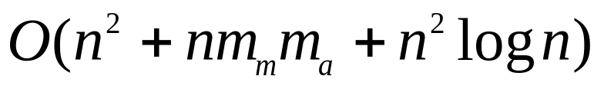

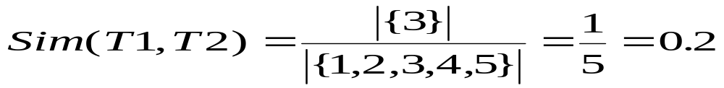
Clustering Categorical Data: ROCK
ROCK: Robust Clustering using linKs,
by S. Guha, R. Rastogi, K. Shim (ICDE’99).
  Use links to measure similarity/proximity
  Not distance based
  Computational complexity:
Basic ideas:
  Similarity function and neighbors:
    Let T₁ = {1,2,3}, T₂={3,4,5}

Slide 94
Rock: Algorithm
Links: The number of common neighbours for the two points.
Algorithm
  Draw random sample
  Cluster with links
  Label data in disk
{1,2,3}, {1,2,4}, {1,2,5}, {1,3,4}, {1,3,5}
{1,4,5}, {2,3,4}, {2,3,5}, {2,4,5}, {3,4,5}
3
{1,2,3} {1,2,4}

Slide 95
CHAMELEON
CHAMELEON: hierarchical clustering using dynamic modeling, by G. Karypis, E.H. Han and V. Kumar’99
Measures the similarity based on a dynamic model
  Two clusters are merged only if the interconnectivity and closeness (proximity) between two clusters are high relative to the internal interconnectivity of the clusters and closeness of items within the clusters
A two phase algorithm
  1. Use a graph partitioning algorithm: cluster objects into a large number of relatively small sub-clusters
  2. Use an agglomerative hierarchical clustering algorithm: find the genuine clusters by repeatedly combining these sub-clusters

Slide 96
Overall Framework of CHAMELEON
Construct
Sparse Graph
Partition the Graph
Data Set
Merge Partition
Final Clusters

Slide 97
Cluster Analysis
What is Cluster Analysis?
Types of Data in Cluster Analysis
A Categorization of Major Clustering Methods
Partitioning Methods
Hierarchical Methods
Density-Based Methods
Grid-Based Methods
Model-Based Clustering Methods
Outlier Analysis
Summary

Slide 98
Density-Based Clustering Methods
Clustering based on density (local cluster criterion), such as density-connected points
Major features:
  Discover clusters of arbitrary shape
  Handle noise
  One scan
  Need density parameters as termination condition
Several interesting studies:
  DBSCAN: Ester, et al. (KDD’96)
  OPTICS: Ankerst, et al (SIGMOD’99).
  DENCLUE: Hinneburg & D. Keim (KDD’98)
  CLIQUE: Agrawal, et al. (SIGMOD’98)

Slide 99
DBSCAN: A density-based clustering method based on connected regions with sufficiently high density
The basic ideas of density-based clustering involve a number of new definitions. We intuitively present these definitions, and then follow up with an example.
The neighborhood within a radius € of a given object is called the € -neighborhood of the object.
If the € -neighborhood of an object contains at least a minimum number, MinPts, of objects, then the object is called a core object.

Slide 100
Given a set of objects, D, we say that an object p is directly density-reachable from object q if p is within the € -neighborhood of q, and q is a core object.
An object p is density-reachable from object q with respect to € and MinPts in a set of objects, D, if there is a chain of objects p1, : : : , pn, where p1 = q and pn = p such that pi+1 is directly density-reachable from pi with respect to e and MinPts, for 1 i n, pi € D.
An object p is density-connected to object q with respect to € and MinPts in a set of objects, D, if there is an object o € D such that both p and q are density-reachable from o with respect to € and MinPts.

Slide 101
Density-Based Clustering: Background
Two parameters:
  Eps: Maximum radius of the neighbourhood
  MinPts: Minimum number of points in an Eps-neighbourhood of that point
N_{Eps}(p): {q belongs to D | dist(p,q) <= Eps}
Directly density-reachable: A point p is directly density-reachable from a point q wrt. Eps, MinPts if
  1) p belongs to N_{Eps}(q)
  2) core point condition:
  |N_{Eps} (q)| >= MinPts
p
MinPts = 5
Eps = 1 cm
q

Slide 102
Density-Based Clustering: Background (II)
Density-reachable:
  A point p is density-reachable from a point q wrt. Eps, MinPts if there is a chain of points p₁, …, p_{n}, p₁ = q, p_{n} = p such that p_{i+1} is directly density-reachable from p_{i}
Density-connected
  A point p is density-connected to a point q wrt. Eps, MinPts if there is a point o such that both, p and q are density-reachable from o wrt. Eps and MinPts.
p
p₁
q
p
q
o

Slide 103
DBSCAN: Density Based Spatial Clustering of Applications with Noise
Relies on a density-based notion of cluster: A cluster is defined as a maximal set of density-connected points
Discovers clusters of arbitrary shape in spatial databases with noise
Outlier
Border
Eps = 1cm
MinPts = 5
Core

Slide 104
DBSCAN: The Algorithm
  Arbitrary select a point p
  Retrieve all points density-reachable from p wrt Eps and MinPts.
  If p is a core point, a cluster is formed.
  If p is a border point, no points are density-reachable from p and DBSCAN visits the next point of the database.
  Continue the process until all of the points have been processed.

Slide 105
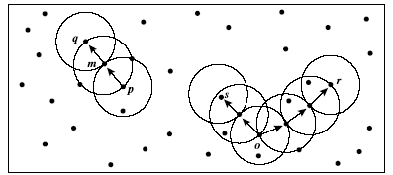
say, let MinPts = 3.
Of the labeled points, m, p, o, and r are core objects because each is in an € -neighborhood containing at least three points.
q is directly density-reachable from m. m is directly density-reachable from p and vice versa.
q is (indirectly) density-reachable from p because q is directly density-reachable from m and m is directly density-reachable from p.
However, p is not density-reachable from q because q is not a core object.
Similarly, r and s are density-reachable from o, and o is density-reachable from o, and o is density-reachable from R.

Slide 106
OPTICS: A Cluster-Ordering Method (1999)
OPTICS: Ordering Points To Identify the Clustering Structure
  Produces a special order of the database wrt its density-based clustering structure
  This cluster-ordering contains info equiv to the density-based clusterings corresponding to a broad range of parameter settings
  Good for both automatic and interactive cluster analysis, including finding intrinsic clustering structure
  Can be represented graphically or using visualization techniques

Slide 107
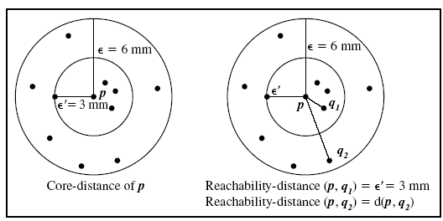
Core-distance and reachability-distance. Figure illustrates the concepts of coredistance and reachability-distance.
Suppose that e=6 mm and MinPts=5.
The core distance of p is the distance, e0, between p and the fourth closest data object.
The reachability-distance of q1 with respect to p is the core-distance of p (i.e., e0 =3 mm) because this is greater than the Euclidean distance from p to q1.
The reachability distance of q2 with respect to p is the Euclidean distance from p to q2 because this is greater than the core- distance of p.

Slide 108
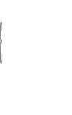

Reachability-distance
undefined
‘
Cluster-order
of the objects

Slide 109
DENCLUE: using density functions
DENsity-based CLUstEring by Hinneburg & Keim (KDD’98)
Major features
  Solid mathematical foundation
  Good for data sets with large amounts of noise
  Allows a compact mathematical description of arbitrarily shaped clusters in high-dimensional data sets
  Significant faster than existing algorithm (faster than DBSCAN by a factor of up to 45)
  But needs a large number of parameters

Slide 110
Denclue: Technical Essence
Uses grid cells but only keeps information about grid cells that do actually contain data points and manages these cells in a tree-based access structure.
Influence function: describes the impact of a data point within its neighborhood.
Overall density of the data space can be calculated as the sum of the influence function of all data points.
Clusters can be determined mathematically by identifying density attractors.
Density attractors are local maximal of the overall density function.

Slide 111
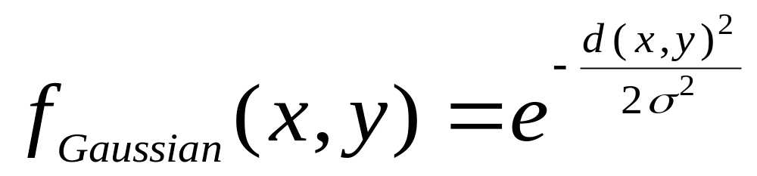
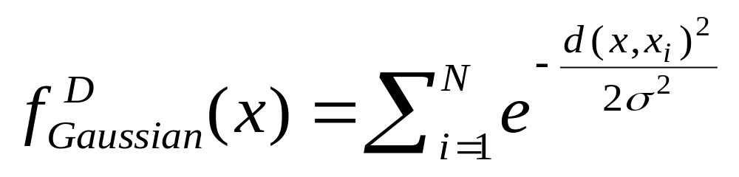

Gradient: The steepness of a slope
Example

Slide 112



Density Attractor

Slide 113

Center-Defined and Arbitrary

Slide 114
Cluster Analysis
What is Cluster Analysis?
Types of Data in Cluster Analysis
A Categorization of Major Clustering Methods
Partitioning Methods
Hierarchical Methods
Density-Based Methods
Grid-Based Methods
Model-Based Clustering Methods
Outlier Analysis
Summary

Slide 115
Grid-Based Clustering Method
Using multi-resolution grid data structure
Several interesting methods
  STING (a STatistical INformation Grid approach) by Wang, Yang and Muntz (1997)
  WaveCluster by Sheikholeslami, Chatterjee, and Zhang (VLDB’98)
    A multi-resolution clustering approach using wavelet method
  CLIQUE: Agrawal, et al. (SIGMOD’98)

Slide 116
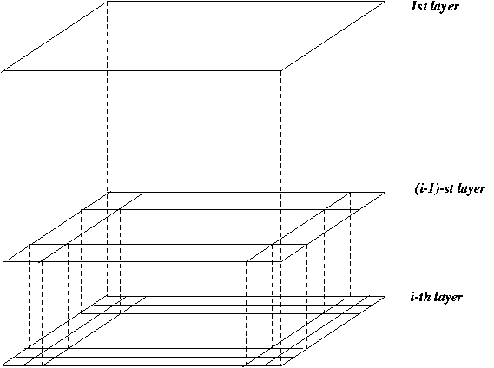
STING: A Statistical Information Grid Approach
Wang, Yang and Muntz (VLDB’97)
The spatial area area is divided into rectangular cells
There are several levels of cells corresponding to different levels of resolution

Slide 117
STING: A Statistical Information Grid Approach (2)
  Each cell at a high level is partitioned into a number of smaller cells in the next lower level
  Statistical info of each cell is calculated and stored beforehand and is used to answer queries
  Parameters of higher level cells can be easily calculated from parameters of lower level cell
    count, mean, s, min, max
    type of distribution—normal, uniform, etc.
  Use a top-down approach to answer spatial data queries
  Start from a pre-selected layer—typically with a small number of cells
  For each cell in the current level compute the confidence interval

Slide 118
STING: A Statistical Information Grid Approach (3)
  Remove the irrelevant cells from further consideration
  When finish examining the current layer, proceed to the next lower level
  Repeat this process until the bottom layer is reached
  Advantages:
    Query-independent, easy to parallelize, incremental update
    O(K), where K is the number of grid cells at the lowest level
  Disadvantages:
    All the cluster boundaries are either horizontal or vertical, and no diagonal boundary is detected

Slide 119
WaveCluster (1998)
Sheikholeslami, Chatterjee, and Zhang (VLDB’98)
A multi-resolution clustering approach which applies wavelet transform to the feature space
  A wavelet transform is a signal processing technique that decomposes a signal into different frequency sub-band.
Both grid-based and density-based
Input parameters:
  # of grid cells for each dimension
  the wavelet, and the # of applications of wavelet transform.

Slide 120
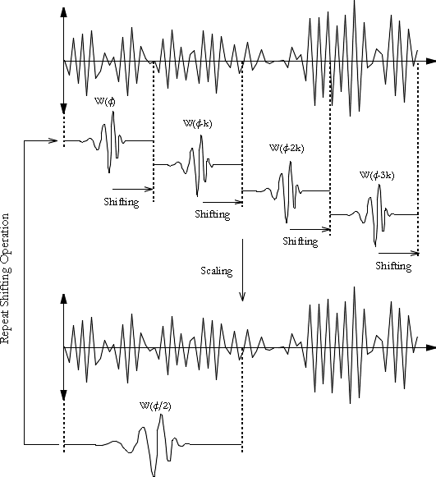
What is Wavelet (1)?

Slide 121
WaveCluster (1998)
How to apply wavelet transform to find clusters
  Summaries the data by imposing a multidimensional grid structure onto data space
  These multidimensional spatial data objects are represented in a n-dimensional feature space
  Apply wavelet transform on feature space to find the dense regions in the feature space
  Apply wavelet transform multiple times which result in clusters at different scales from fine to coarse

Slide 122


What Is Wavelet (2)?

Slide 123

Quantization

Slide 124

Transformation

Slide 125
WaveCluster (1998)
Why is wavelet transformation useful for clustering
  Unsupervised clustering
  It uses hat-shape filters to emphasize region where points cluster, but simultaneously to suppress weaker information in their boundary
  Effective removal of outliers
  Multi-resolution
  Cost efficiency
Major features:
  Complexity O(N)
  Detect arbitrary shaped clusters at different scales
  Not sensitive to noise, not sensitive to input order
  Only applicable to low dimensional data

Slide 126
CLIQUE (Clustering In QUEst)
Agrawal, Gehrke, Gunopulos, Raghavan (SIGMOD’98).
Automatically identifying subspaces of a high dimensional data space that allow better clustering than original space
CLIQUE can be considered as both density-based and grid-based
  It partitions each dimension into the same number of equal length interval
  It partitions an m-dimensional data space into non-overlapping rectangular units
  A unit is dense if the fraction of total data points contained in the unit exceeds the input model parameter
  A cluster is a maximal set of connected dense units within a subspace

Slide 127
CLIQUE: The Major Steps
Partition the data space and find the number of points that lie inside each cell of the partition.
Identify the subspaces that contain clusters using the Apriori principle
Identify clusters:
  Determine dense units in all subspaces of interests
  Determine connected dense units in all subspaces of interests.
Generate minimal description for the clusters
  Determine maximal regions that cover a cluster of connected dense units for each cluster
  Determination of minimal cover for each cluster

Slide 128
Salary (10,000)
Vacation(week)
7
7
6
6
5
5
4
4
3
3
2
2
1
1
0
age
0
age
20
30
40
50
60
20
30
40
50
60
τ = 3
Vacation
Salary
30
50
age

Slide 129
Strength and Weakness of CLIQUE
Strength
  It automatically finds subspaces of the highest dimensionality such that high density clusters exist in those subspaces
  It is insensitive to the order of records in input and does not presume some canonical data distribution
  It scales linearly with the size of input and has good scalability as the number of dimensions in the data increases
Weakness
  The accuracy of the clustering result may be degraded at the expense of simplicity of the method

Slide 130
Cluster Analysis
What is Cluster Analysis?
Types of Data in Cluster Analysis
A Categorization of Major Clustering Methods
Partitioning Methods
Hierarchical Methods
Density-Based Methods
Grid-Based Methods
Model-Based Clustering Methods
Outlier Analysis
Summary

Slide 131
Model-Based Clustering Methods
Attempt to optimize the fit between the data and some mathematical model
Statistical and AI approach
  Conceptual clustering
    A form of clustering in machine learning
    Produces a classification scheme for a set of unlabeled objects
    Finds characteristic description for each concept (class)
  COBWEB (Fisher’87)
    A popular a simple method of incremental conceptual learning
    Creates a hierarchical clustering in the form of a classification tree
    Each node refers to a concept and contains a probabilistic description of that concept

Slide 132

COBWEB Clustering Method
A classification tree

Slide 133
More on Statistical-Based Clustering
Limitations of COBWEB
  The assumption that the attributes are independent of each other is often too strong because correlation may exist
  Not suitable for clustering large database data – skewed tree and expensive probability distributions
CLASSIT
  an extension of COBWEB for incremental clustering of continuous data
  suffers similar problems as COBWEB
AutoClass (Cheeseman and Stutz, 1996)
  Uses Bayesian statistical analysis to estimate the number of clusters
  Popular in industry

Slide 134
Other Model-Based Clustering Methods
Neural network approaches
  Represent each cluster as an exemplar, acting as a “prototype” of the cluster
  New objects are distributed to the cluster whose exemplar is the most similar according to some dostance measure
Competitive learning
  Involves a hierarchical architecture of several units (neurons)
  Neurons compete in a “winner-takes-all” fashion for the object currently being presented

Slide 135
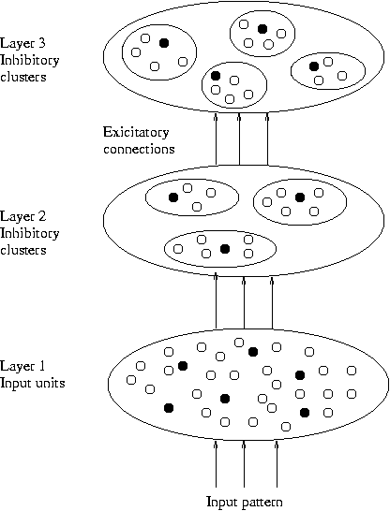
Model-Based Clustering Methods

Slide 136
Self-organizing feature maps (SOMs)
Clustering is also performed by having several units competing for the current object
The unit whose weight vector is closest to the current object wins
The winner and its neighbors learn by having their weights adjusted
SOMs are believed to resemble processing that can occur in the brain
Useful for visualizing high-dimensional data in 2- or 3-D space

Slide 137
Cluster Analysis
What is Cluster Analysis?
Types of Data in Cluster Analysis
A Categorization of Major Clustering Methods
Partitioning Methods
Hierarchical Methods
Density-Based Methods
Grid-Based Methods
Model-Based Clustering Methods
Outlier Analysis
Summary

Slide 138
What Is Outlier Discovery?
What are outliers?
  The set of objects are considerably dissimilar from the remainder of the data
  Example: Sports: Michael Jordon, Wayne Gretzky, ...
Problem
  Find top n outlier points
Applications:
  Credit card fraud detection
  Telecom fraud detection
  Customer segmentation
  Medical analysis

Slide 139

Outlier Discovery: Statistical Approaches
Assume a model underlying distribution that generates data set (e.g. normal distribution)
Use discordancy tests depending on
  data distribution
  distribution parameter (e.g., mean, variance)
  number of expected outliers
Drawbacks
  most tests are for single attribute
  In many cases, data distribution may not be known

Slide 140
Outlier Discovery: Distance-Based Approach
Introduced to counter the main limitations imposed by statistical methods
  We need multi-dimensional analysis without knowing data distribution.
Distance-based outlier: A DB(p, D)-outlier is an object O in a dataset T such that at least a fraction p of the objects in T lies at a distance greater than D from O
Algorithms for mining distance-based outliers
  Index-based algorithm
  Nested-loop algorithm
  Cell-based algorithm

Slide 141
Outlier Discovery: Deviation-Based Approach
Identifies outliers by examining the main characteristics of objects in a group
Objects that “deviate” from this description are considered outliers
sequential exception technique
  simulates the way in which humans can distinguish unusual objects from among a series of supposedly like objects
OLAP data cube technique
  uses data cubes to identify regions of anomalies in large multidimensional data

Slide 142
Cluster Analysis
What is Cluster Analysis?
Types of Data in Cluster Analysis
A Categorization of Major Clustering Methods
Partitioning Methods
Hierarchical Methods
Density-Based Methods
Grid-Based Methods
Model-Based Clustering Methods
Outlier Analysis
Summary

Slide 143
Problems and Challenges
Considerable progress has been made in scalable clustering methods
  Partitioning: k-means, k-medoids, CLARANS
  Hierarchical: BIRCH, CURE
  Density-based: DBSCAN, CLIQUE, OPTICS
  Grid-based: STING, WaveCluster
  Model-based: Autoclass, Denclue, Cobweb
Current clustering techniques do not address all the requirements adequately
Constraint-based clustering analysis: Constraints exist in data space (bridges and highways) or in user queries

Slide 144
Constraint-Based Clustering Analysis
Clustering analysis: less parameters but more user-desired constraints, e.g., an ATM allocation problem

Slide 145
Summary
Cluster analysis groups objects based on their similarity and has wide applications
Measure of similarity can be computed for various types of data
Clustering algorithms can be categorized into partitioning methods, hierarchical methods, density-based methods, grid-based methods, and model-based methods
Outlier detection and analysis are very useful for fraud detection, etc. and can be performed by statistical, distance-based or deviation-based approaches
There are still lots of research issues on cluster analysis, such as constraint-based clustering

