Slide 1
UNIT-3
Concept Description: Characterization and Comparison
Data Mining: Concepts and Techniques

Slide 2
Concept Description: Characterization and Comparison
What is concept description?
Data generalization and summarization-based characterization
Analytical characterization: Analysis of attribute relevance
Mining class comparisons: Discriminating between different classes
Mining descriptive statistical measures in large databases
Discussion
Summary
Data Mining: Concepts and Techniques

Slide 3
What is Concept Description?
From Data Analysis point of view, data mining can be classified into two categories : Descriptive mining and predictive mining
  Descriptive mining: describes the data set in a concise and summarative manner and presents interesting general properties of data
  Predictive mining: analyzes the data in order to construct one or a set of models, and attempts to predict the behavior of new data sets
Data Mining: Concepts and Techniques

Slide 4
What is Concept Description?
Databases usually stores large amount of data in great detail.
However, users often like to view sets of summarized data in concise, descriptive terms.
Such data descriptions may provide an overall picture of a class of data or distinguish it from a set of comparative classes.
Such descriptive data mining is called concept descriptions and forms an important component of data mining
Data Mining: Concepts and Techniques

Slide 5
What is Concept Description?
The simplest kind of descriptive data mining is called concept description. A concept usually refers to a collection of data such as frequent_buyers, graduate_students and so on.
As data mining task concept description is not a simple enumeration of the data. Instead, concept description generates descriptions for characterization and comparison of the data
It is sometimes called class description, when the concept to be described refers to a class of objects
  Characterization: provides a concise and succinct summarization of the given collection of data
  Comparison: provides descriptions comparing two or more collections of data
Data Mining: Concepts and Techniques

Slide 6
Concept Description vs. OLAP
OLAP:
  Data warehouse and OLAP tools are based on multidimensional data model that views data in the form of data cube, consisting of dimensions (or attributes) and measures (aggregate functions)
  The current OLAP systems confine dimensions to nonnumeric data.
  Similarly, measures such as count(), sum(), average() in current OLAP systems apply only to numeric data.
  restricted to a small number of dimension and measure types
  user-controlled process (such as selection of dimensions and the applications of OLAP operations such as drill down, roll up, slicing and dicing are controlled by the users
Concept description in large databases :
  The database attributes can be of various types, including numeric, nonnumeric, spatial, text or image
  can handle complex data types of the attributes and their aggregations
  a more automated process
Data Mining: Concepts and Techniques

Slide 7
Concept Description vs. OLAP
Concept description:
  can handle complex data types of the attributes and their aggregations
  a more automated process
OLAP:
  restricted to a small number of dimension and measure types
  user-controlled process
Data Mining: Concepts and Techniques

Slide 8
Concept Description: Characterization and Comparison
What is concept description?
Data generalization and summarization-based characterization
Analytical characterization: Analysis of attribute relevance
Mining class comparisons: Discriminating between different classes
Mining descriptive statistical measures in large databases
Discussion
Summary
Data Mining: Concepts and Techniques

Slide 9
Data Generalization and Summarization-based Characterization
Data and objects in databases contain detailed information at primitive concept level.
For ex, the item relation in a sales database may contain attributes describing low level item information such as item_ID, name, brand, category, supplier, place_made and price.
It is useful to be able to summarize a large set of data and present it at a high conceptual level.
For ex. Summarizing a large set of items relating to Christmas season sales provides a general description of such data, which can be very helpful for sales and marketing managers.
This requires important functionality called data generalization
Data Mining: Concepts and Techniques

Slide 10
Data Generalization and Summarization-based Characterization
Data generalization
  A process which abstracts a large set of task-relevant data in a database from a low conceptual levels to higher ones.
  Approaches:
    Data cube approach(OLAP approach)
    Attribute-oriented induction approach
1
2
3
4
Conceptual levels
5
Data Mining: Concepts and Techniques

Slide 11
Characterization: Data Cube Approach (without using AO-Induction)
Perform computations and store results in data cubes
Strength
  An efficient implementation of data generalization
  Computation of various kinds of measures
    e.g., count( ), sum( ), average( ), max( )
  Generalization and specialization can be performed on a data cube by roll-up and drill-down
Limitations
  handle only dimensions of simple nonnumeric data and measures of simple aggregated numeric values.
  Lack of intelligent analysis, can’t tell which dimensions should be used and what levels should the generalization reach
Data Mining: Concepts and Techniques

Slide 12
Attribute-Oriented Induction (AOI)
The Attribute Oriented Induction (AOI) approach to data generalization and summarization – based characterization was first proposed in 1989 (KDD ‘89 workshop) a few years prior to the introduction of the data cube approach.
The data cube approach can be considered as a data warehouse – based, pre computational – oriented, materialized approach.
It performs off-line aggregation before an OLAP or data mining query is submitted for processing.
On the other hand, the attribute oriented induction approach, at least in its initial proposal, a relational database query – oriented, generalized – based, on-line data analysis technique
Data Mining: Concepts and Techniques

Slide 13
Attribute-Oriented Induction (AOI)
However, there is no inherent barrier distinguishing the two approaches based on online aggregation versus offline precomputation.
Some aggregations in the data cube can be computed on-line, while off-line precomputation of multidimensional space can speed up attribute-oriented induction as well.
Data Mining: Concepts and Techniques

Slide 14
Attribute-Oriented Induction
Proposed in 1989 (KDD ‘89 workshop)
Not confined to categorical data nor particular measures.
How it is done?
  Collect the task-relevant data( initial relation) using a relational database query
  Perform generalization by attribute removal or attribute generalization.
  Apply aggregation by merging identical, generalized tuples and accumulating their respective counts.
  reduces the size of generalized data set.
  Interactive presentation with users.
Data Mining: Concepts and Techniques

Slide 15
Basic Principles of Attribute-Oriented Induction
Data focusing: task-relevant data, including dimensions, and the result is the initial relation.
Attribute-removal: remove attribute A if there is a large set of distinct values for A but (1) there is no generalization operator on A, or (2) A’s higher level concepts are expressed in terms of other attributes.
Attribute-generalization: If there is a large set of distinct values for A, and there exists a set of generalization operators on A, then select an operator and generalize A.
Attribute-threshold control: typical 2-8, specified/default.
Generalized relation threshold control (10-30): control the final relation/rule size.

Slide 16
Basic Algorithm for Attribute-Oriented Induction
InitialRel: Query processing of task-relevant data, deriving the initial relation.
PreGen: Based on the analysis of the number of distinct values in each attribute, determine generalization plan for each attribute: removal? or how high to generalize?
PrimeGen: Based on the PreGen plan, perform generalization to the right level to derive a “prime generalized relation”, accumulating the counts.
Presentation: User interaction: (1) adjust levels by drilling, (2) pivoting, (3) mapping into rules, cross tabs, visualization presentations.

Slide 17
Example
DMQL: Describe general characteristics of graduate students in the Big-University database
  use Big_University_DB
  mine characteristics as “Science_Students”
  in relevance to name, gender, major, birth_place, birth_date, residence, phone#, gpa
  from student
  where status in “graduate”
Corresponding SQL statement:
  Select name, gender, major, birth_place, birth_date, residence, phone#, gpa
  from student
  where status in {“Msc”, “MBA”, “PhD” }
Data Mining: Concepts and Techniques

Slide 18



Class Characterization: An Example
Initial Relation
Prime Generalized Relation
See Principles
See Algorithm
See Implementation
See Analytical Characterization

Slide 19
Presentation of Generalized Results
Generalized relation:
  Relations where some or all attributes are generalized, with counts or other aggregation values accumulated.
Cross tabulation:
  Mapping results into cross tabulation form (similar to contingency tables).
  Visualization techniques:
  Pie charts, bar charts, curves, cubes, and other visual forms.
Quantitative characteristic rules:
  Mapping generalized result into characteristic rules with quantitative information associated with it, e.g.,

Slide 20
Chapter 5: Concept Description: Characterization and Comparison
What is concept description?
Data generalization and summarization-based characterization
Analytical characterization: Analysis of attribute relevance
Mining class comparisons: Discriminating between different classes
Mining descriptive statistical measures in large databases
Discussion
Summary
Data Mining: Concepts and Techniques

Slide 21
Analytical Characterization
Attribute Relevance Analysis
“ What if I am not sure which attribute to include for class characterization and class comparison ? I may end up specifying too many attributes, which could slow down the system considerably ”
Measures of attribute relevance analysis can be used to help identify irrelevant or weakly relevant attributes that can be excluded from the concept description process.
The incorporation of this processing step into class characterization or comparison is referred to as analytical characterization or analytical comparison
Data Mining: Concepts and Techniques

Slide 22
Why Perform Attribute Relevance Analysis
The first limitation of OLAP tool is the handling of complex objects.
The second limitation is the lack of an automated generalization process : the user must explicitly tell the system which dimensions should be included in the class characterization and how high a level each dimension should be generalized.
Actually, each step of generalization or specialization on any dimension must be specified by the user.
Usually, it is not difficult for a user to instruct a data mining system regarding how high a level each dimension should be generalized.
For ex, users can set attribute generalization thresholds for this, or specify which level a given dimension should reach, such as with the command “generalize dimension location to the country level”.
Data Mining: Concepts and Techniques

Slide 23
Why Perform Attribute Relevance Analysis
Even without explicit user instruction, a default value such as 2 to 8 can be set by the data mining system, which would allow each dimension to be generalized to a level that contains only 2 to 8 distinct values.
On other hand normally a user may include too few attributes in the analysis, causing the incomplete mining results or a user may introduce too many attributes for analysis e.g “in relevance to *”.
Methods should be introduced to perform attribute relevance analysis in order to filter out statistically irrelevant or weakly relevant attributes
Class characterization that includes the analysis of attribute/dimension relevance is called analytical characterization.
Class comparison that includes such analysis is called analytical comparison
Data Mining: Concepts and Techniques

Slide 24
Attribute Relevance Analysis
Why?
  Which dimensions should be included?
  How high level of generalization?
  Automatic vs. interactive
  Reduce # attributes; easy to understand patterns
What?
  statistical method for preprocessing data
    filter out irrelevant or weakly relevant attributes
    retain or rank the relevant attributes
  relevance related to dimensions and levels
  analytical characterization, analytical comparison
Data Mining: Concepts and Techniques

Slide 25
Attribute relevance analysis
  1. Data Collection : Collect data for both the target class and the contrasting class by query processing
  2. Preliminary relevance analysis using conservative AOI: This step identifies a set of dimensions and attributes on which the selected relevance measure is to be applied.
  The relation obtained by such an application of AOI is called the candidate relation of the mining task.
  3. Remove irrelevant and weakly relevant attributes using the selected relevance analysis: We evaluate each attribute in the candidate relation using the selected relevance analysis measure.
  This step results in an initial target class working relation and initial contrasting class working relation.
  4. Generate the concept description using AOI: Perform AOI using a less conservative set of attribute generalization thresholds.
  If the descriptive mining is
    class characterization , only ITCWR is included
    Class Comparison both ITCWR and ICCWR are included
Data Mining: Concepts and Techniques

Slide 26
Relevance Measures
Quantitative relevance measure determines the classifying power of an attribute within a set of data.
Methods
  information gain (ID3)
  gain ratio (C4.5)
  gini index
  χ² contingency table statistics
  uncertainty coefficient
Data Mining: Concepts and Techniques

Slide 27
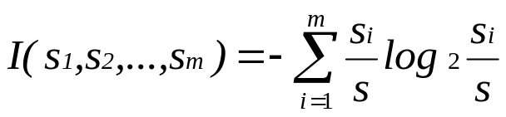
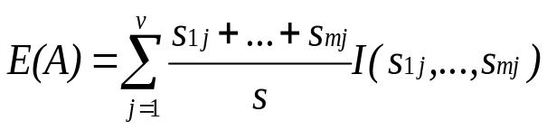

Entropy and Information Gain
S contains s_{i} tuples of class C_{i} for i = {1, …, m}
Information measures info required to classify any arbitrary tuple
Entropy of attribute A with values {a₁,a₂,…,a_{v}} can be used to partition S into the susets {S₁,S₂,..S_{v}} where Sj contain sij samples of class Ci
Information gained by branching on attribute A
Data Mining: Concepts and Techniques

Slide 28
Example: Analytical Characterization
Task
  Mine general characteristics describing graduate students using analytical characterization
Given
  attributes name, gender, major, birth_place, birth_date, phone#, and gpa
  Gen(a_{i}) = concept hierarchies on a_{i}
  U_{i} = attribute analytical thresholds for a_{i}
  T_{i} = attribute generalization thresholds for a_{i}
  R = attribute relevance threshold
Data Mining: Concepts and Techniques

Slide 29
Example: Analytical Characterization (cont’d)
1. Data collection
  target class: graduate student
  contrasting class: undergraduate student
2. Analytical generalization using U_{i}
  attribute removal
    remove name and phone#
  attribute generalization
    generalize major, birth_place, birth_date and gpa
    accumulate counts
  candidate relation(large attribute generalization threshold): gender, major, birth_country, age_range and gpa
Data Mining: Concepts and Techniques

Slide 30
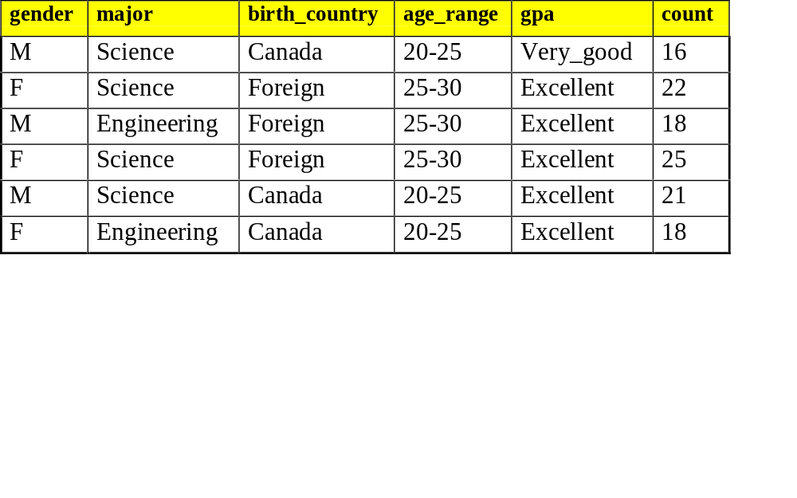
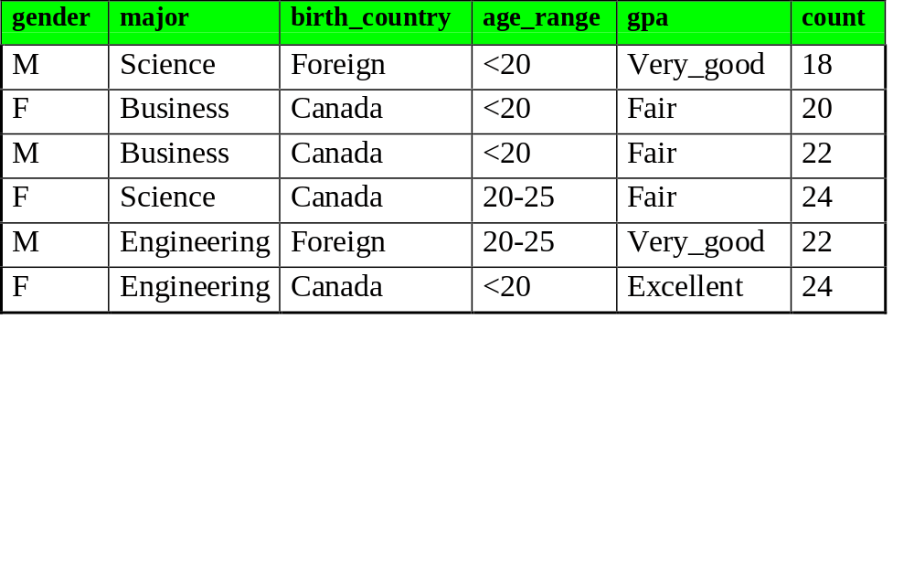
Example: Analytical characterization (2)
Candidate relation for Target class: Graduate students (Σ=120)
Candidate relation for Contrasting class: Undergraduate students (Σ=130)
Data Mining: Concepts and Techniques

Slide 31
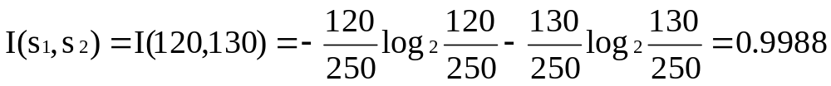
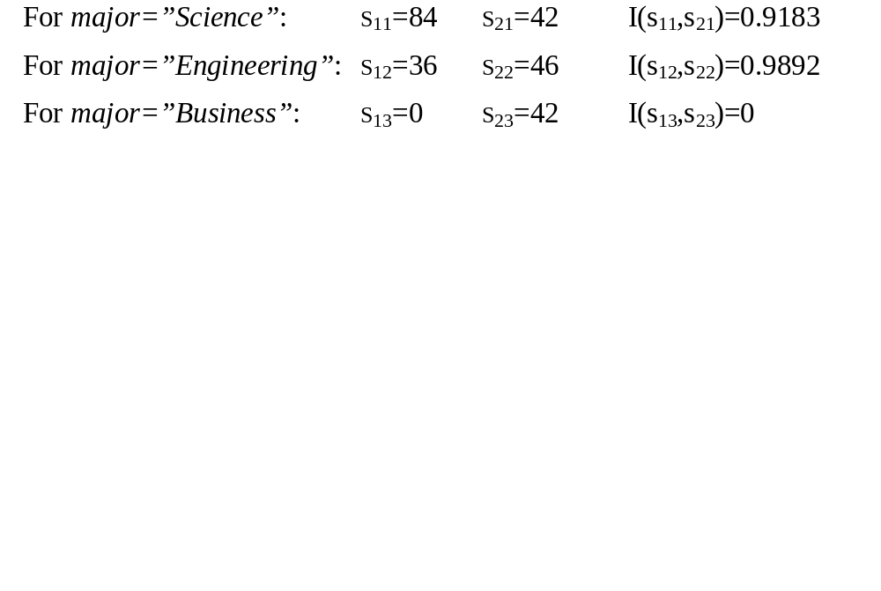
Example: Analytical characterization (3)
3. Relevance analysis
  Calculate expected info required to classify an arbitrary tuple
  Calculate entropy of each attribute: e.g. major
Number of grad students in “Science”
Number of undergrad students in “Science”
Data Mining: Concepts and Techniques

Slide 32
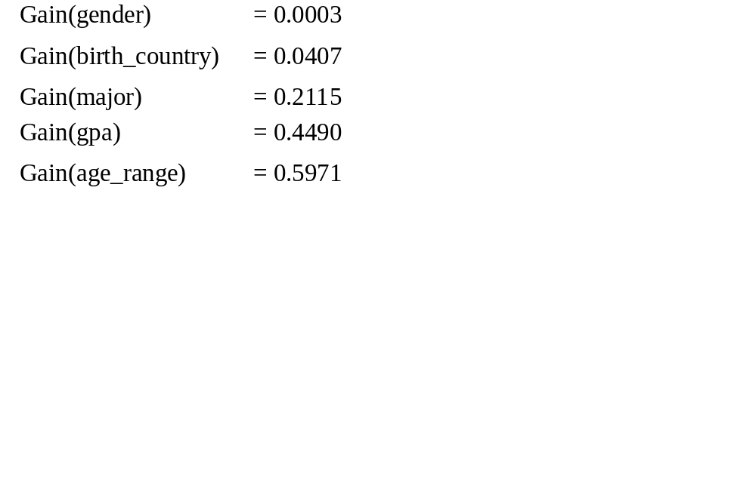
Example: Analytical Characterization (4)
Calculate expected info required to classify a given sample if S is partitioned according to the attribute
Calculate information gain for each attribute
  Information gain for all attributes
Data Mining: Concepts and Techniques

Slide 33
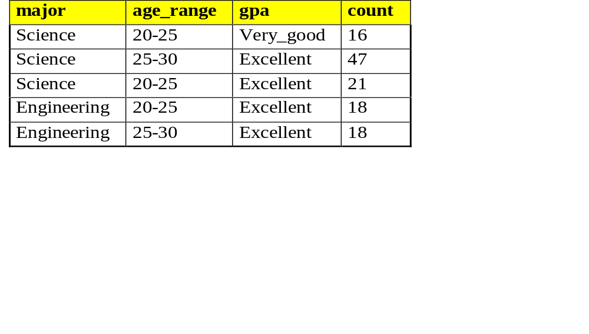
Example: Analytical characterization (5)
4. Initial working relation (W₀) derivation
  R = 0.1
  remove irrelevant/weakly relevant attributes from candidate relation => drop gender, birth_country
  remove contrasting class candidate relation
5. Perform attribute-oriented induction on W₀ using T_{i}
Initial target class working relation W₀: Graduate students
Data Mining: Concepts and Techniques

Slide 34
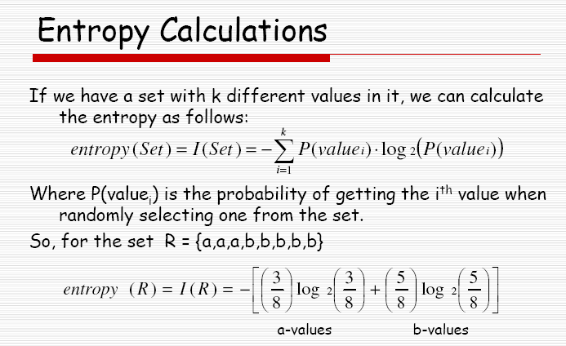
Data Mining: Concepts and Techniques

Slide 35
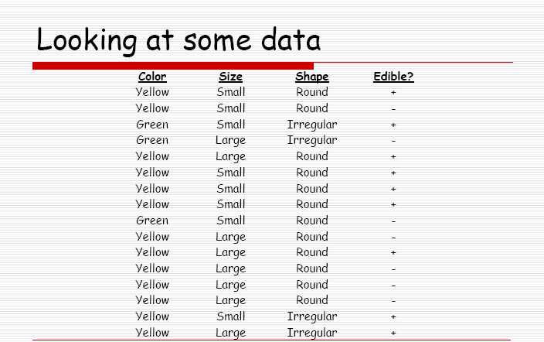
Data Mining: Concepts and Techniques

Slide 36
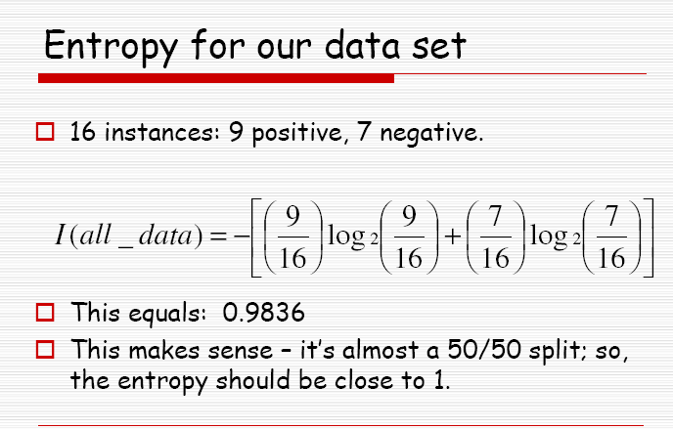
Data Mining: Concepts and Techniques

Slide 37
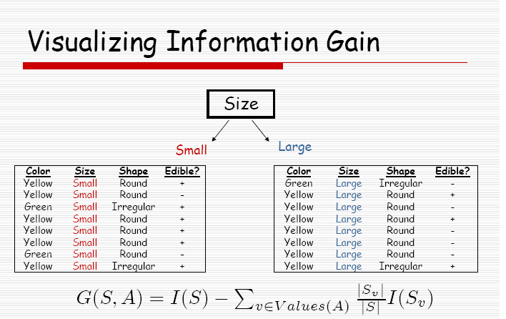
Data Mining: Concepts and Techniques

Slide 38
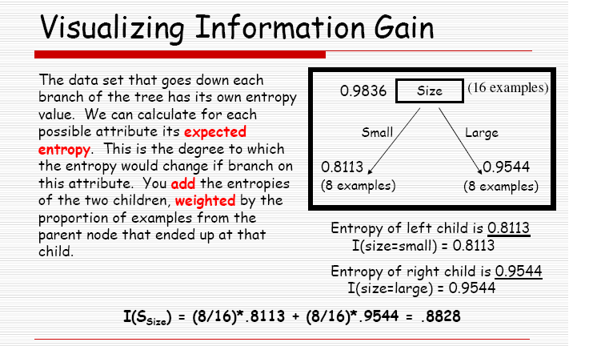
Data Mining: Concepts and Techniques

Slide 39
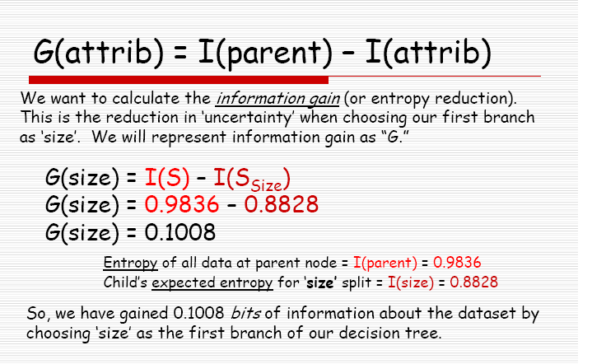
Data Mining: Concepts and Techniques

Slide 40
Chapter 5: Concept Description: Characterization and Comparison
What is concept description?
Data generalization and summarization-based characterization
Analytical characterization: Analysis of attribute relevance
Mining class comparisons: Discriminating between different classes
Mining descriptive statistical measures in large databases
Discussion
Summary
Data Mining: Concepts and Techniques

Slide 41
Chapter 5: Concept Description: Characterization and Comparison
What is concept description?
Data generalization and summarization-based characterization
Analytical characterization: Analysis of attribute relevance
Mining class comparisons: Discriminating between different classes
Mining descriptive statistical measures in large databases
Discussion
Summary
Data Mining: Concepts and Techniques

Slide 42
Class Comparisons Methods and Implementations
Data Collection: The set of relevant data in the database is collected by query processing and is partitioned into target class and contrasting class.
Dimension relevance analysis: If there are many dimensions and analytical comparison is desired, then dimension relevance analysis should be performed on these classes and only the highly relevant dimensions are included in the further analysis.
Synchronous Generalization: Generalization is performed on the target class to the level controlled by user-or expert –specified dimension threshold, which results in a prime target class relation/cuboid. The concepts in the contrasting class(es) are generalized to the same level as those in the prime target class relation/cuboid, forming the prime contrasting class relation/cuboid.
Presentation of the derived comparison: The resulting class comparison description can be visualized in the form of tables, graphs and rules. This presentation usually includes a “ contrasting” measure (such as count%) that reflects the comparison between the target and contrasting classes.

Slide 43
Example: Analytical comparison
Task
  Compare graduate and undergraduate students using discriminant rule.
  DMQL query
use Big_University_DB
mine comparison as “grad_vs_undergrad_students”
in relevance to name, gender, major, birth_place, birth_date, residence, phone#, gpa
for “graduate_students”
where status in “graduate”
versus “undergraduate_students”
where status in “undergraduate”
analyze count%
from student
Data Mining: Concepts and Techniques

Slide 44
Example: Analytical comparison (2)
Given
  attributes name, gender, major, birth_place, birth_date, residence, phone# and gpa
  Gen(a_{i}) = concept hierarchies on attributes a_{i}
  U_{i} = attribute analytical thresholds for attributes a_{i}
  T_{i} = attribute generalization thresholds for attributes a_{i}
  R = attribute relevance threshold
Data Mining: Concepts and Techniques

Slide 45
Example: Analytical comparison (3)
1. Data collection
  target and contrasting classes
2. Attribute relevance analysis
  remove attributes name, gender, major, phone#
3. Synchronous generalization
  controlled by user-specified dimension thresholds
  prime target and contrasting class(es) relations/cuboids
Data Mining: Concepts and Techniques

Slide 46
Example: Analytical comparison (4)
4. Drill down, roll up and other OLAP operations on target and contrasting classes to adjust levels of abstractions of resulting description
5. Presentation
  as generalized relations, crosstabs, bar charts, pie charts, or rules
  contrasting measures to reflect comparison between target and contrasting classes
    e.g. count%
Data Mining: Concepts and Techniques

Slide 47
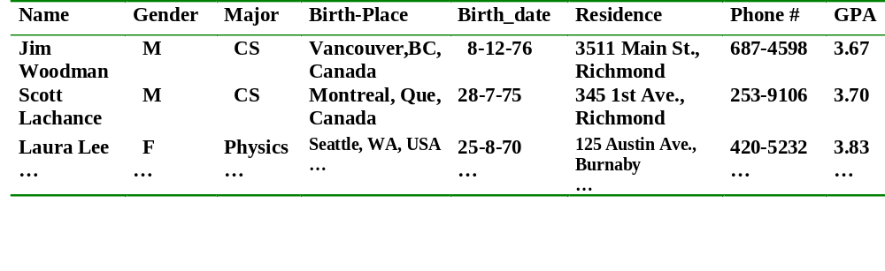
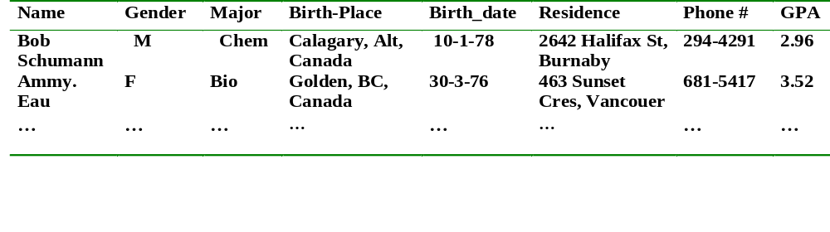
Table 5.7 Initial target class working relation (graduate student)
Table 5.8 Initial contrasting class working relation (graduate student)
Data Mining: Concepts and Techniques

Slide 48
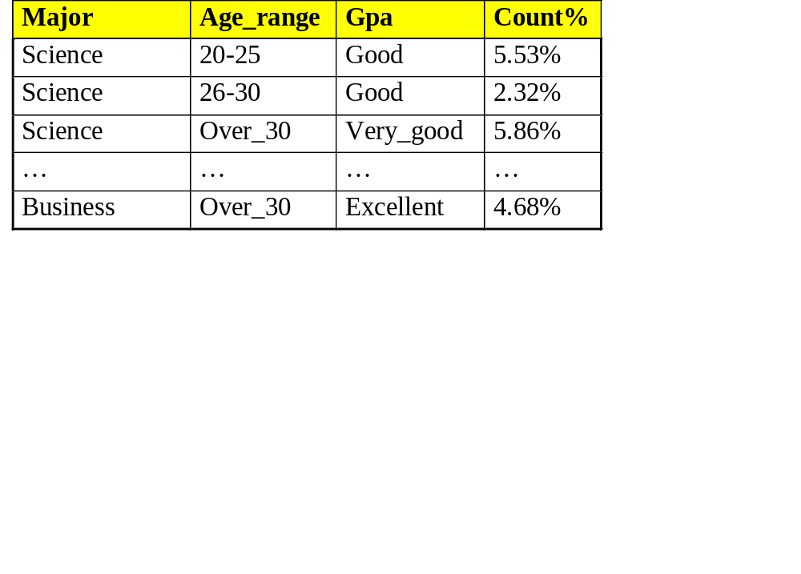
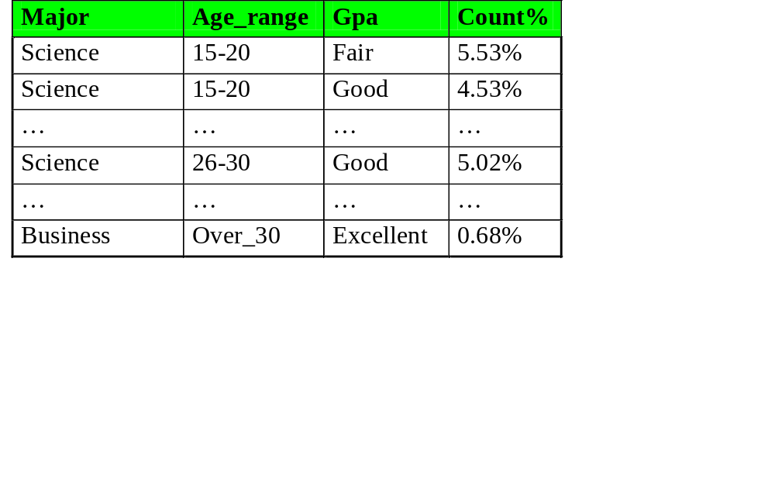
Example: Analytical comparison (5)
Prime generalized relation for the target class: Graduate students
Prime generalized relation for the contrasting class: Undergraduate students
Data Mining: Concepts and Techniques

Slide 49
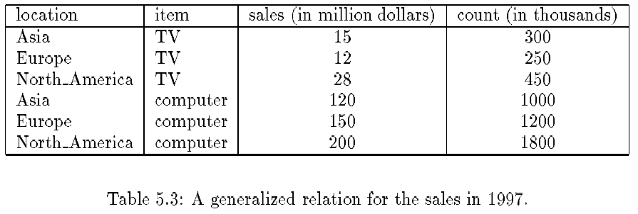
Presentation—Generalized Relation
Data Mining: Concepts and Techniques

Slide 50
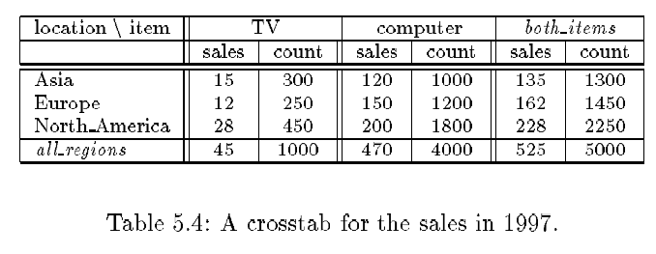
Presentation—Crosstab
Data Mining: Concepts and Techniques

Slide 51
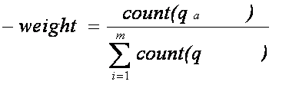
Quantitative Characteristics Rules
Presentation of Class Characterization Descriptions
A logic that is associated with the quantitative information is called Quantitative rule . It associates an interesting ness measure t-weight with each tuple
Cj = target class
q_{a} = a generalized tuple covers some tuples of class
  but can also cover some tuples of contrasting class
t-weight
  range: [0, 1] or [0%, 100%]
t
i
Data Mining: Concepts and Techniques

Slide 52
Data Mining: Concepts and Techniques

Slide 53
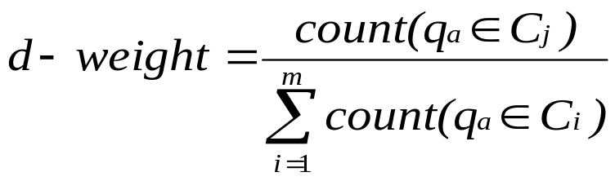
Quantitative Discriminant Rules
Presentation of Class Comparison Descriptions
To find out the discriminative features of target and contrasting classes can be described as a discriminative rule. It associates an interesting ness measure d-weight with each tuple
Cj = target class
q_{a} = a generalized tuple covers some tuples of class
  but can also cover some tuples of contrasting class
d-weight
  range: [0, 1]
Data Mining: Concepts and Techniques

Slide 54
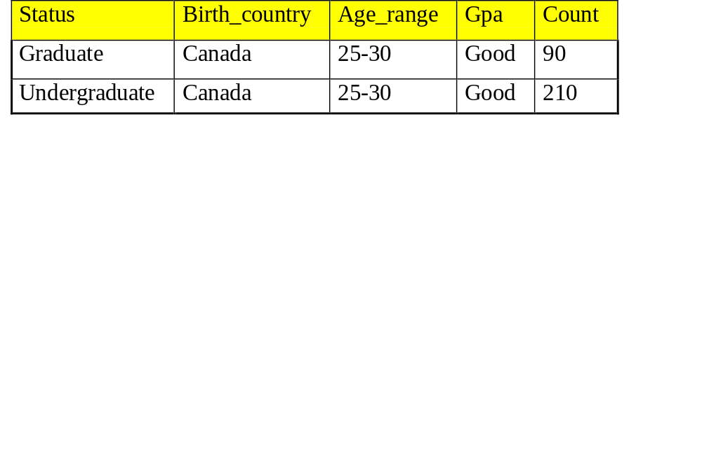
Example: Quantitative Discriminant Rule
Count distribution between graduate and undergraduate students for a generalized tuple
In the above ex, suppose that the count distribution for major =‘science’ and age_range = ’20..25” and gpa =‘good’ is shown in the tables.
The d_weight would be 90/(90+210) = 30% w.r.t to target class and
The d_weight would be 210/(90+210) = 70% w.r.t to contrasting class. i.e.
The student majoring in science is 21 to 25 years old and has a good gpa then based on the data, there is a probability that she is a graduate student versus a 70% probability that she is an undergraduate student. Similarly the d-weights for other tuples also can be derived.
Data Mining: Concepts and Techniques

Slide 55
Example: Quantitative Discriminant Rule
A Quantitative discriminant rule for the target class of a given comparison is written in form of
Based on the above a discriminant rule for the target class graduate_student can be written as
Note : The discriminant rule provides a sufficient condition, but not a
necessary one, for an object. For Ex. the rule implies that if X satisfies the condition, then the probability that X is a graduate student is 30%.
Data Mining: Concepts and Techniques

Slide 56
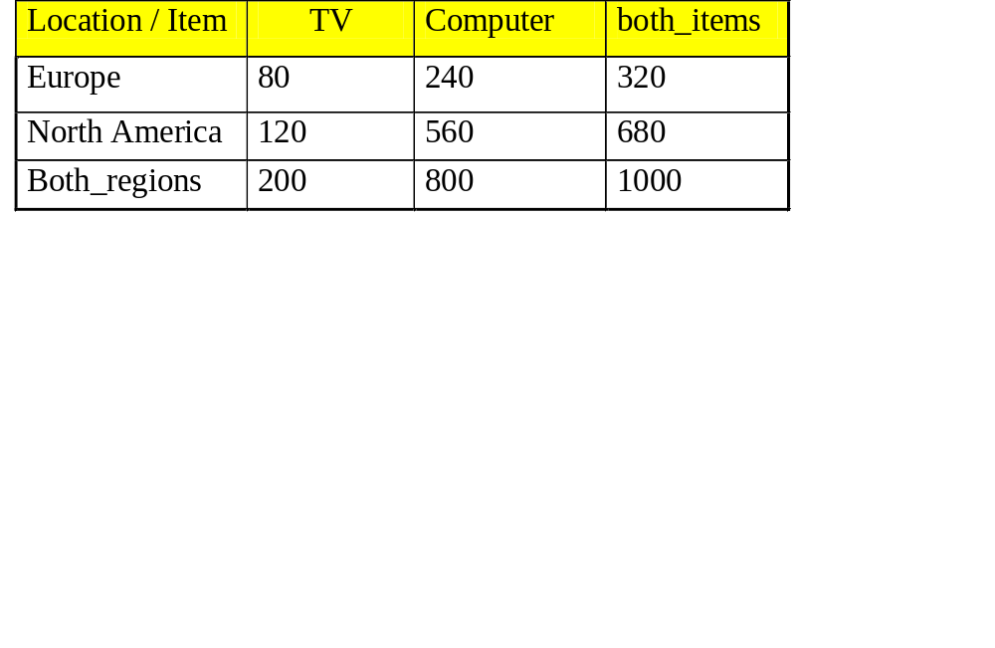
A crosstab for the total number (count) of TVs and computers sold in thousands in 1999
To calculate T_Weight (Typicality Weight)
The formula is
Ex : 1. 80 / (80+240) = 25%
2. 120 / (120+560) = 17.65%
3. 200 / (200+800) = 20%
To calculate D_Weight (Discriminate rule)
The formula is
Ex. 1. 80/(80+120) = 40%
2. 120/(80+120) = 60%
3. 200/(80+120) = 100%
t_weight = count (q_{a})
n
∑
count (q_{i})
i=1
Data Mining: Concepts and Techniques

Slide 57
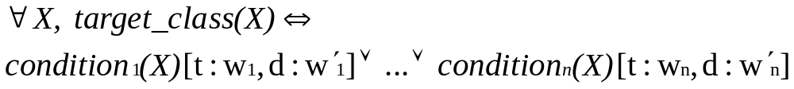
Class Description
Quantitative characteristic rule
  necessary
Quantitative discriminant rule
  sufficient
Quantitative description rule
  necessary and sufficient
Data Mining: Concepts and Techniques

Slide 58
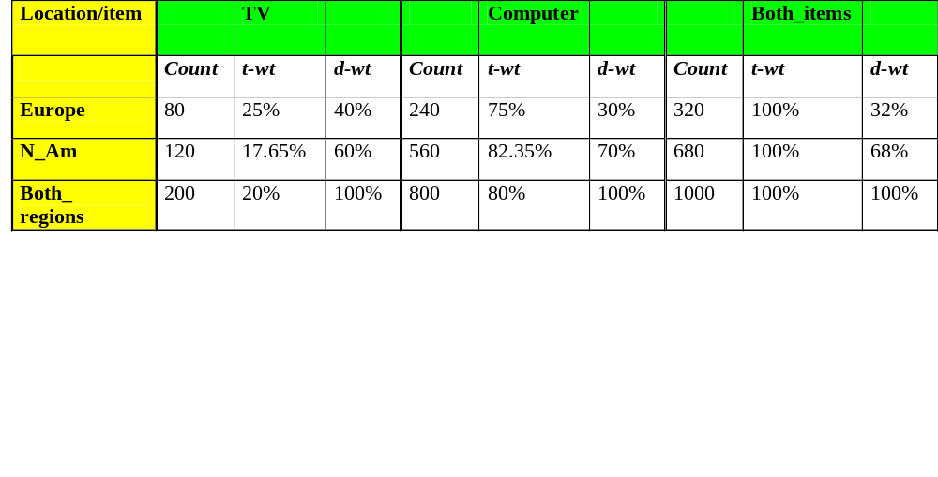
Example: Quantitative Description Rule
Crosstab showing associated t-weight, d-weight values and total number (in thousands) of TVs and computers sold at AllElectronics in 1998
To define a quantitative characteristic rule, we introduce the t-weight as an interestingness measures that describes the typicality of each disjunct in the rule.
t_weight = count (q_{a})
n
∑
count (q_{i})
i=1
Quantitative description rule for target class Europe
Data Mining: Concepts and Techniques

Slide 59
Chapter 5: Concept Description: Characterization and Comparison
What is concept description?
Data generalization and summarization-based characterization
Analytical characterization: Analysis of attribute relevance
Mining class comparisons: Discriminating between different classes
Mining descriptive statistical measures in large databases
Discussion
Summary
Data Mining: Concepts and Techniques

Slide 60
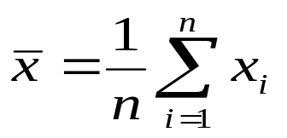

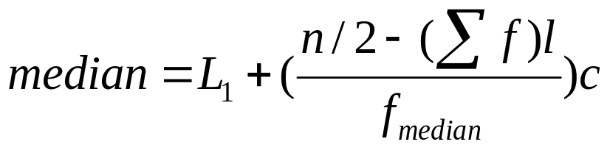
Measuring the Central Tendency
Mean
  Weighted arithmetic mean
Median: A holistic measure
  Middle value if odd number of values, or average of the middle two values otherwise
  estimated by interpolation
Mode
  Value that occurs most frequently in the data
  Unimodal, bimodal, trimodal
  Empirical formula:
Data Mining: Concepts and Techniques

Slide 61
Measuring the Dispersion of Data
Quartiles, outliers and boxplots
  Quartiles: Q₁ (25th percentile), Q₃ (75th percentile)
  Inter-quartile range: IQR = Q₃ – Q₁
  Five number summary: min, Q₁, M, Q₃, max
  Boxplot: ends of the box are the quartiles, median is marked, whiskers, and plot outlier individually
  Outlier: usually, a value higher/lower than 1.5 x IQR
Variance and standard deviation
  Variance s²: (algebraic, scalable computation)
  Standard deviation s is the square root of variance s²
Data Mining: Concepts and Techniques

Slide 62
Boxplot Analysis
Five-number summary of a distribution:
  Minimum, Q1, M, Q3, Maximum
Boxplot
  Data is represented with a box
  The ends of the box are at the first and third quartiles, i.e., the height of the box is IRQ
  The median is marked by a line within the box
  Whiskers: two lines outside the box extend to Minimum and Maximum
Data Mining: Concepts and Techniques

Slide 63

A Boxplot
A boxplot
Data Mining: Concepts and Techniques

Slide 64

Visualization of Data Dispersion: Boxplot Analysis
Data Mining: Concepts and Techniques

Slide 65
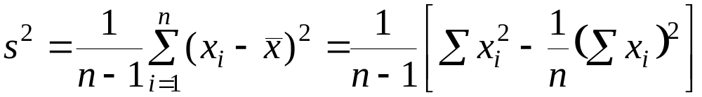
Mining Descriptive Statistical Measures in Large Databases
Variance
Standard deviation: the square root of the variance
  Measures spread about the mean
  It is zero if and only if all the values are equal
  Both the deviation and the variance are algebraic
Data Mining: Concepts and Techniques

Slide 66

Histogram Analysis
Graph displays of basic statistical class descriptions
  Frequency histograms
    A univariate graphical method
    Consists of a set of rectangles that reflect the counts or frequencies of the classes present in the given data
Data Mining: Concepts and Techniques

Slide 67
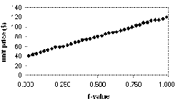
Quantile Plot
Displays all of the data (allowing the user to assess both the overall behavior and unusual occurrences)
Plots quantile information
  For a data x_{i} data sorted in increasing order, f_{i} indicates that approximately 100 f_{i}% of the data are below or equal to the value x_{i}
Data Mining: Concepts and Techniques

Slide 68
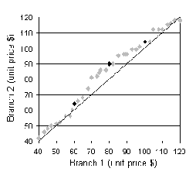
Quantile-Quantile (Q-Q) Plot
Graphs the quantiles of one univariate distribution against the corresponding quantiles of another
Allows the user to view whether there is a shift in going from one distribution to another
Data Mining: Concepts and Techniques

Slide 69
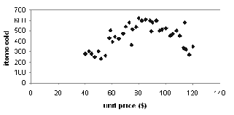
Scatter plot
Provides a first look at bivariate data to see clusters of points, outliers, etc
Each pair of values is treated as a pair of coordinates and plotted as points in the plane
Data Mining: Concepts and Techniques

Slide 70
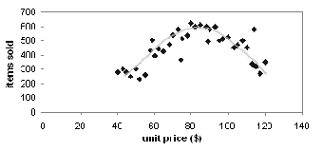
Loess Curve
Adds a smooth curve to a scatter plot in order to provide better perception of the pattern of dependence
Loess curve is fitted by setting two parameters: a smoothing parameter, and the degree of the polynomials that are fitted by the regression
Data Mining: Concepts and Techniques

Slide 71
Graphic Displays of Basic Statistical Descriptions
Histogram: (shown before)
Boxplot: (covered before)
Quantile plot: each value x_{i} is paired with f_{i} indicating that approximately 100 f_{i} % of data are ≤ x_{i}
Quantile-quantile (q-q) plot: graphs the quantiles of one univariant distribution against the corresponding quantiles of another
Scatter plot: each pair of values is a pair of coordinates and plotted as points in the plane
Loess (local regression) curve: add a smooth curve to a scatter plot to provide better perception of the pattern of dependence
Data Mining: Concepts and Techniques

Slide 72
Chapter 5: Concept Description: Characterization and Comparison
What is concept description?
Data generalization and summarization-based characterization
Analytical characterization: Analysis of attribute relevance
Mining class comparisons: Discriminating between different classes
Mining descriptive statistical measures in large databases
Discussion
Summary
Data Mining: Concepts and Techniques

Slide 73
AO Induction vs. Learning-from-example Paradigm
Difference in philosophies and basic assumptions
  Positive and negative samples in learning-from-example: positive used for generalization, negative - for specialization
  Positive samples only in data mining: hence generalization-based, to drill-down backtrack the generalization to a previous state
Difference in methods of generalizations
  Machine learning generalizes on a tuple by tuple basis
  Data mining generalizes on an attribute by attribute basis
Data Mining: Concepts and Techniques

Slide 74
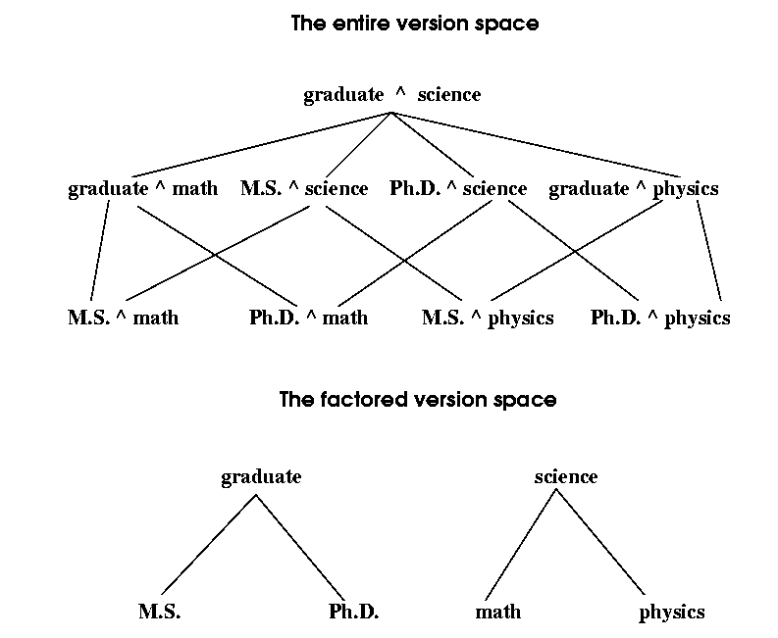
Comparison of Entire vs. Factored Version Space
Data Mining: Concepts and Techniques

Slide 75
Incremental and Parallel Mining of Concept Description
Incremental mining: revision based on newly added data ΔDB
  Generalize ΔDB to the same level of abstraction in the generalized relation R to derive ΔR
  Union R U ΔR, i.e., merge counts and other statistical information to produce a new relation R’
Similar philosophy can be applied to data sampling, parallel and/or distributed mining, etc.
Data Mining: Concepts and Techniques

Slide 76
Chapter 5: Concept Description: Characterization and Comparison
What is concept description?
Data generalization and summarization-based characterization
Analytical characterization: Analysis of attribute relevance
Mining class comparisons: Discriminating between different classes
Mining descriptive statistical measures in large databases
Discussion
Summary
Data Mining: Concepts and Techniques

Slide 77
Summary
Concept description: characterization and discrimination
OLAP-based vs. attribute-oriented induction
Efficient implementation of AOI
Analytical characterization and comparison
Mining descriptive statistical measures in large databases
Discussion
  Incremental and parallel mining of description
  Descriptive mining of complex types of data
Data Mining: Concepts and Techniques

Slide 78
References
Y. Cai, N. Cercone, and J. Han. Attribute-oriented induction in relational databases. In G. Piatetsky-Shapiro and W. J. Frawley, editors, Knowledge Discovery in Databases, pages 213-228. AAAI/MIT Press, 1991.
S. Chaudhuri and U. Dayal. An overview of data warehousing and OLAP technology. ACM SIGMOD Record, 26:65-74, 1997
C. Carter and H. Hamilton. Efficient attribute-oriented generalization for knowledge discovery from large databases. IEEE Trans. Knowledge and Data Engineering, 10:193-208, 1998.
W. Cleveland. Visualizing Data. Hobart Press, Summit NJ, 1993.
J. L. Devore. Probability and Statistics for Engineering and the Science, 4th ed. Duxbury Press, 1995.
T. G. Dietterich and R. S. Michalski. A comparative review of selected methods for learning from examples. In Michalski et al., editor, Machine Learning: An Artificial Intelligence Approach, Vol. 1, pages 41-82. Morgan Kaufmann, 1983.
J. Gray, S. Chaudhuri, A. Bosworth, A. Layman, D. Reichart, M. Venkatrao, F. Pellow, and H. Pirahesh. Data cube: A relational aggregation operator generalizing group-by, cross-tab and sub-totals. Data Mining and Knowledge Discovery, 1:29-54, 1997.
J. Han, Y. Cai, and N. Cercone. Data-driven discovery of quantitative rules in relational databases. IEEE Trans. Knowledge and Data Engineering, 5:29-40, 1993.
Data Mining: Concepts and Techniques

Slide 79
References (cont.)
J. Han and Y. Fu. Exploration of the power of attribute-oriented induction in data mining. In U.M. Fayyad, G. Piatetsky-Shapiro, P. Smyth, and R. Uthurusamy, editors, Advances in Knowledge Discovery and Data Mining, pages 399-421. AAAI/MIT Press, 1996.
R. A. Johnson and D. A. Wichern. Applied Multivariate Statistical Analysis, 3rd ed. Prentice Hall, 1992.
E. Knorr and R. Ng. Algorithms for mining distance-based outliers in large datasets. VLDB'98, New York, NY, Aug. 1998.
H. Liu and H. Motoda. Feature Selection for Knowledge Discovery and Data Mining. Kluwer Academic Publishers, 1998.
R. S. Michalski. A theory and methodology of inductive learning. In Michalski et al., editor, Machine Learning: An Artificial Intelligence Approach, Vol. 1, Morgan Kaufmann, 1983.
T. M. Mitchell. Version spaces: A candidate elimination approach to rule learning. IJCAI'97, Cambridge, MA.
T. M. Mitchell. Generalization as search. Artificial Intelligence, 18:203-226, 1982.
T. M. Mitchell. Machine Learning. McGraw Hill, 1997.
J. R. Quinlan. Induction of decision trees. Machine Learning, 1:81-106, 1986.
D. Subramanian and J. Feigenbaum. Factorization in experiment generation. AAAI'86, Philadelphia, PA, Aug. 1986.
Data Mining: Concepts and Techniques

Slide 80

http://www.cs.sfu.ca/~han/dmbook
Thank you !!!
Data Mining: Concepts and Techniques

