Slide 1
Chapter 2: Factors and Data Frames
This chapter will help the reader understand the following concepts:
Factor levels, summary, ordered factors
Data frame creation, sub-setting, sorting

Slide 2
Introduction to factors
There are three kinds of variables in R programming:
Categorical
ordinal
interval

Slide 3
categorical variable
A categorical variable is one that has two or more categories, but there is no intrinsic ordering to the categories.
For example, gender is one categorical variable with male and female being the possible values.

Slide 4
ordinal variable
An ordinal variable is a categorical variable, but there is an intrinsic order present for the values it can take.
The economic status may be low, medium, or high and grades in college are S, A, B, C, D, E, F.

Slide 5
interval variable
These variables are defined by specific ranges such as $10–$15,
age in the range of 20–25,
height ranging from 5 feet 5 inches to 5 feet 9 inches

Slide 6
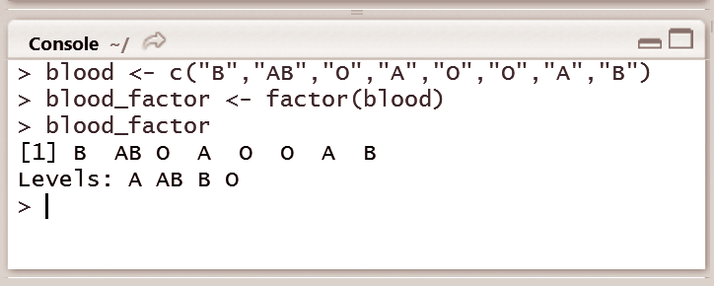
factor
A factor is a statistical data type that stores categorical variables, which is used in statistical modelling.
Factors are stored as a vector of integer values with a set of character values.
To convert this vector to a factor, the factor( ) function can be used as shown in Fig.

Slide 7
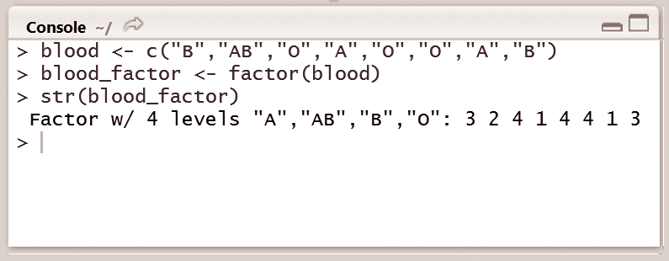
R performs two functions when the factor() function is called on a character vector:
1. First, it scans through the vector to check the availability of different categories, R performs a check for categories of blood groups among “A”, “AB”, “B”, and “O”.
2. Further it sorts the levels alphabetically as can be observed from

Slide 8
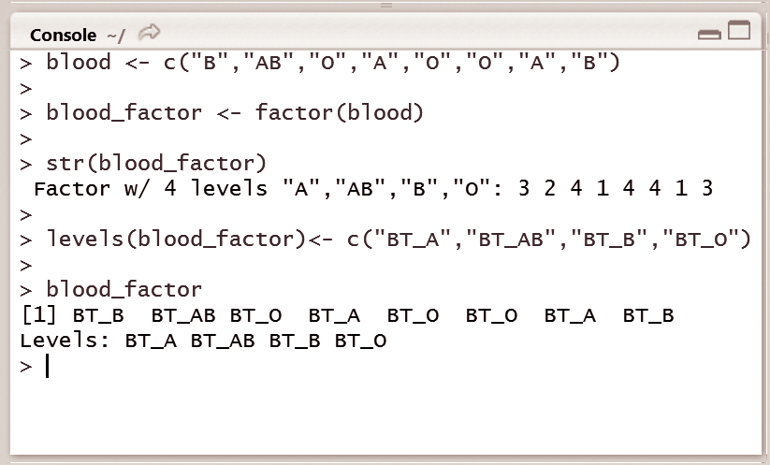
Factor Levels
Factors are integer vectors where each integer corresponds to a category or a level.
R allows programmers to perform this task using the function levels( ).
In case a different ordering of the levels is required, the argument can be specified in the factor function.

Slide 9
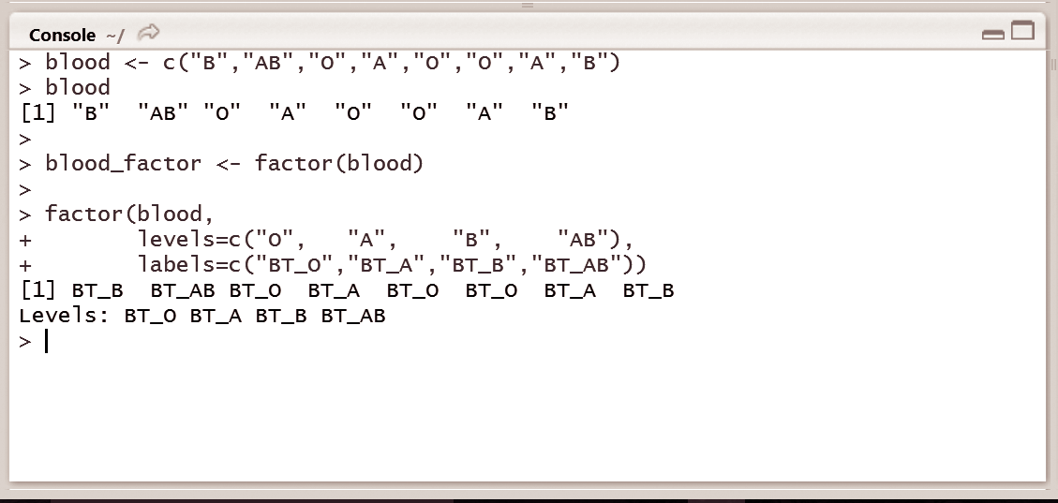
To change the order of the levels, it is possible to manually specify the level names, instead of letting R choose them.
To display the blood types as ‘BT_A’, ‘BT_AB’, ‘BT_B’, and ‘BT_O’, we can use the levels() function.
We can specify the category names or levels by using the labels argument in the factor() function.

Slide 10
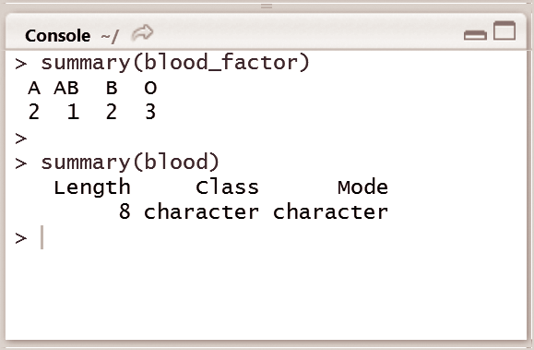
summarizing a Factor
Summary is a generic function used to produce summaries of the results.
For instance, in Fig, summary of the blood_factor object shows the 4 categories of blood groups A, AB, B, and O and the summary of the object blood shows us the number of elements in the vector (which is 8), the class, and the mode of that vector.

Slide 11
ordered Factors
There are examples where a natural ordering exists; sometimes programmers have to deal with factors that do have a natural ordering among their categories.
In the domain of categorical variables, there exists a difference between nominal categorical variables and ordinal categorical variables.
A nominal categorical variable, as mentioned earlier, has no implied order.

Slide 12
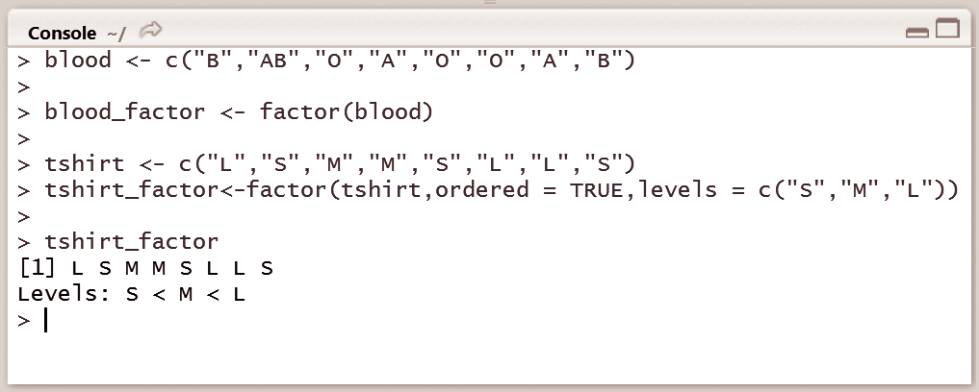
Write a command in R console to create a tshirt_factor, which is ordered with levels ‘S’, ‘M’, and ‘L’. Is it possible to identify from the examples discussed earlier, if blood type ‘O’ is greater or less than blood type ‘A’?
Fig. we can see that it is difficult to identify whether blood type “O” is greater or less than blood type “A”.

Slide 13
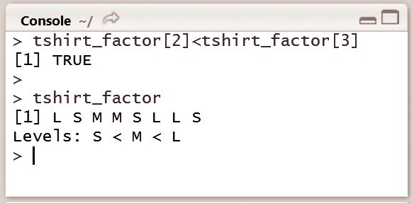
comparing ordered Factors
It is possible to compare ordered factors in R.
This is explained in Fig it is specified that L is indeed greater than M. R provides a way to impose this kind of order on a factor, thus making it an ordered factor. This is achieve by the factor() function, where the argument ordered is set to TRUE and the levels are specified in ascending order.

Slide 14
Data frame
Data sets typically comprise observations, or instances, that have some variables associated with them.
Data frame is a fundamental data structure to store data sets
For example, consider a data set of five people,
A matrix cannot be used to store such information in R, as name would be a character and age would be numeric and these will not fit in a matrix.

Slide 15
Creating a Data Frame
A data frame is created using the function data.frame() by using a variable data.
The parameters are the vectors created earlier, which are passed to the data frame as follows:
data.frame(ID, age, name)
The contents of the data frame can be displayed by printing the contents of the variable data, which looks like a spreadsheet.

Slide 16
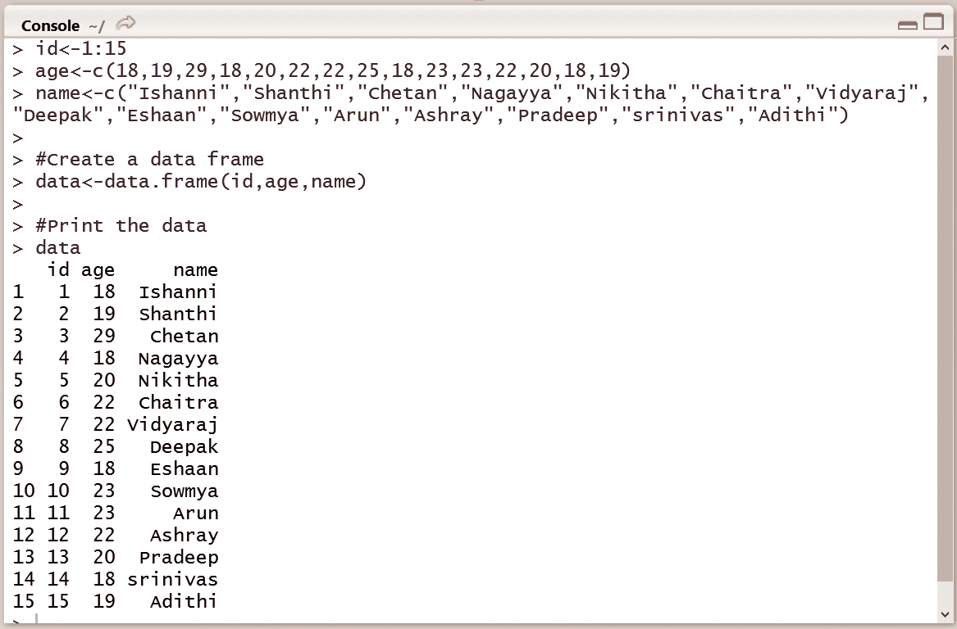

Slide 17
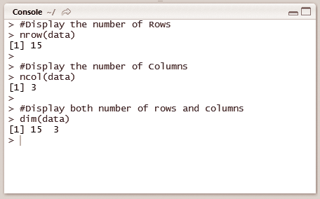
Compute number of rows and columns
The number of rows and columns in a data frame can be computed using the functions nrow() and ncol( )
The number of rows and columns of a data frame can be visualized in an environment window

Slide 18
sub setting of Data Frames
The data frame combines the features of matrices and lists.
To subset a data frame from both matrices and lists, the following syntax can be used;
Single brackets ‘[‘ are used for sub setting matrices
double brackets ‘[[‘
dollar sign ‘$’ are used to select list elements.
Figure illustrates the process of subsetting a data frame by considering the previous data set in Fig. 2.9 containing 15 employee records

Slide 19
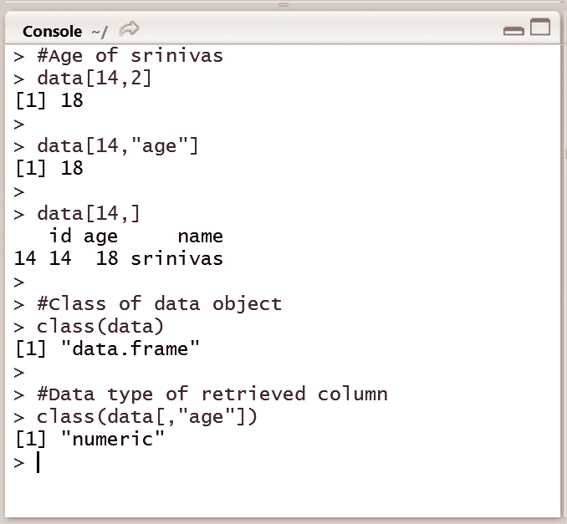

Slide 20
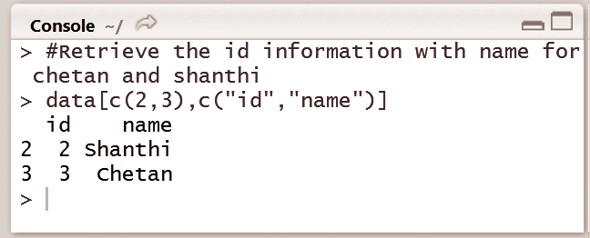
Write the command in R console to retrieve the name and id information from the 2nd and 3rd rows.
Figure illustrates retrieving data from rows 2 and 3 by selecting the name and id information of Chetan and Shanthi.

Slide 21
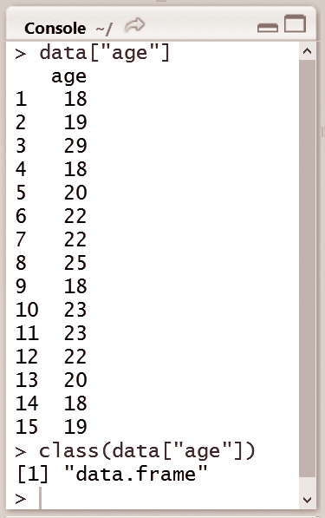
Write the command in R console to create a new data frame containing the ‘age’ parameter from the existing data frame. Check if the result is a data frame or not.
Single brackets can also be used to subset lists; this generates a new list containing only the specified elements. The result is still a data frame, which is a list, but containing only the “age” element as shown in Fig.

Slide 22
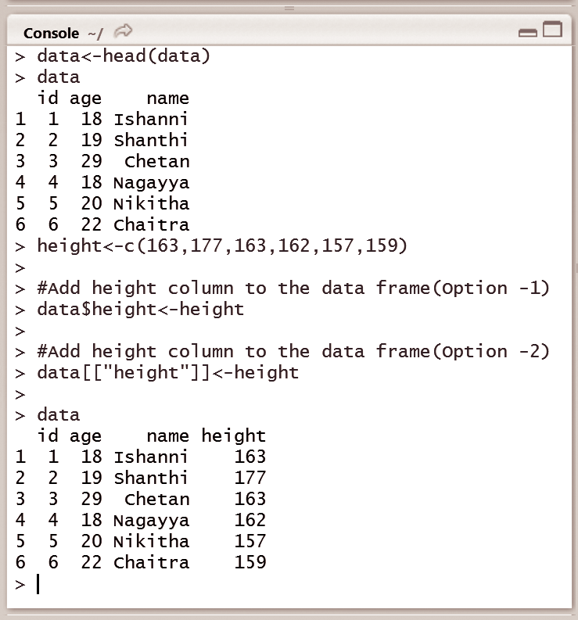
Extending Data Frames
To add a column, new variable, new row, or new observation to the existing data frame, the dollar sign or the double square brackets can be used. In Fig, a vector named ‘height’ is created and is added to data using $ and [ ].

Slide 23
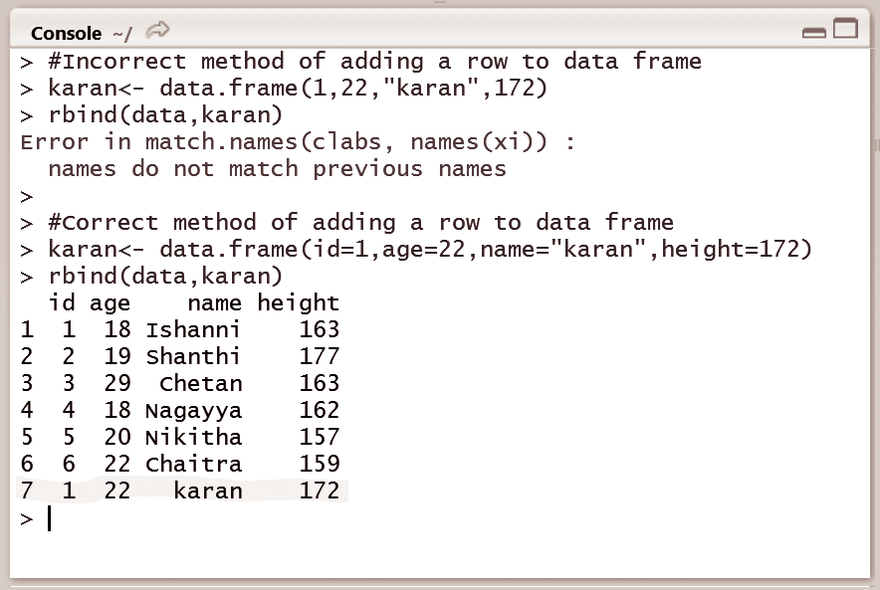
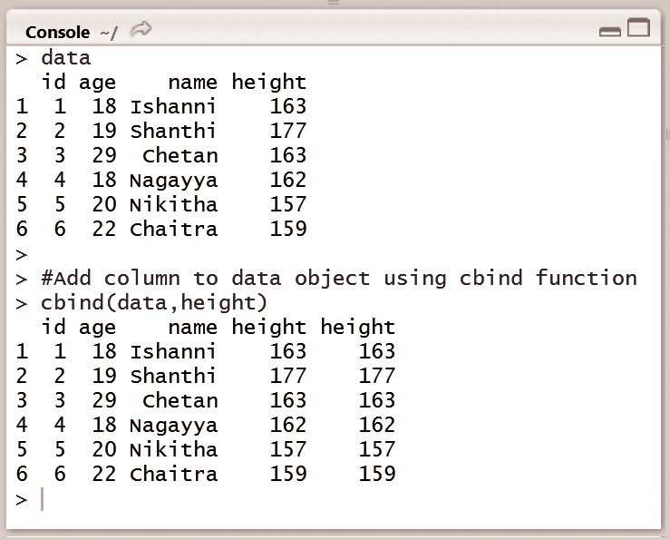
The cbind() function can also be used to build and extend matrices. It works similar to the data frames shown in Fig.
If cbind() works, than rbind() will work fine as well. Indeed, rbind() is used to add new rows to observations
To add the information of another employee named Karan to the data frame, simply creating a vector with the id, name, age, and height, won’t work, because a vector can’t contain elements of different types. A new data frame needs to be created containing only a single observation, and that needs to be added to the existing data frame using rbind(). The usage of cbind() and rbind() are shown in Fig.

Slide 24
sorting Data Frames
To sort the data frame by age, such that the youngest person is on top, and the oldest at the bottom.
the sort() function can be used. This function sorts a vector into ascending or descending order.

Slide 25
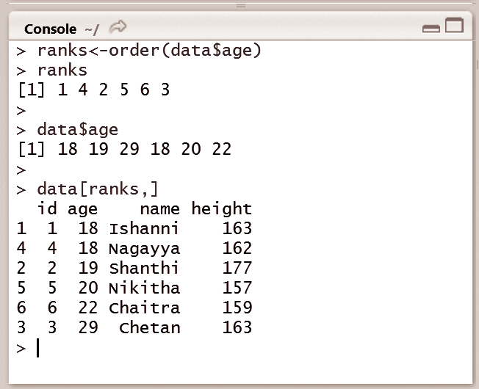
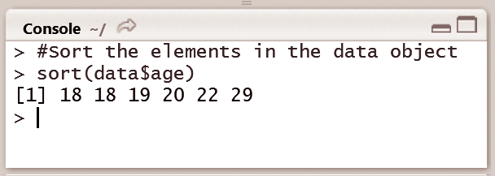
Write the command in R console to display the values of age of data in ascending order using the sort() function.
Fig. it can be observed that if the sorting is done based on the age column, then an ordered version of the age column is returned.
To change the ordering of the rows in the data frame, order() function can be used instead of the sort() function.

Slide 26
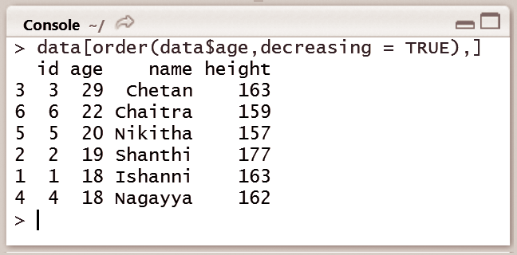
To sort in descending order, the decreasing argument is set to TRUE

