Slide 1
Chapter no. 3: Lists
This chapter will help the reader understand the following concepts:
Creating a list
Accessing and manipulating list elements
Merging lists
Converting lists to vectors

Slide 2
List
A list in R constitutes of different objects such as strings, numbers, and vectors.
it can include another list within it.
It can also include matrices and functions.
Creating a List
A list can be created using the list() function.
Figure demonstrates the creation of an anonymous list list_data, containing strings, numbers, vectors, and logical values as data objects, And also use print statement to print it.

Slide 3
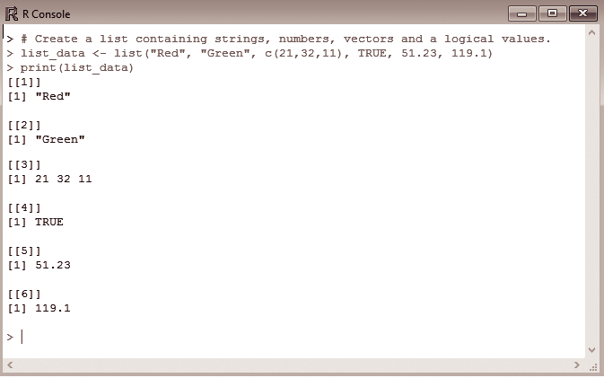

Slide 4
Creating a named List
Lists in R have a special property wherein names can be assigned to the previously defined set of elements in the list.
Named lists can be created using the names() function.

Slide 5
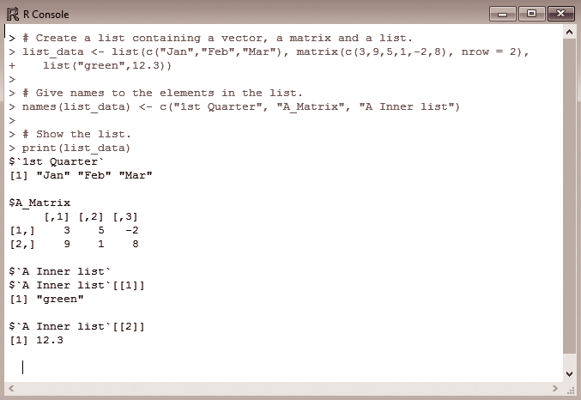
Write the command in R console to create a list containing a vector, a matrix, and a list. Also give names to the elements in the list and display the list.
creates a named list using the names() function.
First a list called list_data containing a vector and a matrix and another list called list are created.
The created list is viewed using the print statement.

Slide 6
Accessing List elements
The elements can be accessed using the index value of that element. For a named list, the elements are accessed based on their names.
In Fig., to access the first element from list_data, the index value of the list is accessed; here the list elements are indexed starting from 1 and not from 0. Therefore printing list_data[1] gives the names of the first and later elements in the list.

Slide 7
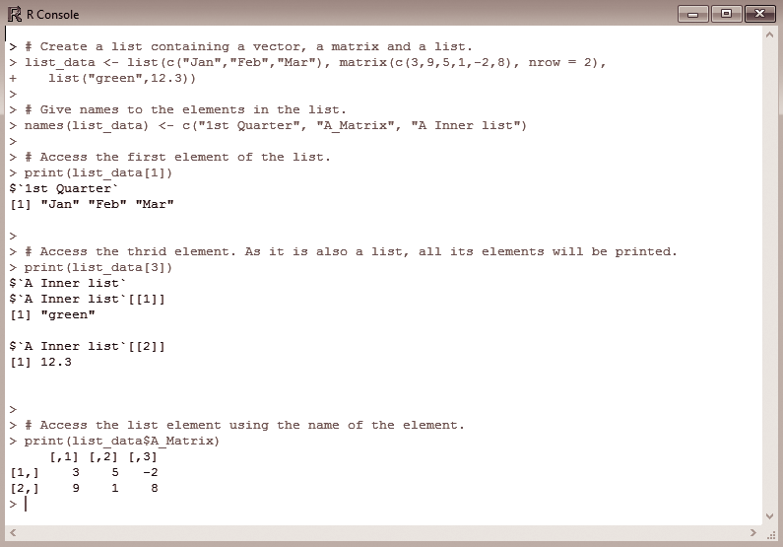

Slide 8
Manipulating List elements
Addition, deletion, and updating operations can be performed on the list to manipulate the elements.
Elements can be added and deleted only at the end of the list
update operation can be performed on any element in the list irrespective of its position

Slide 9
Write the command in R console to add a new element at the end of the list and display the same.
Fig depicts the addition of an element to a list.
Assume list consists of only three elements. To add the fourth element to this list, append the element (which is a string here) “New element” to the 4th indexed position of the list, that is, list_data[4].
To view the added element in the list, print the list and the four elements are displayed.

Slide 10
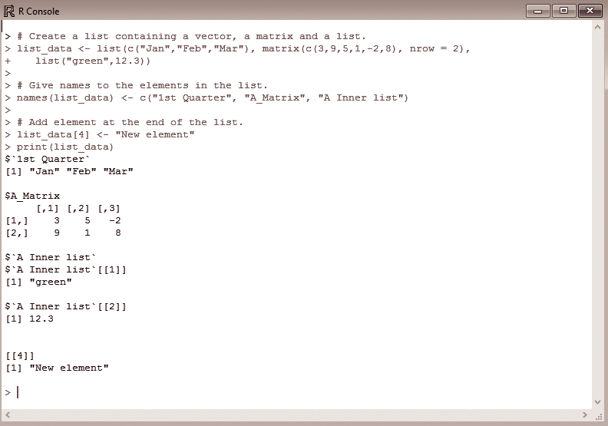

Slide 11
Write the command in R console to delete the fourth element from a list and display the resultant list.
Fig. , the fourth element, “New element” can be deleted by setting its value to NULL.
Printing list_data shows only three elements in the list

Slide 12
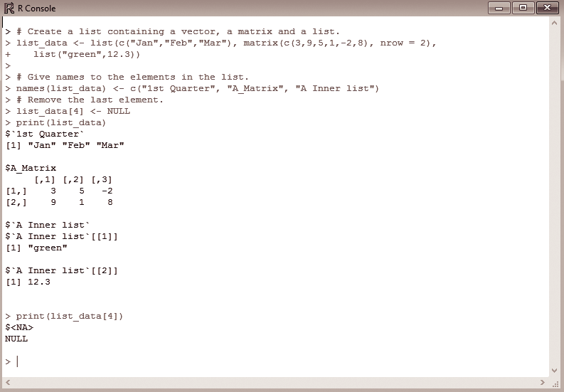

Slide 13
Merging Lists
Multiple lists can be merged by placing all those lists in a single list() function.
Figure, shows two lists list1 and list2 created using the list() function.
placing them in a single list() function gives a merged list called merged.list, which contains the elements of both the lists placed sequentially.

Slide 14
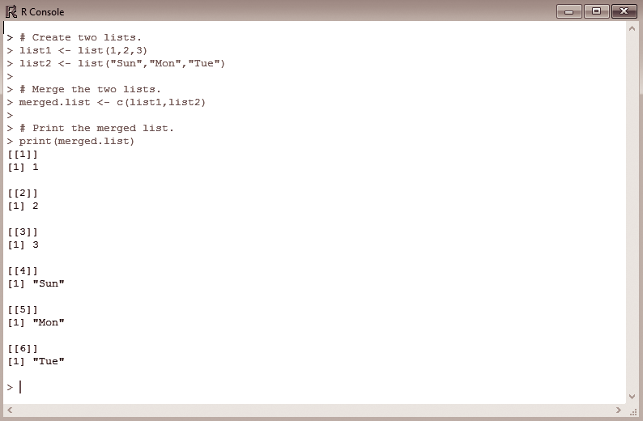

Slide 15
Converting Lists to vectors
There are some special cases where lists are converted to vectors for further manipulation of the data elements.
This is done because in addition to the basic operations of add, delete, and update, there are other arithmetic operations that can be easily applied when the operands are in vector form.
A special function called unlist() is used ; this function takes the input as list and produces vectors

Slide 16
Write the command in R console to create two lists, each containing 5 elements. Convert the lists into vectors and perform addition on the two vectors. Display the resultant vector.
Here two lists namely, list1 and list2 are initially created.
Later with the help of the unlist() function, both the lists are converted to vectors named v1 and v2

Slide 17
