Slide 1
Statistical Programming in R
Srinivasa, Siddesh, Shetty & Sowmya

Slide 2
Objectives
• Using apply, lapply, sapply, tapply, and mapply in R
• Differences between lapply and sapply
• Applications of mapply
• Split function

Slide 3
7.1 Introduction
The apply family belongs to the base package present in R
Avoids explicit use of loop constructs and also allow crossing of data in a different manner
They are essentially implicit loops that iterate over the elements of an object like a data frame or list
Execute some specified set of commands

Slide 4
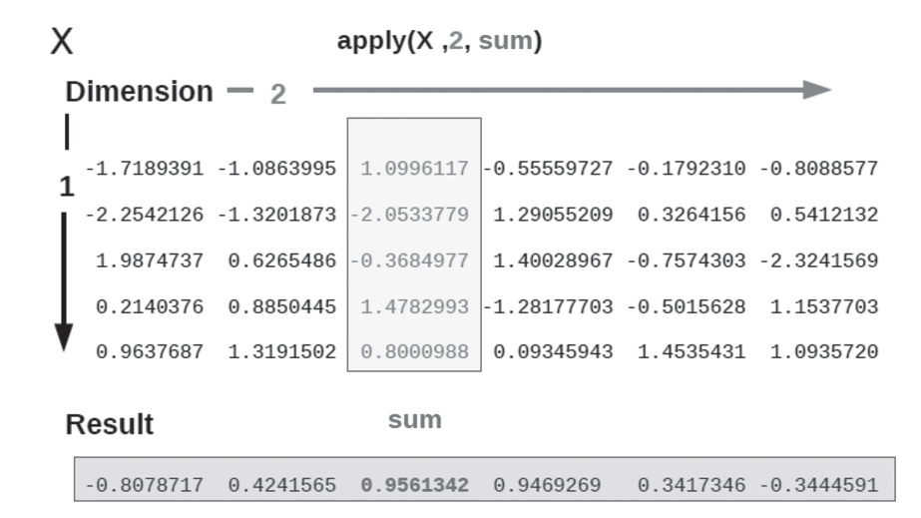
7.2 Using Apply in R
The apply function takes a minimum of three arguments
apply(X, MARGIN, FUN, ...)
FUN is found when match.fun is called and typically may be a function or a symbol

Slide 5
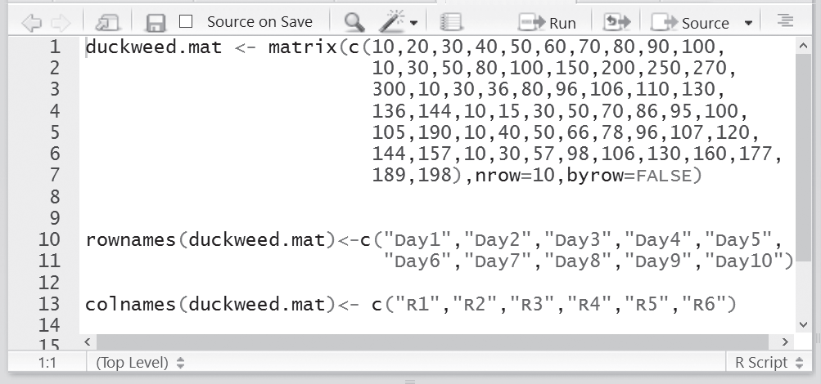
Illustration of Naming rows and columns
Fig. 7.2 Naming rows and columns

Slide 6
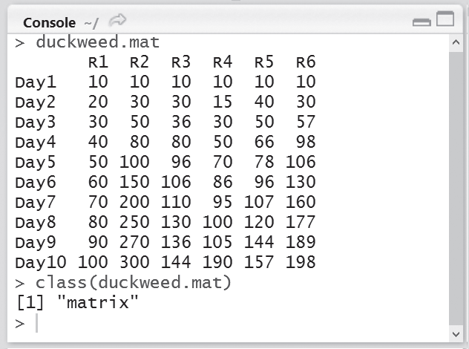
Illustration of Naming rows and columns
Fig. 7.3 Counting number of leaves

Slide 7
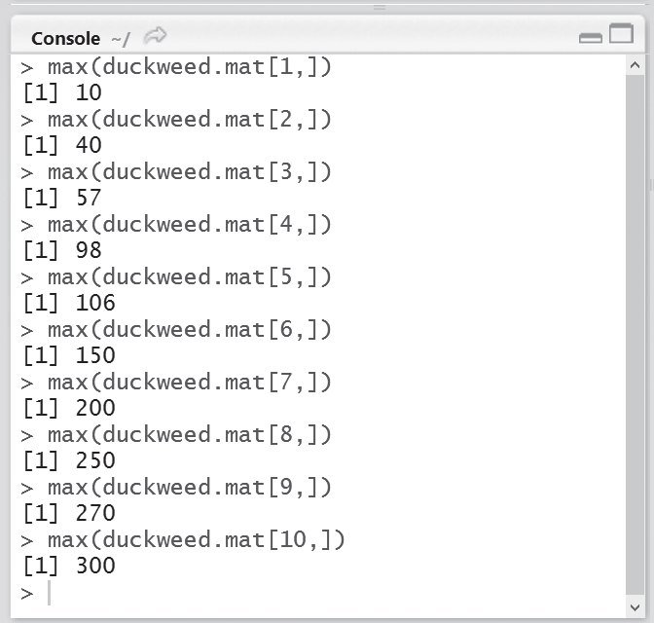
Fig. 7.4 Finding maximum number of leaves

Slide 8
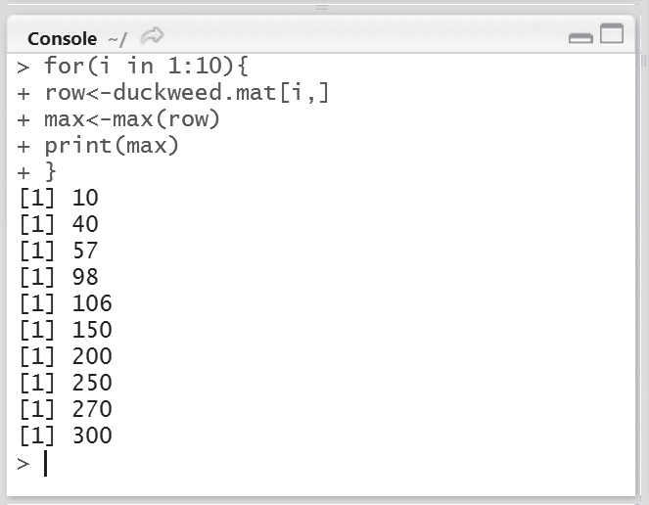
Fig. 7.5 Finding maximum number of leaves using for loop

Slide 9
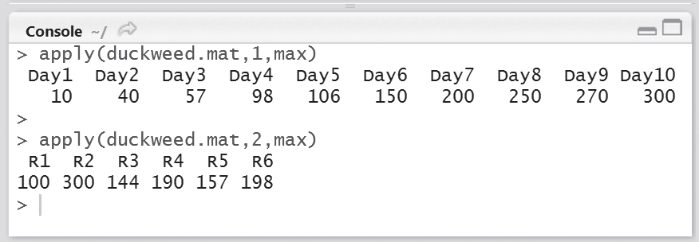
Fig. 7.6 Finding maximum number of leaves using apply function

Slide 10
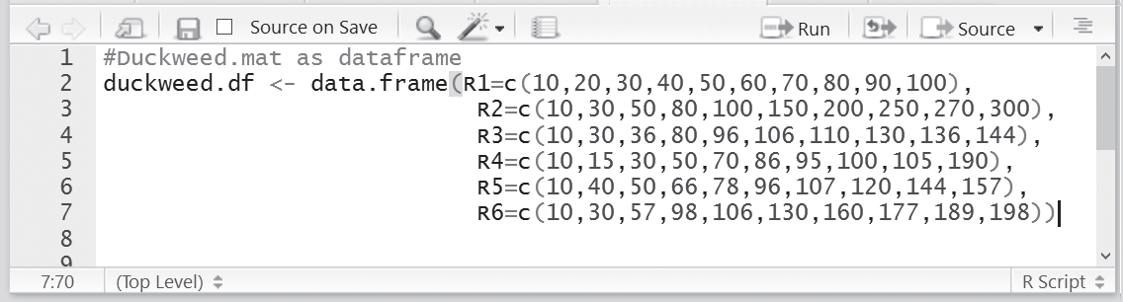
Fig. 7.7 Building a data frame for duckweed

Slide 11
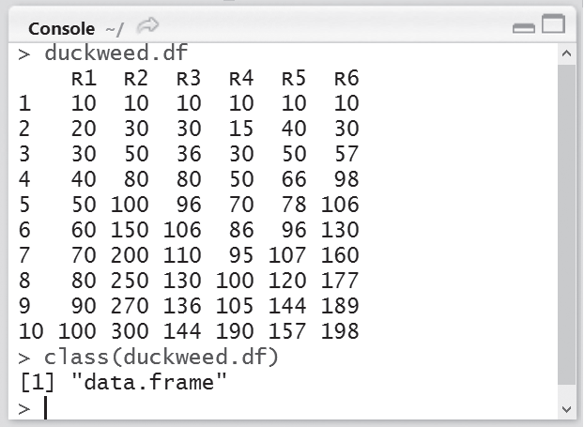
Fig. 7.8 Obtaining the datatype

Slide 12
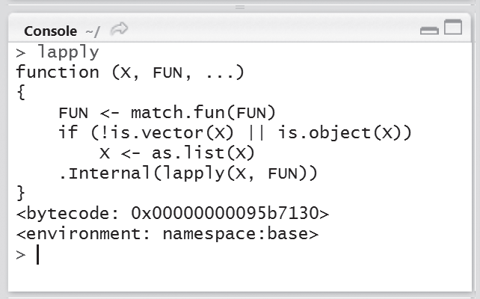
7.3 Using lapply in R
Lapply() is a function that loops over a list and evaluates a function on each element.
The sapply() function also behaves in a similar manner as the lapply function, but it also ensures that the results are more simplified.
apply() takes 3 arguments—X, which is a list, a function FUN (or the name of a function)

Slide 13
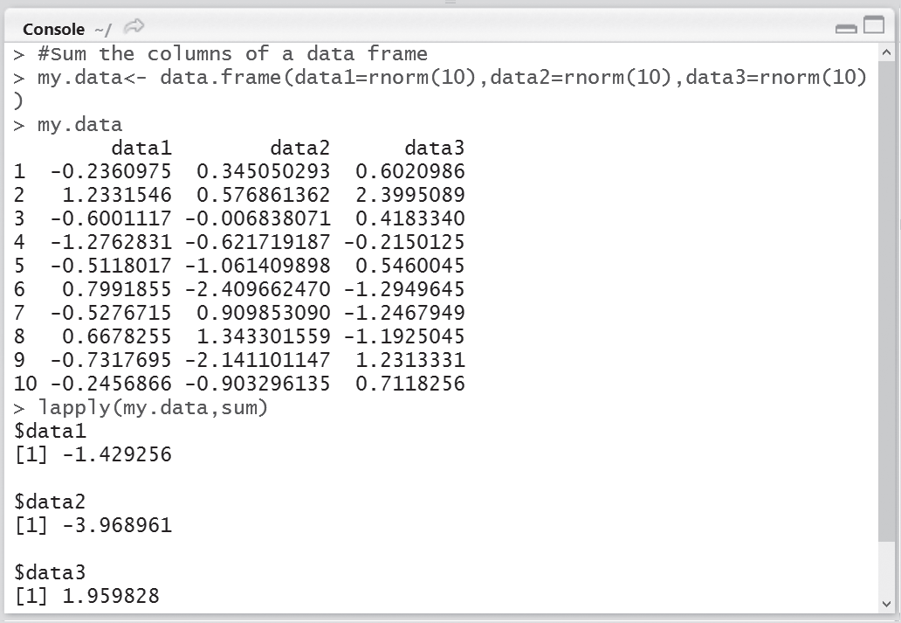
Illustration of lapply()
Fig. 7.20 Summing the columns using lapply

Slide 14
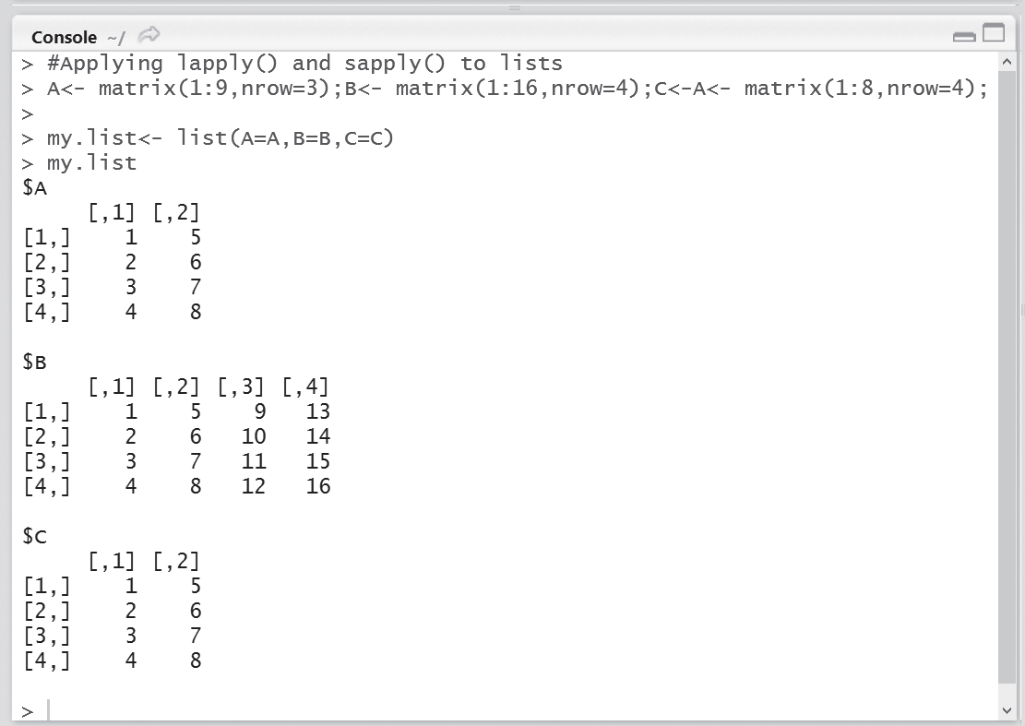
Fig. 7.21 Creating a list consisting of 3 matrices each of different dimension

Slide 15
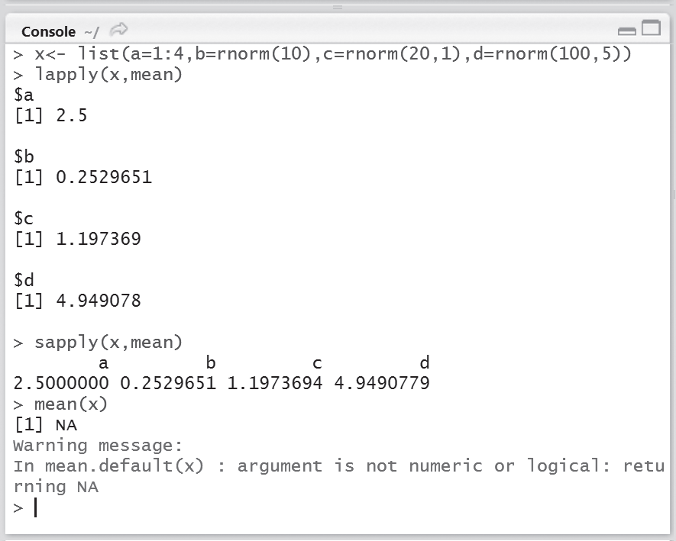
7.4 Using sapply in R
The sapply() function is a user-friendly version and a wrapper of the lapply() function.
It returns a vector by default.

Slide 16
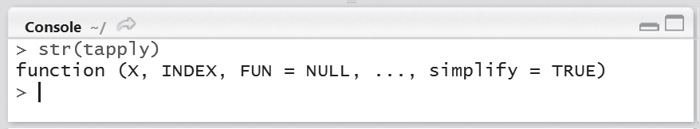
7.5 Using tapply in R
tapply is another important function which is used when a function should be applied over subsets of vectors
Fig. 7.24 Structure of tapply function

Slide 17
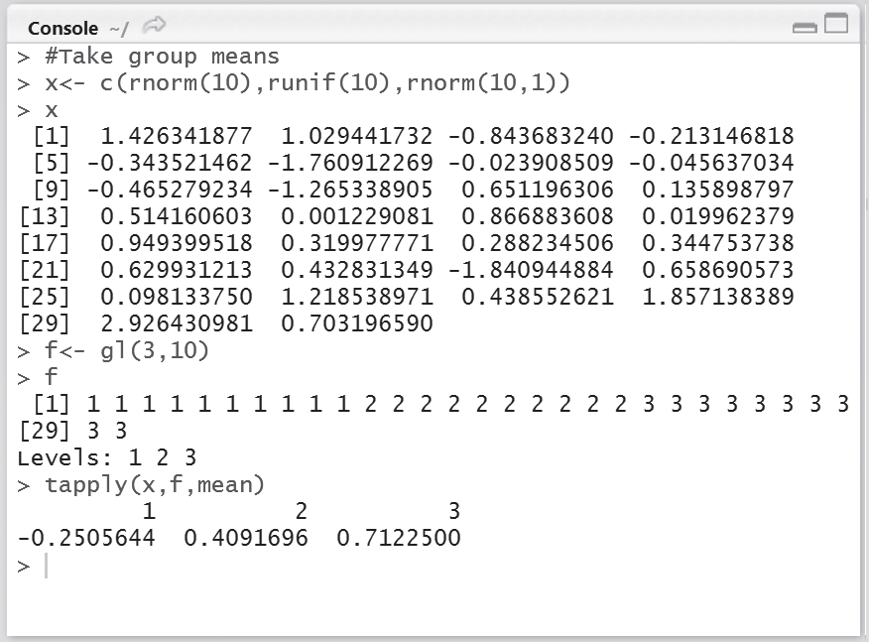
Example:
Write the commands in R console to obtain the mean using tapply function by considering a vector having 10 normal and 10 uniform variables. Assume that these vectors have three groups
Fig. 7.25 Using tapply function to obtain mean

Slide 18
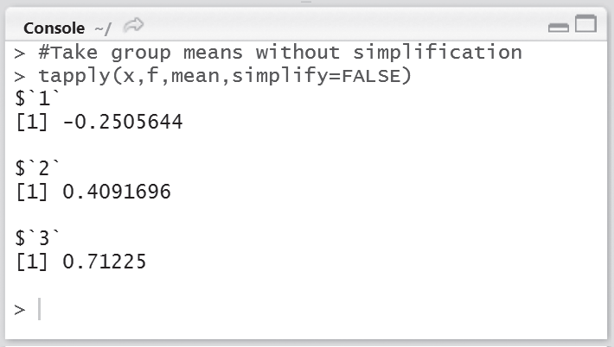
Fig. 7.26 Using simplify = FALSE to obtain a list of three elements

Slide 19
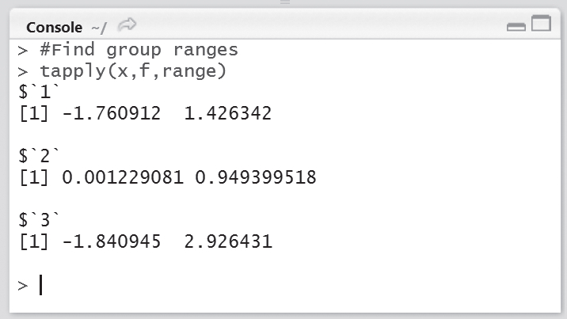
Fig. 7.27 Determining group range

Slide 20
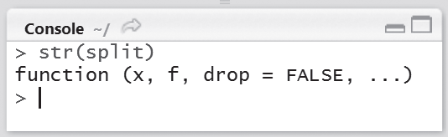
7.5.1 Split function
The split() function can be used by combining two or more functions such as lapply or sapply.
It is not considered a loop function.
Fig. 7.28 Structure of split function

Slide 21
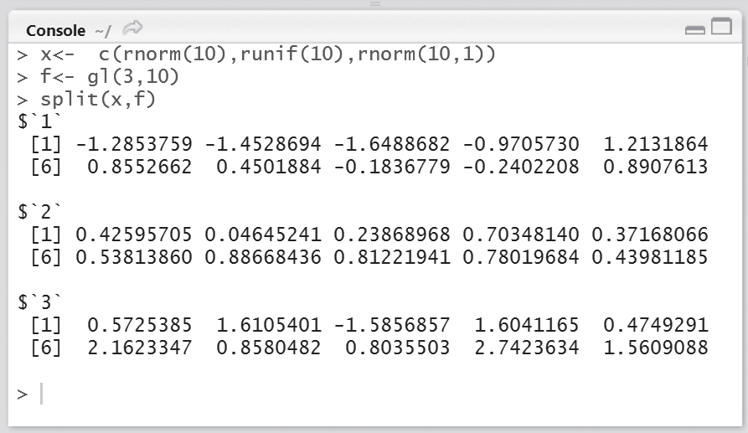
Illustration of split function
Fig. 7.29 Generating a collection having normal random variables

Slide 22
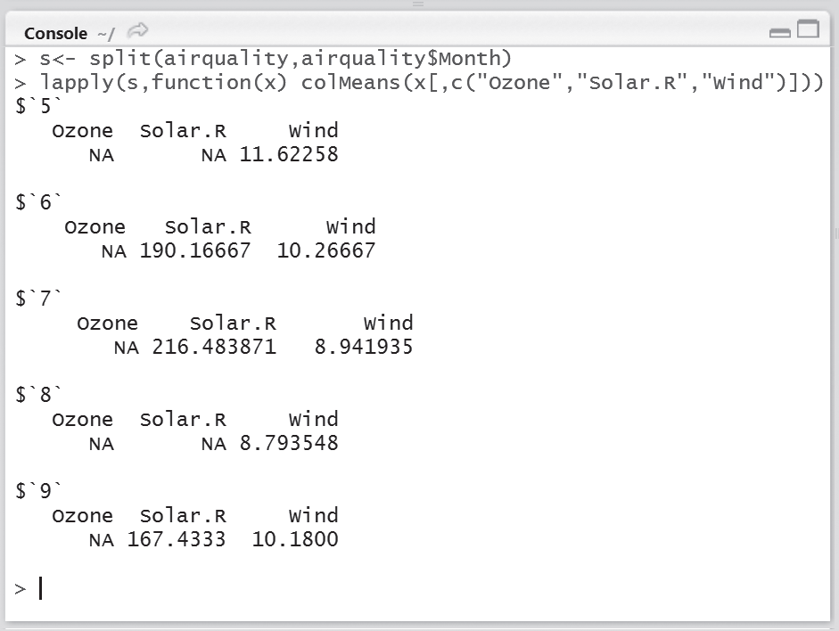
Example
Calculate the mean of ozone, solar radiation, and wind within each month using lapply for airquality dataframe.
Fig. 7.31 Calculating the mean of ozone, solar radiation, and wind using lapply

Slide 23
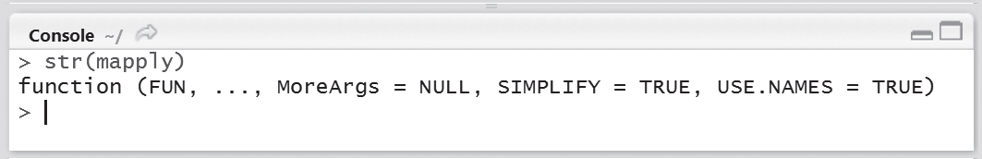
7.6 Using mapply in R
mapply is a multivariate version of the lapply and sapply functions
Fig. 7.33 Structure of mapply

Slide 24
The arguments of the mapply function are described as follows:
FUN: function to apply
…: The function to be passed to mapply has a number of arguments to apply over
MoreArgs: If there are three lists and if a user passes three objects, the defined function shall take at least three arguments in the function; the MoreArgs argument is used if users want to pass more arguments that are needed to the function FUN.
SIMPLIFY: if this is given as TRUE by the user, it signifies that the result should be simplified.

