Slide 1
Statistical Programming in R
Srinivasa, Siddesh, Shetty & Sowmya
© Oxford University Press 2017. All rights reserved.
1

Slide 2
8: Charts and Graphs
Objectives
• Pie chart and 3D pie chart
• Bar chart
• Box plot
• Histogram
• Line graph and multiple line graph
• Scatter plot
© Oxford University Press 2017. All rights reserved.
2

Slide 3
8.1 Introduction
Charts are mainly used to generate a graphical representation of the given data sets.
It is a diagrammatical representation of information, in which the information is shown in the form of a circle, bar, line, etc.
It helps the user to understand the information better and make data visualization simpler.
© Oxford University Press 2017. All rights reserved.
3
Notes:
3

Slide 4
8.2 Pie Chart
Pie charts give more visibility as judging length is more precise than judging volume
Syntax
The general syntax for creating a pie chart using R is as follows:
pie(arguments)
pie (part, labels, edges, radius, clockwise, init.angle, density, angle,col, main)
The following are the arguments:
• part: contains a vector of non-negative numeric values and tells the size of parts
• labels: used to assign names to each part
• edges: used to change the outer circle of the pie; the default value is 200
• radius: used to change the radius of the pie chart circle; the value is between −1 and 1
© Oxford University Press 2017. All rights reserved.
4

Slide 5
• clockwise: used to draw chart parts in the clockwise or counterclockwise direction; takes a Boolean value, that is, true or false
• init.angle: used to specify the initial angle (in degrees) for chart parts; the default value is 0
• density: used to show the density of the shading lines inside the chart; the default value is NULL (no shading)
• angle: used to change the angle of the shading lines inside the chart
• col: used to show colors in chart
• main: used to display the title of the chart
© Oxford University Press 2017. All rights reserved.
5

Slide 6
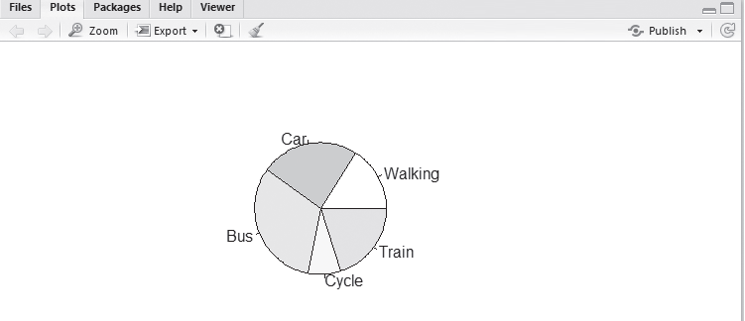
Example:
Using R pie chart, demonstrate the percentage conveyance of various ways for traveling to office such as walking, car, bus, cycle, and train.
© Oxford University Press 2017. All rights reserved.
6

Slide 7
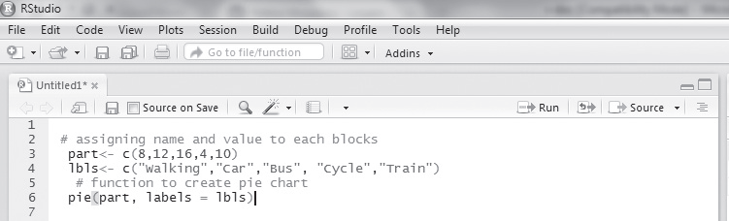
© Oxford University Press 2017. All rights reserved.
7

Slide 8
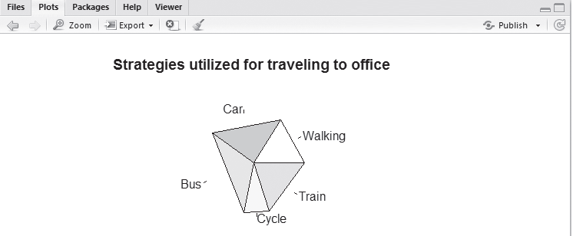
Illustration of Pi()
© Oxford University Press 2017. All rights reserved.
8

Slide 9
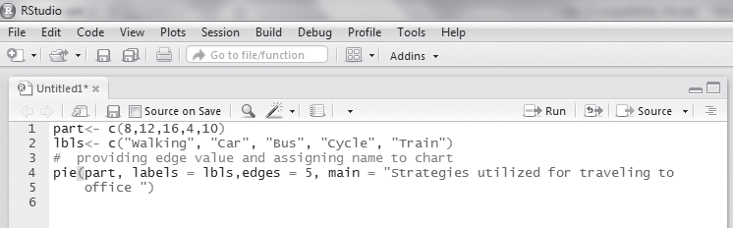
© Oxford University Press 2017. All rights reserved.
9

Slide 10
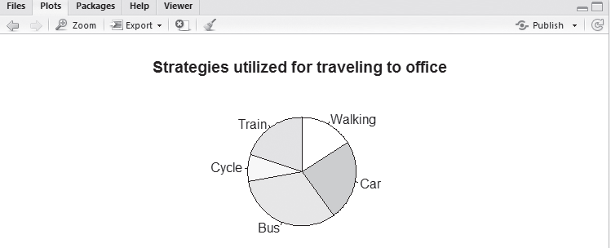
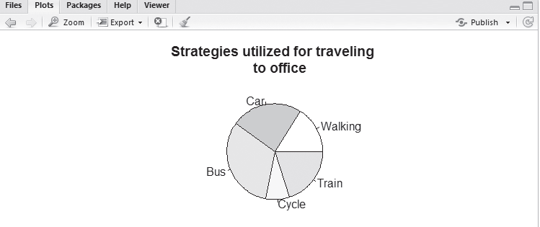
Illustration of Pi()
Commands and output for part, labels, clockwise, and main
© Oxford University Press 2017. All rights reserved.
10

Slide 11
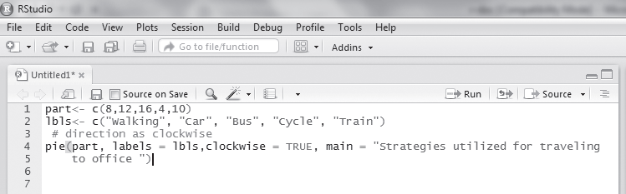
© Oxford University Press 2017. All rights reserved.
11

Slide 12
8.2.1 Chart Legend
Chart legends are used to provide a small description of each part; we can specify where on the chart it should be displayed, that is, top-left, top-right, bottom-left, or bottom-right, etc. In a pie chart, the legend is included using the legend function
legend (graphics)
Example: legend (position, labels, fill)
Here
• position: states the position of legend
• labels: defines the label of blocks
© Oxford University Press 2017. All rights reserved.
12

Slide 13
Example
Using a chart legend, show the percentage conveyance of various ways for traveling to office such as walking, car, bus, cycle, and train.
(i) Walking is assigned red color, car – blue color, bus – yellow color, cycle – green color, and train – white color; all these values are assigned through cols and lbls variables and the legend function.
(ii) The fill parameter is used to assign colors to the legend.
(iii) Legend is added to the top-right side of the chart, by assigning
© Oxford University Press 2017. All rights reserved.
13

Slide 14
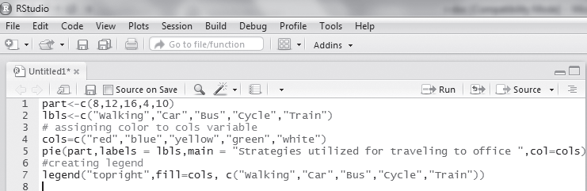
© Oxford University Press 2017. All rights reserved.
14

Slide 15
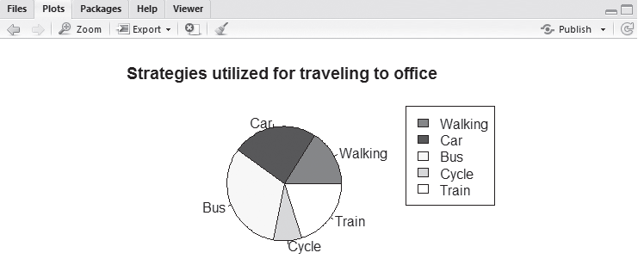
Fig. 8.9 Commands and output for legend
© Oxford University Press 2017. All rights reserved.
15

Slide 16
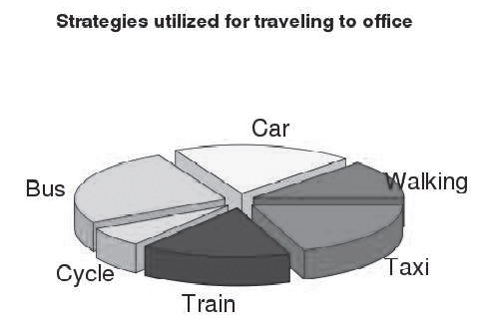
8.2.2 3D Pie Chart
A pie chart of three-dimensional (3D) shape is called a 3D pie chart. It is used to display the information in 3D form.
A 3D pie chart can be created using the pie3D function
Syntax
Pie3D(parameters)
Package plotrix
© Oxford University Press 2017. All rights reserved.
16

Slide 17
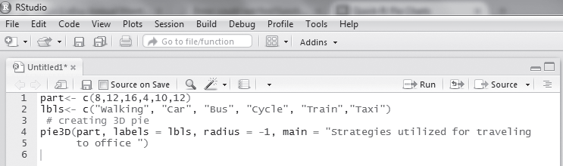
© Oxford University Press 2017. All rights reserved.
17

Slide 18
8.3 Bar Chart
A bar chart represents data in rectangular bars with lengths relative to the value.
Syntax
barplot (arguments)
Example:
barplot (part, names.arg, xlab, ylab, main, col)
The following are the most used arguments in real-time:
• part: contains a vector of non-negative numeric values, tells the size of parts
• main: used to display the title of the bar chart
• xlab: used to provide the label for the X-axis
• ylab: used to provide the label for the Y-axis
© Oxford University Press 2017. All rights reserved.
18

Slide 19
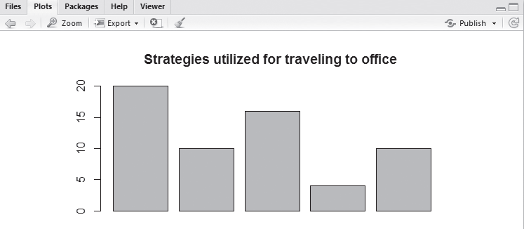
Example
Using R bar chart, demonstrate the percentage conveyance of various strategies utilized for traveling to office such as bike, car, bus, auto, and train.
© Oxford University Press 2017. All rights reserved.
19

Slide 20
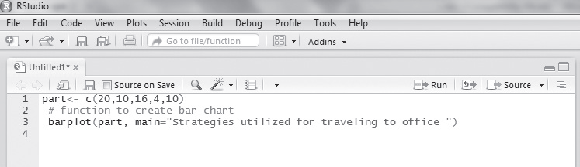
© Oxford University Press 2017. All rights reserved.
20

Slide 21
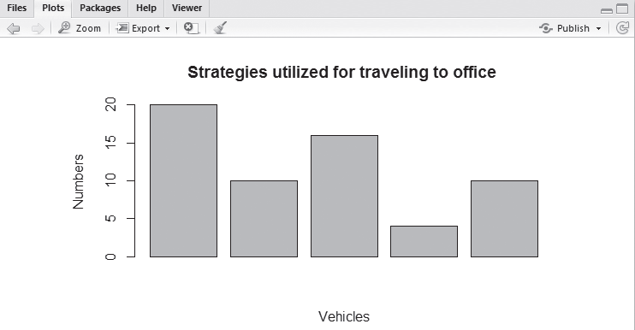
Considering parameters part, main, xlab, and ylab.
(i) Numerical values 8, 12, 16, 4, and 10 are assigned to the part argument.
(ii) The barplot function is used to create a bar chart; here part is used to assign values to each part of the chart and main is used to assign the title ‘Strategies utilized for traveling to office’ for the chart.
(iii) The xlab argument is used to assign the name to x-axis as Vehicles.
(iv) The ylab argument is used to assign the name to y-axis as Numbers
© Oxford University Press 2017. All rights reserved.
21

Slide 22
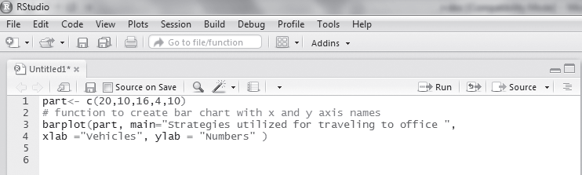
Commands and output for part, main, xlab, and ylab
© Oxford University Press 2017. All rights reserved.
22

Slide 23
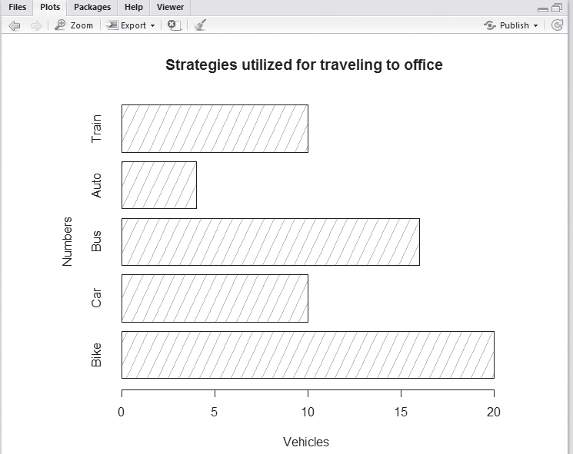
Considering the parameters part, main, xlab, ylab, names.arg, density, and horiz
© Oxford University Press 2017. All rights reserved.
23
Commands and output for part, main, xlab, ylab, names.arg, density, and horiz

Slide 24
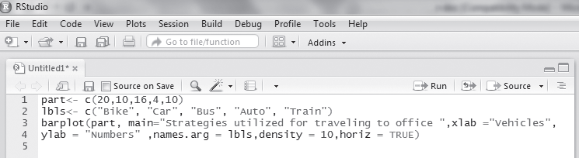
© Oxford University Press 2017. All rights reserved.
24

Slide 25
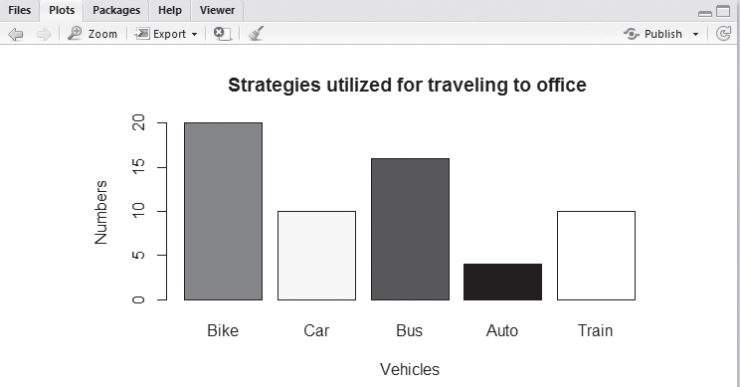
Considering the color parameter
© Oxford University Press 2017. All rights reserved.
25

Slide 26
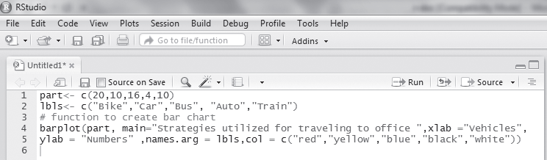
© Oxford University Press 2017. All rights reserved.
26

Slide 27
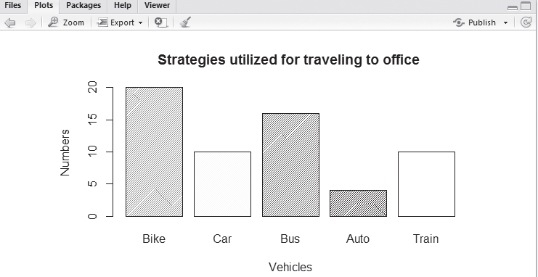
Considering the parameters density, angle, and color
© Oxford University Press 2017. All rights reserved.
27

Slide 28
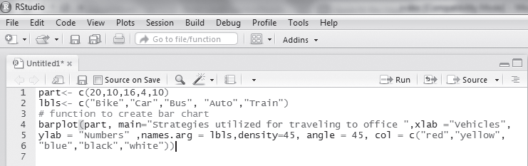
© Oxford University Press 2017. All rights reserved.
28

Slide 29
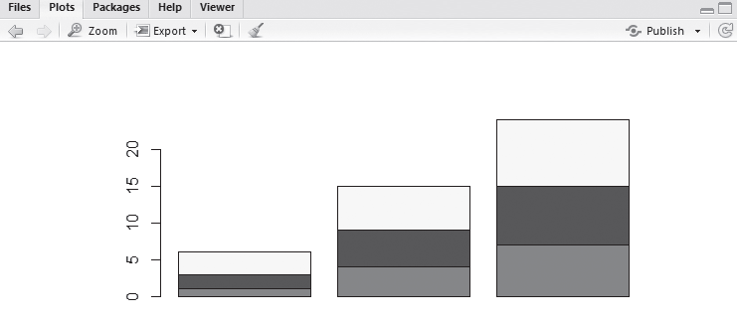
Designing a stacked bar plot using matrix values
© Oxford University Press 2017. All rights reserved.
29

Slide 30
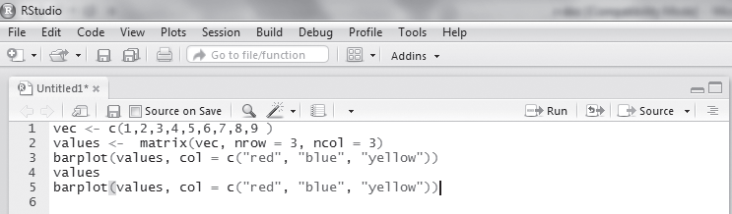
© Oxford University Press 2017. All rights reserved.
30

Slide 31
8.4 Box Plot
The box plot is a method to graphically picture the numerical information, gathered by p
Syntax
boxplot(arguments)
There are various arguments in boxplot, some of them are as follows:
• data: contains a list of data to design a box plot
• x: data or values to draw the box plot
• xlab: label for x-axis
• ylab: label for y-axis
• main: displays the title for the box plot
• col: used to assign color to the box plot.
• notch: used to design a line on each side of the boxes; takes a Boolean value
© Oxford University Press 2017. All rights reserved.
31

Slide 32
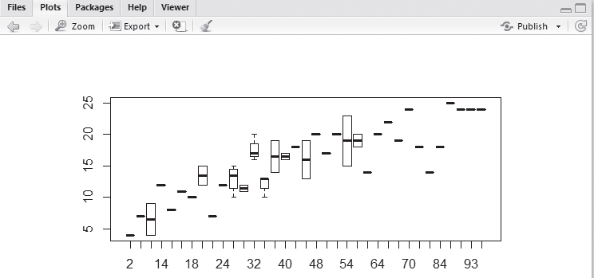
Example
Using box plots demonstrate the relation between the cars speed and the distance taken to stop
Considering the parameters data and x
(i) The boxplot function is used to create a box chart.
(ii) Here we are displaying the speed and dist parameter of Cars data set using x and data parameters
© Oxford University Press 2017. All rights reserved.
32

Slide 33
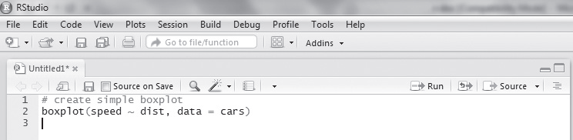
Commands and output for data and x
© Oxford University Press 2017. All rights reserved.
33

Slide 34
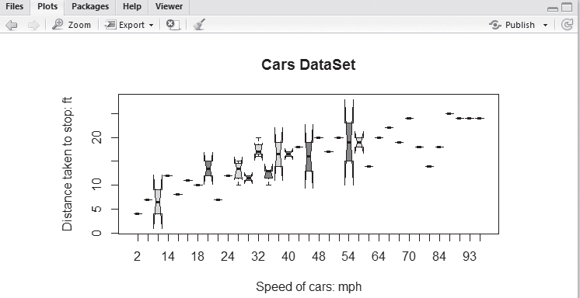
© Oxford University Press 2017. All rights reserved.
34

Slide 35
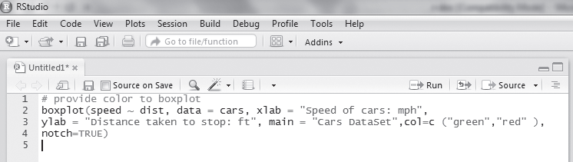
© Oxford University Press 2017. All rights reserved.
35

Slide 36
8.5 Histogram
A histogram is a plot that gives us a chance to find, and show, the hidden recurrence (shape) of a set of continuous information
Syntax hist(arguments)
The following are the list of arguments used:
• data: values to create a histogram
• main: title of the histogram
• col: provides color for blocks
• xlab: label for x-axis
• ylab: label for y-axis
• labels: used to display the values of the blocks at the top; takes a Boolean value
• xlim: used to display values till a specific limit on the x-axis; takes (x1, x2) as input value where x1
and x2 are numbers set of continuous information
© Oxford University Press 2017. All rights reserved.
36

Slide 37
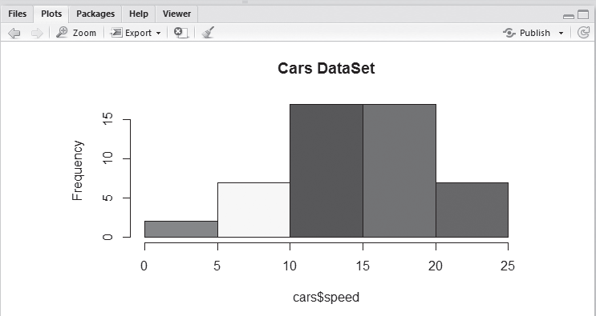
Example
Using R histogram, demonstrate the relationship between the cars speed and distance taken to stop.
© Oxford University Press 2017. All rights reserved.
37

Slide 38
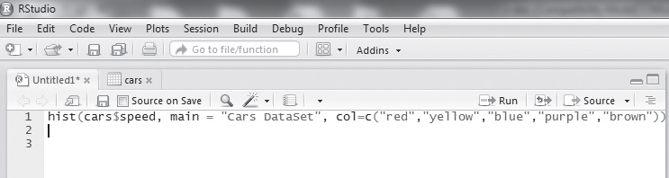
© Oxford University Press 2017. All rights reserved.
38
Commands and output for data, main, and col

Slide 39
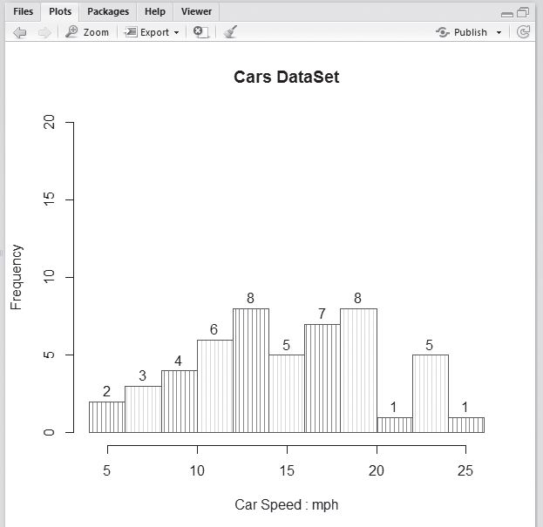
Illustration of Histogram
Considering the parameters density, break, and angle
(i) The value of density is passed as 20; this will create multiple lines inside each block.
(ii) The angle parameter is used to give a particular angle to the vertical lines that are present inside each block; here, angle = 90° will create each line in 90° angle form.
© Oxford University Press 2017. All rights reserved.
39

Slide 40
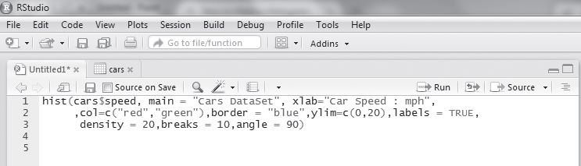
© Oxford University Press 2017. All rights reserved.
40

Slide 41
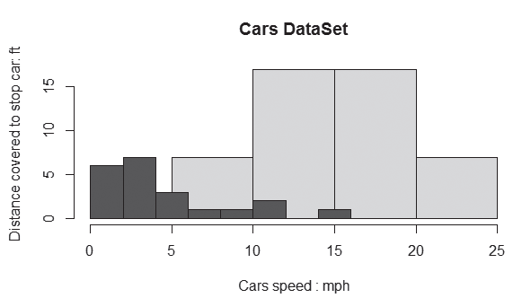
Illustration of Histogram
Combining multiple histograms
(i) Two different histograms are combined by taking values of the inbuilt data set of R Studio, that is, cars, and in the next one we are assigning a value to the variable d.
(ii) Two different function are called to create histograms—one for the cars data set and another one for d variable values.
© Oxford University Press 2017. All rights reserved.
41

Slide 42
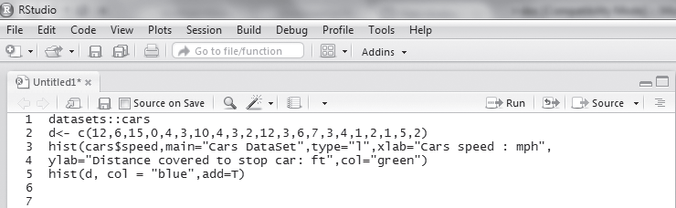
Commands and output for multiple histograms
© Oxford University Press 2017. All rights reserved.
42

Slide 43
8.6 Line Graph
A line graph is a kind of graph used to show information as a sequence of data, which are linked thr
Syntax
plot(arguments)
The following are the list of arguments used:
• data: numeric values, used to create the graph
• type: used to show lines in different forms, as follows:
l: show only line
p: show only points
o: show both points and line
h: show line in vertical format
© Oxford University Press 2017. All rights reserved.
43

Slide 44
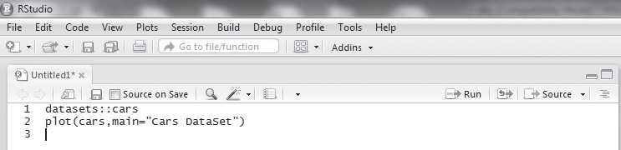
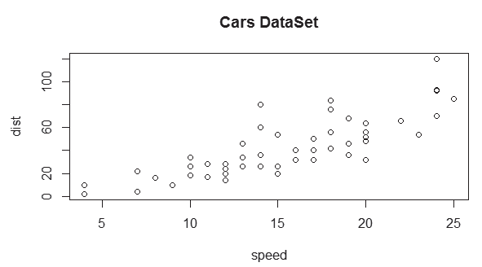
Example
Using R line graphs, demonstrate the relationship between cars speed and the distance taken to stop.
© Oxford University Press 2017. All rights reserved.
44

Slide 45
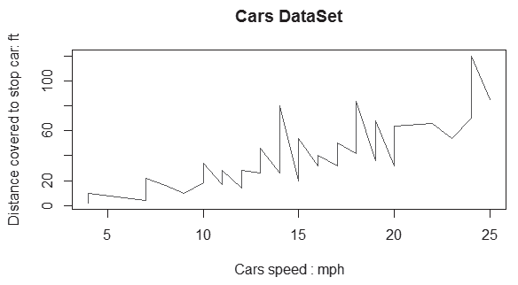
Illustration of Line graph
Considering the parameters data, type = l, col, main, xlab, and ylab
© Oxford University Press 2017. All rights reserved.
45

Slide 46
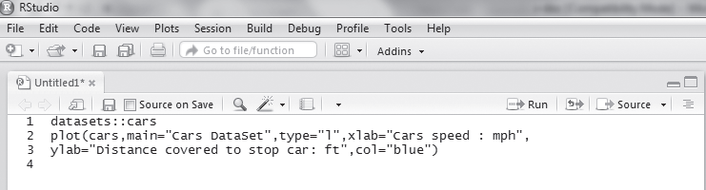
© Oxford University Press 2017. All rights reserved.
46

Slide 47
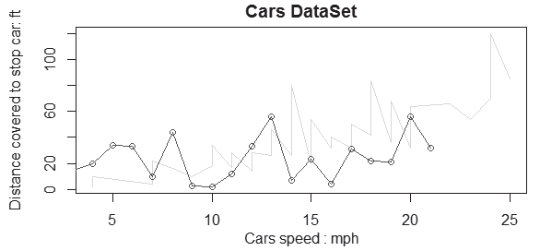
8.6.1 Multiple Lines in Line Graph
Commands and output for multiple lines
© Oxford University Press 2017. All rights reserved.
47

Slide 48
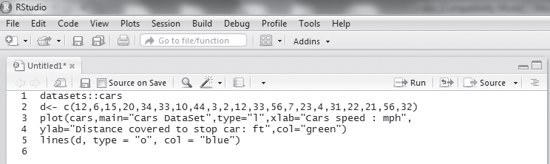
© Oxford University Press 2017. All rights reserved.
48

Slide 49
8.7 Scatter Plot
Scatter plots are used to show the relation between two variables of the given sets of data.
Syntax
Plot(arguments)
The following are some of the arguments used:
• x: data for x-axis
• y: data for y-axis
• main: title of the scatter plot
• type: can take the following values:
p: to show values as points
l: to show values as a line
h: to generate a histogram
© Oxford University Press 2017. All rights reserved.
49

Slide 50
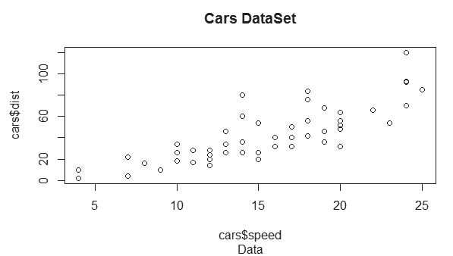
Example
Using scatter plots in R, demonstrate the relationship between cars speed and the distance taken to stop it.
Considering the parameters x, y, sub, and main
© Oxford University Press 2017. All rights reserved.
50

Slide 51
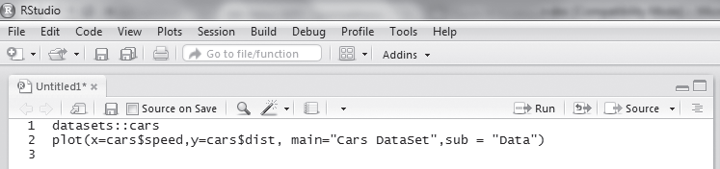
© Oxford University Press 2017. All rights reserved.
51

Slide 52
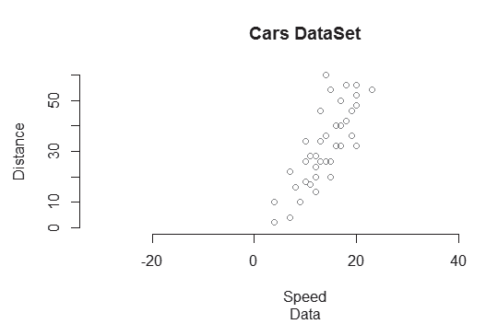
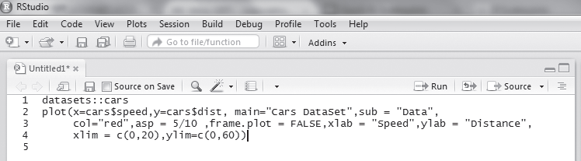
© Oxford University Press 2017. All rights reserved.
52

Slide 53
THANK YOU
© Oxford University Press 2017. All rights reserved.
53

