Slide 1
Statistical Programming in R
Srinivasa, Siddesh, Shetty & Sowmya

Slide 2
Chapter10: Statistical Applications
A systematic study of this chapter will help the reader understand the following concepts:
• Basic statistical operations—mean, median, mode, standard deviation
• Linear regression analysis
• One sample test, paired t-tests, independent t-tests
• Chi-squared goodness of fit test, chi-squared test of independence
• Multiple regression, logistic and exponential regression
• Sampling distribution
• Decision tree

Slide 3
• Time series analysis
• Probability distribution—normal, binomial, and Poisson distributions
• ANOVA
• Correlation and covariance
• Poisson regression
• Survival analysis
• Random forest
• Applications of R programming

Slide 4
10.2 Basic Statistical Operations
Basic statistical operations on any numerical data includes calculation of;
Mean
Median
Mode
Standard deviation

Slide 5
Mean
Mean is calculated as the summation of all the values in the data series divided by the number of values.
Following is the function and syntax definition for calculating the mean:
mean(V, trim=0.0, na.rm= FALSE, …)
V is the input vector;
trim, which sorts the input vector and removes equal number of values specified from both ends of the sorted vector;
na.rm dismisses the missing values from the input vector.

Slide 6
Median
Median is the middle value of any data series. The R function for calculating the median is:
median(V, na.rm=FALSE)
The function takes V as the input vector and na.rm for dismissing the missing values from V to avoid anomalies.

Slide 7
Mode
Mode is defined as a value that has the maximum number of occurrences in the data series.
There may be more than one value with equal number of occurrences.
Mode can be calculated for both numerical data and character data unlike mean and median, which are applicable only for numerical data.

Slide 8
Standard Deviation
Apart from calculating the mean, median, and mode, another important function for any statistical analysis of the data is calculation of standard deviation.
The R function for calculating the same is as follows with syntax definition:
sd(V, na.rm=FALSE)
Function takes any numerical vector V as input with the na.rm parameter.

Slide 9
10.3 Linear Regression Analysis
Linear regression analysis is one of the widely used methods for statistical analysis and the result of this analysis is how exactly the relationship is established between the two variables of the model.
The first variable is known as the independent variable, which comprises the values drawn out of experimental results.

Slide 10
The second variable is the dependent variable, which comprises the values derived from the independent variable.
Linear regression analysis in R constitutes model building with the help of two variables in the equation form as follows:
Yi = a + bXi + ei , i = 1, …, h

Slide 11
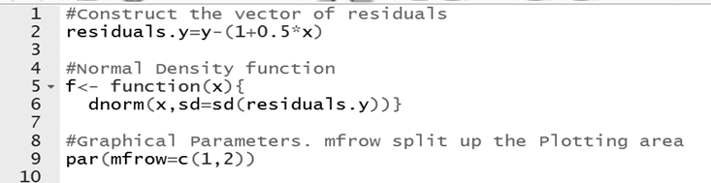
Applying curve and hist functions

Slide 12
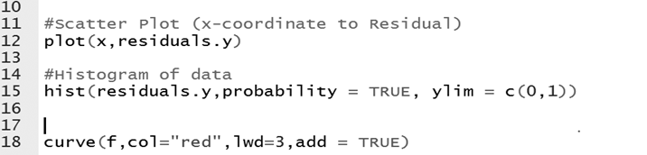
Applying curve and hist functions

Slide 14
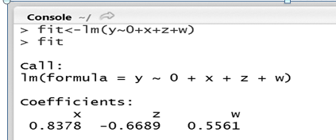
Linear Model Function
R has the lm() function, which stands for ‘linear model’

Slide 15
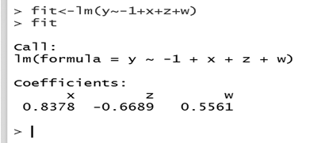

Slide 16
10.4 One Sample T-test
The t-statistic shown in Figure, has −9.8 degrees of freedom, which is n− 1 or 58− 1, that is, 57 degrees of freedom.
Further the p-value obtained here is really close to 0.
If we have a small number,we will see this notation, which is basically saying 5.86e−14.
p-value is definitely less than 0.05, hence the null hypothesis that the population mean is equal to 30 years is not accepted.

Slide 17
10.5 Illustration of Paired T-test

Slide 18
10.6 Illustration of independent t-tests

Slide 19
10.6 Illustration of independent t-tests

Slide 20
10.7 Illustration of chi-squared goodness of fit test

Slide 21
10.8 Chi-squared Test of Independence

Slide 22
10.9 Multiple Regression

Slide 23
10.10 Logistic and Exponential Regression
Logistic model fits in the plot and the parameters for the logistic equation are obtained.
Observe that this model does fit better than the exponential model.
There is another function that we can use to quickly see which model might fit our data best, called the tripleFit function.

Slide 24
10.12 Decision Tree

Slide 25
10.13 Time Series Analysis
Decompose a time series into components such as seasonal, trend, and irregular by considering moving averages.
The following is the syntax for this decomposition:
decompose(x, type = c(“additive”, “multiplicative”), filter = NULL)
where,
x: a time series model
type: the type of the seasonal component used
filter: a vector containing filter coefficients represented using reverse time order

Slide 26
10.14 Probability Distribution
The distribution of values of a random variable is described as probability distribution.
Depending on the possible outcomes, probability distributions are of various types.
Each distribution that is handled by R has four functions. There is a root name for each distribution and this root will be prefixed by one of the following letters:
p: Cumulative distribution function (probability)
q: Inverse cumulative distribution function (quantile)
d: Probability density function (density)
r: Random distribution (random)

Slide 27
10.15 ANOVA
ANOVA short for analysis of variance, is an analytics method used in statistics.
The function of ANOVA is to evaluate the means of the response variable at different factor levels; here the continuous response variable is used with one categorical factor and at least two or more levels.
ANOVA is a function for evaluating hypothesis, to show that there is no difference between at least two means, used when there are no other statistical tools for working.
The aov() function is used in R programming to perform the difference in means.
The following are the types of ANOVAs:
One way ANOVA Contains one fixed factor and only one variable.
Balanced ANOVA Contains any number of factors either fixed or random.
General linear model Allows the user to create covariate and unbalanced designs.

Slide 28
10.16 Correlation and Covariance
Correlation analysis assesses the strength of a linear relationship between two quantitative variables.
This test gives a correlation coefficient known as cor as its primary output.
If cor equals zero, then there is no linear relationship between the two variables;
If cor is greater than zero, then one variable tends to increase as the other increases;
if cor is less than zero, then one variable tends to decrease as the other decreases.
The cor variable can range from −1 to +1. +1 indicates that there is a stronger relationship between the two variables.

Slide 29
10.17 Poisson Regression
Poisson regression is a regression model where the response variable is in the form of counts. Poisson regression is given as
Log(y) = a + b1x1 + b2x2 + …
where,
y: the response variable
a and b: numerical coefficients
x: the predictor variable
glm (formula,data,family)
where,
formula: the symbol representing the relationship between variables
data: the data set used to give values of these variables
family: the R object that specifies the details of the model; the value of family is ‘Poisson’ for logistic regression

Slide 30
10.18 Survival Analysis
Survival analysis deals with data on time until an event occurs.
It is a method used to analyse data in which, the time until the event is of interest. It is also known as failure time analysis or analysis of time.
The basic syntax for creating survival analysis in R is
Surv(time,event)
Survfit(formula)
where,
time: the follow up time until the event occurs
event: indicates the status of occurrence of the expected event
formula: the relationship between the predictor variables

Slide 31
10.19.1 Introduction to Splines
A spline of degree D is a function formed by connecting polynomial segments of degree D such that the function is continuous, the function has D − 1 continuous derivatives, and the Dth derivative is constant between knots.
The syntax is as follows:
splinefun(x,y=NULL, method=”fmm”,ties=mean)
spline(x,y=NULL, n= 3*length(x),method=”fmm”, xmin=min(x), max=max(x),ties=mean)
where,
x and y: vectors that give the coordinates of the points
method: an argument that specifies the type of spline to be used to plot (for e.g.: fmm, natural, periodic)
n: an argument that specifies the spacing between the interval points [xmin, xmax].
xmin: the left-end point of the interval
xmax: the right-end point of the interval
ties: the argument that specifies how x values are handled

Slide 32
10.19.2 Basics of Random Forest
Random forest is an ensemble learning-based classification and regression technique. It is one of the commonly used predictive modelling and machine learning techniques.
In this approach, a huge number of decision trees is created
Basic syntax for creating a random forest in R is
randomForest(formula.data)
where,
formula: a formula describing the predictor and response variables
data: the name of the data set used

Slide 33
END

