Slide 1
UNIT–II: Process Management
Process Concepts
Process Scheduling
Operation on Processes
CPU Scheduling
Scheduling Criteria
Scheduling Algorithms
  First Come First Serve (FCFS)
  Shortest Job First (SJF)
  Priority Scheduling
  Round Robin (RR)
Multilevel Queue Scheduling
Case Studies
  Unix
  Linux
  Windows
Exam Questions

Slide 2
Process Concepts
Process
Process States
Process Control Block (PCB)
Switch from Process to Process
Process Scheduling Queues
Schedulers
|<<

Slide 3
Process
A program in execution.
Process execution must progress in Sequential fashion.
includes:
  Program Counter
  Stack
  Data Section
|<<

Slide 4

Process States
As a process executes, it changes state
  new: The process is being created
  ready: The process is waiting to be assigned to a processor
  running: Instructions are being executed
  waiting: The process is waiting for some event to occur
  terminated: The process has finished execution
|<<

Slide 5

Process Control Block (PCB)
Information associated with each process
Process State
Process number
Program Counter
CPU Registers
Memory Management information
I/O Status information
CPU Scheduling information
Accounting information
|<<

Slide 6

CPU Switch From Process to Process
|<<

Slide 7
Process Scheduling Queues
Job queue
  Set of all processes in the system
Ready queue
  Set of all processes residing in main memory, ready and waiting to execute
Device queues
  Set of processes waiting for an I/O device
Processes migrate among the various queues

Slide 8

Ready Queue and Various I/O Device Queues

Slide 9

Representation of Process Scheduling
|<<

Slide 10
Schedulers
  Question: Draw the process states and…
Long–term Scheduler (or Job scheduler)
  Selects which processes should be brought into the ready queue
  Decision is based on CPU scheduling algorithms like FCFS, priority, execution time or Input/Output requirements.
  This executes relatively infrequently.
Short–term Scheduler (or CPU scheduler or Dispatcher)
  Selects from among the processes that are ready to execute and allocates the CPU to one of them.
  invoked whenever an event occurs, leading to interruption. Ex: clock interrupts, I/O interrupts, operating system calls, signals, etc.
  It must select a new process for the CPU frequently. It must be very fast.
Question: Locate the position where Long Term and Short Term Scheduler execute in the above diagram?

Slide 11

Addition of Medium Term Scheduling
The medium-term scheduler temporarily removes processes from main memory and places them in secondary memory , like hard disk drive, or vice-versa, referred to as "swapping out" or "swapping in”.
It may decide to swap out a process when it
  inactive for some time,
  has a low priority,
  page faulting frequently,
  is taking up a large amount of memory
In order to free up main memory for other processes, swapping the process back in later when more memory is available, or when the process has been unblocked and is no longer waiting for a resource.
Question: Locate where Medium term scheduler works?
|<<

Slide 12
CPU Scheduling
Selects from among the processes in memory that are ready to execute, and allocates the CPU to one of them
CPU scheduling decisions may take place when a process:
  1. Switches from running to waiting state (Non-Preemptive)
  2. Switches from running to ready state (Preemptive)
  3. Switches from waiting to ready (Preemptive)
  4. Terminates (Non-Preemptive)
|<<

Slide 13
CPU utilization - Keep the CPU as busy as possible
Throughput - No. of processes that complete their execution per time unit
  no of processes / (max of completion time - min of arrival time)
  No. of Processes Executed/ Time unit
Turnaround time - Amount of time to execute a particular process
  Arrival time ~ Completion Time
Waiting time - Amount of time a process has been waiting in the ready queue
  Start time ~ Arrival Time,
  Turn Around Time ~ Burst Time
Response time - Amount of time it takes from when a request was submitted until the first response is produced, not output (for time-sharing environment)
  Arrival time ~ 1st Output Time

Slide 14
Optimization Criteria
Max CPU utilization
Max throughput
Min turnaround time
Min waiting time
Min response time
|<<

Slide 15
Scheduling Algorithms
FCFS Scheduling
SJF Scheduling
  Non-Preemptive
  Preemptive
Priority Scheduling
Round Robin
Multilevel Queue Scheduling
|<<

Slide 16
FCFS Scheduling
Process Burst Time
P₁ 24
P₂ 3
P₃ 3
Suppose that the processes arrive in the order: P₁ , P₂ , P₃
Gantt Chart:
Waiting time for P₁ = 0; P₂ = 24; P₃ = 27
Average waiting time: (0 + 24 + 27) / 3 = 17
P₁
P₂
P₃
0
24
27
30

Slide 17
FCFS Scheduling (Cont.)
Process Burst Time
P₁ 24
P₂ 3
P₃ 3
Suppose that the processes arrive in the order: P₂ , P₃ , P₁
Gantt Chart:
Waiting time for P₁ = 6; P₂ = 0; P₃ = 3
Average waiting time: (6 + 0 + 3) / 3 = 3
P₂
P₃
P₁
0
3
6
30

Slide 18
Exercise: Five batch jobs P1 through P5 arrive for execution at times indicated. Each process has a total CPU time requirement as listed below:
Using FCFS, determine the average turnaround and average waiting times. Also draw the Gantt charts.
Process | Arrival time | CPU burst
P1 | 2 | 10
P2 | 1 | 2
P3 | 0 | 5
P4 | 4 | 6
P5 | 3 | 4
|<<

Slide 19
Shortest-Job-First (SJF) Scheduling
Associate with each process the length of its next CPU burst. Use these lengths to schedule the process with the shortest time
Schemes:
  Non-Preemptive
    Once CPU given to the process it cannot be preempted until completes its CPU burst
  Preemptive / Shortest-Remaining-Time-First (SRTF)
    If a new process arrives with CPU burst length less than remaining time of current executing process, preempt.
Optimal
  Gives minimum average waiting time for a given set of processes

Slide 20
Example of Non-Preemptive SJF
Process Arrival Time Burst Time
P₁ 0.0 7
P₂ 2.0 4
P₃ 4.0 1
P₄ 5.0 4
Gantt Chart:
Average waiting time = (0 + 6 + 3 + 7) / 4 = 4
P₁
P₃
P₂
P₄
0
3
7
8
12
16
|<<

Slide 21
Example of Preemptive SJF
Process Arrival Time Burst Time
P₁ 0.0 7
P₂ 2.0 4
P₃ 4.0 1
P₄ 5.0 4
Gantt Chart:
Average waiting time = (9 + 1 + 0 +2) / 4 = 3
P₁
P₂
P₃
P₂
P₄
P₁
0
2
4
5
7
11
16

Slide 22
Exercise: Five batch jobs P1 through P5 arrive for execution at times indicated. Each process has a total CPU time requirement as listed below:
Using Preemptive SJF, determine the average turnaround and average waiting times. Also draw the Gantt charts.
Process | Arrival time | CPU burst
P1 | 2 | 10
P2 | 1 | 2
P3 | 0 | 5
P4 | 4 | 6
P5 | 3 | 4
|<<

Slide 23
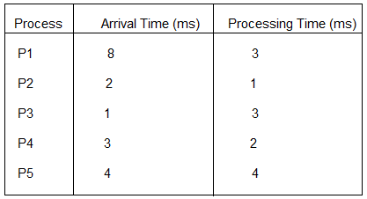
More SJF Examples (Solve by Preemptive &Non-premptive)
1 Proc Arrives Burst
P₁ 0 8
P₂ 1 4
P₃ 2 9
P₄ 3 5
2. Proc Arrives Burst
P₁ 1 2
P₂ 0 7
P₃ 2 7
P₄ 5 3
P₅ 6 1

Slide 24
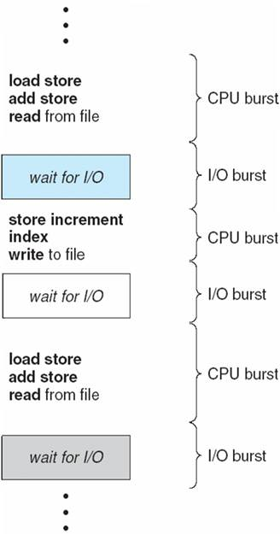
CPU–I/O Burst Cycle
:
Process execution consists of a cycle of CPU execution & I/O wait
The difficulty is knowing the length of the next CPU request

Slide 25

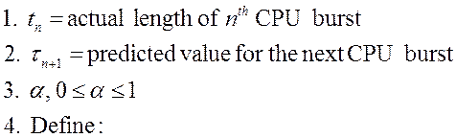
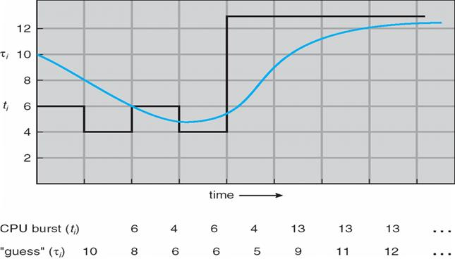
Determining Length of Next CPU Burst
To estimate the length of next CPU burst using the length of previous CPU bursts
Prediction of the Length of the Next CPU Burst (α = 0.5)
Process BT
P1 6
P2 8
P3 7
P4 3

Slide 26
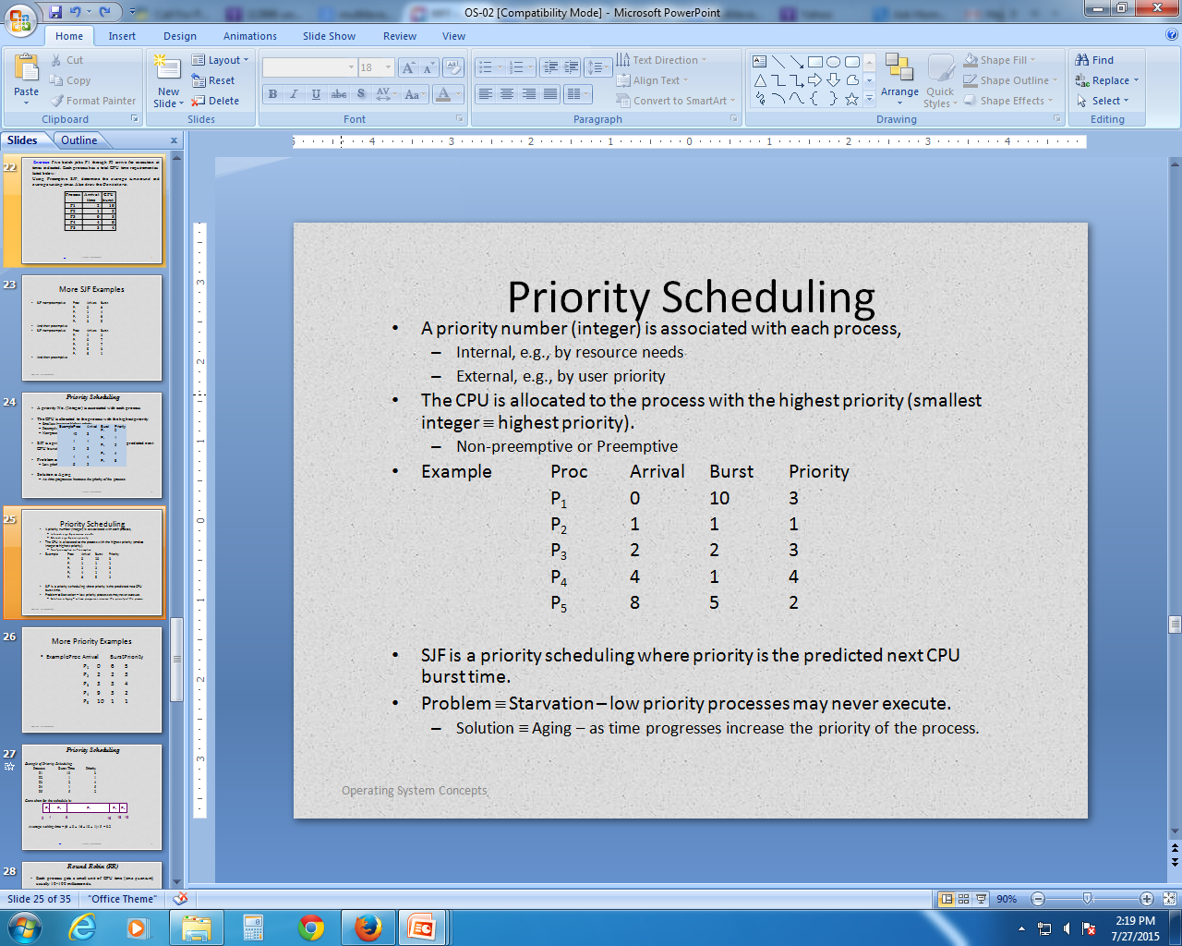
Priority Scheduling
A priority No. (Integer) is associated with each process
The CPU is allocated to the process with the highest priority
  Smallest integer ≡ highest priority
  Preemptive
  Non-preemptive
SJF is a priority scheduling where priority is the predicted next CPU burst time
Problem ≡ Starvation
  Low priority processes may never execute
Solution ≡ Aging
  As time progresses increase the priority of the process

Slide 27
Priority Scheduling
Example of Priority Scheduling
Process Burst Time Priority
P1 10 3
P2 1 1
P3 2 4
P4 1 5
P5 5 2
Gantt chart for the schedule is:
P₂
P₅
P₁
P₃
P₄
0
1
6
16
18
19
Average waiting time = (6 + 0 + 16 + 18 + 1) / 5 = 8.2

Slide 28
More Priority Examples
Example Proc Arrival Burst Priority
P₁ 0 6 5
P₂ 2 2 3
P₃ 3 3 4
P₄ 9 3 2
P₅ 10 1 1

Slide 29
Round Robin (RR)
Each process gets a small unit of CPU time (time quantum), usually 10-100 milliseconds.
After this time has elapsed, the process is preempted and added to the end of the ready queue.
If there are n processes in the ready queue and the time quantum is q, then each process gets 1/n of the CPU time in chunks of at most q time units at once.
No process waits more than (n-1)q time units.

Slide 30
Example of RR with Time Quantum = 20
Process Burst Time
P₁ 53
P₂ 17
P₃ 68
P₄ 24
Gantt chart:
P₁
P₂
P₃
P₄
P₁
P₃
P₄
P₁
P₃
P₃
0
20
37
57
77
97
117
121
134
154
162
Average waiting time
= [(77 + 24) + (20) + (37 + 40 + 17) + (57 + 40)] / 4
= [101 + 20 + 94 + 97] / 4
= 312 / 4
= 78

Slide 31
Solve RR Examples: Draw the Gantt charts and ready ques. Also determine the average response times, average turnaround and average waiting times.
Process | AT | BT
P1 | 2 | 10
P2 | 1 | 2
P3 | 0 | 5
P4 | 4 | 6
P5 | 3 | 4
TQ=3
Process | AT | BT
P1 | 0 | 4
P2 | 1 | 5
P3 | 2 | 2
P4 | 3 | 1
P5 | 4 | 6
P6 | 6 | 3
TQ=2
Process | Arrival time | CPU burst
P1 | 5 | 5
P2 | 4 | 6
P3 | 3 | 7
P4 | 1 | 9
P5 | 2 | 2
P6 | 6 | 3
TQ=3
|<<

Slide 32
Multilevel Queue
Ready queue is partitioned into separate queues:
  Foreground (Interactive)
  Background (Batch)
Each queue has its own scheduling algorithm
  Foreground – RR
  Background – FCFS
Scheduling must be done between the queues
  Fixed priority scheduling;
    (i.e., serve all from foreground then from background).
    Possibility of starvation.
  Time slice
    Each queue gets a certain amount of CPU time which it can schedule amongst its processes;
    i.e., 80% to foreground in RR
    20% to background in FCFS

Slide 33

Multilevel Queue Scheduling
Each queue may have has its own scheduling algorithm: Round Robin, FCFS, SJF…
|<<

Slide 34
Multilevel Queue Examples
ML queue, 2 levels
  RR @ 10 units
  FCFS
  RR gets priority over FCFS
Proc Arrival Burst Queue
P₁ 0 12 FCFS
P₂ 4 12 RR
P₃ 8 8 FCFS
P₄ 20 10 RR
Non-preemptive and preemptive

Slide 35
Multilevel Feedback Queue
In a multi-level queue-scheduling algorithm, processes are permanently assigned to a queue.
Idea: Allow processes to move among various queues.
Examples
  If a process in a queue dedicated to interactive processes consumes too much CPU time, it will be moved to a (lower-priority) queue.
  A process that waits too long in a lower-priority queue may be moved to a higher-priority queue.

Slide 36

Multilevel Feedback Queues
Three queues:
  Q₀ – TQ= 8 ms
  Q₁ – TQ= 16 ms
  Q₂ – FCFS
Scheduling
  A new job enters queue Q₀ which is served FCFS. When it gains CPU, job receives 8 milliseconds. If it does not finish in 8 milliseconds, job is moved to queue Q₁.
  At Q₁ job is again served FCFS and receives 16 additional milliseconds. If it still does not complete, it is preempted and moved to queue Q₂.

Slide 37
Multilevel Feedback Queue
A process can move between the various queues; aging can be implemented this way.
Multilevel-feedback-queue scheduler defined by the following parameters:
  number of queues
  scheduling algorithms for each queue
  method used to determine which queue a process will enter when that process needs service
  method used to determine when to upgrade a process
  method used to determine when to demote a process

Slide 38
Multilevel Feedback Queue Example
Three levels
  RR at 8 units
  RR at 16 units
  FCFS, active
Proc AT BT
P₁ 0 32
P₂ 10 12
P₃ 30 10
Non-preemptive and preemptive

Slide 39
Operating System Examples
Windows XP scheduling
Linux scheduling

Slide 40
Windows Scheduling
Windows uses priority-based preemptive scheduling
Highest-priority thread runs next
Dispatcher is scheduler
Thread runs until
  (1) blocks,
  (2) uses time slice,
  (3) preempted by higher-priority thread
Real-time threads can preempt non-real-time
32-level priority scheme
Variable class is 1-15, real-time class is 16-31
Priority 0 is memory-management thread
Queue for each priority
If no run-able thread, runs idle thread

Slide 41
Windows Priority Classes
Win32 API identifies several priority classes to which a process can belong
  REALTIME_PRIORITY_CLASS, HIGH_PRIORITY_CLASS, ABOVE_NORMAL_PRIORITY_CLASS,NORMAL_PRIORITY_CLASS, BELOW_NORMAL_PRIORITY_CLASS, IDLE_PRIORITY_CLASS
  All are variable except REALTIME
A thread within a given priority class has a relative priority
  TIME_CRITICAL, HIGHEST, ABOVE_NORMAL, NORMAL, BELOW_NORMAL, LOWEST, IDLE
Priority class and relative priority combine to give numeric priority
Base priority is NORMAL within the class
If quantum expires, priority lowered, but never below base
If wait occurs, priority boosted depending on what was waited for
Foreground window given 3x priority boost

Slide 42
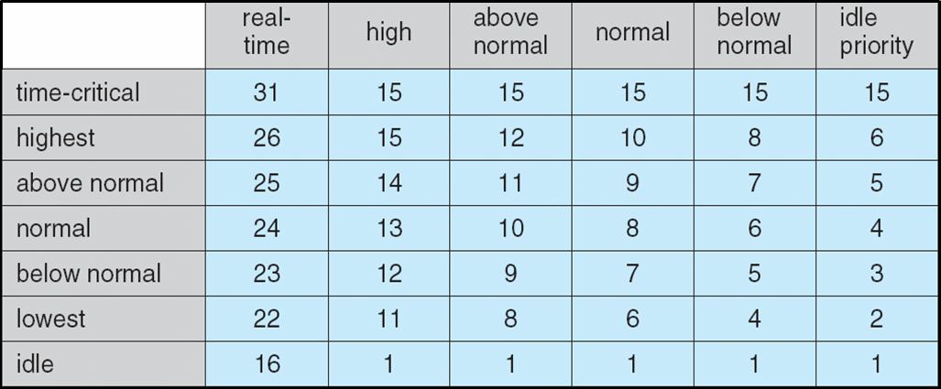
Windows XP Priorities

Slide 43
Linux Scheduling
Constant order O(1) scheduling time
Preemptive, priority based
Two priority ranges: time-sharing and real-time
Real-time range from 0 to 99 and nice value from 100 to 140
Map into global priority with numerically lower values indicating higher priority
Higher priority gets larger q
Task run-able as long as time left in time slice (active)
If no time left (expired), not run-able until all other tasks use their slices
All run-able tasks tracked in per-CPU runqueue data structure
  Two priority arrays (active, expired)
  Tasks indexed by priority
  When no more active, arrays are exchanged

Slide 44
Linux Scheduling (Cont.)
Real-time scheduling according to POSIX.1b
  Real-time tasks have static priorities
All other tasks dynamic based on nice value plus or minus 5
  Interactivity of task determines plus or minus
    More interactive -> more minus
  Priority recalculated when task expired
  This exchanging arrays implements adjusted priorities

Slide 45
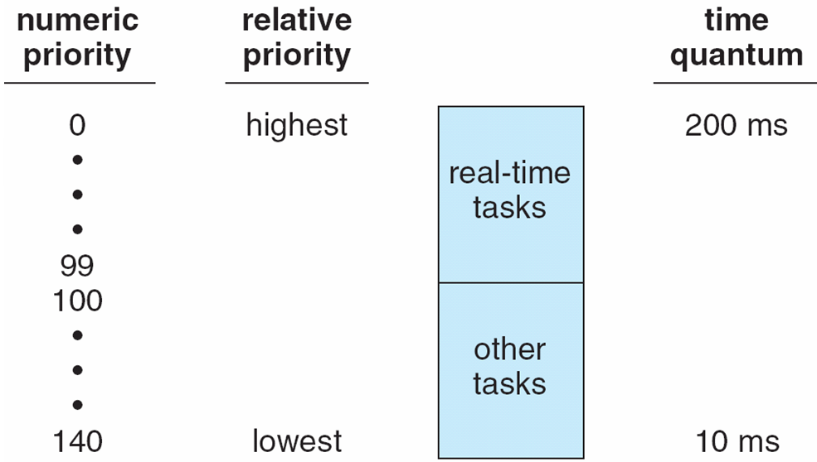
Priorities and Time-slice length

Slide 46
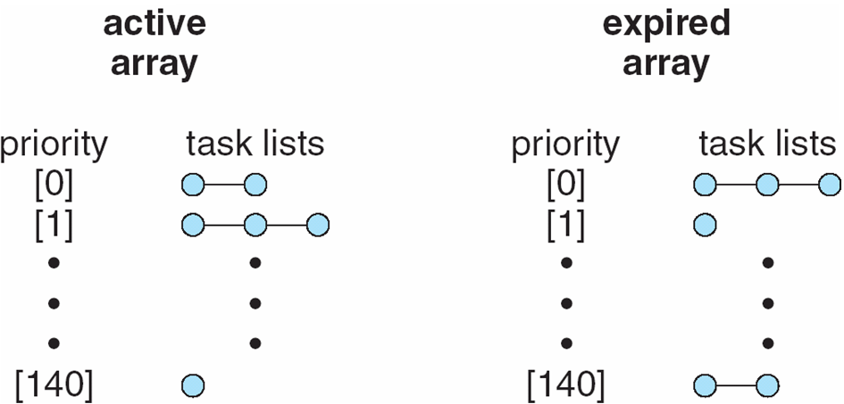
List of Tasks Indexed
According to Priorities

Slide 47
Exam Questions
Explain various steps involved in change of a Process State.
Define Process States.
What is a process? Write the difference between process and program.
Define Process and Program.
Compare & Contrast Process & Thread.
What is the difference between a "thread" and a "process"?
Compare the difference between a thread and a process. List the system calls related to threads.
Define a thread. What are the uses of thread?
What are the reasons for Process Suspension?
What is process control block? Explain its structure.

Slide 48
Exam Questions
Describe the process state transition diagram. Explain Process Control Block.
What are the types of CPU Scheduling?
What are preemptive and non-preemptive scheduling policies?
Compare preemptive and non-preemptive CPU scheduling.
What is CPU scheduler?
What is throughput, turnaround time, waiting time and response time?
Explain any three CPU Scheduling algorithms.

Slide 49
Exam Questions
|<<
18. Assume the following are the jobs to execute with one processor:
The jobs are assumed to have arrived in the order 1, 2, 3, 4, 5.
Give Gantt–Chart illustrating the execution of these jobs using FCFS, RR (quantum =1), Shortest Process Next, Shortest Remaining Time.
What is the turn–around time, waiting time of each job for each of the above scheduling algorithms?
Job | Burst Time | Priority
1 | 10 | 3
2 | 1 | 1
3 | 2 | 3
4 | 1 | 4
5 | 5 | 2

