Slide 1
UNIT–V: File System
Different Types of Files
Access methods
Directory Structures
Various Allocation methods
Disk Scheduling and Management
  Disk Scheduling Algorithms
Example–1
Example–2
FCFS
SSTF
SCAN
C–SCAN
LOOK / C–LOOK
Selecting a Disk Scheduling Algorithm
Introduction to Distributed File System (DFS)
Exam Questions

Slide 2
Different Types of Files
Abstract Data Type
Contiguous Logical Address Space.
Types:
  Data
    Numeric
    Character
    Binary
  Program
Unit 5: File System

Slide 3
File Structure
None
  Sequence of words, bytes
Simple record structure
  Lines
  Fixed length
  Variable length
Complex Structures
  Formatted document
  Relocatable load file
Who decides:
  Operating system
  Program
Unit 5: File System

Slide 4
File Attributes
Attributes | Description
Name | Only information kept in human-readable form
Identifier | Unique tag (number) identifies file within file system
Type | Needed for systems that support different types
Location | Pointer to file location on device
Size | Current file size
Protection | Controls who can do reading, writing, executing
Time, date, and user identification | Data for protection, security, and usage monitoring
Information about files | Kept in the directory structure maintained on the disk
Unit 5: File System

Slide 5
File Operations
Create
Write
Read
Reposition within file
Delete
Truncate
Open(F_{i})
  Search the directory structure on disk for entry F_{i}
  Move the content of entry to memory.
Close (F_{i})
  Move the content of entry F_{i} in memory to directory structure on disk.
Unit 5: File System

Slide 6
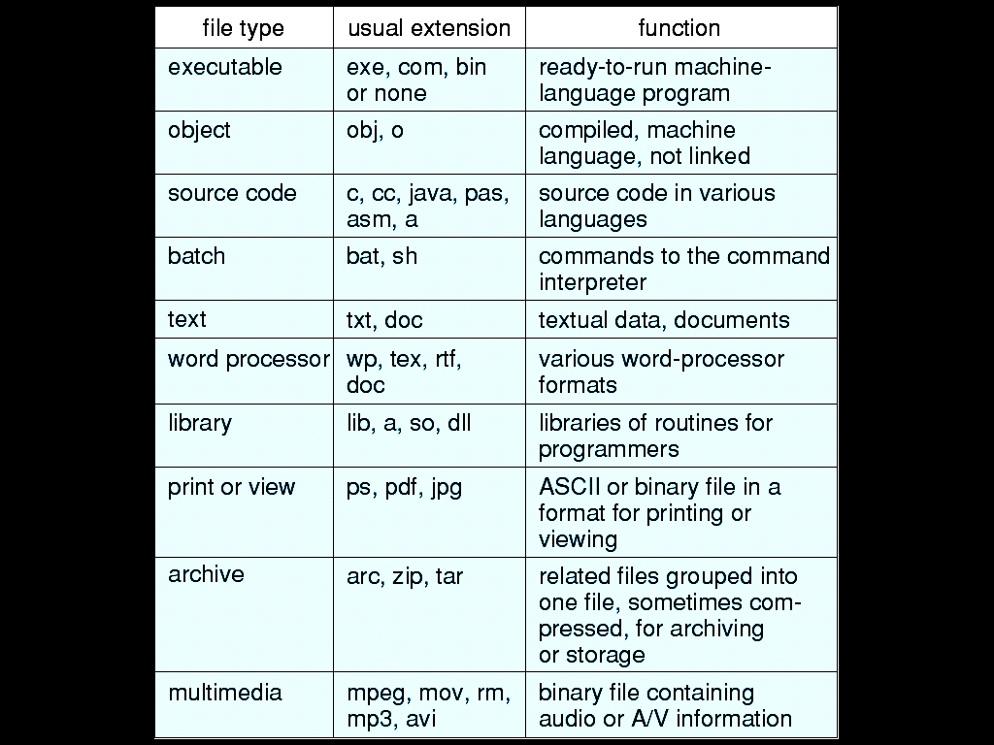
File Types – Name, Extension
|<<
Unit 5: File System

Slide 7
Access Methods
Sequential Access
read next
write next
reset
no read after last write
(rewrite)
Direct Access
read n
write n
position to n
read next
write next
rewrite n
n = relative block number
Unit 5: File System

Slide 8
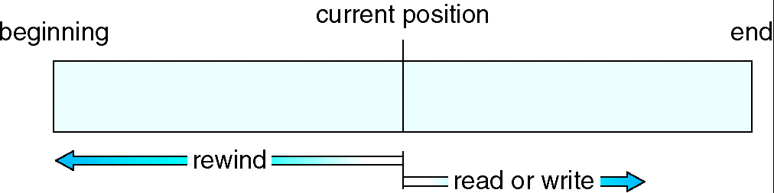
Sequential–Access File
Unit 5: File System

Slide 9
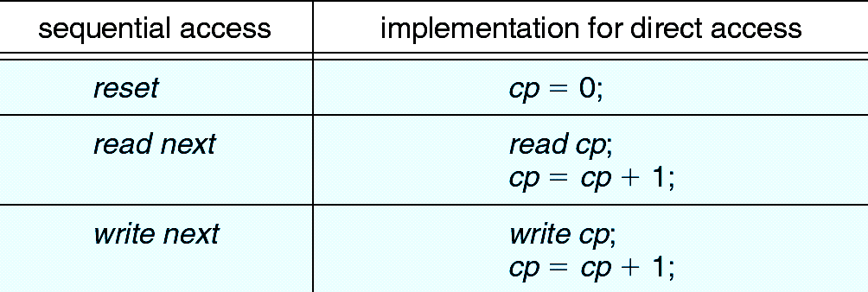
Simulation of Sequential Access on a Direct–Access File
Unit 5: File System

Slide 10
Directory Structure
A collection of nodes containing information about all files.
Directory
Files
F 1
F 2
F 3
F 4
F n
Both the directory structure and the files reside on disk.
Backups of these two structures are kept on tapes.
Unit 5: File System

Slide 11
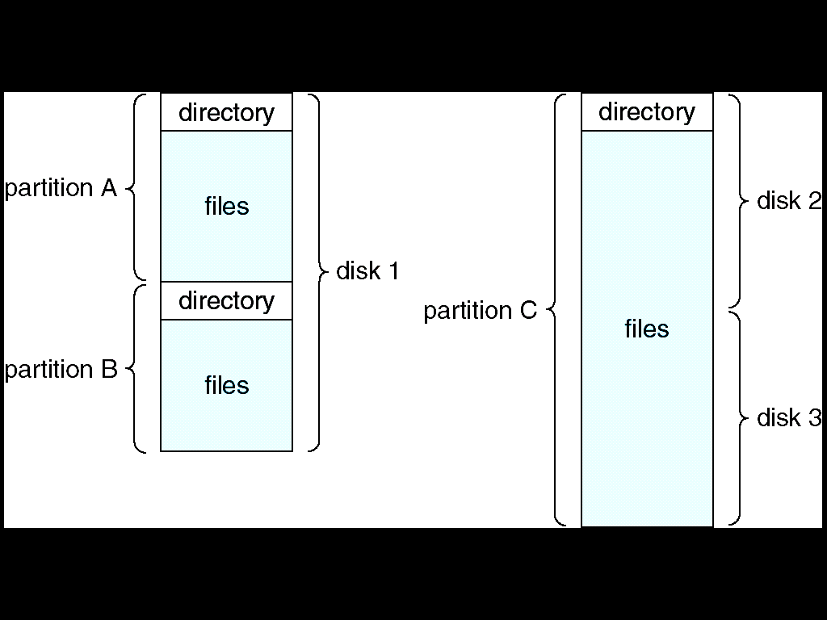
A Typical File–System Organization
Unit 5: File System

Slide 12
Operations Performed on Directory
Search for a file
Create a file
Delete a file
List a directory
Rename a file
Traverse the file system
Unit 5: File System

Slide 13
Organize the Directory (Logically) to Obtain
Efficiency
  Locating a file quickly
Naming
  Convenient to users
  Two users can have same name for different files
  The same file can have several different names
Grouping
  Logical grouping of files by properties
  Examples
    All Java programs
    All games
    …
Unit 5: File System

Slide 14
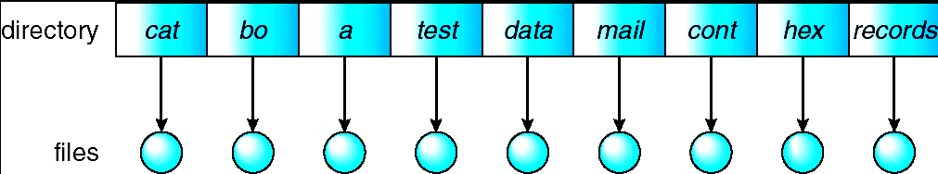
Single-Level Directory
A single directory for all users
Naming problem
Grouping problem
Unit 5: File System

Slide 15
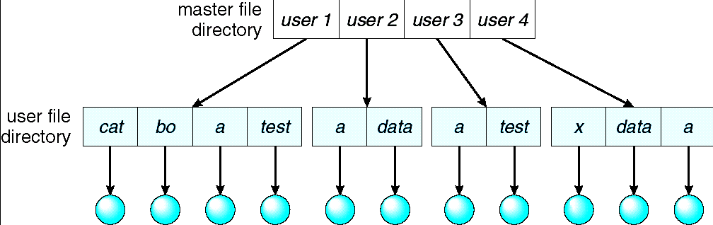
Two-Level Directory
Separate directory for each user
Path name
Can have the same file name for different user
Efficient searching
No grouping capability
Unit 5: File System

Slide 16
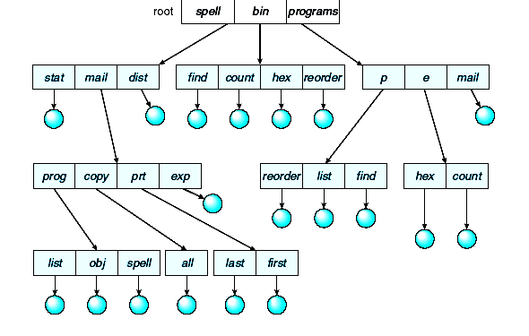
Tree-Structured Directories
Unit 5: File System

Slide 17
Tree-Structured Directories (Cont)
Efficient Searching
Grouping Capability
Current Directory (Working Directory)
  cd /spell/mail/prog
  type list
Unit 5: File System

Slide 18
Tree-Structured Directories (Cont)
Absolute or relative path name
Creating a new file is done in current directory
Delete a file
rm <file-name>
Creating a new subdirectory is done in current directory
  mkdir <dir-name>
Example: if in current directory /mail
mkdir count
|<<
mail
prog
copy
prt
exp
count
Deleting “mail” ⇒ deleting the entire subtree rooted by “mail”
Unit 5: File System

Slide 19
Various Allocation Methods
Refers to how disk blocks are allocated to files.
Contiguous allocation
Linked allocation
Indexed allocation
Unit 5: File System

Slide 20
Contiguous Allocation
Each file occupies a set of contiguous blocks on the disk.
Simple
  Only starting location (block #) and length (No. of blocks) are required.
Random access.
Wasteful of space (dynamic storage-allocation problem).
Files cannot grow.
Unit 5: File System

Slide 21
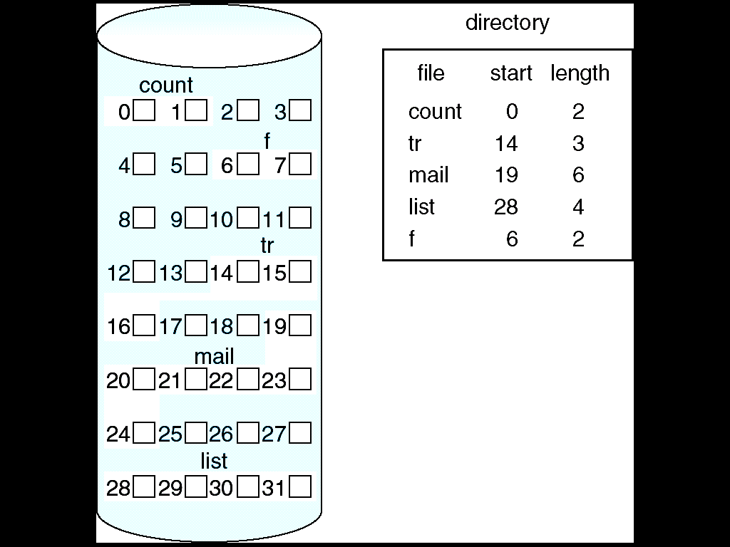
Contiguous Allocation of Disk Space
Unit 5: File System

Slide 22
Linked Allocation
Each file is a linked list of disk blocks.
  Blocks may be scattered anywhere on the disk.
block =
pointer
Unit 5: File System

Slide 23
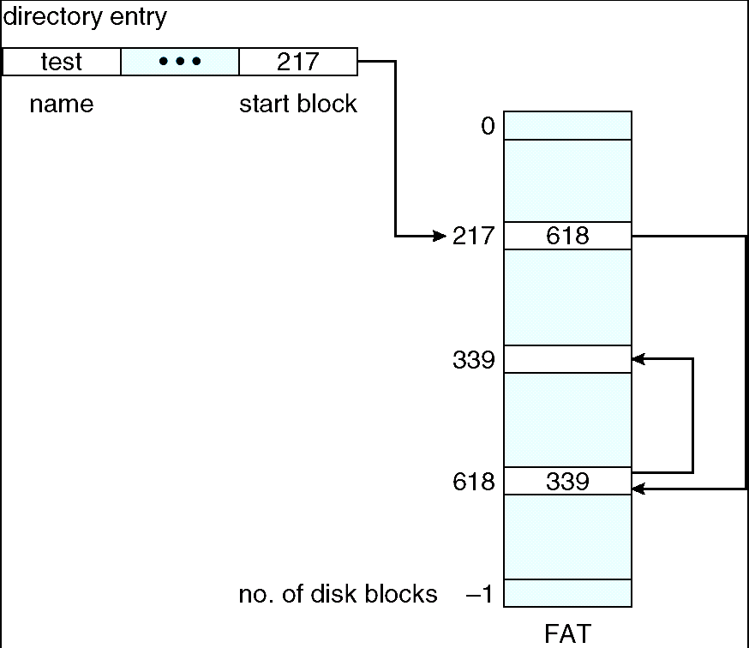
File–Allocation Table
Unit 5: File System

Slide 24
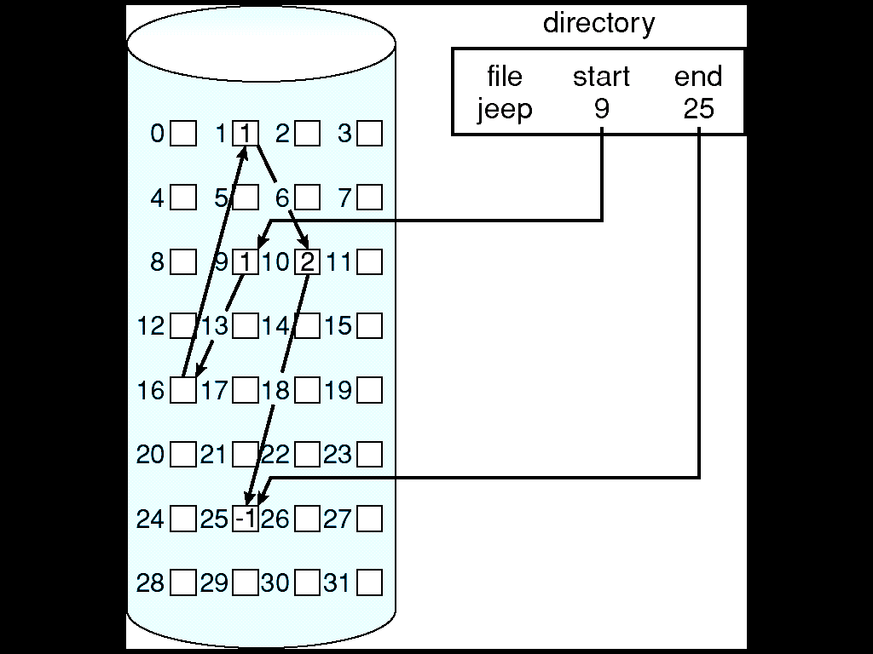
Linked Allocation
Unit 5: File System

Slide 25
Indexed Allocation
Brings all pointers together into the index block.
Logical view.
index table
Unit 5: File System

Slide 26
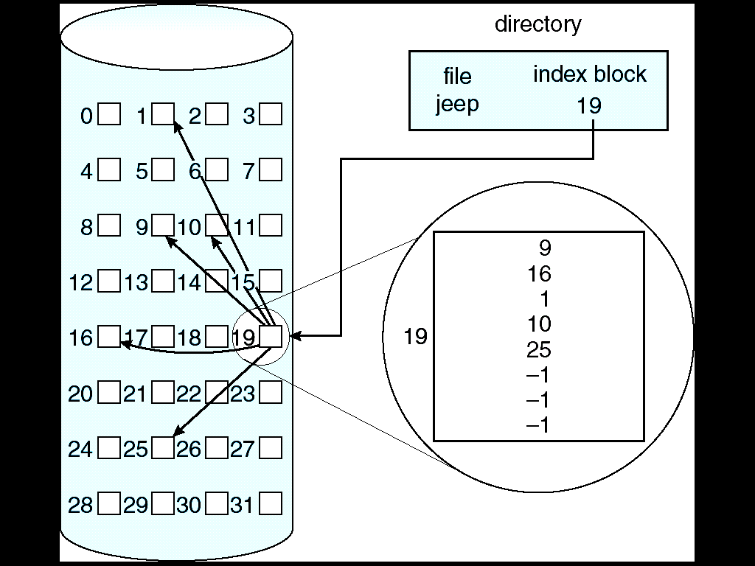
Example of Indexed Allocation
|<<
Unit 5: File System

Slide 27
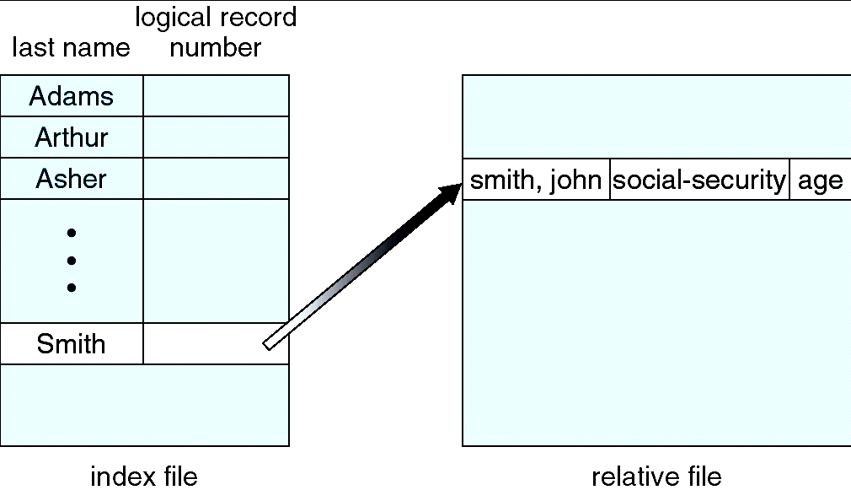
Example of Index and Relative Files
|<<
Unit 5: File System

Slide 28
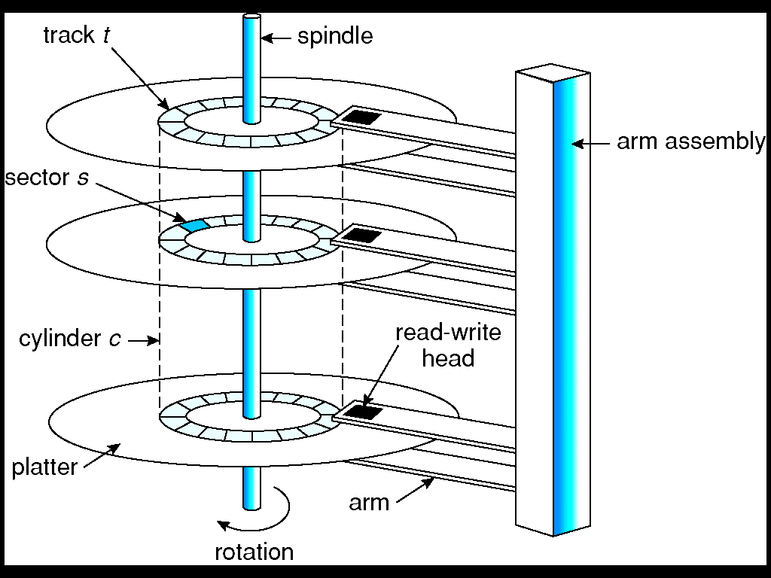
Disk Scheduling and Management
Moving Head Disk Mechanism
Unit 5: File System

Slide 29
Disk Scheduling
Operating System
  Responsible for using Hardware efficiently
  For Disk Drives
    Fast Access Time
    Disk Bandwidth
Components of Access time
  Seek time
    Time for the Disk arm
    to move the Heads to the Cylinder containing the Desired Sector
  Rotational latency
    Additional time waiting for the Disk
    to Rotate the Desired sector to the Disk Head.
Minimize Seek time
Seek time ≈ Seek distance
Disk Bandwidth
  Total No. of bytes transferred divided by the total time between the first request for Service and the Completion of the Last transfer.
|<<
Unit 5: File System

Slide 30
Disk Scheduling – Example 1
1. Suppose that a disk drive has 200 cylinders, numbered 0 to 199. The drive is currently serving a request at cylinder 53, and the previous request was at cylinder 45. The queue of pending requests in FIFO order is 98, 183, 37, 122, 14, 124, 65, 67. Starting from the current head position, what is the total distance (in cylinders) that the disk arm moves to satisfy all the pending requests, for each of the following disk scheduling algorithms?
FCFS
SSTF
c. SCAN
C–SCAN
LOOK
C–LOOK
|<<
Unit 5: File System

Slide 31
Disk Scheduling – Example 2
2. Suppose that a disk drive has 5000 cylinders, numbered 0 to 4999. The drive is currently serving a request at cylinder 143, and the previous request was at cylinder 125. The queue of pending requests in FIFO order is 86, 1470, 913, 1774, 948, 1509, 1022, 1750, 130. Starting from the current head position, what is the total distance (in cylinders) that the disk arm moves to satisfy all the pending requests, for each of the following disk scheduling algorithms?
FCFS
SSTF
c. SCAN
C–SCAN
LOOK
C–LOOK
|<<
Unit 5: File System

Slide 32

FCFS Disk Scheduling
Request queue (0-199).
98, 183, 37, 122, 14, 124, 65, 67
Head pointer 53
|<<
Unit 5: File System

Slide 33

SSTF Disk Scheduling Algorithm
Selects the request with the minimum seek time from the current head position.
SSTF scheduling is a form of SJF scheduling; may cause starvation of some requests.
|<<
Unit 5: File System

Slide 34

SCAN / Elevator Disk Scheduling Algorithm
The disk arm starts at one end of the disk, and moves toward the other end, servicing requests until it gets to the other end of the disk, where the head movement is reversed and servicing continues.
|<<
Unit 5: File System

Slide 35

C-SCAN
Provides a more uniform wait time than SCAN.
The head moves from one end of the disk to the other. servicing requests as it goes. When it reaches the other end, however, it immediately returns to the beginning of the disk, without servicing any requests on the return trip.
Treats the cylinders as a circular list that wraps around from the last cylinder to the first one.
|<<
Unit 5: File System

Slide 36

C-LOOK
Version of C-SCAN
Arm only goes as far as the last request in each direction, then reverses direction immediately, without first going all the way to the end of the disk.
|<<
Unit 5: File System

Slide 37
Selecting a Disk-Scheduling Algorithm
SSTF is common and has a natural appeal
SCAN and C-SCAN perform better for systems that place a heavy load on the disk.
Performance depends on the number and types of requests.
Requests for disk service can be influenced by the file-allocation method.
The disk-scheduling algorithm should be written as a separate module of the operating system, allowing it to be replaced with a different algorithm if necessary.
Either SSTF or LOOK is a reasonable choice for the default algorithm.
|<<
Unit 5: File System

Slide 38
Distributed / Network File System (DFS) / (NFS)
Any File System that allows Access to Files
from Multiple Hosts Sharing via a Computer Network.
  Makes it Possible for Multiple Users on Multiple Machines
to Share Files and Storage Resources.
Client Nodes do not have Direct Access
to the underlying Block Storage
but interact over the Network using a Protocol.
  Makes it possible to Restrict Access to the File System depending on Access lists or Capabilities on both the Servers and the Clients, and also depending on How the Protocol is Designed.
Unit 5: File System

Slide 39
Include facilities for Transparent replication and Fault tolerance.
  When a limited no. of Nodes in a File System go offline,
  the System Continues to Work without Any Data loss.
Unit 5: File System

Slide 40
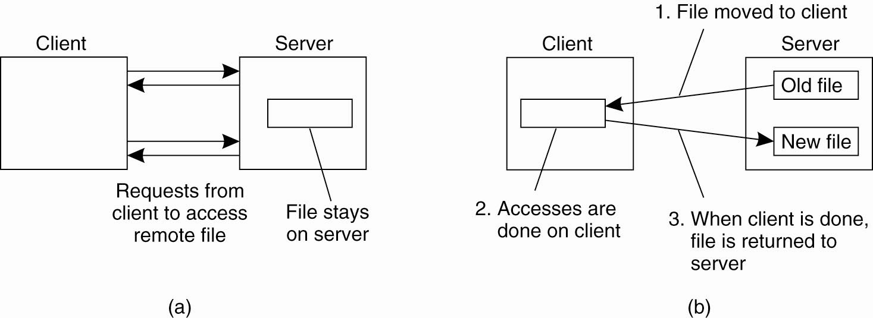
DFS / NFS
Requirements
    Heterogeneity
    Replication
    Transparency
    Consistency
    Concurrency
    Fault tolerance
    Security
    Efficiency
|<<
The remote access model (b) The upload / download model
Unit 5: File System

Slide 41
Exam Questions
|<<
Describe the various attributes of files.
Write short note on file sharing.
Explain Directory Structure.
List the file allocation methods.
Explain the various file allocation methods, their advantages and disadvantages.
Discuss various Disk Scheduling algorithms.
Explain briefly about disk scheduling algorithms and its types.
Unit 5: File System

