Slide 1
UNIT–VI: I/O Systems
I/O Hardware
Application I/O Interface
Kernel I/O Subsystem
Transforming I/O Requests
Performance Issues
Protection and Security
Access Control List (ACL)
Capabilities
Third Party Tools
Exam Questions

Slide 2
Overview
I/O management is a major component of operating system design and operation
Important aspect of computer operation
I/O devices vary greatly
Various methods to control them
Performance management
New types of devices frequent

Slide 3
I/O Hardware
Incredible variety of I/O Devices
Storage Devices – Disks, Tapes, …
Transmission Devices – Network cards, Modems
Human Interface Devices – Screen, Keyboard, Mouse
Other Specialised Devices – Steering of a Space shuttle
Common Concepts
Port (Connection point)
Bus (Connection of Common Set of wires)
Controller (Host Adapter)
Operates a Port, Bus, or a Device.
Devices have addresses, used by
Direct I/O instructions
Memory–Mapped I/O

Slide 4
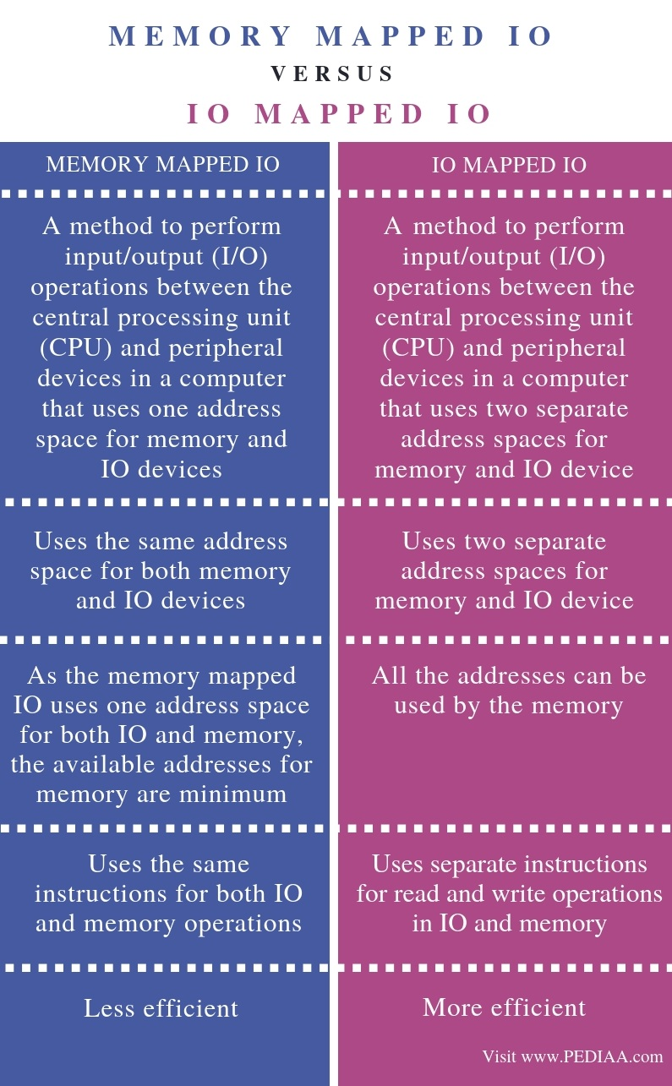

Slide 5
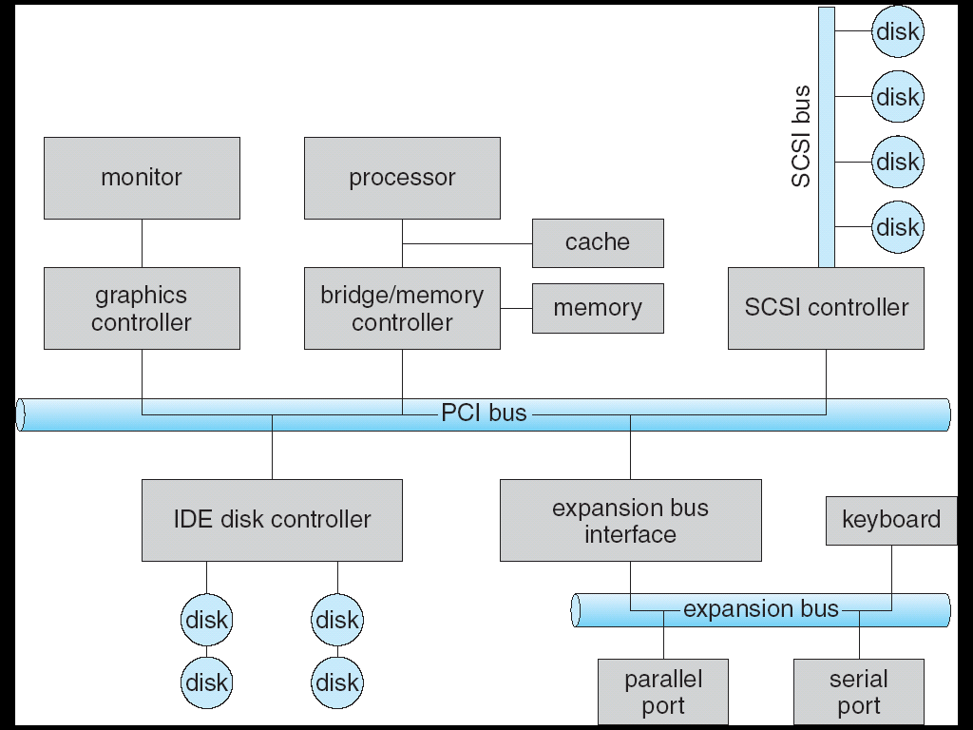
A Typical PC Bus Structure
PCI Peripheral Component Interconnect
SCSI Small Computer System Interface
IDE Integrated Development Environment

Slide 6
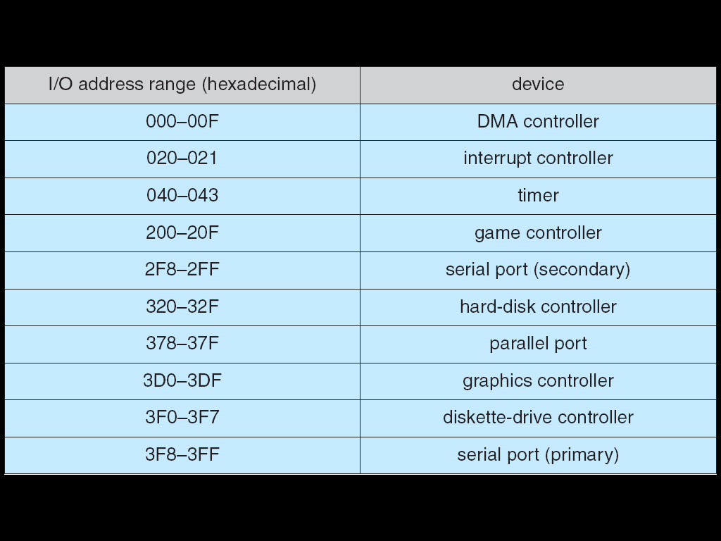
Device I/O Port Locations on PCs (Partial)

Slide 7
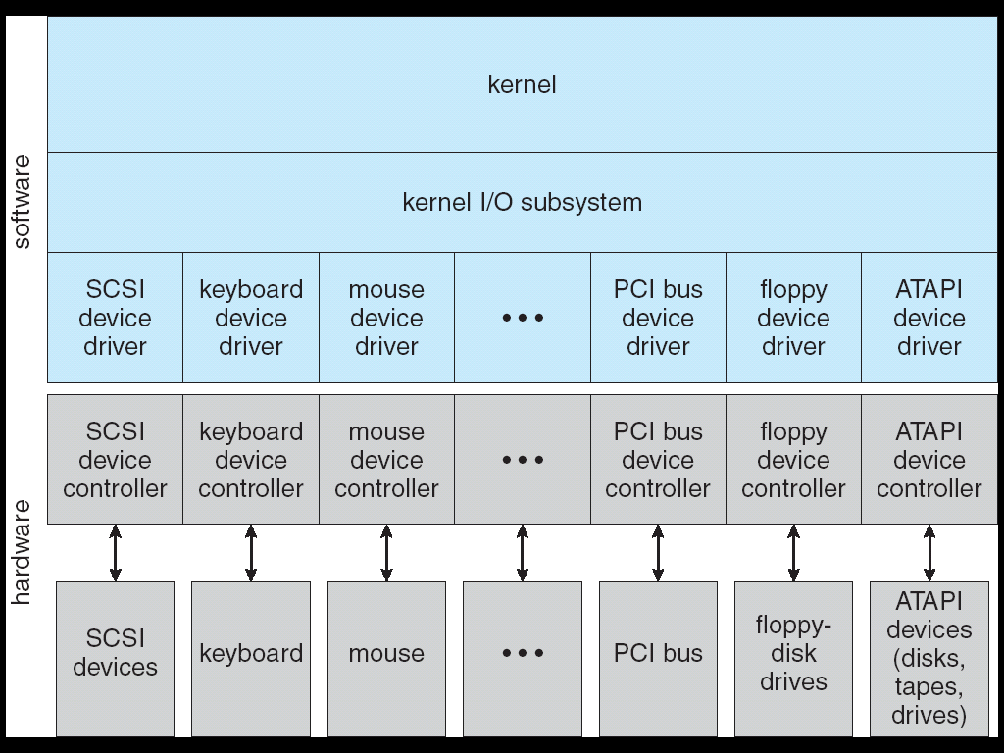
Kernel I/O Structure
ATAPI Advanced Technology Attachment with Packet Interface
PCI Peripheral Component Interconnect
SCSI Small Computer System Interface

Slide 8
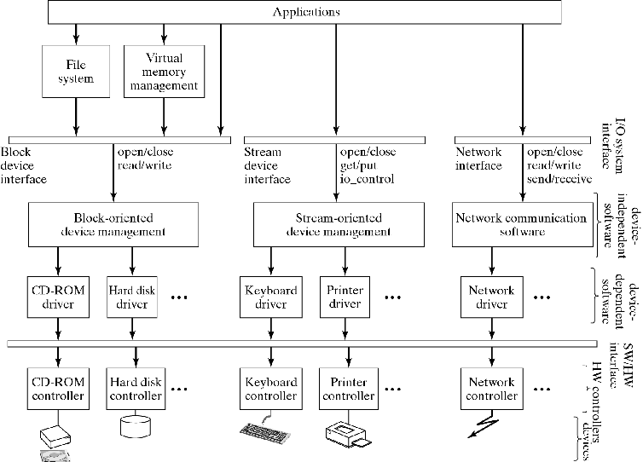
Hierarchical Model of the I/O System

Slide 9
Hierarchical Model of the I/O System
I/O system interface:
Abstract interface to the I/O system
I/O system can be divided into two layers:
Device-Independent I/O Software:
Data buffering, data caching, device scheduling, device naming, …
Device drivers:
Incorporate specific knowledge of devices they access
Supplied by device manufacturer
New driver must be installed when new device is added to system
Software-hardware interface:
Each I/O device is accessed through a special hardware device called a device controller, by reading and writing registers provided by the controller
These registers constitute the software/hardware interface

Slide 10
Hierarchical Model of the I/O System
Kernel
Kernel I/O Subsystem

Slide 11
Kernel I/O subsystem
Main tasks of I/O system:
Present logical (abstract) view of devices
Hide details of hardware interface
Hide error handling
Facilitate efficient use
Overlap CPU and I/O
Support sharing of devices
Protection when device is shared (disk)
Scheduling when exclusive access needed (printer)

Slide 12
I/O System Interface

Slide 13
I/O System Interface
Block-Oriented Device Interface
direct access
contiguous blocks
usually fixed block size
Operations:
Open: verify device is ready, prepare it for access
Read: Copy a block into main memory
Write: Copy a portion of main memory to a block
Close: Release the device
Note: these are lower level than those of the FS
Used by File System and Virtual Memory System
Applications typically go through the File System

Slide 14
I/O System Interface
Stream-Oriented Device Interface
character-oriented
sequential access
Operations:
Open: reserve exclusive access
Get: return next character of input stream
Put: append character to output stream
Close: release exclusive access
Note: these too are different from those of the FS but some systems try to present a uniform view of files and devices

Slide 15
Block and Character Devices
Block Devices
include Disk Drives
Commands include Read, Write, Seek
Raw I/O or File–System Access
Memory–mapped File Access possible
Character Devices
include Keyboards, Mice, Serial Ports
Commands include Get, Put
Libraries layered on top allow Line Editing

Slide 16
I/O System Interface
Network Interface
key abstraction: socket
endpoints of a “line” between two processes
once established, use protocol to communicate
Connection-less protocols
send messages, called datagrams
Operations: send, receive (to/from sockets)
Connection-based protocols
establish a connection called virtual circuit
Operations: connect, accept, read, write

Slide 17
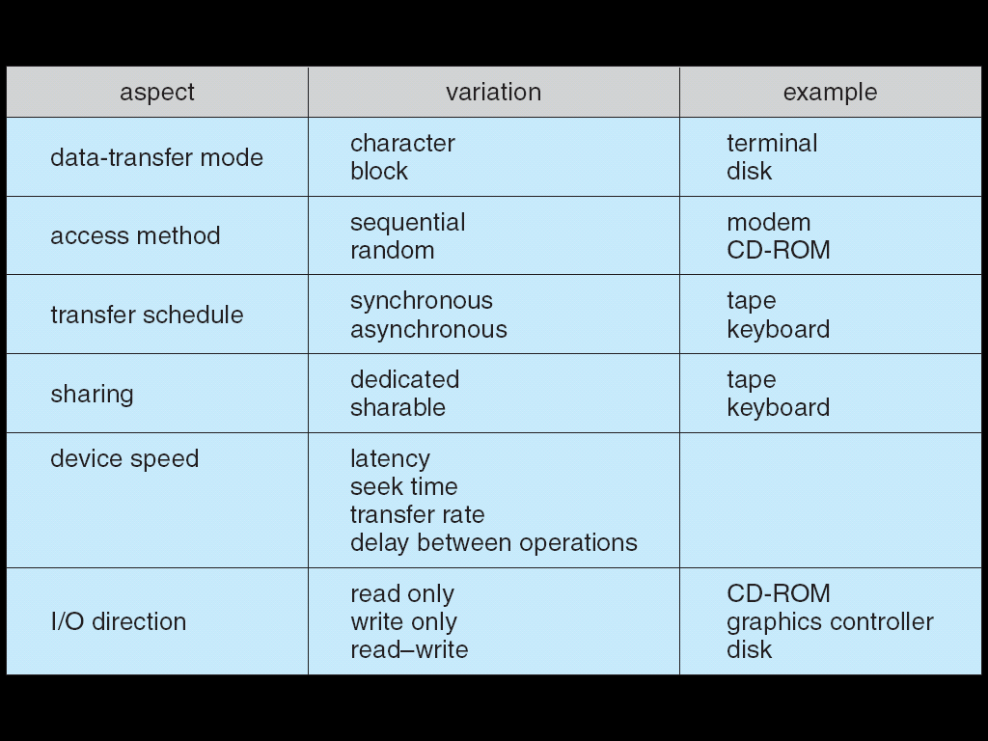
Characteristics of I/O Devices

Slide 18
Blocking, Non-blocking (Synchronous) and Asynchronous Data Transfer in I/O
Applications may issue either blocking or non-blocking system call for doing the I/O data transfers:
Blocking
Process suspended until I/O completed
Easy to use and understand
Insufficient for some needs
Non-blocking (also called as Synchronous)
I/O call returns as much as available
User interface, Data copy (buffered I/O)
Implemented - via multi-threading
Returns quickly - with count of bytes read or written
Asynchronous (Alternative to non-blocking system call)
Process runs while I/O executes
Difficult to use
I/O subsystem Signals process when I/O completed

Slide 19
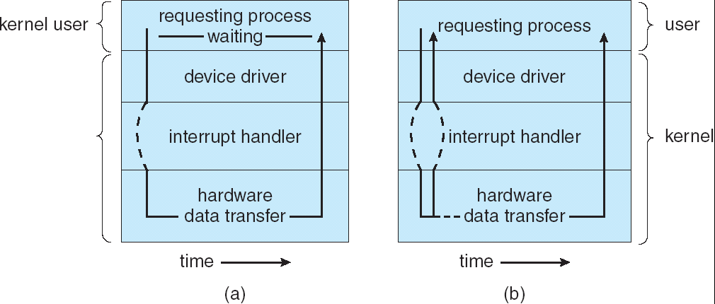
Two I/O Methods
|<<
Synchronous
Asynchronous

Slide 20
I/O Devices

Slide 21
I/O Devices – Output
Display monitors
Printers (ink jet, laser)
I/O Devices – Input
Keyboards
most common: “QWERTY”
Pointing devices
Mouse
Trackball
Joystick
Scanners

Slide 22
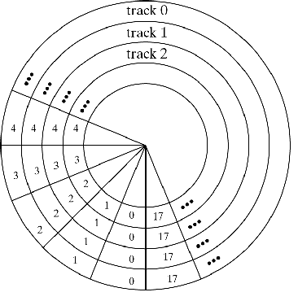
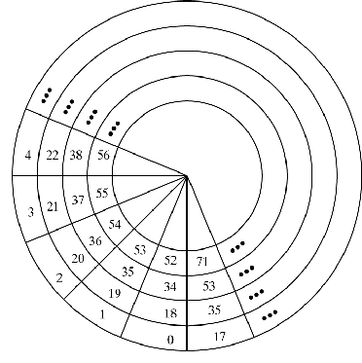
I/O Devices – Storage
Disks
Surface, tracks/surface, sectors/track, bytes/sector
All sectors numbered sequentially 0..(n-1) (device controller provides mapping)

Slide 23
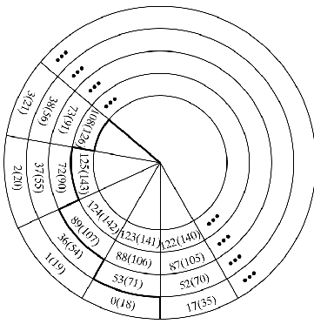
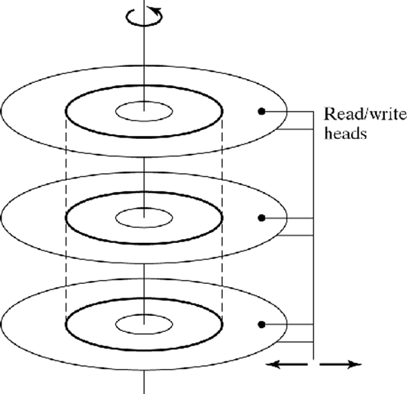
I/O Devices – Storage
Double-sided or multiple surfaces
Tracks with same diameter = cylinder
Sectors are numbered within cylinder consecutively to minimize seek time

Slide 24
I/O Devices – Storage
Optical disks
CD-ROM, CD-R (WORM), CD-RW
Originally designed for music
Data stored as continuous spiral, subdivided into sectors
Higher storage capacity: 0.66 GB/surface
Constant linear speed (200-530 rpm), high data rate

Slide 25
Hierarchical Model of the I/O System

Slide 26
Handshaking relationship between the host and a Device Controller
|<<
Execution of Handshaking in a polling loop or via interrupts
Offloading of the work to a DMA Controller for large transfers
Polling Determines State of Device
Command–Ready
Busy
Error
Busy–wait Cycle
To wait for I/O from Device

Slide 27
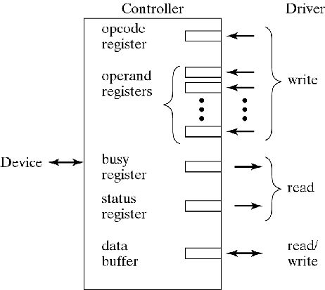
Device Drivers
accept command from application
get/put character
read/write block
send/receive packet
interact with device controller (hardware) to carry out command
driver-controller interface:
set of registers

Slide 28
Programmed I/O with Polling
Who moves the data?
How does driver know when device is ready?
CPU is responsible for
moving every character to/from controller buffer
detecting when I/O operation completed

Slide 29
Programmed I/O with Interrupts
CPU is responsible for moving data, but
Interrupt signal informs CPU when I/O operation completes

Slide 30
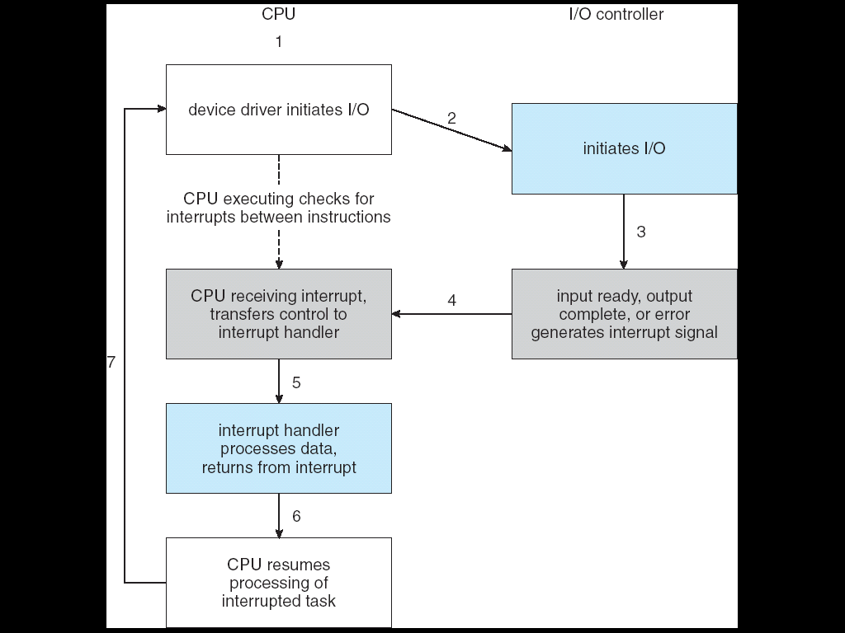
Interrupt–Driven I/O Cycle

Slide 31
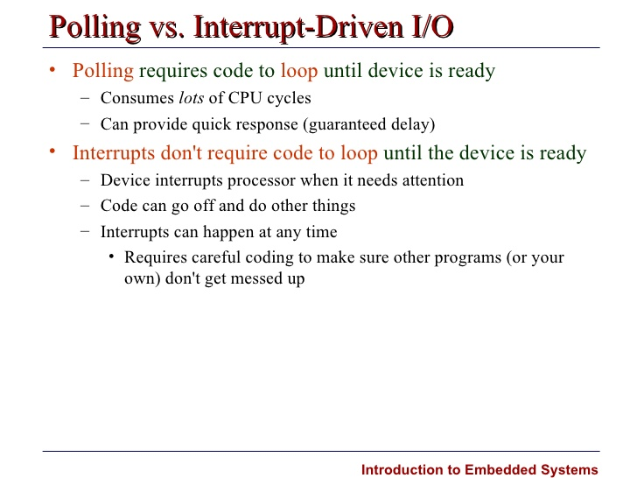

Slide 32
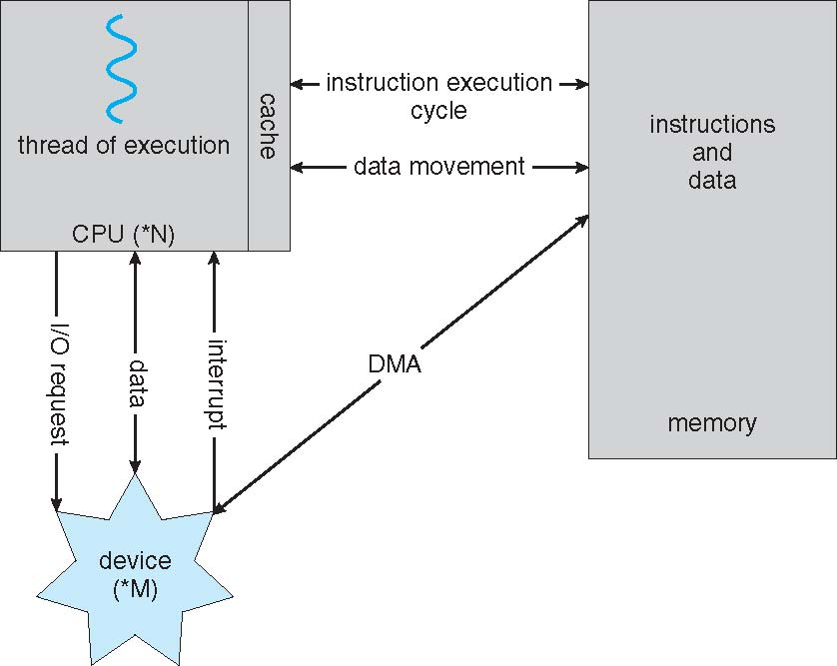
Direct Memory Access
CPU does not transfer data, only initiates operation
DMA controller transfers data directly to/from main memory
Interrupts when transfer completed
Used to avoid Programmed I/O
for large Data Movement
Requires DMA Controller
Bypasses CPU
to transfer Data directly between I/O Device and Memory

Slide 33
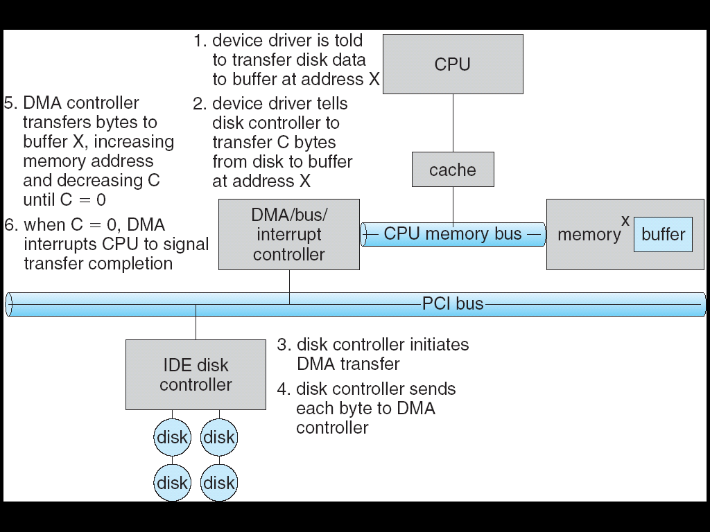
Six Step Process to Perform DMA Transfer
|<<

Slide 34
Kernel I/O Subsystem
Functions
Management of the name space for files and devices
Access Control to files and devices
Operation Control (Ex: A modem cannot seek ( ))
File–System space allocation
Device allocation

Slide 35
Device Management

Slide 36
Kernel I/O Subsystem
Scheduling
Buffering
Caching
Spooling
Device Reservation
I/O protection
Error Correction
Scheduling
Some I/O request ordering via per–device queue
Some Operating Systems try fairness
Buffering
Store data in memory while transferring between devices
To cope with device speed mismatch
To cope with device transfer size mismatch
To maintain “copy semantics”
Caching
Fast memory holding copy of data
Always just a copy
Key to performance

Slide 37
Kernel I/O Subsystem
Spooling
Hold output for a device
If device can serve only one request at a time
i.e., Printing
Device reservation
Provides exclusive access to a device
System calls for allocation and deallocation
Watch out for deadlock

Slide 38
Error Handling
OS can recover from
Disk Read
Device unavailable
Transient Write failures
Most return
An error no. or code when I/O request fails
System error logs
Hold problem reports
I/O Protection
User process may accidentally or purposefully attempt to disrupt normal operation via illegal I/O instructions
All I/O instructions defined to be privileged
I/O must be performed via system calls
Memory-mapped and I/O port memory locations must be protected too

Slide 39
Kernel Data Structures
Kernel keeps state info for I/O components, including
open file tables
network connections
character device state
Many, many complex data structures to track
Buffers
memory allocation
“dirty” blocks
Some use object-oriented methods and message passing
to implement I/O

Slide 40
Transforming I/O Requests to Hardware Operations
Consider reading a file from disk for a process:
Determine device holding file
Translate name to device representation
Physically read data from disk into buffer
Make data available to requesting process
Return control to process

Slide 41
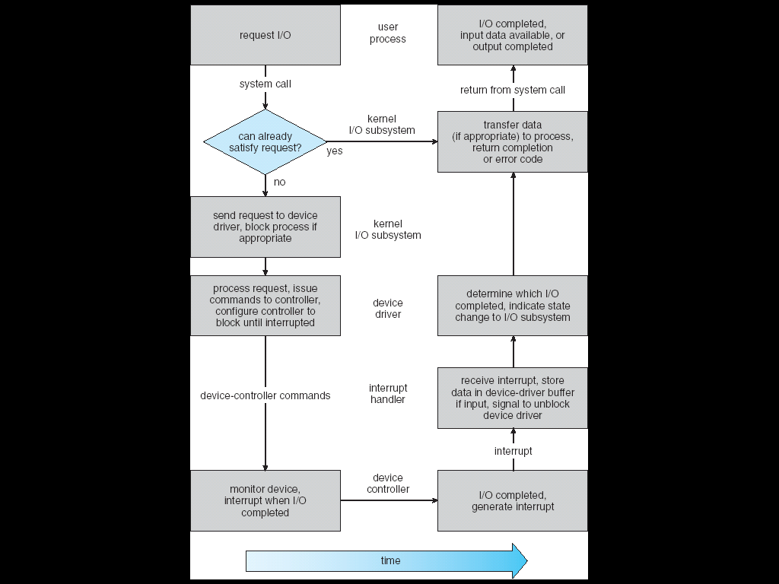
Life Cycle of an I/O Request
|<<

Slide 42
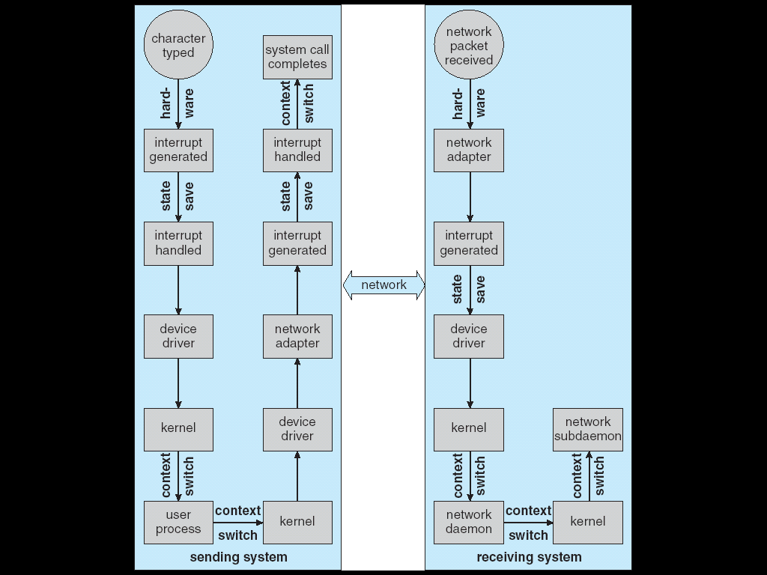
Intercomputer Communications

Slide 43
Improving Performance
Reduce no. of Context Switches
Reduce Data Copying
Reduce interrupts by using
Large transfers
Smart controllers
Polling
Use DMA
Balance
CPU
Memory
Bus
I/O performance
for highest throughput

Slide 44
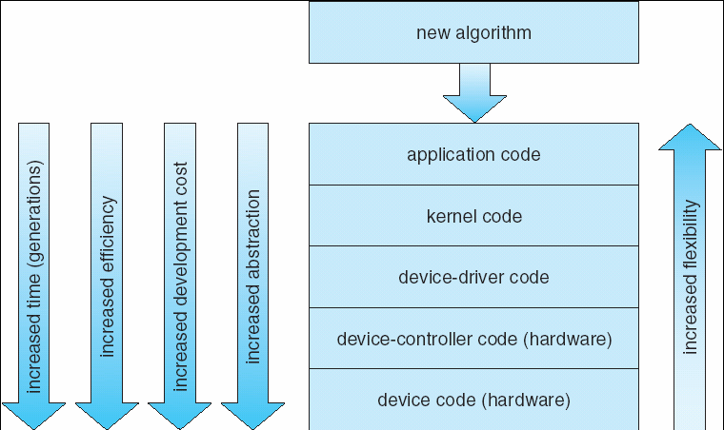
Device-Functionality Progression
|<<

Slide 45
Protection
Goals of Protection
Principles of Protection
Access Matrix
Implementation of Access Matrix
Access Control
Revocation of Access Rights
Capability-Based Systems

Slide 46
Goals of Protection
Operating system consists of a collection of objects, hardware or software
Each object has a unique name and can be accessed through a well-defined set of operations.
Protection problem - ensure that each object is accessed correctly and only by those processes that are allowed to do so.

Slide 47
Principles of Protection
Guiding principle – principle of least privilege
Programs, users and systems should be given just enough privileges to perform their tasks
Must Provide a means for
Specifying the Controls to be imposed,
together with a means of enforcement.
Must have the mechanism for Controlling
the Access of Programs, Processes, or users
to the resources defined by a Computer System.

Slide 48
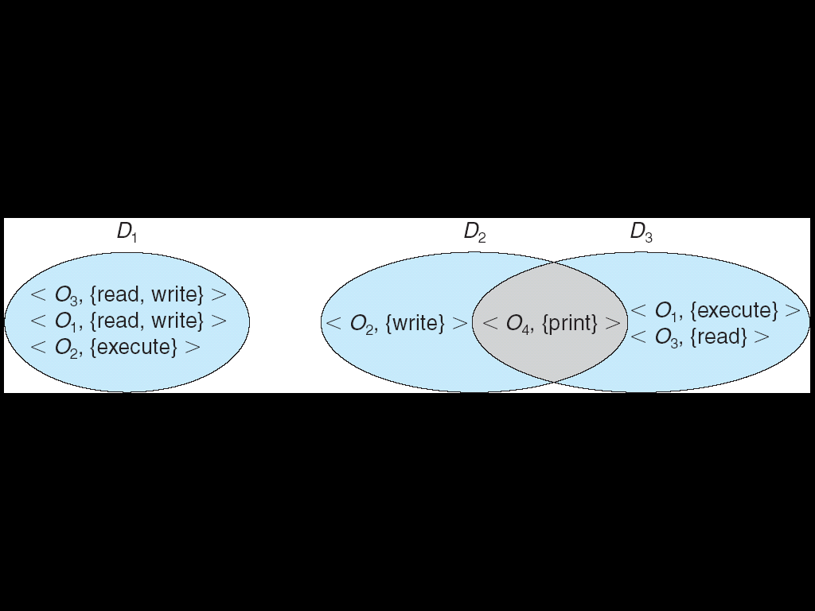
Domain Structure
Access-right = <object-name, rights-set> where rights-set is a subset of all valid operations that can be performed on the object. Domain = set of access-rights

Slide 49
Access Matrix
View protection as a matrix (access matrix)
Rows represent domains
Columns represent objects
Access(i, j) is the set of operations that a process executing in Domain_{i} can invoke on Object_{j}

Slide 50
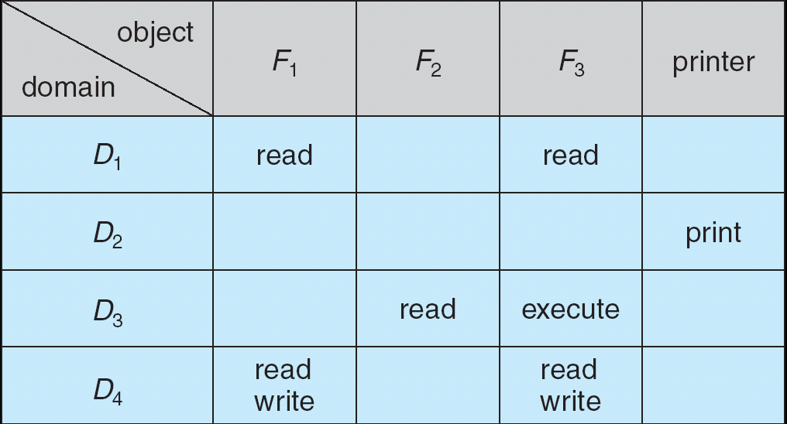
Access Matrix

Slide 51
Use of Access Matrix
Access matrix design separates mechanism from policy.
Mechanism
Operating system provides access-matrix + rules.
It ensures that the matrix is only manipulated by authorized agents and that rules are strictly enforced.
Policy
User dictates policy.
Who can access what object and in what mode.

Slide 52
Use of Access Matrix (Cont.)
If a process in Domain D_{i} tries to do “op” on object O_{j}, then “op” must be in the access matrix.
Can be expanded to dynamic protection.
Operations to add, delete access rights.
Special access rights:
copy op from O_{i} to O_{j}
owner of O_{i}
control – D_{i} can modify D_{j} access rights
transfer – switch from domain D_{i} to D_{j}

Slide 53
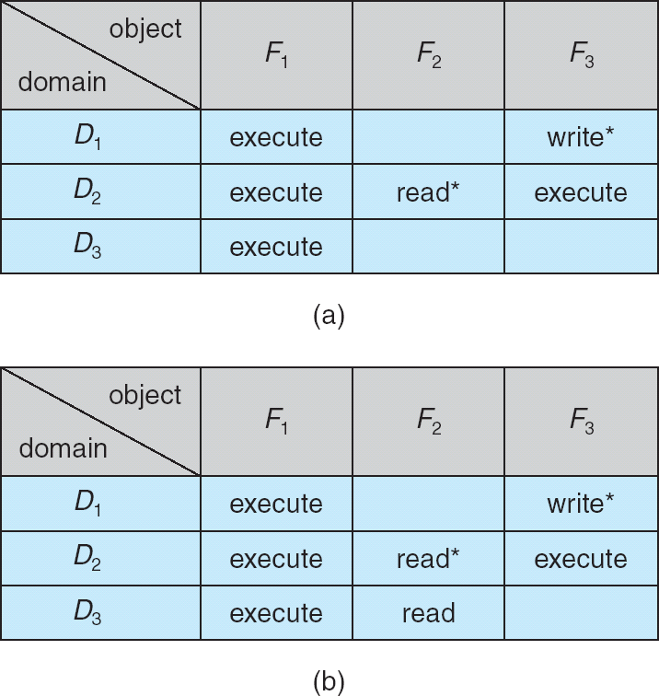
Access Matrix with Copy Rights
The ability to copy rights is denoted by an asterisk, indicating that processes in that domain have the right to copy that access within the same column, i.e. for the same object. There are two important variations:
If the asterisk is removed from the original access right, then the right is transferred, rather than being copied. This may be termed a transfer right as opposed to a copy right.
If only the right and not the asterisk is copied, then the access right is added to the new domain, but it may not be propagated further. That is the new domain does not also receive the right to copy the access. This may be termed a limited copy right

Slide 54
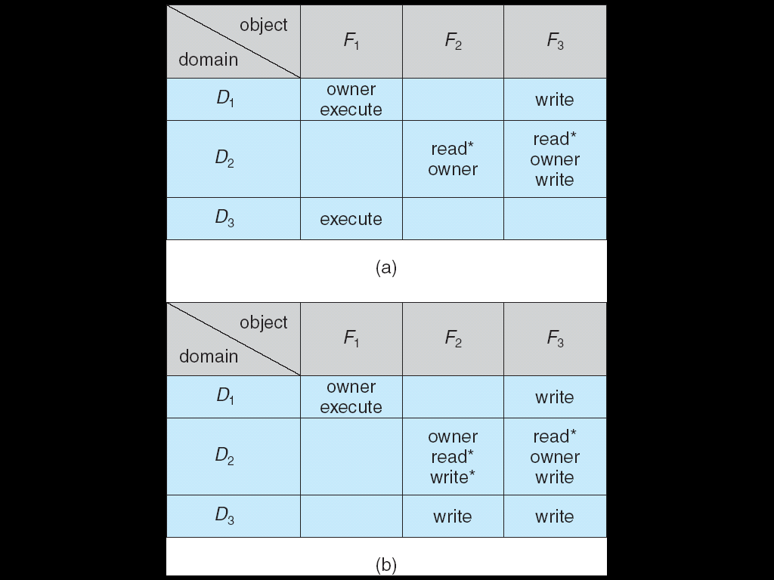
Access Matrix With Owner Rights
The owner right adds the privilege of adding new rights or removing existing ones
Copy and owner rights only allow the modification of rights within a column.

Slide 55
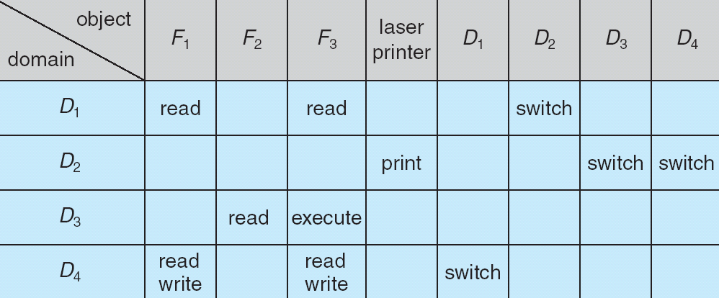
Access Matrix of Figure A With Domains as Objects
Access Matrix With Control and Switch Rights
The addition of control rights, which only apply to domain objects, allow a process operating in one domain to affect the rights available in other domains. For example in the table above, a process operating in domain D4 has the right to control any of the rights in domain D2

Slide 56
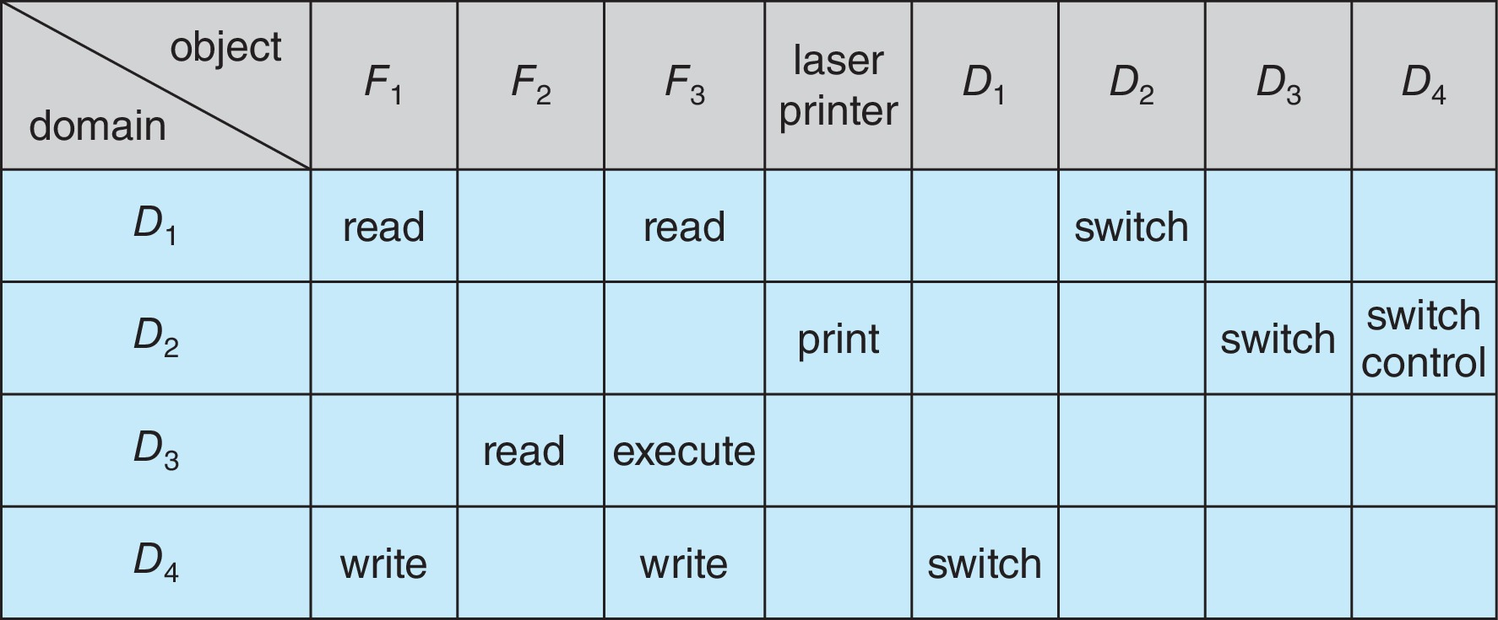
Modified Access Matrix due to Control rights

Slide 57
Implementation of Access Matrix
Each column = Access-control list for one object Defines who can perform what operation.
Object i (O_{i}) Access Control List Domain 1 = Read, Write Domain 2 = Read Domain 3 = Read 
Each Row = Capability List (like a key) Fore each domain, what operations allowed on what objects.
Object 1 – Read
Object 4 – Read, Write, Execute
Object 5 – Read, Write, Delete, Copy

Slide 58
Access Control List (ACL)
|<<
Associated with Each File and Directory.
Specifies User names and the types of Access allowed for Each User.
When User requests access to a particular file, the Operating System checks the access list associated with that file.
If that user is listed for the requested access, the access is allowed.
Otherwise, a Protection Violation occurs, and the user job is denied access to the file.
Main problem is Length.

Slide 59
Capabilities
|<<
All access to objects (Ex: every program/file) is done thru Capabilities, and Capabilities provide the only means of accessing Objects.
If Program A holds a Capability to talk to Program B, then the two Programs can grant Capabilities to each other.
Although a Program can hold an infinite no. of Capabilities, better is to hold a fixed no. of Capabilities, and improve as they are needed.
The only way to obtain Capabilities is to have them granted as a result of Some Communication.

Slide 60
Third Party Tools
First Party Tools
would be Something created Oneself.
Second Party Tools
would be tools bought from a Vendor, like an IDE.
Third Party Tools
are tools for use with Second Party Tools
that aren't from the Second Party Vendor.
Add–ons to make Second Party Tools more Useful.
Carry Considerable
Continuity,
Accuracy and
Privacy Risks
Examples:
Macros
bots (Web Crawler/Spider, Program performs automated tasks)
Software / Scripts
|<<

Slide 61
Security
|<<
Ensures the authentication of System users
to protect the integrity of the information
stored in the System.
Prevents
unauthorised access,
malicious destruction or alteration of data,
and accidental introduction of inconsistency.

Slide 62
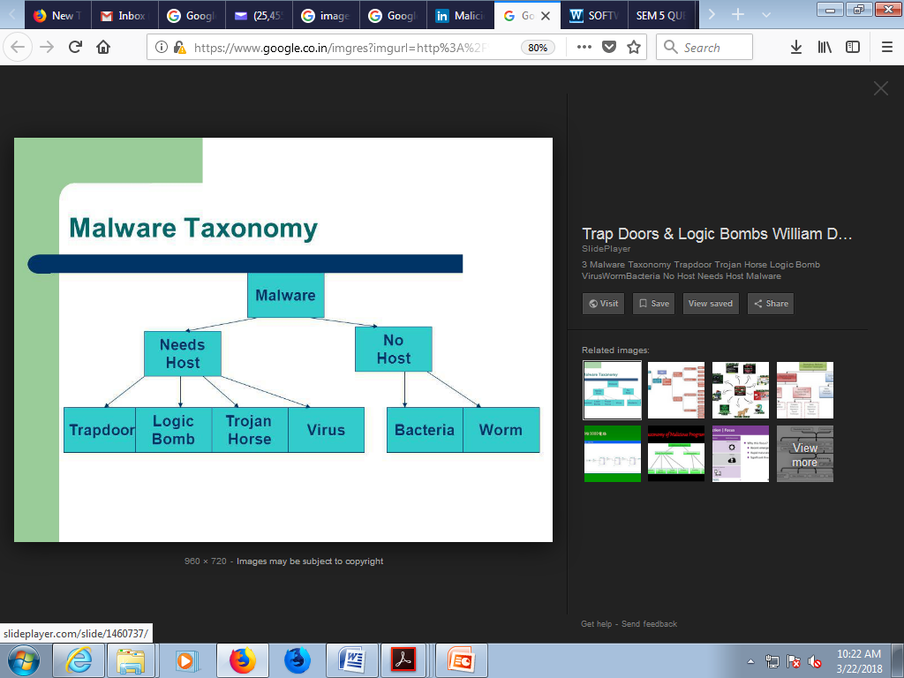
The Security Problem
System secure if resources used and accessed as intended under all circumstances
Unachievable
Intruders (crackers) attempt to breach security
Threat is potential security violation
Attack is attempt to breach security
Attack can be accidental or malicious
Easier to protect against accidental than malicious misuse

Slide 63
Security Violations
Categories
Breach of confidentiality
Breach of integrity
Breach of availability
Theft of service
Denial of service

Slide 64
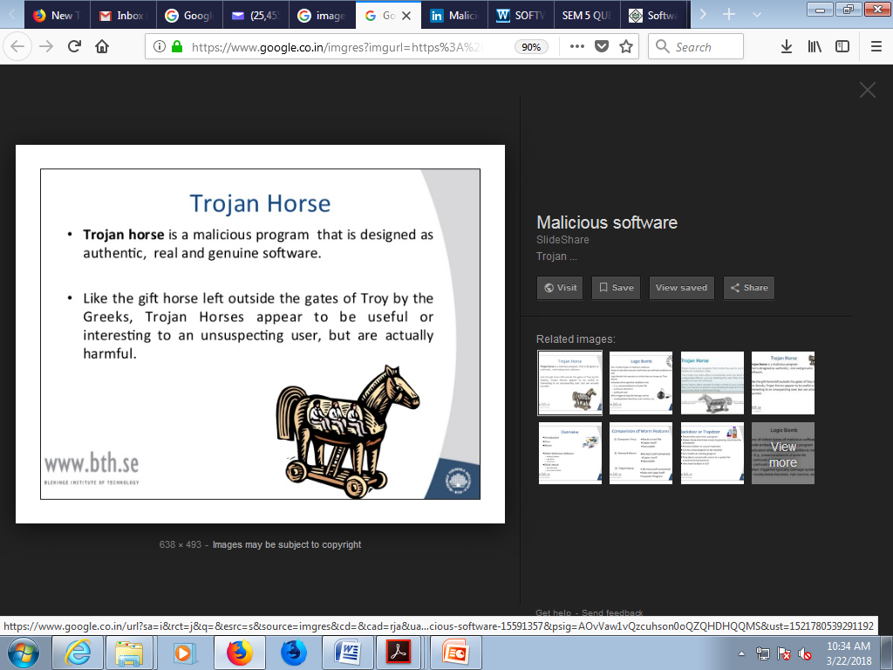
Program Threats
Many variations, many names
Trojan Horse
Code segment that misuses its environment
Exploits mechanisms for allowing programs written by users to be executed by other users
Spyware, pop-up browser windows, covert channels
Up to 80% of spam delivered by spyware infect the systems
Trap Door
Specific user identifier or password that circumvents normal security procedures
Could be included in a compiler
How to detect them?

Slide 65
Program Threats (Cont.)
Logic Bomb
Program that initiates a security incident under certain circumstances
Stack and Buffer Overflow
Exploits a bug in a program (overflow either the stack or memory buffers)
Failure to check bounds on inputs, arguments
Write past arguments on the stack into the return address on stack
When routine returns from call, returns to hacked address
Pointed to code loaded onto stack that executes malicious code
Unauthorized user or privilege escalation

Slide 66
Threats summarized
Back doors (trap doors) - Allow unauthorized access to your system
Logic bombs -hidden features in programs that go off after certain conditions are met
Viruses - or programs that modify other programs on a computer, inserting copies of themselves
Worms- programs that propagate from computer to computer on a network, without necessarily modifying other programs on the target machines
Trojan horses- programs that appear to have one function but actually perform another function
Bacteria (rabbit programs) - make copies of themselves to overwhelm a computer system's resources

Slide 67
Exam Questions
|<<
Contrast and Compare Program initiated I/O and Interrupt initiated I/O.
Write about the kernel I/O subsystem in detail.
Discuss the various issues in designing I/O facility.
Explain about I/O System, Protection and Security.
What is protection? Explain about access control list and capabilities.
Explain briefly access control list, capability?

