Slide 1
UNIT–I: Introduction
Introduction to Operating System
Architecture
Various Operating System Services
System Calls and its types
System Programs
OS Structure
Types of Operating Systems
Unit-I: Introduction

Slide 2
Introduction to Operating System
  Prerequisites
  Operating System (OS)
  Resources of a Computer System
  User View
  System View
  Objectives and Functions of OS
Unit-I: Introduction

Slide 3
Prerequisites
|<<
Basic Data Structures
Computer Organisation
High–Level Language (C, …)
Unit-I: Introduction

Slide 4
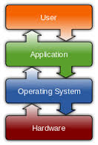
Operating System (OS)
Defn1: OS is software that manages computer hardware and software resources and provides common services for computer programs. (source: Wiki)
    Defn2: Controls and coordinates use of Hardware
    among Various Applications and Users
    Defn3:Collection of System Software (Programs),
    which makes it User friendly and Most efficient
Kernel
Program running at all times on the Computer
Unit-I: Introduction

Slide 5
Kernel
The parts of the Operating System that could not be ported because they involve direct access to hardware that would be different for each type of machine was called the Kernel.
The Kernel (part of OS), but is specific to the hardware on which it’s running.
The rest of the Operating System can be written once in a high level language (like C), then ported to a new machine by re-compiling it in the new machine.
The Operating System still takes care of Memory Management, Device Management and Communication, Execution Management, etc.
Unit-I: Introduction

Slide 6
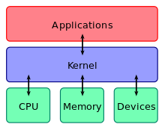
Kernel
Central module and Part of the OS that loads first, and it remains in main memory.
So, it has to be as small as possible while still providing all the essential services required by other parts of the operating system and applications.
Its loaded into a protected area of memory to prevent it from being overwritten by programs or other parts of the operating system.
Responsible for
  process and task management in CPU
  memory management,
  I/O management.
The kernel connects the system hardware to the application software.
For example the Linux kernel is used in numerous operating systems including Linux, FreeBSD, Android and others.
Unit-I: Introduction

Slide 7
Most Popular Operating Systems
|<<
AT & T / BSD
Unix
Sun Microsystems’
Solaris 2
Linux
Microsoft
MS-DOS
Windows 95 / 98 / NT
Windows 2000 (Windows Me)
Windows XP
Windows Vista
Windows 7 / Windows 8
DEC
VMS (Virtual Memory System)
TOPS–20 (Total Operations Processing System)
IBM
OS/2
Apple
Macintosh
Unit-I: Introduction

Slide 8
User View
Varies according to the interface used
Goal
    To maximize the work, the user is performing
  Ease of use
  Performance
  Resource utilization
Mainframe / Minicomputer
  Share Resources
  Exchange Information
  Designed to maximize Resource utilization
    All Available CPU Time, Memory and I/O used efficiently
Unit-I: Introduction

Slide 9
User View (contd.)
Workstations (Perform Effective Resource Sharing)
  Connected to Networks of other workstations and Servers
  Dedicated Resources at disposal
  Also Share Resources such as Networking and Servers
  (File, Compute, Print Servers)
  Handheld Computers (Ease of use)
  Standalone units for Individual users
  Connected to Networks
  (Directly by wire / through wireless Modems and Networking)
  Perform relatively few remote operations
  (Power, Speed, Interface limitations)
  Designed mostly for individual usability
  Embedded Computers in Home Devices and Automobiles (Performance)
  Have Numeric Keypads
  May turn indicator lights on or off to show status
  Designed primarily to run without user intervention
Unit-I: Introduction

Slide 10
System View
Most intimately involved with Hardware
Resource Allocator
Acts as Manager of Resources.
Decides to allocate Resources to Specific Programs and Users
so that OS operates the Computer System Efficiently and Fairly
Important as many Users access the same Mainframe / Minicomputer
Control Program
Manages Execution of User Programs
to prevent Errors and Improper use of Computer
Concerned with Operation and Control of I/O Devices
Unit-I: Introduction

Slide 11
Objectives and Functions of Operating System
Essential part of a Computer System
Purpose: To provide an environment in which a User can Execute Programs in a Convenient and Efficient manner
Program that acts as an intermediary between the User of a Computer and the Computer Hardware
Must Ensure Correct Operation of Computer System
Provides Certain Services to Programs and users of those programs in order to make their Tasks Easier
Controls and Coordinates the use of Hardware among Various Application Programs for the Various users
Primary Goals- User friendly, Efficient Operation of the Computer System
Unit-I: Introduction

Slide 12

Computer System Organization
Computer-system operation
  One or more CPUs, device controllers connect through common bus providing access to shared memory
  Concurrent execution of CPUs and devices competing for memory cycles

Slide 13
Computer-System Architecture
Single-Processor Systems
Multiprocessor Systems
Clustered Systems
Multiprogramming System
Multitasking system

Slide 14
Computer System Architecture
Single Processor Systems
  One CPU
  May have other special-purpose processors (such as disk controllers)
    Run a limited instruction set
    Do not run user processes
    Sometimes managed by OS
    For example a disk controller processor receives a sequence of requests from the main CPU and implements its own disk queue and scheduling algorithm to relieve the main CPU of the overhead of disk scheduling.

Slide 15

How a Modern Computer Works

Slide 16
Multiprocessor systems
Two or more processors in close communication, sharing the computer bus and sometimes the clock, memory, and peripherals.
Advantages:
  Increased throughput
    The speed-up ratio with N processors is not N however.
  Economy of scale
    Sharing of peripherals, mass storage, power supplies
  Increased reliability
    Graceful degredation
    Fault tolerance
      Failure detection, diagnose and correction
      Hardware duplication

Slide 17
Multiprocessor Systems
Two types:
  Asymmetric multiprocessing in which each processor is assigned a specific task. A master processor controls the system, scheduling and allocating work to slave processors.
  Symmetric multiprocessing (SMP) in which each processor performs all tasks within the operating system. All processors are peers.

Slide 18

Symmetric Multiprocessing Architecture

Slide 19
Clustered Systems
Gather together multiple CPUs to accomplish computation
Composed of two or more individual systems coupled together.
High availability service.
  Each node can monitor one or more of the others over the LAN.
  If the monitored machine fails, the monitoring machine can take ownership of its storage and restart the applications that were running on the failed machine.
Computer 1
interconnect
Computer 2
interconnect
Computer N
Storage Area Network

Slide 20
Clustered Systems (cont..)
Structure
  Asymmetric clustering: One machine is in hot-standby mode while the other is running applications. Hot-standby machine only monitors the active server.
  Symmetric clustering:Two or more hosts are running applications and are monitoring each other
Parallel Clusters allow multiple hosts to access the same data on the shared storage. May need a distributed lock manager (DLM).
Unit-I: Introduction

Slide 21
Differences between Multiprocessor and Clustered System
Multiprocessors are tied together and in clustered system individual systems are tied together.
LAN networking is used in Clustered system, in Multiprocessing system LAN etc is not required.
The aim is high availability in clustered system whereas in multiprocessing it is time saving.
The processors share common system clock and common data structures.
Unit-I: Introduction

Slide 22

A Dual-Core Design

Slide 23

Multiprogramming
|<<
No. of Programs in execution.
Increases CPU utilization by organizing jobs so that
the CPU always has one job to execute.
CPU is never idle.
OS functions to
Keep several jobs in memory simultaneously.
Pick and begins to execute one of the jobs in the memory.
Job may have to wait for some task (I/O operation) and OS simply switches to, and executes, another job.
When that job needs to wait, the CPU is switched to another job, and so on.
When the first job finishes waiting, it gets the CPU back.
Allow time-sharing.
Unit-I: Introduction

Slide 24
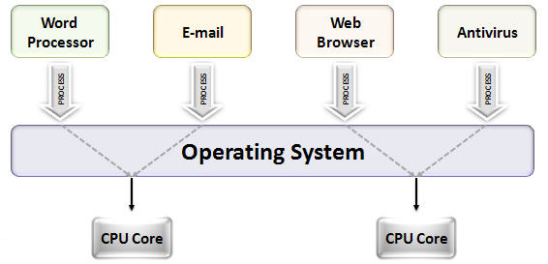
Multitasking / Multiprocessing
|<<
Multiple Tasks are performed during the Same period of time.
Tasks Share Common Processing Resources
such as CPU and Main Memory.
In Uniprocessor Systems,
Multitasking Solves the problem by Scheduling which task may be the one running at any given time, and when another waiting task gets a turn.
Context Switch
Act of reassigning a CPU from one task to another one.
Multiuser
Allows for Multiple users to use the Same Computer
at the Same time and Different times.
Unit-I: Introduction

Slide 25
Multithreading
|<<
Operating Systems that allow Different parts of a Software program to run Concurrently.
Examples
  Linux
  Unix
  Windows 2000
  Applications
    Any kind of application which has Distinct tasks which can be performed independently.
  Any application with a GUI.
  Any application which requires Asynchronous response.
  Network based applications are ideally suited.
Unit-I: Introduction

Slide 26
Various Operating System Services
|<<
Provides No. of Services.
Lowest level – System Calls
Allow running program to make requests from the OS directly.
Higher level – Command Interpreter or Shell
User issues request without writing program.
Categories
Program Control
Status Requests
I/O Requests
Unit-I: Introduction

Slide 27
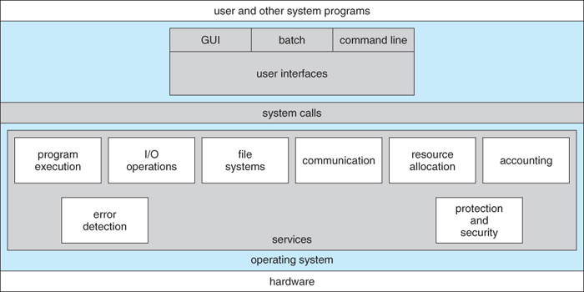
Operating System Services
|<<
  User Interface
  Program Execution
  I/O Operations
  File-System Manipulation
  Communications
  Error Detection
  Other Services
    Resource Allocation
    Accounting
    Protection and Security
Unit-I: Introduction

Slide 28
  User Interface
|<<
    All Operating Systems have User Interface (UI)
    Command-Line Interface (CLI)
    Graphics User Interface (GUI)
  Program Execution
    Load Program into Memory
    Run the Program
    End Execution, either Normally or Abnormally (indicating Error)
Unit-I: Introduction

Slide 29
  I/O Operations
|<<
    Running Program may require I/O,
    which may involve File or I/O Device.
  File–System Manipulation
    Programs need to
    Read and Write Files and Directories,
    Create and Delete Files and Directories,
    Search Files and Directories,
    List File Information,
    Permission Management.
Unit-I: Introduction

Slide 30
Communications
|<<
  Processes may exchange information, on the Same Computer or between Computers over a Network
    Communications may be via
      Shared Memory or
      thru Message Passing (Packets moved by the Operating System)
Unit-I: Introduction

Slide 31
Error Detection
|<<
    May occur in
      the CPU and Memory Hardware,
      I / O Devices,
      User Program
    For each type of Error,
      OS should take the appropriate action to ensure correct and consistent computing
    Debugging facilities
      can greatly enhance the User’s and Programmer’s abilities
      to efficiently use the System
  Resource Allocation
  When Multiple Users or Multiple Jobs running Concurrently,
  Resources must be Allocated to each of them.
Unit-I: Introduction

Slide 32
  Accounting
|<<
  To Keep Track of
  Which Users use How much
  What Kinds of Computer Resources
  Protection and Security
    Protection
      Involves ensuring that all Access to System Resources is Controlled
    Security of the System
      from outsiders requires User Authentication,
      extends to defending External I / O Devices from Invalid Access attempts
Unit-I: Introduction

Slide 33

Basic Structure/Components of a Computer System
Hardware
Operating System
Application Programs
Users
Central Processing Unit (CPU)
Memory
Input–Output (I/O) / Peripheral Devices
Provides basic Computing Resources.
Unit-I: Introduction

Slide 34
Application Programs
Word Processors (MS–Word)
Spreadsheets (MS–Excel)
Compilers (C, Java, …)
Web Browsers (Internet Explorer, Mozilla)
Database Systems
Video Games
Define the ways in which the resources are used
to solve the computing problems of the users.
  Users
    People
    Machines
    Other Computers
Unit-I: Introduction

Slide 35
System Calls
System Calls and Programs
|<<
System Calls
  Types of System Calls
System Programs
Provides Interface between Running Program and the Operating System.
  Generally available as Assembly–Language Instructions.
  Languages Defined to replace Assembly Language for Systems Programming allow System Calls to be made Directly (e.g., C, C++).
Methods used to Pass Parameters between a Running Program and the Operating System.
  Pass Parameters in Registers.
  Store the Parameters in a Table in Memory, and the Table Address is passed as a Parameter in a Register.
  Push (store) the Parameters onto the Stack by the Program, and Pop off the Stack by Operating System.
Unit-I: Introduction

Slide 36
Examples of System Calls and System Programs
System call : function that is called from a program. Examples include:
  open(), close(), read(), write().
A system program is a complete program executed from a shell prompt, from within a shell script. Example commands (system utilities) include:
  cat, ls, date, make
Thus, system calls are used within programs; system utilities are programs
Unit-I: Introduction

Slide 37

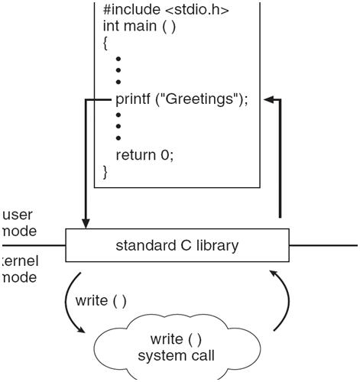
Unit-I: Introduction

Slide 38
Types of System Calls
|<<
Process Control
File Management
Device Management
Information Maintenance
Communications
  OS Services
  User Interface
  Program Execution
  I/O Operations
  File-System Manipulation
  Communications
  Error Detection
  Other Services
    Resource Allocation
    Accounting
    Protection and Security
Unit-I: Introduction

Slide 39
System Calls – Process Control
|<<
End, Abort
Load, Execute
Create Process, Terminate Process
Get Process Attributes, Set Process Attributes
Wait for time
Wait Event, Signal Event
Allocate and Free Memory
Unit-I: Introduction

Slide 40
System Calls – File Management
|<<
Create File, Delete File
Open, Close
Read, Write, Reposition
Get File attributes, Set File attributes
System Calls – Device Management
Request Device, Release Device
Read, Write, Reposition
Get Device attributes, Set Device attributes
Logically Attach or Detach Devices
Unit-I: Introduction

Slide 41
System Calls – Information Maintenance
|<<
Get Time or Date, Set Time or Date
Get System Data, Set System Data
Get Process, File, or Device attributes
Set Process, File, or Device attributes
System Calls – Communications
Create, Delete Communication connection
Send, Receive Messages
Transfer Status information
Attach or Detach Remote Devices
Unit-I: Introduction

Slide 42

Example of System Calls
System Call Sequence
to Copy the contents of One file to another file.
|<<
Unit-I: Introduction

Slide 43
System Programs
|<<
Provide Convenient environment
for Program Development and execution.
Categories
Programming Language Support
Program Loading and Execution
File Management
File Modification
Status information
Communications
System Calls
Process Control
File Management
Device Management
Information Maintenance
Communications
Unit-I: Introduction

Slide 44
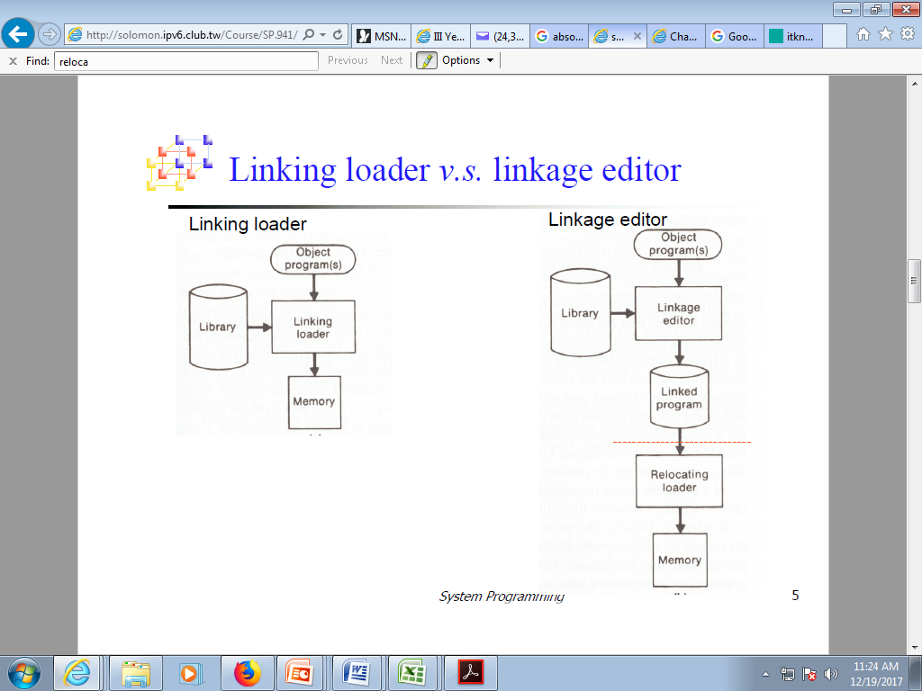
System Programs – Programming Language Support
|<<
Compilers
Assemblers
Interpreters
System Programs – Program Loading & Execution
Absolute Loaders
Relocatable Loaders
Linkage Editors
Overlay Loaders
Debugging Systems
Unit-I: Introduction

Slide 45
System Programs – File Management
|<<
Create
Delete
Copy
Rename
Print
Dump
List
Manipulate Files and Directories
System Programs – File modification
Text Editors
To Create and Modify the Contents of Files Stored on Disk or Tape.
Screen Editor – vi
Line Editor – edlin, ed, …
Unit-I: Introduction

Slide 46
System Programs – Status information
|<<
Date
Time
Amount of available Memory / Disk Space
No. of users
…
System Programs – Communications
Provide mechanism for creating virtual connections
among processes, users and different computer systems.
Allow users to
Send messages to one another’s Screens.
Browse Web pages.
Send Electronic Mail messages.
Log-in Remotely.
Transfer Files from one machine to another.
Unit-I: Introduction

Slide 47
Types of Operating Systems
|<<
Batch Processing Systems
Interactive Systems
Time Sharing
Time Slicing
Distributed Systems
Network Systems
Real–Time Systems
Evolution of OS
Unit-I: Introduction

Slide 48

Batch Processing Systems
Computer runs one and only one application at a time.
Early Computers were physically enormous machines
run from a console.
Common input devices
Card readers
Tape drives
Common output devices
Line printers
Tape drives
Card punches
Unit-I: Introduction

Slide 49
Batch Processing (during earlier days)
|<<
OS always resident in memory.
CPU is often idle.
User do not interact directly with computer systems.
User prepare a job and submit to computer operator.
Operators batch together jobs with similar needs
and run them through the computer as a group.
Programmers would leave their programs
with the operator.
The operator would sort the programs into batches
with similar requirements
and as the computer became available
would run each job.
Unit-I: Introduction

Slide 50
Interactive Processing
|<<
User and Computer System interact.
User Requests.
System Responds.
The process goes on.
Unit-I: Introduction

Slide 51
Time Sharing
|<<
Variable CPU Time to different processes.
Once CPU Time is allocated to a process,
will not be interrupted till it
completes its execution, or
waiting for an I/O, or
cannot continue its execution.
Time Slicing
Equal Amount of CPU time allocated
among Various Processes.
Unit-I: Introduction

Slide 52
Distributed Systems
• Distribute the Computation among Several Physical Processors
Loosely Coupled System
Each Processor has its Own Local Memory
Processors Communicate with one another
thru Various Communications lines,
such as High–Speed buses or Telephone lines
• Enables Parallelism
but speed up is not the goal
Advantages of Distributed Systems
  Resources Sharing
  Computation Speed up–load Sharing
Reliability
Communications
Unit-I: Introduction

Slide 53
Distributed Systems
|<<
Distributed Operating System
Less Autonomy between Computers
Gives the impression,
Single Operating System Controlling the Network
Types of Distributed Systems
Client–Server Systems
Peer–to–Peer Systems
Network Systems
Equal Amount of CPU time allocated among Various Processes.
Unit-I: Introduction

Slide 54
Real–Time Systems
Special purpose OS.
Used when rigid time requirements have been placed on the operation of a processor or the flow of data.
Used as control device in a dedicated application.
Sensors bring data to the computer.
The computer analyses the data and possibly adjust controls to modify the sensor inputs.
Well-defined, Fixed-time constraints.
Processing must be done within the defined constraints.
Ex: Systems controlling scientific experiments
Medical imaging systems
Industrial control systems
Certain display systems
Automobile-engine fuel-injection systems
Home-appliance controllers
Weapon systems
Unit-I: Introduction

Slide 55
Types of Real–Time Systems
|<<
Hard real-time systems
Guarantee critical tasks be completed on time.
Soft real-time systems
Critical real-time task gets priority over other tasks
and retains the priority until it completes.
Ex: Multimedia
Advanced scientific projects
Undersea exploration
Planetary rovers
Unit-I: Introduction

Slide 56

Evolution of Operating Systems
|<<
Unit-I: Introduction

Slide 57
Exam Questions
Define OS.
Write about Evolution of Operating Systems.
Explain basic Structure of a Computer System & also Explain its basic elements.
Discuss the basic components of a virtual computer.
What are OS Objectives?
What is an Operating System? Explain the functions of OS.
Discuss the various approaches of designing an operating system.
Write about Multitasking.
Explain the concept of Multiprogramming.
Unit-I: Introduction

Slide 58
Exam Questions
|<<
What are the multi-tasking, multi-programming and multi-threading?
Explain the following:
a. Multiprogramming
b. Timesharing
c. Virtual Memory
What are Distributed Operating Systems?
What are the types of real-time systems?
What is dispatcher?
What is a system call? Explain the categories of system calls.
What is a system program? Explain different types of system programs.
Unit-I: Introduction

