Slide 1
Unit5
Introduction , Architecture , CGI environment variable, GET and POST methods Cookies ,File upload.
Python for Database: Introduction ,Connections , Executing queries ,Transactions Handling error

Slide 2
What CGI
The Common Gateway Interface, or CGI.
CGI is a set of standards that define how information is exchanged between the web server and a custom script/client.
The Common Gateway Interface, or CGI, is a standard for external gateway programs to interface with information servers such as HTTP servers.
The current version is CGI/1.1

Slide 3
Web Browsing
Your browser contacts the HTTP web server and demands for the URL, i.e., filename.
Web Server parses the URL and looks for the filename. If it finds that file then sends it back to the browser, otherwise sends an error message indicating that you requested a wrong file.
Web browser takes response from web server and displays either the received file or error message.

Slide 4
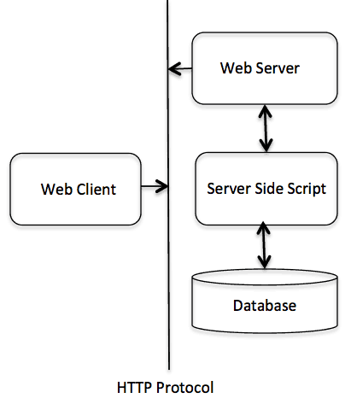

CGI Architecture

Slide 5
Configuration of web server is the first step
All the CGI Programs to be executed by the HTTP server are kept in a pre-configured directory. This directory is called CGI Directory.
By convention, CGI files have extension as.cgi, but you can keep your files with python extension .py as well.

Slide 6
https://www.youtube.com/watch?v=YvN4BlLS65Y

Slide 7
CGI Configuration
CGI Configuration
  Install and configure IIS server for enabling server side communication.
  You can get more details on configuration on below link
Notes:
https://www.apachelounge.com/download/https://www.apachelounge.com/download/
https://mid.as/kb/00143/install-configure-apache-on-windows#configure-apache
Apache configuration windows
https://editrocket.com/articles/python_apache_windows.html

Slide 8
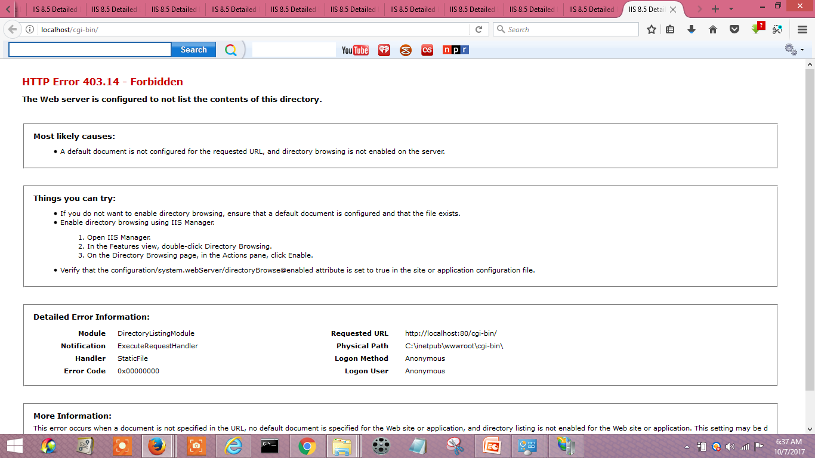

Slide 9
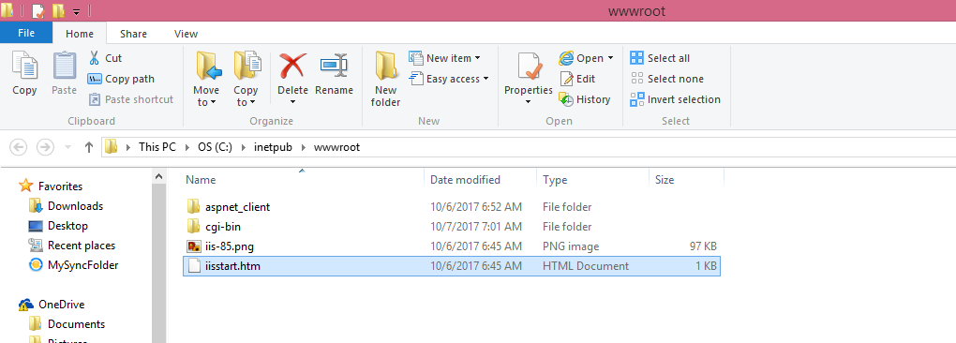

Slide 10
Sreeram_cgi.html
<!doctype html>
<html lang="en">
<head>
<title>CGI document</title>
</head>
<body>
<h1> welcome to CGI in Python</h1>
</body>
</html>

Slide 11
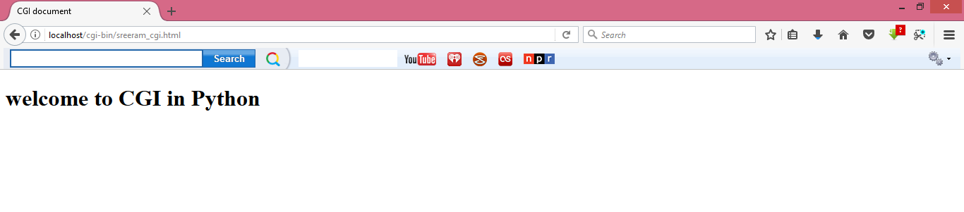

Slide 12
Cgi configuration
https://www.youtube.com/watch?v=T-kS-wt5qj0

Slide 13
CGI environment variable
All the CGI programs have access to the following environment variables.
These variables play an important role while writing any CGI program.

Slide 14
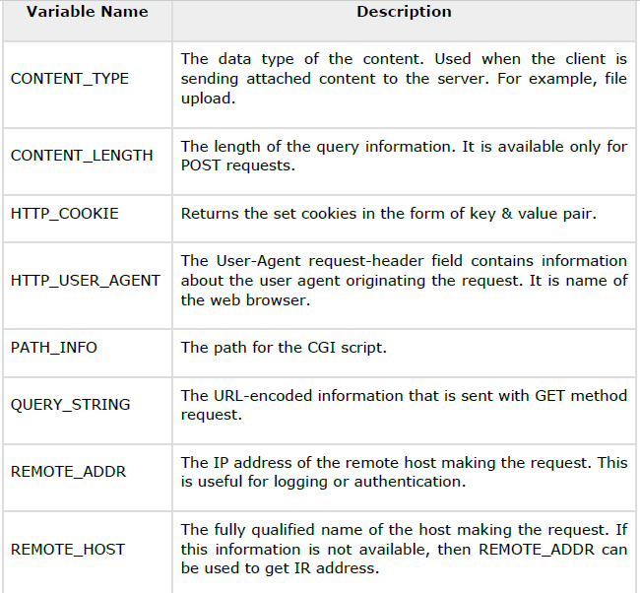

Slide 15
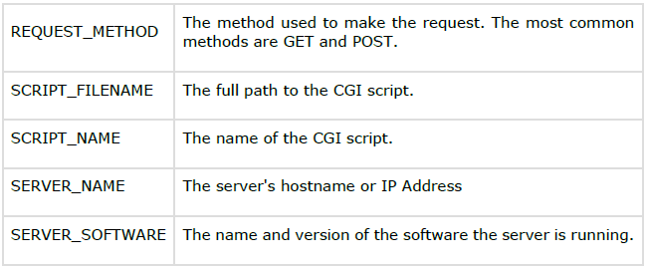
Continue….

Slide 16
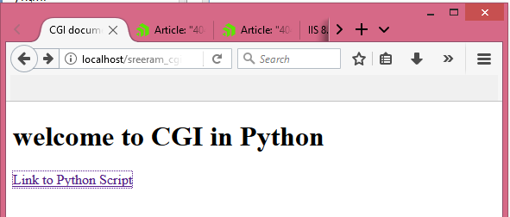
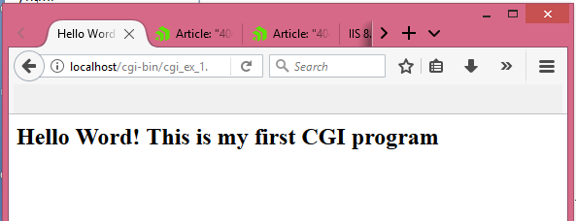
#!/usr/bin/python
print ("Content-type:text/html\r\n\r\n")
print ('<html>')
print ('<head>')
print ('<title>Hello Word - First CGI Program</title>')
print ('</head>')
print ('<body>')
print ('<h2>Hello Word! This is my first CGI program</h2>')
print ('</body>')
print ('</html>')
<!doctype html>
<html lang="en">
<head>
<title>CGI document</title>
</head>
<body>
<h1> welcome to CGI in Python</h1>
<a href="cgi-bin/cgi_ex_1.py">Link to Python Script</a>
</body>
</html>

Slide 17
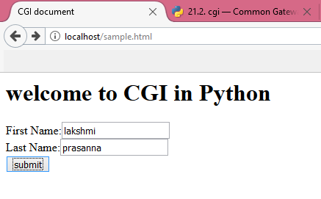
Form submission using CGI
Sample.html
<html>
<head>
<title>CGI document</title>
</head>
<body>
<h1> welcome to CGI in Python</h1>
<form action="cgi-bin/cgi_ex_1.py" method="get">
First Name:<input type="text" name="first_name"><br/>
Last Name:<input type="text" name="last_name"> <br/>
<input type="submit" value="submit"/>
</form>
</body>
</html>

Slide 18
cgi_ex_1.py
import cgi
import cgitb
form=cgi.FieldStorage()
first_name=form.getvalue('first_name')
last_name=form.getvalue('last_name')
print ("content-type:text/html\r\n\r\n")
print ('<html>')
print ('<head>')
print ('<title>Form EXAMPLE using CGI</title>')
print ('</head>')
print ('<body>')
print ('<h2>Hello</h2>')
print (first_name,last_name)
print ('</body>')
print ('</html>')

Slide 19
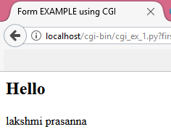
Type the following url in browser
  http://localhost/sample.html
Enter first name and lastname in the text field and click on submit

Slide 20
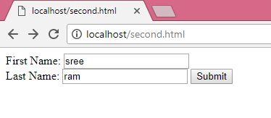
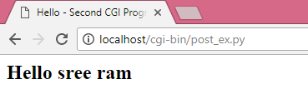
<html>
<head><title>post</title></head>
<body>
<form action="/cgi-bin/post_ex.py" method="post">
First Name: <input type="text" name="first_name"><br />
Last Name: <input type="text" name="last_name" />
<input type="submit" value="Submit" />
</form>
<body>
</html>
#!/usr/bin/python
# Import modules for CGI handling
import cgi, cgitb
# Create instance of FieldStorage
form = cgi.FieldStorage()
# Get data from fields
first_name = form.getvalue('first_name')
last_name = form.getvalue('last_name')
print ("Content-type:text/html\r\n\r\n")
print ("<html>")
print ("<head>")
print ("<title>Hello - Second CGI Program</title>")
print ("</head>")
print ("<body>")
print ("<h2>Hello %s %s</h2>" % (first_name, last_name))
print ("</body>")
print ("</html>")

Slide 21
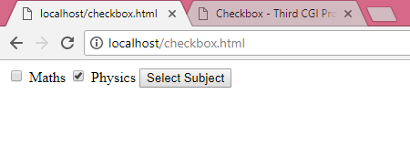
Checkbox.html
POST
<form action="/cgi-bin/checkbox.py" method="POST" target="_blank">
<input type="checkbox" name="maths" value="on" /> Maths
<input type="checkbox" name="physics" value="on" /> Physics
<input type="submit" value="Select Subject" />
</form>

Slide 22
checkbox.py
#!/usr/bin/python
# Import modules for CGI handling
import cgi, cgitb
# Create instance of FieldStorage
form = cgi.FieldStorage()
# Get data from fields
if form.getvalue('maths'):
math_flag = "ON"
else:
math_flag = "OFF"
if form.getvalue('physics'):
physics_flag = "ON"
else:
physics_flag = "OFF"
print ("Content-type:text/html\r\n\r\n")
print ("<html>")
print ("<head>")
print ("<title>Checkbox - Third CGI Program</title>")
Print( "</head>")
print ("<body>")
print ("<h2> CheckBox Maths is : %s</h2>" % math_flag)
print ("<h2> CheckBox Physics is : %s</h2>" % physics_flag)
print ("</body>")
print ("</html>“)

Slide 23
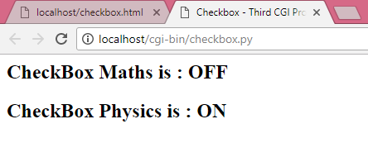
output
Open browser and type following information in the addressbar
http://localhost/checkbox.html
Press enter

Slide 24
Radio Button
radiobuttion.py
<form action="/cgi-bin/radiobuttion.py" method="post“ target= "_blank">
<input type="radio" name="subject" value="maths" /> Maths
<input type="radio" name="subject" value="physics" /> Physics
<input type="submit" value="Select Subject" />
</form>

Slide 25
#!/usr/bin/python
# Import modules for CGI handling
import cgi, cgitb
# Create instance of FieldStorage
form = cgi.FieldStorage()
# Get data from fields
if form.getvalue('subject'):
subject = form.getvalue('subject')
else:
subject = "Not set"
print ("Content-type:text/html\r\n\r\n")
print ("<html>")
print ("<head>")
print ("<title>Radio - Fourth CGI Program</title>")
print ("</head>")
print ("<body>")
print ("<h2> Selected Subject is %s</h2>" % subject)
print ("</body>")
print ("</html>")

Slide 26
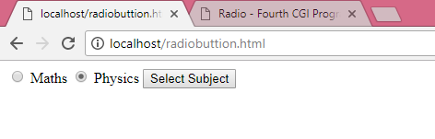
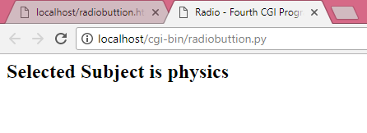
output

Slide 27
Cookies in CGI
What is cookie:
  a small piece of data sent from a website (web server) and stored in a user’s browser while the user is browsing that website
HTTP protocol is a stateless protocol.
For a commercial website, it is required to maintain session information among différent pages.

Slide 28
Your server sends some data to the visitor's browser in the form of a cookie.
The browser may accept the cookie. If it does, it is stored as a plain text record on the visitor's hard drive.
Now, when the visitor arrives at another page on your site, the cookie is available for retrieval.
Once retrieved, your server knows/remembers what was stored.

Slide 29
Cookies are a plain text data record of 5 variable-length fields:
Expires: The date the cookie will expire. If this is blank, the cookie will expire when the visitor quits the browser.
Domain: The domain name of your site.
Path: The path to the directory or web page that sets the cookie. This may be blank if you want to retrieve the cookie from any directory or page.
Secure: If this field contains the word "secure", then the cookie may only be retrieved with a secure server. If this field is blank, no such restriction exists.
Name=Value: Cookies are set and retrieved in the form of key and value pairs

Slide 30
It is very easy to send cookies to browser. These cookies are sent along with HTTP Header before to Content-type field.
Assuming you want to set UserID and Password as cookies.
Setting the cookies is done as follows:

Slide 31
Set the cookies
#!/usr/bin/python
print( "Set-Cookie:UserID=XYZ;\r\n" )
print( "Set-Cookie:Password=XYZ123;\r\n" )
print ( "Set-Cookie:Expires=Tuesday, 31-Dec-2019 23:12:40 GMT";\r\n" )
print ( "Set-Cookie:Domain=www.tutorialspoint.com;\r\n" )
print ( "Set-Cookie:Path=/perl;\n" )
print ( "Content-type:text/html\r\n\r\n" )
...........Rest of the HTML Content....
It is optional to set cookies attributes like Expires, Domain, and Path. It is notable
that cookies are set before sending magic line "Content-type:text/html\r\n\r\n.

Slide 32
Retrieve the cookie
It is very easy to retrieve all the set cookies. Cookies are stored in CGI environment variable HTTP_COOKIE and they will have following form
https://pymotw.com/3/http.cookies/

Slide 33

#!/usr/bin/python
# Import modules for CGI handling
from os import environ
import cgi, cgitb
if environ.has_key('HTTP_COOKIE'):
for cookie in map(strip, split(environ['HTTP_COOKIE'], ';')):
(key, value ) = split(cookie, '=');
if key == "UserID":
user_id = value
if key == "Password":
password = value
print "User ID = %s" % user_id
print "Password = %s" % password

Slide 34
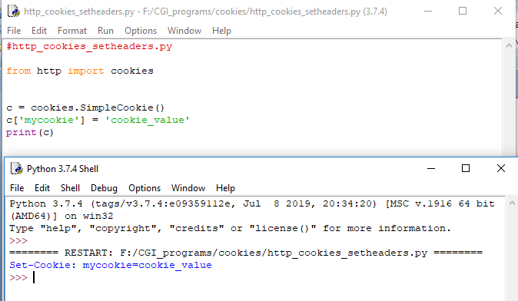
Set cookie

Slide 35
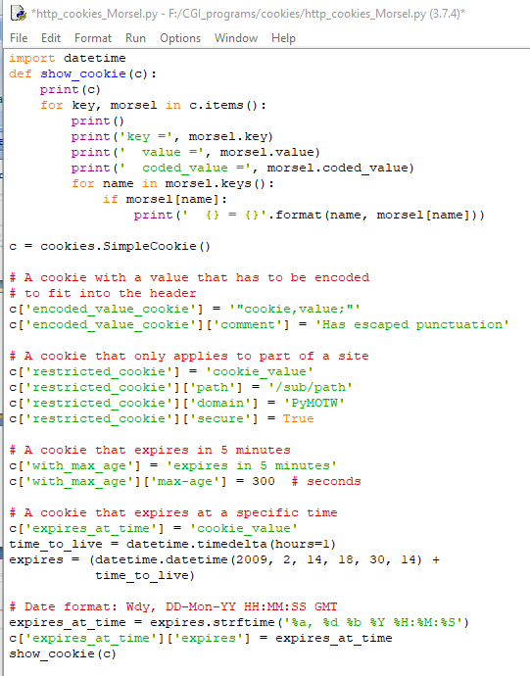

Slide 36
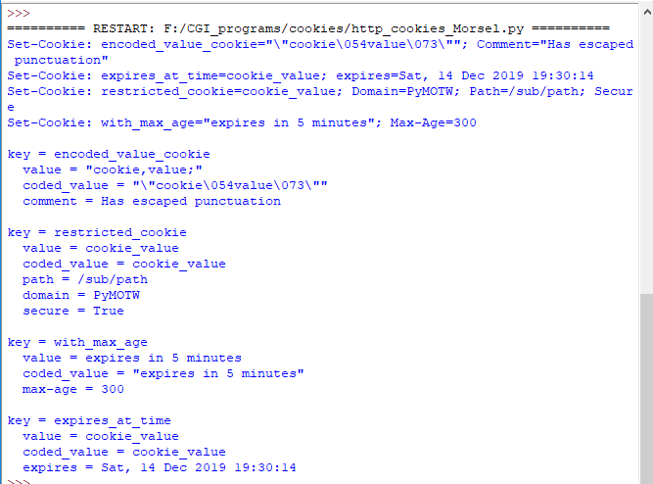

Slide 37
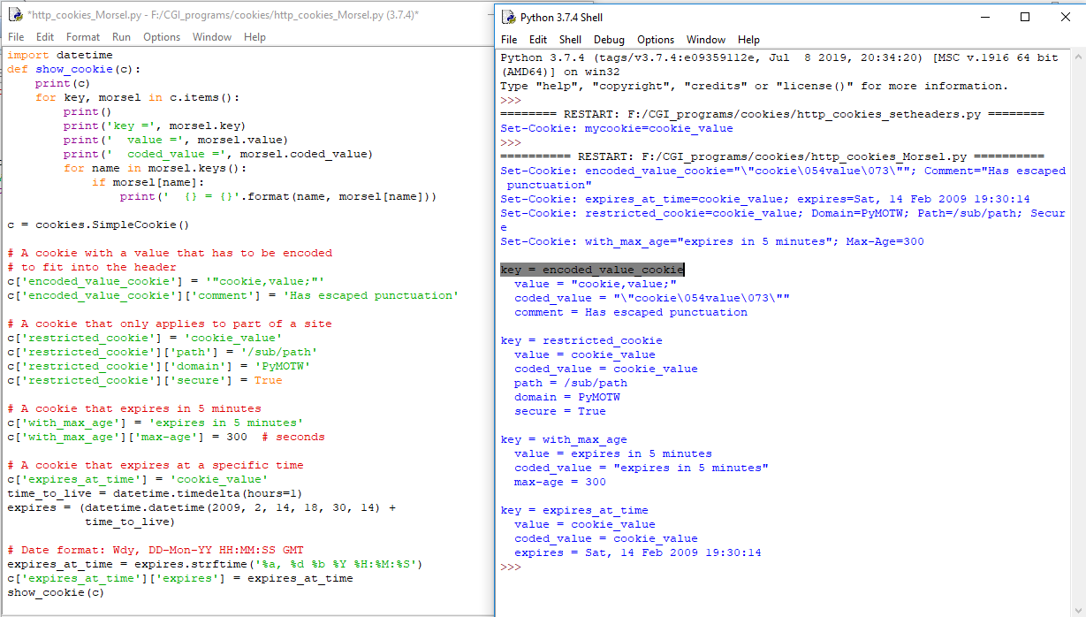

Slide 38
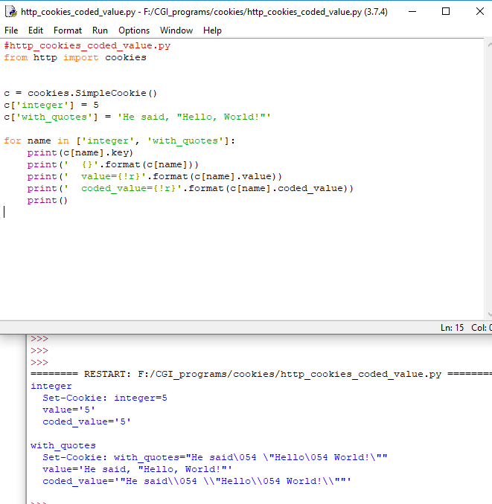

Slide 39
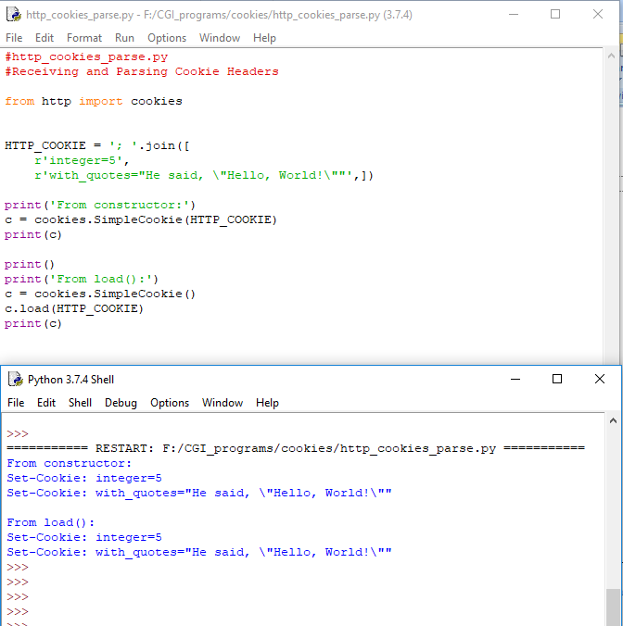

Slide 40
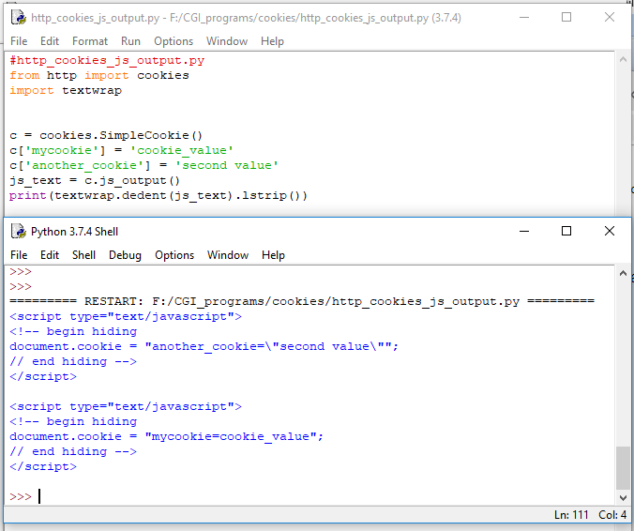

Slide 41
File upload
<html>
<body>
<form enctype="multipart/form-data"
action="cgi-bin/fileupload.py" method="post">
<p>File: <input type="file" name="filename" /></p>
<p><input type="submit" value="Upload" /></p>
</form>
</body>
</html>

Slide 42
#!/usr/bin/python
import cgi, os
import cgitb; cgitb.enable()
form = cgi.FieldStorage()
# Get filename here.
fileitem = form['filename']
# Test if the file was uploaded
if fileitem.filename:
# strip leading path from file name to avoid
# directory traversal attacks
fn = os.path.basename(fileitem.filename)
open(‘../CGI/' + fn, 'wb').write(fileitem.file.read())
message = 'The file "' + fn + '" was uploaded successfully'
else:
message = 'No file was uploaded'
print ("""\
Content-Type: text/html\n
<html>
<body>
<p>%s</p>
</body>
</html>
""" % (message,))

Slide 43
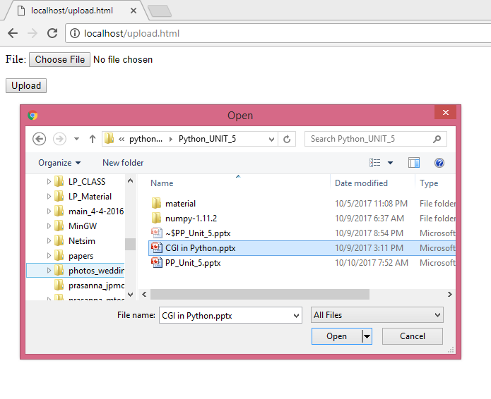
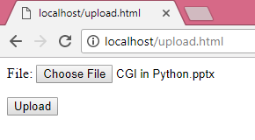
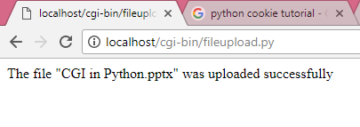

Slide 44
Database
Python supports many database servers-
  MySQL,
  Oracle,( dc_oracle2 and cx_oracle)
  PostgreSQL,(psycopg, PyGresQL and pyPgSQL)
  SQLite,
  Sybase,
  Microsoft SQL Server,
  mSQL,
  Microsoft Access(pypyodbc), and many more.

Slide 45
It supports
  Data Query Statements,
  Data Definition Language (DDL), and
  Data Manipulation Language (DML).
Advantages of Database Programming with Python
  Platform-independent
  Faster and more efficient
  Portable
  Support for relational database systems
  Easy to migrate and port database application interfaces
  Support for SQL cursors
  It handles open and closed connections

Slide 46
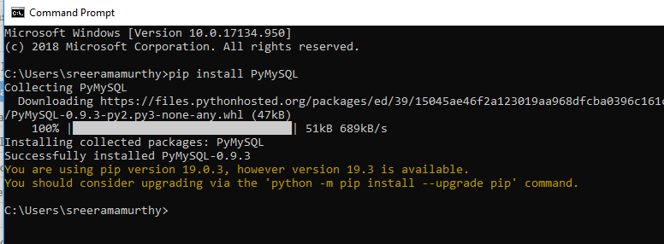

Slide 47
#!/usr/bin/python
import MySQLdb
# Open database connection
db = MySQLdb.connect("localhost","testuser","test123","TESTDB" )
# prepare a cursor object using cursor() method
cursor = db.cursor()
# Drop table if it already exist using execute() method.
cursor.execute("DROP TABLE IF EXISTS EMPLOYEE")
# Create table as per requirement
sql = """CREATE TABLE EMPLOYEE (
FIRST_NAME CHAR(20) NOT NULL,
LAST_NAME CHAR(20),
AGE INT,
SEX CHAR(1),
INCOME FLOAT )"""
cursor.execute(sql)
# disconnect from server
db.close()

Slide 48
#!/usr/bin/python
import MySQLdb
# Open database connection
db = MySQLdb.connect("localhost","testuser","test123","TESTDB" )
# prepare a cursor object using cursor() method
cursor = db.cursor()
# Prepare SQL query to INSERT a record into the database.
sql = """INSERT INTO EMPLOYEE(FIRST_NAME,
LAST_NAME, AGE, SEX, INCOME)
VALUES ('Mac', 'Mohan', 20, 'M', 2000)"""
try:
# Execute the SQL command
cursor.execute(sql)
# Commit your changes in the database
db.commit()
except:
# Rollback in case there is any error
db.rollback()
# disconnect from server
db.close()

Slide 49
Download MYSQL database from the following link and saved it and install MSQL
https://dev.mysql.com/downloads/file/?id=490027
After install connect to database(create database)
Now that you’ve installed everything, let’s begin connecting to the database. Let’s create a database first.

Slide 50
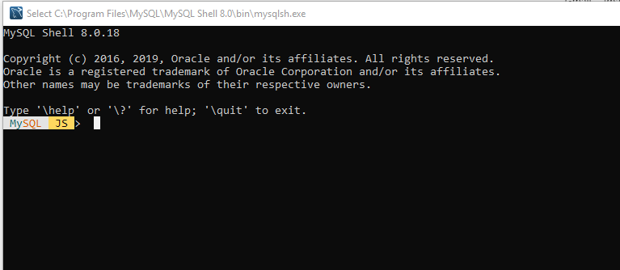

Slide 51
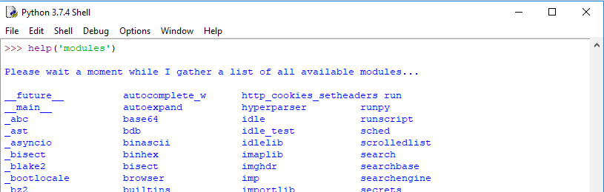
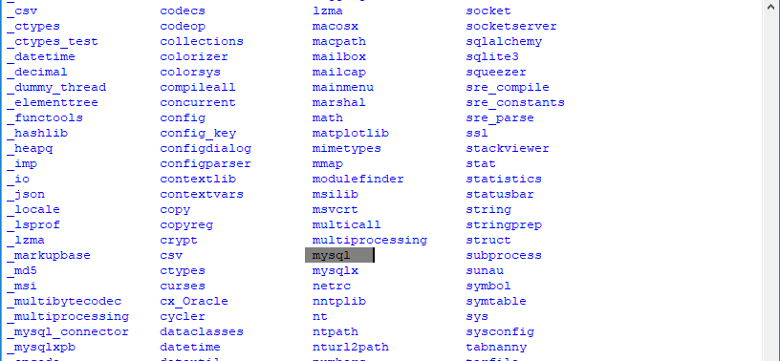
Checking mysql in python

Slide 52
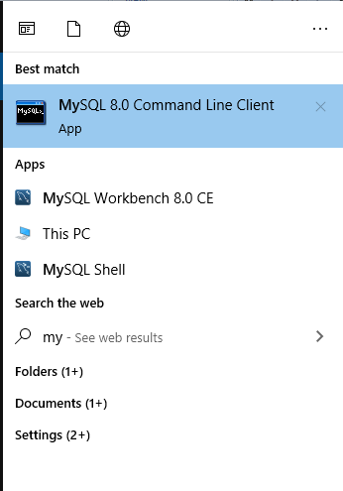
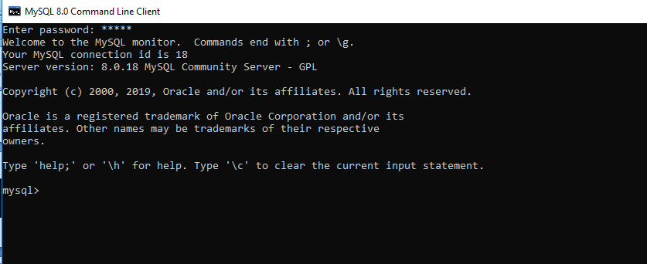
Working with mysql database

Slide 53
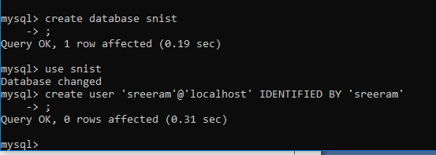
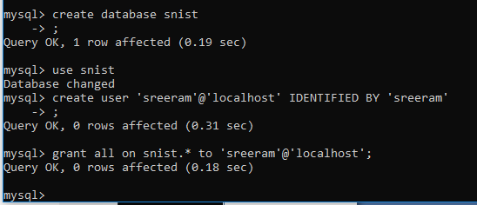
Connecting Python Database
Connecting Python Database
mysql> create user ‘sreeram’@’localhost’ IDENTIFIED BY ‘yourpassword’

Slide 54
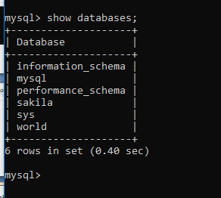

Slide 55
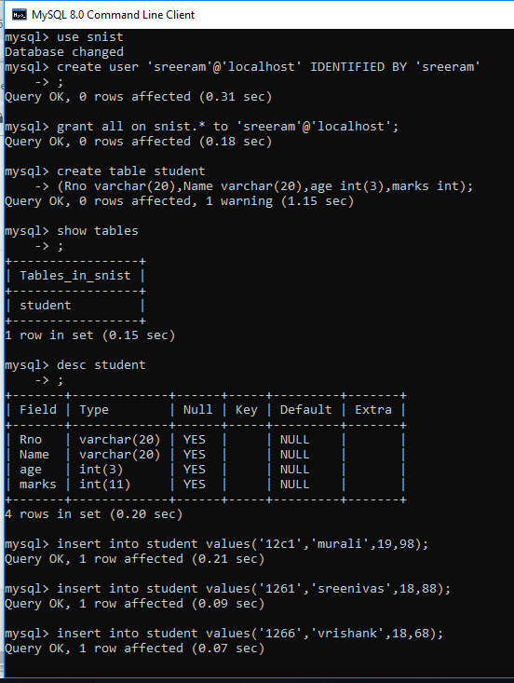

Slide 56
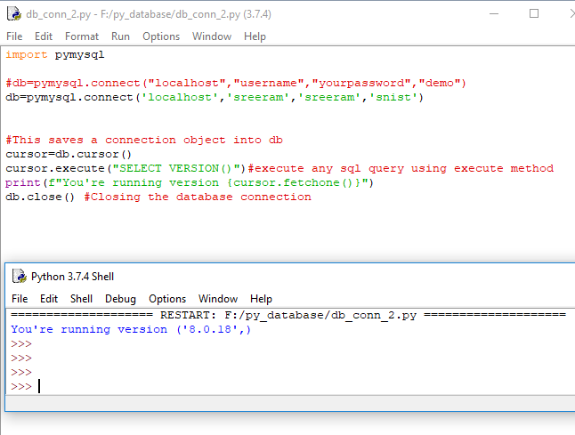

Slide 57
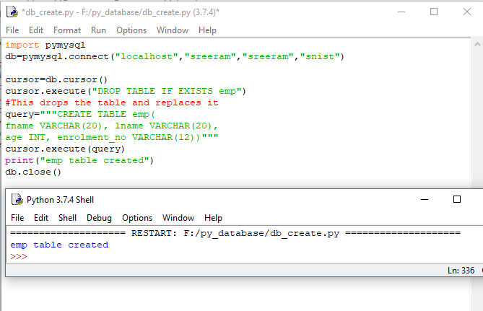
Create Tables in Python Database?

Slide 58
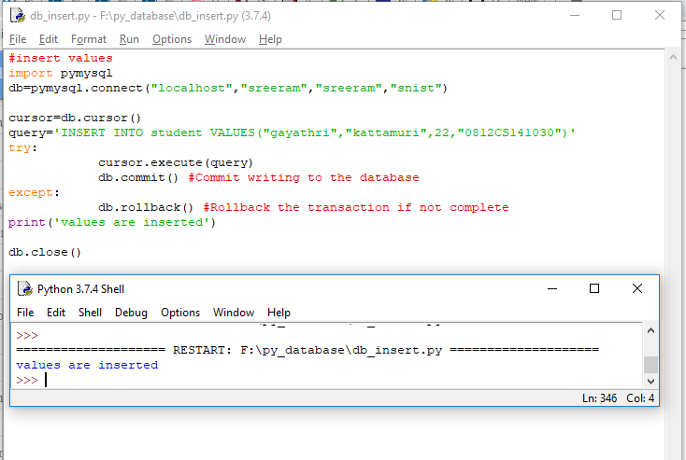
Insert values
Notes:
https://data-flair.training/blogs/python-database-access/

Slide 59
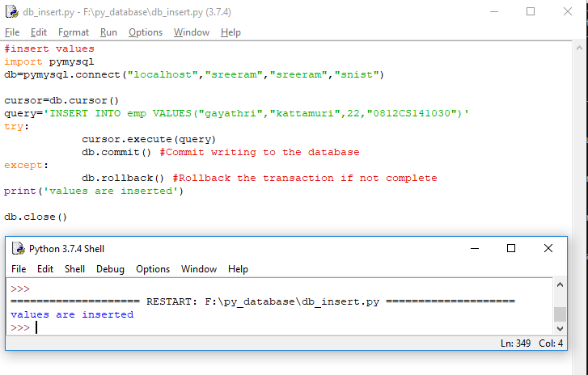
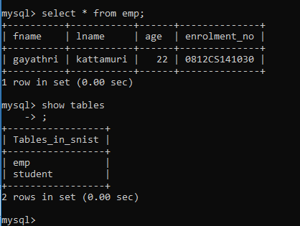

Slide 60
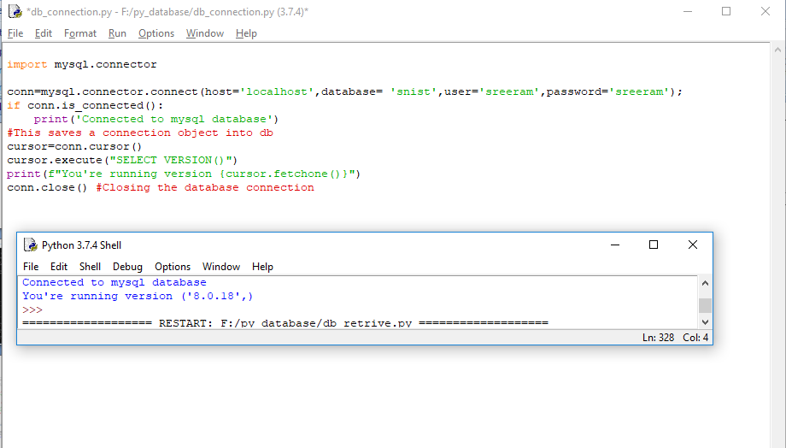

Slide 61
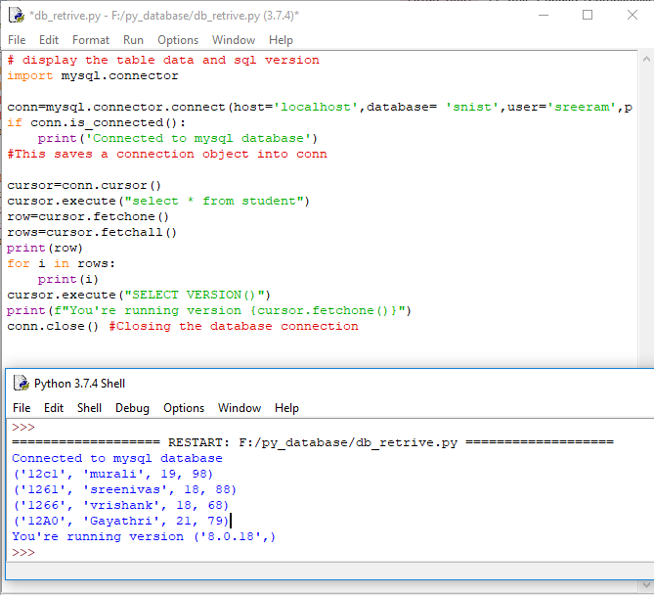
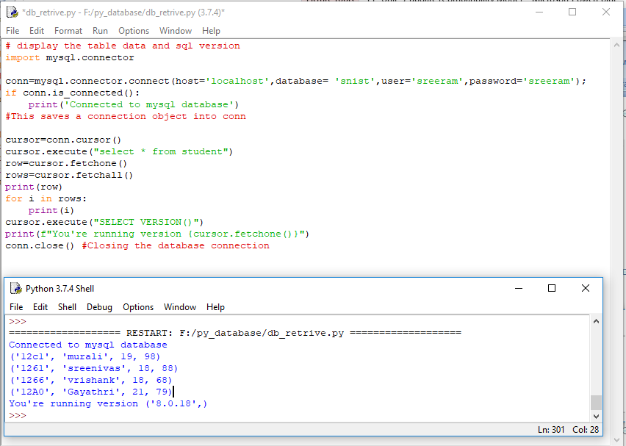

Slide 62
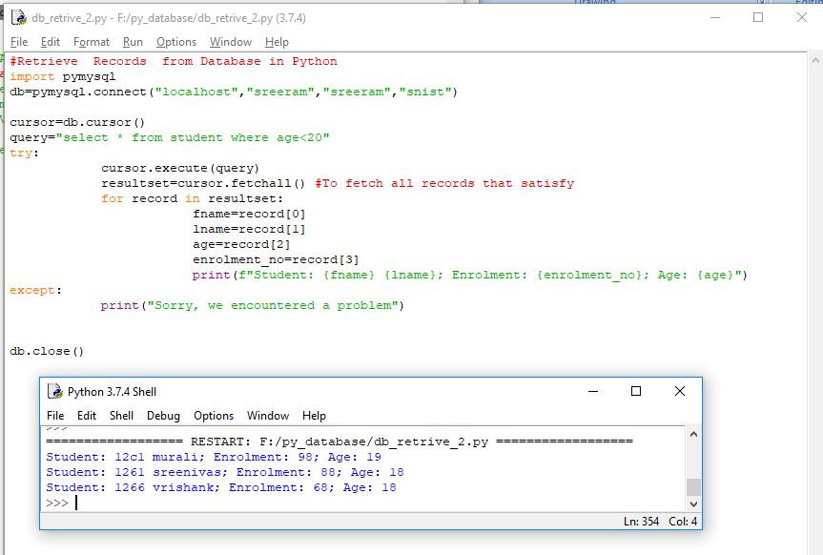
Read Records in Python Database?

Slide 63
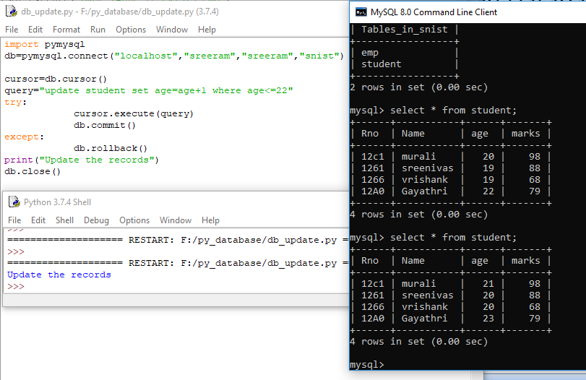
Update the records

Slide 64
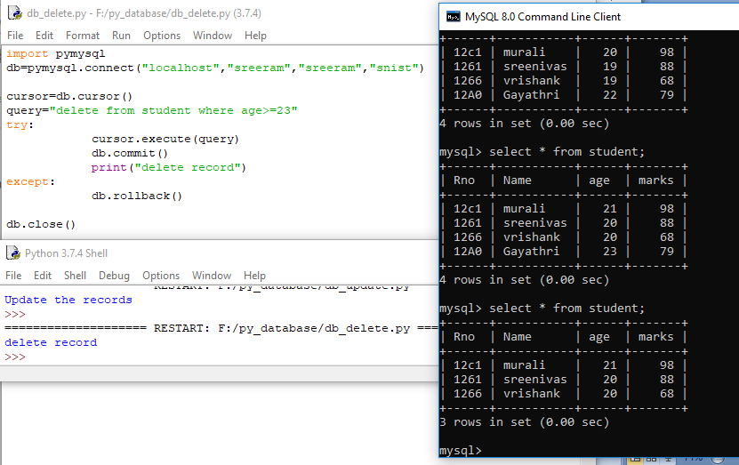
Delete Records in Python Database

Slide 65
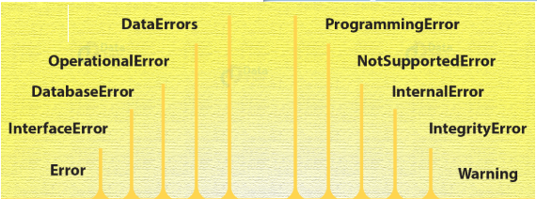
Errors in Transactions
When holding a transaction, you may come across ten different kinds of errors:

Slide 66
Error
This is the base class for errors and a subclass to StandardError.
InterfaceError
This is a subclass to Error and Python uses it for errors relating to the module for database access.
DatabaseError
This is a subclass to Error and Python uses it for database errors.
OperationalError
This is a subclass of DatabaseError. When Python loses connection to a database, it throws this error.
This may happen when we haven’t selected a database.
DataError
This is a subclass of DatabaseError.
Python uses this when there is an error in the data.

Slide 67
InternalError
This is a subclass of DatabaseError. Python uses this for errors internal to the module we use for the database access.
IntegrityError
Also a subclass of DatabaseError. Python uses this for cases where there can be damage to relational integrity.
This may happen when you try to enter duplicate records in the database.
ProgrammingError
This is a subclass of DatabaseError. Errors like bad table names cause this.
This may happen when we try to create a duplicate database.
NotSupportedError
A subclass of DatabaseError. When we attempt to call functionality that it doesn’t support, Python raises this error.
Warning
This is a subclass of StandardError. Python uses this for non-fatal issues.
So, this was all about Python Database Access. Hope you like our explanation.

Slide 68
Thank you

