Slide 1

PYTHON PROGRAMMING
Unit-III
Lecture-1
Modules, Packages, Files and
Exception Handling in Python
Mr. Satyam Akunuri
Assistant Professor
Department of CSE
SNIST
2 January 2020
1 April 2017
1
1

Slide 2
Topics to be Covered
What is Module
Uses of Modules in Python
What is Package?
How to create and access the packages in Python?
File Operations
Exception Handling in Python
2 January 2020
2
2

Slide 3
Modules in Python
2 January 2020
3

Slide 4
What are Modules ?
Modules refer to a file containing Python statements and definitions.
A file containing Python code, for e.g.: example.py, is called a module and its module name would be example.
2 January 2020
4
4

Slide 5
Use of Modules
We use modules to break down large programs into small manageable and organized files.
Furthermore, modules provide reusability of code.
We can define our most used functions in a module and import it, instead of copying their definitions into different programs.
2 January 2020
5

Slide 6
Creation of a Module
Type the following and save it as example.py
def add(a, b):
"""This program adds two numbers and return the result”””
result = a + b
return result
2 January 2020
6
1 April 2017
6

Slide 7
How to import modules in Python?
We can import the definitions inside a module to another module or the interactive interpreter in Python.
We use the import keyword to do this.
To import our previously defined example
we type the following in the Python prompt.
>>> import example
2 January 2020
7
1 April 2017
7

Slide 8
It only enters the module name example
there.
Using the module name we can access the function using the dot . operator.
For example:
>>> example.add(10,20)
30
2 January 2020
8
8

Slide 9
Another Example: (Fibonacci numbers module)
def fib2(n): # return Fibonacci series up to n
result = []
a, b = 0, 1
while a < n:
result.append(a)
a, b = b, a+b
return result
Now enter the Python interpreter and import this module fibo.py with the following command:
>>> fibo.fib2(100)
[0, 1, 1, 2, 3, 5, 8, 13, 21, 34, 55, 89]
2 January 2020
9
9

Slide 10
If you intend to use a function often you can assign it to a local name:
>>> fib = fibo.fib2
>>> fib(500)
[0 1 1 2 3 5 8 13 21 34 55 89 144 233 377]
2 January 2020
10
10

Slide 11
More on Modules…
A module can contain executable statements as well as function definitions.
They are executed only the first time the module name is encountered in an import statement.
Each module has its own private symbol table, which is used as the global symbol table by all functions defined in the module
2 January 2020
11
11

Slide 12
Import with renaming
We can import a module by renaming it as follows.
>>>import fibo as f
>>>f.fib(50)
[0 1 1 2 3 5 8 13 21 34]
2 January 2020
12
12

Slide 13
Python from...import statement
We can import specific names from a module without importing the module as a whole.
# import only pi from math module
from math import pi
print("The value of pi is", pi)
The value of pi is 3.141592653589793
2 January 2020
13
13

Slide 14
We imported only the attribute pi from the module.
In such case we don't use the dot operator.
We could have imported multiple attributes as follows.
>>> from math import pi, e
>>> pi
3.141592653589793
>>> e
2.718281828459045
2 January 2020
14
1 April 2017
14

Slide 15
Import all names
We can import all names(definitions) from a module using the following construct.
#import all names from the standard module math
from math import *
print("The value of pi is", pi)
The value of pi is 3.141592653589793
We imported all the definitions from the math module.
This makes all names except those beginnig with an underscore, visible in our scope.
2 January 2020
15
1 April 2017
15

Slide 16
Packages in Python
2 January 2020
16

Slide 17
Packages in Python
We don't usually store all of our files in our computer in the same location. We use a well-organized hierarchy of directories for easier access.
Similar files are kept in the same directory, for example, we may keep all the songs in the "music" directory.
Python allows you to group related modules together as a package.
2 January 2020
17

Slide 18
Packages in Python…
As our application program grows larger in size with a lot of modules, we place similar modules in one package and different modules in different packages.
This makes a project (program) easy to manage and conceptually clear.
2 January 2020
18

Slide 19
Creation of Package
Similar, as a directory can contain sub-directories and files, a Python package can have sub-packages and modules.
A directory must contain a file named __init__.py in order for Python to consider it as a package.
This file can be left empty but we generally place the initialization code for that package in this file.
2 January 2020
19

Slide 20
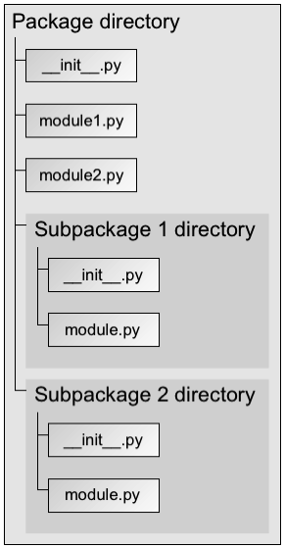
2 January 2020
20

Slide 21
You import a module from a package using dot syntax.
import package.module
from package import module
Packages themselves may contain packages; these are sub packages.
To access sub packages,you just need to use a few more dots.
import package.subpackage.module
from package.subpackage import module
2 January 2020
21

Slide 22
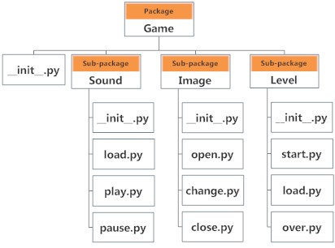
Example Program On Package
2 January 2020
22

Slide 23
importing module from a package
We can import modules from packages using the dot (.) operator.
For example, if want to import the start module in the above example,
import Game.Level.start
if this module contains function selectdifficulty(),
we must use the full name to reference it.
Game.Level.start.selectdifficulty(2)
We can Also use the following statements
from Game.Level import start
start.selectdifficulty(2)
2 January 2020
23

Slide 24
Files in Python
2 January 2020
24

Slide 25
What is a file?
File is a named location on disk to store related information.
It is used to store data permanently in a non-volatile memory (e.g. hard disk).
Since, random access memory (RAM) is volatile which loses its data when computer is turned off, we use files for future use of the data.
2 January 2020
Mr. Satyam Akunuri
25

Slide 26
File Operations
Creation of a file
Reading data from the file
Writing data into the file
Closing of the file
2 January 2020
Mr. Satyam Akunuri
26

Slide 27
File Operations
In Python, a file operation takes place in the following order.
Open a file
Read or write (perform operation)
Close the file
2 January 2020
Mr. Satyam Akunuri
27

Slide 28
Creation of a file
f=open(“filename”, ”mode”)
>>> f = open("test.txt") # open file in current directory
Python has a built-in function open() to open a file.
This function returns a file object, also called a handle, as it is used to read or modify the file accordingly.
2 January 2020
Mr. Satyam Akunuri
28

Slide 29
Python File Modes
Mode | Description
'r' | Open a file for reading. (default)
'w' | Open a file for writing. Creates a new file if it does not exist or truncates the file if it exists.
'x' | Open a file for exclusive creation. If the file already exists, the operation fails.
'a' | Open for appending at the end of the file without truncating it. Creates a new file if it does not exist.
't' | Open in text mode. (default)
'b' | Open in binary mode.
'+' | Open a file for updating (reading and writing)
2 January 2020
29

Slide 30
f = open("test.txt") # equivalent to 'r' or 'rt'
f = open("test.txt",'w') # write in text mode
f = open("img.bmp",'r+b') # read and write in binary mode
2 January 2020
30

Slide 31
How to close a file Using Python?
When we are done with operations to the file, we need to properly close the file.
Closing a file will free up the resources that were tied with the file and is done using Python close() method.
Python has a garbage collector to clean up unreferenced objects but, we must not rely on it to close the file.
f = open("test.txt",encoding = 'utf-8')
# perform file operations
f.close()
2 January 2020
31

Slide 32
Write data to a File
In order to write into a file in Python, we need to open it in write 'w', append 'a' or exclusive creation 'x' mode.
Writing a string or sequence of bytes (for binary files) is done using write() method.
This method returns the number of characters written to the file.
f=open("test.txt",'w’)
f.write(“this is first file\n")
f.write("This second file\n\n")
f.write(“this is third line\n“)
2 January 2020
32

Slide 33
Read data from files
To read a file in Python, we must open the file in reading mode.
There are various methods available for this purpose. We can use the read(size) method to read in size number of data. If size parameter is not specified, it reads and returns up to the end of the file.
>>> f = open("test.txt",'r')
>>> f.read(4) #read the first 4 data
>>>print(f.read()) #read the entire file
2 January 2020
33

Slide 34
We can read a file line-by-line using a for loop. This is both efficient and fast. >>> for line in f: ... print(line, end = '') ... This is first line This is second line This is third line | Alternately, we can use readline() method to read individual lines of a file. This method reads a file till the newline, including the newline character. >>> f.readline() 'This is first line\n' >>> f.readline() 'This is second line\n' >>> f.readline() ‘This is third line\n' >>> f.readline() ‘ ‘
2 January 2020
34

Slide 35
readLines()
Lastly, the readlines() method returns a list of remaining lines of the entire file. All these reading method return empty values when end of file (EOF) is reached.
>>> f.readlines()
['This is first line\n', 'This is second file \n', ‘this is third line\n']
2 January 2020
35

Slide 36
with open("test.txt") as f:
with open("out.txt", "w") as f1:
for line in f:
f1.write(line)
2 January 2020
36

Slide 37
import os.path import sys def main(): f1=input("Enter Source file").strip() f1=input("Enter Target file").strip() #check if target file exist if os.path.isfile(f2): print(f2+"already exist") sys.exit() try: #Open files for input and output infile=open(f1,"r") outfile=open(f2,"w") #Copy data from input file to output file countLines=countChars=0 for line in infile: countLine+=1 countChars+=len(line) outfile.write(line) | print(countLines,"lines and“ ,countChars,"chars copied") except FileExistsError e: print(e) finally: infile.close() outfile.close() main()
2 January 2020
37

Slide 38
Exception Handling
2 January 2020
38

Slide 39
Python Errors and Built-in Exceptions
Python (interpreter) raises exceptions when it encounter errors.
For example: divided by zero.
Error caused by not following the proper structure (syntax) of the language is called syntax error or parsing error.
>>> if a < 3
File "<interactive input>", line 1
if a < 3
^
SyntaxError: invalid syntax
We can notice here that a colon is missing in the if statement.
2 January 2020
39
39

Slide 40
Exception
Errors can also occur at runtime and these are called exceptions.
They occur, for example, when a file we try to open does not exist (FileNotFoundError), dividing a number by zero (ZeroDivisionError), module we try to import is not found (ImportError) etc.
2 January 2020
40
40

Slide 41
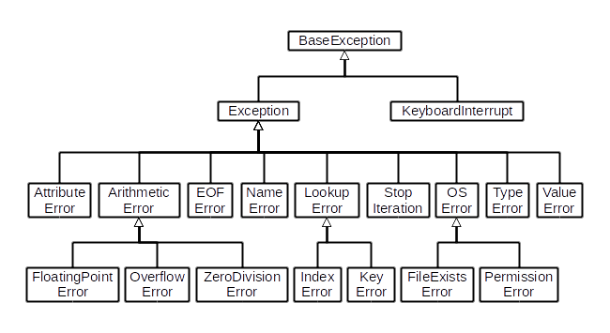
2 January 2020
41

Slide 42
Whenever these type of runtime error occur, Python creates an exception object.
If not handled properly, it prints a traceback to that error along with some details about why that error occurred.
>>> 1 / 0
Traceback (most recent call last):
File "<string>", line 301, in runcode
File "<interactive input>", line 1, in <module>
ZeroDivisionError: division by zero
2 January 2020
42
42

Slide 43
>>> open("imaginary.txt")
Traceback (most recent call last):
File "<string>", line 301, in runcode
File "<interactive input>", line 1, in <module>
FileNotFoundError: [Errno 2] No such file or directory: 'imaginary.txt'
2 January 2020
43
1 April 2017
43

Slide 44
We can handle these built-in and user-defined exceptions in Python using try, except and finally statements
2 January 2020
44
1 April 2017
44

Slide 45
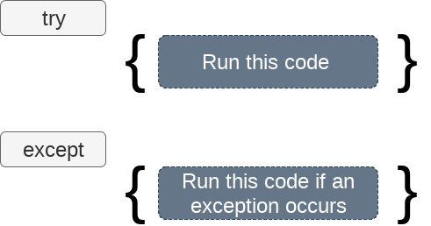
Exception handling in python
If the python program contains suspicious code that may throw the exception, we must place that code in the try block.
The try block must be followed with the except statement which contains a block of code that will be executed if there is some exception in the try block.
2 January 2020
45
1 April 2017
45

Slide 46
try: #block of code except Exception1: #block of code except Exception2: #block of code #other code | try: #block of code except Exception1: #block of code else: #this code executes if no except block is executed
2 January 2020
46

Slide 47
try:
a = int(input("Enter a:"))
b = int(input("Enter b:"))
c = a/b;
print("a/b = %d"%c)
except Exception:
print("can't divide by zero")
else:
print("Hi I am else block")
2 January 2020
47

Slide 48
Declaring multiple exceptions
Python allows us to declare the multiple exceptions with the except clause.
Declaring multiple exceptions is useful in the cases where a try block throws multiple exceptions.
2 January 2020
48

Slide 49
The finally block
We can use the finally block with the try block in which, we can pace the important code which must be executed whether the try statement throws an exception or not.
try:
# block of code
# this may throw an exception
finally:
# block of code
# this will always be executed
2 January 2020
49

Slide 50
try:
# do something
pass
except ValueError:
# handle ValueError exception
pass
except (TypeError, ZeroDivisionError):
# handle multiple exceptions
# TypeError and ZeroDivisionError
pass
except:
# handle all other exceptions
Pass
finally:
# Mandatory Code
pass
2 January 2020
50

Slide 51
Raising Exceptions
In Python programming, exceptions are raised when corresponding errors occur at run time, but we can forcefully raise it using the keyword raise.
try:
... a = int(input("Enter a positive integer: "))
... if a <= 0:
... raise ValueError("That is not a positive number!")
except ValueError as ve:
... print(ve)
...
Enter a positive integer: -2
That is not a positive number!
2 January 2020
51

Slide 52
User defined Exception Example
class AgeError(Exception):
pass
try:
a = int(input("Enter a age of a person: "))
if a < 18:
raise AgeError
else:
print(“ you are Allwed to vote")
except AgeError:
print("Age shouldnot be less than 18!")
2 January 2020
52

Slide 53
Assignment (Guessing a Number)
Develop a program will ask the user to enter a number until they guess a stored number correctly. To help them figure it out, hint is provided whether their guess is greater than or less than the stored number.
2 January 2020
53
1 April 2017
53

