Slide 1
Unit -VI
Working with NumPy/PlotPy/SciPy/GUI Programming
Introduction , Tkinter programming , Tkinter widgets

Slide 2
Introduction
GUI programming
We have previously seen how to write text-only programs which have a command-line interface( CLI)
Python provides various options for developing graphical user interfaces (GUIs).
  Tkinter
  wxPython
  Jpython

Slide 3
Tkinter: Tkinter is the Python interface to the Tk GUI toolkit shipped with Python.
wxPython: This is an open-source Python interface for wxWindows
JPython: JPython is a Python port for Java which gives Python scripts seamless access to Java class libraries on the local machine

Slide 4
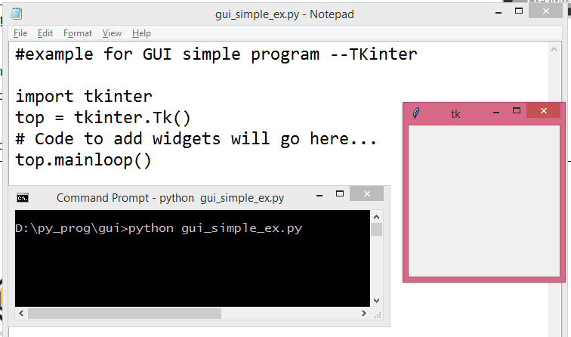
Tkinter Programming

Slide 5
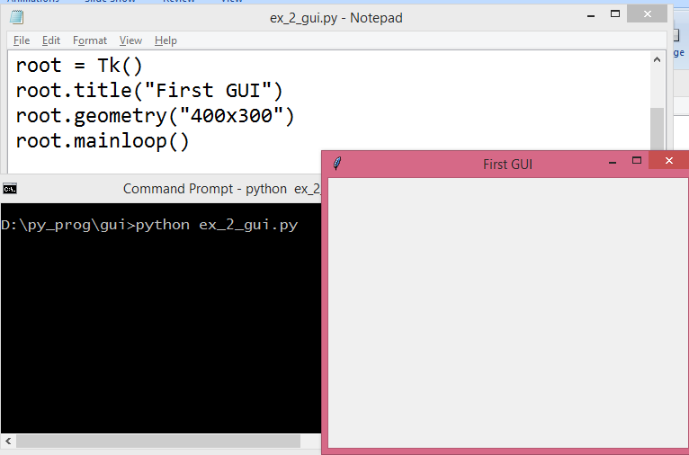
Window size

Slide 6
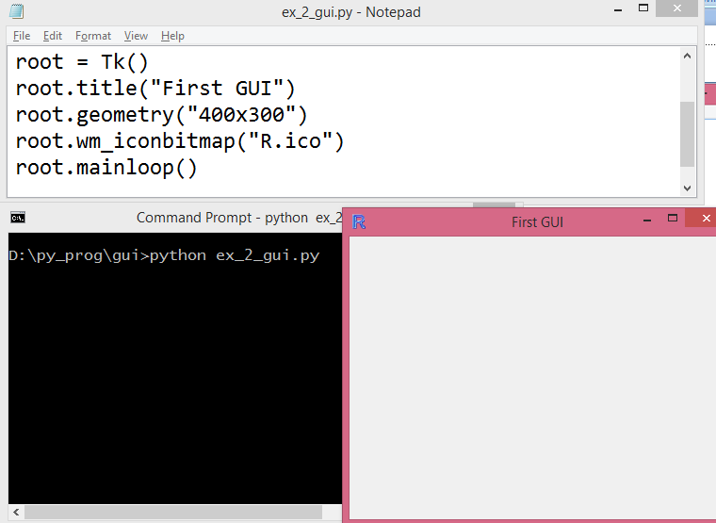

Slide 8
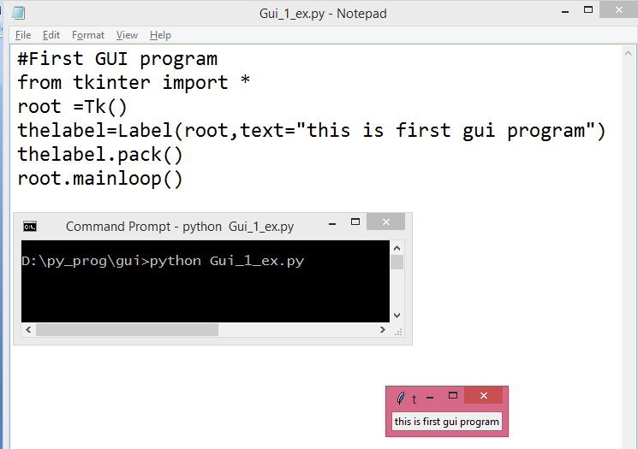
Label

Slide 9
Tkinter Widgets
Widget is a GUI component that displayed on the screen and can perform a task as a desired by the user.
Tkinter provides various controls, such as buttons, labels and text boxes used in a GUI application. These controls are commonly called widgets.
There are currently 15 types of widgets in Tkinter. We present these widgets as well as a brief description in the following table:

Slide 10
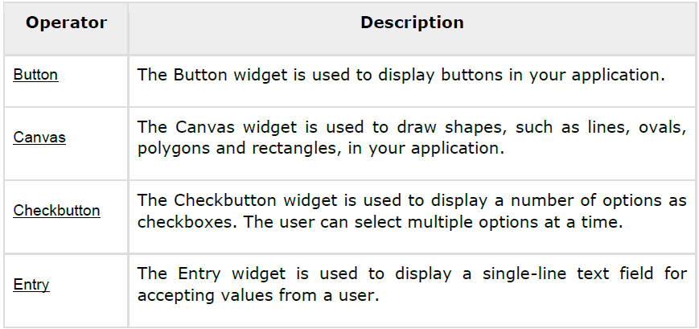

Slide 11
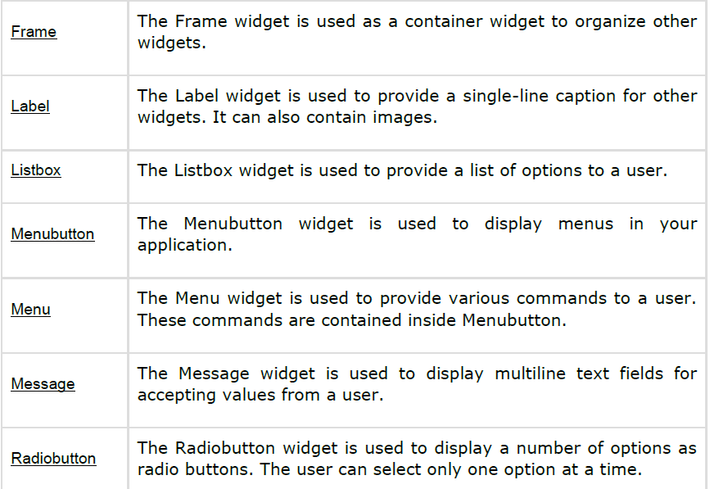

Slide 12
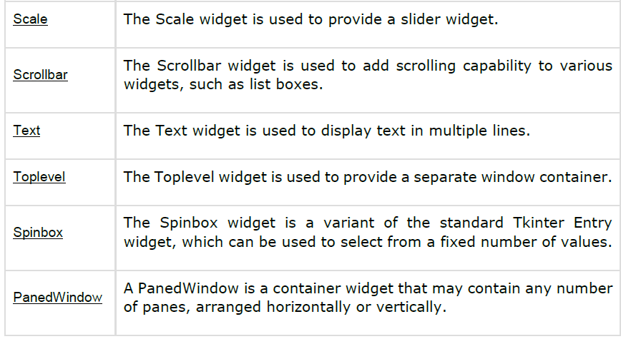
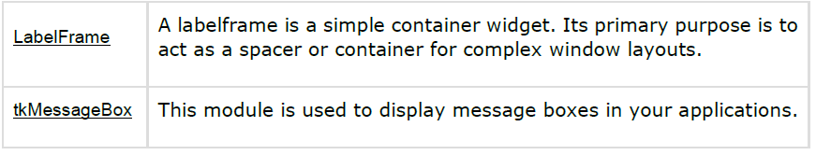

Slide 13
Button
The Button widget is used to add buttons in a Python application.
These buttons can display text or images that convey the purpose of the buttons. You can attach a function or a method to a button which is called automatically when you click the button.
Syntax: w = Button ( master, option=value, ... ) Parameters
master: This represents the parent window.
options: Here is the list of most commonly used options for this widget.
These options can be used as key-value pairs separated by commas.

Slide 14
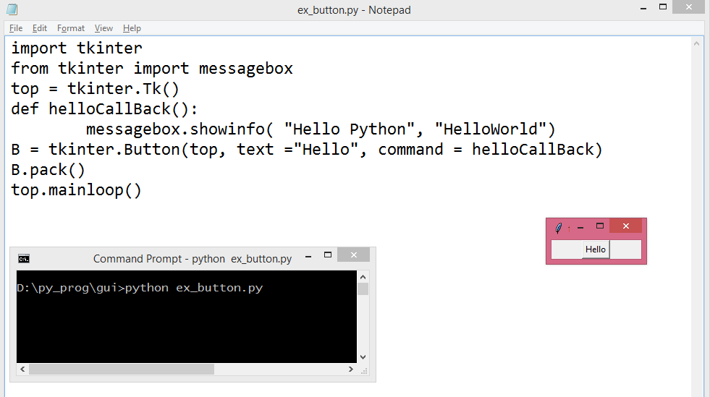
Messagebox and Button

Slide 15
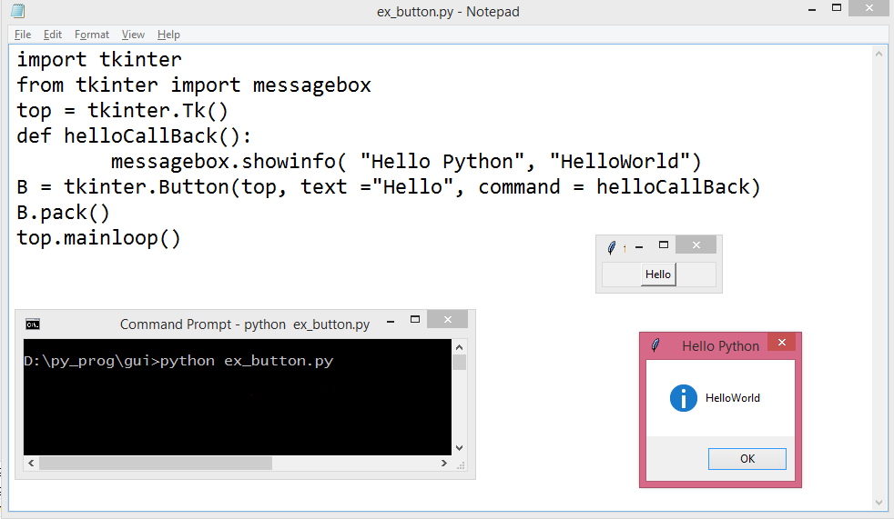

Slide 16
Button
Button (frame,text=‘clickme’,width=15,height=2,bg=‘yellow’,fg=‘blue,activebackground=‘green’,activeforeground=‘red’,command=buttonclick)

Slide 17
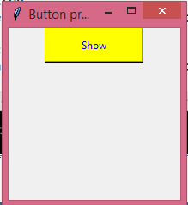
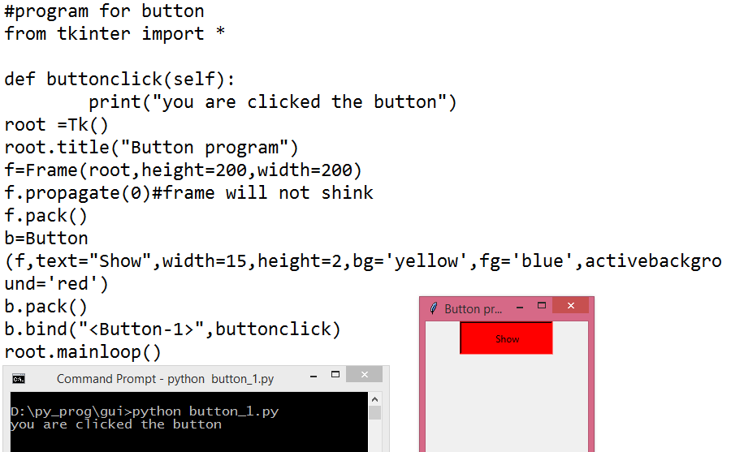

Slide 19
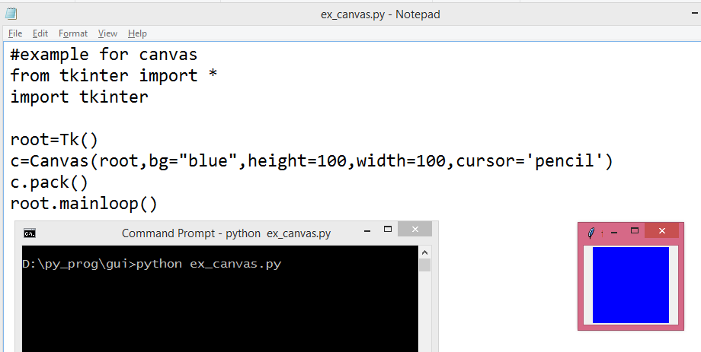
Canvas

Slide 20
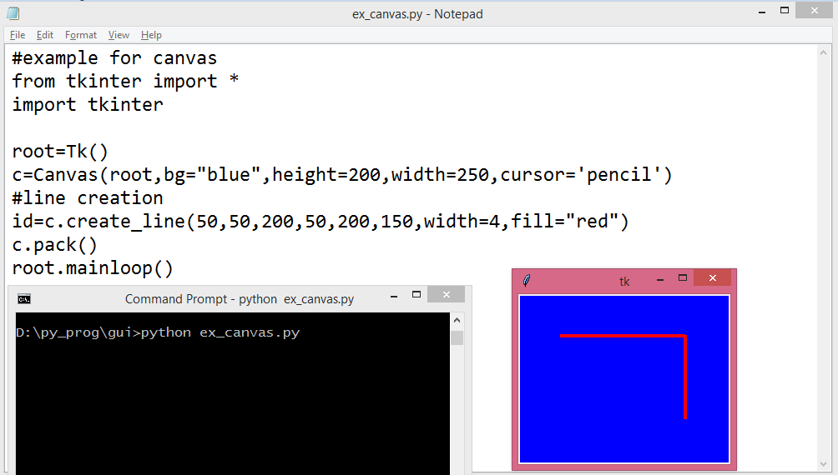
Draw line

Slide 21
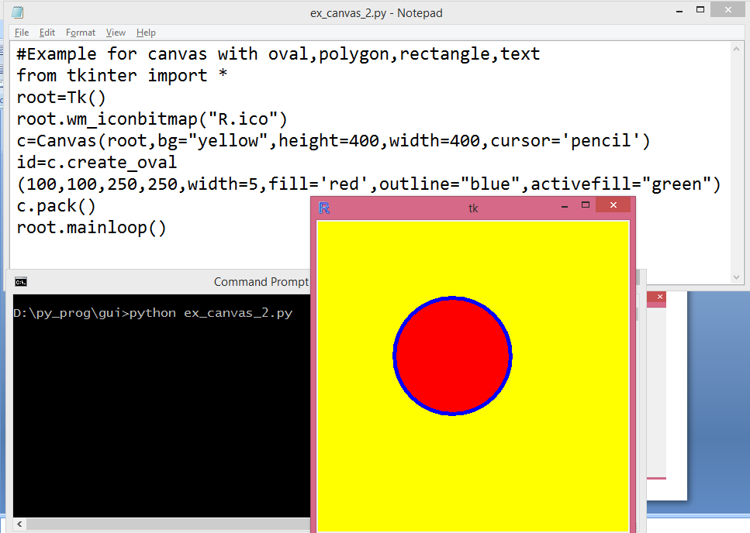

Slide 22
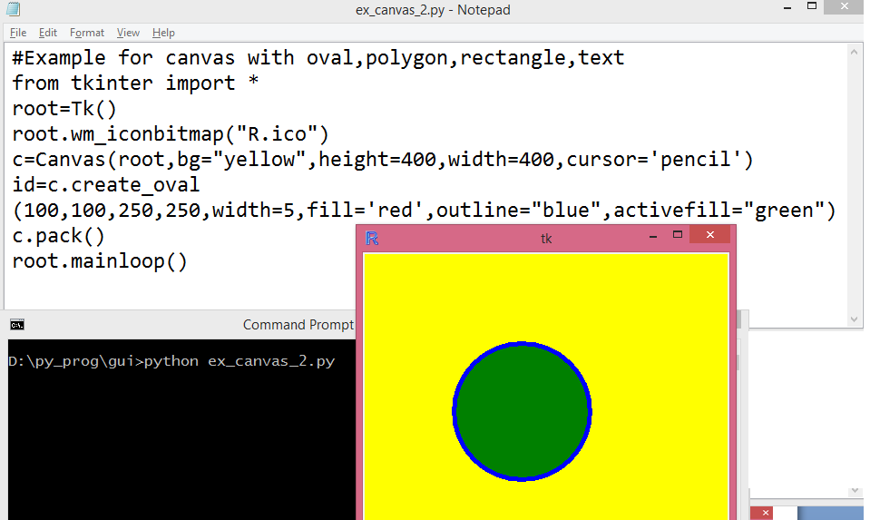
Move cursor on oval

Slide 23
Rectangle,oval,arc,polygon,text
#Example for canvas with oval,polygon,rectangle,text
from tkinter import *
root=Tk()
root.wm_iconbitmap("R.ico")
c=Canvas(root,bg="yellow",height=400,width=500,cursor='pencil')
id=c.create_oval (100,100,250,250,width=5,fill='red',outline="blue",activefill="green")
id=c.create_rectangle (0,300,100,400,width=2,fill="gray",outline="black",activefill="orange")
#insert text
fnt=('Times',20,'bold italic underline‘) id=c.create_text(300,50,text="MY GUI program using CANVAS", font=fnt,fill="purple",activefill="violet")
#Draw polygon
id=c.create_polygon (10,10,200,200,300,200,width=3,fill='pink',outline='red',smooth=1,activefill=‘brown')
#create ARC
id=c.create_arc (100,100,400,300,width=3,start=270,extent=180,outline="red",style="arc")
c.pack()
root.mainloop()

Slide 24
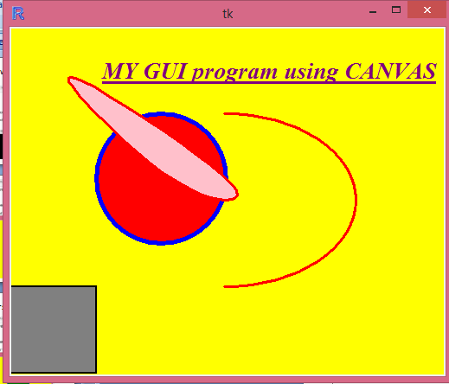

Slide 25
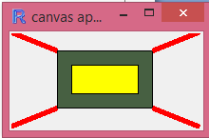
Canvas application

Slide 26
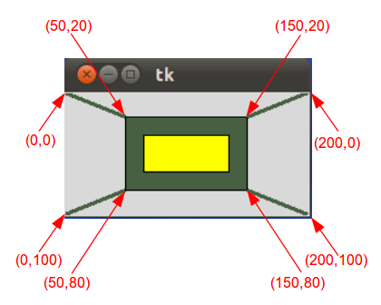
sample

Slide 27
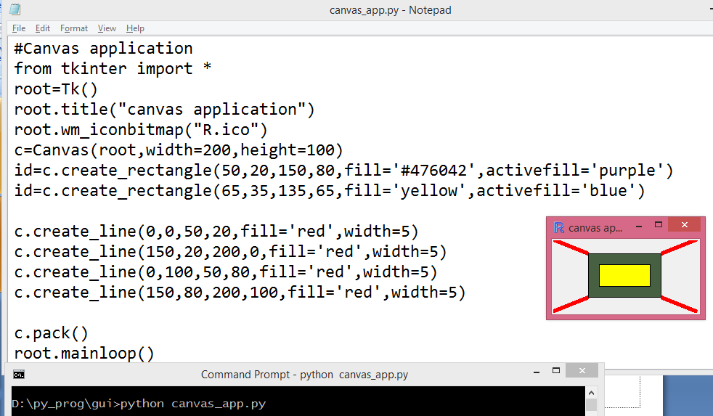

Slide 28
Arcs
# Example for ARCS
from tkinter import *
root=Tk()
root.title("ARCS")
root.wm_iconbitmap("R.ico")
c=Canvas(root,bg="white",width=700,height=600)
id=c.create_arc(100,100,400,300,width=3,start=270,extent=180,outline='red',style='arc')
id=c.create_arc(90,100,400,300,width=3,start=90,extent=180, outline='green',style='arc')
id=c.create_arc(100,350,300,550,width=5,start=0,extent=180,outline='blue',style='arc')
id=c.create_arc(320,360,500,550,width=5,start=90,extent=180,outline='yellow',style='arc')
id=c.create_arc(340,360,500,550,width=5,start=270,extent=180,outline='purple',style='arc')
id=c.create_arc(650,250,450,100,width=7,start=0,extent=180,outline='black',style='arc')
id=c.create_arc(600,150,500,250,width=8,start=90,extent=90,outline='indigo',style='arc')
id=c.create_arc(650,270,450,100,width=9,start=180,extent=180,outline='pink',style='arc')
c.pack()
root.mainloop()

Slide 29
#import image files
from tkinter import *
root =Tk()
root.title("Image")
root.wm_iconbitmap("lakshmi.gif")
c=Canvas(root,bg='green',height=500,width=500)
file1=PhotoImage(file='vinayaka.gif')
file2=PhotoImage(file='lakshmi.gif')
id=c.create_image(200,20,anchor=NE,image=file1,activeimage=file2)
id=c.create_image(420,20,anchor=NE,image=file2,activeimage=file1)
id=c.create_text(200,200,text='pray the god to pass all exams',font=
('Helvetica',20,'bold'),fill='blue')
c.pack()
root.mainloop()

