Slide 1
SciPy, Matplotlib

Slide 2
History of NumPy
Originally, Python was not developed as a language for numerical computing. However, due to its simplicity it attracted attention of scientists.
- Numeric matrix package was designed in 1995. It is slow for large arrays (still operating, but outdated);
- Numarray was designed as a replacement for Numeric package. It is fast for large arrays, but slow for small arrays. (also outdated);
- Numpy is a combination of Numeric and Numarray was released in 2006 (Numpy 1.0).

Slide 3
NumPy package
NumPy is the fundamental package for scientific computing with Python. It contains among other things:
a powerful N-dimensional array object
sophisticated (broadcasting) functions
tools for integrating C/C++ and Fortran code
useful linear algebra, Fourier transform, and random number capabilities
Besides its obvious scientific uses, NumPy can also be used as an efficient multi-dimensional container of generic data. Arbitrary data-types can be defined. This allows NumPy to seamlessly and speedily integrate with a wide variety of databases.
from www.numpy.org/
Notes:
3

Slide 4
NumPy arrays
The main feature of NumPy is an array object.
• All array elements have to be the same type (usually float or integer);
• Array elements can be accessed, sliced, and manipulated in the same way as the lists;
• Arrays can be N-dimensional;
• The number of elements in the array is fixed;
• Shape of the array can be changed.

Slide 5
History of SciPy
SciPy is a package for scientific computing that provides a standard collection of common numerical operations on top of the Numeric array data structure. SciPy is a product of merging three pieces of codes (based on Numeric) that were developed by Travis Oliphant, Eric Jones and Pearu Peterson in one package. SciPy was released in 2001.
https://en.wikipedia.org/wiki/SciPy#History_of_SciPy

Slide 6
SciPy as a scientific tool
Modules for:
– statistics, optimization;
– integration, interpolation;
– linear algebra, solving non-linear equations;
– Fourier transforms;
– ODE solvers, special functions;
– signal and image processing.

Slide 7
Library overview
The SciPy package of key algorithms and functions core to Python's scientific computing capabilities. Available sub-packages include:
constants: physical constants and conversion factors (since version 0.7.0)
cluster: hierarchical clustering, vector quantization, K-means
fftpack: Discrete Fourier Transform algorithms
integrate: numerical integration routines
interpolate: interpolation tools
io: data input and output
lib: Python wrappers to external libraries
from https://en.wikipedia.org/wiki/SciPy#The_SciPy_Library.2FPackage
Notes:
7

Slide 8
Library overview
linalg: linear algebra routines
misc: miscellaneous utilities (e.g. image reading/writing)
ndimage: various functions for multi-dimensional image processing
optimize: optimization algorithms including linear programming
signal: signal processing tools
sparse: sparse matrix and related algorithms
spatial: KD-trees, nearest neighbors, distance functions
special: special functions
stats: statistical functions
weave: tool for writing C/C++ code as Python multiline strings
Notes:
8

Slide 9
Linear algebra
Python’s mathematical libraries, NumPy and SciPy, have extensive tools for numerically solving problems in linear algebra.
from http://www.physics.nyu.edu/pine/pymanual/html/chap9/chap9_scipy.html
Notes:
9

Slide 10
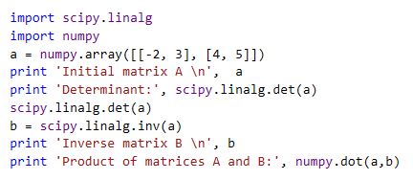
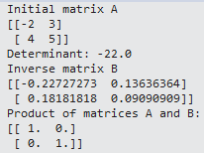
Basic computations in linear algebra
SciPy has a number of routines for performing basic operations with matrices.
from http://www.physics.nyu.edu/pine/pymanual/html/chap9/chap9_scipy.html

Slide 11


Solving systems of linear equations
Solving systems of equations is nearly as simple as constructing a coefficient matrix and a column vector. Suppose you have the following system of linear equations to solve:
The first task is to recast this set of equations as a matrix equation of the form Ax=b. In this case, we have:
from http://www.physics.nyu.edu/pine/pymanual/html/chap9/chap9_scipy.html
Notes:
11

Slide 12


Next we construct the array A and vector b as NumPy arrays and find vector x:

Slide 13
Basic plotting functions
Matplotlib basics
Line chart
Bar chart
Scatter plot
Colors, markers, line styles
Ticks, titles, axis labels, legends, annotations
Saving plots

Slide 14
Basic statistics and more plots
Basic stats: Mean, median, range, standard deviation, correlation
Histogram
Error Bar
Boxplot
Imshow
Subplots
T-test and other statistical testing

Slide 15
Summary statistics of a single data set
Information (numbers) that give a quick and simple description of the data
Maximum value
Minimum value
Range (dispersion): max – min
Mean
Median
Mode
Quantile
Standard deviation
Etc.

Slide 16

Mean vs average vs median vs mode
(Arithmetic) Mean: the “average” value of the data
Average: can be ambiguous
The average household income in this community is $60,000
The average (mean) income for households in this community is $60,000
The income for an average household in this community is $60,000
What if most households are earning below $30,000 but one household is earning $1M
Median: the “middlest” value, or mean of the two middle values
Can be obtained by sorting the data first
More efficient algorithm (~linear time) exists
Does not depend on all values in the data.
More robust to outliers
Mode: the most-common value in the data
def mean(a): return sum(a) / float(len(a))
def mean(a): return reduce(lambda x, y: x+y, a) / float(len(a))
Quantile: a generalization of median. E.g. 75 percentile is the value which 75% of values are less than or equal to

Slide 17

Variance and standard deviation
Describes the spread of the data from the mean
Is the mean squared of the deviation
Standard deviation (square root of the variance): σ
Easier to understand than variance
Has the same unit as the measurement
Say the data measures height of people in inch, the unit of σ is also inch. The unit for σ² is square inch …
Corrected estimation of population standard deviation from sample
If standard deviation is estimated from sample, most likely it is an underestimate.
Can be corrected by replacing n in the above formula with n-1.
Default for many implementations
For bigger data set, effect is very small

Slide 18
Population vs sample
Population: all members of a group in a study
The average height of men
The average height of living male ≥ 18yr in USA between 2001 and 2010
The average height of all male students ≥ 18yr registered in Fall’17
Sample: a subset of the members in the population
Most studies choose to sample the population due to cost/time or other factors
Each sample is only one of many possible subsets of the population
May or may not be representative of the whole population
Sample size and sampling procedure is important

Slide 19
Simulation of population/sample standard deviation
Generated an array of 1 million random numbers
Computed the population standard deviation
Randomly draw k data points from the data, compute uncorrected and corrected standard deviation. Repeat 1000 times. Compute the average.

Slide 20
Setup ipython with --pylab
In spyder, select “Tools =>Preferences=>Ipython console=>Graphics”, check “automatically load Pylab and NumPy modules”
Optionally, can also change “Graphics backend” from Inline to Automatic for more interactive plotting (but lose the ability to copy figure to clipboard)
Useful in experimenting different options of plotting
enables shortcut commands to common functions in matplotlib and numpy to be imported automatically. MATLAB-like.
E.g. plot functions, random number generator
To test whether --pylab has been set:
Without --pylab:
plot(rand(10))
import numpy as np
import matplotlib.pyplot as plt
plt.plot(np.random.rand(10))

Slide 21
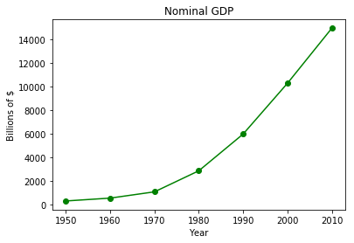
import matplotlib.pyplot as plt
years = list(range(1950, 2011, 10))
gdp = [300.2, 543.3, 1075.9, 2862.5, 5979.6, 10289.7, 14958.3]
# create a line chart, years on x-axis, gdp on y-axis
plt.plot(years, gdp, color='green', marker='o', linestyle='solid')
# add a title
plt.title("Nominal GDP")
# add a label to the y-axis
plt.ylabel("Billions of $")
# add a label to the x-axis
plt.xlabel("Year")
plt.show()
Line graph.
Good for showing trend.
Type plt.plot? to see more options, such as different marker and line styles, colors, etc.

Slide 22
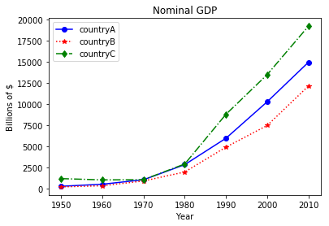
import matplotlib.pyplot as plt
years = list(range(1950, 2011, 10))
gdp1 = [300.2, 543.3, 1075.9, 2862.5, 5979.6, 10289.7, 14958.3]
gdp2 = [226.0, 362.0, 928.0, 1992.0, 4931.0, 7488.0, 12147.0]
gdp3 = [1206.0, 1057.0, 1081.0, 2940.0, 8813.0, 13502.0, 19218.0]
# create a line chart, years on x-axis, gdp on y-axis
# use format string to specify color, marker, and line style
# e.g. ‘bo-’: color=‘blue’, marker=‘o’, linestyle=‘solid’
plt.plot(years, gdp1, ‘bo-', years, gdp2, ‘r*:', years, gdp3, ‘gd-.')
# add a title
plt.title("Nominal GDP")
# add a label to the y-axis
plt.ylabel("Billions of $")
# add a label to the x-axis
plt.xlabel("Year")
# add legend
plt.legend([‘countryA', ‘countryB', ‘countryC'])
plt.show()

Slide 23
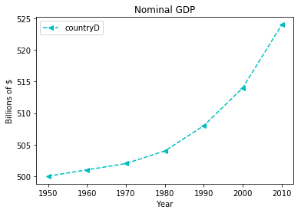
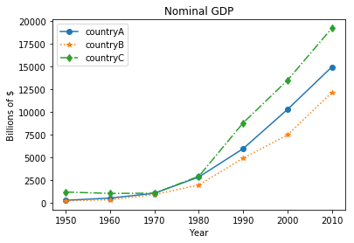
Caveat in making/interpreting line graphs
Are the following interpretations of the graphs correct?
A. The GDP of countryD has a similar growth rate as the other countries.
B. From 1950 to 1970, the GDP of all four countries did not change much.
C. From 1980 to 2010, GDP of countryC grows much faster than countryA.
D. From 1980 to 2010, GDP of countryA grows much faster than countryB.

Slide 24
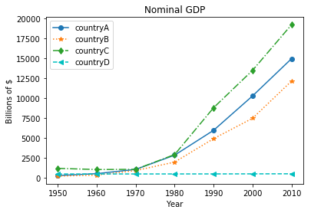
Caveat in making/interpreting line graphs
plt.plot(years, gdp1, ‘bo-', years, gdp2, ‘r*:', years, gdp3, ‘gd-.')
plt.plot(years, gdp4, 'c<--')
plt.legend(['countryA', 'countryB', 'countryC', 'countryD'])
Are the following interpretations of the graphs correct?
A. The GDP of countryD has a similar growth rate as the other countries.
B. From 1950 to 1970, the GDP of all four countries did not change much.
C. From 1980 to 2010, GDP of countryC grows much faster than countryA.
D. From 1980 to 2010, GDP of countryA grows much faster than countryB.

Slide 25
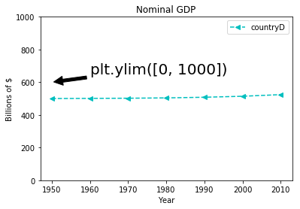
Caveat in making/interpreting line graphs
Are the following interpretations of the graphs correct?
A. The GDP of countryD has a similar growth rate as the other countries.
B. From 1950 to 1970, the GDP of all four countries did not change much.
C. From 1980 to 2010, GDP of countryC grows much faster than countryA.
D. From 1980 to 2010, GDP of countryA grows much faster than countryB.

Slide 26
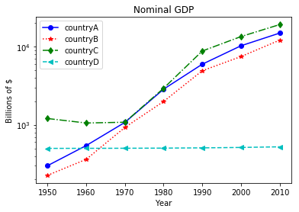
Plotting in logarithm scale
Logarithm scale plotting is often preferred to visualize changes over time.
plt.semilogy(years, gdp1, 'bo-',
years, gdp2, 'r*:',
years, gdp3, 'gd-.',
years, gdp4, 'c--<')
# add a title
plt.title("Nominal GDP")
# add a label to the y-axis
plt.ylabel("Billions of $")
# add a label to the x-axis
plt.xlabel("Year")
# add legend
plt.legend(['countryA', 'countryB', 'countryC', 'countryD'])
plt.show()

Slide 27
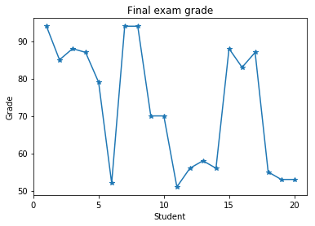
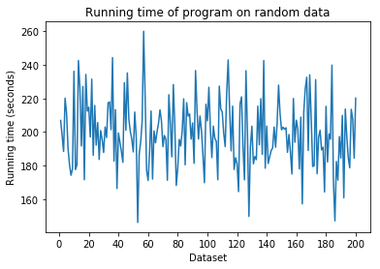
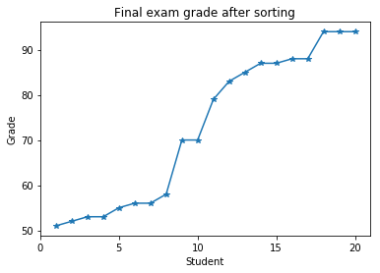
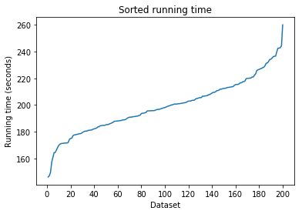
Poor choice of line graph
Line graphs are useful to display trend
Acceptable

Slide 28
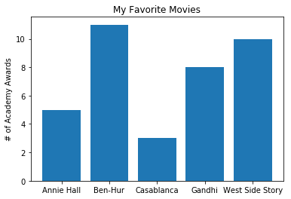
Bar charts
Good for presenting/comparing numbers in discrete set of items
movies = ["Annie Hall", "Ben-Hur", "Casablanca", "Gandhi", "West Side Story"]
num_oscars = [5, 11, 3, 8, 10]
xs = range(len(movies)) # xs is range(5)
# plot bars with left x-coordinates [xs], # heights [num_oscars]
plt.bar(xs, num_oscars)
# label x-axis with movie names at bar centers
plt.xticks(xs, movies)
# alternatively, use the following to replace # the two lines above
#plt.bar(xs, num_oscars, tick_label=movies)
plt.ylabel("# of Academy Awards")
plt.title("My Favorite Movies")
plt.show()

Slide 29
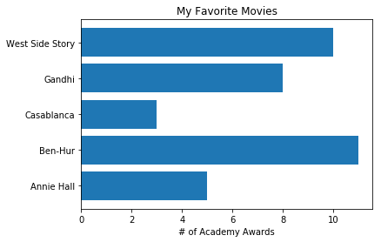
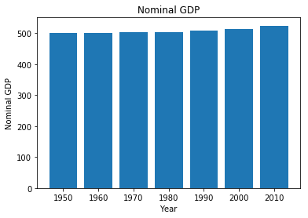
Barh vs bar
plt.barh(xs, num_oscars, tick_label=movies)
plt.xlabel("# of Academy Awards")
plt.title("My Favorite Movies")
By default, the y-axis in a bar chart (or x-axis in barh) starts from 0, in contrast to a line chart.

Slide 30
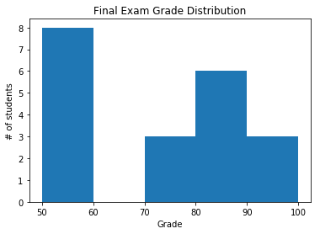
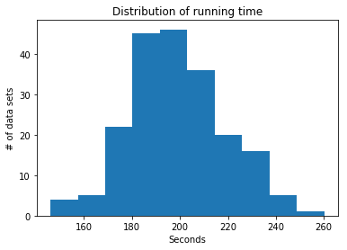
More examples of bar chart
These are also called histograms (discuss later)
More advanced bar charts (bar charts with multiple groups, etc.) will be discussed later in pandas.

Slide 31
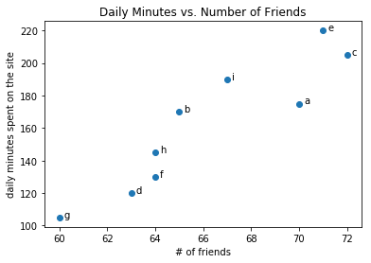
Scatterplots
Good for visualizing the relationship between two paired sets of data
friends = [ 70, 65, 72, 63, 71, 64, 60, 64, 67]
minutes = [175, 170, 205, 120, 220, 130, 105, 145, 190]
labels = ['a', 'b', 'c', 'd', 'e', 'f', 'g', 'h', 'i']
plt.scatter(friends, minutes)
# label each point
for i in range(len(friends)):
plt.annotate(labels[i], xy=(friends[i], minutes[i]),
xytext=(5, 0), textcoords='offset points')
plt.title("Daily Minutes vs. Number of Friends")
plt.xlabel("# of friends")
plt.ylabel("daily minutes spent on the site")

Slide 32
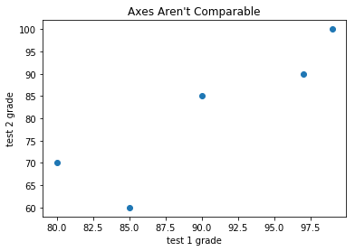
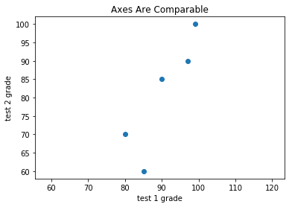
Similar to line plot, the axes of scatter plot can auto scale.
Can be set with xlim([xlow, xhigh]) or ylim([ylow, yhigh]) or axis([xlow, xhigh, ylow, yhigh])
Or force equal range with axis(‘equal’)
plt.scatter(test_1_grades, test_2_grades)
plt.axis("equal")
plt.scatter(test_1_grades, test_2_grades)

Slide 33
Other important functions
Create figures with numbers
E.g. plt.figure(1), plt.figure(2), etc, to specify which figure to plot on
Useful when dealing with multiple figures at the same time
plt.xticks()
plt.yticks()
plt.savefig()
Type in plt.savefig? for usage or search matplotlib documentation for more details

